Slide 1




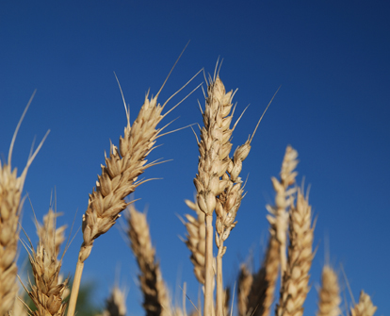
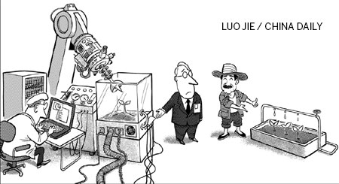

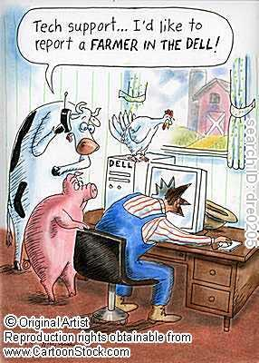
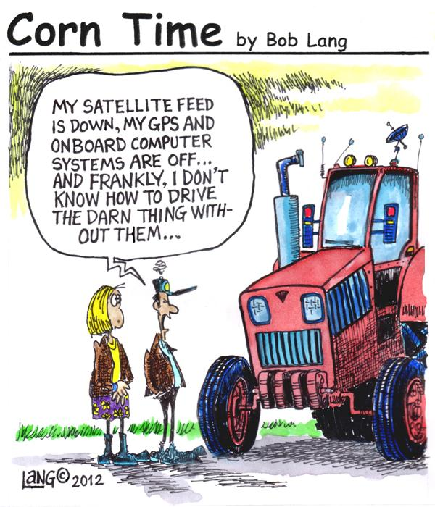
Crop canopy sensors:
potential and challenges
Olga S. Walsh, Western Triangle Agricultural Research Center (WTARC), Conrad, Montana
ULTIMATE GOALS
ULTIMATE TOOLS
ADDRESSING THE NEEDS OF Continuously growing population
World population is estimated to reach 7 billion by 2013 and 9.1 billion by 2050
25,000 people (adults and children) die every day from hunger and related causes (Food and Agriculture Organization, 2009)
Cereal grain production has to increase by 70% to 100% by 2050 to meet the demand for food (Godfray et al, 2010)
MAINTAINING ENVIROMNETAL QUALITY
Population pressure and continuously intensifying agricultural production contribute to:
Climate change (mainly due to global greenhouse gas emission that are estimated to increase by 50% by 2050)
Environmental pollution (air, soil, water) – due to low efficiency of nutrient and water use
Decline in biodiversity (due to land-use change; agriculture has been the main cause of biodiversity loss, coupled with climate change)
(Organization for Economic Co-Operation and Development, 2012)
PRECISION AGRICULTURE
Development and practical application of management strategies that improve the efficiency, sustainability and profitability of all aspects of agricultural systems.
To reach our ultimate goals, all agriculture must become precision agriculture. Understanding current and future challenges and demands, all of us involved in agriculture are encouraged to operate with this in mind.
PRECISION NUTRIENT MANAGEMENT
Conventional fertilizer application – one rate based on average needs of the field/fields; does not account for variability in production potential(natural, acquired, spatial, temporal); average rate is excessive in some parts and inadequate in others
Nitrogen (N) – the most limiting nutrient in most crop production systems
Nitrogen Use Efficiency (NUE) – estimated to be about 33% worldwide (Raun and Johnson, 1999), more recent estimates of NUE are about 35% for developing countries and 60% for developed countries (Gupta, Khosla, 2012)
10% increase in NUE of these crops would result in savings of about US$5 billion per year, as well as improvement in environmental quality (Gupta, Khosla, 2012)
Precision Nutrient Management entails timely and precise fertilizer application to meet plant needs as they vary across the landscape
Sensor-Based Technologies – precision agriculture tools, allow to account for variability and to make more informed decisions.
CROP CANOPY SENSORS - POTENTIAL
  Evaluation of crop’s nutrient status
  Estimation of crop’s biomass production
  Estimation of crop’s yield potential
  Determining of crop stress and decease
  Crop breeding/selection
  Making fertilizer recommendations
  Variable-Rate fertilizer and chemical application
FUN FACTS LEARNED FROM PRODUCERS
  “Sometimes we have more technologies than we know what to do with”
  “Often, your neighbor is your precision agriculture consultant”
  “Precision agriculture – sure! We are really involved, we soil test every 5 years or so”
  “Some use GPS, auto-steer, remote sensing for variable rate application, and some use the coffee shop-based recommendations!”
COMMONLY REPORTED CHALLENGES AND POSSIBLE SOLUTIONS
MEASUREMENTS MAY BE AFFECTED BY SEVERAL FACTORS:
Sensor make and model (different wavelengths, calibration, sensitivity, accuracy)
Time of sensing/growth stage (plant height, amount of biomass, leaf architecture, amount of accumulated nutrients)
Environment: crop type (row vs non-row), crop management (till vs no-till), temperature, soil color (color variation, moisture)
Human factors/user (for hand-held units): height, speed, steadiness, consistency
➔ Need solid unbiased research to verify and quantify these effects
ADOPTION OF SENSOR-BASED TECHNOLOGIES MAY BE HINDERED BY:
High cost ➔ Must be justified, need solid studies clearly showing advantages – either increased profit or minimized inputs
Informational and communication gap between research/manufacturers and users lead to confusion and discouragement ➔ Need continuous extension, workshops, dealer customer support, on-farm trials
Scientific community needs to have a sense of urgency, take the leadership role in conducting research, communicate and extend new methodologies to crop producers
CONTACT INFORMATION: Dr. Olga S. Walsh, WTARC, MSU; telephone: (406)278-7707; e-mail: olga.walsh@montana.edu;
web: http://ag.montana.edu/wtarc/

