Slide 1
Ag Leader’s Market Observations for Crop Sensors

Slide 2
Outline
Experiences in Sensor Sales and Usage
Review of Challenges to sales
Simple Message
Future

Slide 3
Experiences in Sensor Sales and Usage
Sales in first quarter of 2012 increased drastically
Positive results from reporting users from 2009, 2010, and 2011
Confidence and experience increasing
Customer interest beginning to grow

Slide 4
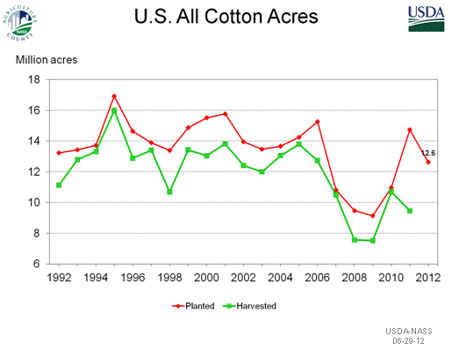
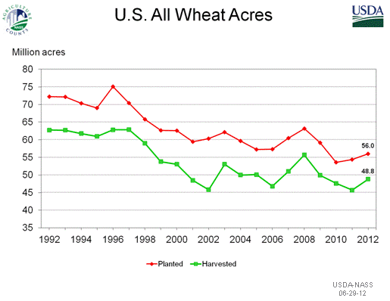
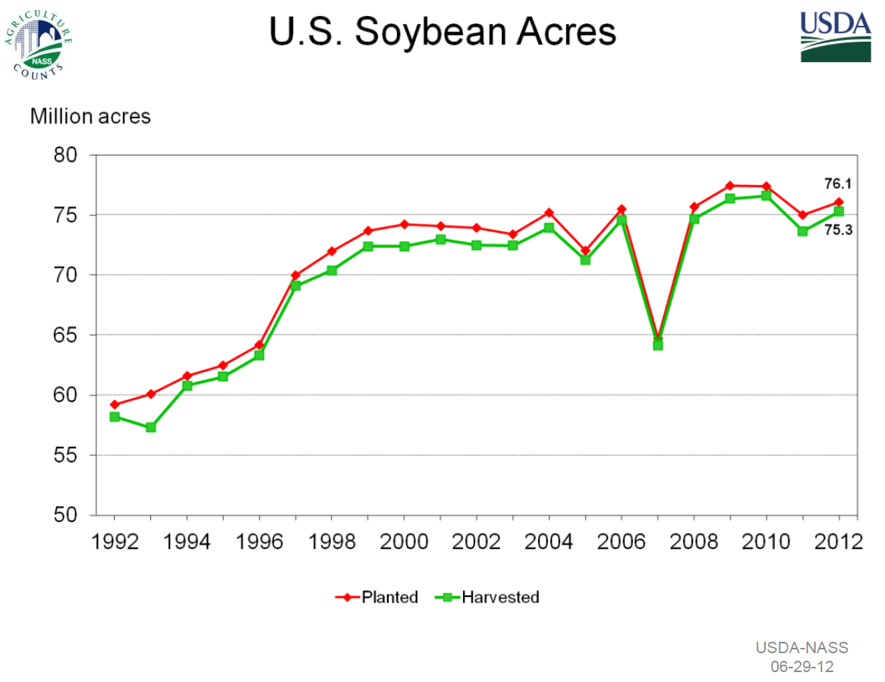
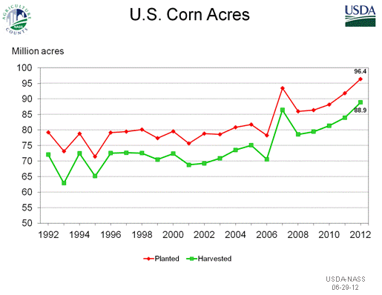
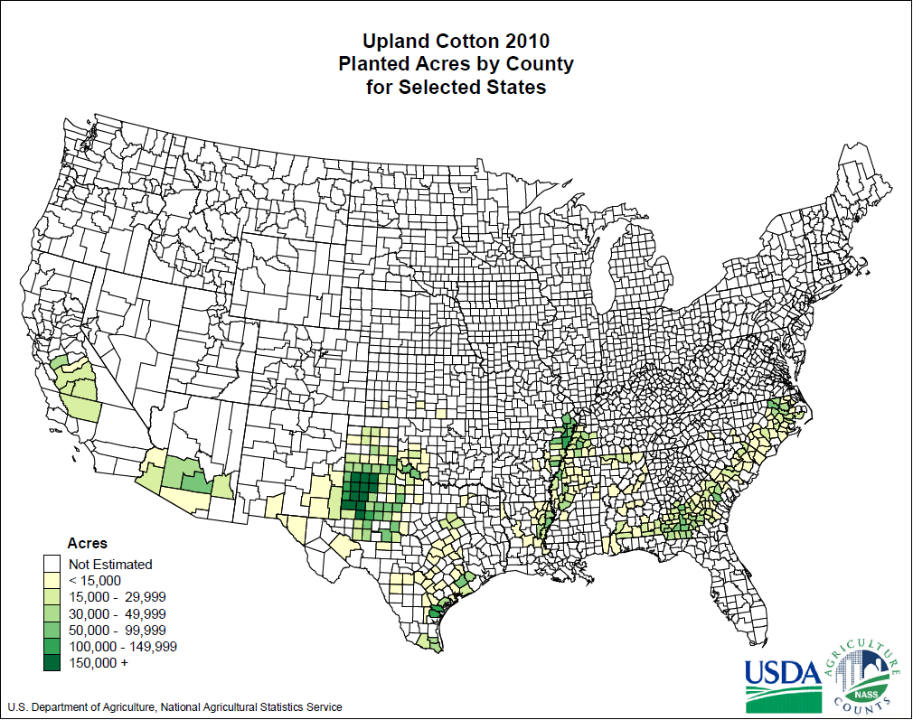
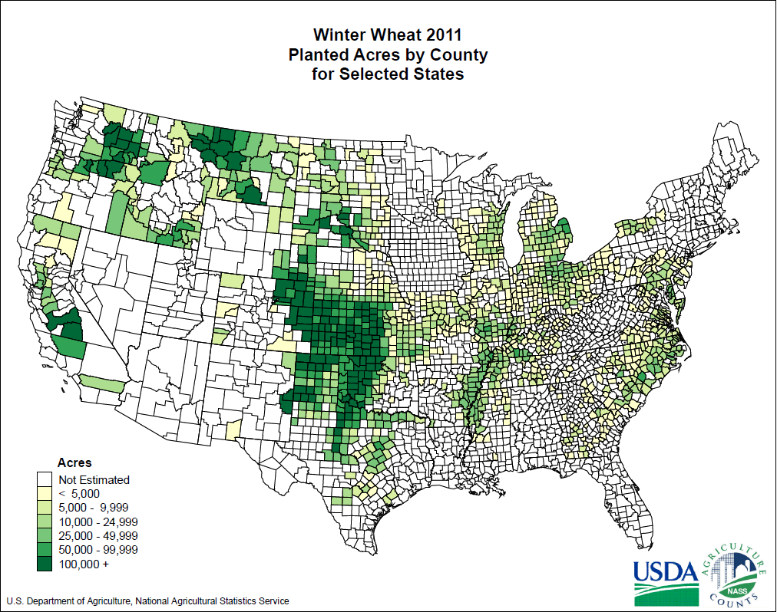
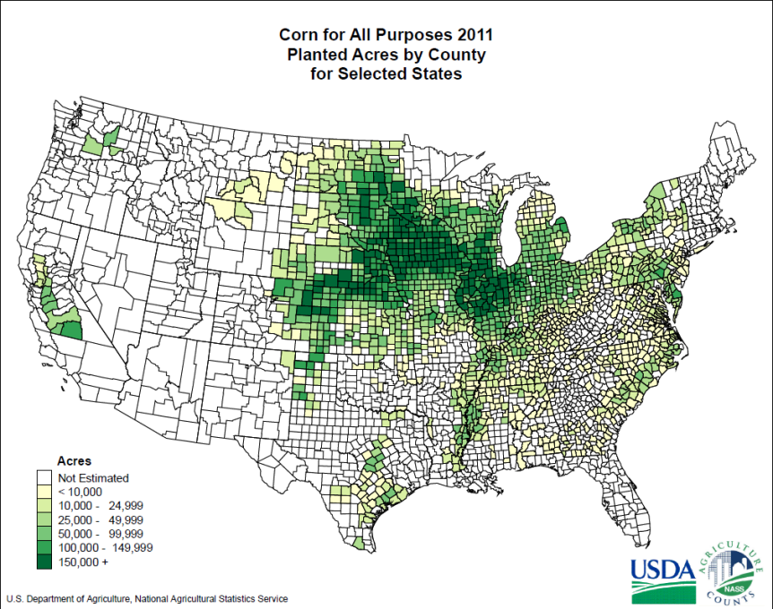
Challenges to Crop Sensor Sales
Wheat is a dream and Cotton is king, but Corn is supreme
Notes:
United States Department of Agriculture National Agriculture Statistics Service (2012).
Planted Acres by County[Image]. Retrieved from
http://www.nass.usda.gov/Charts_and_Maps/Crops_County/cr-pr.asp
United States Department of Agriculture National Agriculture Statistics Service (2012).
Corn Acreage by Year [Image]. Retrieved from
http://www.nass.usda.gov/Charts_and_Maps/Field_Crops/cornac.asp

Slide 5
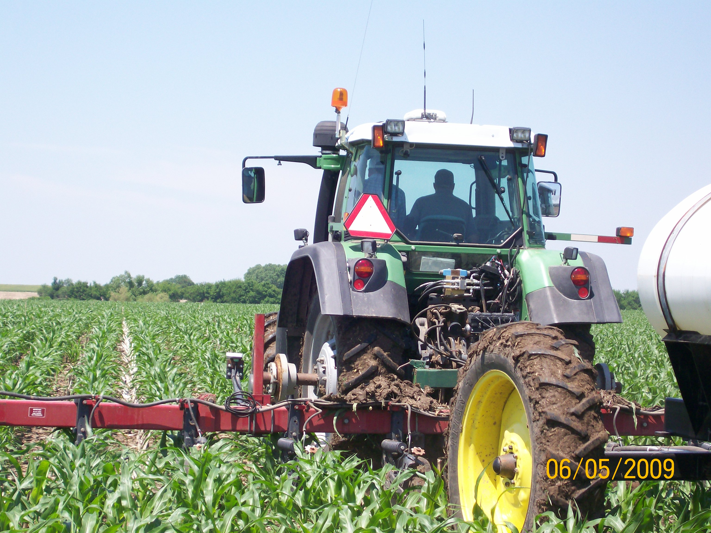
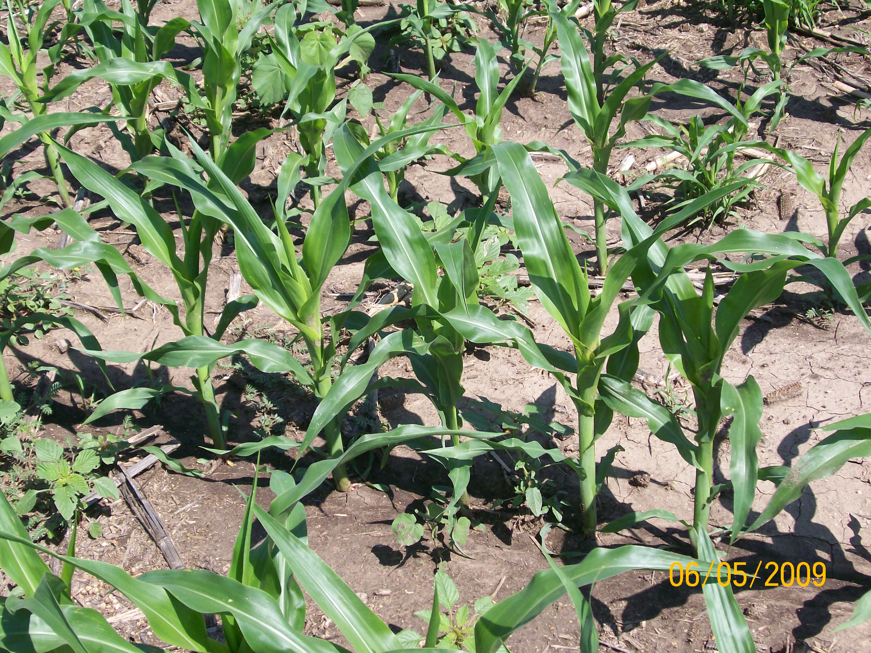
Challenges to Crop Sensor Sales
Sidedressing corn not primary
Waiting till V5 narrows window of application and sales opportunities

Slide 6

Challenges to Crop Sensor Sales
Drought Happens!

Slide 7
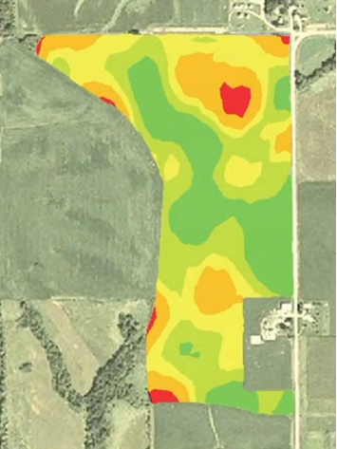
Simple Message
Uniform Rates all too common
Variable rate can do better than a uniform rate
Notes:
We may be able to see a way to get 100mpg, but when we are only getting 15mpg and slight improvements gets us to 30mpg don’t forget that slow progress is still progress. Growers don’t adapter new technologies over night

Slide 8
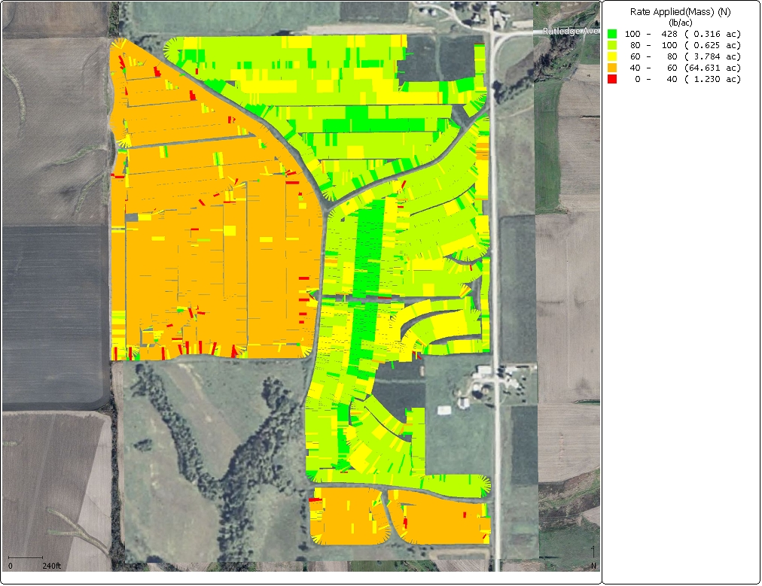
Simple Message
Compare Algorithms, but also compare to growers own practices

Slide 9
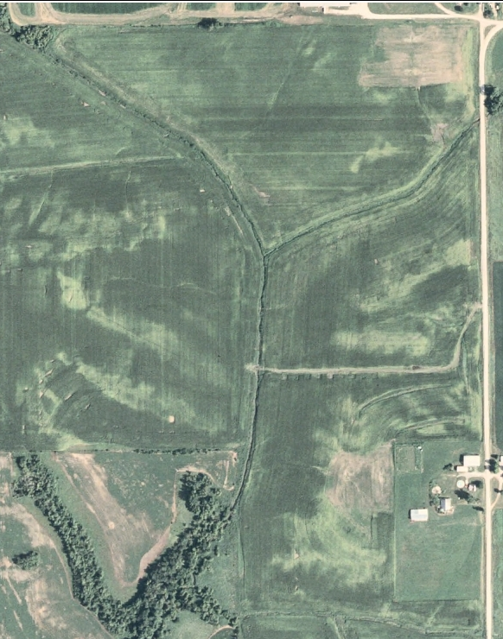
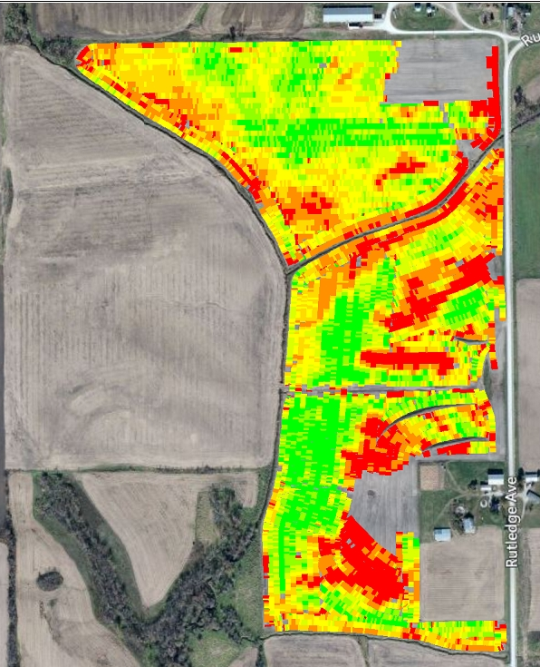
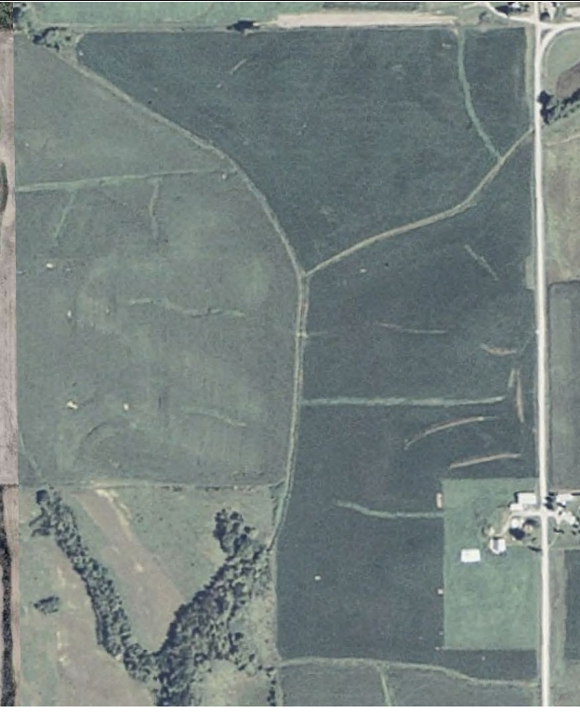
Simple Message
Compare to information that the growers’ have, not what they will have

Slide 10
Future of OptRx
Increase crop type options
Education
Experience

Slide 11
Questions?

