Slide 1
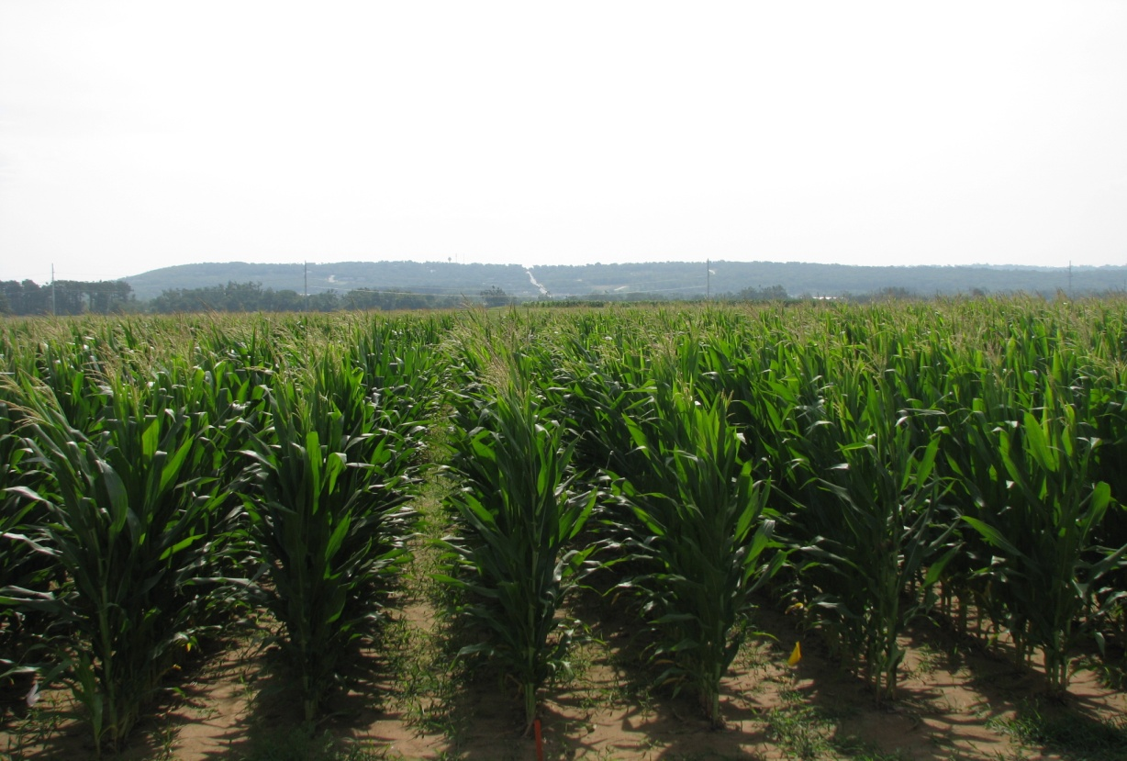

N Status
through
Smartphone Image Analysis
FieldScout
GreenIndex+

Slide 2
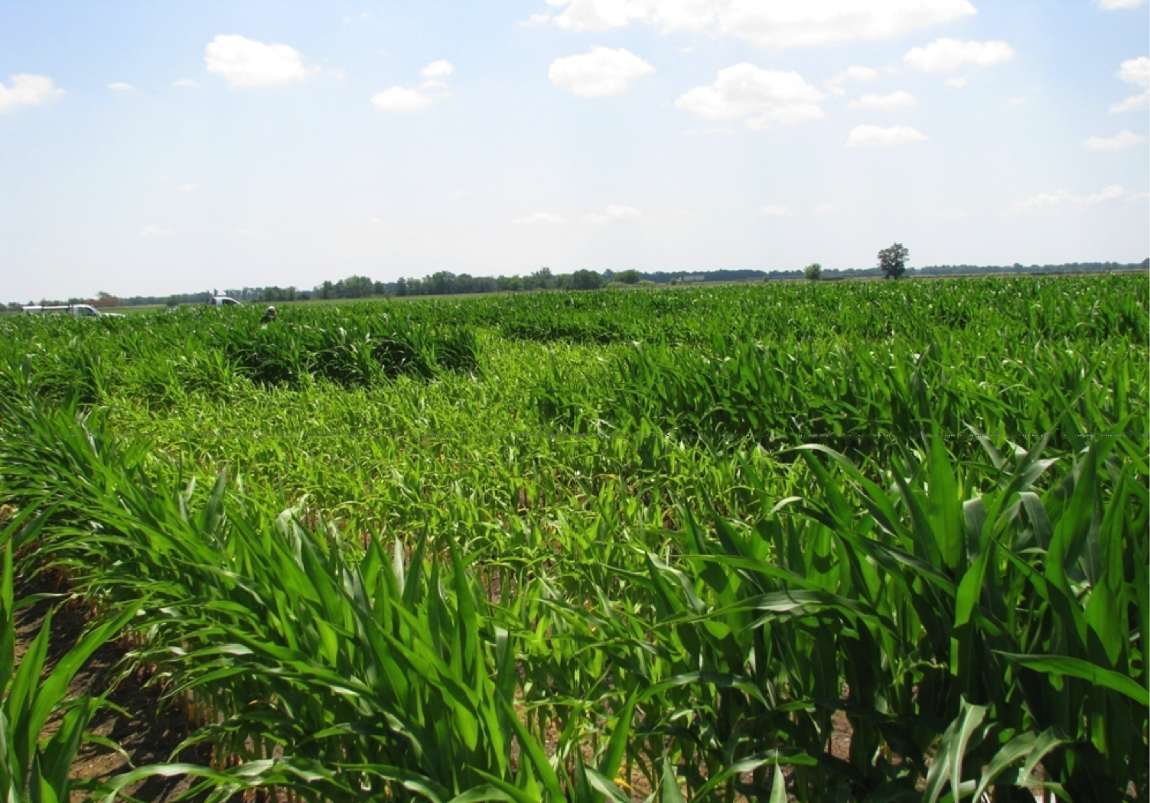
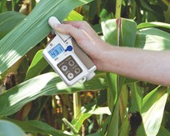
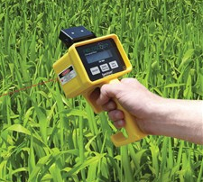
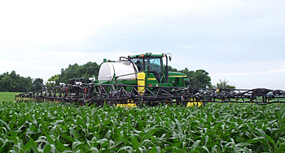

Slide 3
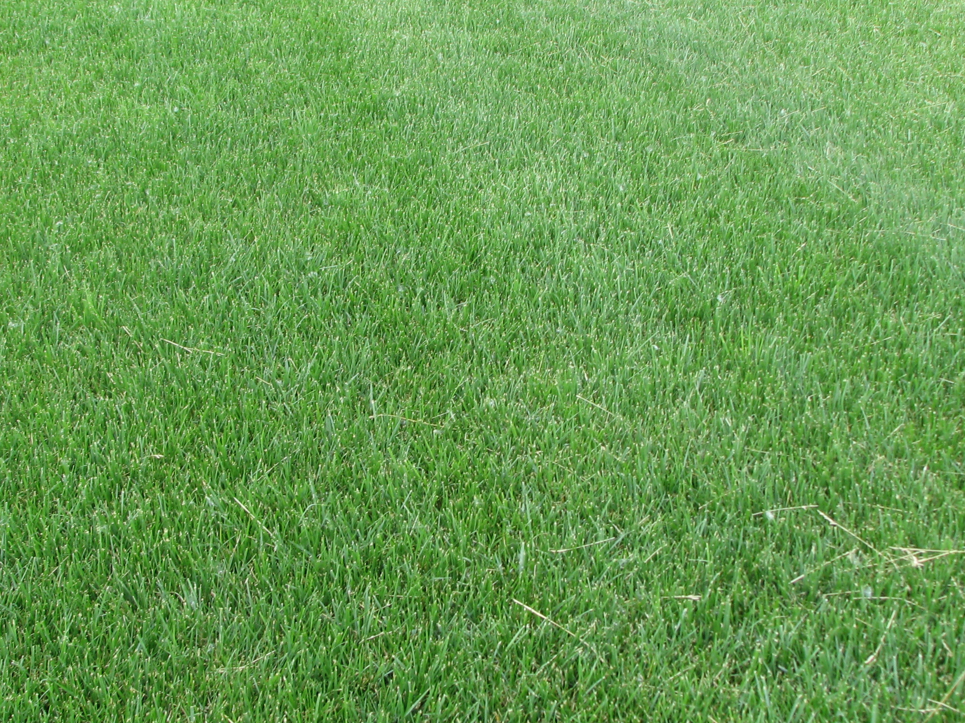
University of Arkansas
Digital Image Analysis
Karcher and Richardson
2003 – Turf
RGB -> HSB
DGCI – Dark Green Color Index

Slide 4
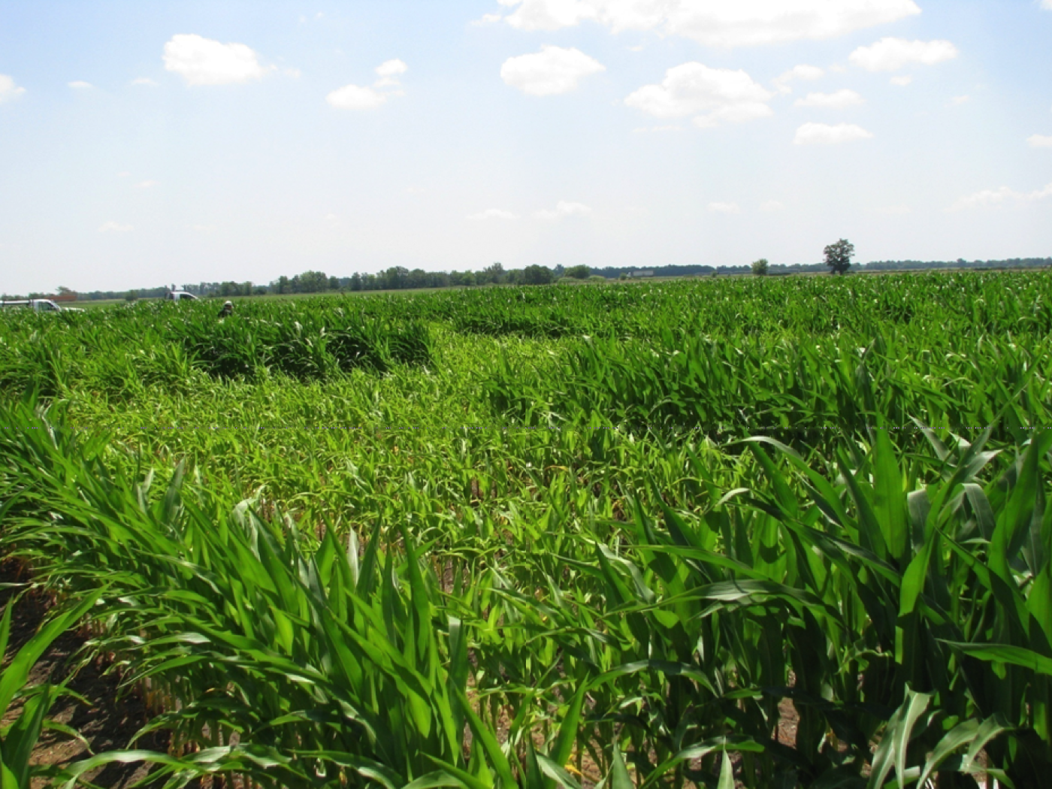
University of Arkansas
Digital Image Analysis
Rorie, Purcell, Karcher and King
2008-2009 – Corn
2008:
Greenhouse
Black background
Single camera
SPAD meter
Laboratory N analysis

Slide 5
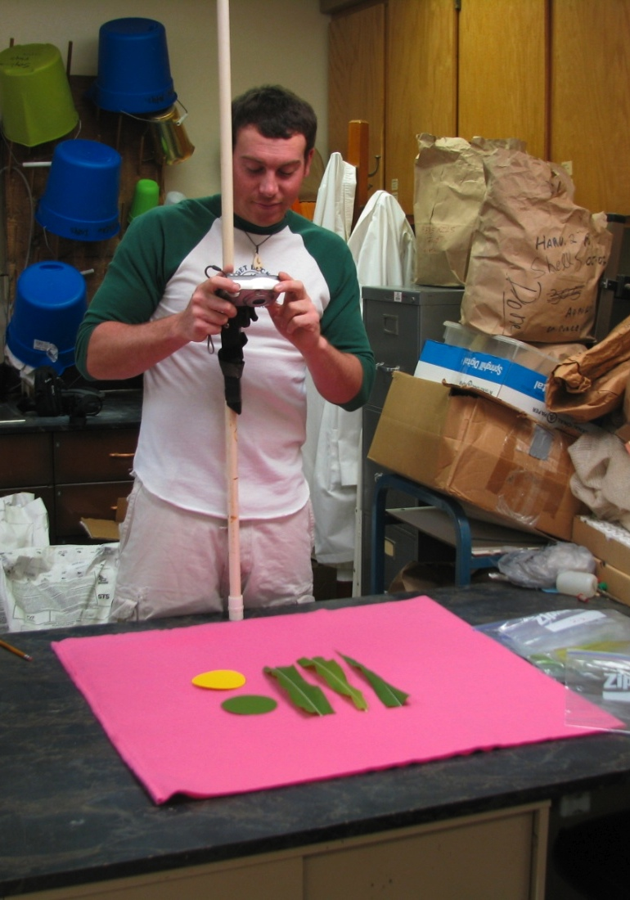
2009:
Greenhouse
Pink background
Green and yellow standard color disks
Multiple cameras
SPAD meter
Laboratory N analysis

Slide 6
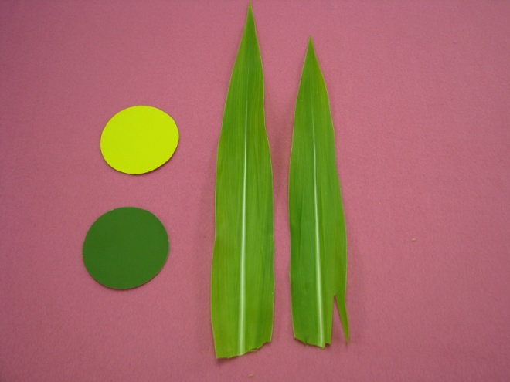
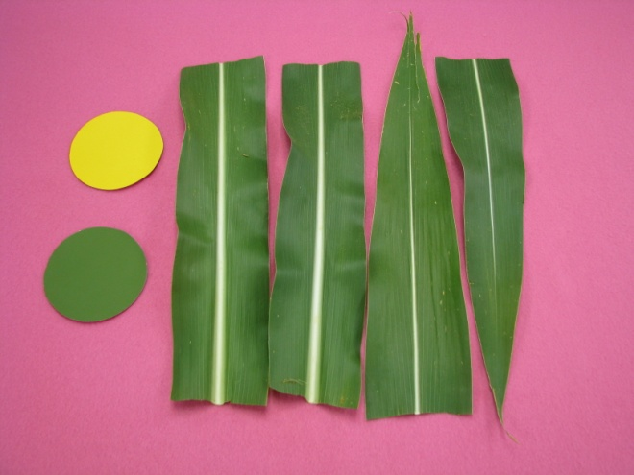
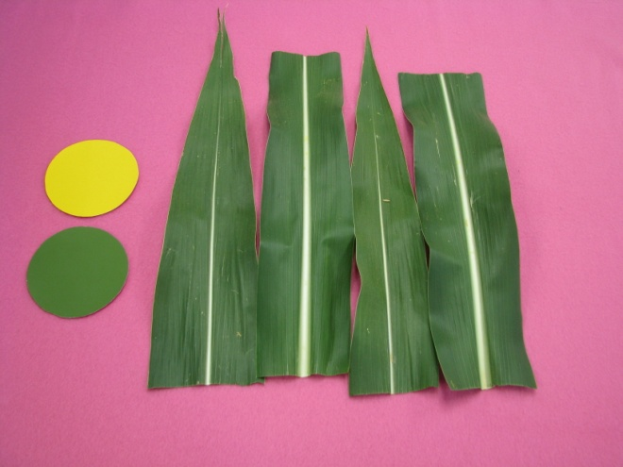
Digital Image Analysis
From field plots,
photographed with varied lighting
A.
B.
C.
N conc = 1.5%
DGCI = 0.39
SPAD = 22
N conc = 2.4%
DGCI = 0.63
SPAD = 47
N conc = 3.1%
DGCI = 0.68
SPAD = 57

Slide 7
Corn Yield and Leaf N
Associated with “Greenness”
Rorie, Purcell, Mozaffari, Karcher, King, Marsh, and Longer (2008-2009)
Field tests, 5 locations
6 or 7 N rates
DGCI vs SPAD: average r² = 0.87
DGCI vs Leaf N: average r² = 0.80
DGCI vs Yield: average r² = 0.80

Slide 8
Corn N Measurement and Fertilization
via Image Analysis (Poster)
Siddons, Purcell, and Mozaffari (2010-2011)
Field tests, 8 locations
Fertilization at emergence and V6
DGCI, SPAD, Lab N at V6 and tasseling
Calibration curve derived for recommended N rates for 90% and 95% maximum yield potentials

Slide 9
Using DGCI to Recommend N Rates for Maximum Yield Potentials
* Preliminary Results *
Corn
Wheat
Turf (bermuda grass, bentgrass, tall fescue)
X Flooded rice

Slide 10
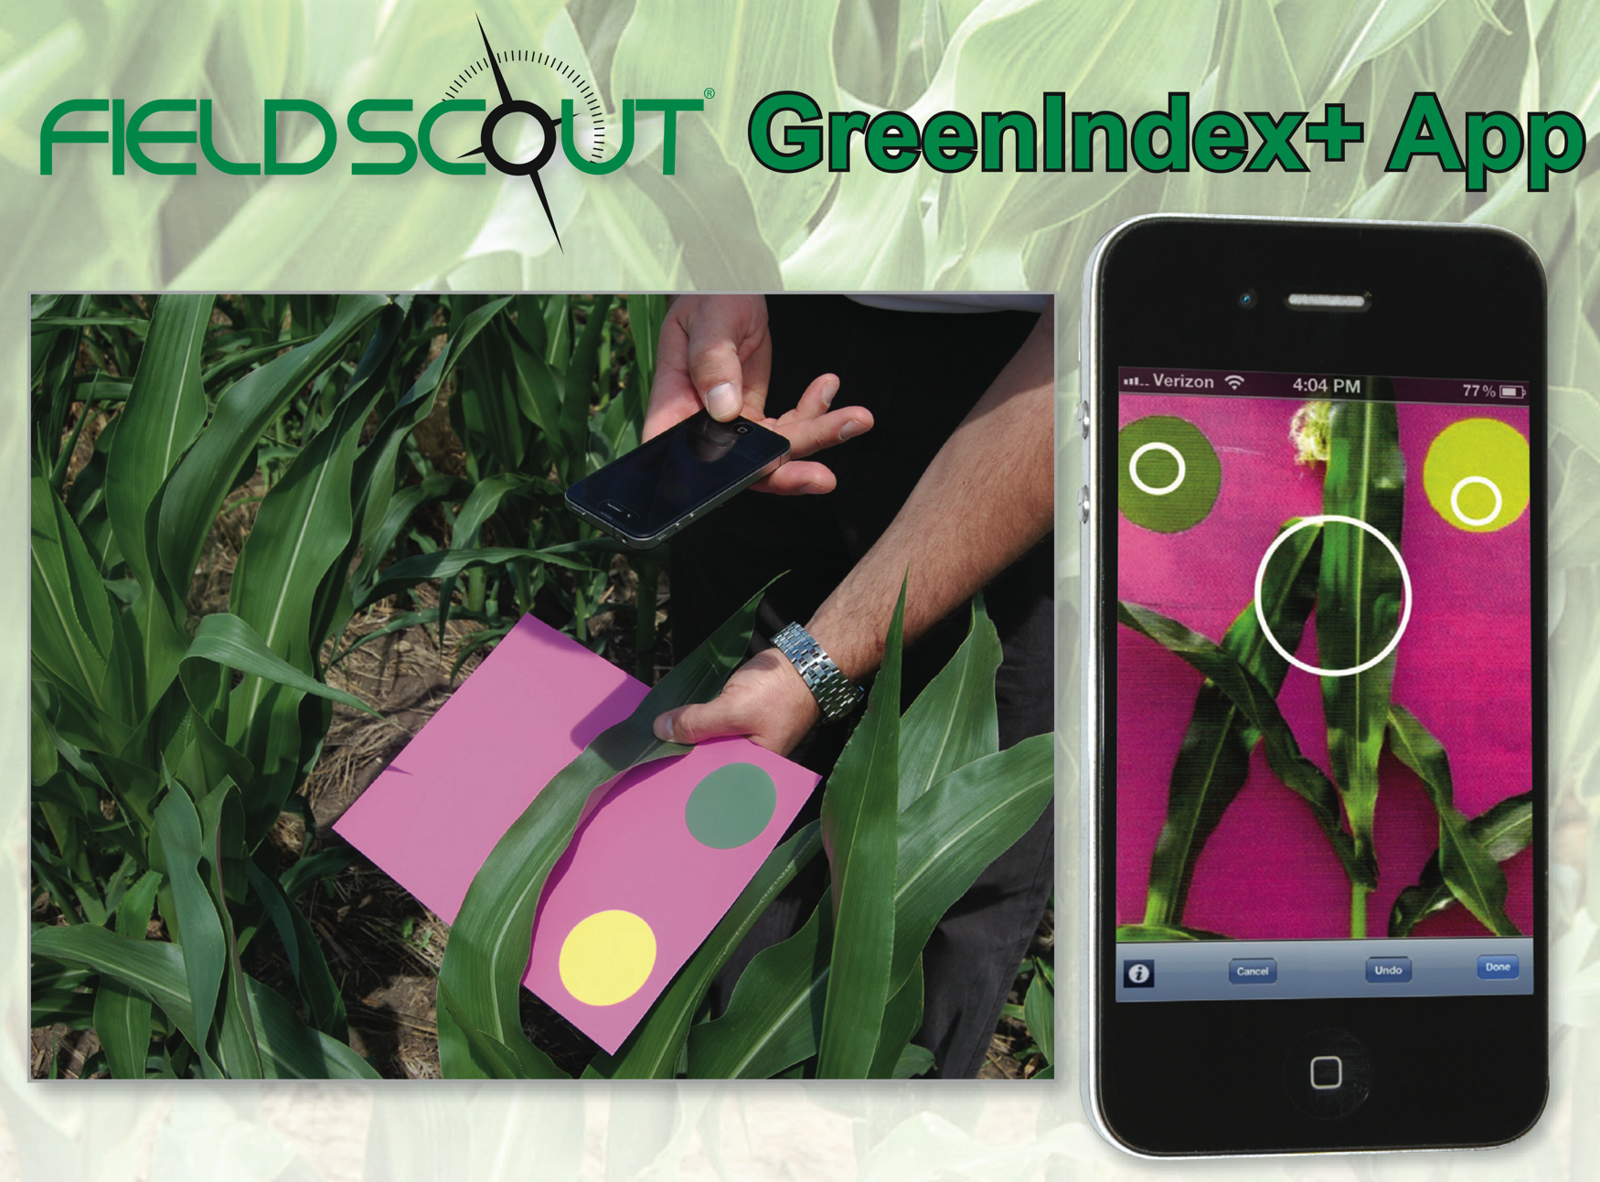


Slide 11

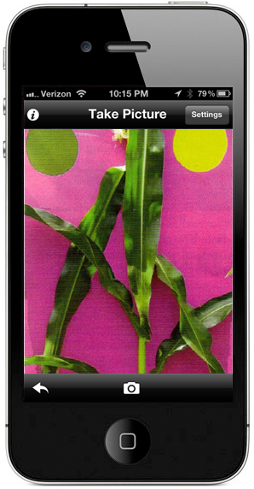
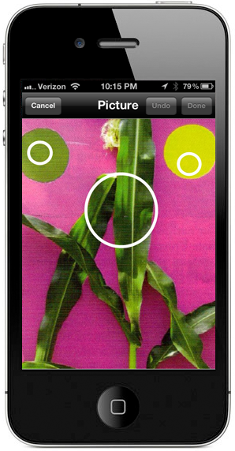
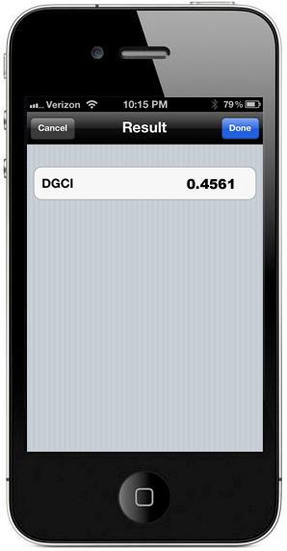
Click
Tap
Read, Repeat

Slide 12
