Slide 1


North American NUE Trials: Evidence for Soil Texture and Weather Adjustments for In-season Corn Nitrogen Fertilization
Nicolas Tremblay
Newell Kitchen
Horticulture Research and Development Centre,
Saint-Jean-sur-Richelieu, Quebec
Cropping Systems & Water Quality Research Unit
Columbia, MO
M.Y. Bouroubi, C. Bélec, R. Mullen, W. Thomason, S. Ebelhar, D. Mengel,
B. Raun, D. Francis, E.D. Vories, and I. Ortiz-Monasterio

Slide 2

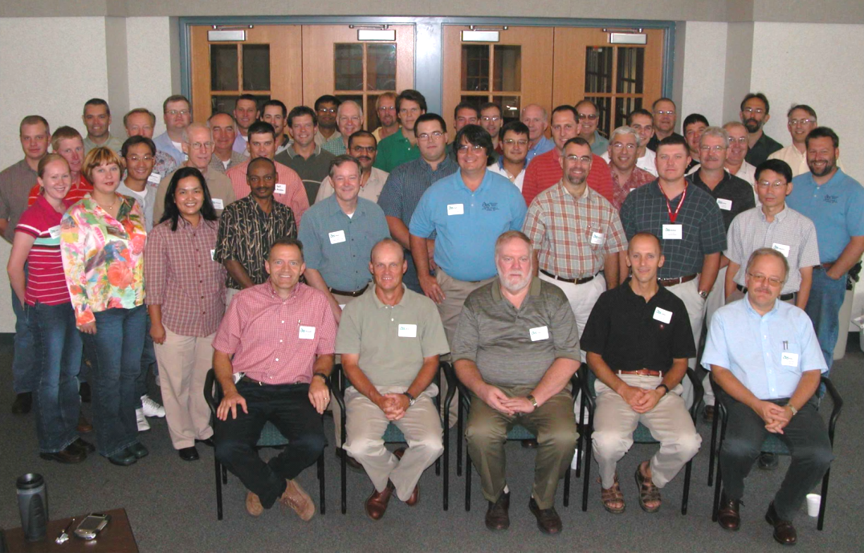
Could a universal algorithm be developed with proximal canopy sensing for directing in-season corn N fertilization?

Slide 3
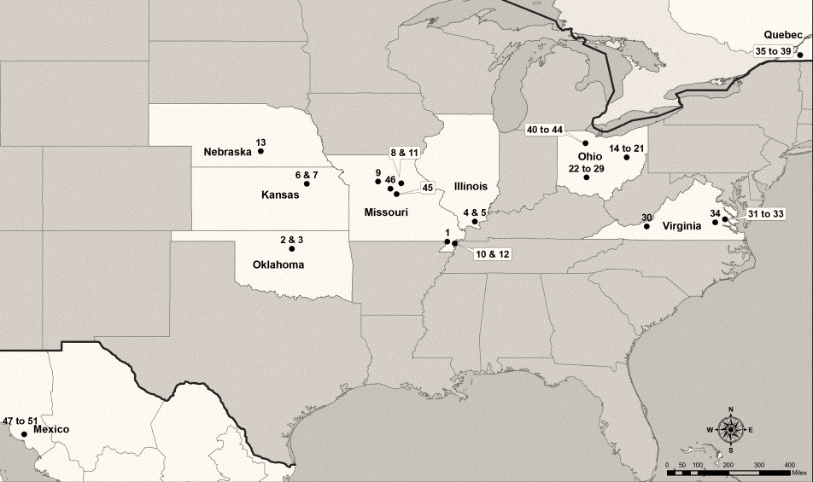
North-American Regional Trials
Notes:
Meta-analyses on aggregated large datasets
Wide range in soil types, (textural classes) precipitation, distribution of precipitation, growing degree days

Slide 4

Need of a breakthrough
We need
  To identify (done) and rank factors at play
  To establish interactions, if any
  To quantify their consequences on N_{opt}
  To generalize the conclusions
Meta-analyses offer a solution

Slide 5
Arnqvist and Wooster 1995
Meta-analysis is an effective synthetic method for summarizing and reviewing previous quantitative studies.
In comparison to a narrative review, meta-analysis has the advantage of objectivity and better control of Type II error (i.e. failure to reject a false null hypothesis)…
…and therefore the potential to integrate a large collection of results from various studies in order to address a particular question.

Slide 6
The virtues of meta-analysis
Weigh studies according to variability
Allow for agglomeration of studies conducted (in a diversity of conditions) and generalization
Between-group variability is associated with different categories (explaining discrepancies among studies and factors to consider for N_{opt})
Quantitative estimate of effect size, which is calculated as the response to a specific treatment (e.g. fertilization with nitrogen) relative to a control (e.g. no nitrogen fertilization)

Slide 7
North-American Database
2006 to 2009 growing seasons
51 corn in-season nitrogen trials
45 locations in USA, Qc and Mexico
In-season rate (ISNR) (35→195 kg N ha⁻¹)
Notes:
Meta-analyses on aggregated large datasets
Wide range in soil types, (textural classes) precipitation, distribution of precipitation, growing degree days

Slide 8
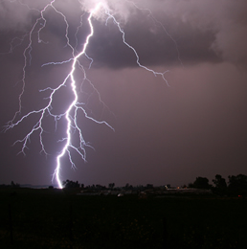
Response as a function of weather and soil
Weather:
Precipitation/Irrigation
Cumulative (PPT)
Distribution (Shannon Diversity Index (SDI) )
Abundant & Well-Distributed Rainfall (AWDR)
Heat
Corn Heat Units (CHU)
Window of interest (optimize side-dress N response):
Days Before Side Dress (BSD)
Days After Side Dress (ASD)
Soil surface textures:
  Course/Medium- loam, silt loam, sandy loam, loamy fine sand, fine sandy loam
  Fine- clay, silty clay, silty clay loam, clay loam
SD
15 30
SD
30 15
Notes:
Histrogram threshholding (optimize value of weather parameters) ~45 day window around the SD was the magic window. Either 15 or 30 before to 30 to 15 after.

Slide 9
Wide Range of Conditions Classed

Slide 10
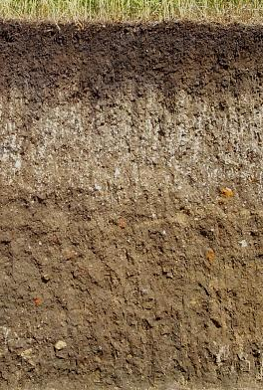
The Soil Factor

Slide 11

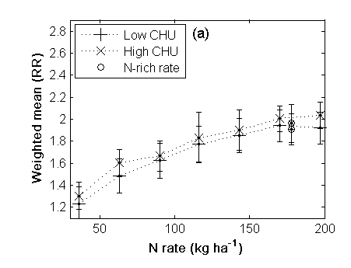
Corn Heat Units

Slide 12
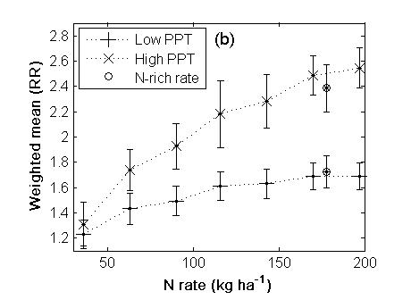
Precipitation

Slide 13
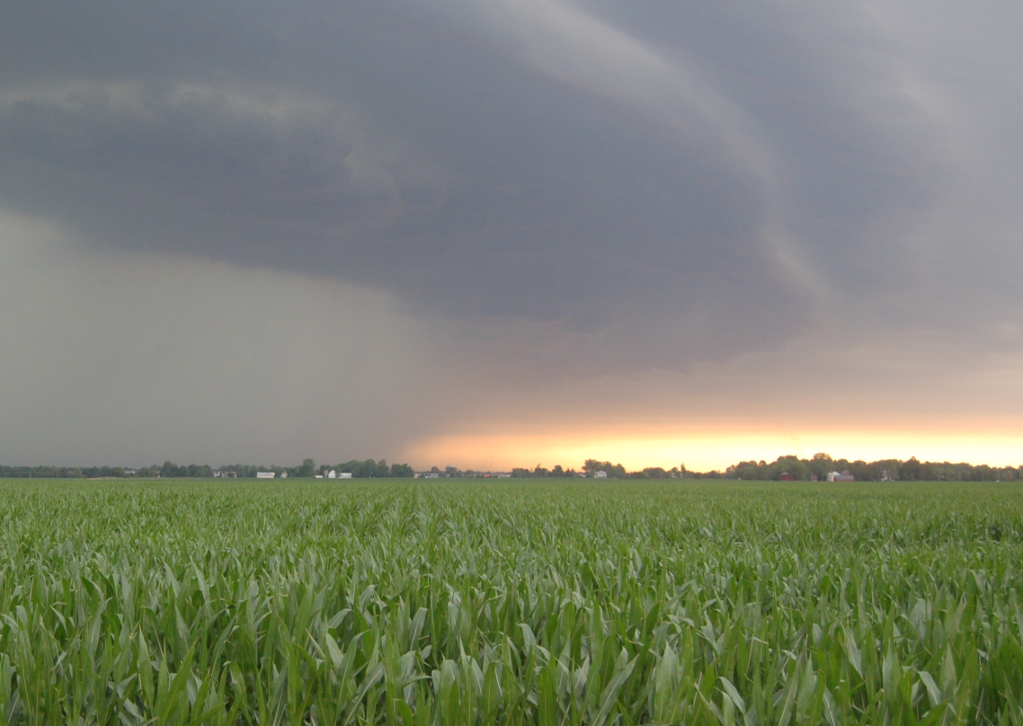
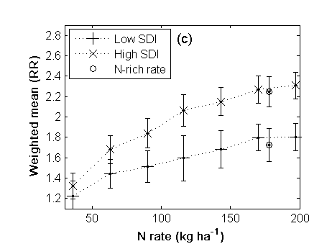
Shannon Diversity Index

Slide 14
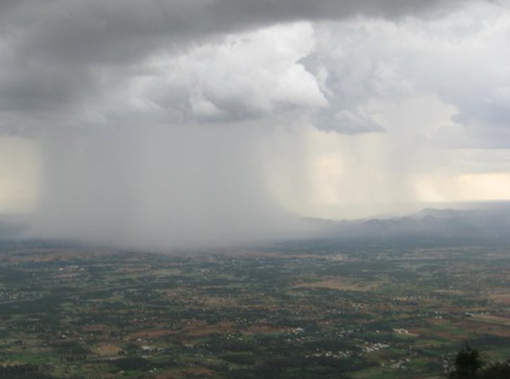
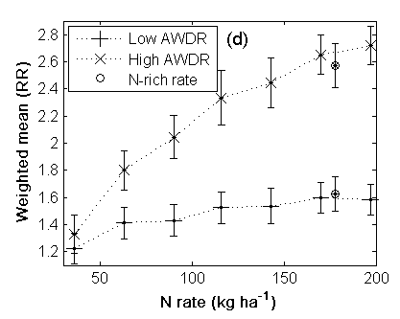
Abundant and Well-Distributed Rainfall

Slide 15
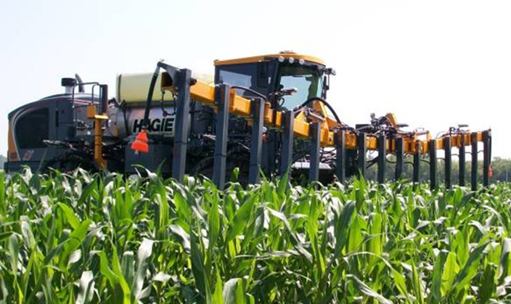
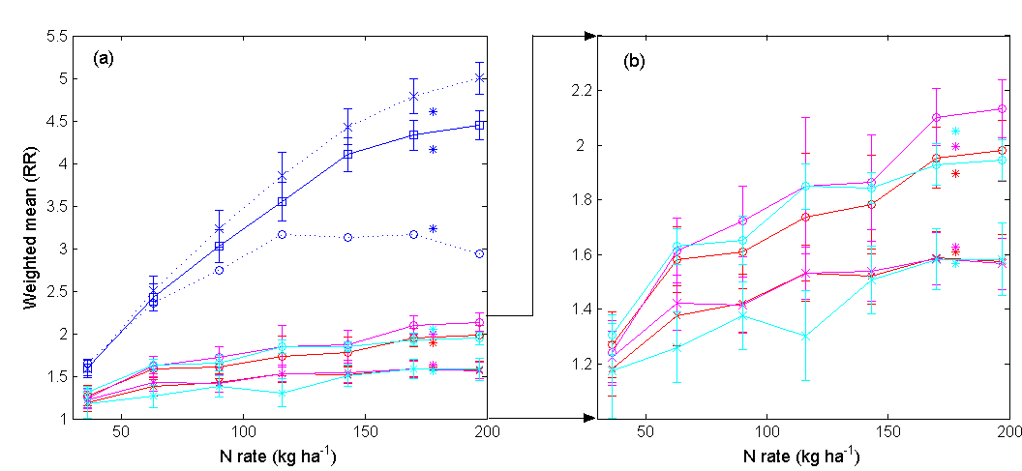
Soil-CHU-Rain Interactions

Slide 16
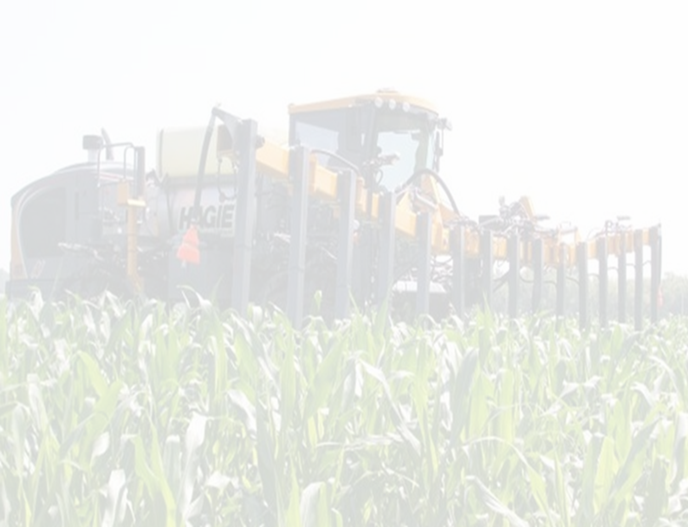
Potential Direction for In-season N Fertilizer Recommendations
Medium textures = 1.6x
Fine textures = 2.7x
Low AWDR = 1.5x
High AWDR = 2.1x
Low AWDR = 1.5x
  Low CHU = 1.9x
  High CHU = 1.5x
High AWDR = 4.5x
  Low CHU = 5x
  High CHU = 3x
Notes:
Potential improvement with N as compared to unfertilized control: Response Index

Slide 17
Weather:
Precipitation/Irrigation
Cumulative (PPT)
Distribution (Shannon Diversity Index (SDI) )
Abundant & Well-Distributed Rainfall (AWDR)
Heat
Corn Heat Units (CHU)
SD
15 30
SD
30 15
Could a universal algorithm be developed for informing canopy-sensed corn N fertilization?

