Slide 1
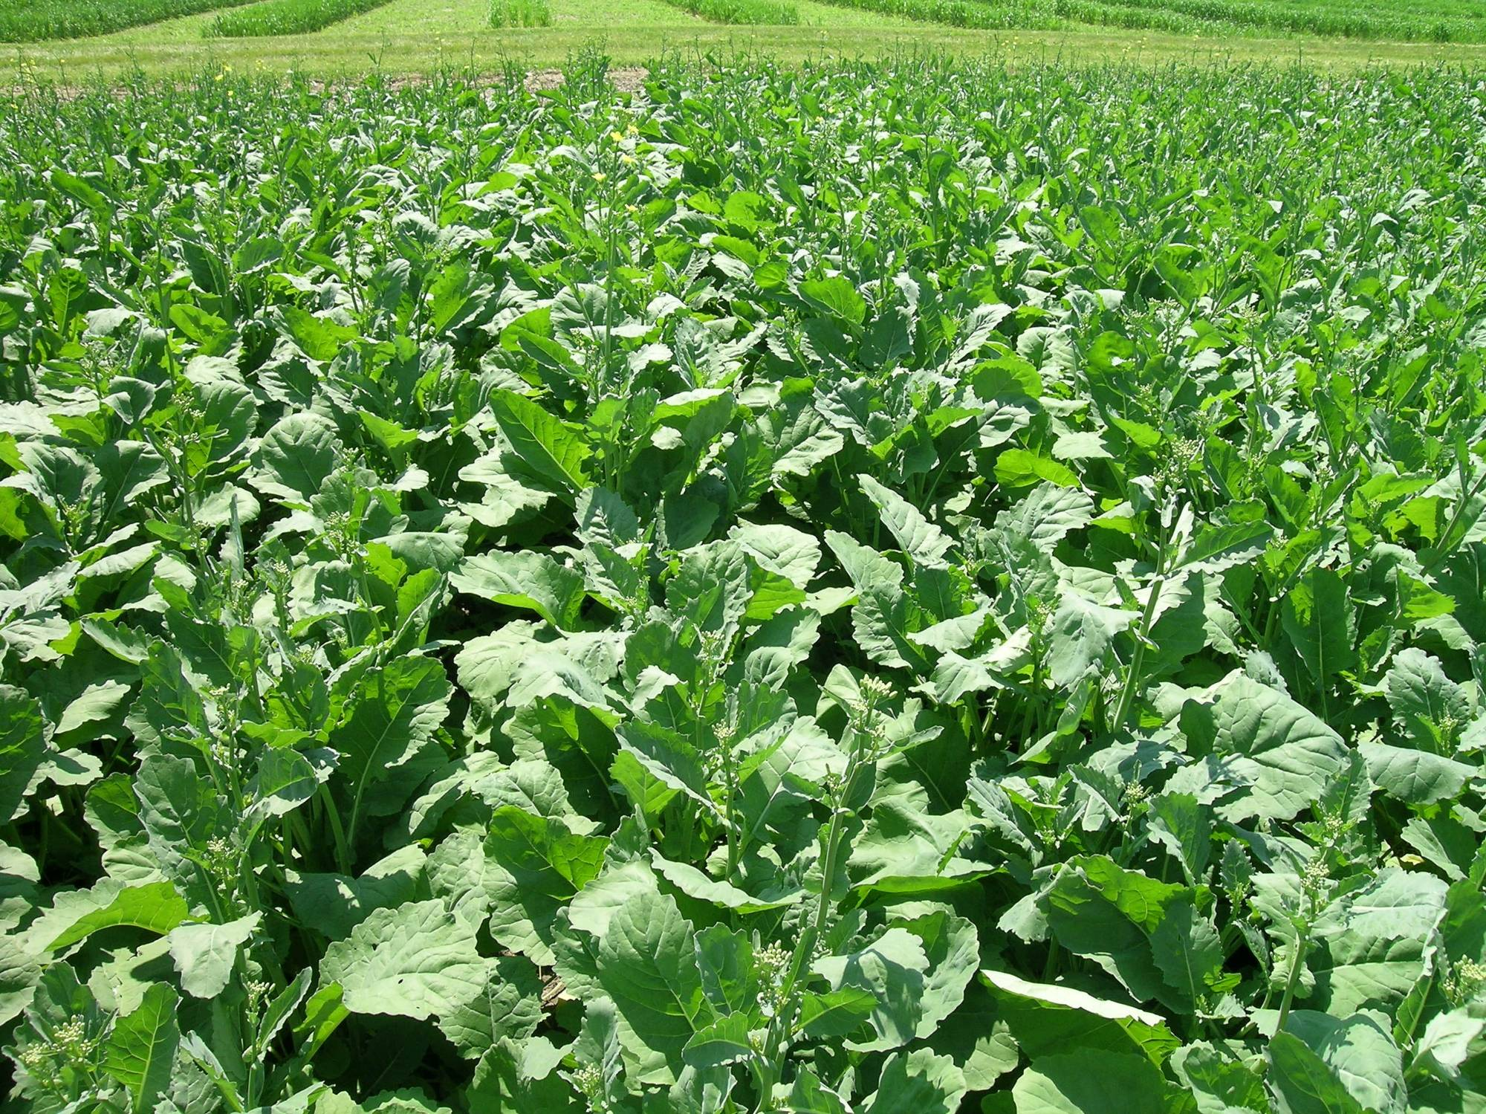
Nitrogen Use Efficiency Workshop
Canopy Reflectance Signatures: Developing a Crop Need-Based Indicator for Sidedress Application of N Fertilizer to Canola
Dr. Bao-Luo Ma
Research Scientist – Crop Physiology
Eastern Cereal and Oilseed Research Centre (ECORC), Ottawa, ON
613-759-1521, baoluo.ma@agr.gc.ca
Canada

Slide 2
Introduction
• Canola:
Is the important source of edible oil after soybean
< 2% erucic acid in oil and <30 µmoles glucosinolates g⁻¹ canola meal.
Rapeseed: 25-45% erucic acid and 50-100 µmoles glucosinolates
• Becoming an important crop in the Eastern Canada:
canola offers growers a good return
an excellent rotation crop/alternative crop
operation of TRT has brought canola growers closer to a crushing and refinery plant
canola acres are poised for significant growth
Notes:
Canola is still a relatively new crop in Eastern Canada. Between 2006 and 2011, canola production in Eastern Canada (Ontario and east) increased 305% to over 141,000 acres, while farm cash receipts increased almost 700% to $46.3 million.

Slide 3
Challenge for growers and industry
Ensure a stable supply of high quality oilseed
Improve canola productivity
Cultivar more resilient to climate variability
Adoption of best management practices
Minimizing negative impacts on environment
Nutrient management, key to increase yield and oil content
Need tools for best nutrient management
Notes:
Crushing company needs a stable supply of high quality oilseed, growers want to improve canola productivity and their profitability. To do, cultivars more adaptable to climate variability are required, best management practices are tested and locally available, so that they will minimize negative impacts on the environment.

Slide 4

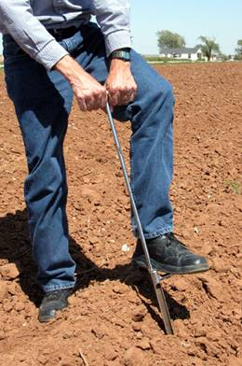
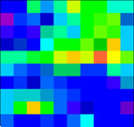


Soil Sampling
Grid Sampling a 52 Acre Field
1 sample every 2.5 acres
21 samples per field
1 sample every 0.625 acres
83 samples per field
1 sample every 0.156 acres
333 samples per field
The large spatial variability reduces the effectiveness of using soil N as a tool for fertilizer recommendation for improved NUE.
Notes:
Traditionally, we based on experience and soil N test as a tool for fertilizer recommendation. However, soil sampling and chemical analysis are both labor and time-consuming, it is therefore impractical to account for the large spatial variability. Optical sensing technology offers promising for on-the-go variable application of N to account for spatial variability to improve NUE.

Slide 5
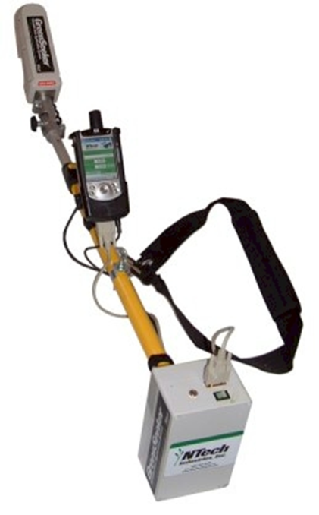
Nutrient availability and canopy signature
pH = 6.9, warm spring
pH = 6.0, cool spring
Notes:
But this technique may be affected by soil and environmental conditions. For example, in 2005, shortly before sidedressing, canopy reflectance measured with the handheld GreenSeeker clearly differentiated plots with low preplant N from well fertilized plots. However, in 2006, the NDVI data could not separate N treatments greater than 30 kg N ha⁻¹ as NDVI was negatively associated with preplant N application rates. This two field was site-by-site, while in 2005 we had a warm spring and the soil pH was 6.9. In 2006, it was a cool spring and the soil pH was averaged 6.0.

Slide 6
Crop response to soil pH
Most field crops grow best in soils with slightly acid reaction (pH 7.0 – 6.5)
Almost all plant nutrients are available in optimal for plant growth
pH < 6.0, likely deficient in Mg, Ca, K
Strongly acid soil (pH < 5.0, Al, Fe, Mn toxicity)
pH >7.0, Fe, Mn, Zn, Cu unavailable for plant growth

Slide 7
Objectives
Build knowledge of oilseed crop for Eastern Canada
Develop a crop need-based indicator to be used for canola recommendations;
Develop nutrient best management practices for growing canola in eastern Canada

Slide 8
Materials and Methods

Slide 9
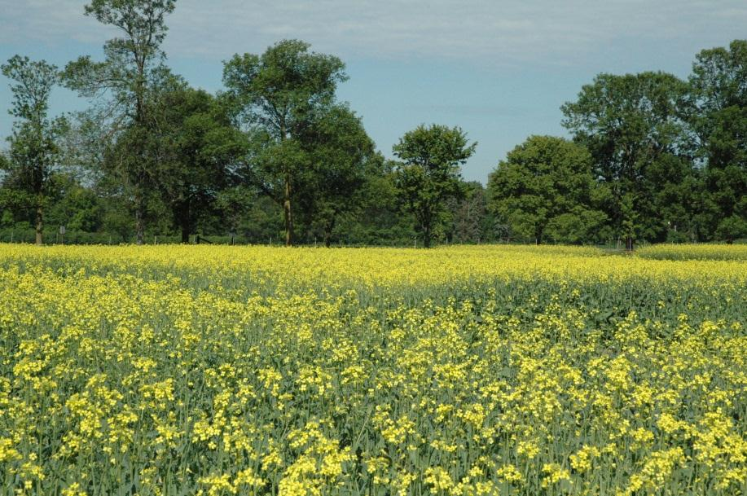
Experimental Locations
Central Experimental Farm, Ottawa, ON
(2011, 2012, 2013)
North Bay, ON
(2012, 2013)
3) Guelph, ON
(2012, 2013)
4) Two sites in QC
5) One site in NB
6) One site in NS

Slide 10
Experimental Design
A field experiment with combinations of preplant and sidedress N fertilizer as urea, was arranged in a RCB design with 4 replications in each site-year.
  Preplant: 0, 50, 100, 150, 200 kg N ha⁻¹
  Sidedress: 50+50, 50+100, 50+150 kg N ha⁻¹
  Hybrid: Bayer InVigor 5440 (LL) (in 2011 & 2012), InVigor 5440 and L150 (2013)
  In all site-years, research plot experiments
  In North Bay, a 50 ac field with preplant fertilizer strips and a plot study also nested in the field in 2013

Slide 11
Data Collection
Soil samples (0-30 cm) at seeding, sidedress, early flowering and after harvest.
Biomass sampling and leaf area measurements from rosette to 20% flowering
Canopy reflectance measurements using two sensors: Greenseeker and CropScan from pre-sidedressing to early flowering
5) Final yield @10% moisture
6) Yield components
7) Straw and grain N concentrations

Slide 12
Results

Slide 13
48 mx 400 m (157 feet x 1312 feet)
48 mx 400 m
48 mx 290 m
(157 feet x 951 feet)
48 mx 400 m
48 mx 290 m
48 mx 400 m
48 mx 290 m
48 mx 400 m
48 mx 290 m
48 mx 400 m
48 mx 290 m
48 mx 400 m
North Bay field demonstration plots
Notes:
This is a co-op farmer’s field of size roughly 21 ha or over 50 acres in 2012. We divided the field into 12 strips to implement different levels of N applied at preplant.

Slide 14
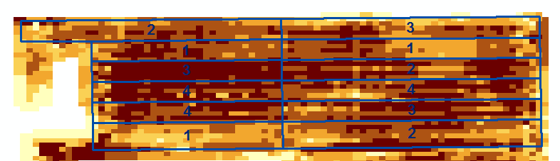
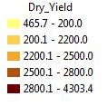
Treatments (kg N/ha) | mean dry yield (Kg/ha)
0 | 2619
2. 50 | 2709
3. 100 | 2759
4. 150 | 2771
Mean calculated from yield map based on strips
North Bay field demonstration plots 2012
Notes:
This included 4 N treatments and replicated 3 times. Clearly N was not utilized efficiently as within a stripbecause there was large spatial variability in soil fertility and field productivity potentials. For example, seed yield varied across the field from < ½ a ton to 4.3 t/ha, but compared to 0 N treatment, the highest N treatment only resulted in a yield increase of 5.8%. Even worse, from 50 to 150 kg N/ha treatments, the yield increase was only 2.3% or for each additional kg N/ha, yield increased only 0.6 kg/ha! Clearly it was necessary to supply in season N application according to spatial patterns!

Slide 15

2013 Ottawa Plot Exp.
Seeding: May 6
Sidedress: June 14
pH = 6.3
Notes:
In this year, spring was a bit cool with lots of rains. Development of the canola crop was slow. On June 10, the crop reached 4 fully expanded leaf stage and sidedress was applied in mid June. At that time, GreenSeeker delineated 0 N plots from preplant N treatments up to 100 kg /ha for variety L150. Shortly after sidedress, canopy reflectance differed among N treatments for both cultivars. It was noted that the highest N treatment had the lowest NDVI value for both cultivars up to June 13, and still low NDVI up to June 21.

Slide 16
Notes:
At the North Bay site, the spring was also cool and rainy but the field had a higher pH value. Canopy reflectance was measured before sidedress application, using a Crop Scan multispectrophotometer. The calculated NDVI values clearly separated preplant N treatments, and with larger NDVI values on June 24 than on June 18.

Slide 17
Relationship between canopy reflectance and soil NO₃-N at the early flowering stage
Seeding: May 11, 2011
Sidedress: Jun 14
pH = 7.1
Seeding: May 14, 2012
Sidedress: Jun 14
pH = 6.5
Notes:
Greenseeker NDVI readings in Ottawa had a strong correlation with soil nitrate levels measured at the 20% flowering stage in both 2011 and 2012, indicating canopy reflectance signature was a good indicator of soil N supplying power.

Slide 18
Relationship between canopy reflectance and yield
Ottawa -2012
Notes:
There was also a strong correlation between canopy reflectance measured by Greenseeker at early flowering and canola grain yields at Ottawa and the Guelph sites in 2011, but due to severe drought that occurred during the grain filling period in 2012, there was no correlation between yield and NDVI at the Ottawa site in 2012.

Slide 19
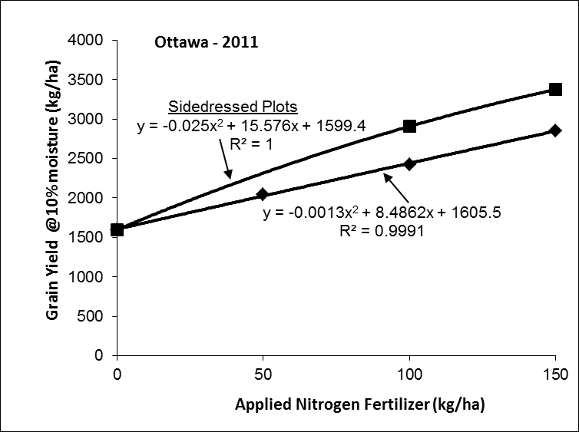
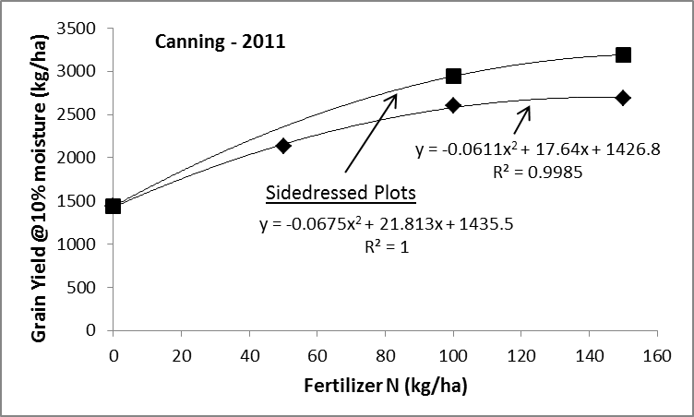
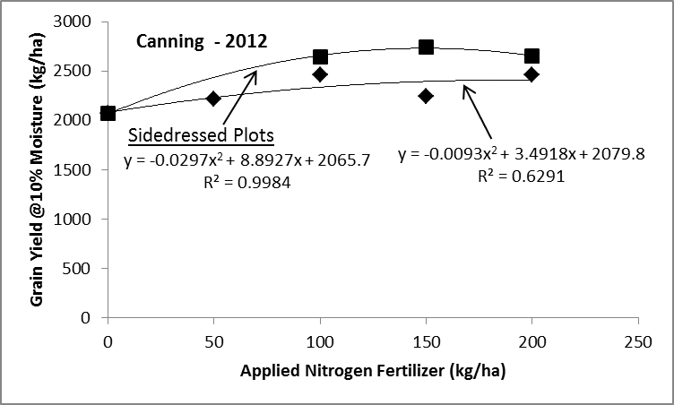
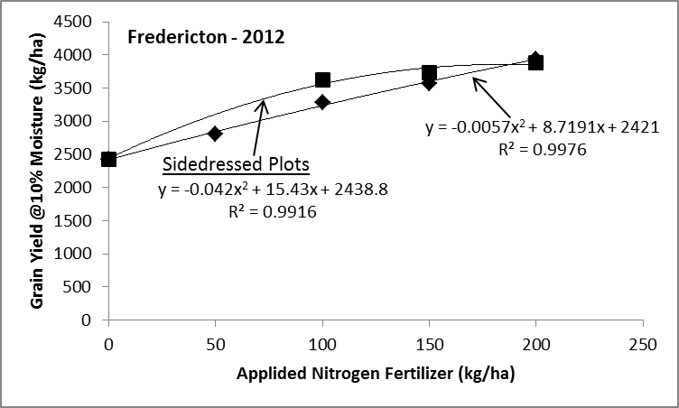
Canola yield response to N
Notes:
In most cases, sidedress application of N had significantly higher yields than the plots that received the same amount of N before planting (100, 150 and 200 kg ha-1). On average, for every kilogram of N applied, canola yields increased by 9.7 kg ha-1 for preplant application. However, when additional N was sidedressed later in June, yield increased by 13.7 kg ha-1.

Slide 20
Conclusions
Canola seed yield responded to N fertilizer positively, more so with sidedress application;
For each kg N ha⁻¹, seed yield increased by 9.7 for preplant application, by 13.7 kg ha⁻¹ for sidedress;
Drought severely affected canola response to N;
There was a close relationship between NDVI and soil NO₃-N, between NDVI and seed yield;
Canopy reflectance expressed as NDVI delineated N treatments at sidedress stage;
Reflectance signatures were affected by soil conditions such as low pH, cool temperatures;

Slide 21
Conclusions (cont’d)
There is a small window for sidedress, but late delineation of N effects by NDVI is a big challenge;
It is possible to estimate N requirement by measuring canopy reflectance.
Multi-site, multi-year data are needed to account for environmental extremes, spatial and temporal variability, and to derive NDVI – N rate algorithms;
Need to examine the balance between N:S and the optimum range of other nutrients;
Variable rate application of N using precision technology will play an important role.

Slide 22
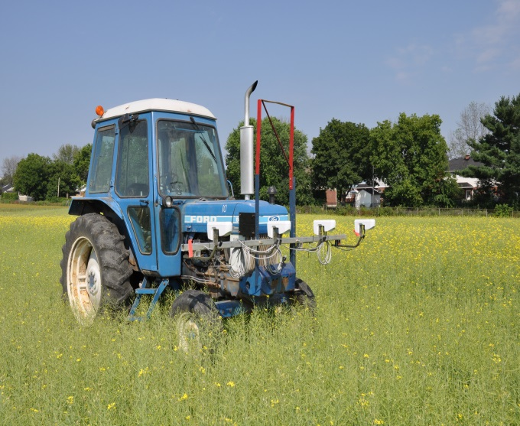
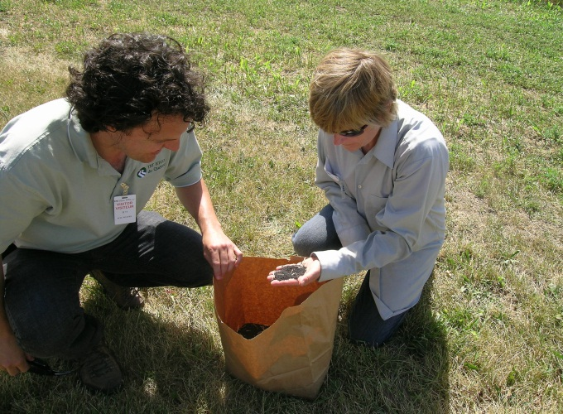

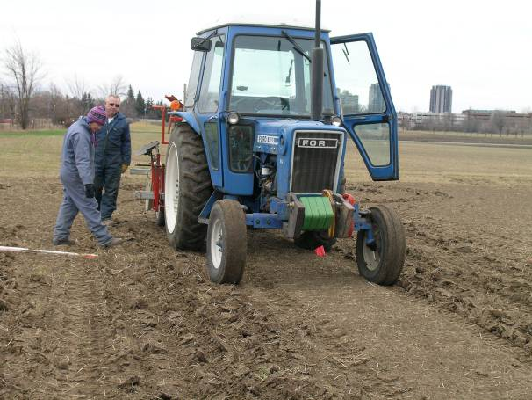
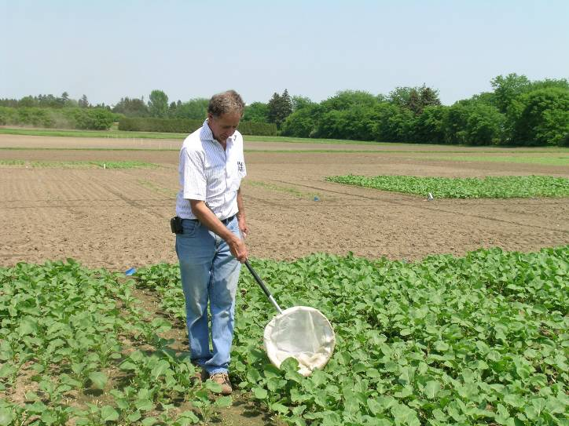
Acknowledgements
ECODA: Rory Francis, Etienne Tardiff, Don Smith
Professional: D. Smith, C. Caldwell, P. Scott, A. Vanasse, H. Earl, J. Shang
Technical support staff and students

