Slide 1
DEVELOPMENT OF AN IN-SEASON ESTIMATE OF YIELD POTENTIAL UTILIZING SOIL MOISTURE DATA FOR WINTER WHEAT
Jacob T. Bushong
2013 NUE Conference
Des Moines, Iowa
August 5-7

Slide 2
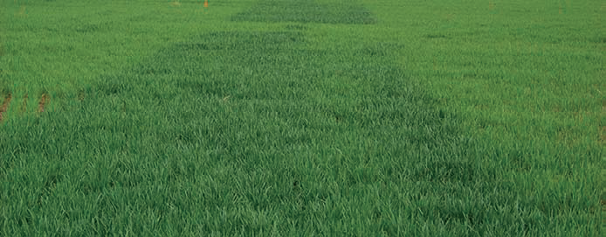
Introduction
Current OSU winter wheat midseason N rate recommendations are determined using:
Grain Yield Potential
Response index (RI), N-Rich strip and the farmer practice
Assumed maximum grain yield for the region
Economic factors (grain price & fertilizer price)
Farmer
Practice
N-Rich Strip

Slide 3
Grain Yield Potential
Based upon NDVI and GDD
In-season estimate of yield (INSEY)=NDVI/GDD

Slide 4
Soil Moisture Impact on Grain Yield Potential
Aids in stand establishment and early vegetative growth
Increases nutrient uptake of mobile nutrients
Yields can be maximized if consistent available water is present throughout the growing season

Slide 5
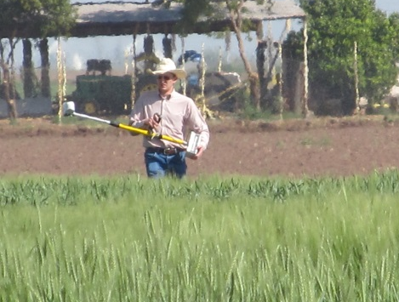
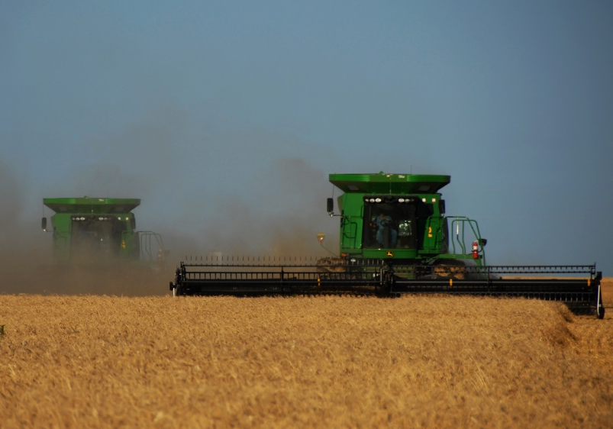
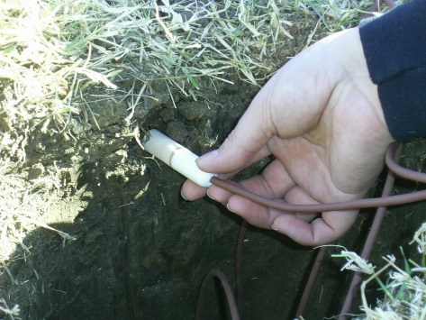
Objective
To improve the current method for estimating in-season grain yield potential by utilizing soil moisture data.
+
=
Photo courtesy of Oklahoma State University

Slide 6
Weather Monitoring
Oklahoma Mesonet
Collaboration with Oklahoma State & University of Oklahoma
120 automated weather monitoring stations statewide
Measures air temperature, wind speed, soil temperature, soil moisture
Soil moisture data, since 1996

Slide 7
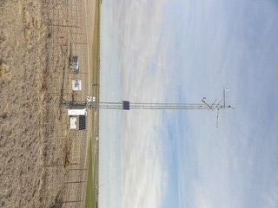
Soil Moisture & Temperature
Soil Moisture
Heat dissipation sensors
Depths of 5, 25, 60, 75 cm
Data reported as Fractional Water Index (FWI)
Range from 0.00 to 1.00
Soil Temperature
Recorded at 1.5 m above the surface

Slide 8
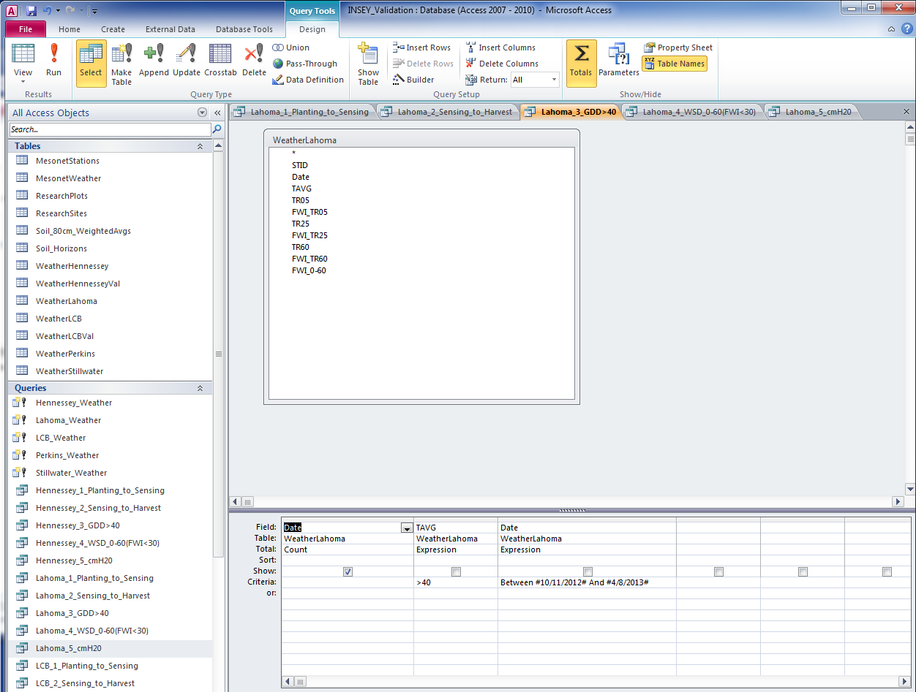
Data Acquisition and Manipulation
Downloaded from website
www.mesonet.org
Average daily values
SQL queries designed to retrieve desired data

Slide 9
Model Inputs
Normalized Difference Vegetation Index (NDVI)
Growing Degree Days (GDD’s)
Soil Moisture Factor (SMF)

Slide 10
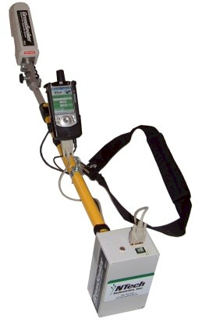
Normalized Difference Vegetation Index (NDVI)
Collected with Trimble Greenseeker Optical Sensor
NDVI_{RED} = | ρ₇₈₀ - ρ₆₇₀
 | ρ₇₈₀ +ρ₆₇₀

Slide 11
Growing Degree Days (GDD’s)
Current: Days from planting to sensing where the average daily temperature > 4.4 °C
Proposed: Days from planting to sensing where the average daily temperature > 4.4 °C and FWI > 0.30

Slide 12
Stillwater, OK (2012-13)
NDVI
FWI
GDD 47 77 98 136 180
Data sources: USGS Earth Explorer and Mesonet.org

Slide 13
Soil Moisture Factor (SMF)
Proportion of 0-80cm PAW at sensing to the daily water use (ET) of the growing crop from sensing to harvest
Assumed harvest date of June 10
Assumed daily water use 5 mm day⁻¹
FWI index converted to PAW utilizing soil water content values (PWP, FC, SAT) from USDA-NRCS soil survey
Value cannot exceed 1.0

Slide 14
Model Calibration Sites
Lahoma: Grant silt loam (fine-silty, mixed, superactive, thermic Udic Argiustolls)
Stillwater: Kirkland silt loam (fine, mixed, superactive, thermic Udertic Paleustolls)
Perkins: Konawa fine sandy loam (fine-loamy, mixed, active, thermic Ultic Haplustalfs)
Data collected from 2003 to 2011
22 total site-years of data
Plots had a wide range of pre-plant N rates
Data collected over a range of growth stages (Feekes 3 to 10)

Slide 15
Model Validation Sites
Lahoma: Grant silt loam (fine-silty, mixed, superactive, thermic Udic Argiustolls)
Stillwater: Kirkland silt loam (fine, mixed, superactive, thermic Udertic Paleustolls)
Perkins: Konawa fine sandy loam (fine-loamy, mixed, active, thermic Ultic Haplustalfs)
Hennessey: Bethany silt loam (fine, mixed, superactive, thermic Pachic Paluestolls)
LCB: Port silt loam (fine-silty, mixed, superactive, thermic Cumulic Haplustolls)
LCB: Konawa fine sandy loam (fine-loamy, mixed, active, thermic Ultic Haplustalfs)
Data collected from 2012 and 2013
11 total site-years of data
Plots had a wide range of pre-plant N rates
Data collected over a range of growth stages (Feekes 3 to 10)

Slide 16
Model Development
Stepwise regression was utilized
Maximize the adjusted R²
Three models developed
All Calibration Sites (Lahoma, Stillwater, Perkins)
Loamy Calibration Sites (Lahoma, Stillwater)
Coarse Calibration Site (Perkins)

Slide 17
Model Parameters Estimates
 | All Sites |  | Loamy Sites |  | Coarse Sites
Parameter | Est. | Pr > |t| | Est. | Pr > |t| | Est. | Pr > |t|
Intercept | 8.32 | --- | 9.62 | --- | 4.68 | ---
GDD | -0.09 | <0.0001 | -0.08 | 0.0320 | -0.06 | 0.1261
SMF | -10.66 | <0.0001 | -13.82 | <0.0001 | -5.03 | 0.2157
NDVI | -15.68 | <0.0001 | -17.17 | 0.0005 | -13.19 | 0.0356
GDD*SMF | 0.11 | <0.0001 | 0.11 | 0.0029 | 0.05 | 0.2408
GDD*NDVI | 0.22 | <0.0001 | 0.18 | 0.0051 | 0.23 | 0.0014
NDVI*SMF | 25.80 | <0.0001 | 31.44 | <0.0001 | 16.51 | 0.0250
NDVI*GDD*SMF | -0.28 | <0.0001 | -0.27 | <0.0001 | -0.22 | 0.0064

Slide 18
Validation Results

Slide 19
Lahoma (Grant)
R²

Slide 20
Stillwater (Kirkland)
R²

Slide 21
Hennessey (Bethany)
R²

Slide 22
Lake Carl Blackwell (Port)
R²

Slide 23
All Loamy Sites
R²

Slide 24
Perkins (Konawa)
R²

Slide 25
Lake Carl Blackwell (Konawa)
R²

Slide 26
All Coarse Sites
R²

Slide 27
All Sites
R²

Slide 28
All Sites
New INSEY
Current INSEY
Actual Yield (Mg/ha)
Actual Yield (Mg/ha)
X
X
RMSE = 0.92
RMSE = 0.95
Predicted Yield (Mg/ha)
Predicted Yield (Mg/ha)

Slide 29
Conclusions
Soil moisture at the time of sensing had a significant effect on final wheat grain yield for all locations
Models that included soil moisture parameters typically outperformed current models at most locations
One model developed from loamy and coarse textures sites is sufficient to use compared to having different models based on soil type.

Slide 30
Next Steps
Investigate the GDD adjustment for soil moisture
What depth?
Soil moisture threshold?
Evaluate which estimate of grain yield provides the most accurate mid-season N rate recommendation
Evaluate if Vertisol soils can use the new model or if they need their own model

Slide 31
Questions?

