Slide 1
Critical issues
Maintaining food and energy security with a minimum amount of resources and increasing climate variability.
Conducting agricultural research that will survive the post oil peak.
How will the agricultural system change when if oil goes to $300 or $400/barrel?

Slide 2
Why precision N management is key to maintain food security David Clay, Gregg Carlson, and Sharon Clay

Slide 3
First what can we hope to accomplish using precision management,
The management gap is the difference between the genetic potential and the achievable yield.
What benchmarks are available.

Slide 4
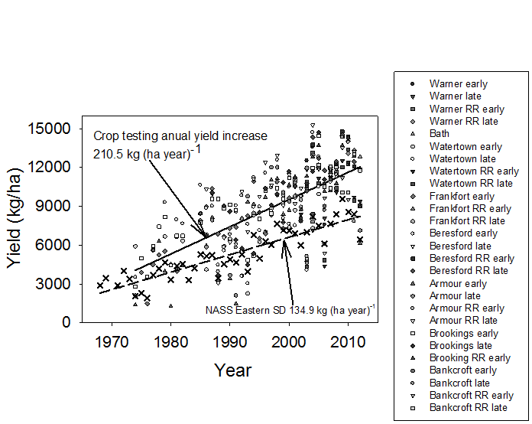
Opportunity to increase yields depends on the benchmark.

Slide 5
Drought resilience, how have we done (SD from 1974 to 2012)
 | Harvested |  |  | Selling price |  |  | Yields |  |  | Return |  |  | $ return in 2012
Crop | 1974 | 2012 |  | 1974 | 2012 |  | 1974 | 2012 |  | 1974 | 2012 |  | from higher yields
 | ha×1000 | ha×1000 |  | $/Mg | $/Mg |  | Mg/ha | Mg/ha |  | $/ha | $/ha |  | $/ha
Corn | 943 | 2,145 |  | 135 | 277 |  | 2.07 | 6.32 |  | 279 | 1,756 |  | 1,183
Soybean | 149 | 1,906 |  | 269 | 518 |  | 1.34 | 2.01 |  | 363 | 1,046 |  | 347
Wheat | 1,252 | 904 |  | 179 | 302 |  | 1.23 | 3.07 |  | 222 | 930 |  | 556
Total | 2,344 | 4,955

Slide 6
Causes for the improved drought resilience
Soil health
Genetics
Tillage

Slide 7
Soil health

Slide 8
Impact on plant available water

Slide 10
Calculating improvements in plant available water
SD NASS |  | No-tillage |  |  | Water increase in the surface 15 cm
region | 2004-2007 | 2008-2010 | 2004-2010 |  | No-till | Con. till | SOC | Total
 |  | % adoption |  |  | cm | cm | cm | cm
NC | 97 | 69 | 85 |  | 4.42 | 0.39 | 0.61 | 5.42
C | 68 | 57 | 63 |  | 3.28 | 0.96 | 0.61 | 4.85
NE | 20 | 11 | 16 |  | 0.83 | 2.18 | 0.61 | 3.63
EC | 11 | 5 | 8 |  | 0.42 | 2.39 | 0.61 | 3.42
SE | 29 | 33 | 31 |  | 1.61 | 1.79 | 0.61 | 4.02
NW | 40 | ns | nc |  | 2.08 | 1.56 | 0.61 | 4.25
SC | 88 | ns | nc |  | 4.58 | 0.31 | 0.61 | 5.50
CW | 82 | ns | nc |  | 4.26 | 0.47 | 0.61 | 5.34
Ave. | 54 | 35 | 41 |  |  |  |  | 4.55

Slide 11
Return from reduced tillage and soil health
Region | Water (cm) | $ return due to soil
NC | 5.42 | 314,079,000
C | 4.85 | 192,166,000
NE | 3.63 | 156,307,000
CE | 3.42 | 150,990,000
SE | 4.02 | 174,466,000
NW | 4.25 | 43,869,000
SC | 5.5 | 59,186,000
CW | 5.34 | 337,244,000
Total |  | 1,124,788,000

Slide 12
Soil + genetic impacts, summary
From 1974 to 2012
maize (+4.3 Mg ha⁻¹), $1,183/ha
soybean (+0.67 Mg ha⁻¹), $347/ha
wheat (+1.84 Mg ha⁻¹), $556/ha
Soil management impacts
22% corn
61% soybean
41% wheat

Slide 13
Genetic improvements
Improved water use efficiency
Relationship between year of published research and water use efficiency in studies conducted across the US Great Plains.
Based on Musick and Dusek (1980), Eck (1984), Unger (1986), Howell et al., 1989), Steiner et al. (1991), Howell et al. (1995),
Hattendorf et al., 1988, Lamm et al., 1991, Hillel and Guron (1973), Steweart et al. (1975), Hanks et al. (1978, Stegman (1982),
Payero et al. (2009), Trooien et al. (1999), Kim et al. (2008), Monsanto (2010), and Pioneer (2009).

Slide 15
In-season N
Can provide information needed to reduce the yield gap.
By using in-season sensor based information we can avoid the complexity associated with spatially dependent N response functions as well as improving water use efficiencies.

