Slide 1
New development of Hybrid-Maize model
Haishun Yang
Associate Professor / Crop Simulation Modeler,
Dept. Agronomy & Horticulture
University of Nebraska – Lincoln
Aug 6, 2013

Slide 2
Outline
General approach and applications of the Hybrid-Maize model
Recent focus of Hybrid-Maize development: corn water stress and its impacts
Remarks

Slide 3
Scientific approach of Hybrid-Maize model
Hybridization of phenology-based, empirical approach with physiology-based, mechanistic approach. Features:
Phenology-based canopy expansion
Physiology-based photosynthesis and respirations
Corn-specific kernel setting and grain filling functions
Calibrated for corn yield potential under optimal conditions.
Internal parameter settings transparent and modifiable
Require only “farmer-know” user input settings.
Comprehensive outputs

Slide 4
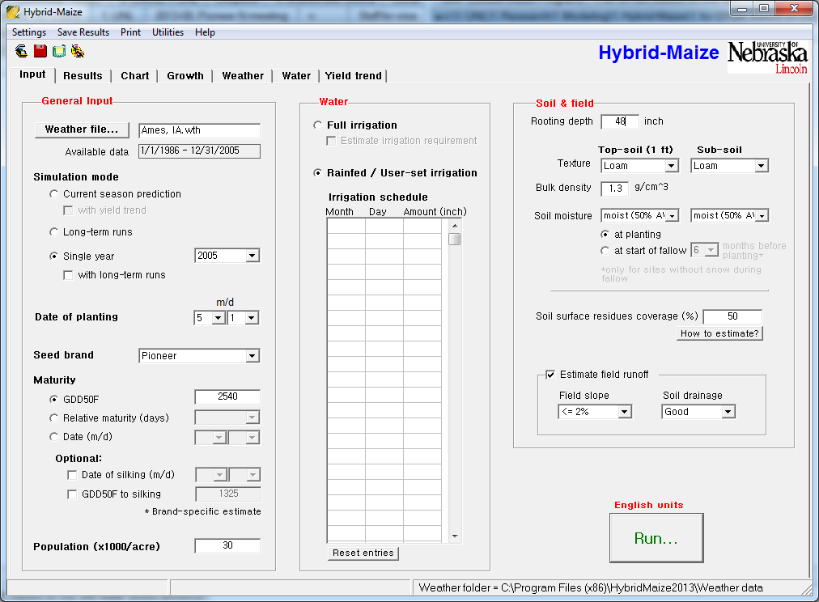
Input settings of Hybrid-Maize model

Slide 5
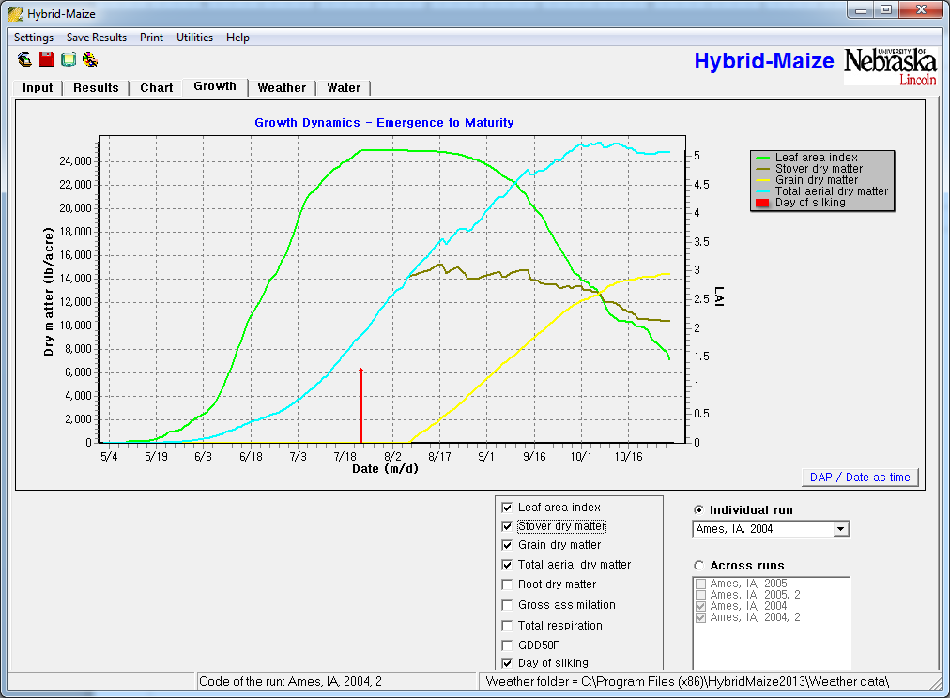
Hybrid-Maize output: growth dynamics

Slide 6
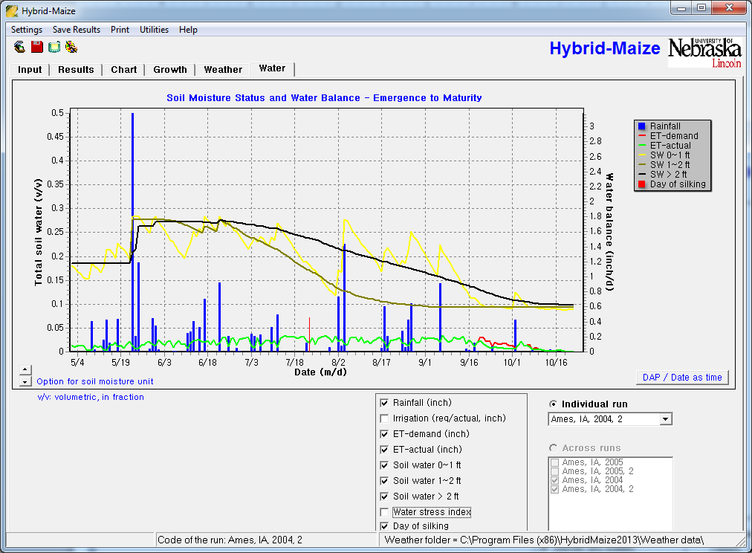
Hybrid-Maize output: soil water dynamics

Slide 7
Applications of Hybrid-Maize model
Assess overall site yield potential and its variability based on historical weather data
Evaluate changes in yield with management (planting date, hybrid maturity, plant density, soil type, irrigation)
Explore options for optimal irrigation management;
Conduct in-season simulations to evaluate actual growth up to the current date based on real-time weather data, and to forecast final yield scenarios based on historical weather data for the remainder of the growing season.
Help determine N requirement of corn
Hybrid-Maize does NOT allow assessment of different options for nutrient management, nor does it account for yield losses due to weeds, insects, diseases, lodging, and other stresses.

Slide 8
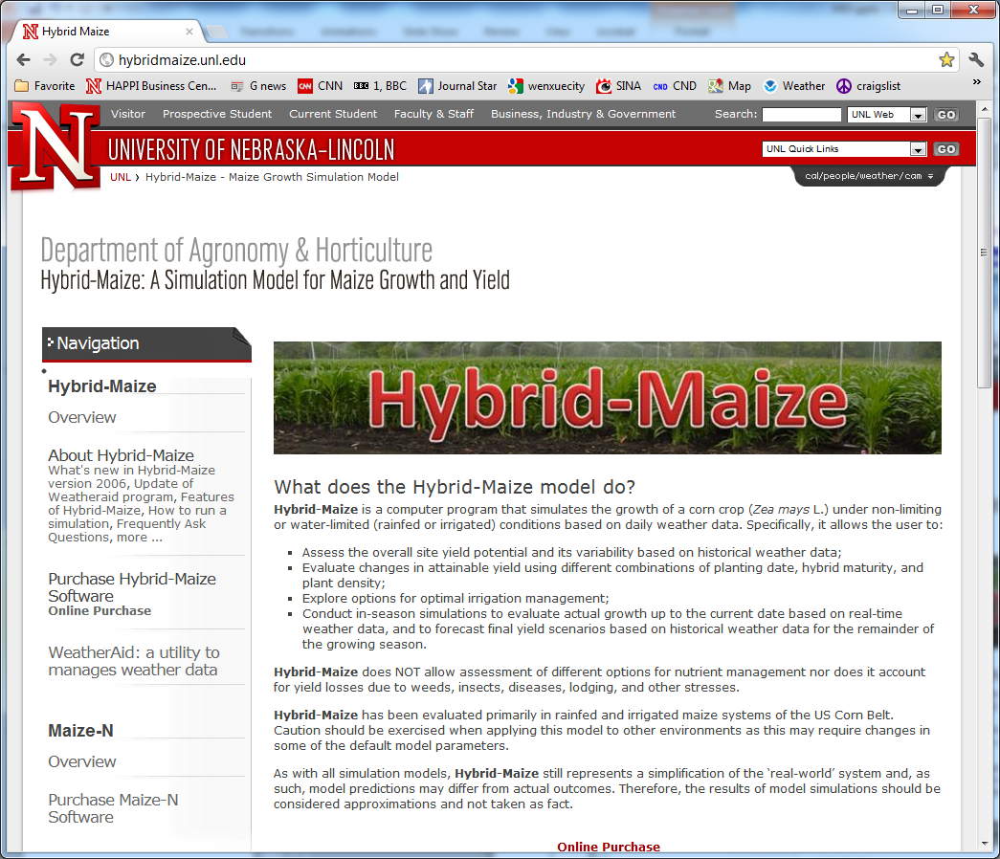
HM website http://hybridmaize.unl.edu/
Hybrid-Maize team
Haishun Yang
Achim Dobermann
Ken Cassman
Dan Walters
Patricio Grassini

Slide 9
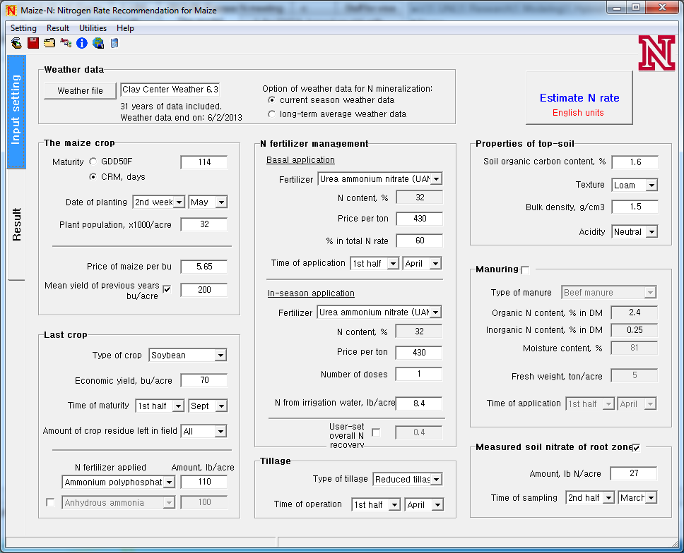
Maize-N: partially driven by HM model
Use HM model for estimate yield potential and variability for the given crop management.
The yield potential sets the upper end of yield-N rate curve and yield variability leads to N rate range.

Slide 10
Recent focus in Hybrid-Maize development
Corn water stress and its impacts on corn development and yield:
Root distribution: vertically and laterally
Root water uptake from different depths
Water stress on canopy expansion before silking
Water stress on kernel setting
Water stress on senescence
Water stress on final yield

Slide 11
Root distribution function: old vs new
Old hybrid: low pop, weak drought tolerant
New hybrid: high pop, better drought tolerant
Wider, shallower (3-4 ft)
Narrower deeper
(4-5 ft)
1 m
1.5 m
HM uses (1) potential root depth (150 cm) and (2) actual rooting depth (user setting) to set root distribution
The weight of each layer depth (10 cm) follows the curve for computing water uptake from each layer.

Slide 12
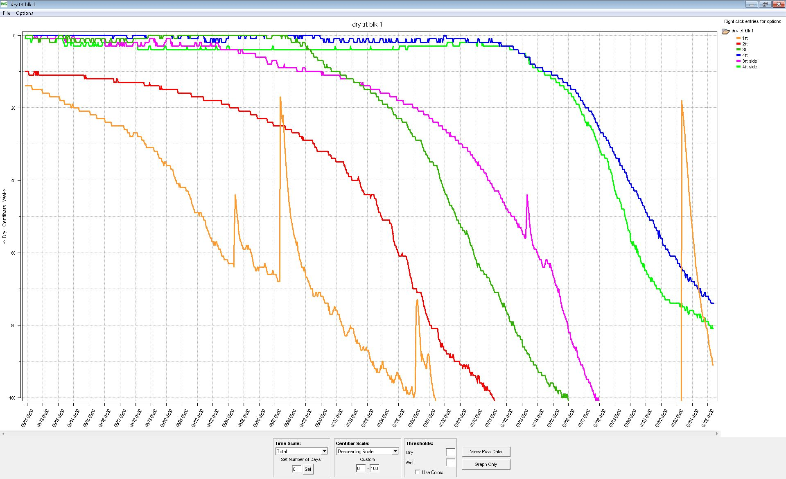
Soil water withdraw down to 4 ft under water stress condition in Lincoln, NE, 2013
4-ft
3-ft
1-ft
2-ft
Soil water pressure
6/11
7/1
7/25

Slide 13
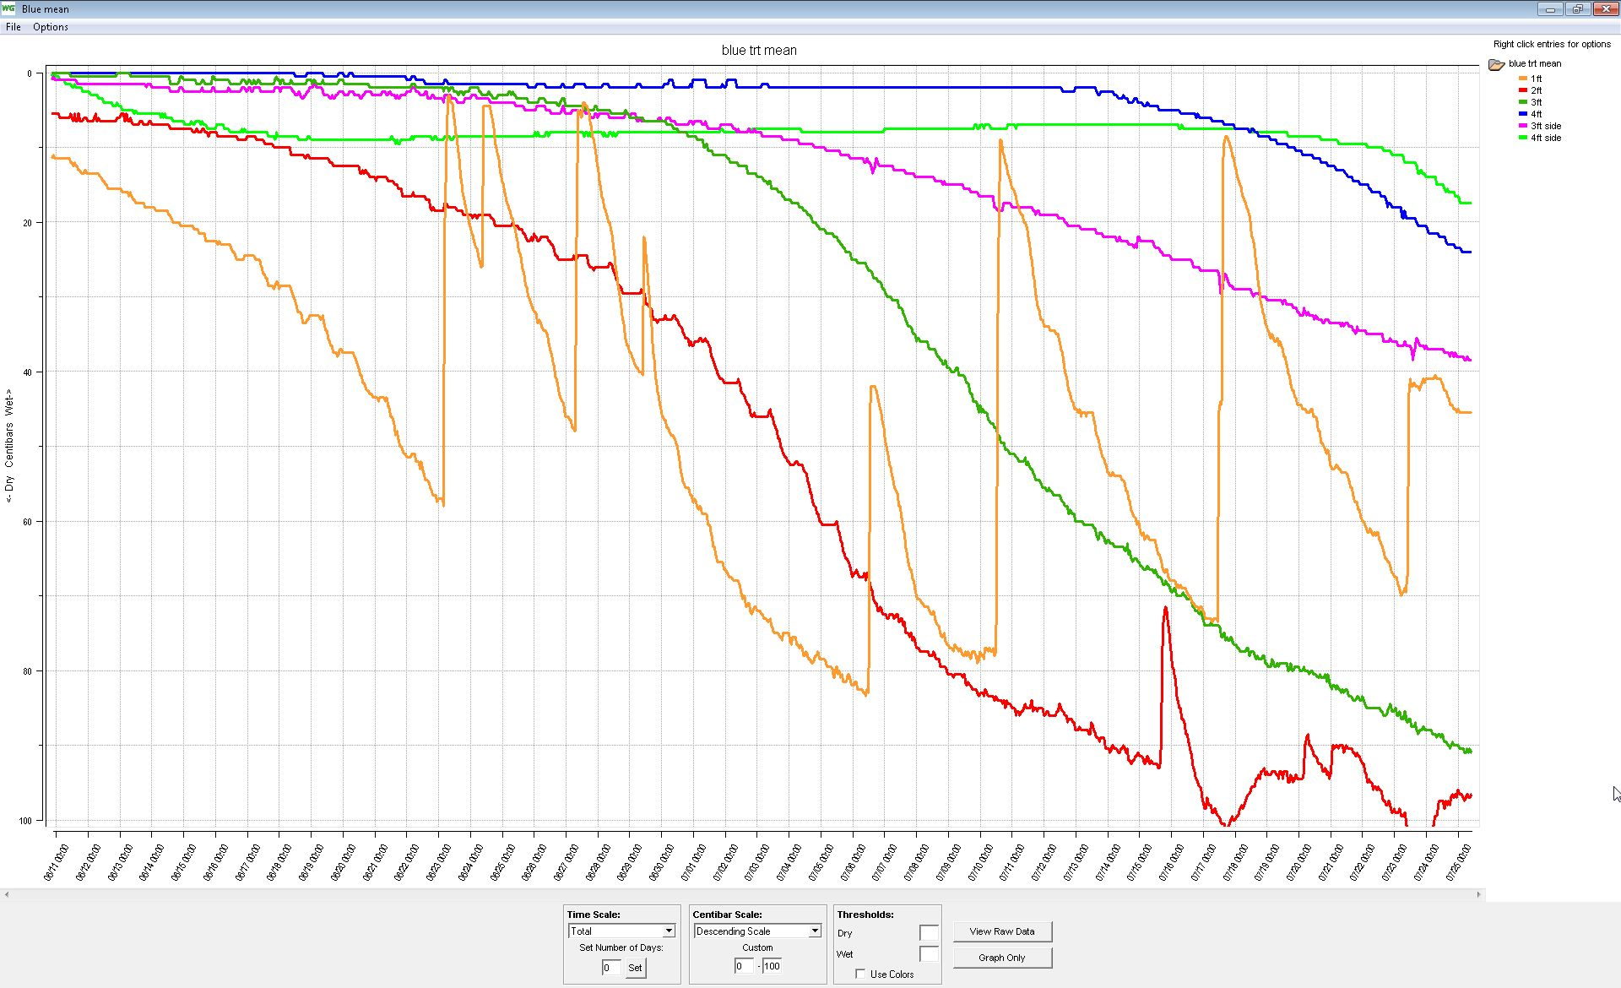
Soil water withdraw down to 4 ft under irrigated condition in Lincoln, NE, 2013
4-ft
3-ft
2-ft
1-ft
Soil water pressure
6/11
7/1
7/25

Slide 14
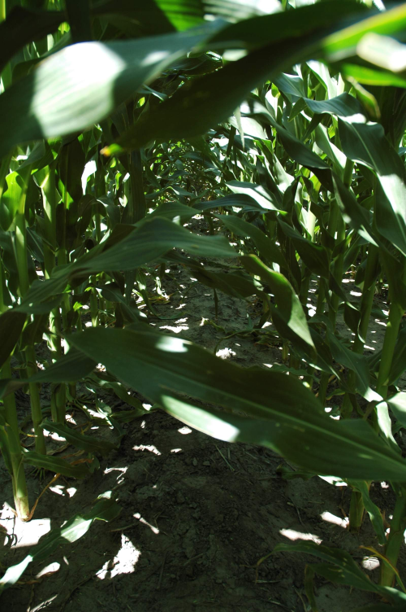
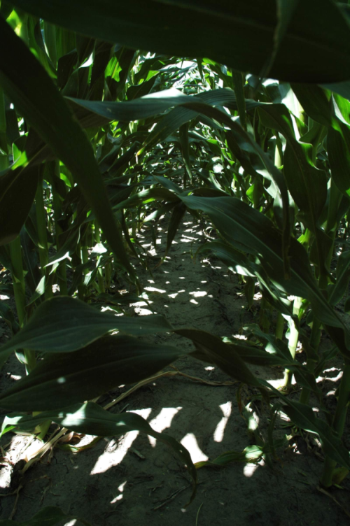
Water stress retards canopy development
HM deploys new control of water stress over canopy expansion:
Daily canopy expansion stops at water stress index > 0.5
Non-irrigated
Irrigated
7/22/2005 in North Platte

Slide 15
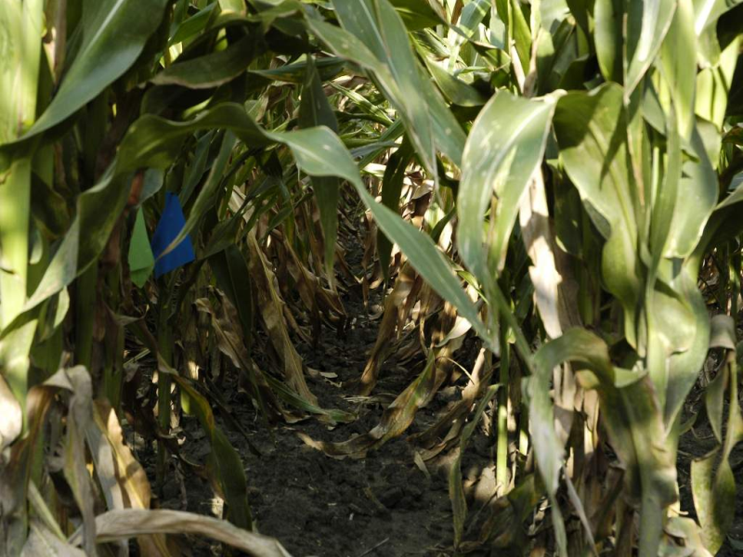
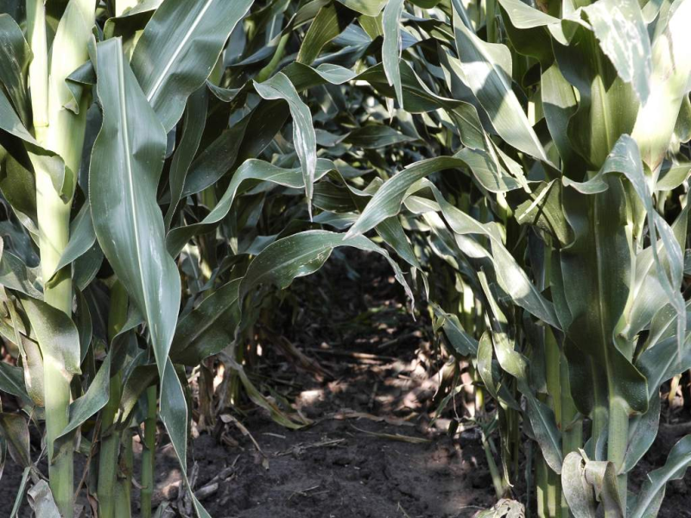
Water stress accelerates leaf senescence
Non-irrigated
Irrigated
7/22/2005 in North Platte
Leaf senescence due to water stress:
senescenceByWaterStress = WSI * maxSBWS

Slide 16
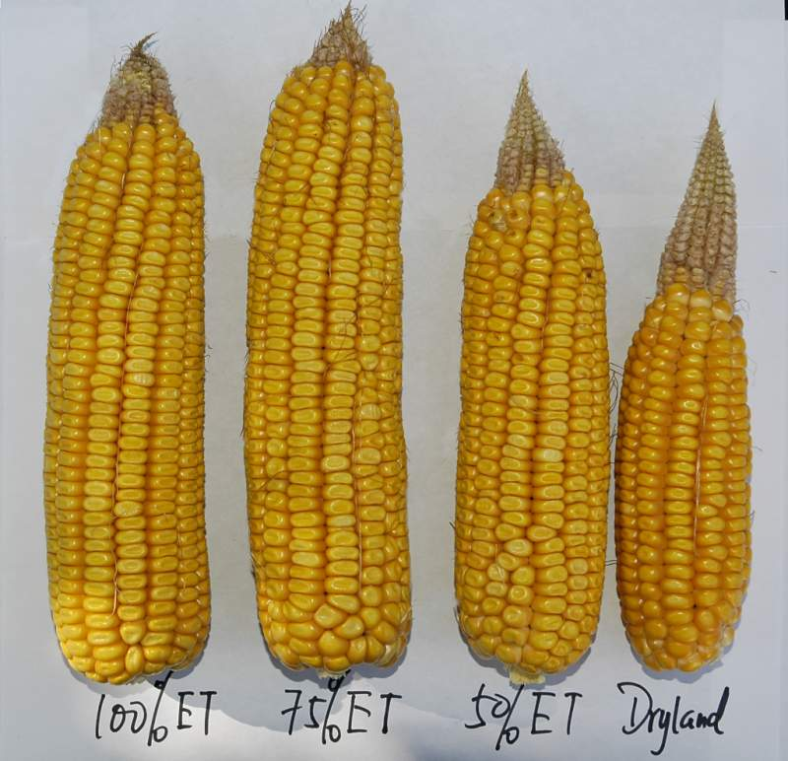
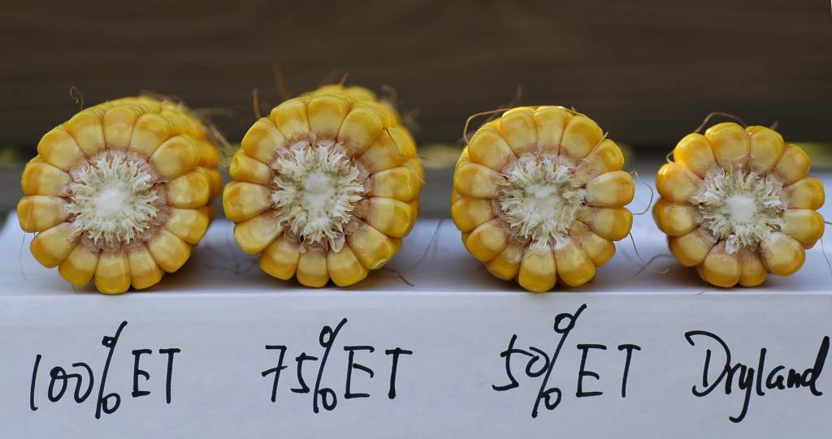
Water stress results in small ears and smaller kernels
2005 in North Platte
Effect of water stress on kernel setting:
PSKER := sumP/(1+GRRG) *1000/silkingBracketDays*3.4/5
GPP := G2 - 676/(PSKER/1000)

Slide 17
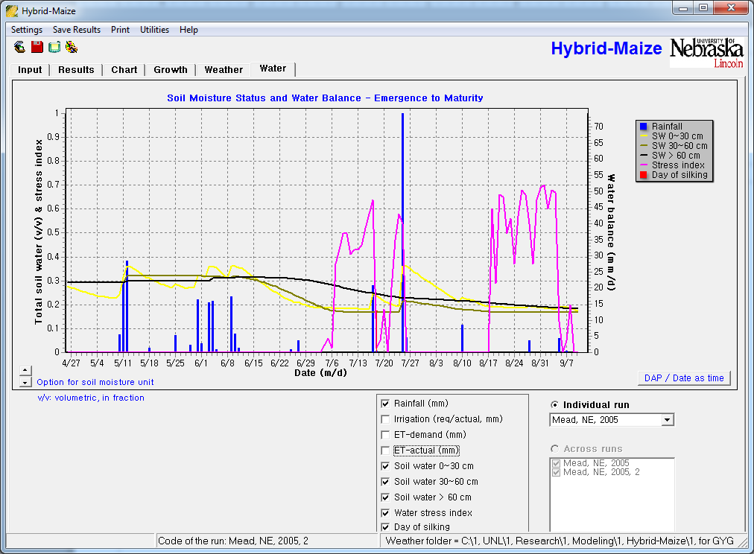
HM simulation of soil water dynamics and crop water stress: Mead, NE, 2005

Slide 18
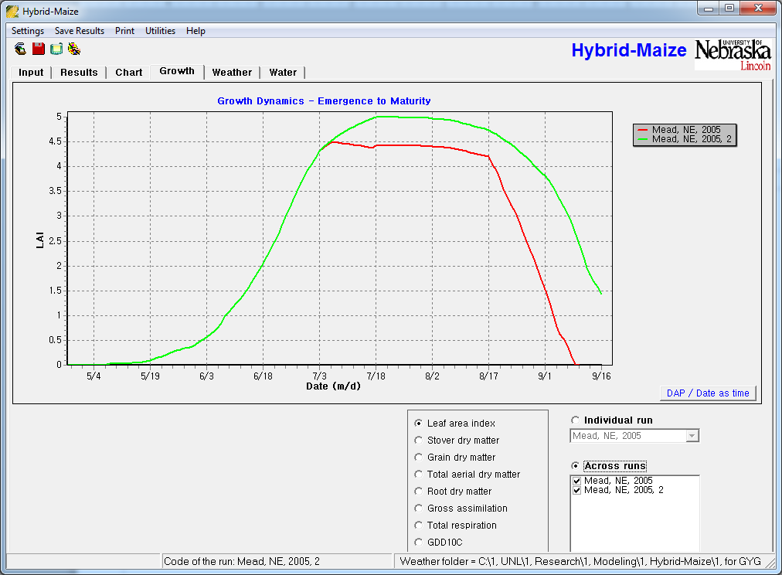
HM simulation of corn LAI under irrigated and water stress conditions: Mead, NE, 2005

Slide 19
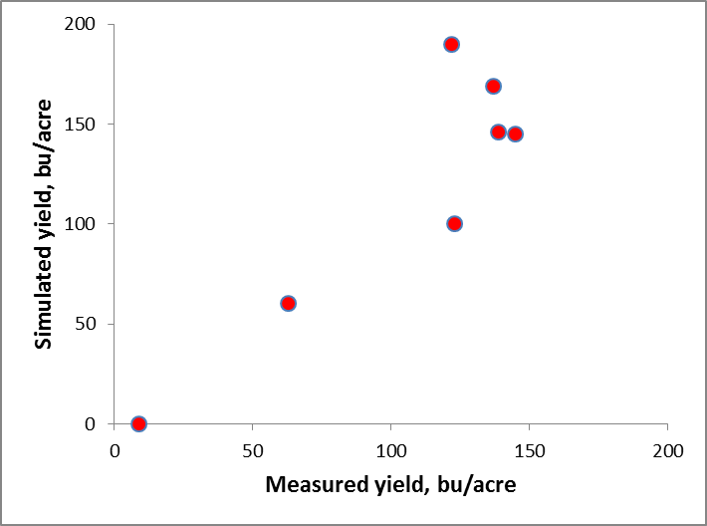
Preliminary test of updated Hybrid-Maize on yield simulation under water stress conditions
Location/year | Measured, bu/acre | HM simulation, bu/acre
Mead, NE, 2001 | 139 | 146
Mead, NE, 2003 | 123 | 100
Mead, NE, 2005 | 145 | 145
Clay Center, NE, 2005 | 63 | 60
Clay Center, NE, 2006 | 122 | 190
North Platte, NE, 2005 | 137 | 169
North Platte, NE, 2006 | 9 | 0
Hybrid-Maize model ver 2013 will be released in Aug, 2013

Slide 20
Remarks
There are still gaps in quantitative understanding about water stress on corn development and physiological processes
Better understanding of soil water uptake and its dynamics help predict N requirement, N availability, and application method.
Specifically designed field experiments are required to provide the data for model development, testing and validation.
Modeling has to follow breeding; breeding can also learn from modeling.

Slide 21
Thanks

