Slide 1
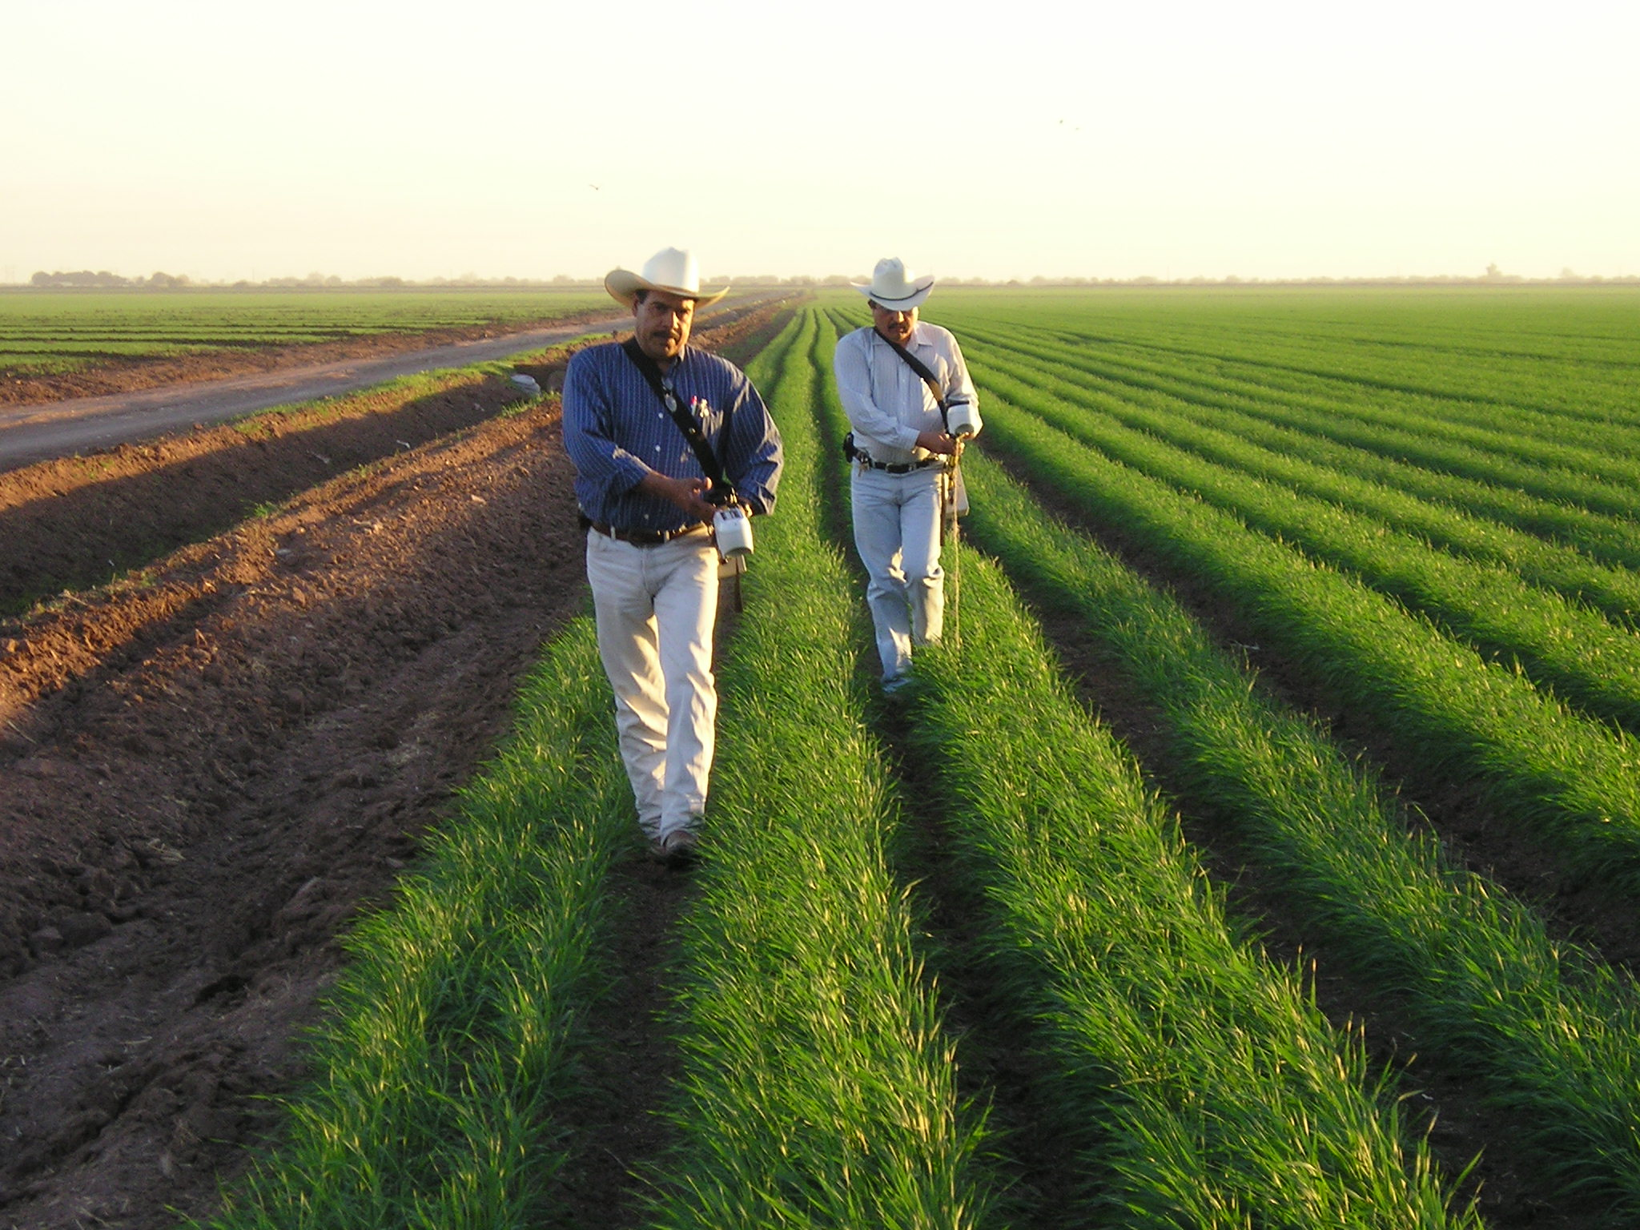
CIMMYT Experiences with Crops Sensors in Mexico
Ivan Ortiz-Monasterio

Slide 2
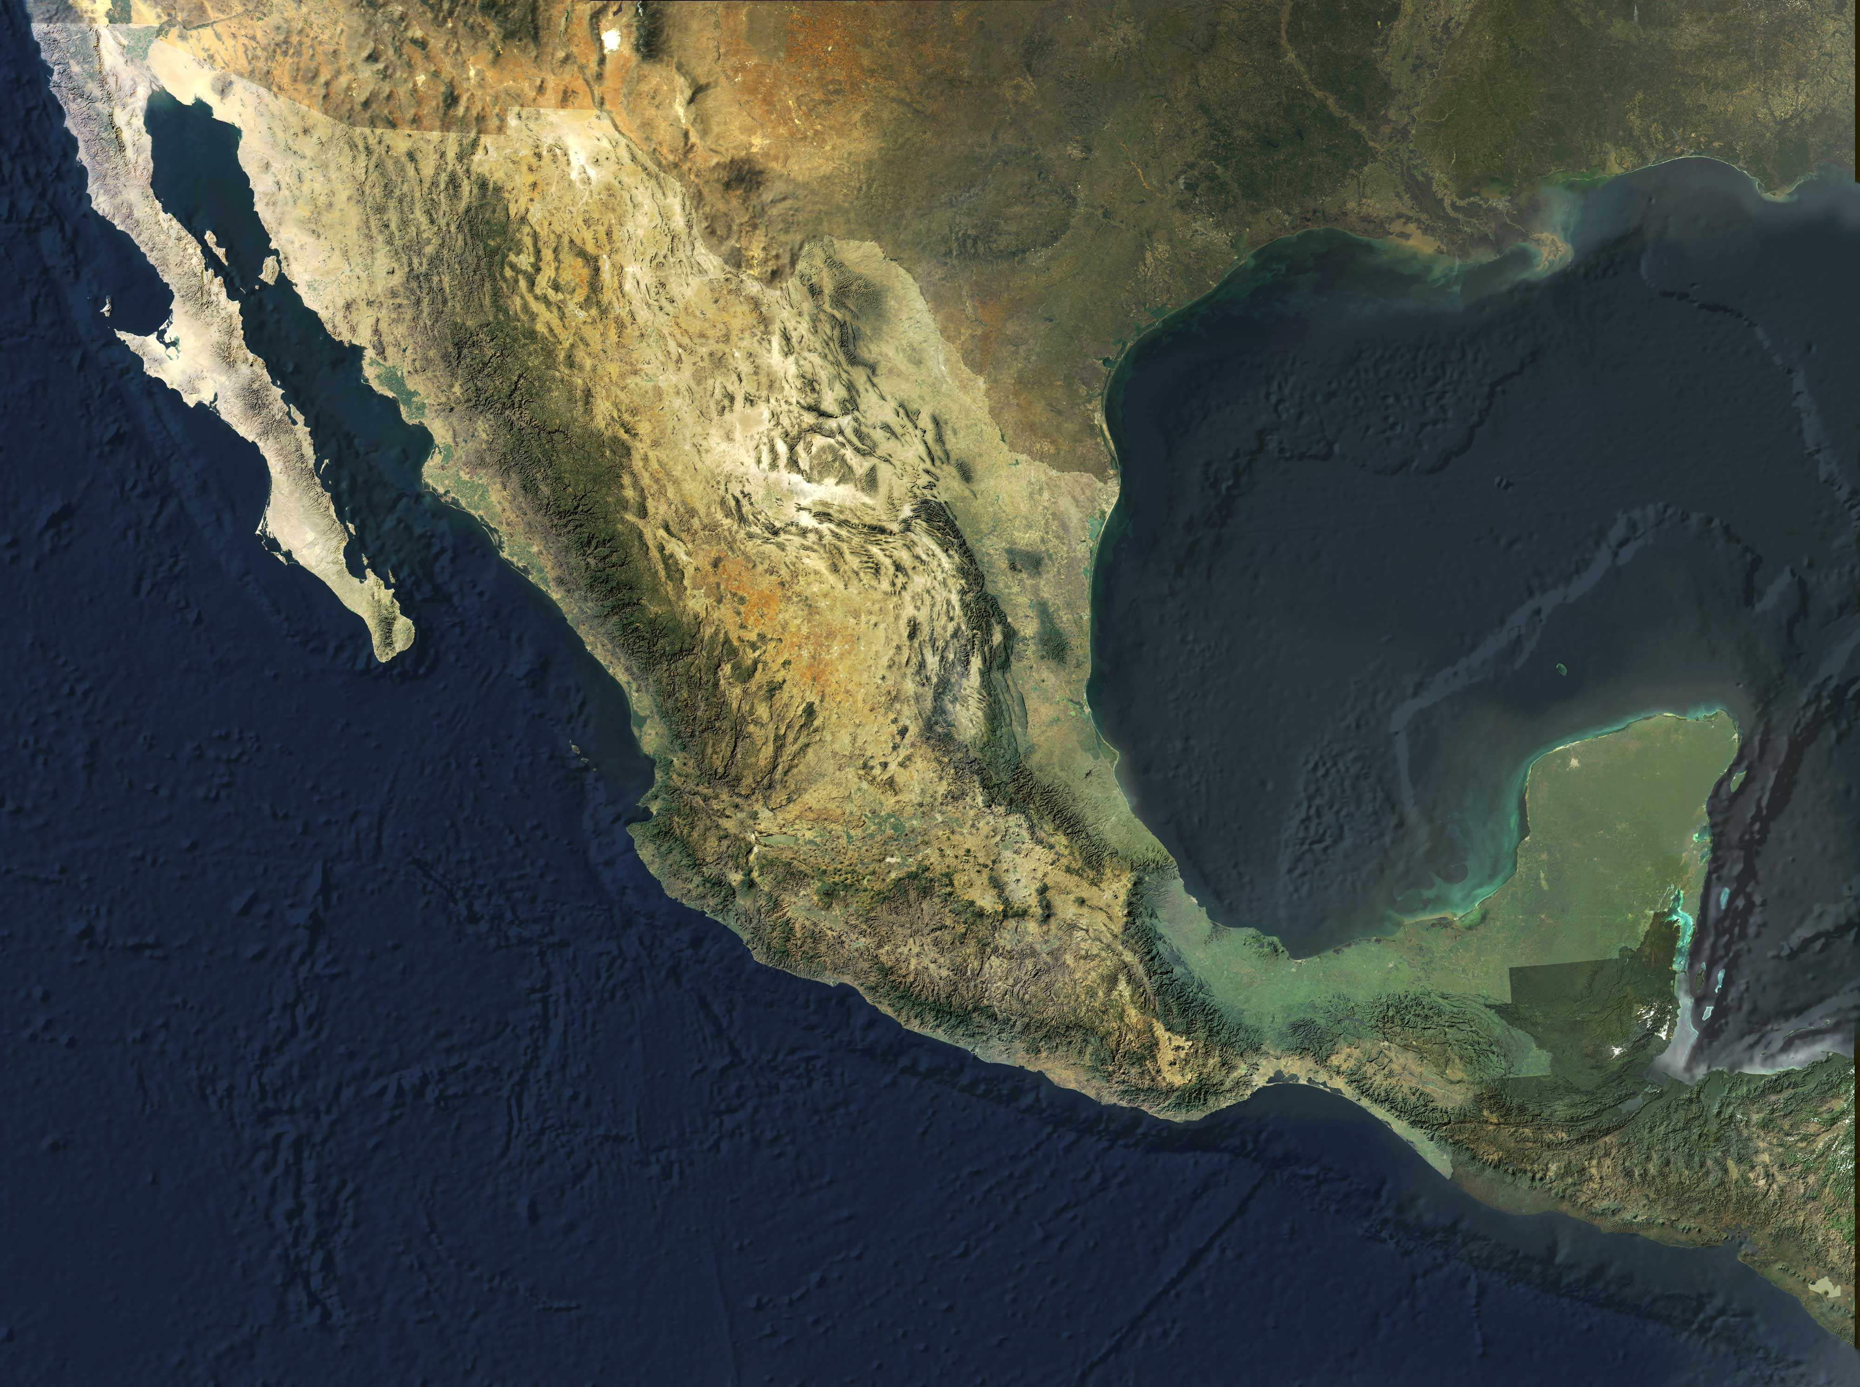
Yaqui Valley

Slide 3
Percentage Nitrogen Recovery in
Wheat in the Yaqui Valley
(average of 30 fields)
Recovery by
the plant
Losses

Slide 4
Losses to the environment
NH₃
NOx
N₂O
N₂
Urea
NH₄⁺
NO₃⁻
Organic
Matter
NH₄⁺
NO₃⁻
N₂O
N₂
Nitrification
Denitrification

Slide 5
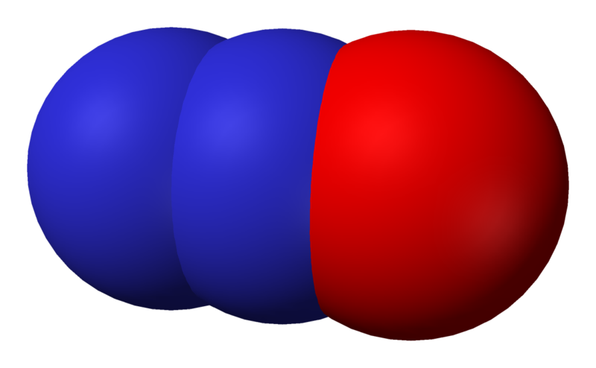
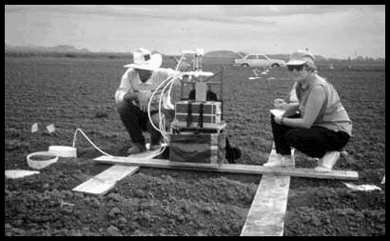
Nitrous oxide
N₂O
Work in Yaqui, one of the highest emission of N2O in an agricultural system reported in the literature when published
Matson et al., 1998
Science

Slide 6
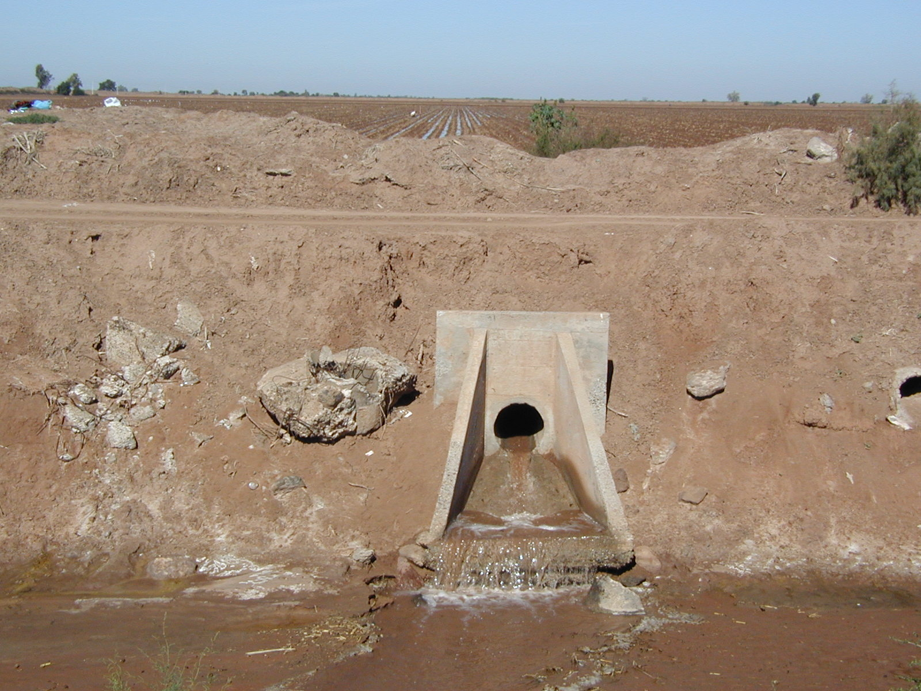
Losses through run-off
Measuremente in drains
NO₃ 0 – 12 mg/L average 6 mg/L
NH₄ 0 - 12 mg/L average 6 mg/L
        Harrison et al, 2003

Slide 7
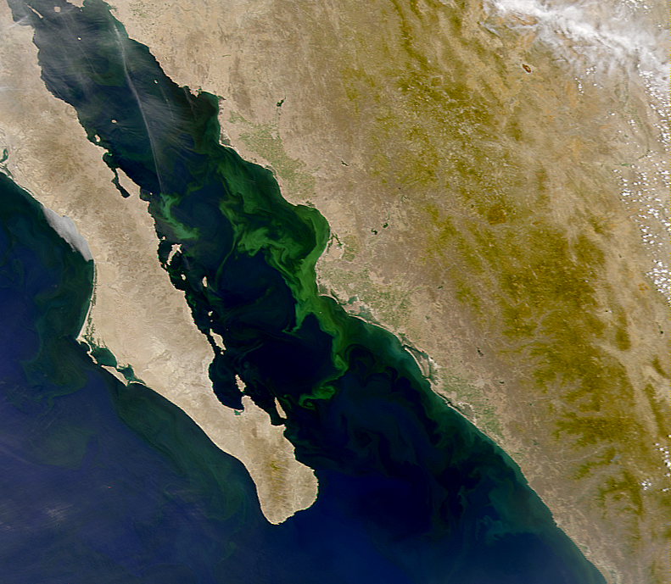
Beman et al. 2005
Nature

Slide 8
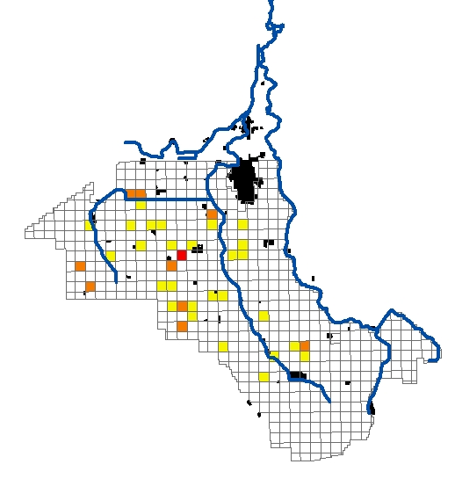
Nitrate levels in the water table in the Yaqui Valley
NO₃
<10 ppm (allowed)
10- 40 ppm
116 ppm

Slide 9
Costs of Production Wheat Cycle 2009-2010
Soil preparation | $1,470 | 11%
Planting | $1,267 | 9%
Fertilization | $3,654 | 26%
Irrigation and Drainage | $1,753 | 13%
Pest control | $3,612 | 26%
Harvesting | $1,370 | 10%
Other | $720 | 5%
Total | $13,846 | 100%
*Does not include interest Exchange rate 1 USD= 12.5 Mex peso Source: AOASS 2009

Slide 10
Management for N use Efficiency
1. Rate
2. Timing
3. Source
4. Placemente

Slide 11
Cumulative nitrogen absorption curve in wheat
250 kgN/ha
0%
25%
Farmer’s management
75%
Fertilization

Slide 12
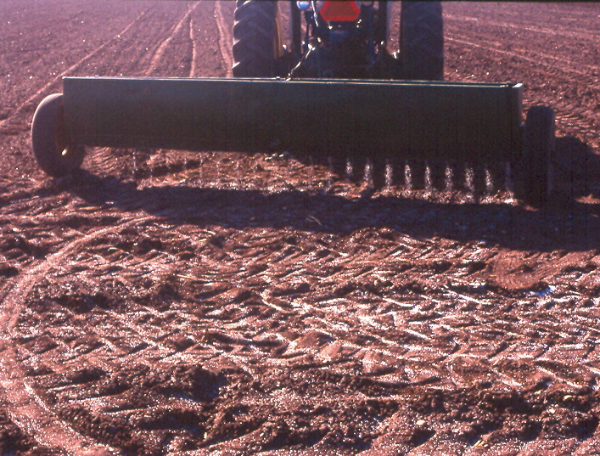
Urea or NH₃
180 kg N /ha
Pre-plant

Slide 13
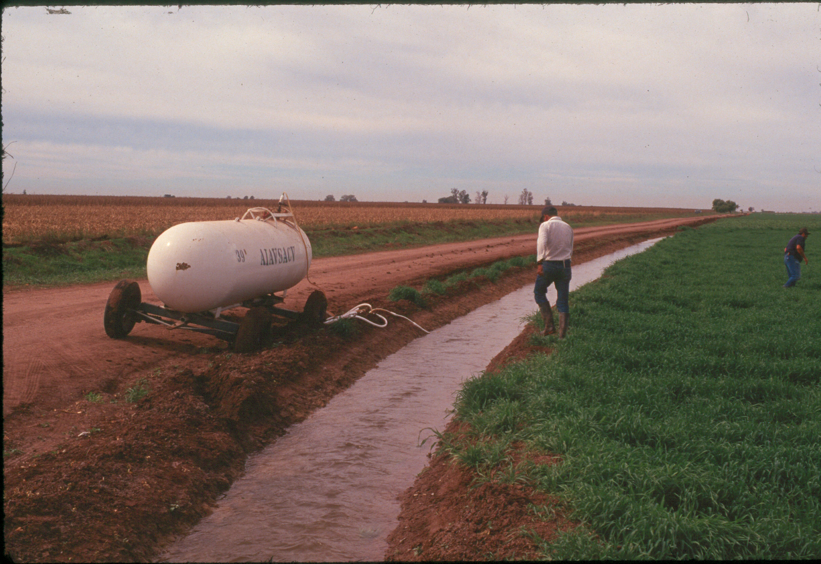
70 kgN/ha

Slide 14
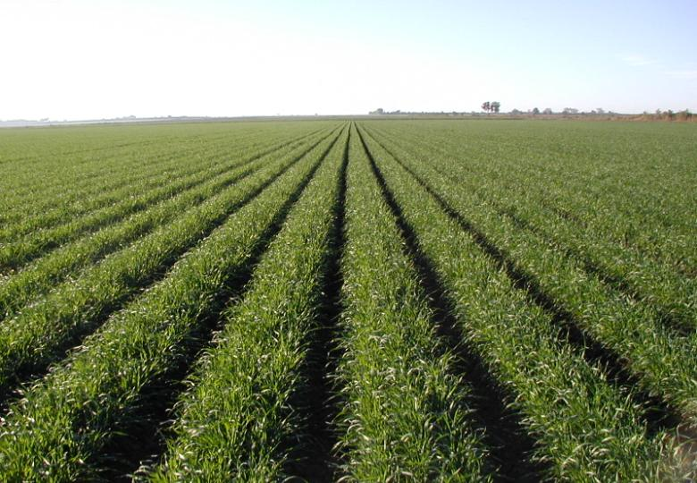
Yaqui Valley
Average Wheat Yield 2011-2012
7.2 t/ha
Average N rate
250 kgN/ha

Slide 15
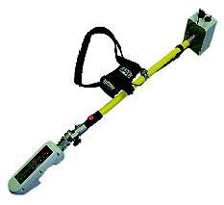
Right Rate
Sensor Technology
Diagnostic tool that allows to establish N fertilization needs for each individual field.
Colaboration with
Oklahoma State University
Bill Raun

Slide 16


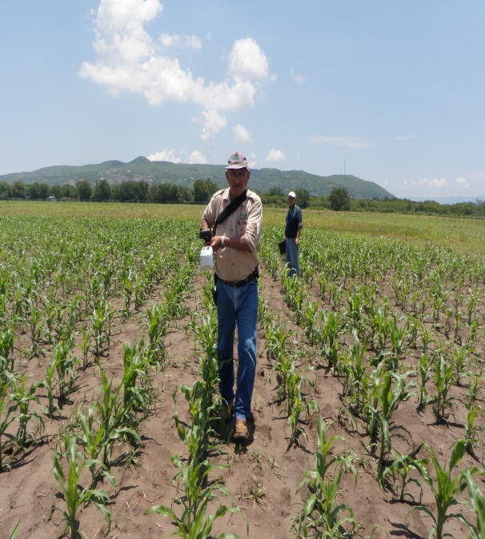
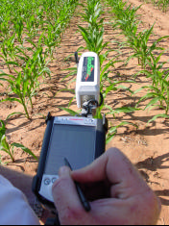
Use of GreenSeeker sensor for N management
1. N RICH STRIP
2. DATA COLLECTION WITH THE GREENSEEKER
3. USE OF THE ALGORITHM
FRANJA RICA
AREA SENSOR
PRACTICAS PRODUCTOR
COMPONENTES DEL SENSOR
TOMA DE LECTURAS EN CAMPO

Slide 17
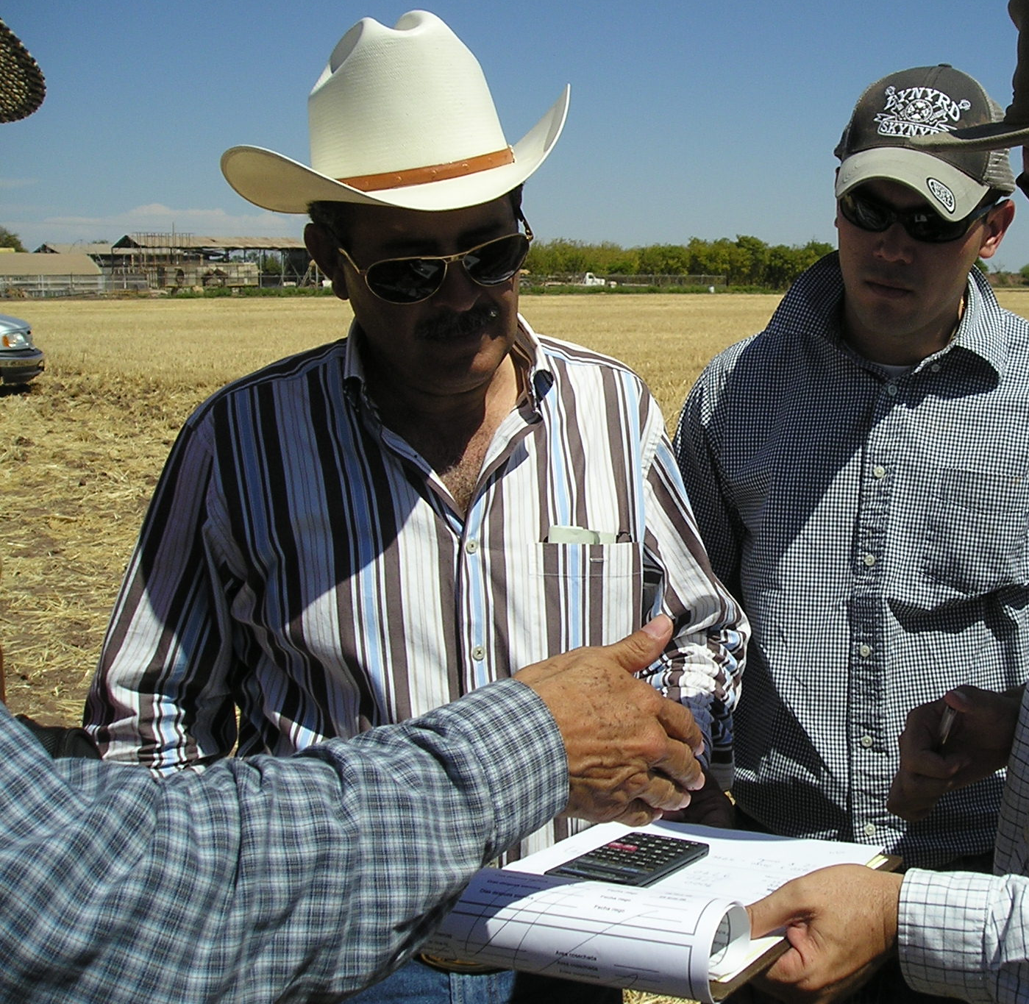
Technology Transfer

Slide 18
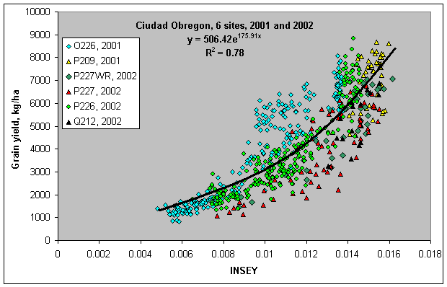

Slide 19
Area Under GreenSeeker Management in Southern Sonora

Slide 20
Total
# Evaluations in
Farmers’ fields
86
60
101
107
78
=
432
Wheat yield (kg/ha)

Slide 21
N Saving Using the GreenSeeker
2007-2008
60 kgN/ha
1.00 USD/kgN = 60 USD/ha
2008-2009
68 kgN/ha
1.30 USD/kgN = 88 USD/ha
2009-2010
64kg N/ha
1.00 USD/kgN = 64 USD/ha

Slide 22
Wheat Nitrogen Models

Slide 24
Percentage of area planted by variety in
AOASS during 2010-2011

Slide 26
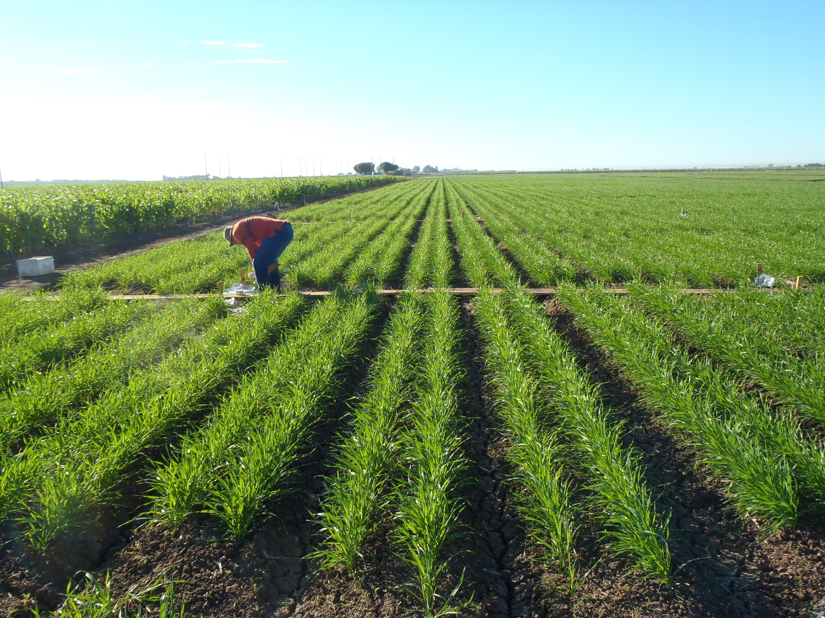
SPRING WHEAT CULTIVAR “CIRNO”

Slide 28
Advisor | Ing. Roberto García Ponce |  |  | Ing. Roberto García Ponce |  |  | Ramón gil
Information | Recomendation |  |  | Recomendation |  |  | Recomendation
 | Obregón Algorithm | CIRNO Algorithm | 2000-2011 Algorithm | Obregón Algorithm | CIRNO Algorithm | 2000-2011 Algorithm | Obregón Algorithm | CIRNO Algorithm | 2000-2011 Algorithm
Cultivar | ATIL | ATIL | ATIL | CIRNO | CIRNO | CIRNO | CIRNO | CIRNO | CIRNO
Max Yield (Kg/Ha) | 8000 | 8000 | 8000 | 8000 | 8000 | 8000 | 8000 | 8000 | 8000
Sowing date | Dec-22-12 | Dec-22-12 | Dec-22-12 | 22-Dec-12 | 22-Dec-12 | 22-Dec-12 | 12/12/2012 | 12/12/2012 | 12/12/2012
Sending Date: | Feb-13-13 | Feb-13-13 | Feb-13-13 | 5-Feb-13 | 5-Feb-13 | 5-Feb-13 | 1/22/2013 | 1/22/2013 | 1/22/2013
NDVI (FRN) | 0.685 | 0.685 | 0.685 | 0.712 | 0.712 | 0.712 | 0.729 | 0.729 | 0.729
NDVI (PDA) | 0.668 | 0.668 | 0.668 | 0.695 | 0.695 | 0.695 | 0.672 | 0.672 | 0.672
Expected NUE | 0.35 | 0.35 | 0.35 | 0.35 | 0.35 | 0.35 | 0.35 | 0.35 | 0.35
Days after sowing | 43 | 43 | 43 | 45 | 45 | 45 | 41 | 41 | 41
Potential Yield without N (Kg/Ha) | 7900 | 6751 | 4759 | 7439 | 6677 | 4705 | 8000 | 7494 | 5310
Potential Yield with N (Kg/Ha) | 8161 | 6974 | 4916 | 7672 | 6886 | 4852 | 9067 | 8494 | 6018
Apply N (Kg/Ha) | 18.25 | 15.6 | 11 | 16.32 | 14.65 | 10.32 | 74.67 | 69.95 | 49.57
Apply N, (Urea Kg/Ha) | 41 | 35 | 24 | 36 | 33 | 23 | 166 | 155 | 110
-14%
-41%
-8%
-30%
-6%
-33%

Slide 29
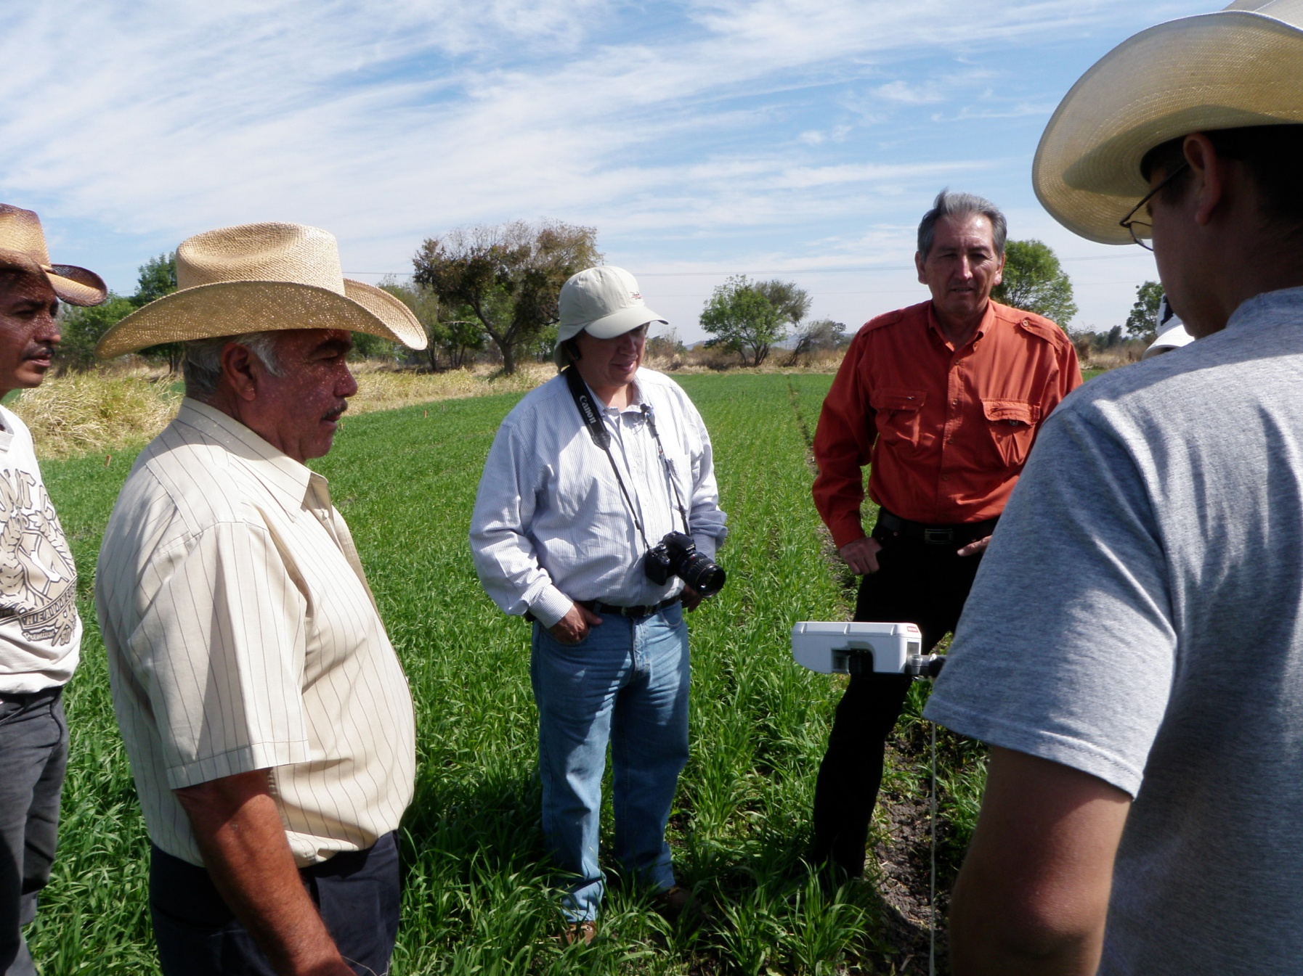
Guanajuato

Slide 30
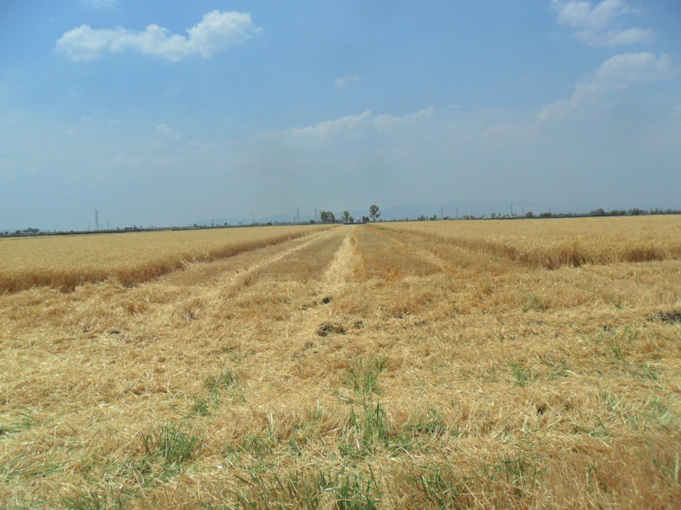
Guanajuato 2011-2012
Sensor
Farmer
N Rich Strip
Validation Trials in Cruces de Rojas, Penjamo
Cultivars Cortazar y Urbina

Slide 31
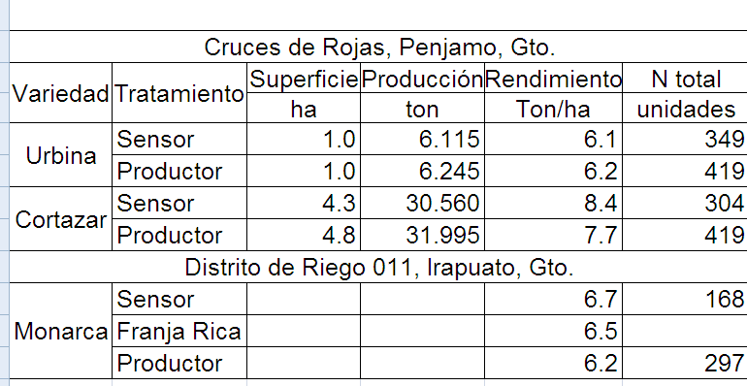
Commercial Yield Comparison of 3 wheat cultivars
under farmer management and sensor
management in Guanajuato
-70
-115
-129

Slide 32
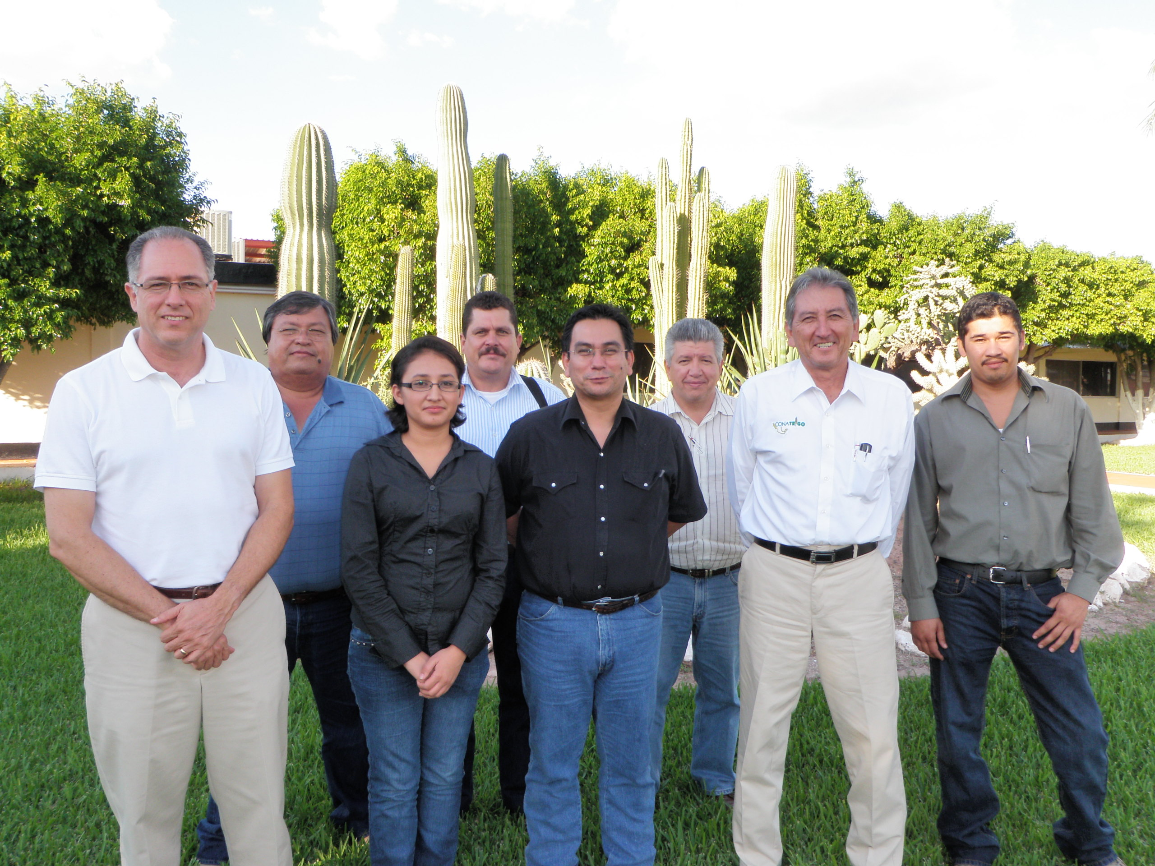
SENSOR USE COMRECIALLY
IN WHEAT 2012-2013
3000 has
5000 to 6000 has
50 has
1000 has

Slide 34
Wheat Phosphorus Models

Slide 35
Experiment for P Model
Randomized Complete Block Design with 3 replications
Twenty one spring wheat genotypes including bread wheat and durum wheat.
Two levels of P, 0 an 80 kg P2O5/ha
Plot size, five meters long x 3.2 m wide
Three years, each year P levels were located in the same plots.

Slide 36
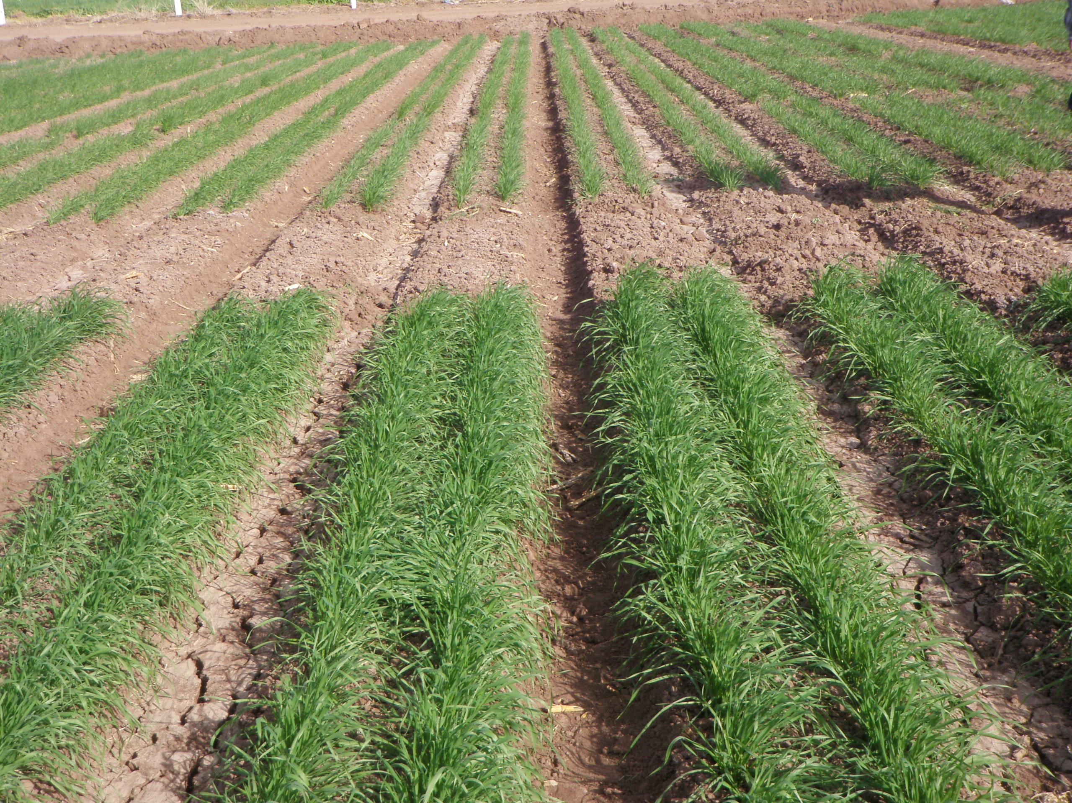
OP
+P

Slide 37
Figure .- INSEY vs wheat grain yield at the begining of stem elongation during a three year experiment.

Slide 38
Figure .- INSEY vs durum wheat grain yield at the begining of stem elongation during a three year experiment.

Slide 39
Figure .- INSEY vs bread wheat grain yield at the begining of stem elongation during a three year experiment.

Slide 40
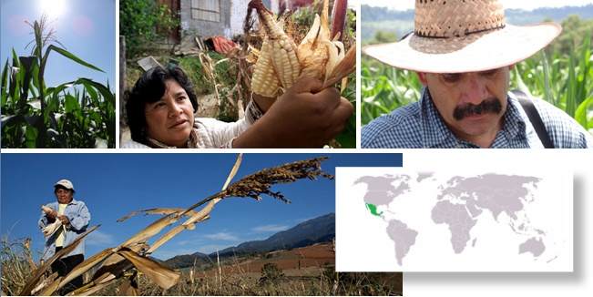


MasAgro

Slide 41
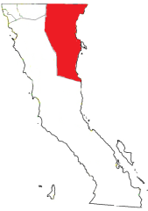
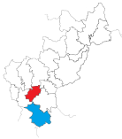
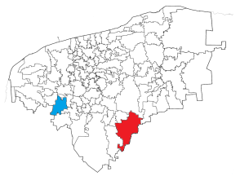
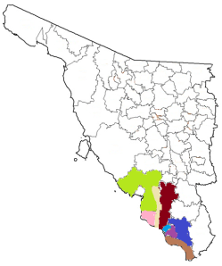
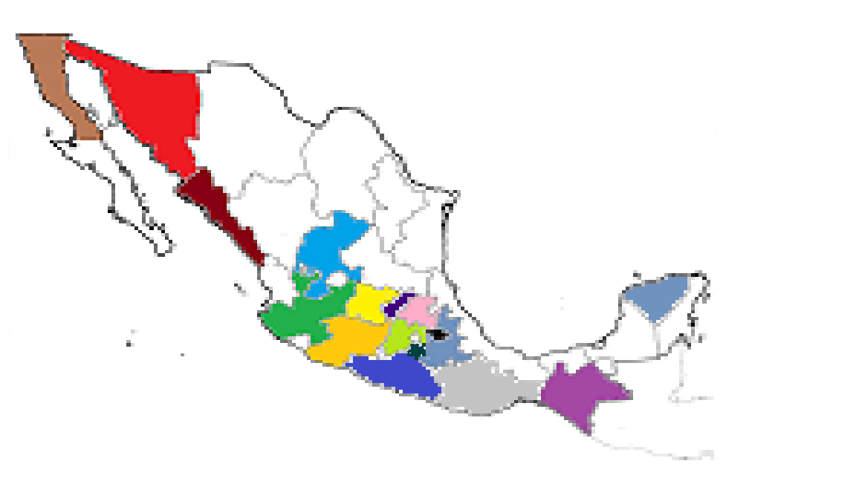
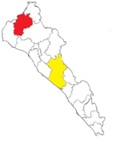
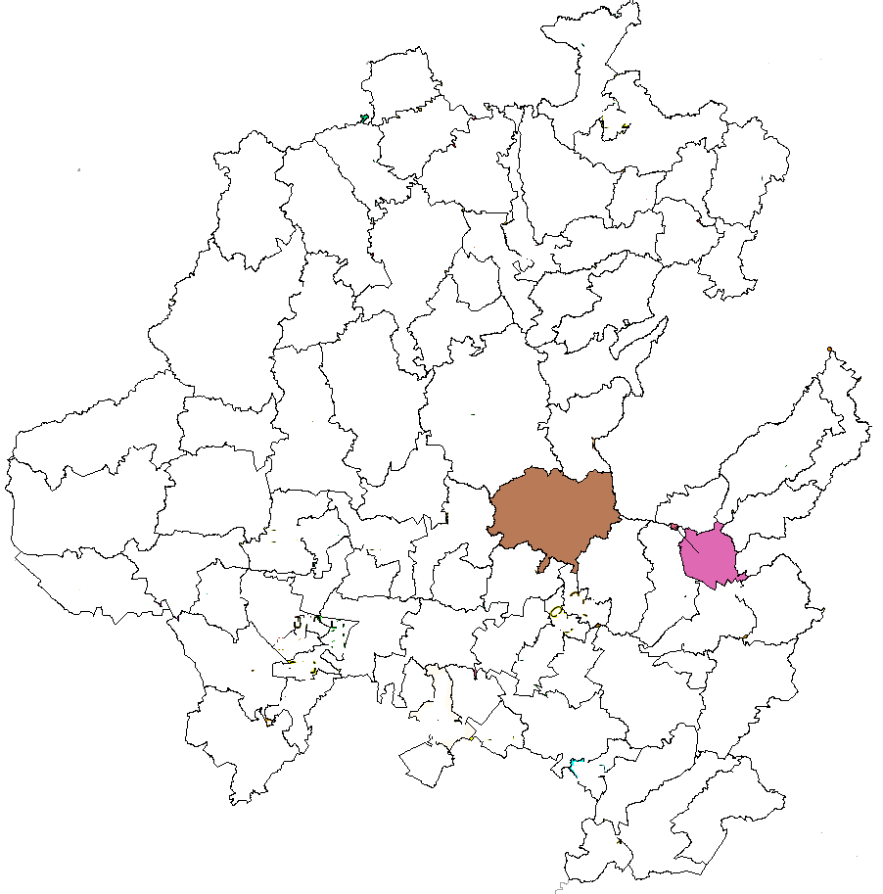
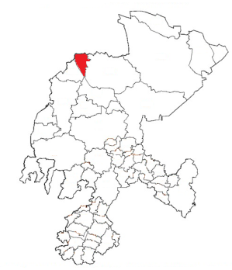
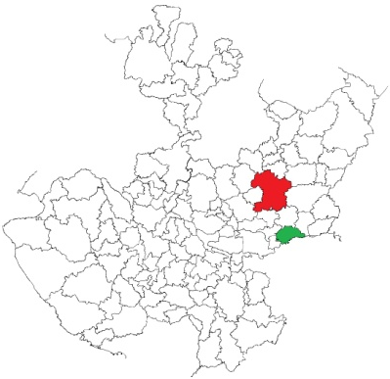
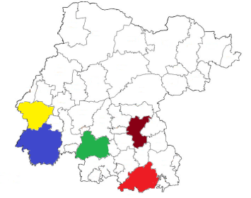
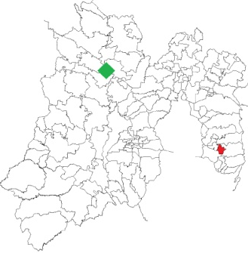
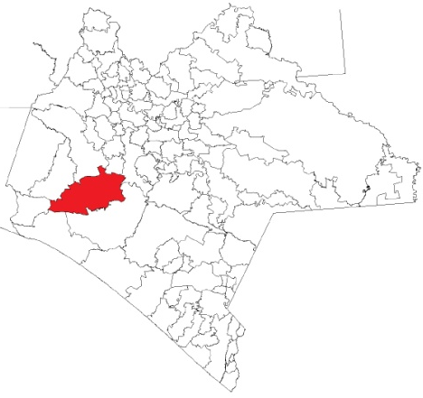
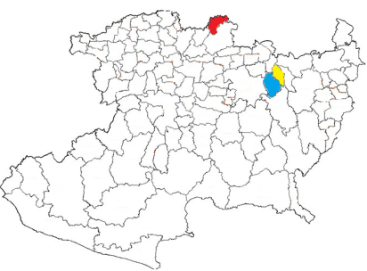
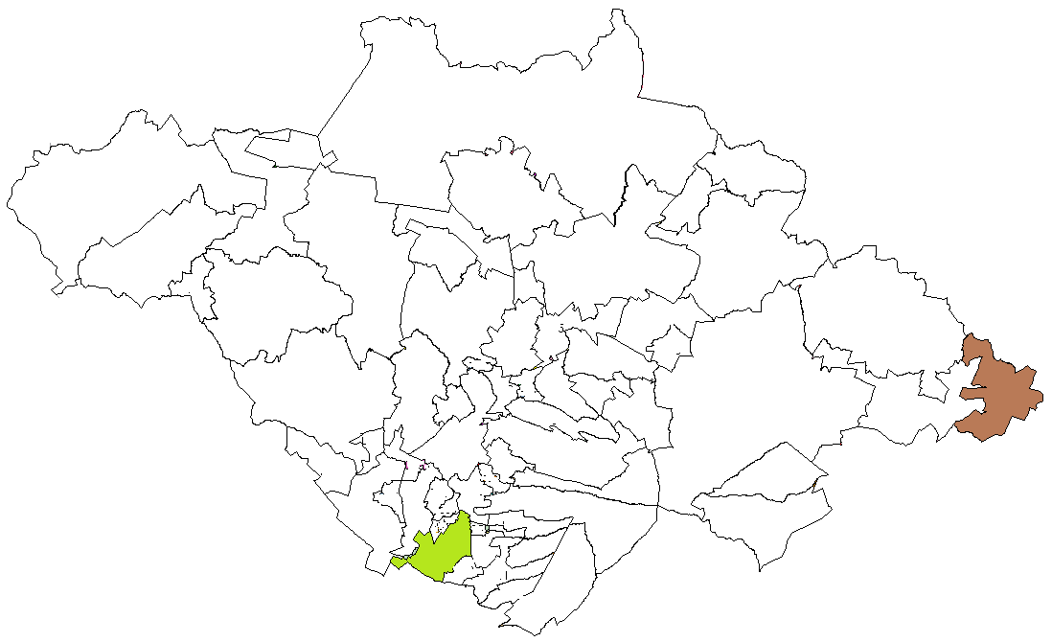
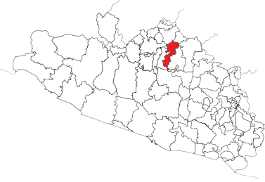
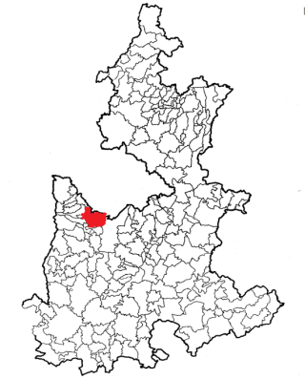
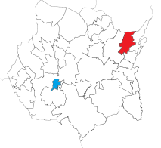
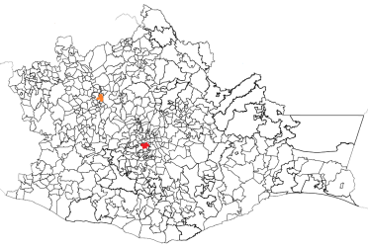
GREENSEEKER SENSOR CALIBRATION 2012
Baja California
Querétaro
Sonora
Yucatan
Sinaloa
Hidalgo
Guanajuato
Zacatecas
Jalisco
Edo. De México
Tlaxcala
Puebla
Michoacan
Chiapas
Guerrero
Morelos
Oaxaca

Slide 42
Maize Nitrogen Models

Slide 43
SENSOR VALIDATION
IN MAIZE 2012-2013
Obregon
Sinaloa
Guanajuato

Slide 46
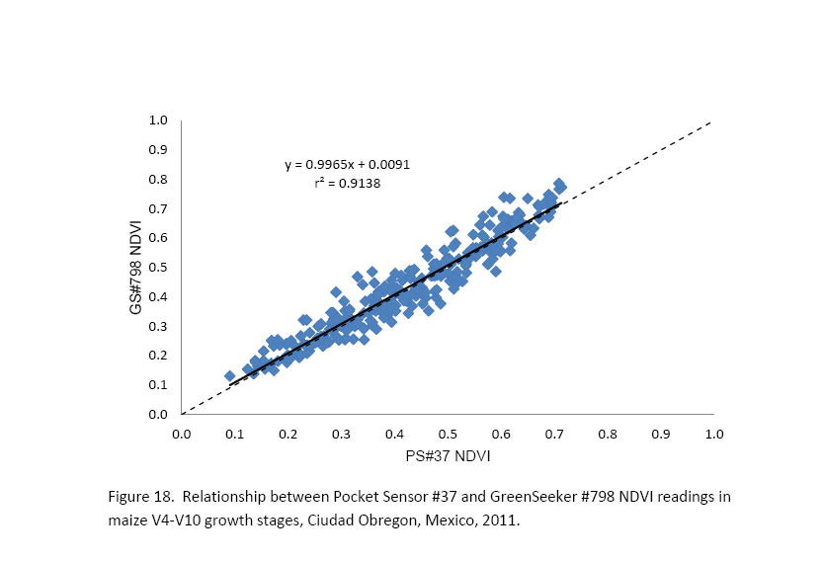
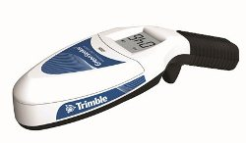
Crain et al., 2012
Journal of Sensor

Slide 47
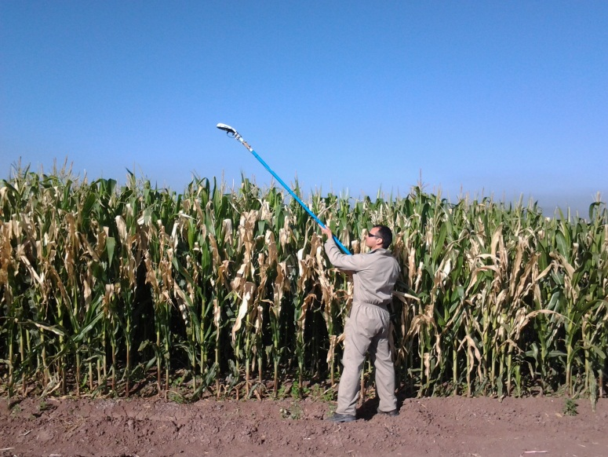
Hand held sensor with extension kit

Slide 48
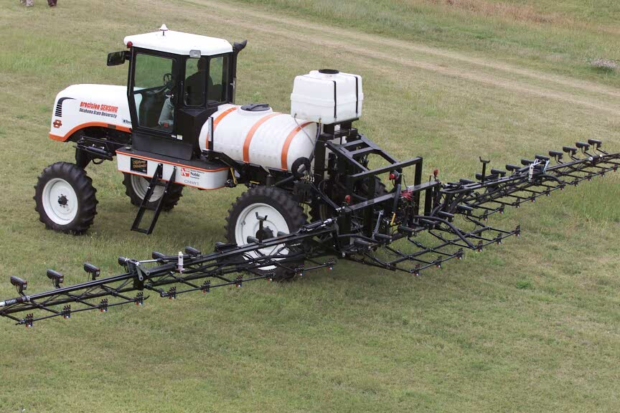
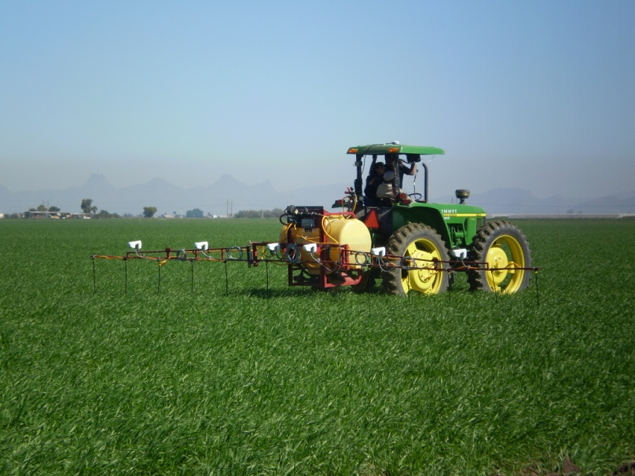
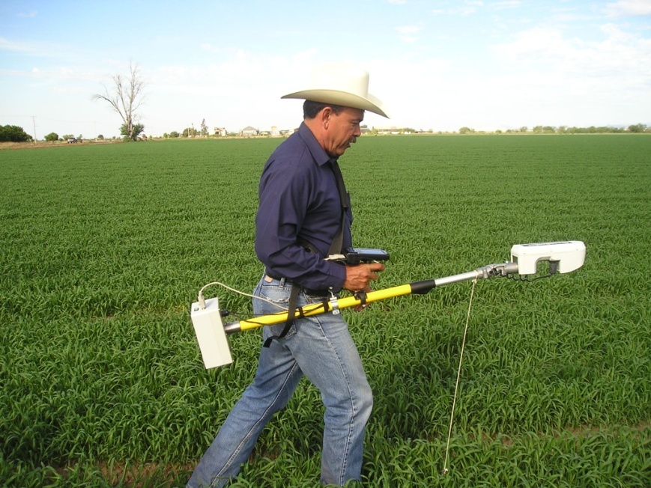
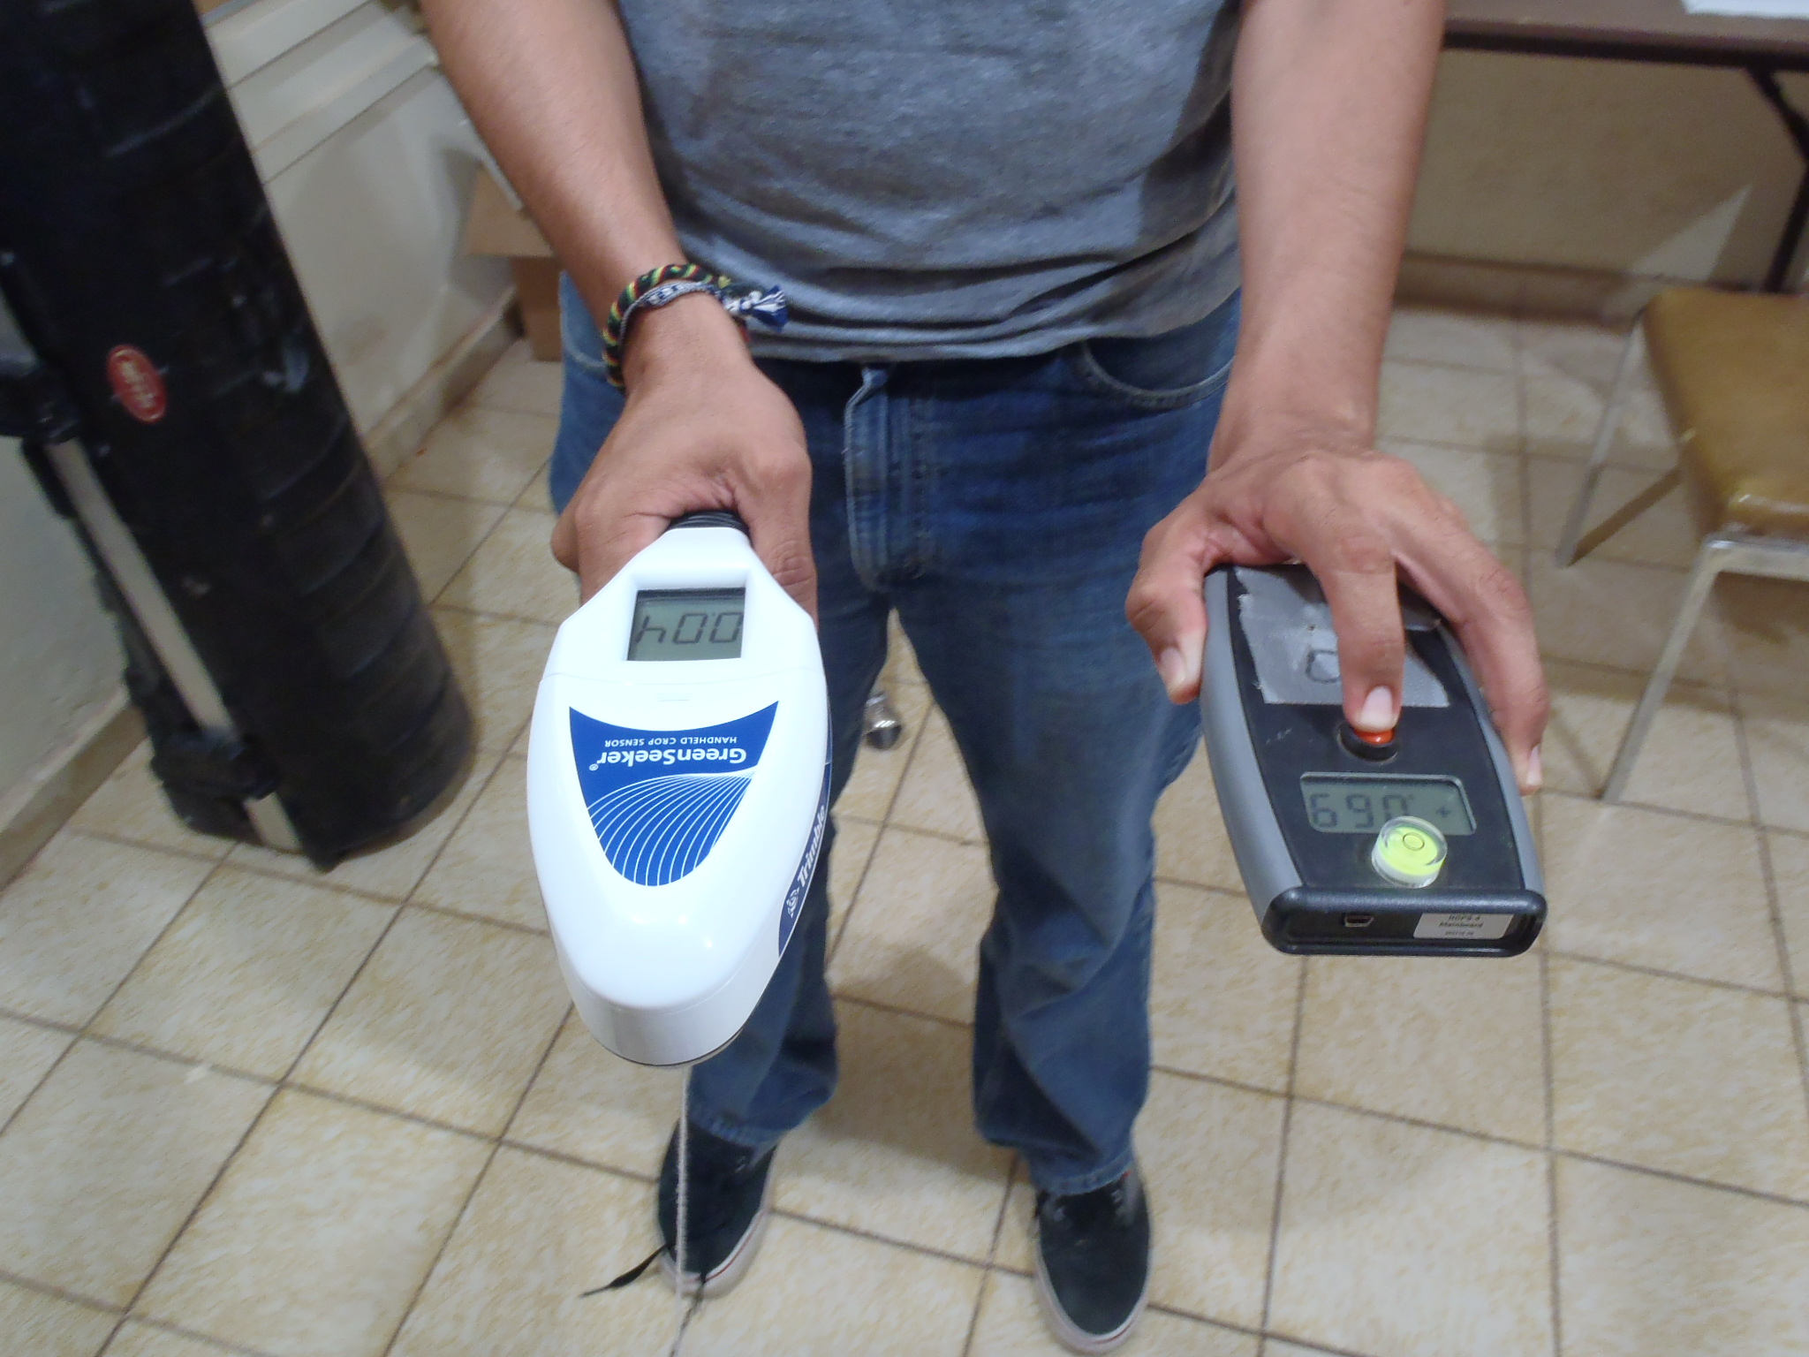
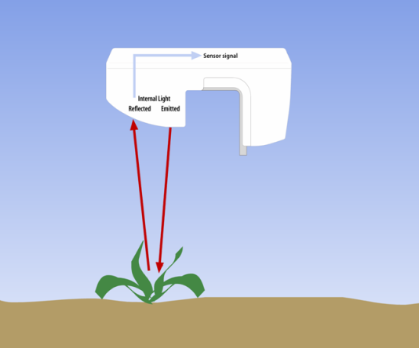
Sensor Technology for nutrient management at different scales
120,000 USD
30,000 USD
5,000 USD
500 USD

Slide 49
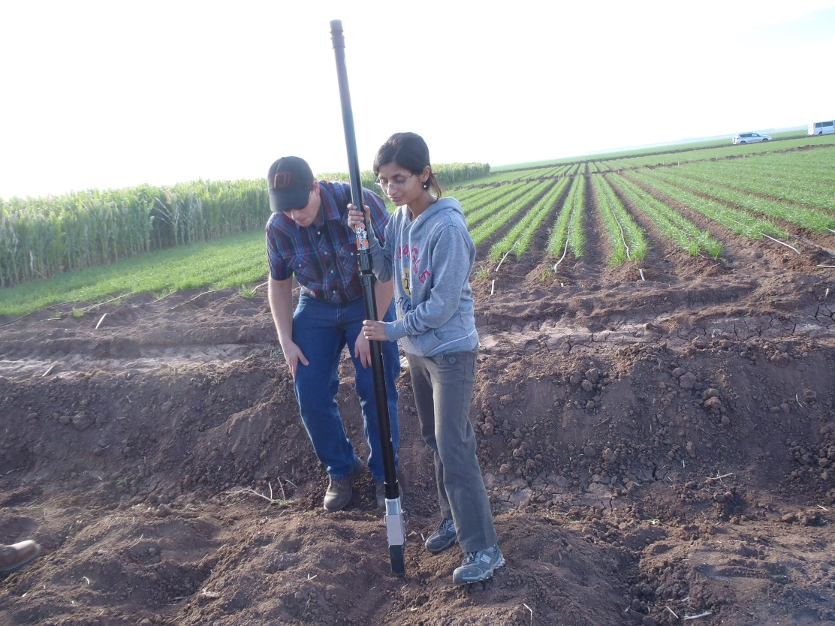
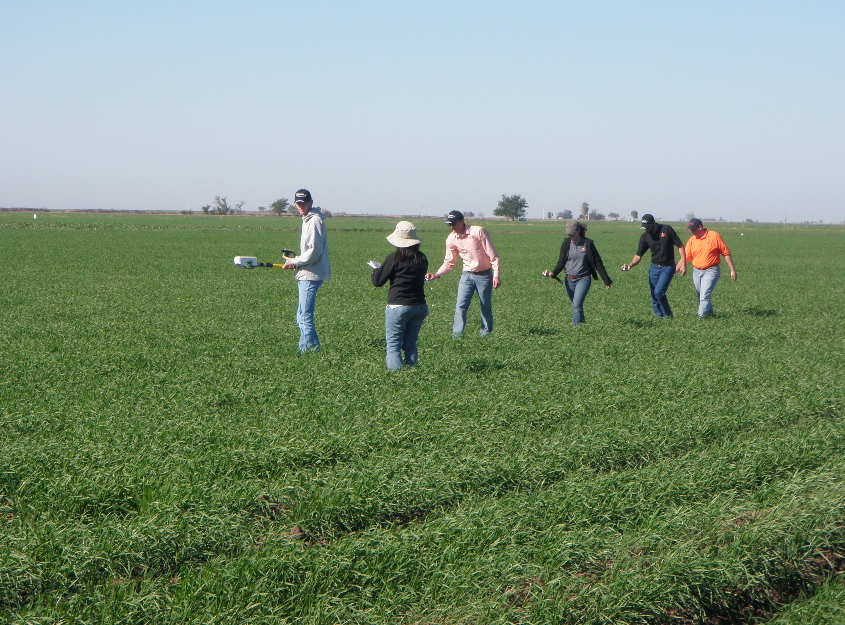


OSU-CIMMYT-TRIMBLE
GS2

Slide 50


Slide 51


Slide 52



Slide 53

China
Pakistan
India
Source: D. Hodson

Slide 54
Spring wheat INSEY Yaqui vs Pakistan
Pakistani data: Dr. Imtiaz Husain

Slide 55
Spring Wheat INSEY Yaqui vs India
Indian data: Dr. Ramesh K. Sharma

Slide 56

Satellite N Diagnostics with Rapid Eye
Urs Schulthess and Ivan Ortiz-Monasterio

Slide 57

Example of a field with a N rich strip in the Yaqui Valley

Slide 58
Relationship between NDVI from GreenSeeker and a Rapid Eye satellite image of January 23, 2012
Information from:
15 fields
  N rich strips
  Control
  Total of 30 points
  GreenSeeker reading were taken with +/- 7 days from when the satellite image was aquired
The satellite seems to measure larger differences in NDVI than the GreenSeeker (slope=0.63). This may have some implications when N recommendations are derived from this information.

Slide 59


GreenSat
GreenSat with Spot 6
http://www.cmgs.gob.mx:8080/ddr/ndvi.aspx

Slide 60



Slide 61




Thermal and Multispectral cameras
Hyperspectral scanner

Slide 62

Flying over CENEB, CIMMYT’s
Research Station in Obregon

Slide 63

Multispectral Image of CENEB CIMMYT
Blocks 710 and 810
Figure 1: False color image of CIMMYT station at Obregon acquired from the multispectral camera at 1 m resolution on Feb. 15, 2013. Plots with dense vegetation are shown in red. The road on the left going N-S is N. E. Borlaug, while the road in the middle of the image going E-W is the division between blocks 710 and 810.

Slide 64

Thermal Image of CENEB - CIMMYT
Blocks 710 and 810
Figure 2. Thermal image of CIMMYT station at Obregon acquired from the thermal camera at 2 m resolution on Feb. 14, 2013. Well-watered (cooler) plots are shown in blue, while water-stressed (warmer) plots are shown in green and red. Roads and bare soil areas have an even higher temperature and are shown in yellow.

Slide 65
Multispectral Camera
Tetracam, Inc. (Model Mini MCA6)
Wavelengths:
550, 670, 700, 710, 750, 800
Vegetative Indices:
700, 670, 550 --> TCARI
670, 800 --> OSAVI, NDVI
750, 710 --> red edge
20 – 50 cm resolution

Slide 66
Hyperspectral Scanner
Headwall Photonics (Model: 1003B-20001)
250 bands of 6.4 nanometer width
400 to 885 nanometer region
Swaths of 500 meter at 30-50 centimeter pixel resolution.
Thermal Camera
Flir Systems AB (Model Flir A600 – Series)

Slide 67



Viewer
(1.5-3 h endurance)

Slide 68

Source: G.V. Subbarao

Slide 69
Thank you

