Slide 1
Trimble® GreenSeeker Handheld Crop Sensor Update
Eric Miller, Jacob Bushong, and Bill Raun
NUE Conference
August 6th, 2013

Slide 2
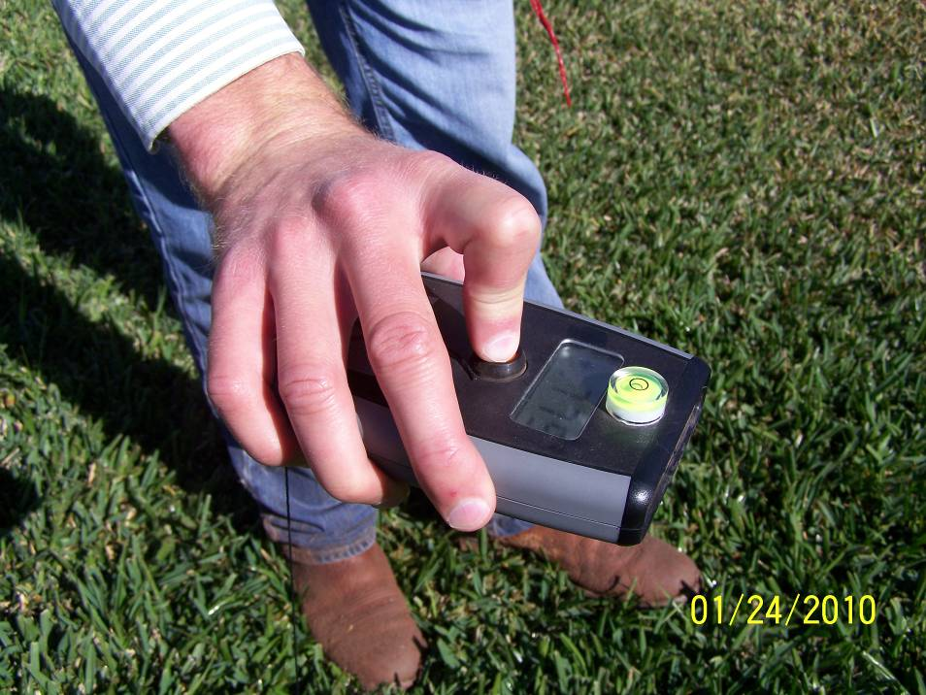
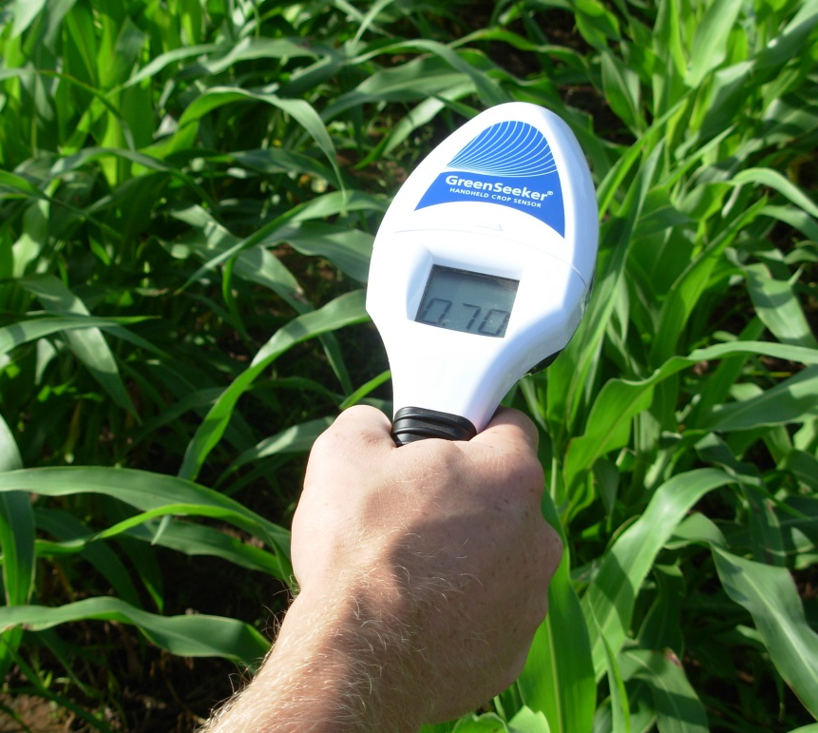
Objective
Develop a small and cost-effective NDVI sensor to duplicate the results of a commercial GreenSeeker sensor (Crain et al., 2012)
Picture courtesy of Jared Crain

Slide 3
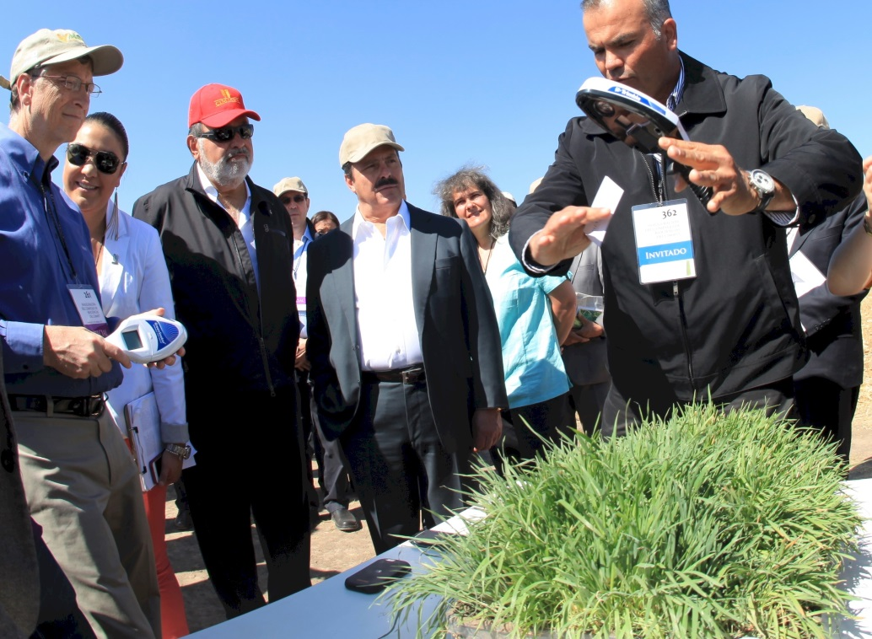
Handheld sensor’s debut
MSRP $495 USD

Slide 4
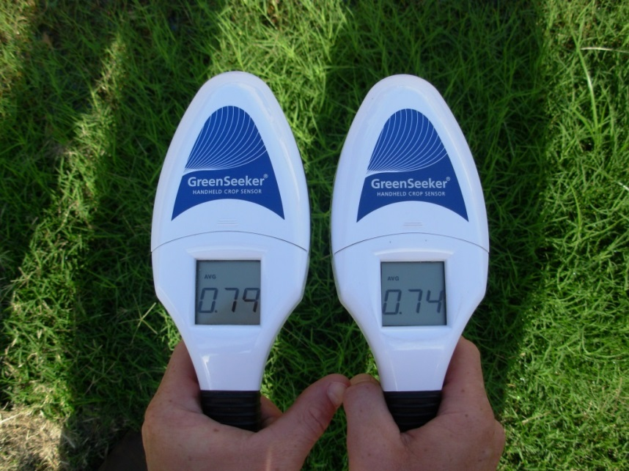
Issues
Issue #1- 1:1 Relationship with the GreenSeeker
Issue 2: Handheld to handheld reliability

Slide 5
Relationship with the GreenSeeker

Slide 6
Regression model parameters
Model parameters and analysis of variance; slope equal to 1 and intercept equal to 0
Sensor Readings | Parameter of the model† |  | R² | n | Significance (Pr > F)
NDVI | a | b |  |  | Intercept | Slope
All | 0.05 | 0.97 | 0.88 | 1485 | <0.001 | 0.001
Greater than 0.50 | -0.08 | 1.21 | 0.72 | 160 | 0.002 | <0.001
Less than 0.50 | 0.07 | 0.93 | 0.78 | 1325 | <0.001 | <0.001
† a = intercept, b = slope

Slide 7
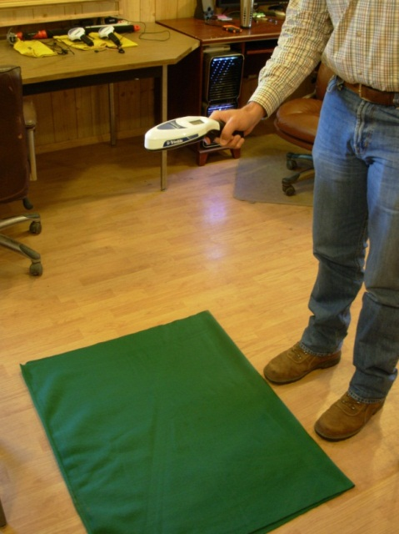
Fabric evaluation
3 handheld sensors
Hand #1, Hand #2, and Hand #7
1 GreenSeeker (GS)
9 solid colored 1 x 1 m fabric
0.91 m above the fabric
5 second collection time
0.05
NDVI
0.90

Slide 8
Fabric evaluation regression
= significant to α=0.05

Slide 9
Fabric evaluation stability
= significant to α=0.05

Slide 10
Influence on N recommendations
Nitrogen recommendations, changes in predicted NDVI, and changes in N recommendations
 | Farmer Practice | N rich strip | N rec.† | ΔPredicted NDVI‡ |  | ΔN (lbs ac⁻¹)
Crop | NDVI | NDVI | lbs ac⁻¹ | Max | Min | Max | Min
Wheat | 0.8 | 0.83 | 7.5 | 0.072 | 0.030 | -7.5 | -7.5
Wheat | 0.625 | 0.83 | 52.6 | 0.066 | 0.026 | -15.9 | -6.1
Wheat | 0.45 | 0.83 | 56 | 0.063 | 0.021 | 22.5 | 3.2
Wheat | 0.6 | 0.65 | 12 | 0.065 | 0.025 | -12 | 6.3
Wheat | 0.5 | 0.65 | 36.7 | 0.064 | 0.022 | -15.7 | 5.4
† N recommendations made from sensor-based nitrogen rate calculator; 120 days with GDD > 0; 100 bu ac⁻¹ maximum yield ‡ Changes in predicted NDVI determined as the difference between the linear regression equation from the fabric evaluation and farmer practice NDVI

Slide 11
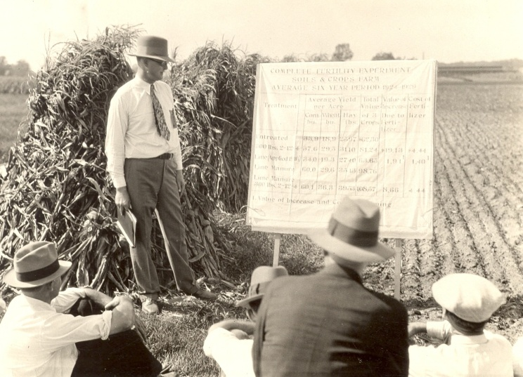
Questions?

