Slide 1
Interactions of Nitrogen Management Strategy with Corn Hybrid and Population
Dave Franzen – North Dakota State University
Newell Kitchen – USDA-ARS, Columbia, MO
Laura Stevens, Richard Ferguson – University of Nebraska-Lincoln

Slide 2
Questions
How do two different N rate recommendation strategies (sensor vs. model) compare across a broad region?
What are the interactions among N rate strategy, corn hybrid and population across this region?

Slide 3
Locations

Slide 4
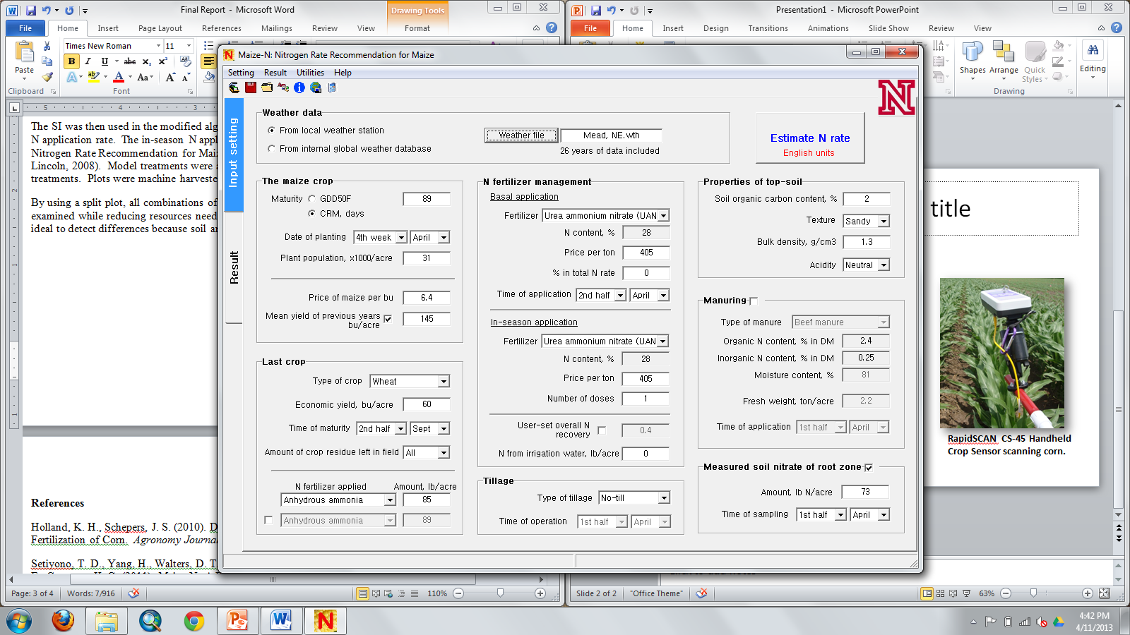
Nitrogen Rate Strategies
Maize-N Model : Nitrogen Rate Recommendation for Maize
Based on the Hybrid-Maize crop growth model; use of local, historic weather data.
(Yang, H.S., et al., UNL, 2008)
Notes:
Henry

Slide 5
Nitrogen Rate Strategies
Sensor: Holland Scientific RapidScan (3 band: red, red-edge, NIR)
Schepers/Holland algorithm for N rate calculation; growth stage target V9-10.
Notes:
Henry

Slide 6
Nitrogen Rate Strategies
Base N rate 0-75 lb/acre, depending on site (applied at or prior to planting).
In-season N applied immediately after sensing at V9-V10 growth stage.

Slide 7
Treatments
Hybrid: High drought tolerance, low drought tolerance.
Population: 32,000 & 42,000 plants/acre.
Nitrogen rate: unfertilized check, high N reference, Maize-N model rate, canopy sensor rate.
Location: Three states, each with a high yield and a moderate yield potential site.

Slide 8
2012

Slide 9
2012 Highlights
Weather conditions – warm and dry
Mineralization in Nebraska, large available N
Large amount of drought stress in Missouri
Difficult planting conditions leading to poor stands in North Dakota
At all sites, the model strategy called for more N than the sensor strategy
Agronomic efficiency was not correlated to N strategy for many of the sites
Partial factor productivity was correlated to N strategy for all sites
Sensor treatment had higher NUE as seen by partial factor productivity
Notes:
Partial factor productivity for N was calculated by dividing yield by total fertilizer N rate.
Agronomic efficiency was calculated by taking the difference in yield between the fertilized treatment and the check and dividing by total N application.

Slide 10
2012 Partial Factor Productivity of N

Slide 11
2012 Grain Yield—N Strategy/Hybrid Effects
* Sensor treatments for reps 2, 3, 4 had incorrect N application
*Error bars are std error

Slide 12
2013
Change of Maize-N to include in-season weather data

Slide 13
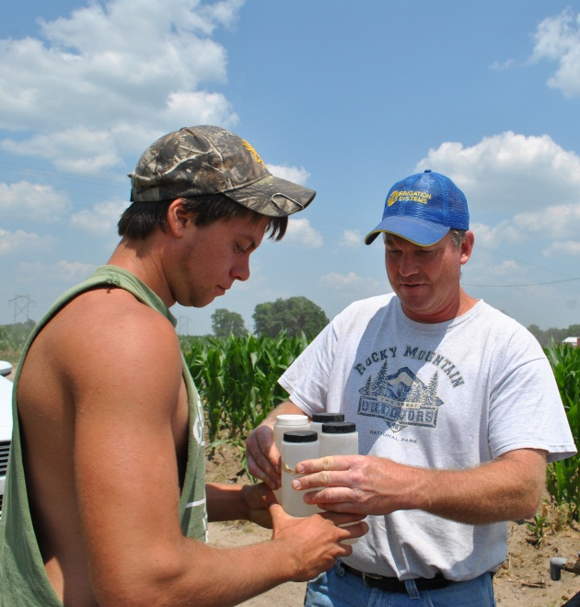
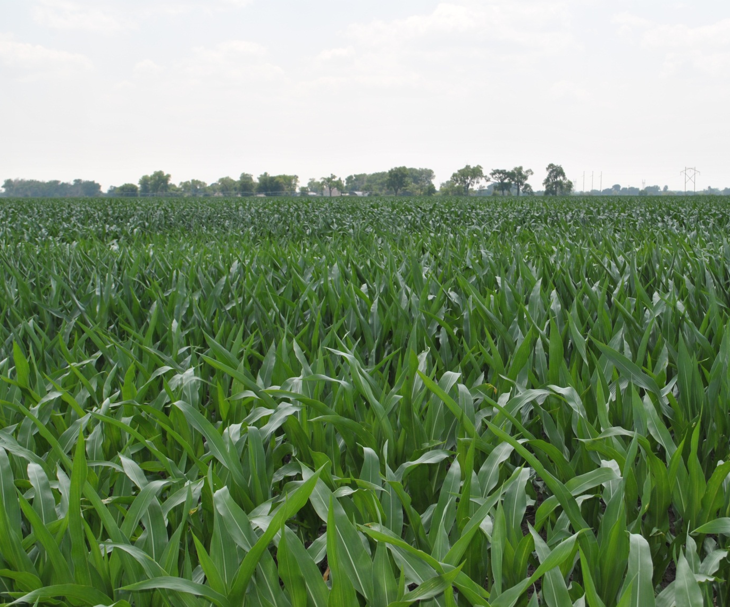
Nebraska
July 1, 2013
Merrick Co.

Slide 14
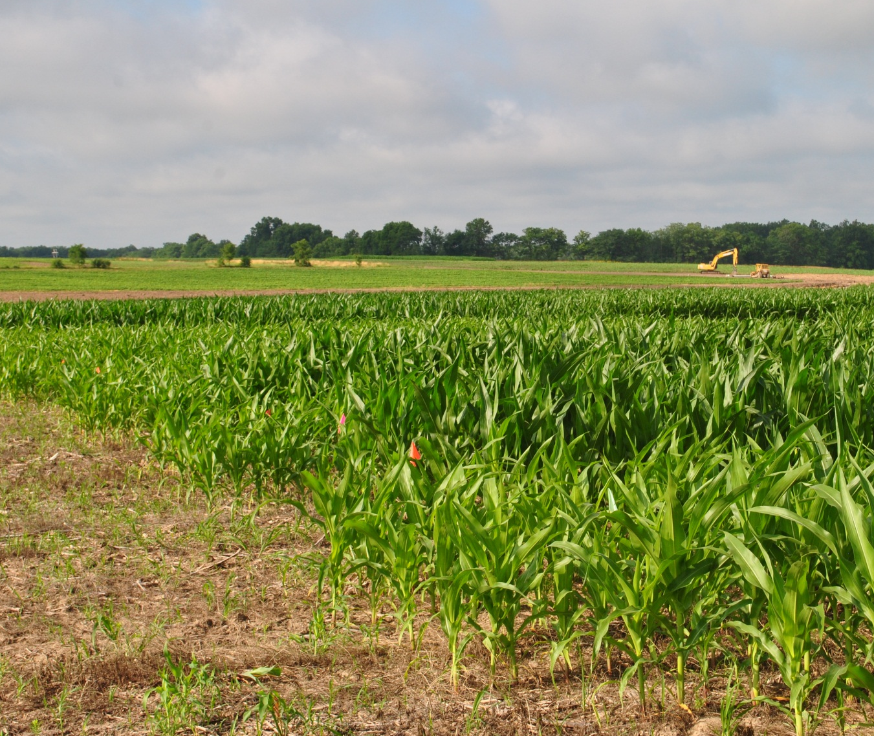
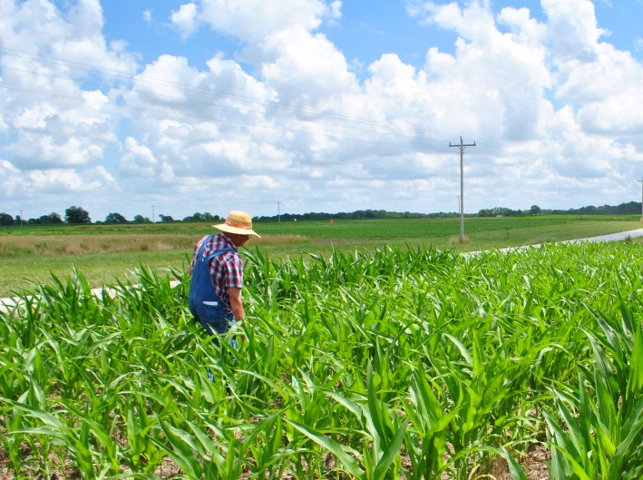
Missouri
July 16, 2013
Bay

Slide 15
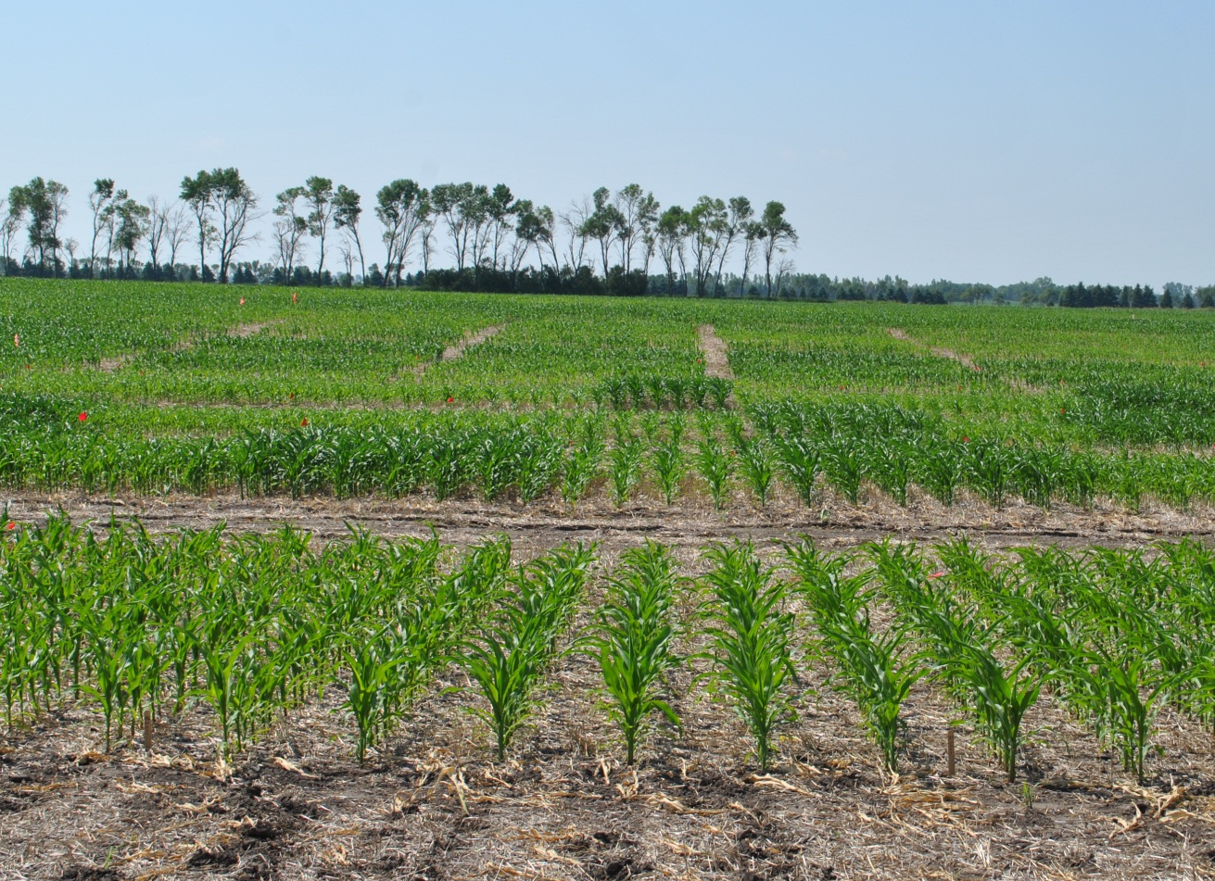
North Dakota
July 3, 2013
Valley City

Slide 16
Vegetation Indices and Nitrogen Rate Nebraska

Slide 17
Vegetation Indices and Nitrogen Rate Nebraska

Slide 18
Vegetation Indices and Nitrogen Rate Missouri

Slide 19
Vegetation Indices and Nitrogen Rate Missouri

Slide 20
Vegetation Indices and Nitrogen Rate North Dakota

Slide 21
Vegetation Indices and Nitrogen Rate North Dakota

Slide 22
Change in NDRE Relative to N Applied
(NDRE post-sidedress – NDRE at sidedress)/#N applied in season

Slide 23
2013 Highlights
More visually obvious treatment differences, better stands and water conditions
Model called for more N at 4 out of 6 sites

