Slide 1
Moving Beyond Nitrogen with Field Sensors
Jim Schepers (emeriti)
Agronomy and Horticulture Dept.
University of Nebraska

Slide 2
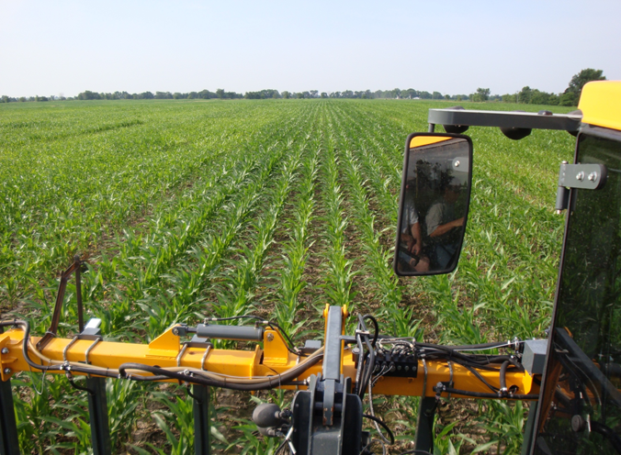
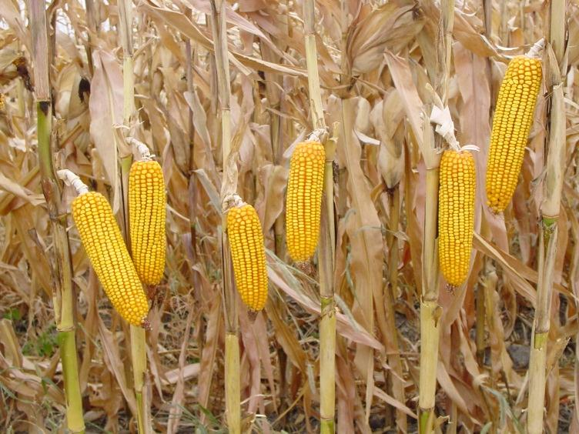
Premise – in-season differences in crop vigor will be proportional to yield at harvest
$$≈$$
“ No correlation between looks and yield “
Henry A. Wallace
“ No correlation between looks (ears) and yield “
Henry A. Wallace

Slide 3
Irrigated Corn - 2009

Slide 4
~ V6

Slide 5
Back in 2003, 2004 and - - - - -
“Relative yield has no value” - Bill Raun
Point Yield
----------------------------------------------------------------
Reference Yield
Relative Yield =
Reference Yield
----------------------------------------------------------------
Point Yield
RI _{yield} =

Slide 6
Why is Sensor Adoption Slow ?
Lack of perceived spatial variability
Time window is too short
Don’t have a high-clearance sprayer
Anhydrous ammonia is cheaper
Too costly for small producers
Other adaptive management options (fertigation)
Intimidated by the technologies
Not compatible with strip-tillage

Slide 7
Why is Sensor Adoption Slow ?
Reports of reduced yields with sensors
Marketed from an equipment perspective
John Deere system is not compatible with AgLeader
Flow-rate change is slow
Don’t like N-rich strip requirement
Don’t believe yield potential prediction is reliable
Algorithm structure and options not explained
Lack of technical assistance / publications

Slide 8
My Impressions - - - -
N fertilizer is still an excellent investment
Adaptive management aspect of sensors is not
perceived as environmental attribute
Producers don’t understand NUE implications
Crop canopy sensors are simply a TOOL
Effective promotion resides with seed companies,
service agencies, and curious producers

Slide 9
Nitrogen Use Efficiency - NUE
NUE = 45%

Slide 10
NUE = 45%

Slide 12
ECONOMICS - Return per $1.00 invested in N fertilizer
$11.51
Assume:
$1.20 / kg N
$240 / ton corn grain

Slide 13
Effect of over or under-application by 10% ?

Slide 14
Effect of over or under-application by 10% at EONR ?
EONR - where the cost of the last unit of N equals the increase in grain value.

Slide 15
Observation - After producers get past the intimidation of new software, they want to know more about how the algorithms work and how they can manipulate the inputs to accomplish their management objectives.

Slide 16
RapidSCAN Data - July 2, 2013

Slide 17
RapidSCAN - User Inputs
Reference Index (NDRE or NDVI)
Minimum N rate
Maximum N rate
N credits
Back-off (none, slow, medium, fast)

Slide 18
RapidSCAN Data - July 2, 2013

Slide 19
Data Output
PLOT | NRATE | VREF | NDRE | SI | NDVI | RE | NIR | R | LATITUDE | LONGITUDE | ELEVATION | HDOP | FIXTYPE | DATE | TIME | N | MAXNDRE | MAXNDVI | MINNDRE | MINNDVI | STDNDRE | STDNDVI | CVNDRE | CVNDVI
Plot 38
N-rate 23.8
Virtual Reference 0.3520
NDRE 0.3256
SI 0.9250
NDVI 0.7599
Red-edge reflectance 19.434
NIR reflectance 38.261
Red reflectance 5.210
Latitude 41.365873
Longitude 97.864848
Elevation 495.7
HDOP 0.75
Fixture type GP
Date 3/7/2013
Time 14:13:15
Number of readings* 17
Maximum NDRE 0.3785
Maximum NDVI 0.8259
Minimum NDRE 0.2618
Minimum NDVI 0.5907
Stdev NDRE 0.0278
Stdev NDVI 0.0486
CV NDRE 0.0853
CV NDVI 0.0639
* Readings recorded at 2 Hz

Slide 20
Thank You
Jim Schepers
402-310-6150
james.schepers@gmail.com

