Slide 1
North American 4R Research Fund: Status and Outlook
Clifford S. Snyder, PhD, CCA
Member, Technical Advisory Group
Acknowledging Paul E. Fixen, PhD and TAG Chair
NUE Workshop -Sensor-Based Nutrient Management Community of ASA
Des Moines, IA
August 6-7, 2013

Slide 2
Current Regional N & P projects in NA with IPNI support
N source evaluation and management
  Large Urea Granules for Broadcast Application for No-till Cropping – AB
  Large Urea Granules for Broadcast Application in Perennial Forage Grasses – AB
  Evaluation of Urea N Fertilizer Treated with a Polymer Additive to Increase Fertilizer Efficiency – SK
  Evaluation of Ammonium Sulfate Nitrate in Virginia Snap Bean Production – VA
  Evaluation of Ammonium Sulfate Nitrate in Virginia Sweet Corn Production – VA
Improving prediction of crop N rate needs
  Beta-testing the Adapt-N Tool in On-farm Strip Trials – NY
  N Rate Study for Potato Production in Northeast Florida – FL
  Long-term Optimum N Rates for Corn Yield and Soil Organic Matter in Ontario – ON
  N Recalibration for Corn in North Dakota – ND
  Interaction of N Management, Hybrid Selection and Population in Corn Production – NE, ND, MO
Improving understanding of N losses to the environment
  Nitrous Oxide Emissions from the Application of Fertilizers: Source Partitioning – CA
  A Micrometeorological Study to Quantify NH₃ Volatilization Losses from Surface Applied Urea in the Semiarid NGP – MT
  Contribution of AFOs and Synthetic Fertilizers to NH₃ Deposition in Rocky Mountain National Park – CO
N interactions and efficiency in cropping systems
  Investigating Corn Hybrid Interactions with N and Foliar Fungicides – ON
  N Fertilization Methods for No-till Cropping of Winter Wheat in Central Montana – MT
  Improving N Fertilizer Management in Surface-irrigated Cotton – AZ
  Global Maize Project in the United States – IA, IN, MN, VA
K, secondary, and micro studies excluded
Do we really need another industry based research fund?
P source evaluation and management
  Evaluation of P and N Fertilizers Treated with Polymer Additives to Increase Fertilizer Efficiency – AB
  Evaluation of Fertilizer Application Uniformity and Nutrient Distribution – AL
Improving prediction of crop P rate needs - removal and efficiency
  Improving Accuracy of Nutrient Removal Estimates - MO
  Nutrient Removal by Fruit & Vegetable Crops in Texas – TX
  Biomass & Macronutrient Accumulation & Losses in Switchgrass During & After the Growing Season – AR
  Comparative Nutrient Use Efficiency by Candidate Biofuel Crops – IN
  Documenting Nutrient Deficiency & Accumulation Rate in Vegetables – TN
Improving soil test calibration
  Soil Test P Level and Yield Potential - NE
  Effect of Long-Term N, P, and K Fertilization of Irrigated Corn and Grain Sorghum - KS
  Soil Testing Verification in the Fall River Valley, Northeastern California – CA
Crop P management and interactions
  Mineral Nutrition of Leafy Lettuce and the Impact on Verticillium Severity – CA
  Applied Fertility Management for Irrigated Soybean Production – KS
  K and P Fertilization of Grass Pastures – FL
  Loblolly Pine Stand Fertilization at Mid-Rotation to Increase Small & Large Sawtimber Volume – GA
  Soil Fertility Management for High Population, Narrow Row Corn Production – NC
http://www.ipni.net/researchdatabase

Slide 3
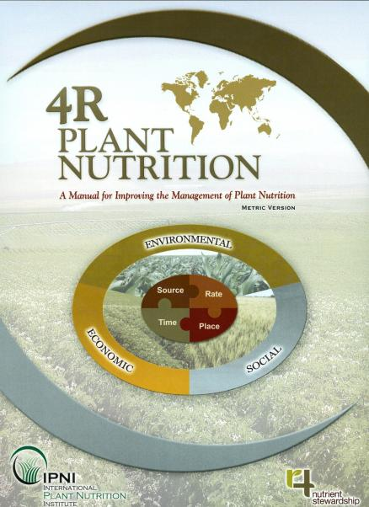
The scientific principles behind the 4Rs and the practices that support them have been documented in the IPNI manual based on decades of research by the scientific community
However, research gaps exist in applying these principles in meeting contemporary challenges facing agriculture
  Plot or field results often disconnected from larger scale impacts of greatest concern to stakeholders

Slide 4
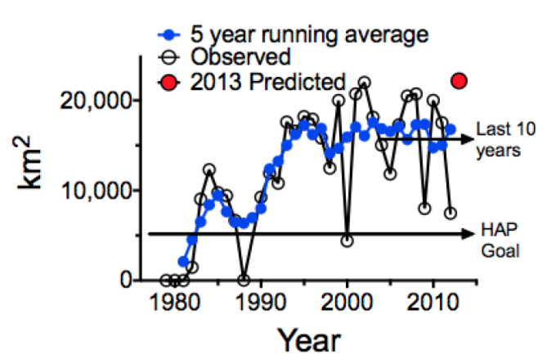
Measured and estimated size of the hypoxic zone from 1979 to 2012 and the predicted size for 2013
measured size in 2013
HAP is the goal of the Hypoxia Action Plan by 2015
Are we comfortable with this and with our ability to respond?
Can we connect in-field practices with downstream impacts?
Rabalais & Turner, 6/18/2013

Slide 5
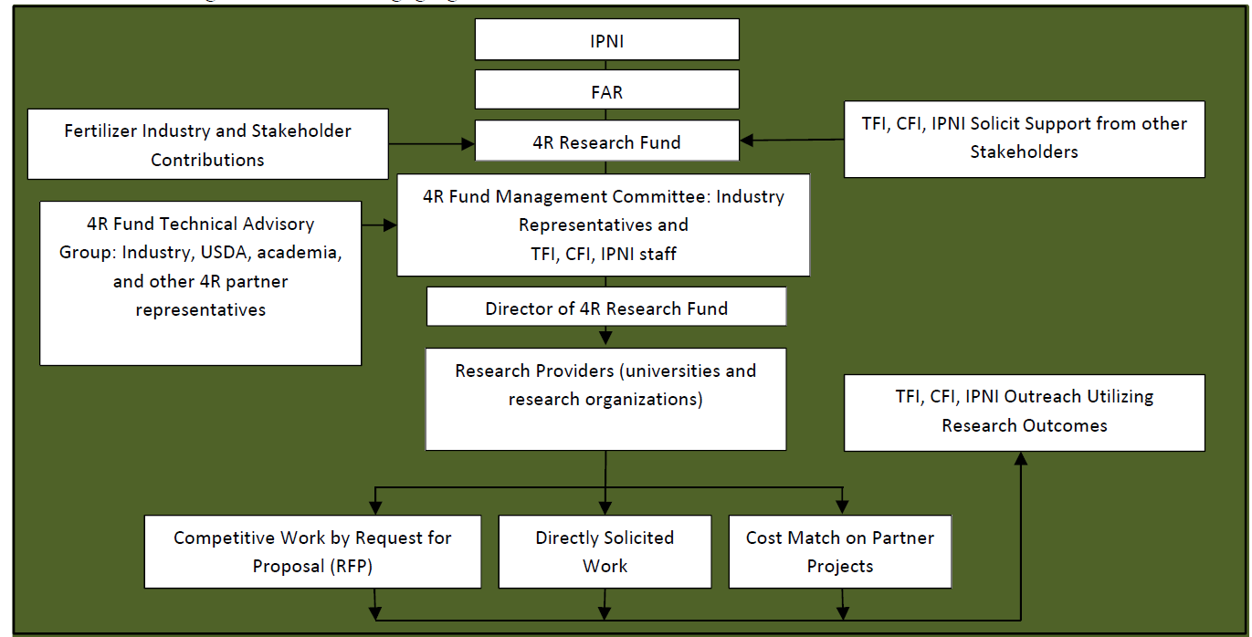
4R Research Fund Structure

Slide 6
4R Research Fund Management Committee (FMC)
Voting Members
AgriServices of Brunswick – Bill Jackson
Agrium – Doug Beever
CF Industries – Rosemary O’Brien
CHS – Michael Johnson
J. R. Simplot – John Malinowski
Potash Corp – Jeff Holzman
Richardsons – Steve Biggar
The Mosaic Company – Mark Kaplan
United Suppliers – Jeff Carr
Willard Ag – Billy Willard
Ex-Officio Members
CFI – Clyde Graham
IPNI – Terry Roberts
TFI – Lara Moody (Chair)
USDA Natural Resources Conservation Service – Tom Christianson
USDA Agricultural Research Service – Mark Walbridge

Slide 7
4R Research Fund Technical Advisory Group (TAG)
Private Industry
Dr. Greg Binford, Wilbur-Ellis
Dr. Howard Brown, GROWMARK
Dave Coppess, Heartland Coop
Dr. Kyle Freeman, Mosaic Company
Dr. Rigas Karamanos, Viterra
Alexandre Mailloux, La Coop Federee
Dr. Robert Mullen, Potash Corp
Dr. Steve Petrie, Yara NA
Dr. Terry Tindall, J.R. Simplot
Dr. Greg Schwab, Koch
Dr. Yebin Zhao, CF Industries
Universities
Dr. Tim Hartz, Univ. of California-Davis
Dr. Matt Helmers, Iowa State Univ.
Dr. Ivan O’Halloran, Univ. of Guelph
Federal
Dr. Cynthia Grant, AAFC
Dr. Daren Harmel, USDA-ARS
Dr. Newell Kitchen, USDA-ARS
Dr. Peter Kleinman, USDA-ARS
Shannon Zezula, USDA-NRCS
Other
Melissa Bauer, B&M Crop Consulting
Dave DeGeus, The Nature Conservancy
Gail Hesse, Ohio Lake Erie
Jean Payne, IL Fertilizer & Chemical
International Plant Nutrition Inst.
Dr. Paul Fixen, IPNI (Chair)
Dr. Cliff Snyder, IPNI
Ex-Officio
Lara Moody, TFI
Kristian Stephens, CFI

Slide 8
4R Fund activity to date
Contributions:
  Goal: $1.4 to 2 M/year
  Received in 2013: $1.1M plus
Technical Advisory Group
  Met in Chicago on May 20
Fund Management Committee
  Met via conference call on June 17

Slide 9
4R Research Fund objectives as recommended by the TAG and revised/approved by the FMC
Quantify potential environmental, economic and social impacts resulting from combinations of source, rate, time and place decisions. Research measures and procedures utilized should:
  for each treatment or system, justify source, rate, time and place aspects whether or not they are directly evaluated;
  focus on commercial fertilizers;
  relate impacts to those for traditional or baseline practices in comparable geographies while considering the potential for broader application;
  emphasize high productivity systems (per unit area per unit time) for the region evaluated.

Slide 10
4R Research Fund objectives as recommended by the TAG and revised/approved by the FMC
Quantify potential environmental, economic and social impacts resulting from combinations of source, rate, time and place decisions.
Develop and populate an open access 4R Fund data repository that will enable use of 4R data in models (e.g. APEX, EPIC, DAYCENT, DNDC, SPARROW, .etc.) used by USDA, EPA, USGS, and others; and
Integrate, publish and disseminate new research results and pre-existing knowledge to educate stakeholders on the environmental, social and economic benefits/impacts of 4R management. Stakeholders include farmers/ranchers, the fertilizer industry, extension, researchers, regulators, policy makers, the food industry, and consumers.

Slide 11
Project priorities and protocols
Discussion initiated but not completed by TAG
  High priority to:
    Definition of essential data to be collected
    Literature syntheses taking advantage of existing synthesis products
      Identify critical gaps
      Potential topics are being identified
    Survey of existing practices in key regions for baseline establishment
  Develop narrowly focused RFPs (general call or solicited)
  Look for opportunities where field efforts are underway
Committees established
  Meta-analyses
  Baseline Surveys
  Canadian projects

Slide 12
Canadian projects
Agriculture and Agri-Food Canada’s AgriInnovation research grant program
  Part of Canada’s version of the US Farm Bill
  Offers a 3:1 match for industry cash; Deadline of 6/30/2013
Five proposals (3 N, 2P) passed on to the 4R Fund TAG from CFI
  4R Fund request of $656,000 over 5yrs ($131,000/yr)
  With AAFC match totals to $2.5M ($500,000/yr)
TAG recommended that the FMC:
  grant CFI permission to advance the set of proposals to AAFC to meet the June 30 deadline, provided that …
  dialogue continue with the researchers to refine the projects before funding decisions are made later this year
FMC supported the TAG recommendation

Slide 13
Next steps
FMC will meet in late September at TFI World Fertilizer Conf.
TAG has been asked to have recommendations for RFPs or specific projects ready for the September meeting
Breakfast meeting of TAG members at Nutrient Stewardship Summit in Des Moines, IA on June 26
Now is a great time to offer input to TAG members

