Slide 1

A Meta-Analysis on Sensors Readings from the 2006-2009 North-American Regional Corn Trial
Nicolas Tremblay, M.Y. Bouroubi
C. Bélec, R. Mullen, N. Kitchen, W. Thomason, S. Ebelhar, D. Mengel, B. Raun, D. Francis, E.D. Vories, and I. Ortiz-Monasterio

Slide 2
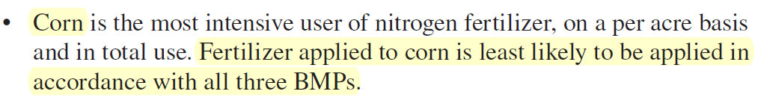
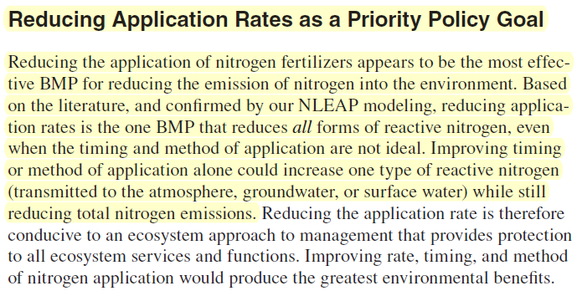
Priorities for N
(2011)
Corn
Rate

Slide 3
North-American Regional Corn Trial

Slide 4
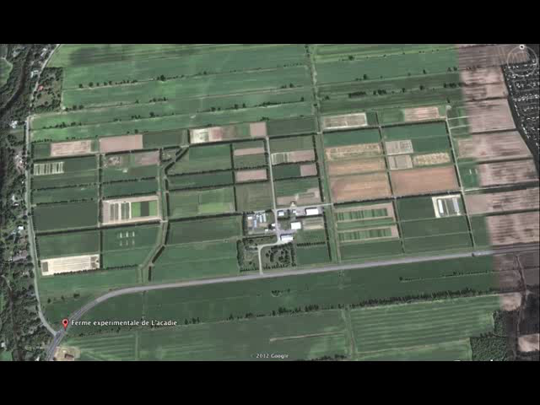
L’Acadie Experimental Farm (Agriculture and Agri-Food Canada), Quebec

Slide 5




Tastes Great! Less Filling!
Comparing Algorithms for Nitrogen Management
August 5, 2009

Slide 6
Conclusions
Similarities
  Use of reference strip & subsequent measurement of response/sufficiency
Differences
  How N is applied spatially
    Sufficiency approach – response is variable
    Yield-based approach – yield potential is variable (response could be variable)
Challenges
  Better prediction of in-season responsiveness
Soils?
Weather?

Slide 7

Soils
Weather
Shannon Diversity Index
T° = CHU
Rain = PPT, SDI
  « AWDR » = PPT * SDI
Fine textures
CHU
SD
AWDR
15 30
Medium textures

Slide 8
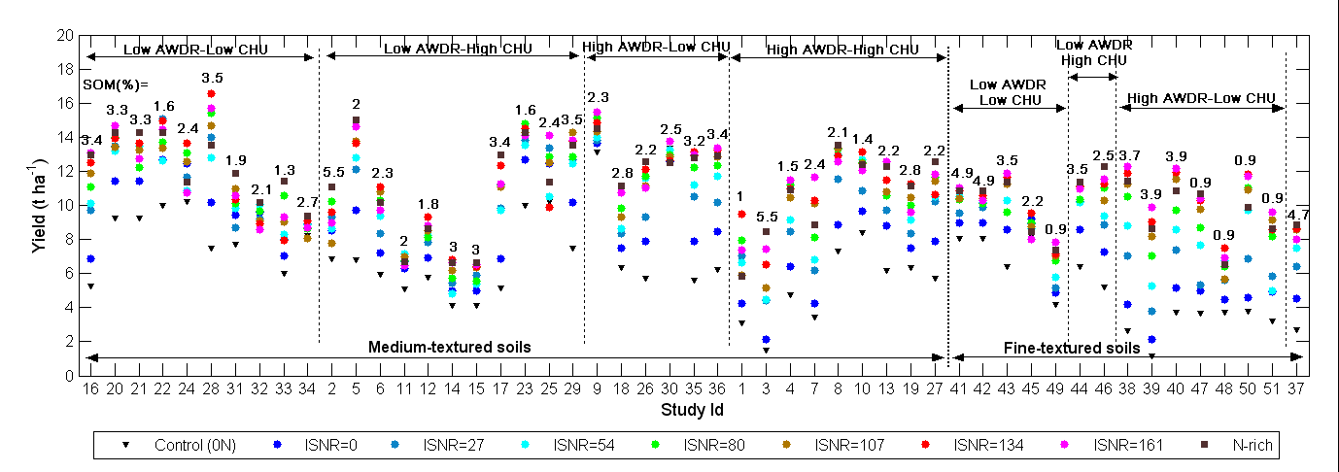
Corn Yield * In-Season N Rates
Results

Slide 9
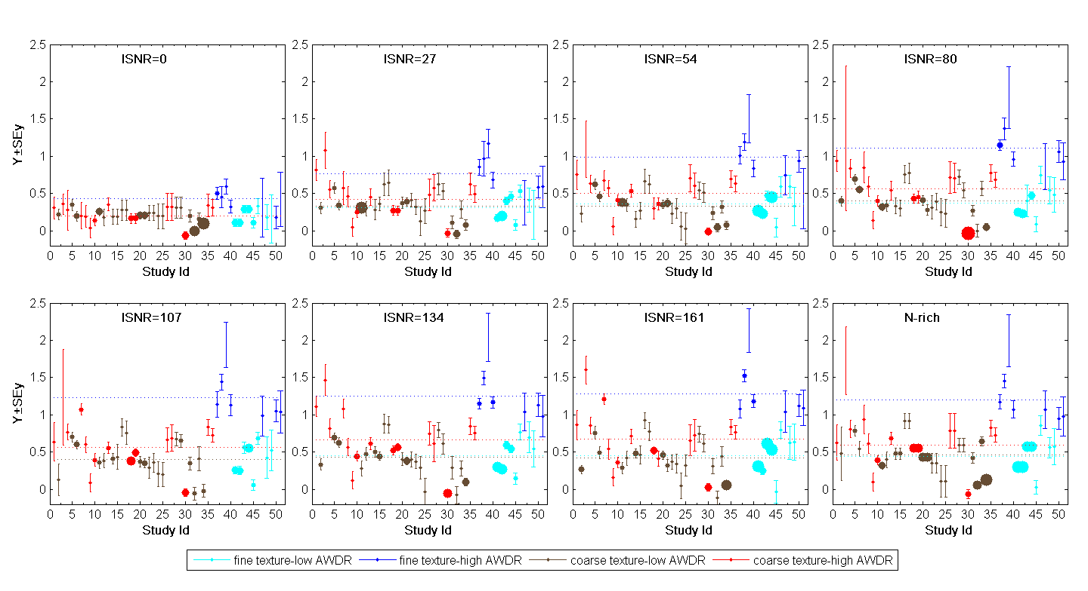
Why a meta-analysis?
Weigh studies according to variability
Allow for agglomeration of studies conducted (in a diversity of conditions) and generalization
Between-group variability is associated with different categories (explaining discrepancies among studies and factors to consider for response to N)
Quantitative estimate of effect size, which is calculated as the response to a specific treatment (e.g. fertilization with nitrogen) relative to a control (e.g. no nitrogen fertilization)

Slide 10
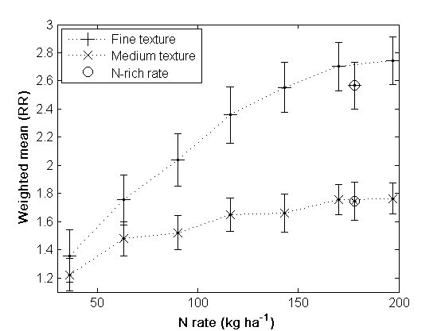
In-season N vs Textures

Slide 11
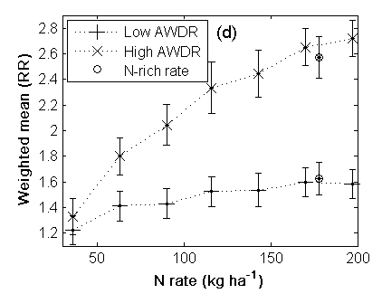
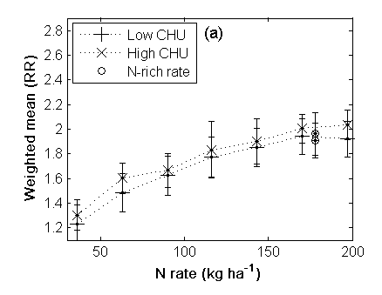
In-Season N vs Weather
CHU
Rain

Slide 12
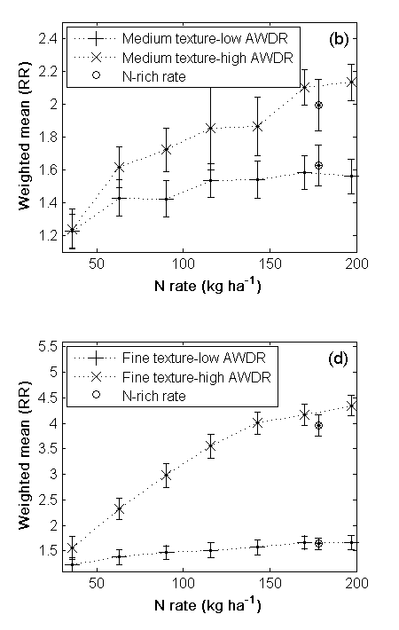
Interaction texture * rain
Medium textures
Fine textures

Slide 13
Publication
Tremblay, N., M.Y. Bouroubi, C. Bélec, R. Mullen, N. Kitchen, W. Thomason, S. Ebelhar, D. Mengel, B. Raun, D. Francis, E.D. Vories, and I. Ortiz-Monasterio. 2012. Corn Response to Nitrogen is Influenced by Soil Texture and Weather. Agronomy Journal 104(6): 1658-1671.
https://www.agronomy.org/publications/aj/pdfs/104/6/1658

Slide 14
Since then…
Report from co-author Newell Kitchen to this group last year
New meta-analyses worked out from the same DB
  Sensor-based NSI
  Influence of SOM

Slide 15
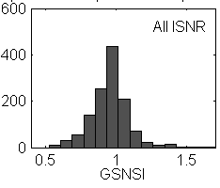
NSI distribution (Low < 0.95 < High)

Slide 16
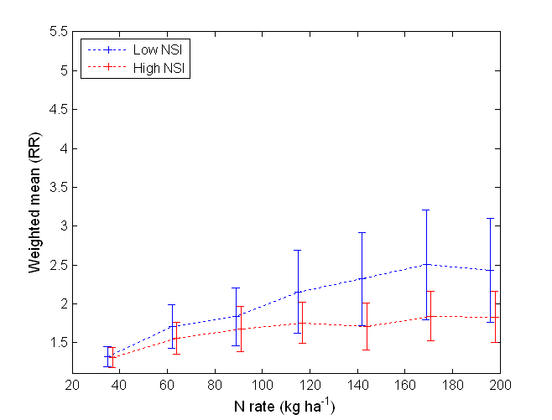
NSI as a substitute

Slide 17
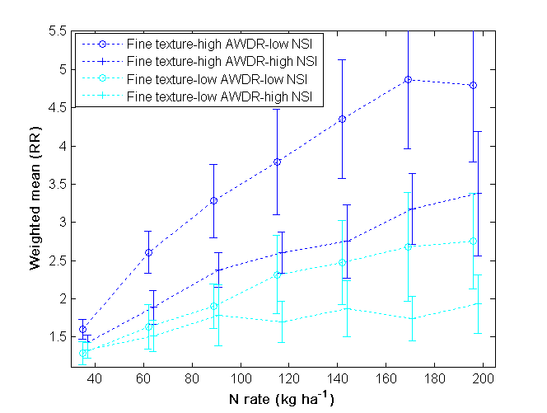
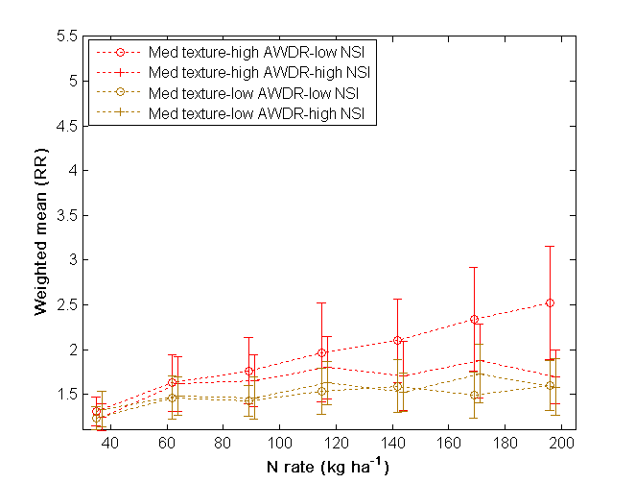
NSI as a Complement to Texture and Rain

Slide 18
SOM (Low < 2.5% < High)
When do we have more effect of N?
  Option a: In a soil with low SOM?
  Option b: In a soil with high SOM?

Slide 19
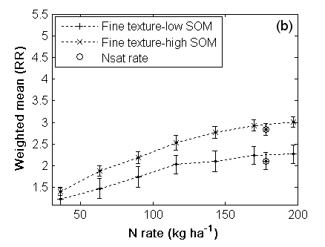
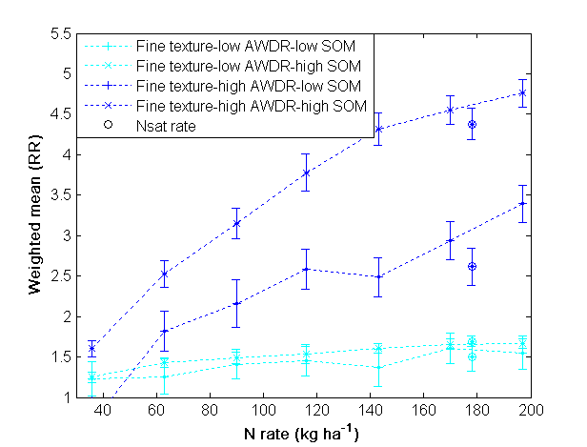
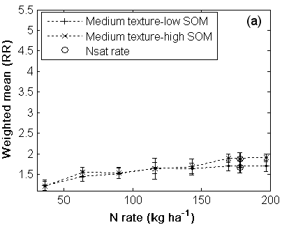
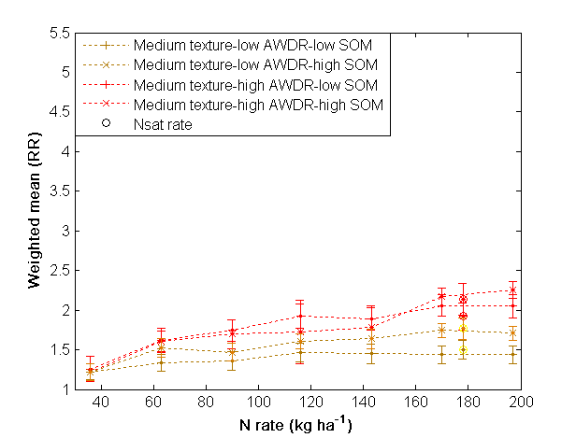
N vs SOM (Low < 2.5% < High)

Slide 20
SOM by texture group in the DB
Soil | Min | Max | Mean | SD | Median
Medium textures | 1.00 | 5.50 | 2.59 | 0.99 | 2.40
Fine textures | 0.90 | 4.90 | 2.81 | 1.58 | 3.50

Slide 21
Conclusions
Texture * rain is determinant
  Rain is not only quantity but also spread
NSI
  Alternative in the absence of texture* rain info
  Complement: especially for fine textures under high rain
SOM
  Better response to N under high SOM (fine textures?)
Meta-analyses
  Suited and powerful
  Good data; good meta-data; good learning

Slide 22
Seeking N responses datasets
Corn, (winter, spring) wheat, canola, potato
Required data | Useful
Soil texture Tillage practice Soil organic matter (%) or organic N and C Planting dates N fertilization history Harvest dates Yield history Daily rainfall (+ irrigation, if applicable) Daily minimum and maximum air temperatures | Field locations (GPS coordinates) Crop rotations Soil analysis (fertility and pH) Soil apparent bulk density N source and method of application Cultivar variety and hybrid Crop tissue analyses
Nicolas.Tremblay@agr.gc.ca

Slide 23
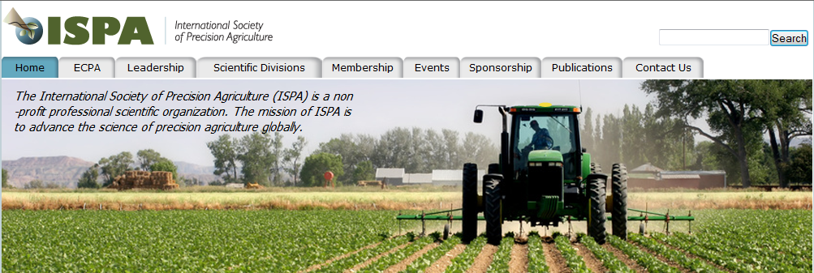
International Society for Precision Agriculture
12th
International Conference on Precision Agriculture
Sacramento, California, July 20-23, 2014

