Slide 1
Shane Swedlund
Applied Technology Division
Brookings - Facility & Engineering Manager
Raven Industries
ravenprecision.com
twitter.com/RavenIndustries
facebook.com/ravenprecision

Slide 3
Headquarters:
Sioux Falls, South Dakota
est. 1956
Approx.
1,200 Employees
Publicly Traded
RAVN (NASDAQ)
Engineered Films
Aerostar
Applied Technology
Three Divisions

Slide 4
Construction Films | Geo Liners and Covers
Agricultural Covers and Liners | Energy | House Wrap

Slide 5
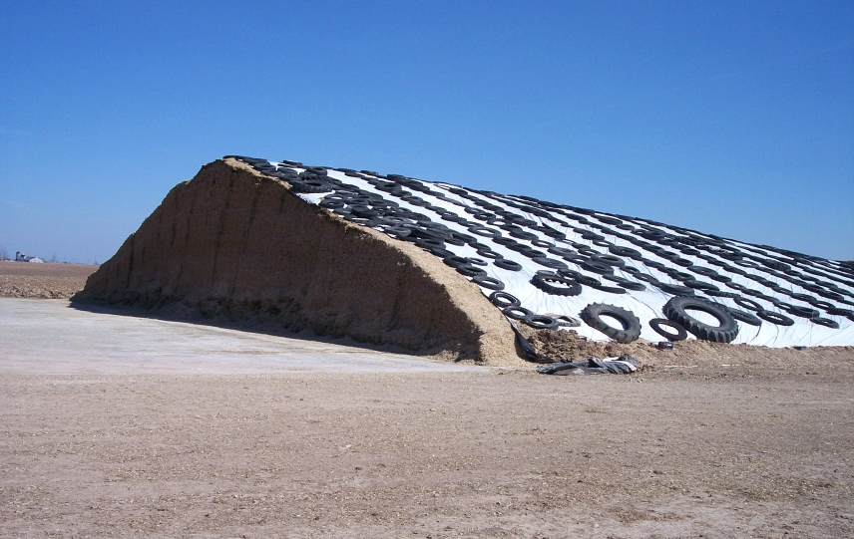
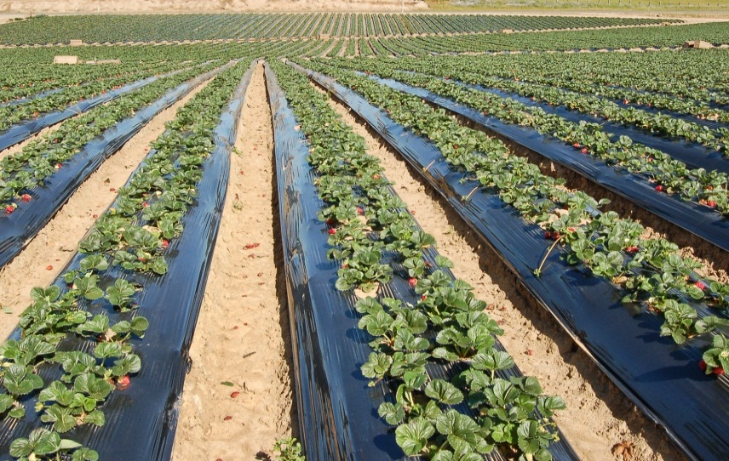
EFD AGRICULTURAL PRODUCTS
Oxygen barrier silage covers preserve feed quality and nutrients, improving productivity for dairy farms and feeding operations.
Barrier fumigation films help assure improved yields of fruits and vegetables while controlling unwanted weeds and insects.

Slide 6
Aerostats | Military | Inflatables | Protective | Industrial Controls
Communication, Aviation and GPS Systems | Network Encryption Systems

Slide 7
Google will use Raven-designed-
and-developed high-tech balloons
as part of its new project for
balloon-powered Internet access.

Slide 8
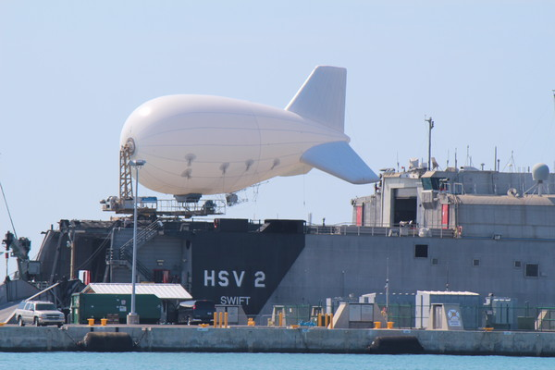
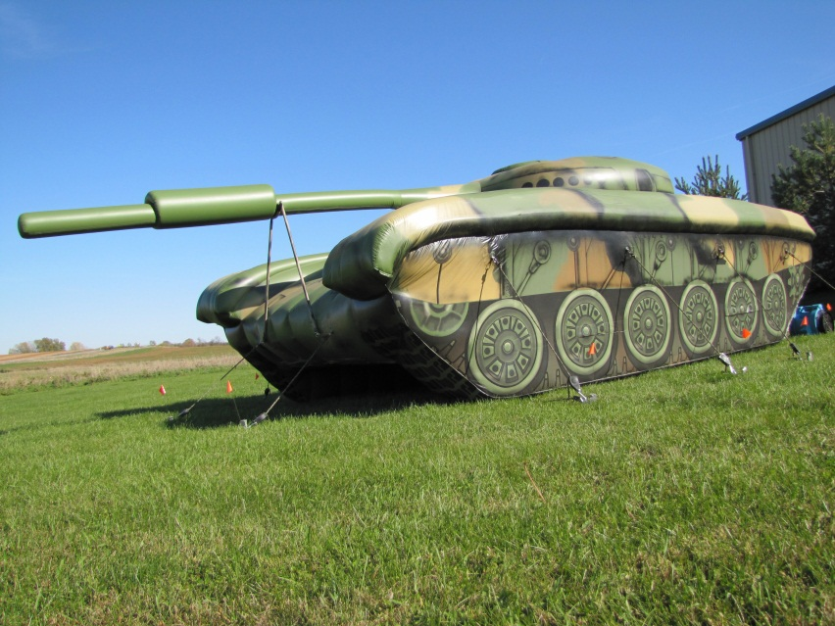

Slide 9
LOCATIONS
United States | Canada | Netherlands
PERSONNEL
United States | Canada | Netherlands
Costa Rica | Europe | Russia | China
Australia
REPAIR CENTERS
United States | Australia | Brazil
Argentina | Russia | France | UK
Applied Technology Division

Slide 10
Notes:
We continue to strive to be a full solutions provider

Slide 11
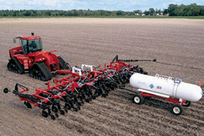
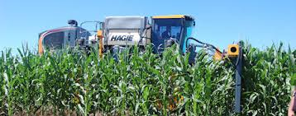
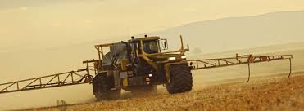
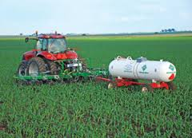
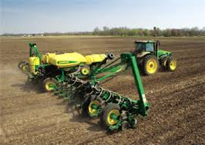
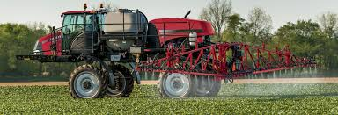
ALL SEASON CONTROLS
FALL APPLIED
Anhydrous
N Stabilizers
Manure/Slurry
Strip till
LATE SEASON
UAN
Rescue
SPRING APPLIED
Liquid
Dry
VRA
Burndown
Right Fertilizer Source
Right Rate
Right Time
Right Place
SIDEDRESS
Anhydrous
UAN
Granular
Rescue
AT PLANT
Seed rate
Starter Fert.
Insect/Herb-cide
Air seeder 1-pass
POST EMERGE
Crop Protection
Direct Injection

Slide 12
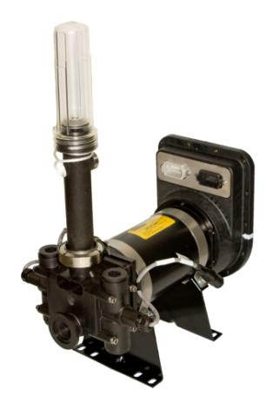
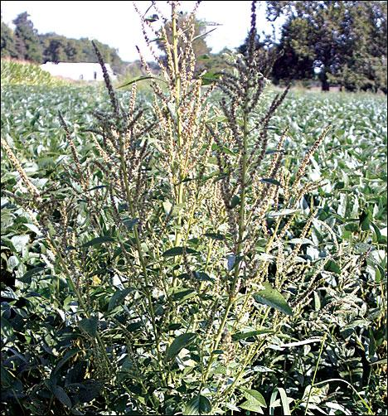
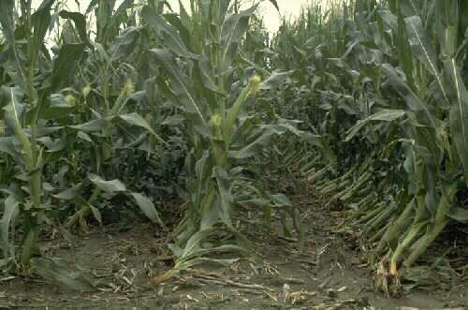
APPLICATION CONTROLS
Eliminate tank mixing
Self-priming, calibrating and rinse assist
Starter fertilizer applications
ISO compatible
Weed resistance
Corn rootworm
Sidekick™ Pro

Slide 13
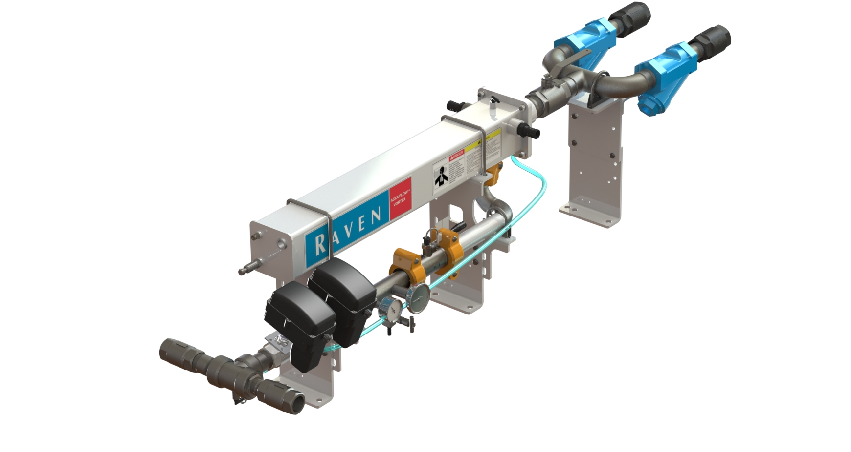
APPLICATION CONTROLS
Increased capacity
Smaller footprint on the toolbar
Higher operating speeds
Colder temperatures
AccuFlow™ Vortex
AccuFlow HP+™

Slide 14
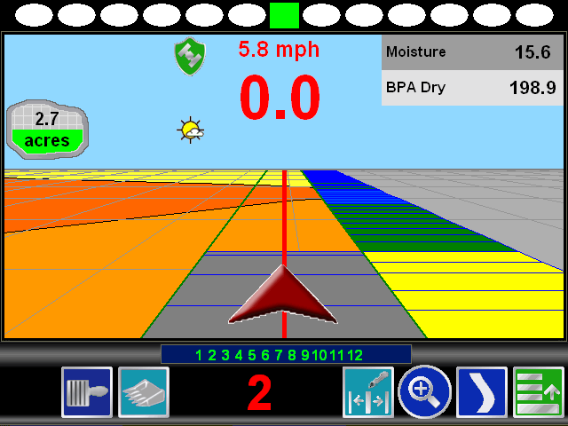
SmartYieldTM Pro Data Accuracy
95% to 97% accuracy with 3 calibrations per crop and in-season spot checks
Continuous moisture sensing
Accurately matches the dynamics of the combine over a wider range of flow rates
Accuracy directly correlated to variation in test weight and accuracy of grain cart scales

Slide 15
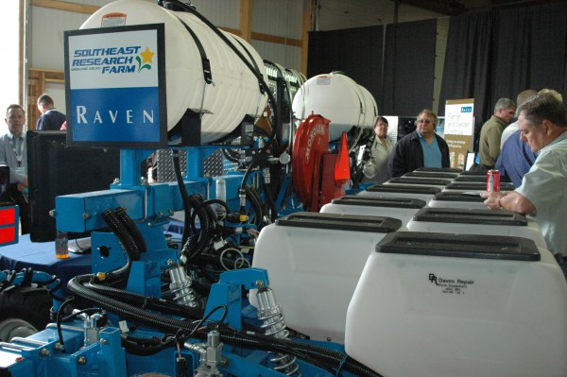
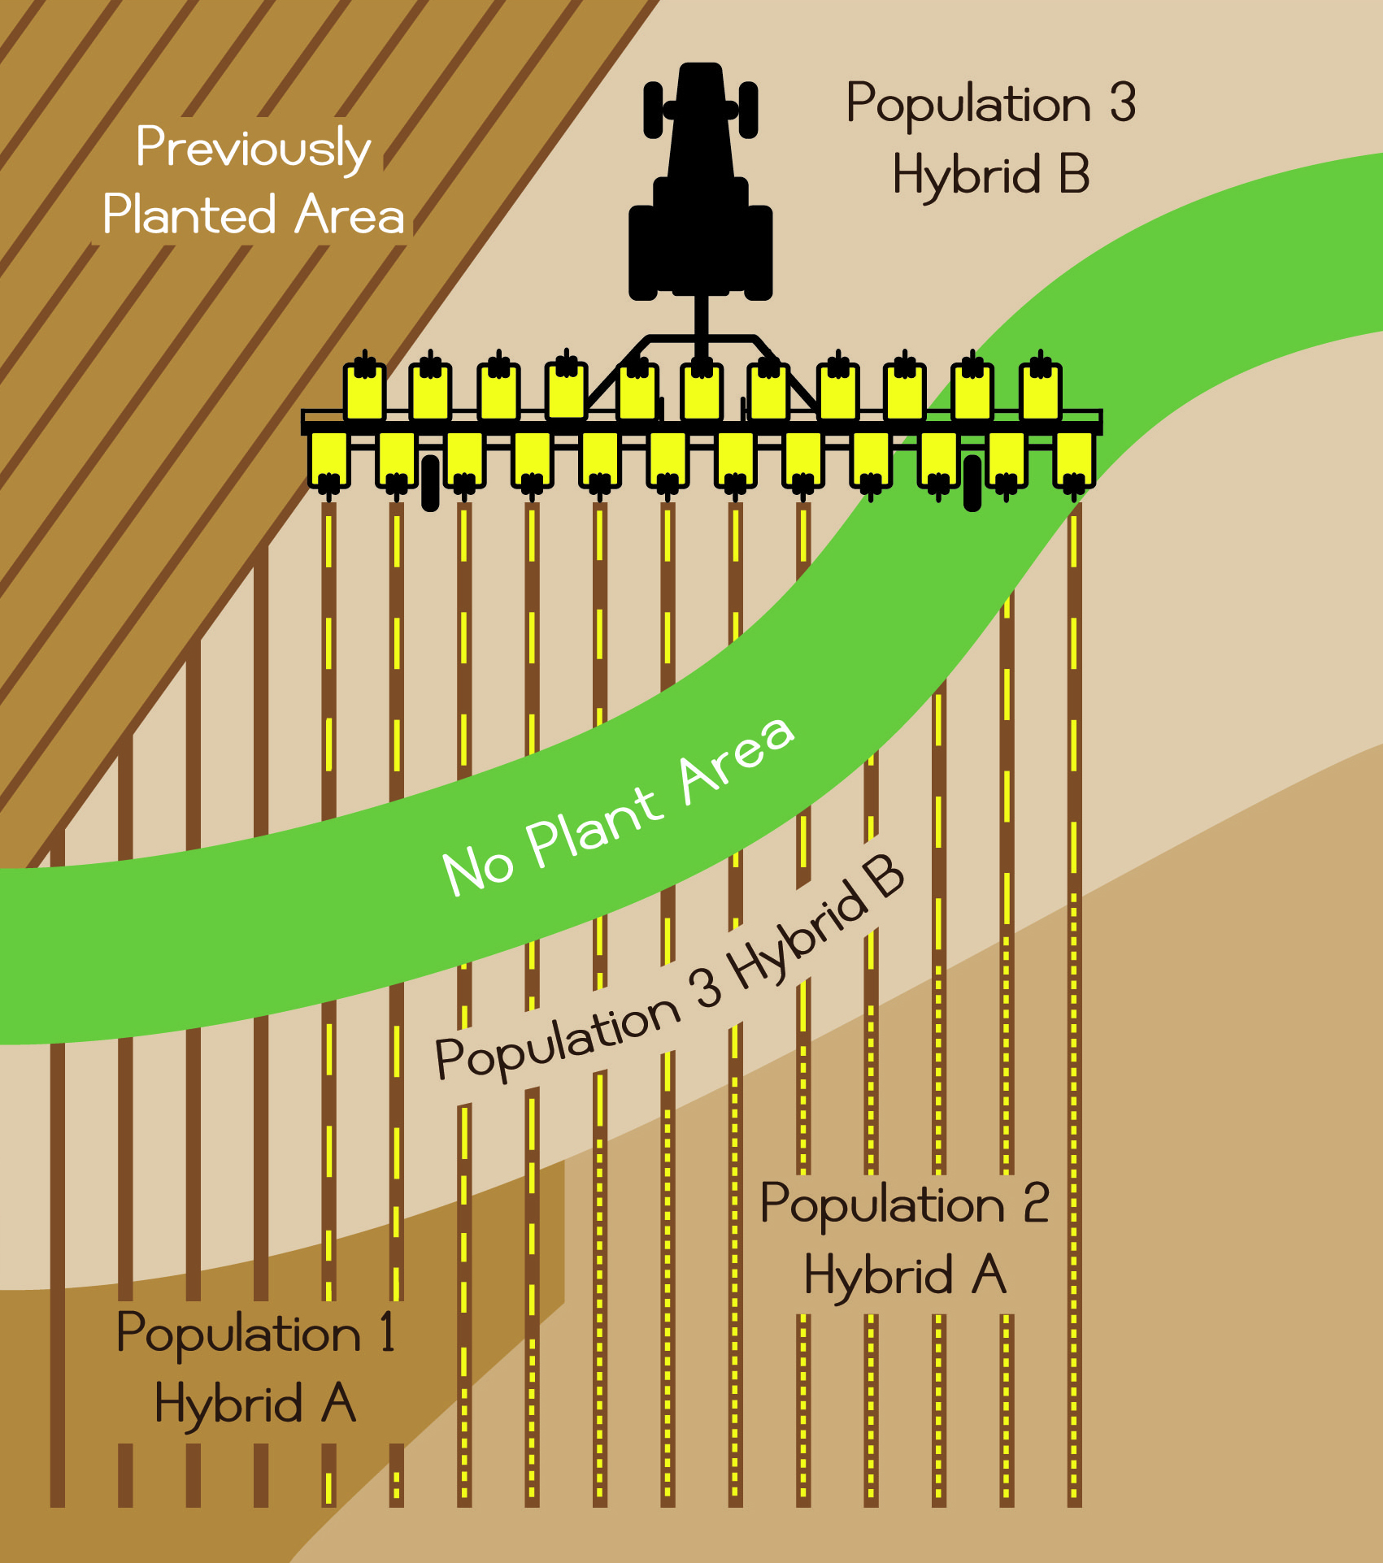
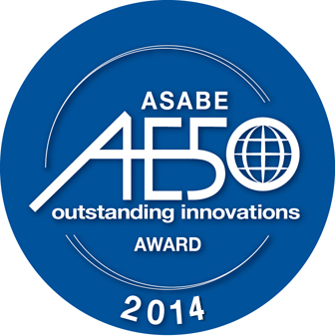
PLANTER CONTROLS
OmniRow® Multi-hybrid
Switch between hybrids on the fly
Studies show 5 to 11 bu/a increase

Slide 16
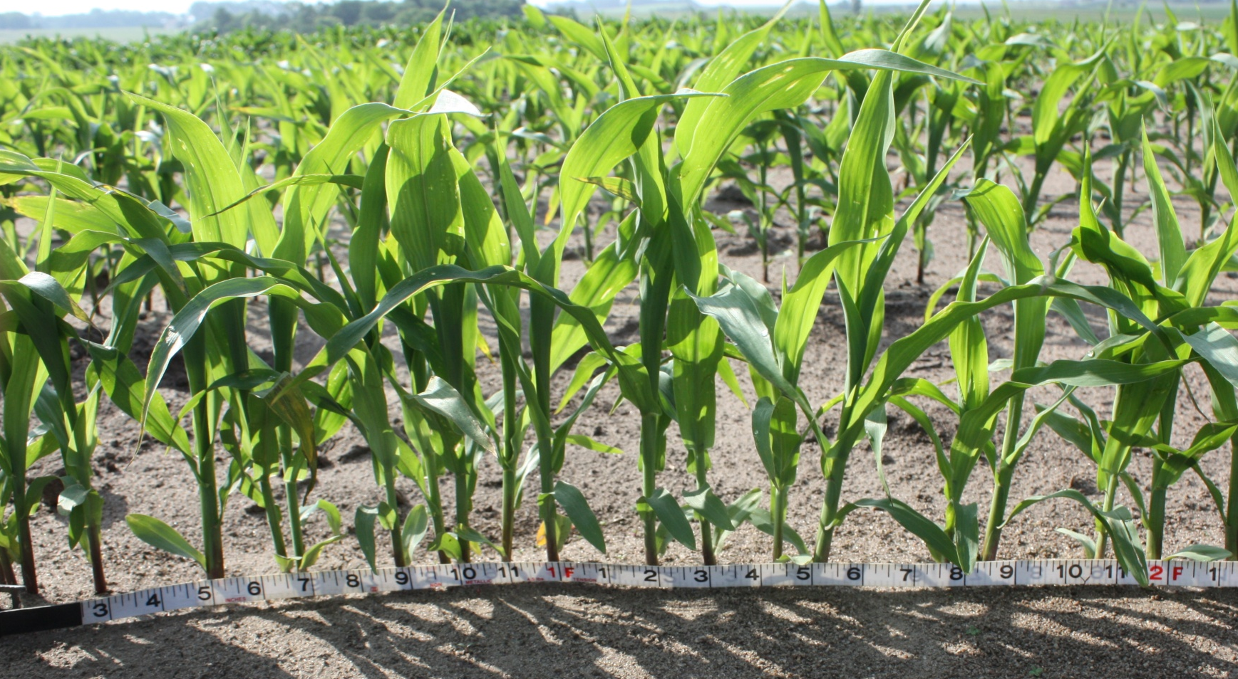
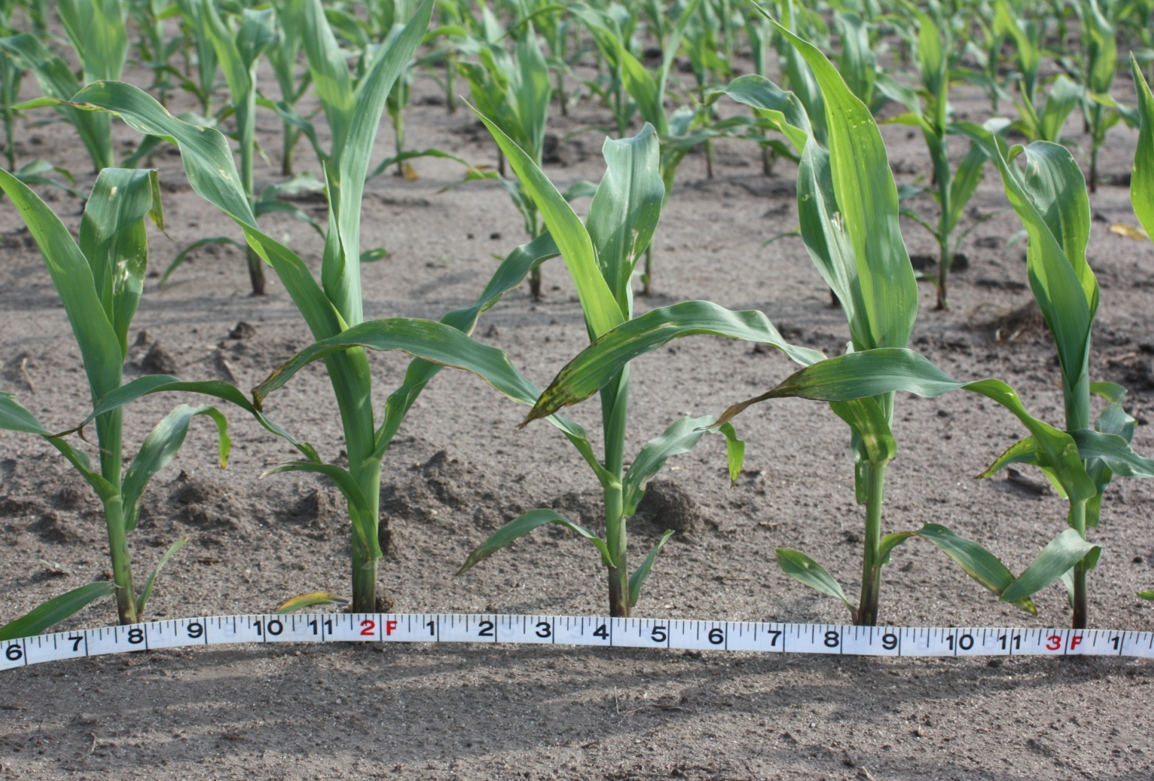
OMNIROW®
WITHOUT TURN COMPENSATION
WITH TURN COMPENSATION

Slide 17
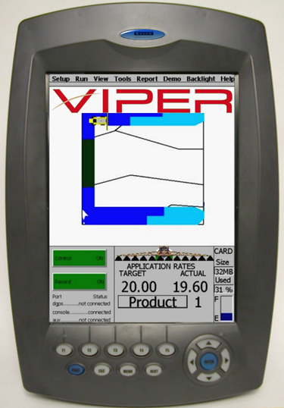
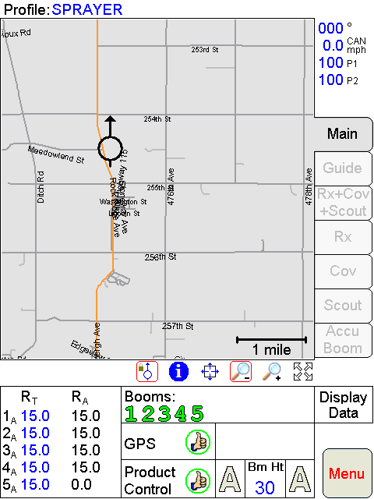
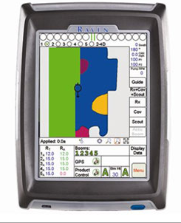
HAPPY 13TH BIRTHDAY VIPER!

Slide 18
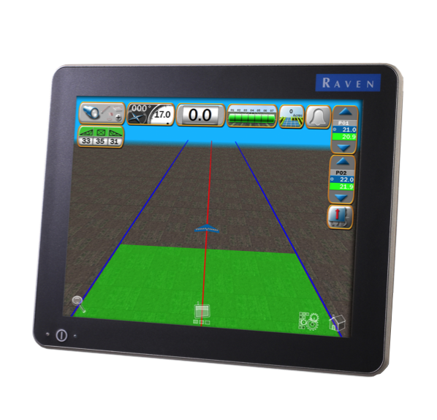
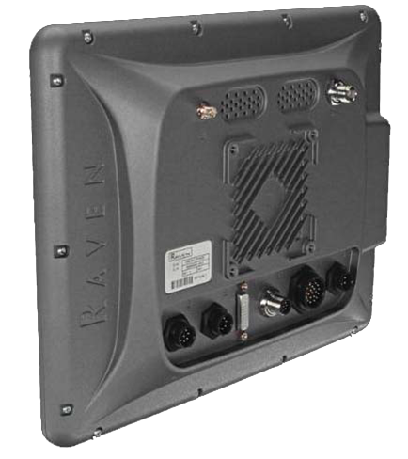
VIPER® 4 RAVEN OPERATING SOFTWARE (ROS)
Simple. Powerful. Connected.
12.1” display (1024x768)
Portrait OR landscape
Weather station
Customization
Grower, Farm, Field data structure
User configurable product profiles
agX database integrated
Better data management

Slide 19
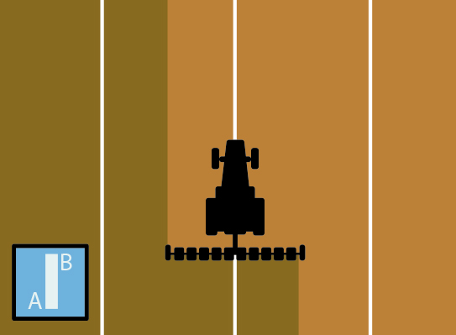
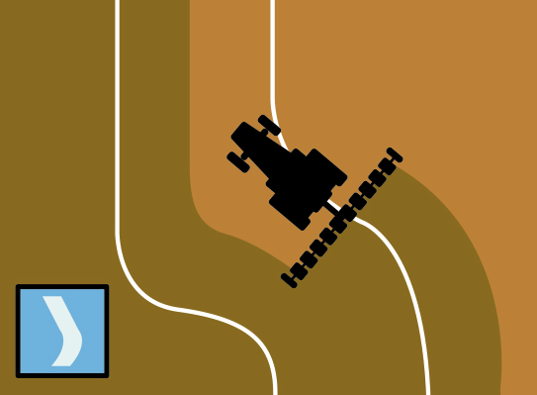
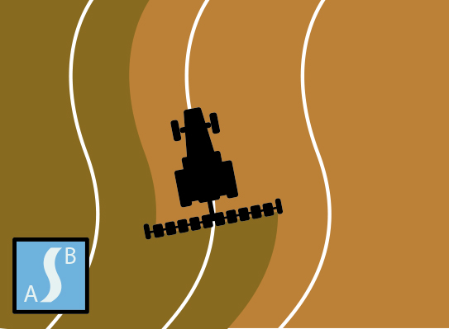
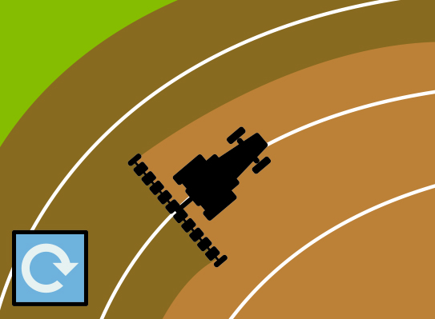
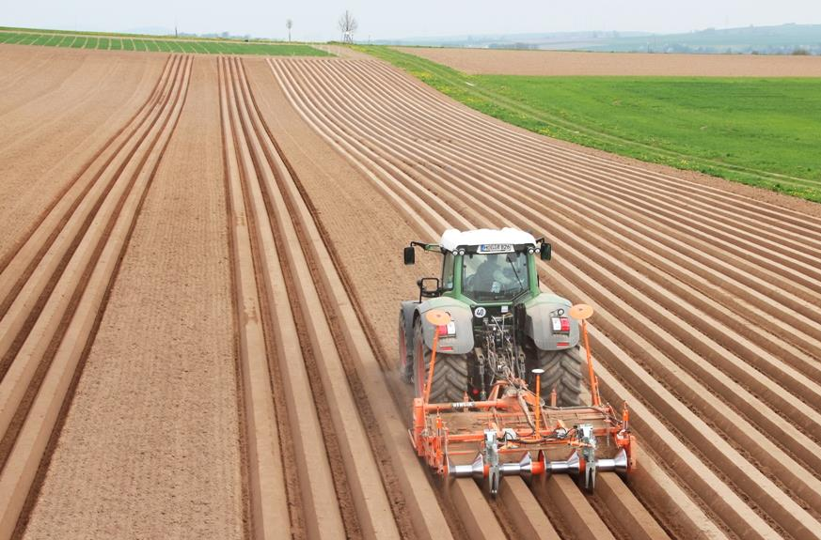
SMARTRAX™ SMARTRAX™ RTK SMARTRAX™ MD
GUIDANCE & STEERING
RTK accuracy and repeatability from year-to-year
Best-in-class operating speeds for covering more ground faster
SBG – Implement Steering

Slide 20
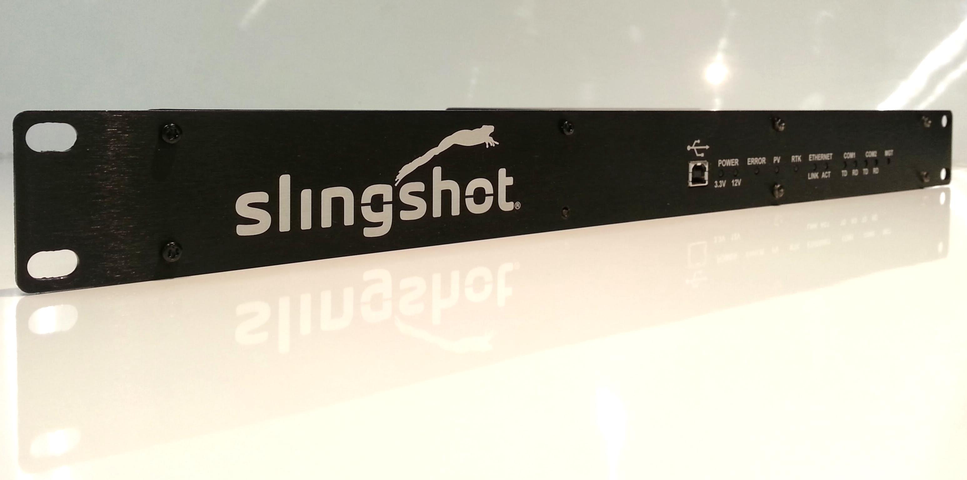
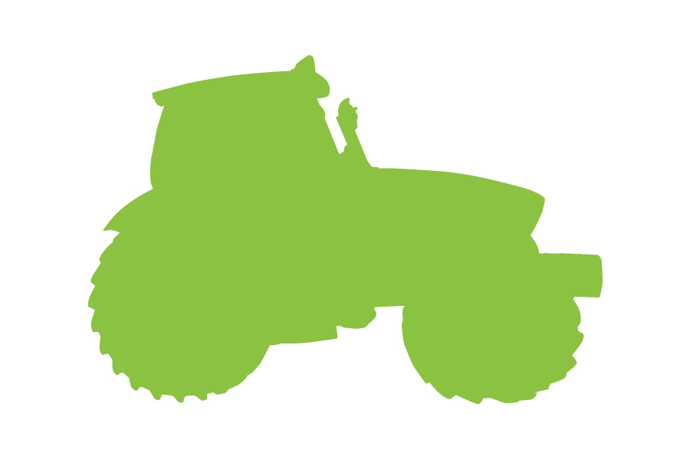
High-speed
connectivity
Wireless data
transfer
Fleet tracking
Remote support
GNSS Corrections

Slide 21
SLINGSHOT® API PARTNERS

Slide 22
Helping Feed The World
20 years ago, a farmer grew enough food for 85 people
Today, a farmer grows enough food for 155 people
…with 37% less land
…and 69% less erosion
Over the next 40 years, more food has to be produced than the previous 10,000 years
…combined

Slide 23
Shane Swedlund
shane.swedlund@ravenind.com
(605) 212-6800
ravenprecision.com
twitter.com/RavenIndustries
facebook.com/ravenprecision

