Slide 1
Sensor Based Nutrient Management
2014 Conference, Sioux Falls, SD
Update on Optical Sensors Technology for the Fertilization of Spring Wheat in Mexicali, B. C., Mexico
Jesús Santillano-Cázares, Ph. D.
Professor-Research
Universidad Autónoma de Baja California
Mexicali, B.C., México
jsantillano@uabc.edu.mx
August 6th , 2014
Notes:
Click slide. Good afternoon. Thanks to this year´s organizing committee of the Sensor Bases Management Community for the opportunity to present the results of our research.
Thanks to the audience for attending this presentation.
The title of this presentation is “Update on Optical Sensors Technology for the Fertilization of Spring Wheat in Mexicali, B. C., Mexico” . Click slide.

Slide 2
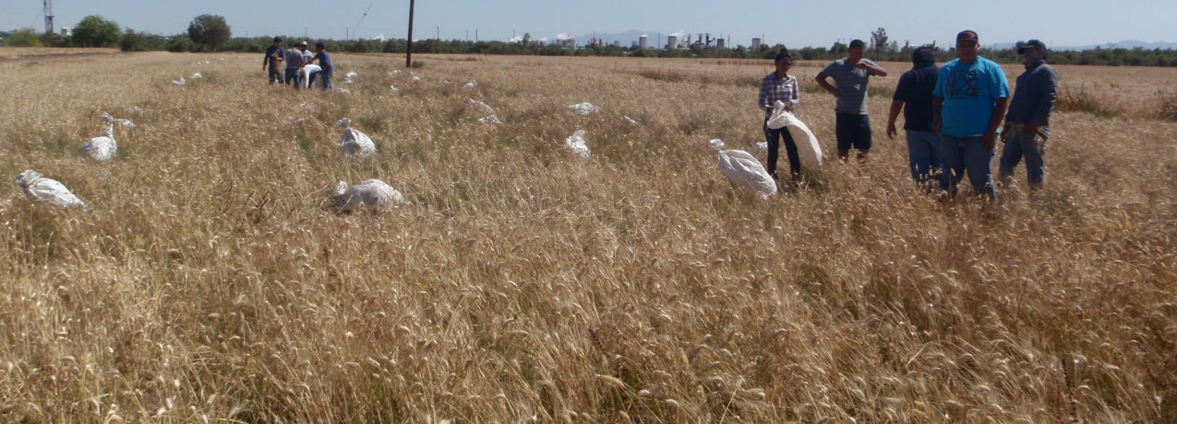
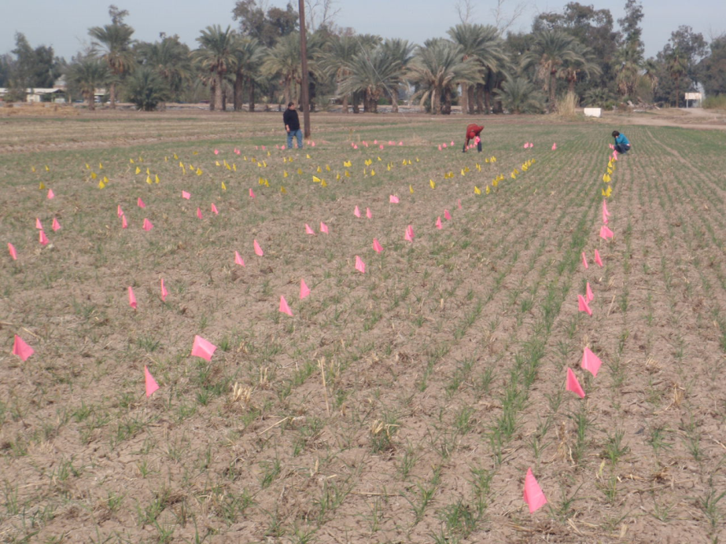
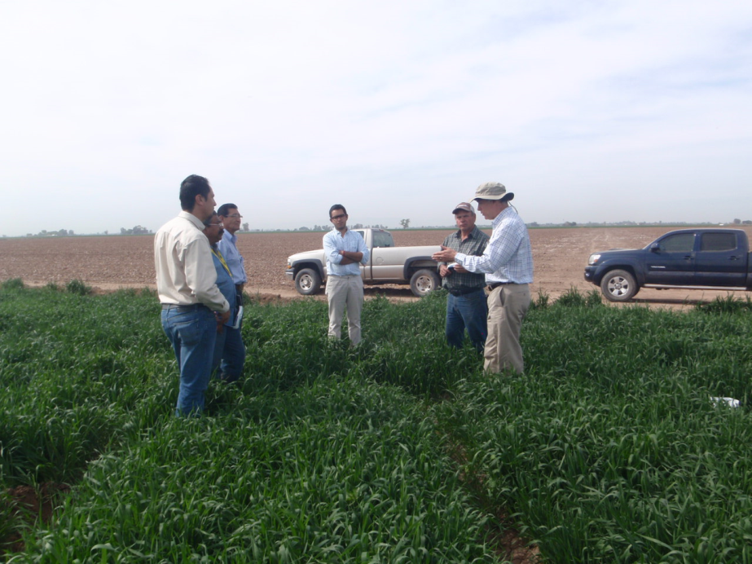
Appreciation
Dr. Iván Ortiz-Monasterio-CIMMYT
María Elena Cárdenas and Alberto Mendoza-CIMMYT
Students from ICA-UABC
Notes:
First of all…

Slide 3
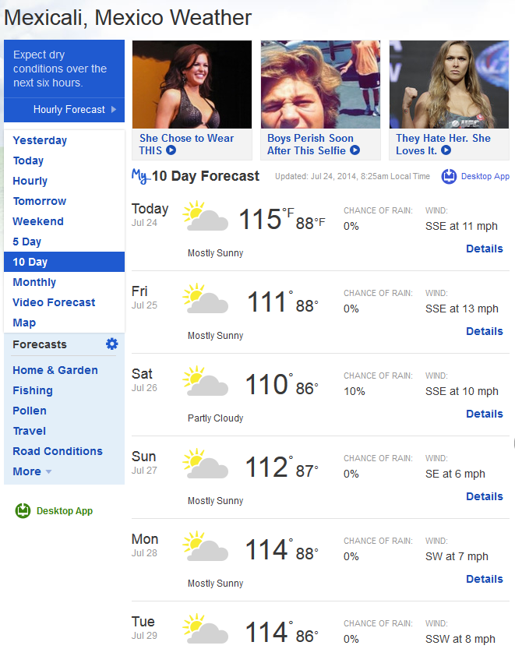
Where in the world is Mexicali located?
Notes:
This is an introduction about where in the world Mexicali, BC Mexico is located. Click slide.

Slide 4
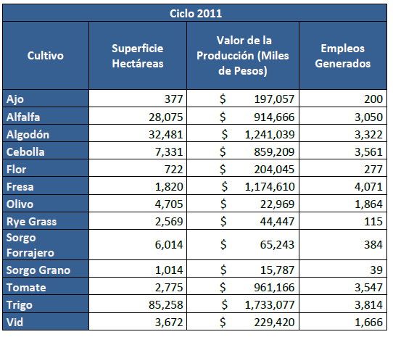
Notes:
Wheat production is important in Baja California because of the economy and jobs it provides. 140 million USD and almost 4,000 jobs/season.

Slide 5
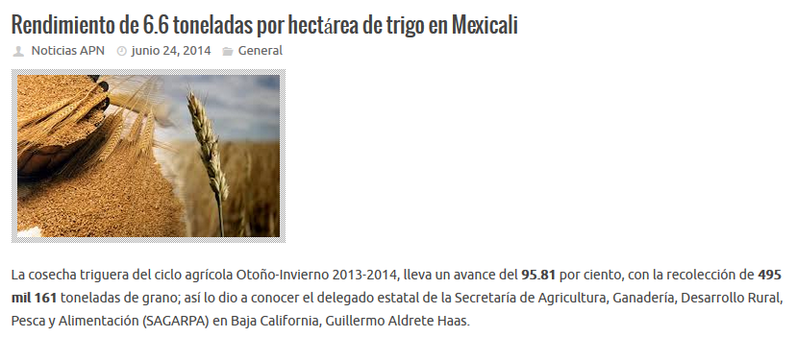
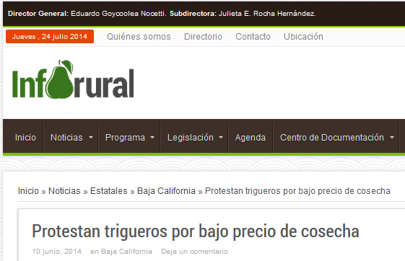
6.6 × 300* = $ 1,980 BRUTE INCOME
1,980 – 1,700 = $ 280/ha NET INCOME
280 × 20 ha = $ 5,600 ANNUAL NET PROFIT…LOW/INSUFICIENT!.
*Including government subsidy
Notes:
With a mean yield of 6.6 ton/ha and a brute income of $ 300.00 USD, including government subsidy of around $ 30 USD/ha.

Slide 6
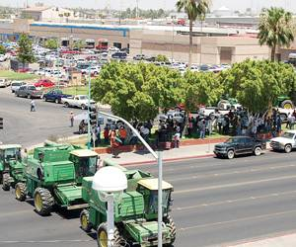
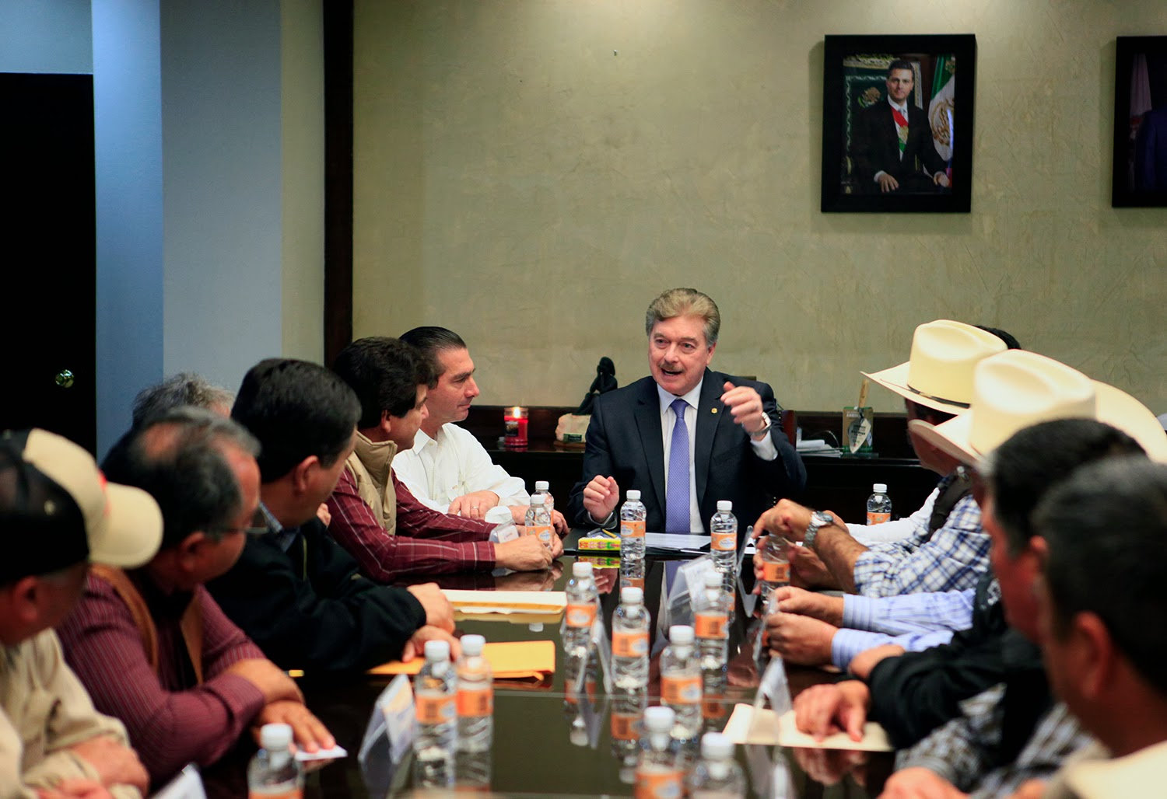

Slide 7
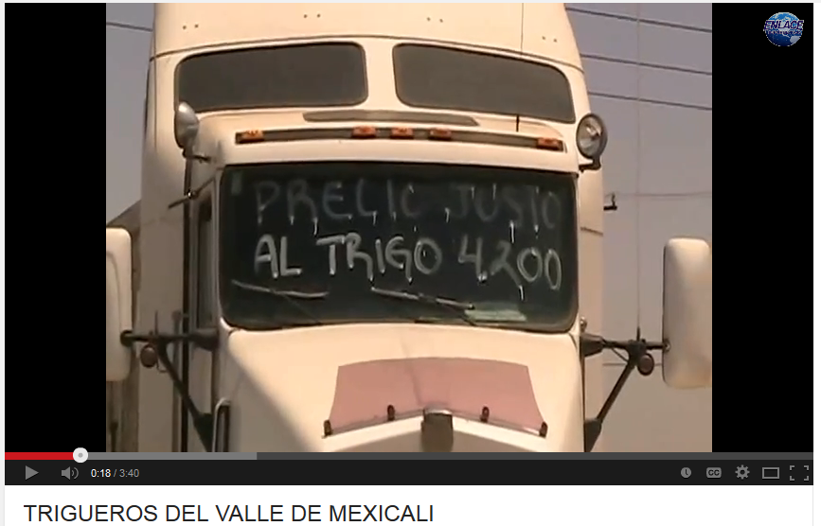
Farmers demand around $ 336.00 USD
(a deficit of $ 36.00 USD/ton)
https://www.youtube.com/watch?v=eW4uxxyKAGU

Slide 8
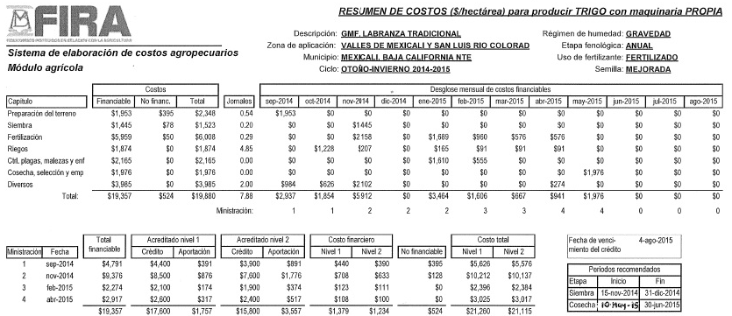
Fertilizer$: Worthwhile to increase efficiency
Fertilizer costs $ 500 USD/ha. 30% out of the total production costs
Total Production Cost $ 1,700 USD/ha
Notes:
A bief introduction about the problem is faced. In this slide estimated costs of production are $ 1,700 USD, with fertilizers representing cose to 1/3 of the total.

Slide 9
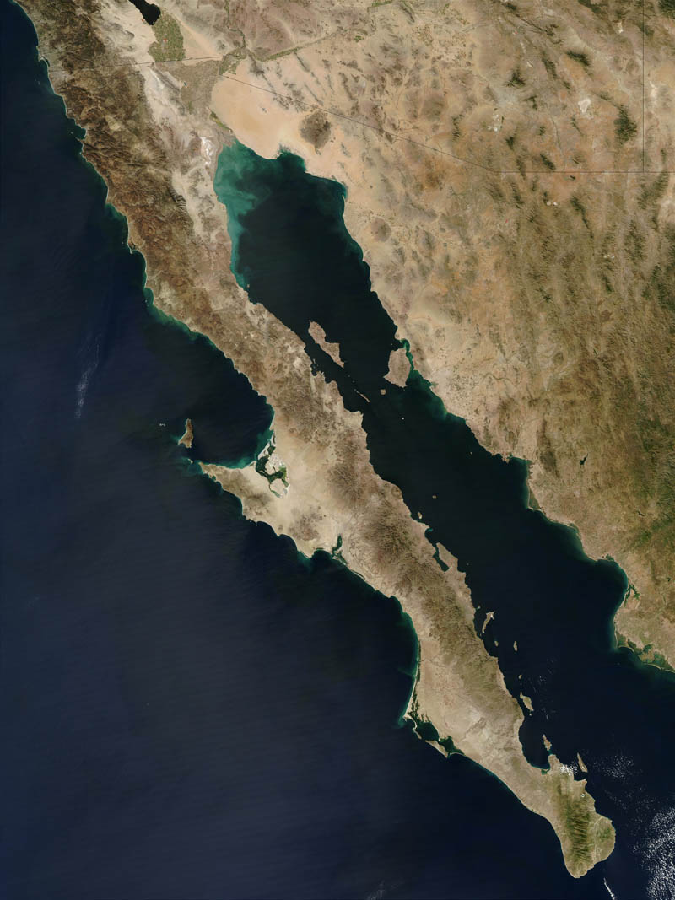
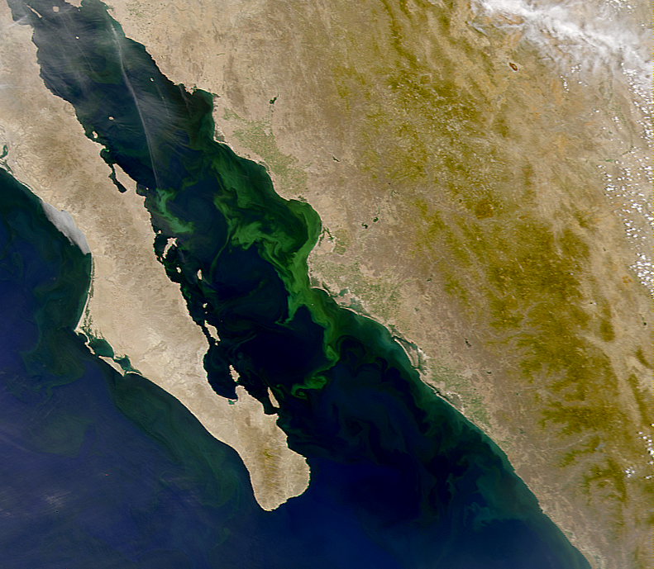
The Environmental Dimension of N Use Efficiency
Beman et al. 2005
Nature
Notes:
Apart from the economic aspect of low efficiency of fertilizers application, more important is the environmental aspect of low fertilizers efficiency. Beman and collaborators from Stanford University (2005), nicely depicted algae explosion in the sea of Cortez (also known as the Gulf of California) as a result of runoff fertilizers applied in the valley del Yaqui, in Sonora, Mexico. Algae explosion affects water quality as oxygen is deficient when decomposes. Click slide. Although not scientifically documented, the same phenomenon and due to the same causes may be occurring in the valley of Mexicali.
Other big environmental issues are nitrate contamination of water reservoirs contamination by leaching and N2O emissions to the atmosphere, contributing to global warming. So we had environmental, social and economic reasons to try to increase N use efficiency. Click slide.

Slide 10
Some tools to manage
N fertilization on crop production
Soil analyses
Chloropill meters
3. Plant tissue analyses
4. Optical infrared sensors-CIMMYT-OSU
5. Satellite images-CIMMYT
6. N index-USDA-ARS
Notes:
The state government passed on to us the responsibility to find alternatives to increase N use efficiency. We reviewed classical as well as innovative strategies to increase N use efficiency and decided that, at the time, sensor-based N fertilization was a promising tool to test in Mexicali. Click slide.

Slide 11
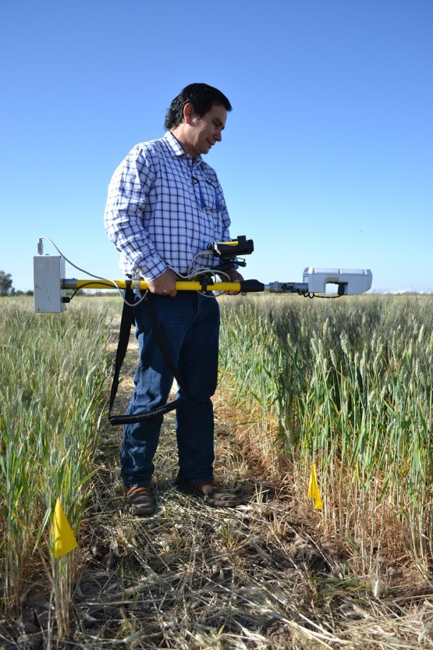
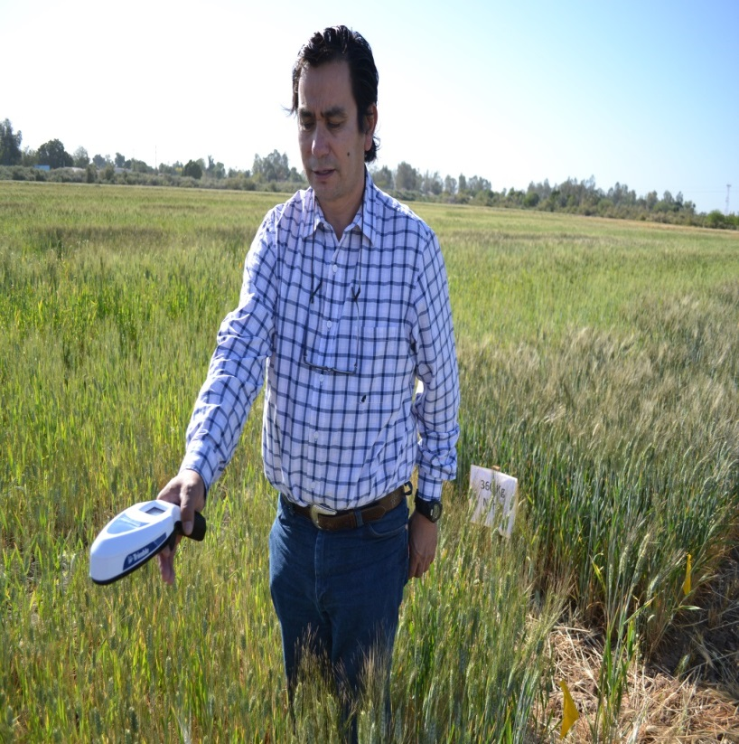
Sensor Technology GreenSeeker™
Diagnostic tool that allows one to identify the optimum N rate for each individual farmer’s field/year.
Notes:
Manufacturer have developed a manual sensor and just recently they delivered the pocket version of the sensor, thinking in developing countries. Click slide.

Slide 12
Objectives of this presentation
To present the latest version of our yield prediction equation for wheat grown in Baja California, Mexico (Calibration).
To share the latest results on technology transfer (not validation any more) of sensor based technology in Baja California, Mexico.
Notes:
Before presenting the objectives of the study, is important to point out that the development of the sensor based technology for each region where the technology is intended to be implemented, consists of three stages. Orderly, these are: Calibration, validation and technology transfer.
Calibration experiments are required to develop a grain yield prediction model in which grain yield is predicted as early as the beginning of stem elongation (by mid season).
Validation experiments are designed to test if fertilizer recommendations, derived from the predicted yields, are the optimum in terms of using the lowest possible fertilizer, without reducing grain yields, as compared to the conventional farmers practice.
The technology transfer phase consists on the fertilization of complete fields, using the sensor based technology. Click slide.
In this presentation I will present results of the first two stages (calibration and validation). Click slide.

Slide 13
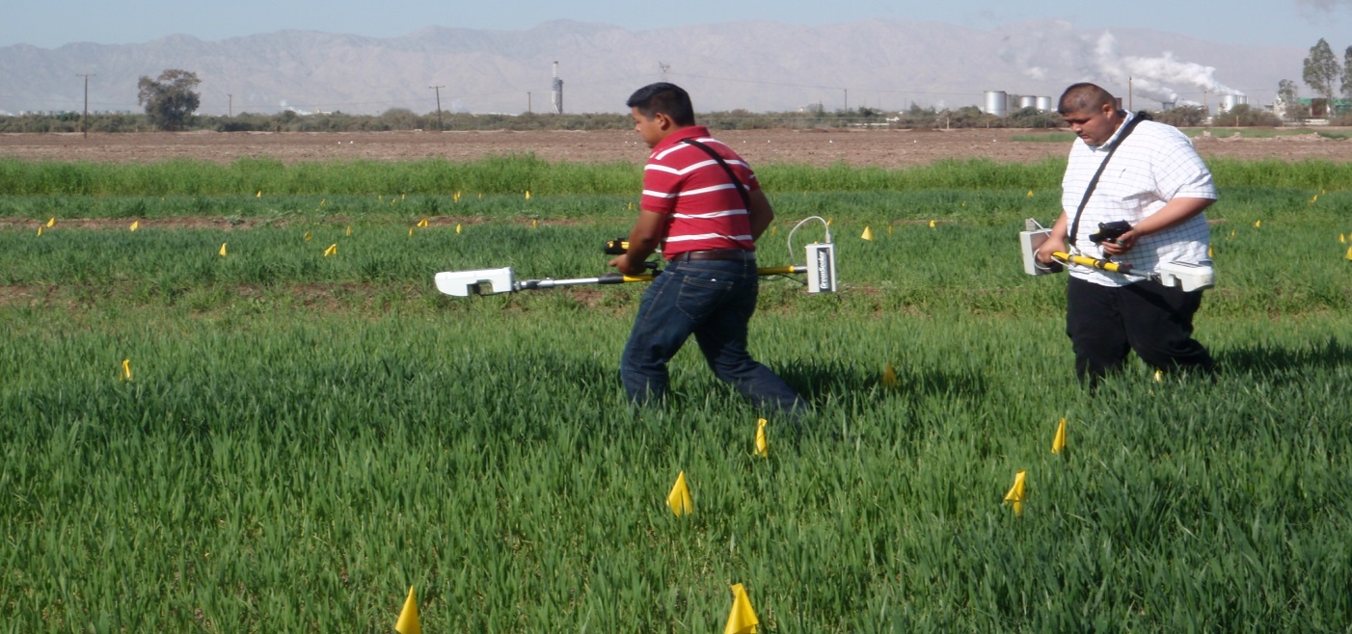
Materials and Methods
Calibration experiments- 8 N rates from 0-420 kg/ha, several locations.
Calibration experiments have been run for five cycles now (since 2009-10), although the first cycle was a “learning cycle”
Notes:
Calibration experiments were conducted in 2010-2011 and 2011-2012 to predict grain yields based in INSEY (in season estimation of yield).
Treatments were applied to create a range of variability of NDVI´s and yields: 0, 60, 120, 180, 240, 300, 360 and 420 kg/ha. These experiments were run in our experimental station along with cooperating farmers.
Sensor measurements (NDVI) were collected at the beginning of stem elongation and harvested grain when mature. Click slide.

Slide 14
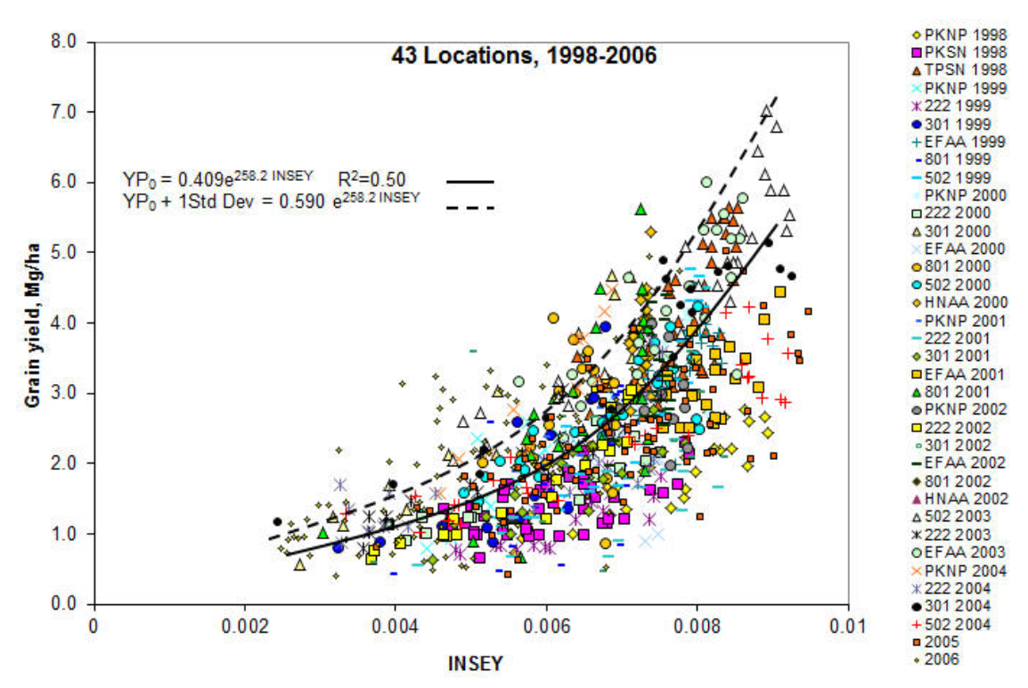
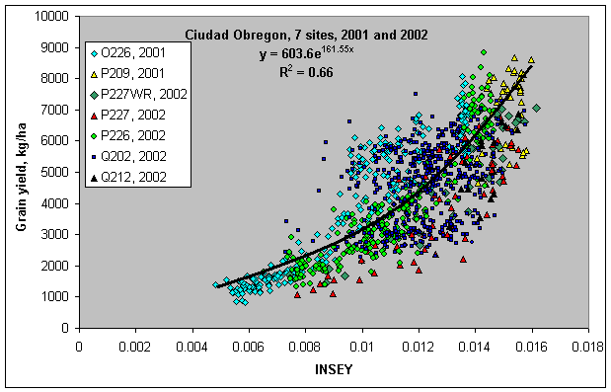
INSEY = NDVI / # of days from planting to sensing
Notes:
Once having grain yield and NDVI data from the plots, an exponential model was fitted between INSEY and yield an a first version of our prediction equation was obtained. This is the objective of calibration experiments. Click slide.

Slide 15
Validation experiments
Validation experiments were conducted on the growing cycle 2011-2012 and 2012-2013.
Nitrogen rich strips were established in cooperating farmer´s fields, leaving a fraction of one side of the field to be treated as conventionally done by farmers and the other side applying N fertilizers as recommended by the sensor technology.
Technology transfer
2012-2013 and 2013-2014. Complete commercial fields of 20 ha were fertilized according with sensor based technology recommendations.
Notes:
Click slide.

Slide 16
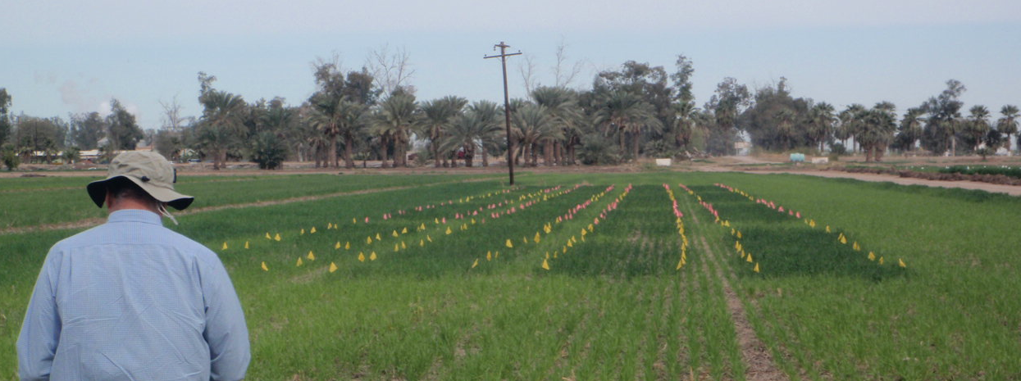
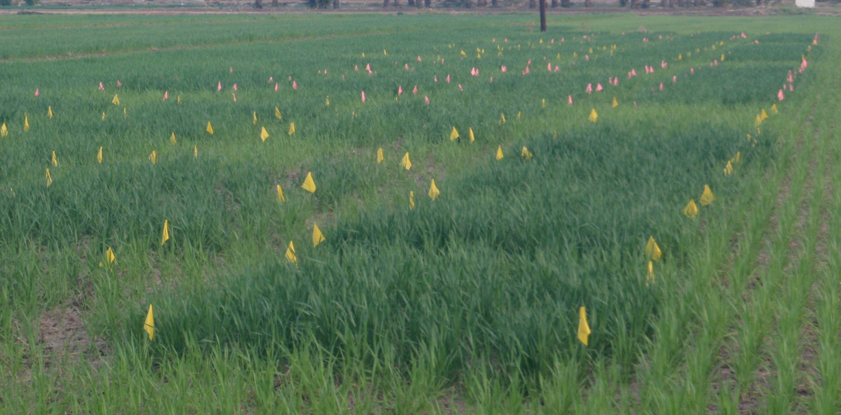
Results and Discussion
Calibration Experiments
Notes:
En exponential model was fitted, consistent with Ortiz-Monasterio and Raun, for the valley of Yaqui, in Sonora, Mexico, and, by Raun, for winter wheat and corn, in Oklahoma USA. Click slide.

Slide 17
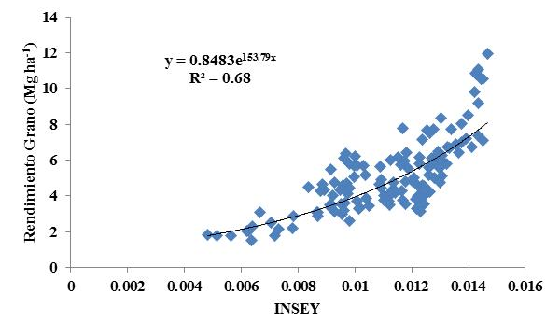
Model at the end of the 2011-2012 growing cycle
This included six fields in two cycles 2010-11 and 2011-12.

Slide 18
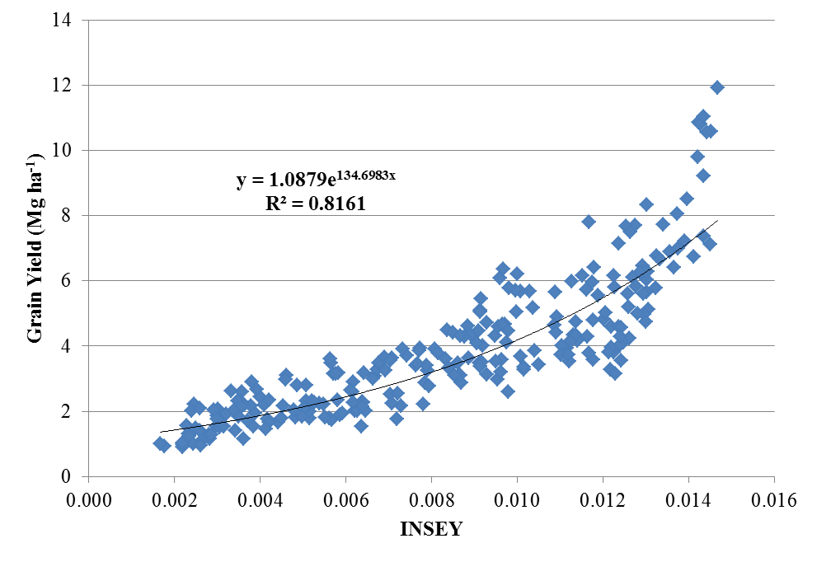
Model at the end of 2012-2013 growing cycle
This model includes 12 fields in three growing cycles (2010-2011, 2011-2012 y 2012-2013)
Notes:
En exponential model was fitted, consistent with Ortiz-Monasterio and Raun, for the valley of Yaqui, in Sonora, Mexico, and, by Raun, for winter wheat and corn, in Oklahoma USA. Click slide.

Slide 19
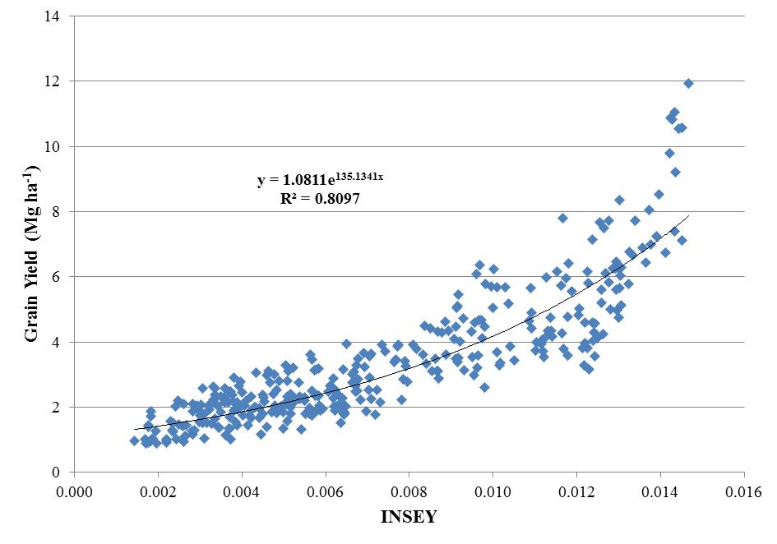
Latest Model at the end of cycle 2013-2014
This model includes 16 fields in four growing cycles: 2010-2011, 2011-2012, 2012-2013 and 2013-2014)

Slide 20
Equation version | Constant | INSEY | Exponential | Estimated Yield (ton/ha)
Mexicali al 2012-2013 | 1.088 | 0.002 | 134.6983 | 1.4
Mexicali al 2013-14 | 1.0811 | 0.002 | 135.1341 | 1.4
Mexicali al 2012-2013 | 1.088 | 0.004 | 134.6983 | 1.9
Mexicali al 2013-14 | 1.0811 | 0.004 | 135.1341 | 1.9
Mexicali al 2012-2013 | 1.088 | 0.006 | 134.6983 | 2.4
Mexicali al 2013-14 | 1.0811 | 0.006 | 135.1341 | 2.4
Mexicali al 2012-2013 | 1.088 | 0.008 | 134.6983 | 3.2
Mexicali al 2013-14 | 1.0811 | 0.008 | 135.1341 | 3.2
Mexicali al 2012-2013 | 1.088 | 0.010 | 134.6983 | 4.2
Mexicali al 2013-14 | 1.0811 | 0.01 | 135.1341 | 4.2
Mexicali al 2012-2013 | 1.088 | 0.012 | 134.6983 | 5.5
Mexicali al 2013-14 | 1.0811 | 0.012 | 135.1341 | 5.5
Mexicali al 2012-2013 | 1.088 | 0.014 | 134.6983 | 7.2
Mexicali al 2013-14 | 1.0811 | 0.014 | 135.1341 | 7.2
Mexicali al 2012-2013 | 1.088 | 0.016 | 134.6983 | 9.4
Mexicali al 2013-14 | 1.0811 | 0.016 | 135.1341 | 9.4

Slide 21
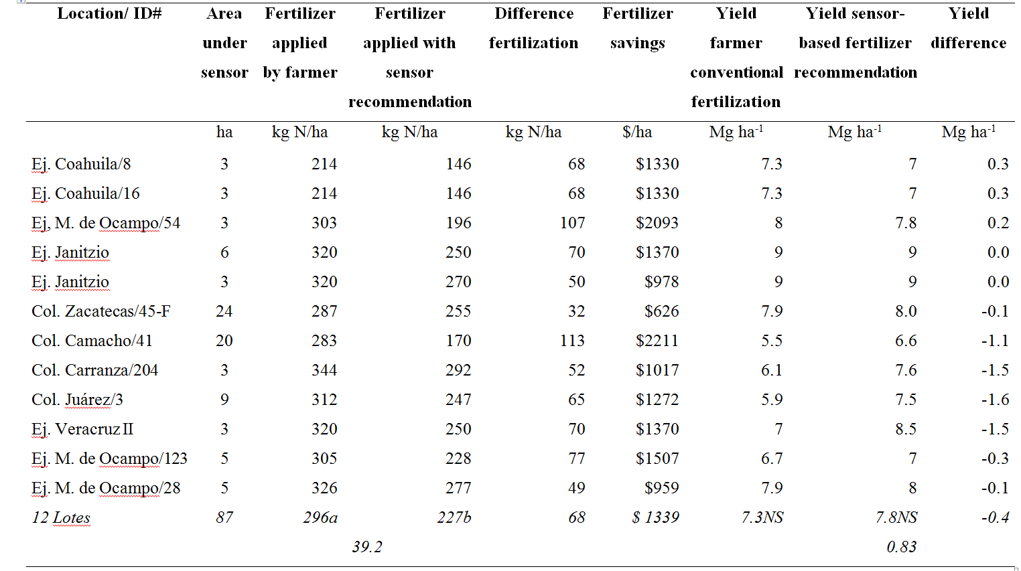
Validation Experiments
2011-2012
ᵻ
Savings of about $ 100 USD/ha
ᵻ Different letters within the same row indicate significant differences, according with the Tukey test (P ≤ 0.05). NS = Non significant (P > 0.05)
Notes:
Click slide.

Slide 22
Validation Experiments
2012-2013
A highly significant difference was found between farmer´s practice and the sensor based fertilization (P < 0.0001). The mean rate used by farmers was 301 kg N ha⁻¹; while with the sensor was 234 kg N ha⁻¹; resulting a in a difference of 67 kg de N ha⁻¹. Furthermore, farmers not participating in SBT applied 313-320 Kg de N ha⁻¹, in which case the difference would be of about 80 kg de N ha⁻¹.
No difference in yield was found between the two fertilizer rates (P = 0.8387). Following the farmer´s practice a yield of 6.14 Mg ha⁻¹ was recorded; while following the sensor recommendation, a yield of 6.07 Mg ha⁻¹ was recorded.
ᵻ

Slide 23
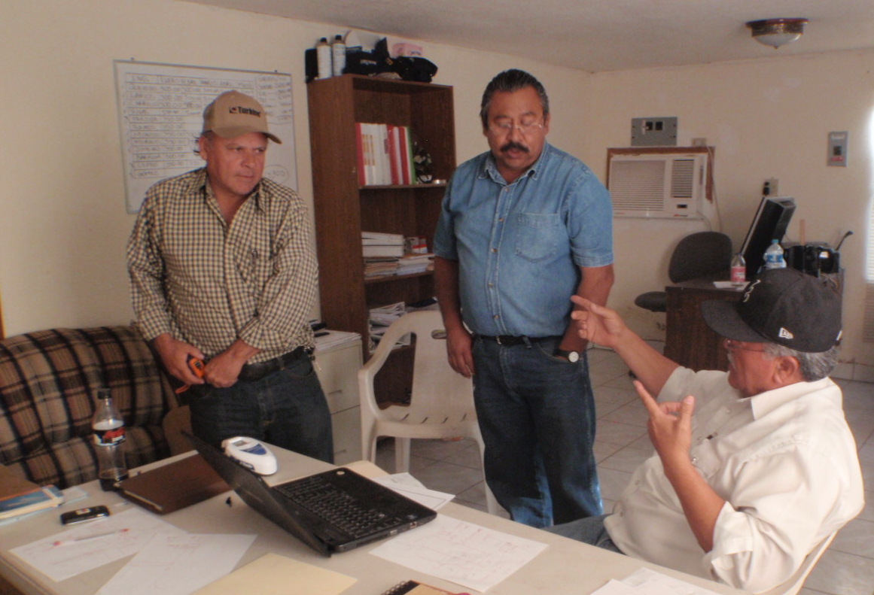
Technology Transfer Process
2013-2014

Slide 24
In 2013-14, more than 5,200 ha (on 314 commercial fields) applied the sensor based fertilizer recommendation*. The mean N rate APPLIED was 260 kg/ha (*from 245 kg/ha RECOMMENDED) and mean yield was 6.6 ton/ha (15 aditional units for peace of mind).
As a reference to assess the magnitude of the advantages of using the GrenSeeker™ technology in our region, consider that the mean yields by traditional fertilization have been 6.5 ton/ha, applying rates from 250 to 320 kg N/ha (or more!, as shown previously).
Thus, yields using the GrenSeeker™ are the same as traditional farmers, BUT the SBF utilized the lower end of the range applied by farmers not using the SBT; with savings of 60-70 kg N/ha; with an additional income of close to $ 100 USD/ha.
These savings of $ 100 USD/ha would substantially close the gap between farmer´s expectations and actual price they are being paid in Baja California, Mexico.

Slide 25
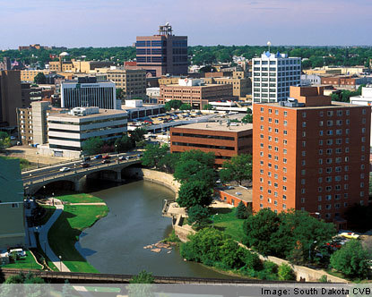
Thank you very much

Slide 26
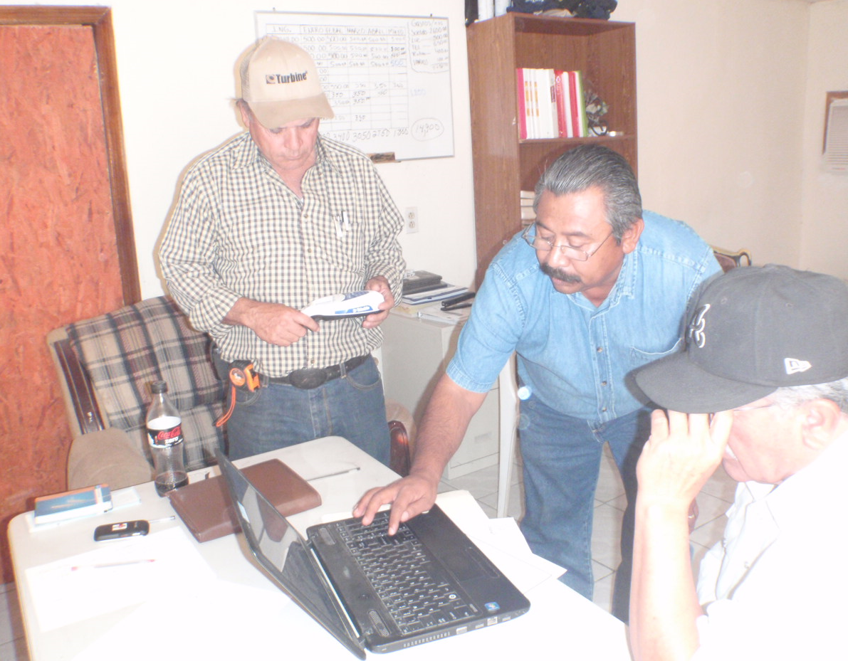
Showing how the algorithm works to a new extension agricultural agent by other fellow agents

Slide 27
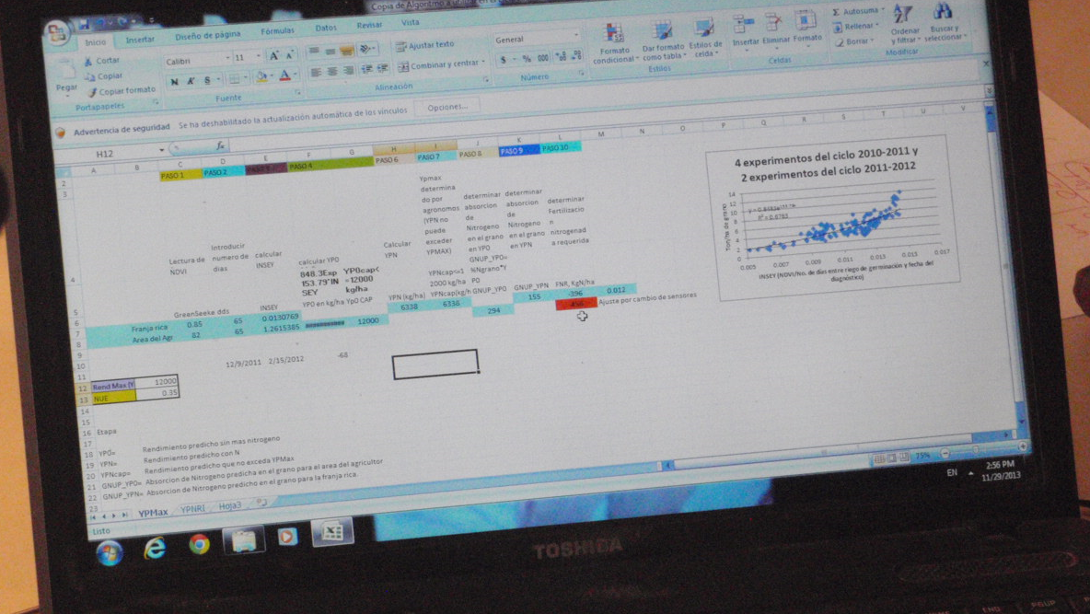
Showing how the algorithm works to a new extension agricultural agent by other fellow agents

Slide 28
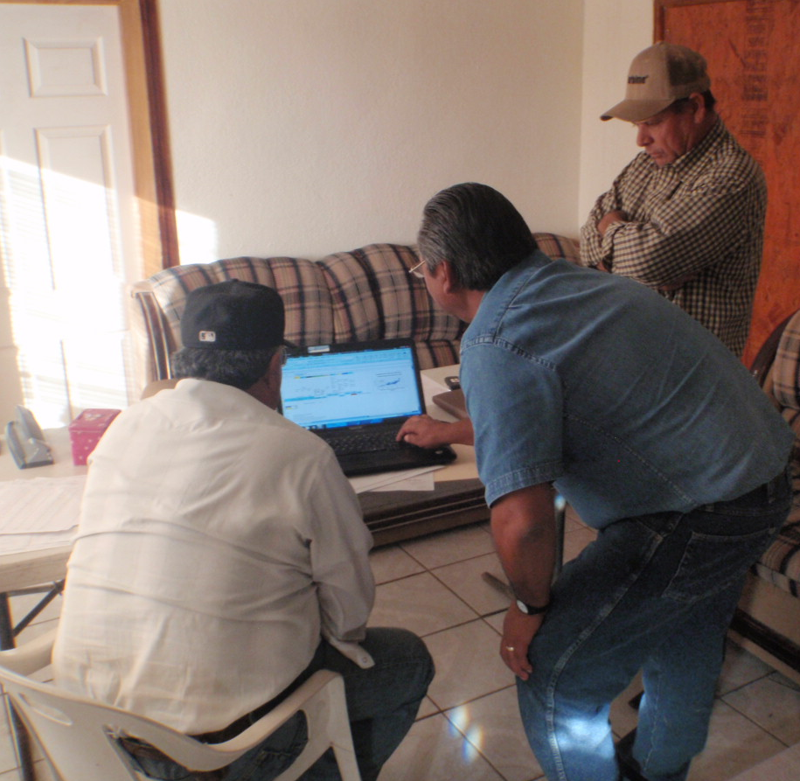
Showing how the algorithm works to a new extension agricultural agent by other fellow agents

Slide 29
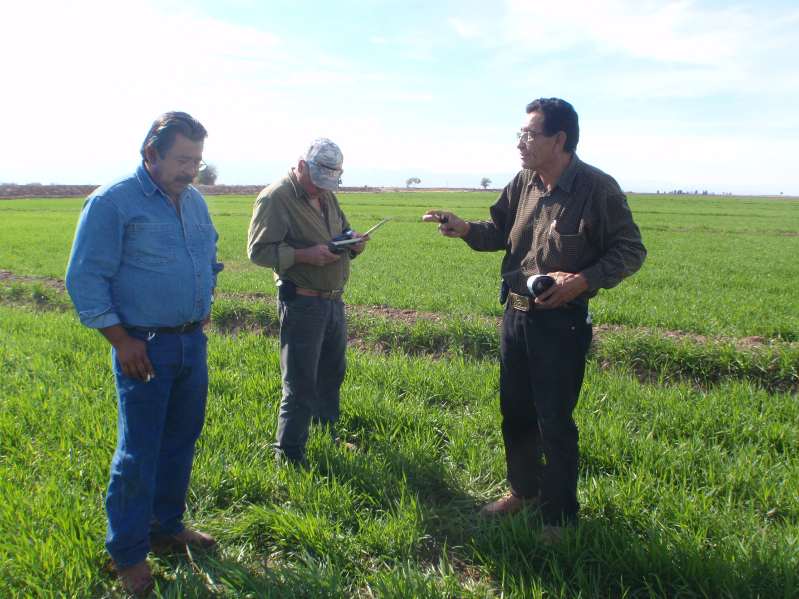
Feedback among extension agricultural agents, about the sensor based technology, right in the field

Slide 30
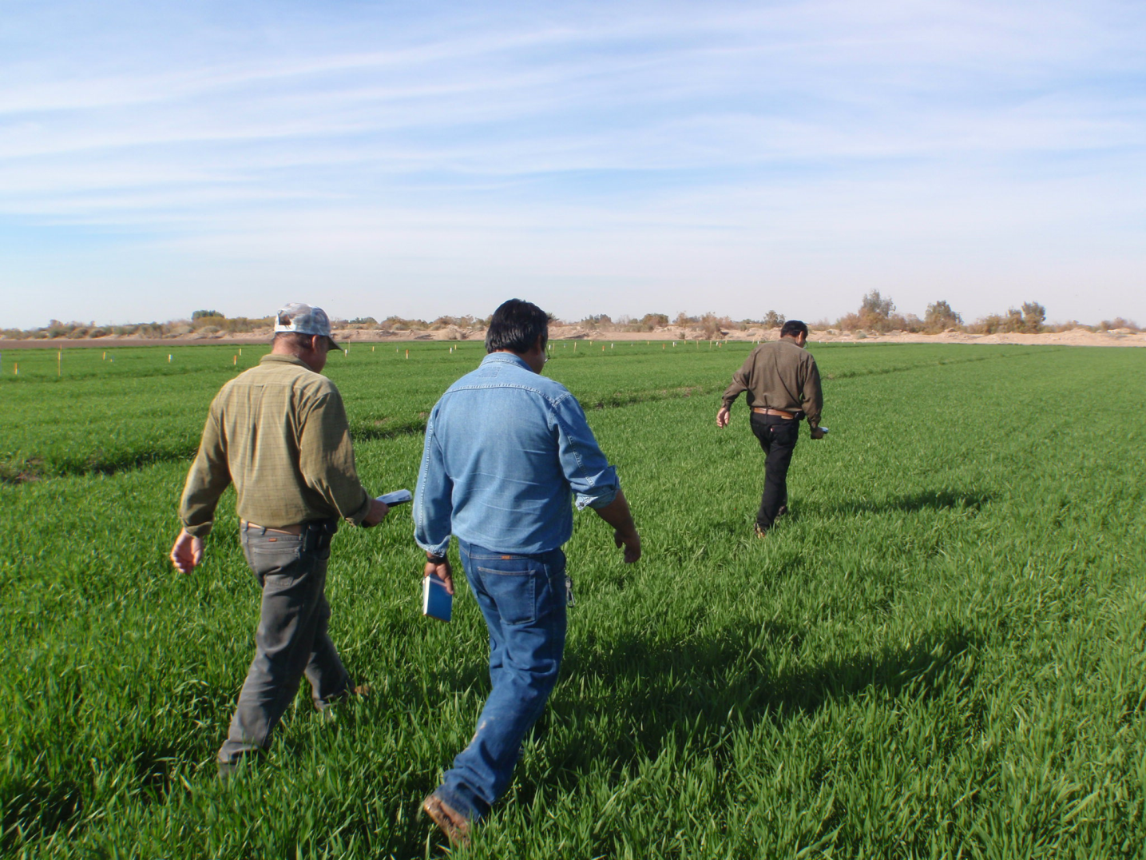
Feedback among extension agricultural agents, about the sensor based technology, right in the field

Slide 31
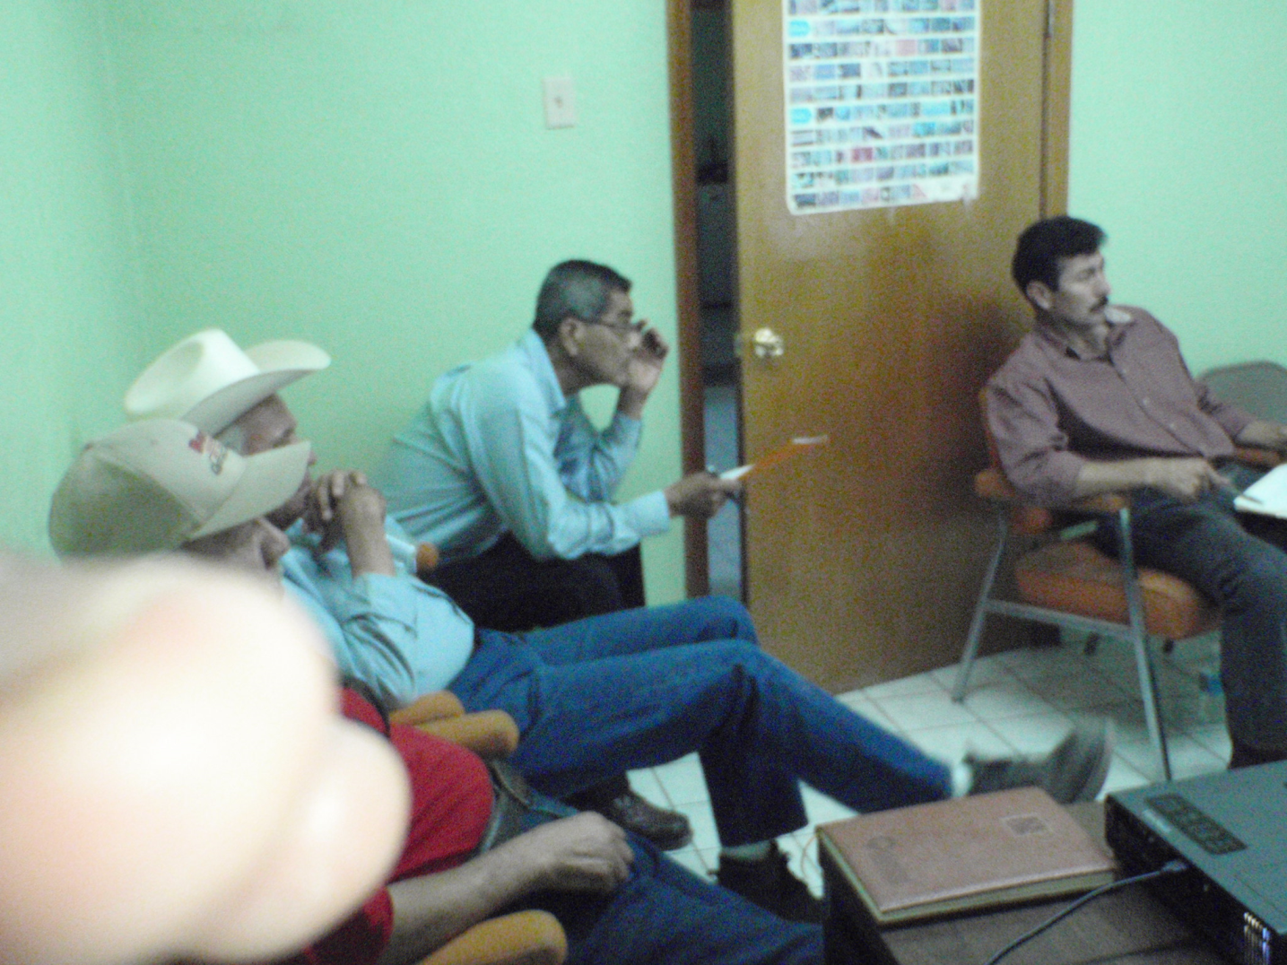
Negative body language from some agents regarding SBT

Slide 32
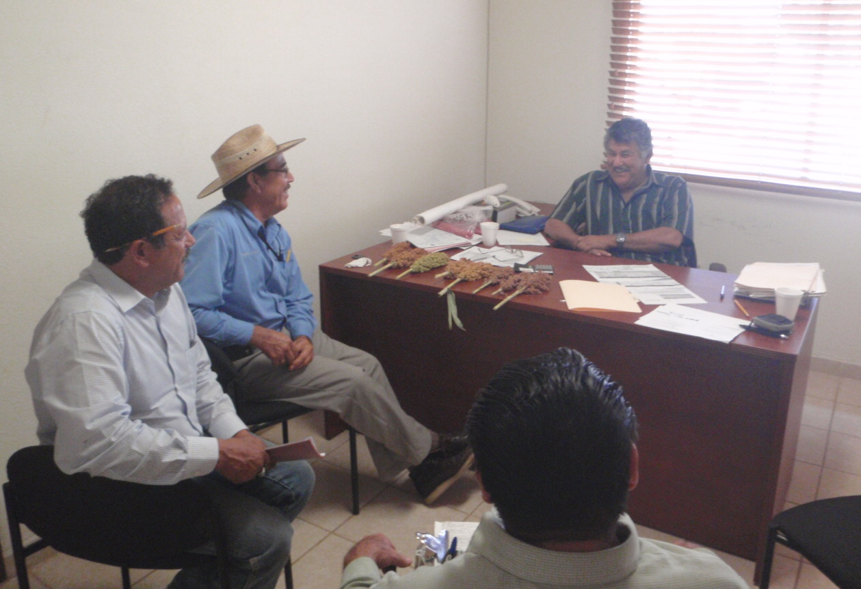
Another group of extension agricultural agents, before starting the past wheat cycle

Slide 33
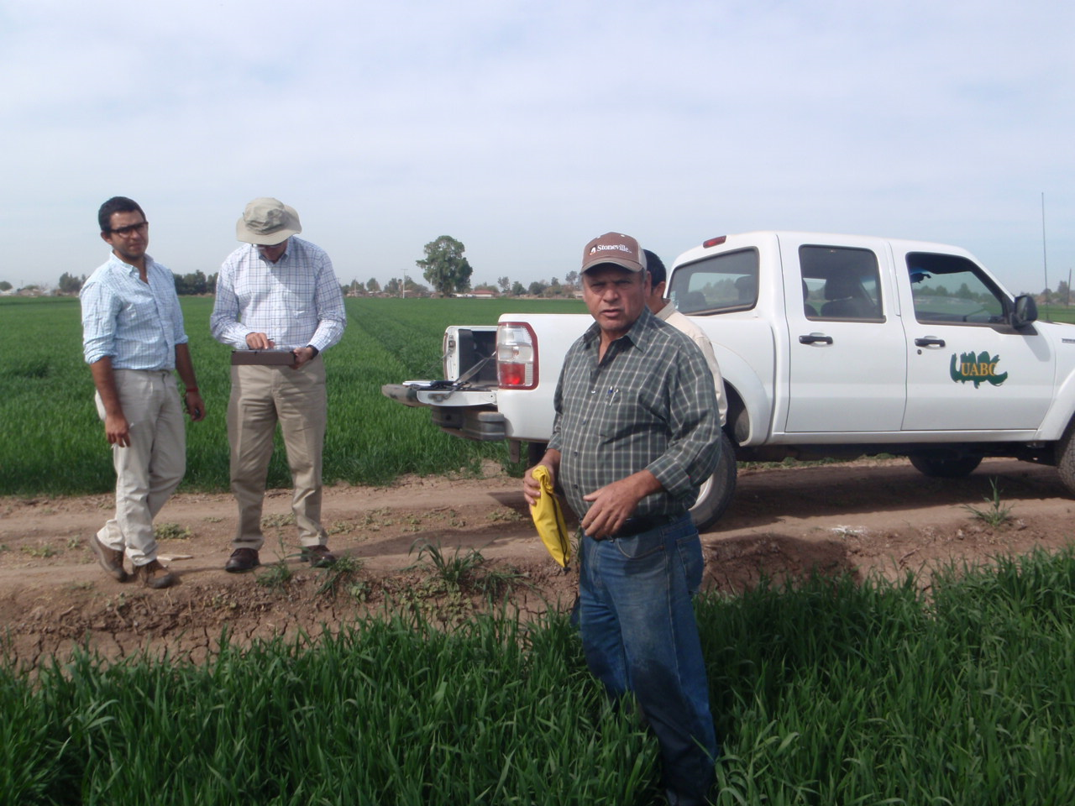
Dr. Ivan Ortiz-Monasterio, from CIMMYT, supervising the technology transfer process in Mexicali

Slide 34
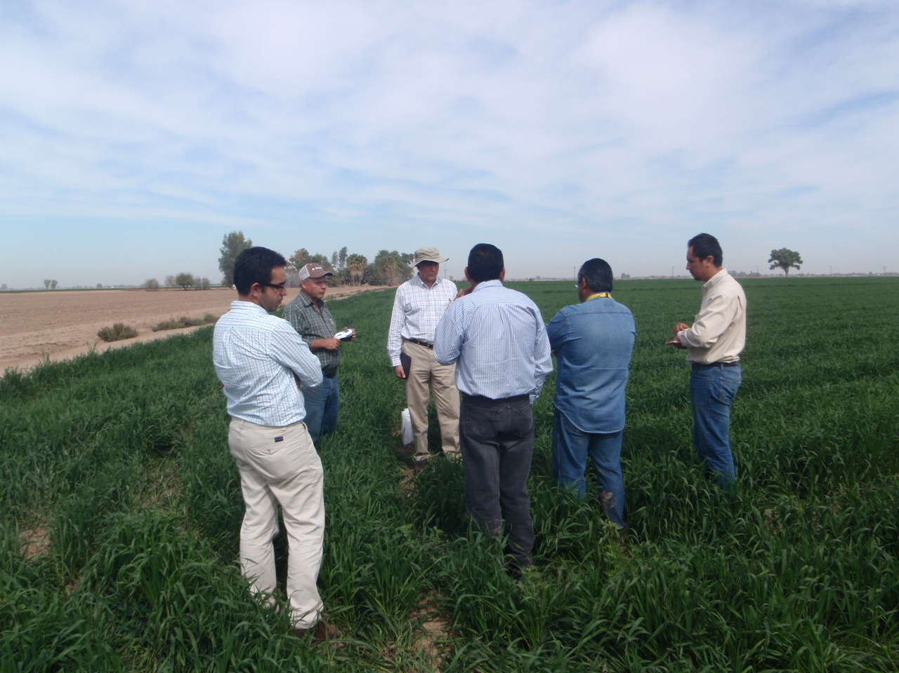
Dr. Ivan Ortiz-Monasterio, from CIMMYT, supervising the technology transfer process in Mexicali

Slide 35
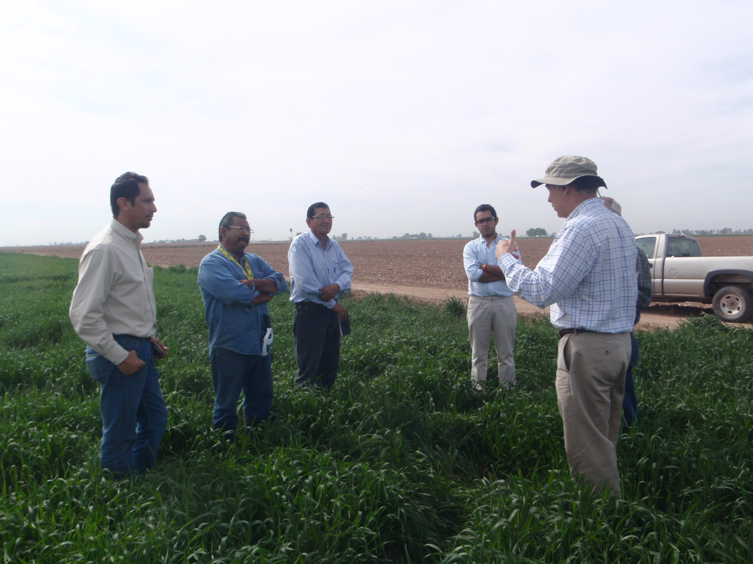
Dr. Ivan Ortiz-Monasterio, from CIMMYT, supervising the technology transfer process in Mexicali

