Slide 1
Algorithm Development and Sensor Based Nitrogen Research in Kansas
Ray Asebedo and Dave Mengel
Department of Agronomy
Kansas State University

Slide 2
Objectives of KSU Soil Fertility Sensor Research
Develop nutrient management systems that effectively capture the relationship between the crop, soil, and environment
Currently working on N algorithms for Winter Wheat, Corn, Grain Sorghum
N Recommendations made from these systems must be economically sound and environmentally friendly
These systems must be easily incorporated into existing farmer practices and address farmers needs

Slide 3
Factors Affecting Algorithm Design
Crop Physiology: Yield Factors and the stage of development when they occur
    Winter Wheat: tillers/plantpop, head size, grain fill
    Corn: plant pop, ear size, grain fill
    Grain Sorghum: tillers/plantpop, head size, grain fill
Soil and Weather
  N Mineralization potential
  N loss potential
  Precipitation, temperature
    What can the local environment actually support consistently? 80 bushel wheat or 45 bushel?
Farmer and Consultant Needs

Slide 4
Current Algorithm Components
Biomass Optimization
  Water and Nutrient Efficiency
Yield Potential Determination
Nitrogen Response/Recoverable Yield
Agronomic Efficiency(lb N/bu)
Nitrogen Recovery Efficiency
Single N Application at Feekes 4
Multiple N Application Feekes 4-9

Slide 5
Current Algorithm Components
Biomass Optimization
Yield Potential Determination
Nitrogen Response/Recoverable Yield
Agronomic Efficiency(lb N/bu)
Nitrogen Recovery Efficiency
Single N Application at Feekes 4
Multiple N Application Feekes 4-9

Slide 6
How do we address these factors?

Slide 7
Winter Wheat and N Managment
Feekes 4 (Spring green up)
  Head size determination at Feekes 5.
  Difficult to assess N mineralization.
Feekes 7 (Two nodes visible on stem)
  Rapid vegetative growth, potential for tiller abortion due to N stress.
  Easier to assess N mineralization.
Feekes 9 (Flag leaf)
  Maintain yields, address late season N loss.
  Increase grain N/protein

Slide 8
Making a Plant Factory that Fits the Environment for Efficient Yield
Common issue in Kansas is Farmer induced mega plant factories.
  Why? Because big plant factories look good and is good talk at the coffee shop
  More Kansas Farmers believe “More” will get you “More” yield. Which isn’t an uncommon human characteristic
Addressing undersized factory in early spring
  Common in Kansas to be dry in the late fall and winter. Poor fall tillering

Slide 9
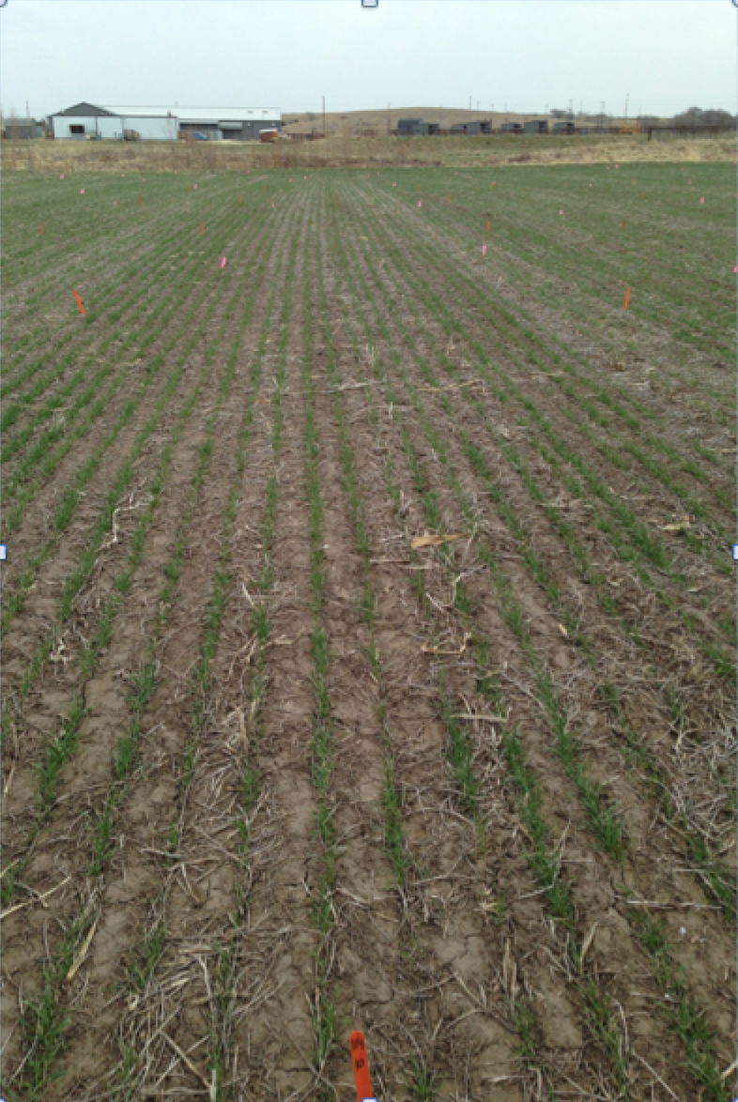
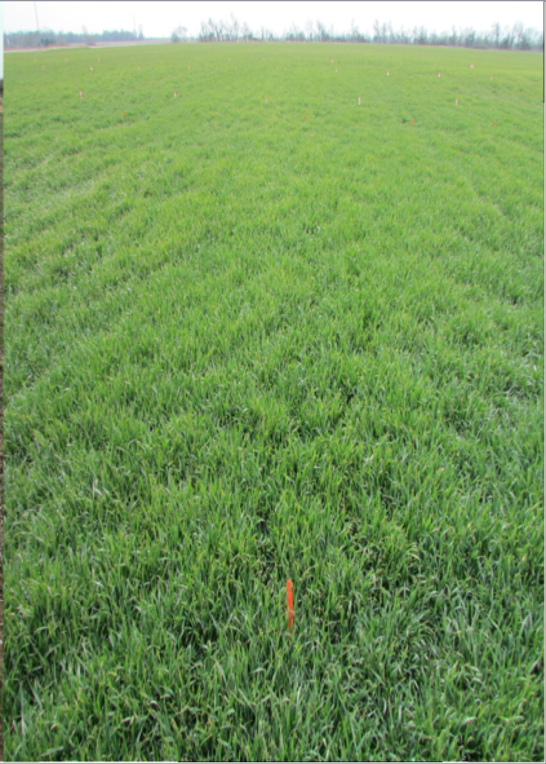
Winter Wheat, Feekes 4
Manhattan, KS
Red NDVI = 0.20
Pittsburg, KS
Red NDVI = 0.87

Slide 10
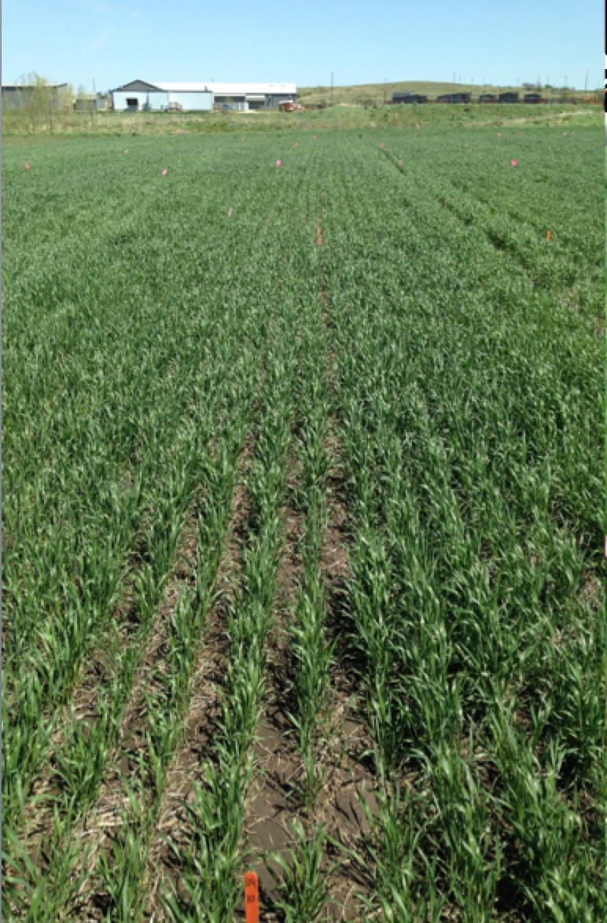
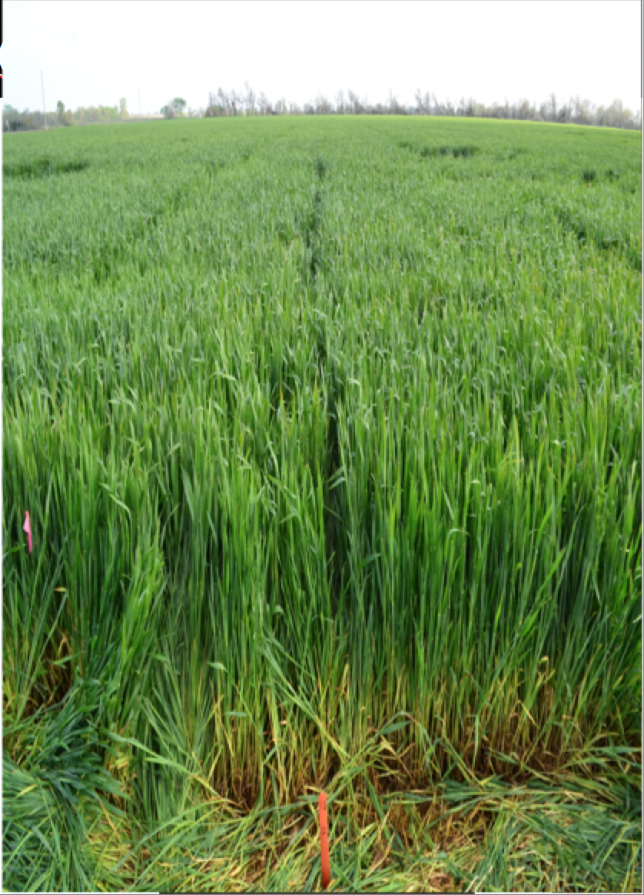
Winter Wheat, Feekes 9
Manhattan, KS
Red NDVI = 0.65
Yield = 60 bushel/acre
Pittsburg, KS
Red NDVI = 0.87
Yield = 60 bushel/acre

Slide 11
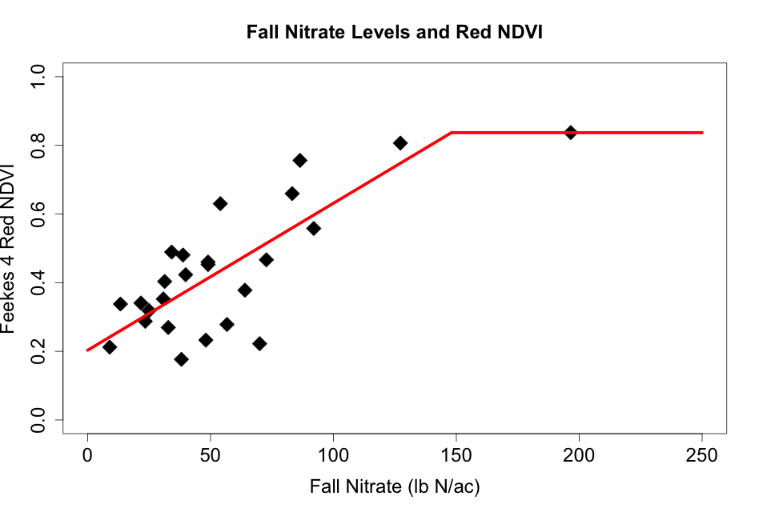
Winter Wheat No N Applied, Feekes 4
Intercept = 0.20
Plateau = 0.83

Slide 12
Winter Wheat No N Applied, Feekes 4

Slide 13
Winter Wheat Tillers, Feekes 4
Seeding Rates 90-120 lb/ac, 7.5 inch rows, Fall Applied N Rates 0-150 lb/ac

Slide 14
Winter Wheat No N Applied, Feekes 4

Slide 15
Winter Wheat No N Applied, Feekes 4
High N and Sufficient Water:
High Fall Tillering
Excessive biomass production
N and/or Water Stress:
Poor Fall and Spring Tillering
Head Size Reductions

Slide 16
Winter Wheat No N Applied, Feekes 4
Poor Fall Tillering Corrected with Spring Tillering and Head Size Maximized:
N and/or water applied
High N and Sufficient Water:
High Fall Tillering
Excessive biomass production
N and/or Water Stress:
Poor Fall and Spring Tillering
Head Size Reductions

Slide 17
Winter Wheat No N Applied, Feekes 4
N and Water Sufficiency for adequate Fall and Spring Tillering, additional N needed for maximizing grain yield
Poor Fall Tillering, Correction with Spring Tillering and Head Size Maximized:
N and/or Water Supplementation needed
High N and Sufficient Water:
High Fall Tillering
Excessive biomass production
N and/or Water Stress:
Poor Fall and Spring Tillering
Head Size Reductions

Slide 18
Winter Wheat No N Applied, Feekes 4
Difficult area for N recommendations and N Ref Strip is no help if water stress is also observed

Slide 19
Winter Wheat Yield Potential

Slide 20
Winter Wheat Yield Potential
Excess biomass:
Lodging, Disease,
Water Stress
Sign of high N in soil
Very low biomass:
Stable, low to moderate Yield
Can’t Capitalize on favorable years

Slide 21
Winter Wheat Yield Potential
Working Biomass Range

Slide 22
Winter Wheat Yield Potential
Kansas
West/ Central
Northeast
South
east

Slide 23
How is this Data Utilized
Feekes 4 Red NDVI readings give us an approximation of how much Fall profile N is needed to produce a given Red NDVI/biomass
  Farmer will need to know how much N to apply in the Fall to achieve recommended factory size, soil sample if possible
Providing a drought does not occur in the season, this data using Red NDVI provides us with a baseline obtainable yield if no additional N is applied.
With an additional component that has been developed, Algorithm functions without N reference strip

Slide 24
Manhattan, 2013
High Productivity Bottom Ground, Poor Fall Tillering, Yield Goal = 60 bu/ac
120 lb N
No N Ref
80 lb N
82 lb N
110 lb N

Slide 25
Manhattan, 2013
Water Stressed High Ground, No Fall Tillering, Yield Goal = 60 bu/ac
120 lb N
109 lb N
110 lb N
No N Ref
89 lb N

Slide 26
Solomon, 2013
Low Soil Profile N, dry, Poor Fall Tillering, Yield Goal = 60 bu/ac
No N Ref
120 lb N
70 lb N
77 lb N
73 lb N

Slide 27
Ancillary Data to be Incorporated
Soils in Kansas classified for potential N leaching and denitrification throughout the state, automated N recovery efficiency adjustments
Weather data
Adjust N recommendation within its confidence interval based on grain:N price ratio

Slide 28
Future Development:
Moving Beyond Nitrogen
With improved sensor capabilities and merging ancillary data, expand algorithms to identify other nutrient deficiencies and make recommendations

Slide 29
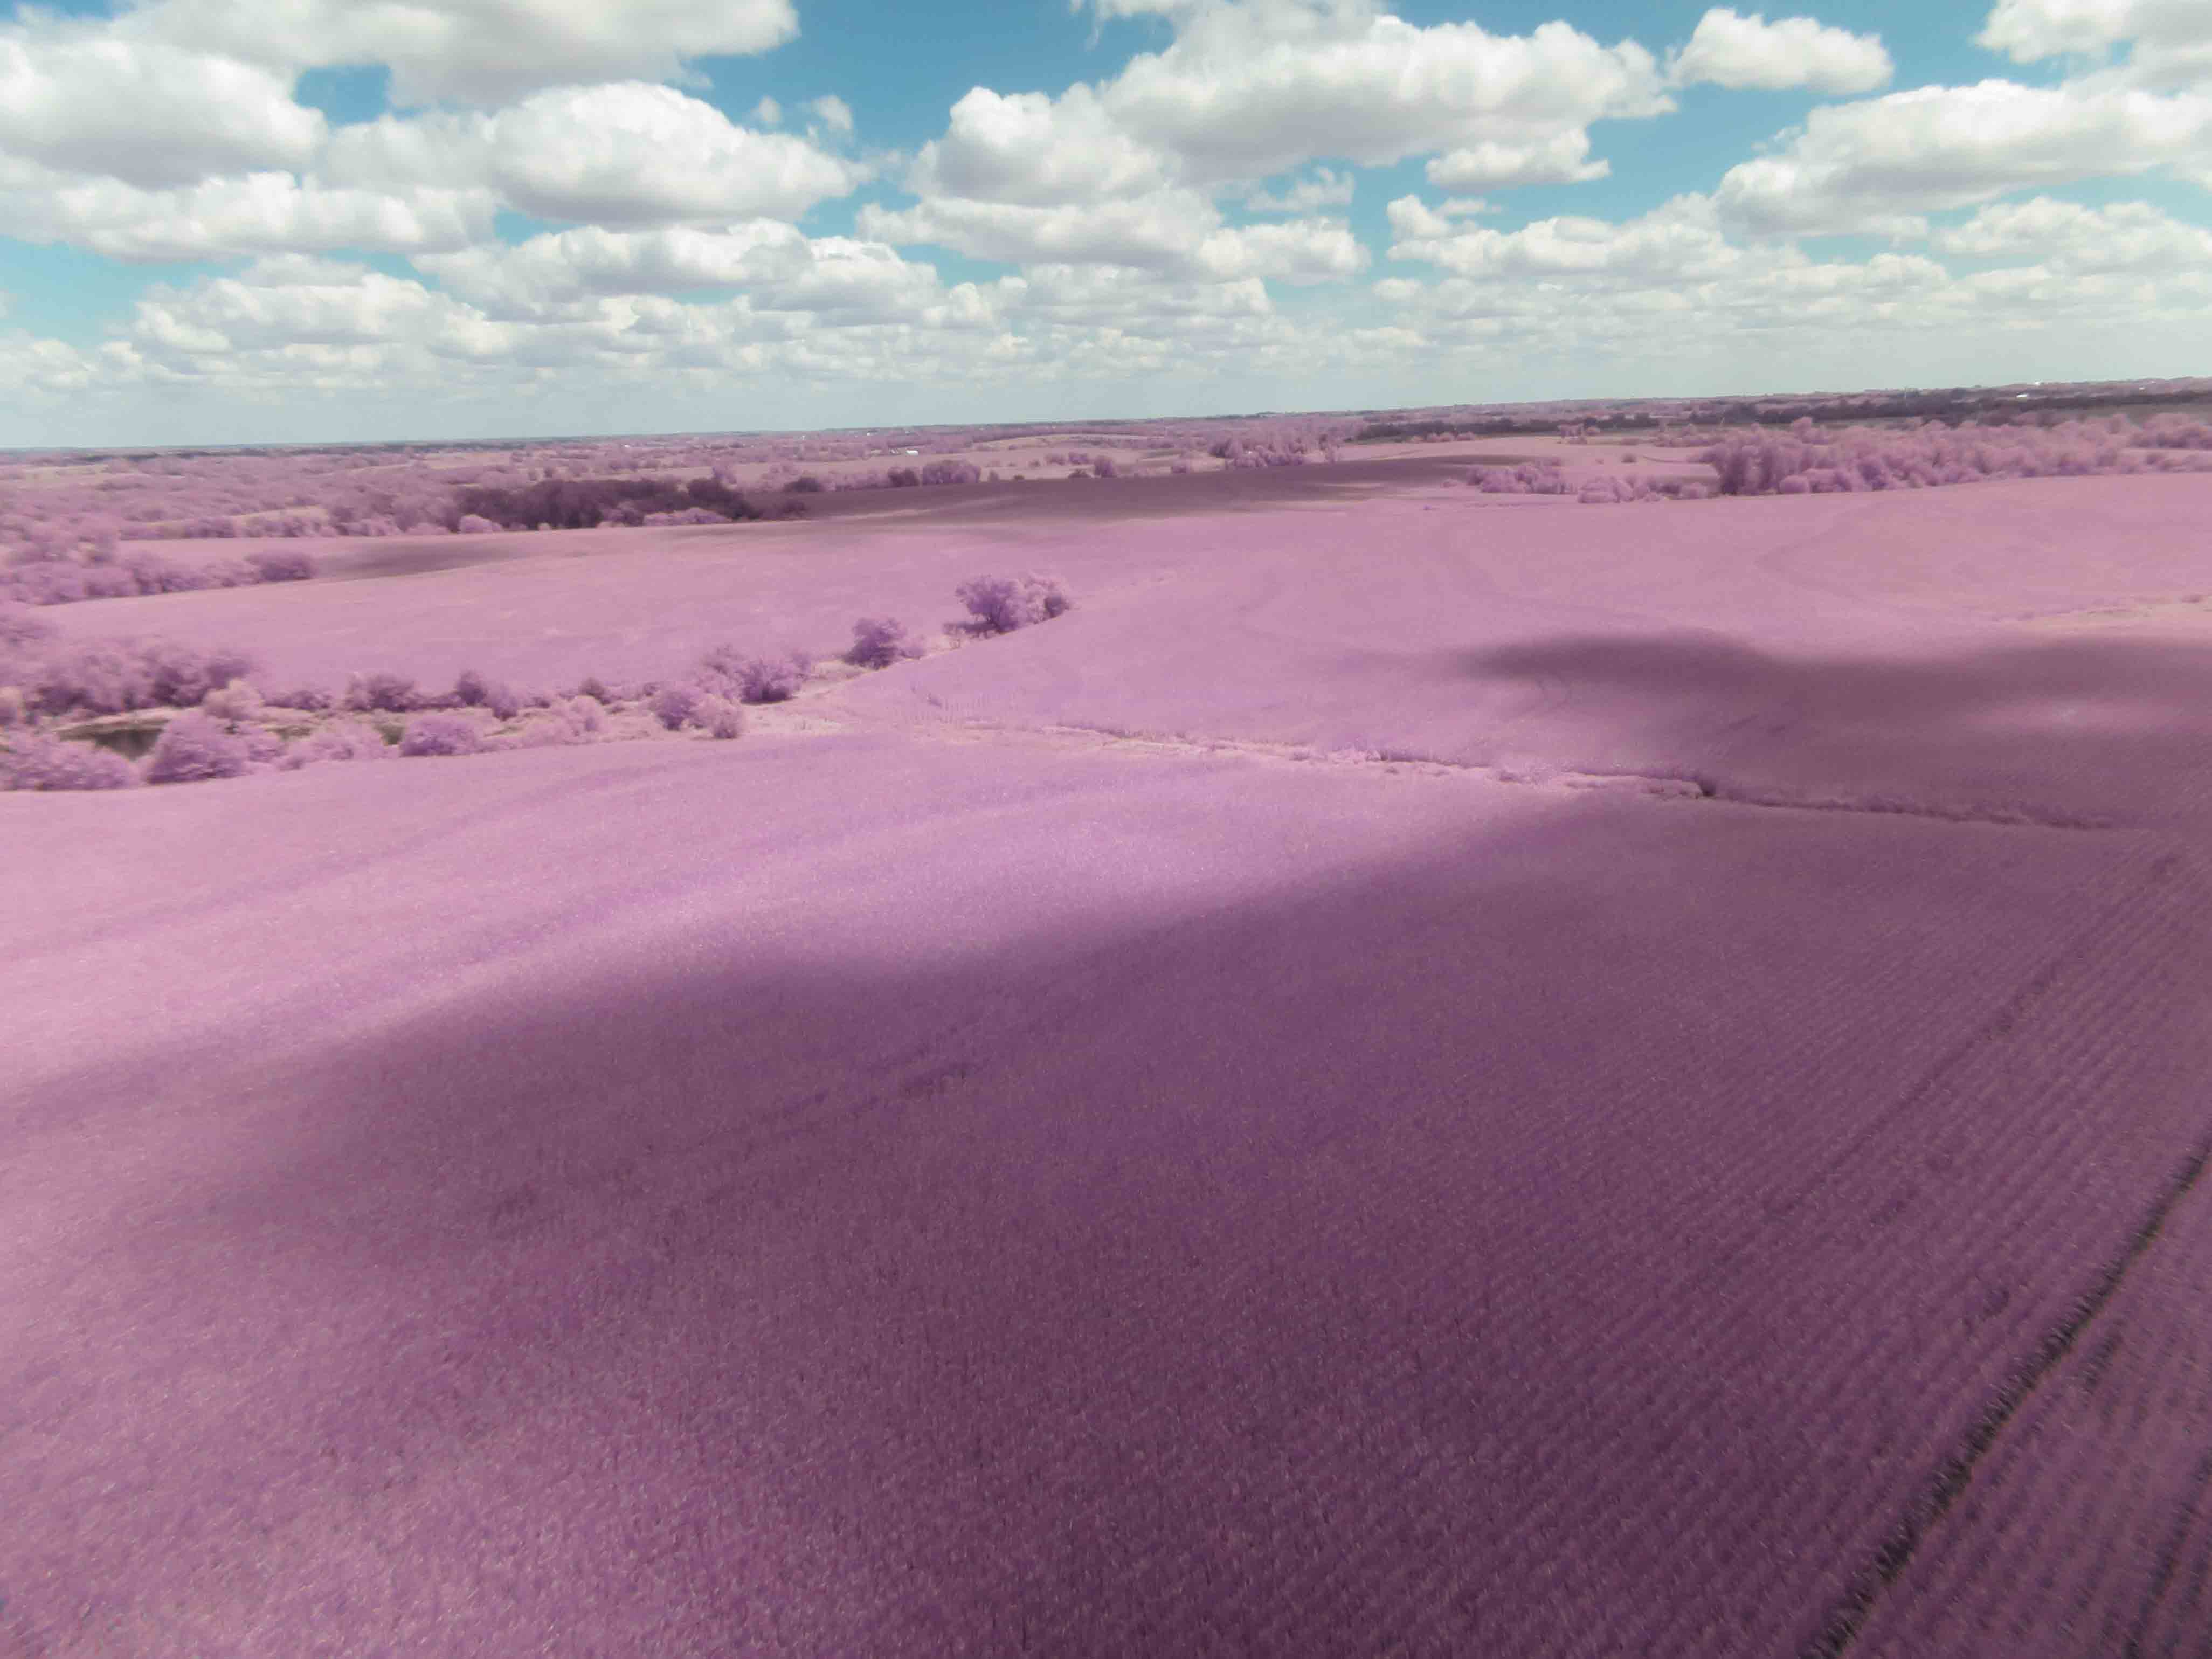
Questions

