Slide 1
From Precision to Decision:
Transforming the Crop Cycle
Russ Linhart
GreenSeeker Sales Specialist
Russ_linhart@trimble.com

Slide 2
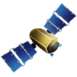

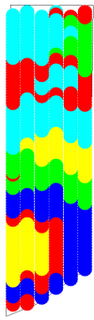


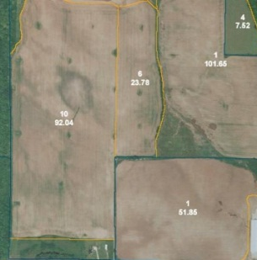
What is Precision Agriculture?
The big picture in detail…
Global positioning
Intelligent equipment
Aerial imagery
Managing resources
Inches
Feet
Miles

Slide 3
GreenSeeker Technology Update
Trimble realizes that there are several areas of opportunity to bolster sensor based nitrogen rate control implementation
Integrated several new technologies to add to the information needed to make intelligent cropping decisions.

Slide 4
Factors Affecting Nitrogen Management
Soil
  Chemical and Physical Properties
  Soil Zones
Weather
  Precipitation
Access to sensor data
  In crop sensing is not always practical
Data Handling
  How to move and disseminate data.

Slide 5
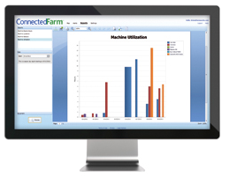

Innovations that simplify operations and increase the profitability of farms throughout the world.
The farm of the future needs to:
  Optimize yields for profit
  Optimize for weather
  Optimize the control of inputs
  Complete tasks quickly by coordinating assets
  Record and report all tasks carried out
  Reduce labor costs
How will they do this?
  Connecting the activities of the entire crop cycle
  Reducing environmental impacts through sustainable agricultural practices
  Utilizing data to create informed decisions
Return on Investment - ROI
  Improving the utilization of all inputs and assets
Notes:
Maintaining soil moisture and working at optimum moisture windows

Slide 6
Transforming The Crop Cycle
Precision Agriculture is a technology solution that transforms the crop production cycle, driving efficiency, sustainability and profitability while protecting the environment.

Slide 7
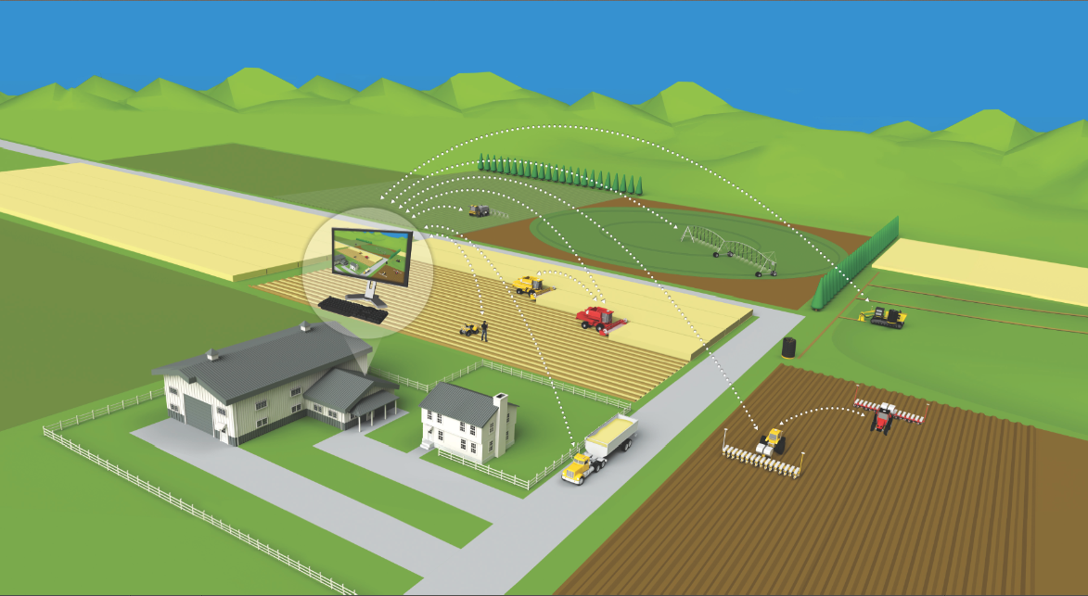


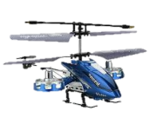
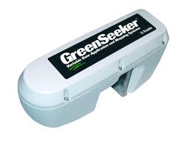


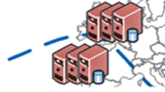

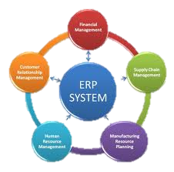
From Precision to Decision
Mobile Applications
Aerial Imagery
Global positioning
Field sensors
Smart Sprayers
Mobile Office
IQ Irrigation
Smart Harvesters
Smart Drainage
Mobile Office
Logistics tracking
Smart Planters

Slide 8
Soil Information System
SIS

Slide 9
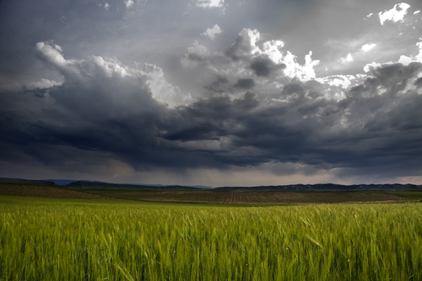
RainWave®
… is the first company to accurately deliver nationwide rainfall information to a point based upon latitude and longitude.

Slide 10
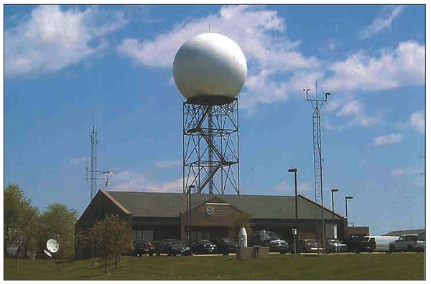
RainWave®
…takes ¹Doppler data, processes through our ²proprietary software then ³manually checks prior to delivering data.

Slide 11
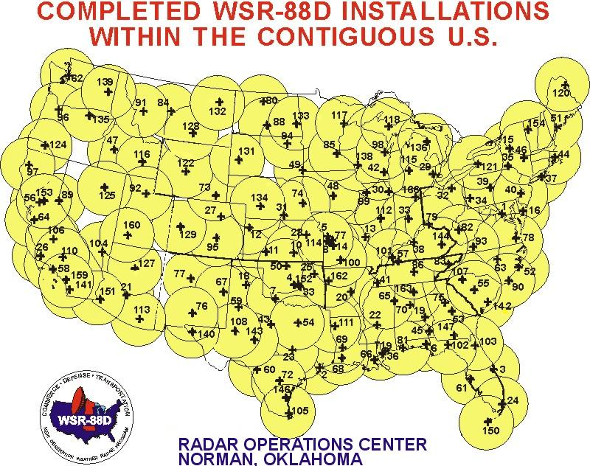
Doppler Radar Coverage

Slide 12
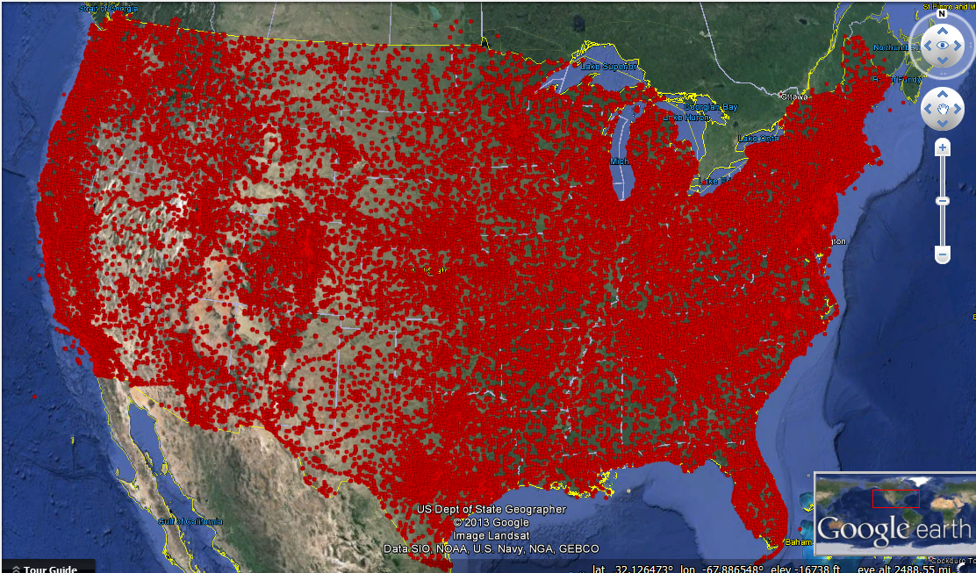
Quality Control

Slide 13
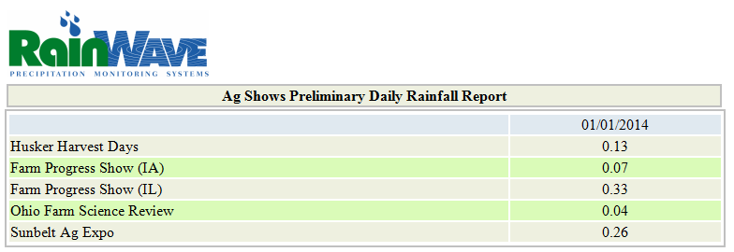
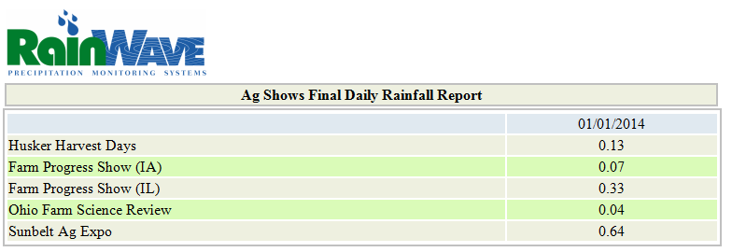
Deliverables
Daily (5:00AM and Noon)

Slide 14
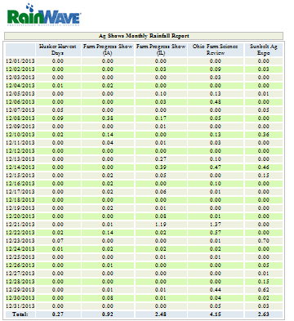
Deliverables
Monthly

Slide 15
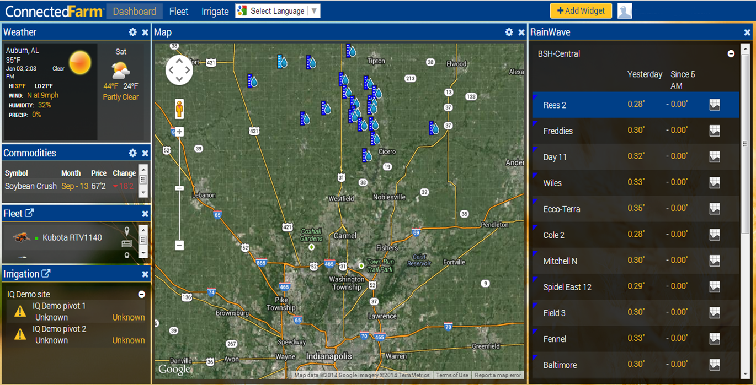
Connected Farm™ Dashboard
RainWave Point(s)
Notes:
Expanding on a region, we see rainfall on each of the fields.

Slide 16
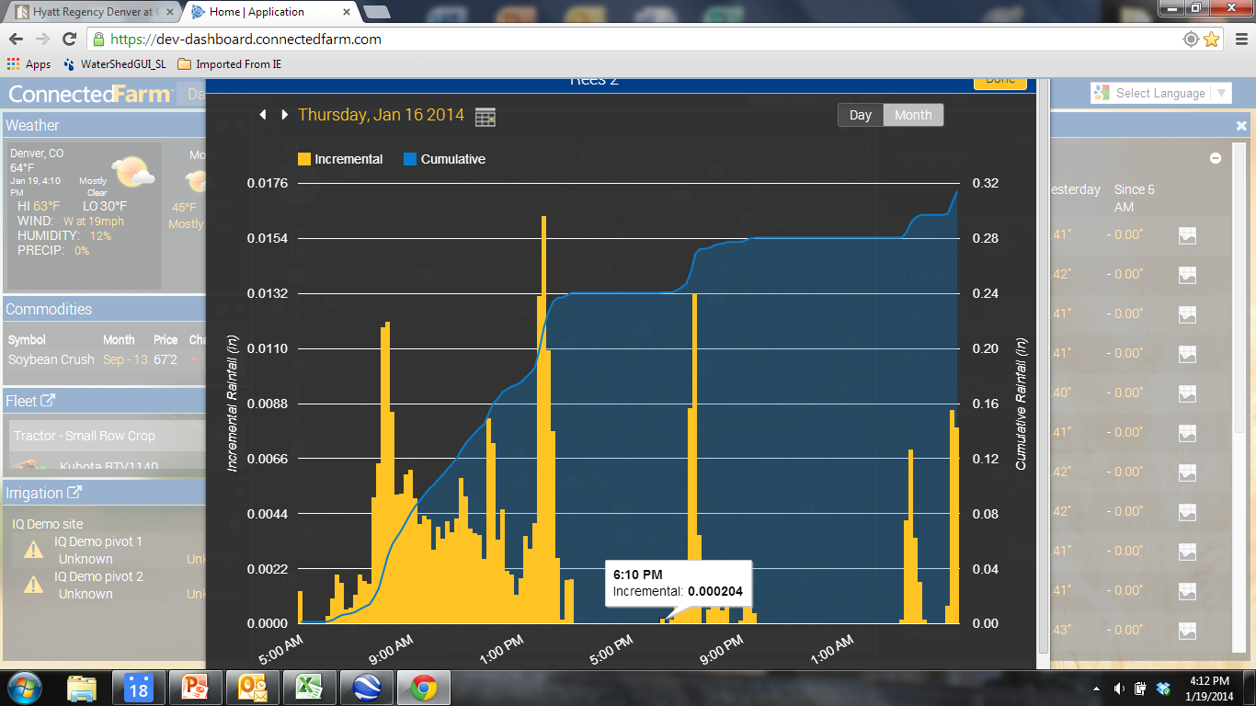
Connected Farm™ Dashboard
Notes:
Touching the graph icon shows the rainfall in 10 min increments.
This adds value in the following areas:
1. effective rainfall.
2. forensics
a. did the herbicide application wash off prior.
b. did I receive rainfall during a critical growth stage.

Slide 17
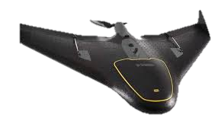
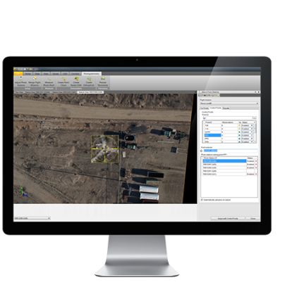
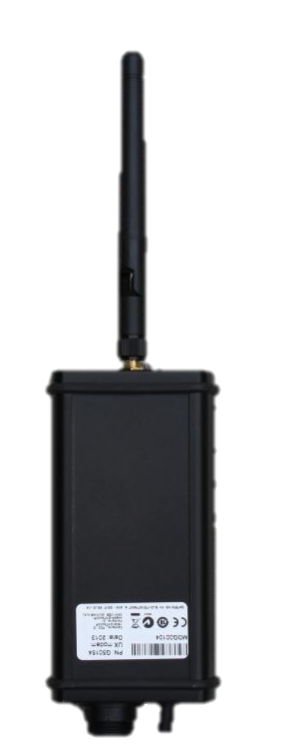
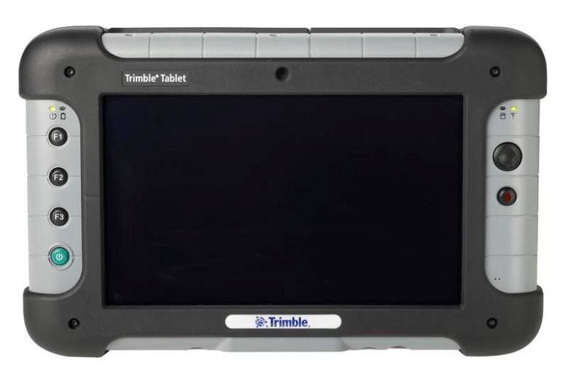
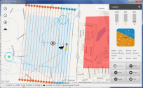
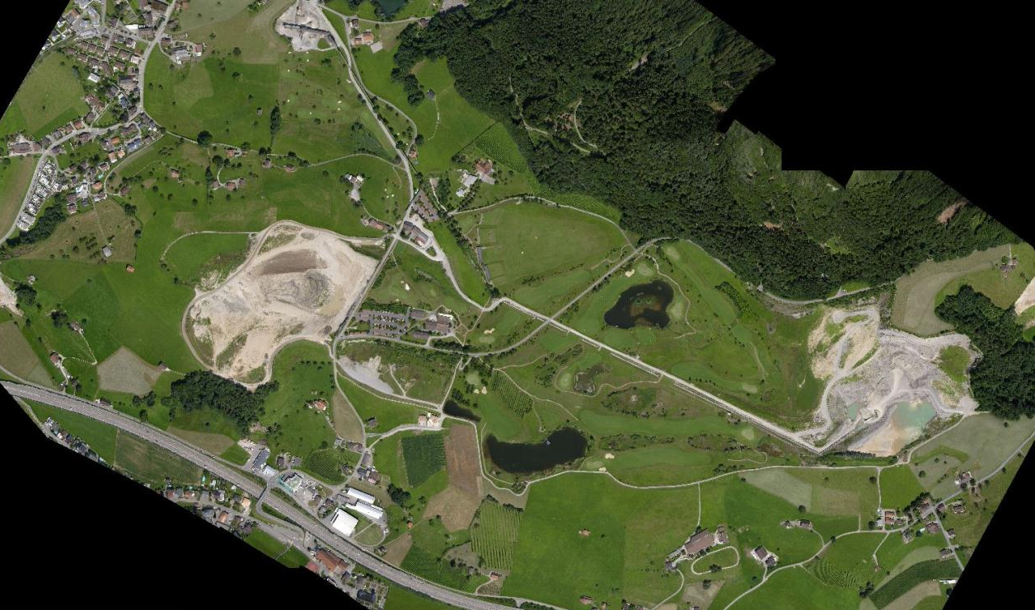
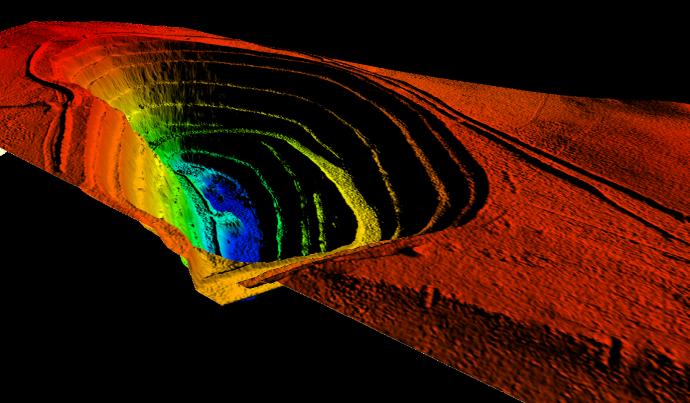
Trimble UX5 UAV
Agricultural Applications
Crop Scouting
Topographic map generation
Boundary surveys
Resource monitoring
Site planning
The Trimble Solution
Mission & flight planning
Image acquisition & flight monitoring
Image processing & creating deliverables

Slide 18
PurePixel

Slide 19
About
PurePixel
  Innovative strategy for processing multispectral imagery
  Input from satellites, fixed wing aircraft, and UAVs
Precision Vegetation Vigor Index (pVVI)
  Advanced vegetation index for precise crop health assessment
  Major differentiators - noise-filtered, calibrated
  Enables analytics

Slide 20
pVVI Difference – Noise Filtering
Standard vegetation indices are influenced by factors that mask the true vegetation signature
  Soil moisture → greater moisture elevates index
  Soil color → darker colors elevate index
  Soil organic matter → higher levels elevate index
  Shadows → presence elevates index

Slide 21
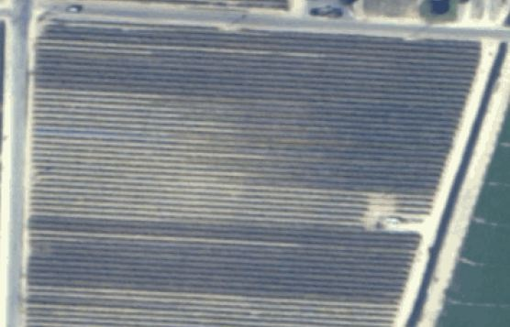
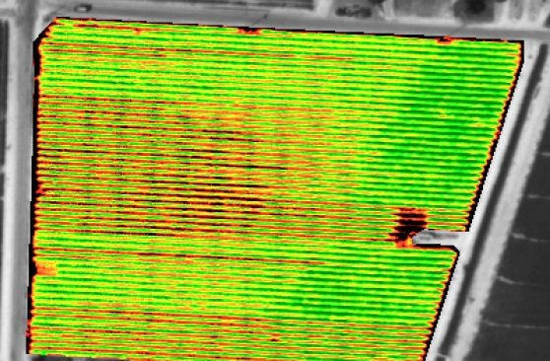
pVVI Difference – Noise Filtering
Example: irrigation patterns in standard vegetation index
Wet →
Dry →
Wet →
Dry →
Natural color
Standard vegetation index
PurePixel filters the noise from background variability to provide an accurate account of the canopy signature

Slide 22

pVVI Difference - Calibration
Uncalibrated
index
Weakest
vegetation
present
Strongest
vegetation
present
pVVI
1
Low crop vigor/
young crop
60
Moderate crop vigor/
Moderate crop maturity
120
High crop vigor/
mature crop
If full spectrum of data values exists in a field pVVI and an uncalibrated index will look the same (this condition is unlikely)

Slide 23
pVVI Difference - Calibration
Field with generally young crop or poor health
Compress scale to fit data
Uncalibrated
index
Weakest
vegetation
present
Strongest
vegetation
present
Fit data to consistent scale
pVVI
1
Low crop vigor /
young crop
60
Moderate crop vigor/
moderate crop maturity
120
Strong crop vigor/
mature crop
Range of data values in field
In real world situations pVVI better represents actual data values vs. an uncalibrated index

Slide 24
pVVI Difference - Calibration
Field with generally mature crop or strong health
Compress scale to fit data
Uncalibrated
index
Weakest
vegetation
present
Strongest
vegetation
present
Fit data to consistent scale
pVVI
1
Low crop vigor/
young crop
60
Moderate crop vigor/
moderate crop maturity
120
Strong crop vigor/
mature crop
Range of data values in field
In real world situations pVVI better represents actual data values vs. an uncalibrated index

Slide 25
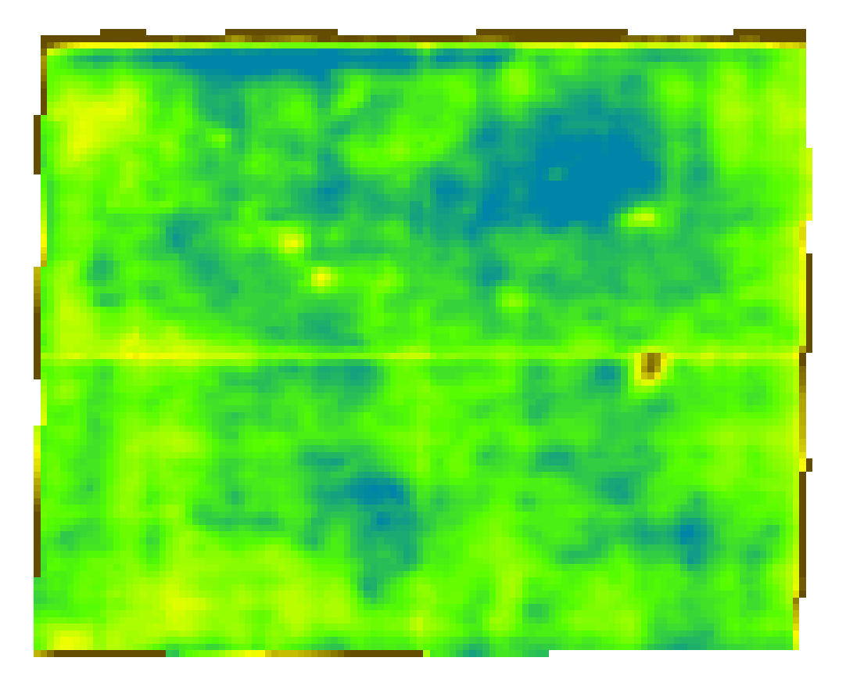
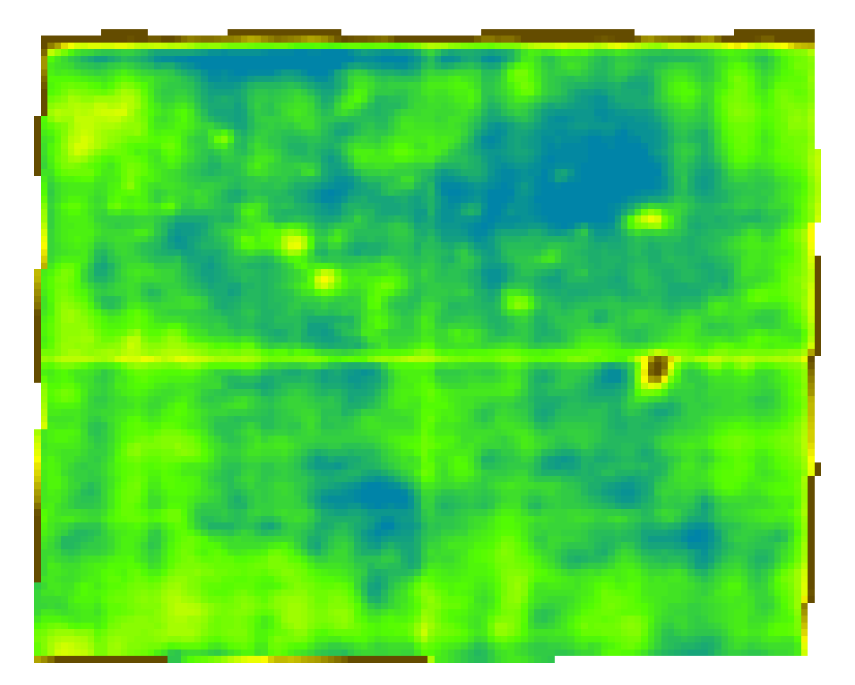
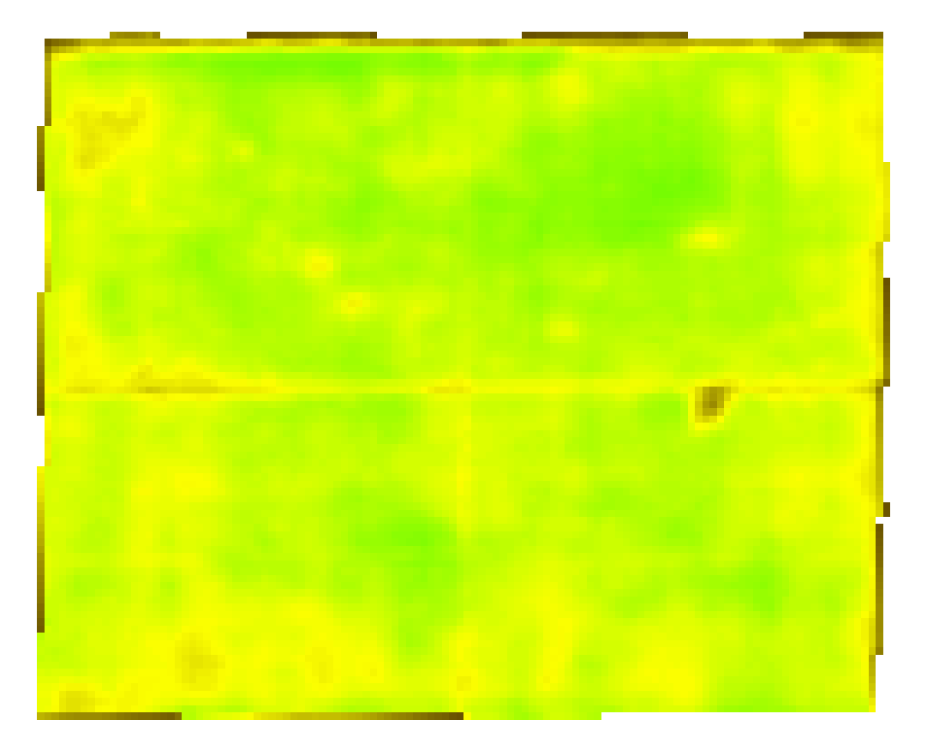
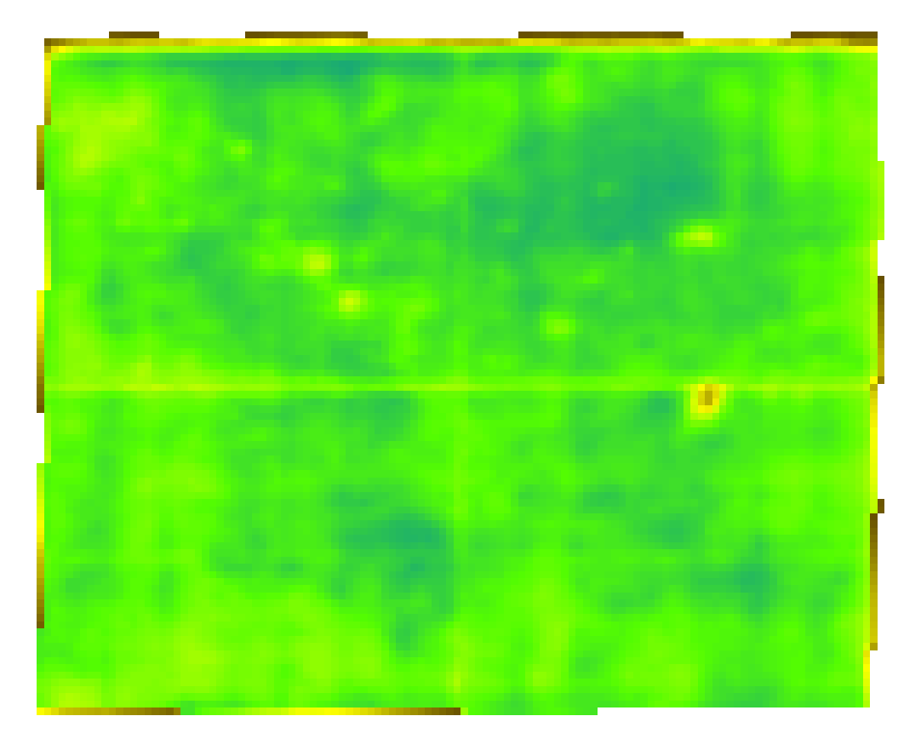
pVVI Difference - Calibration
Tracking crop health through the season
Early season
Late season
Uncalibrated
index
pVVI

Slide 26
pVVI Difference
Attribute | pVVI | NDVI
Can use imagery collected with satellite, fixed-wing aircraft, or UAS based sensors | Yes | Yes
Produces vegetation index maps for analyzing crop health | Yes | Yes
Filters noise from variable soil properties and moisture conditions to improve vegetation index accuracy | Yes | No
Creates calibrated maps for precise assessment of vegetation health | Yes | No

Slide 27
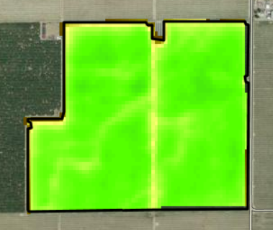
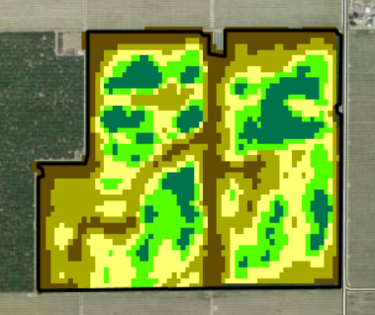


pVVI Map Types
Vegetation Index - Natural
Vegetation Index - Clustered
Absolute scale showing true state of crop health
Percentile buckets to accentuate the crop healthy variability within a field

Slide 28
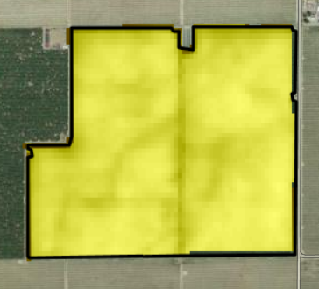
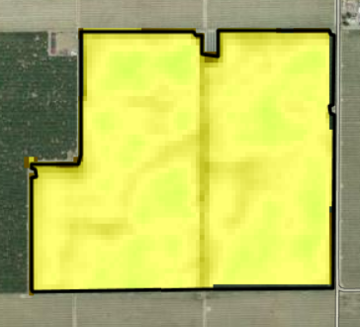
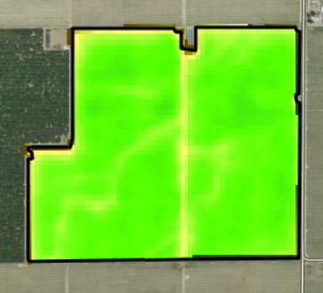
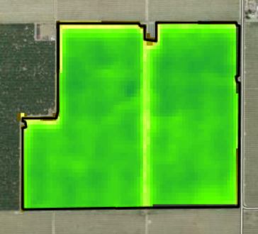
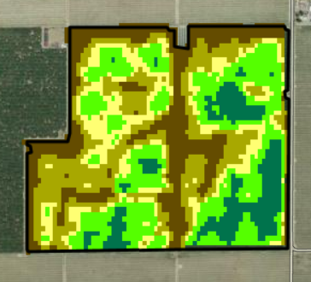
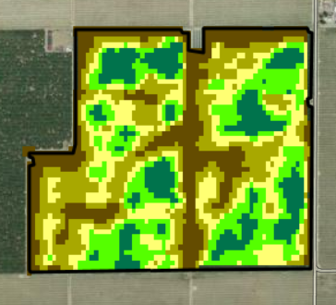
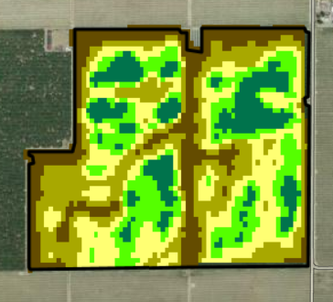
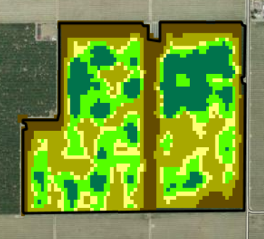
pVVI Map Types
Vegetation Index –
Natural
Vegetation Index –
Clustered
May
June
July
August

Slide 29
Applications
Minimize scouting expenses by using PurePixel to target only problematic fields.
Use actual differences in crop vigor to make better decisions on whether issues warrant management attention.
Analyze maps through a growing season to detect, remediate, and monitor for issues that can affect your bottom line.
Analyze maps over multiple growing seasons to identify changes in overall crop health.

Slide 30
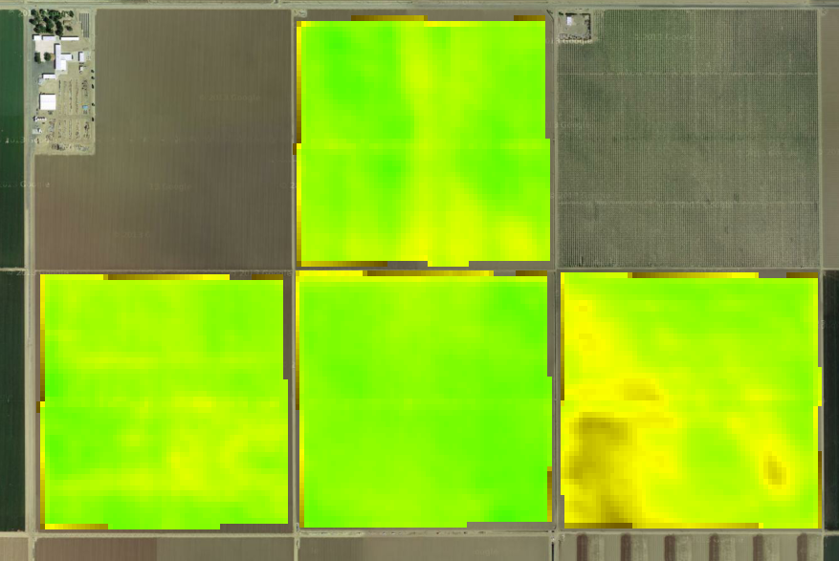

Applications
Scout the fields that actually have variability
Limited variability – scouting to be focused elsewhere
High variability – scouting efforts focused here

Slide 31
Applications
Minimize scouting expenses by using PurePixel to target only problematic fields.
Use actual differences in crop vigor to make better decisions on whether issues warrant management attention.
Analyze maps through a growing season to detect, remediate, and monitor for issues that can affect your bottom line.
Analyze maps over multiple growing seasons to identify changes in overall crop health.

Slide 32
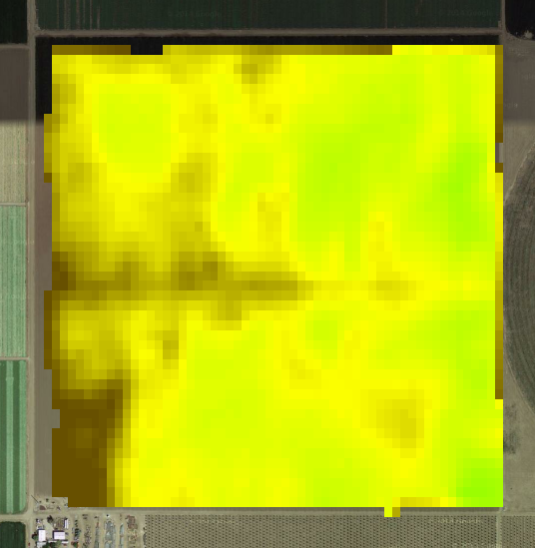
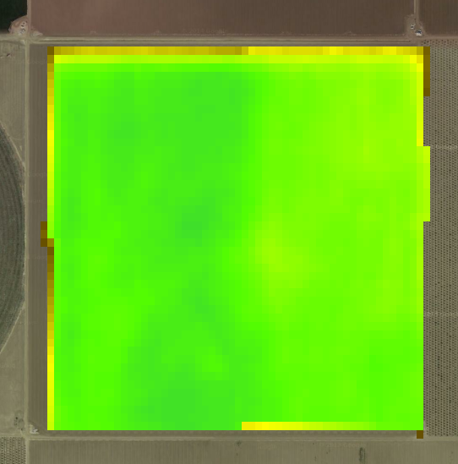
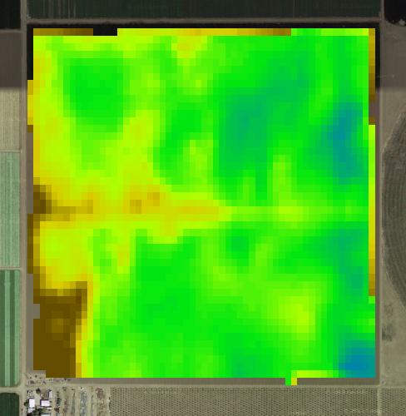
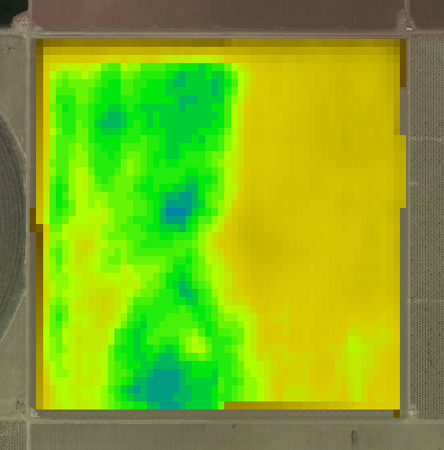
Applications
Determine if there are actual differences in crop health
High Variability Field
Low Variability Field
pVVI
Uncalibrated Index

Slide 33
Applications
Minimize scouting expenses by using PurePixel to target only problematic fields.
Use actual differences in crop vigor to make better decisions on whether issues warrant management attention.
Analyze maps through a growing season to detect, remediate, and monitor for issues that can affect your bottom line.
Analyze maps over multiple growing seasons to identify changes in overall crop health.

Slide 34
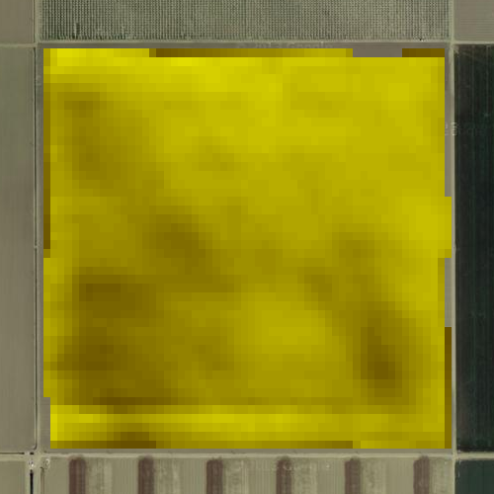
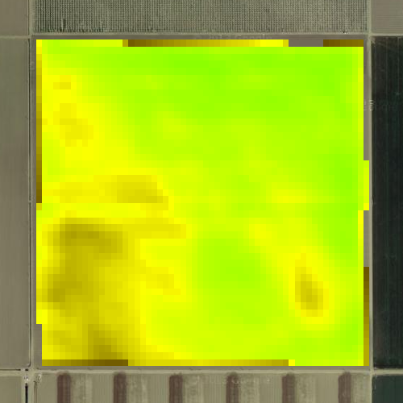
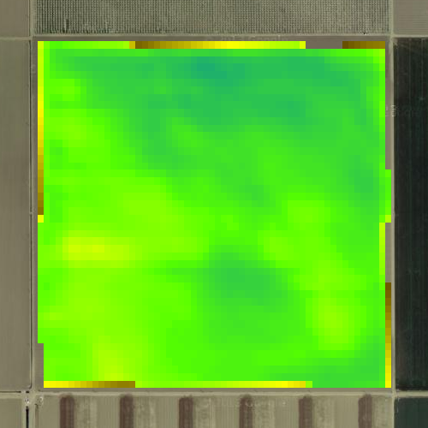
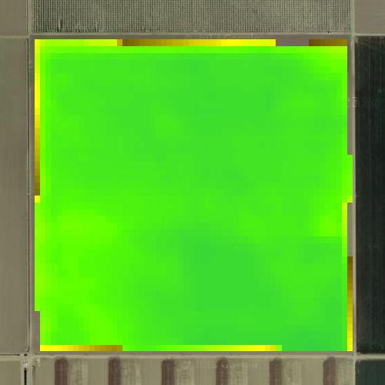
Applications
Monitor evolution in crop health
6/20
7/5
7/21
8/18

Slide 35
Applications
Minimize scouting expenses by using PurePixel to target only problematic fields.
Use actual differences in crop vigor to make better decisions on whether issues warrant management attention.
Analyze maps through a growing season to detect, remediate, and monitor for issues that can affect your bottom line.
Analyze maps over multiple growing seasons to identify changes in overall crop health.

Slide 36



Applications
Recognize year-to-year changes
2011
2012
2013

Slide 37
Availability - Timing
Historical imagery to 2013
New imagery: 24-48 hours
Order processing: 2-60 minutes

Slide 38
Availability - Geography
Current offering is United States only
eCommerce limitation
Target addition of Argentina, Brazil, Canada, Europe, and ROW

Slide 39
Intelligent Irrigation with the
Irrigate-IQ™ Solution

Slide 40

Irrigate-IQ is a smart irrigation tool
  Variable rate irrigation on pivot and linear irrigators
  Remote monitoring and control
Combines data capture and storage services
Helps farmers manage their resources and costs more effectively
Tools:
  Hardware
  Software
  Services

Slide 41
On-Farm Benefits
Complete irrigation solution from one central source
The combination of RainWave® and Irrigate-IQ™ provides a powerful productivity tool
Optimizing irrigation to match crop, soil and topography will provide farmers with increased yield
In time, hybrid seed types matched to soil and irrigation patterns will provide a uniformed return for all areas under irrigation

Slide 42
Benefits to the User
Reduce water waste, pumping cost, electrical cost
Increase yield through mapping application depth to soil type
Ensure accurate application to root zone for both fertigation and water – ensuring maximum plant uptake
Capture data of what went where and when
Manage and control of irrigator systems remotely
  NEW! Connected Farm Irrigate App

Slide 43




What Can You Do With It?
Monitor
Control
Plan
Apply

Slide 44




Monitor
Monitor the irrigation system status from the Connected Farm™ dashboard

Slide 45

Control
Control irrigation system from any device

Slide 46



Plan
Create, manage, and upload variable rate irrigation plans and exclusion zones

Slide 47
Apply
Perform targeted application of water, fertigation, or effluent based on the irrigation plan
Individual nozzle control
  Combination of hardware
  and software
  Controlled by valves which
  are switched to apply differing
  application rates

Slide 48

Apply
Smart irrigation
  Using GPS the speed and direction of a pivot can be calculated and using GIS mapping the farmer can generate a selective irrigation pattern
  This allows differing amounts of water to be applied along the length of the pivot by actuating the valves when necessary based on the position of the pivot

Slide 49
Hardware Components
Hardware programs and control irrigators:
  Capturing and transmitting data
  Generating and sending prescriptions
  Managing areas/zones under the irrigator
Hardware:
  IQL-100 control module
  IQC-100 communication module
  IQG-100 GNSS module
  IQV-100 valve module
  IQP-100 power module
  Cables

Slide 50

Software Components
Software developed provides full access to users via the web from any connected device
Irrigate-IQ Software provides:
  Live connectivity to irrigators.
  Simple to generation of prescriptions.
  Easy creation of zones/areas.
  Reporting of application data.

Slide 51


Integrated Features
Integration with the Connected Farm™ dashboard
Integration with the Connected Farm™ irrigate app

Slide 52









Transforming crop production
Crop cycle management is evolving rapidly through technology that can access information instantly – everywhere in the cycle
Increase yields by responding to crop needs
Manage inputs with past and current information
Sustainably manage water and soil
Notes:
Our business goal is to make farmers and crop production more profitable and productive by enabling three key area’s of efficiency and decision making.
Controlled inputs to reduce costs and while improving yield
Real-time information to react to crop changes
Automated and assisted decision making to make decisions based on data and preplanned activities
Through real time data collection, tools to automatically manage the on farm activities, and a central location to view, analyze, and distribute information the decisions we enable lead to higher profits, often with less inputs, and with more control of the inputs.

Slide 53




Food for a hungry population
In areas where small scale farming occurs our handheld solutions help make local decisions easier
10s of acres
Family Farms
Notes:
Even our smallest acreage farmers find value in our technologies. By simplifying the use of these tools they can make their own decisions on how to better fertilize or cultivate their crop. Rice, the most widely grown food staple directly benefits from our GreenSeeker technology. By using hand held sensors and phone applications anyone anywhere in the world can improve the way they respond to the needs of the crops. Some of our most sophisticated GNSS engines are introduces to regions new to this technology through displays like the EZ-Guide 250 that is simple and intuitive to use.

Slide 54






Food for a growing population
When large scale food and fuel production seek higher yields, connectivity enables real-time decisions for higher profits
1,000’s of acres
Large Scale Producers
Notes:
As farming and raw material production operations increase in size the management of the resources becomes a driving factory in profitability. The ConnectedFarm is an important tool for managers of large operations to make quicker decisions with more facts. Sugarcane is one of the most asset intensive industries in the world. By managing how many vehicles are actively working, and how quickly they are completing their task, better planning and positioning of 500,000 dollar machines ensures the highest value inputs are achieving their best performance.
In 2050 the UN predicts 9 Billion people will need to be fed. The amount of water and land we have won’t significantly increase to raise crops, however our population will increase in numbers and appetite for a larger variety of food.
EQUIPMENT LOCATION AND STATUS:
In realtime locate and communicate with remote equipment. Determine their status and whether they are waiting for more work.
ASSEST UTLIZATION:
Analyze the percentage of time expensive harvesters and supply vehicles are sitting idle to better plan the placement of the fleet or plan maintenance.
MEASURE AND ANALYZE PROFIT:
In each step of the cropping cycle maps are generated recording the amount of seed placed in the ground, the amount of fertilizer, the conditions of the soil, and ultimately the yeild. Through these input measurements and the yeild the manager can determine the profitablity for each region of the field, and how best to improve the following year. In many applications the rate of fertilizer can be adjusted on the go while the operator is in the field.

Slide 55







Sustainable food for a population
In areas where sustainable farming is a focus, precision agriculture reduces over-application and provides tools to manage natural resources
10,000+ acres
Managers & Consultants
Notes:
Waterways and watersheds are an increasing concern in many regions where fertilizers and chemicals are applied. For farmers to become better stewards of the land they need tools and technologies to help them control and record what and where they apply. Water management tools effectively contour the land to reduce erosion and to optimize the use of water when it is scarce or costly. In the San Joaquin Valley of California our guidance systems allow underground drip irrigation to be installed and recorded so that the plants are placed directly over the drip lines to optimize water usage.
WM TOPO:
Survey fields and design optimal water retention and controlled runoff.
PRESCRIPTION MAPPING:
Create prescriptions and apply up to 6 different materials simultaneously in a single pass for best use of inputs.
PREVENT OVERLAP AND WASTED INPUTS:
Prevent chemical/pesticide overlap, in your headlands and waterways, by automatically controlling up to 48 individual sections/nozzles

Slide 56













A world of solutions
Applied to all scales of agribusiness
For all brands and types of equipment
Trimble Positioning
CenterPoint™ RTK
CenterPoint™ RTX
RangePoint™ RTX
Notes:
What makes Trimble successful is our technologies are developed and offered to farming regions across every farming region in the world. By using technologies unique to Trimble and those developed specifically for farming we create tailored solutions to customers in all types of food, fiber and fuel production. Our experts in the local regions which are our resellers are the best in their industry and provide those using the technology the experience that improves their yields, saves them money by reducing costs and effectively managing resources, and helps them build a long term sustainable practice.

