Slide 1

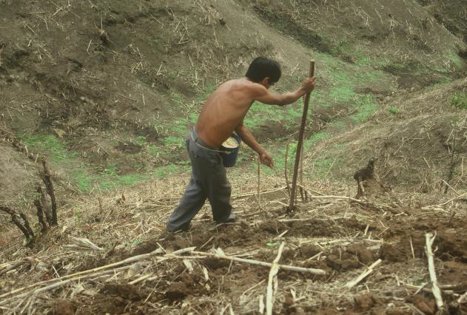
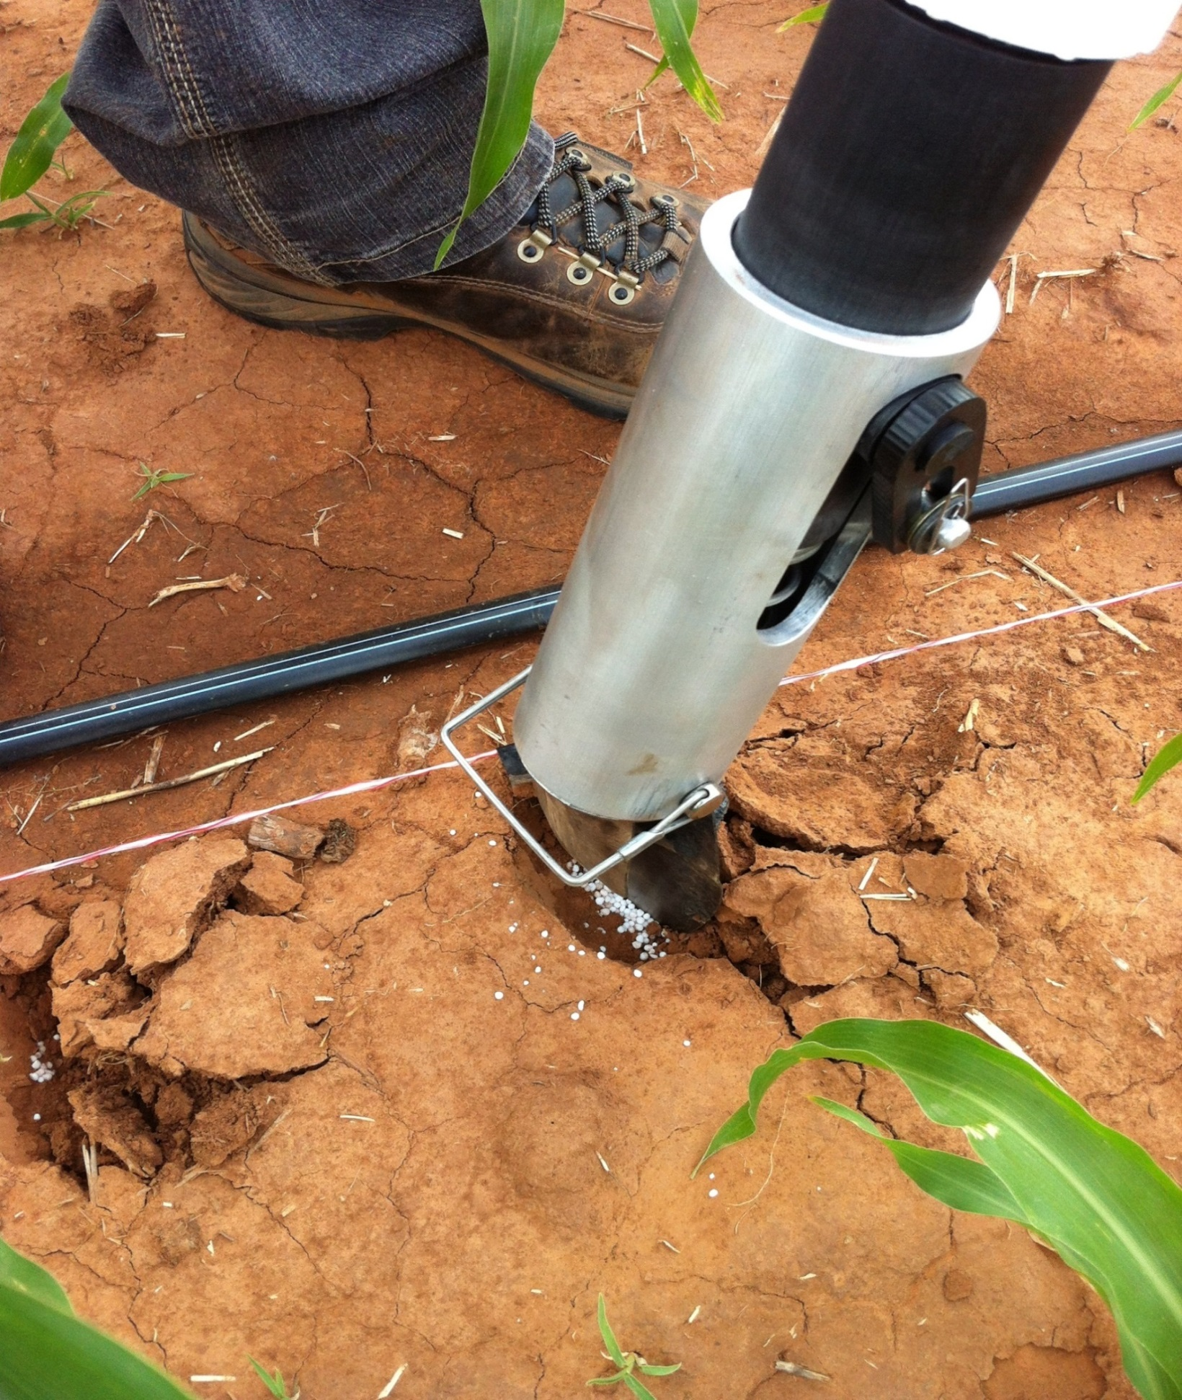
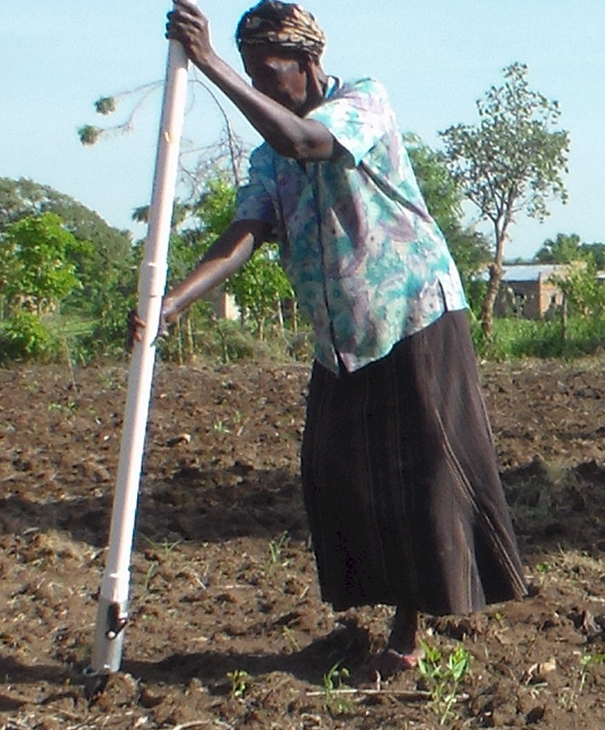
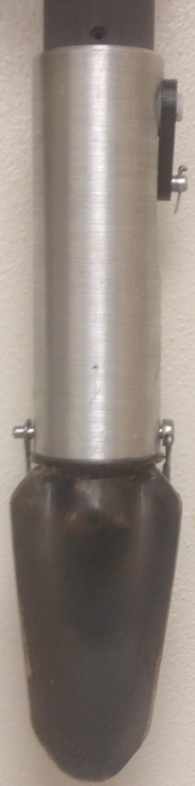
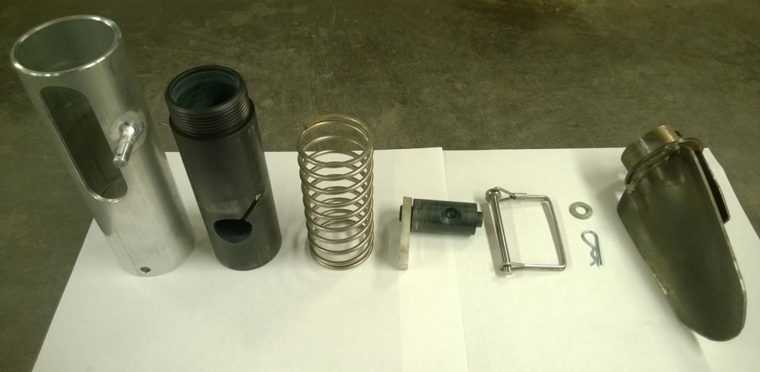
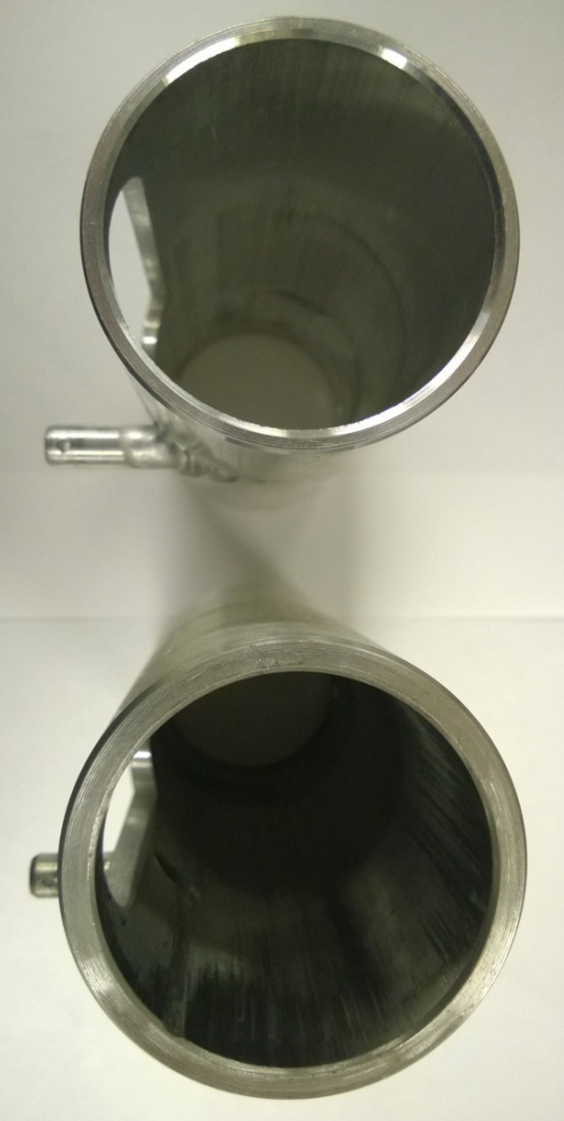
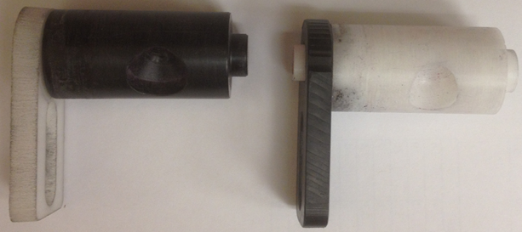
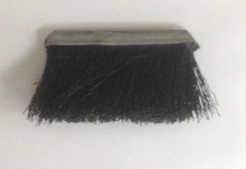
DEVELOPMENT AND EVALUATION OF A SINGULATING MAIZE HAND PLANTER FOR USE IN DEVELOPING COUNTRIES
L. Aula¹, B.M. Figueiredo¹, N. Macnack¹, S. Dhital¹, J. Mullock¹, E. Miller¹, J.S. Dhillon¹, P. Omara¹, R. Taylor² and W. Raun¹.
¹ Plant and Soil Sciences, Oklahoma State University
² Biosystems and Agricultural Engineering, Oklahoma State University
INTRODUCTION
MATERIALS AND METHODS
Maize (Zea mays L.) is one of the most important staple crops for small-holder farmers in the developing world. Maize provides 50% of the calories to third world countries (Ofori et al., 2009). In the developing world, maize planting is accomplished via labor intensive methods.
The use of wooden sticks is a common practice (Fig.1) where 2-4 seeds are placed per hill, 40 cm apart.
Oklahoma State University has developed a maize hand planter (GreenSeeder) capable of placing one seed per hill and with numerous agronomic benefits.
GreenSeeder tested in June 2014
Variables evaluated;
  Seed sizes: 4069, 3643, 2761 seeds/kg;
  Drums: 450S, 716M;
  Housing: H373, H514;
  Springs: High Strength (HS), Low strength (LS).
Seed sizes tested with springs, drums and housings
Operation; surface struck 100 times
Blank, single, & multiple seeds were recorded
Data analyzed using SAS 9.3
a
a
a
a
Fig. 5. Performance of the OSU hand planter using different housing and seed size
Housing and seed size combination had a significant effect on singulation. 2761 and H373 resulted in 90% singulation.
RESULTS
b
ab
b
S I N G U L A T I N G M A I Z E H A N D P L A N T E R
Fig. 1. Farmer in Central America planting maize with traditional metal/wooden stick
OBJECTIVE
Different letters above bars with the same color, significantly different (p < 0.05)
Different letters above bars with the same color indicate that they are significantly different (p < 0.05)
Fig. 3. Percentage of Singles, Doubles and Blanks for Strength of spring
Fig. 6. Percent Blanks, Singles and Doubles using different seed sizes
To develop a singulating maize hand planter that delivers at least 85% single seeds and that will result in increased yields and planting efficiency
Singulation significantly higher (86%) with larger seeds than with smaller seeds (44%).
High seed singulation recorded with HS and 2761 seeds/kg.
CONCLUSIONS
DESIGN
Use of appropriate drum, spring and seed size is vital to achieve high singulation.
Current GreenSeeder offers a viable alternative to traditional stick planting for improving maize production in developing countries.
OSU design also provides an option to apply urea fertilizer, reducing potential volatilization loss.
GreenSeeder major components;
Seed hopper, 1.4 m long PVC pipe
Metering unit;
  Spring
  Drum
  Brush
  Housing
Planter tip
A
C
B
D
Different letters above bars with the same color, significantly different (p < 0.05)
E
F
G
Fig. 4. Performance of Planter with Different Drums and seeds
Fig. 2 A. Assembled metering unit; B. (Left to right) External housing, internal housing, spring, drum and lever, tip retainer clip, drum and lever washer and retainer clip and tip; C. H373 External housing; D. H514 External housing; E. 450S Drum; F. 716M Drum; G. Internal brush.
Use of drum 450S and 2761 seed size resulted in the highest percent singulation (90%).
Fig. 7. Urea-N topdress application (left) and a farmer in East Africa planting maize using the GreenSeeder (right)

