Slide 1
The history and current status of N sensing research at the University of Minnesota.
John Lamb, Daniel Kaiser and Jeff Vetsch

Slide 2
History
Why?
  Increase NUE!
    Production?
    Environmental?
Logic behind the in-season approach.

Slide 3
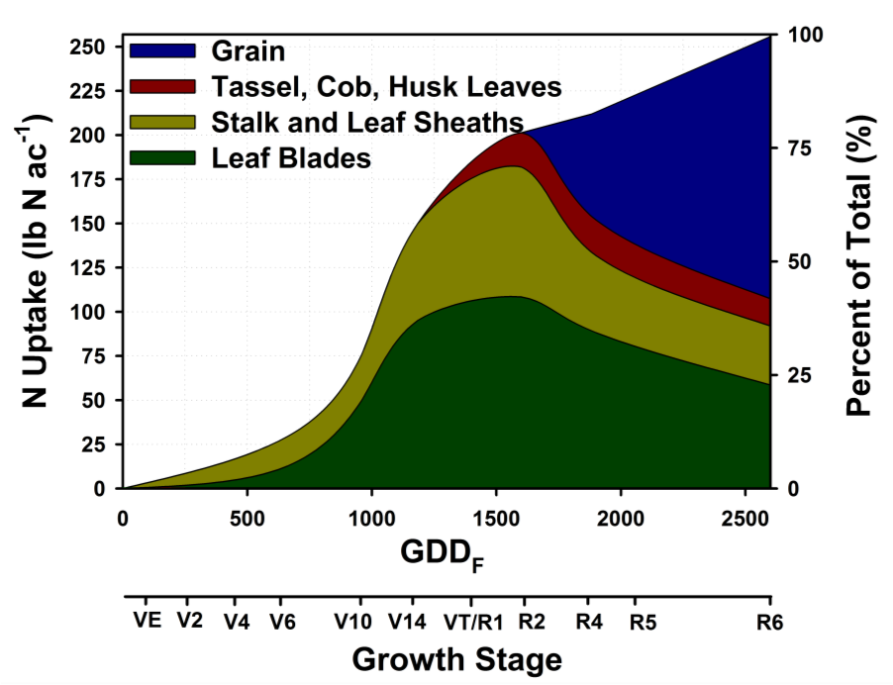

Slide 4
Concerns:
Can we use split applications for optimum grain yield?
How late in the season can we go?

Slide 5
Direct comparisons
Site | Rot | Total N applied | Pre-plant | V7 | V12
 |  | lb N/A | Corn grain yield (bu/A)
08-1 | CS | 90 | 168^{V2} | 161 | 150
07-1 | CS | 90 | 181^{V2} | 176 | 128
06-1 | CS | 90 | 197^{V2} | 195 | 184
05-1 | CS | 105 | 151 | 152^{V9} | 150 ns
04-1 | CC | 120 | 181 | 181^{V8} | 179 ns
Randall and Vetsch

Slide 6
Summary:
1 of 25 sites had a positive yield response to sidedress N at V6
8 of 25 sites had a negative yield response (averaged 16 bu./ac.)
16 of 25 sites had no response - similar yields
Side-dress application should be made no later than V6

Slide 7
What sensing tools do we have?
One low tech – Supplemental N Worksheet.
Three higher tech
  Chlorophyll meter
  Greenseeker
  Crop Circle
One research grade
  Tetracam

Slide 8
U of MN Supplemental Nitrogen Worksheet for Corn (use in June)
Question 1. When was the N applied?
Question 2. What was the predominant spring soil condition (May)?
Question 3. How does the crop look?
Super low tech but has been very useful the last three growing season.
  (is a human low tech?)

Slide 9

Sensor Based N Management
Offers a relatively simple method to manage N without having to physically take a sample
Sensors have been in place for about 20 years
  Earliest was SPAD Chlorophyll meter (~1995)
Satellite imagery has been around for longer
  Offers some advantages but also some major limitations
    Limitations: return rate, minimum amounts of data to purchase, limited control on when the picture will be taken

Slide 10
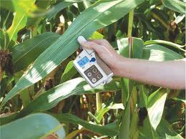
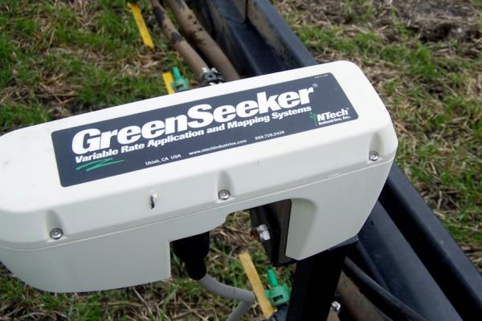
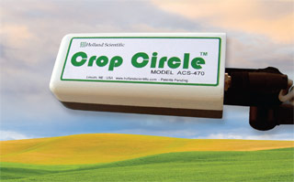
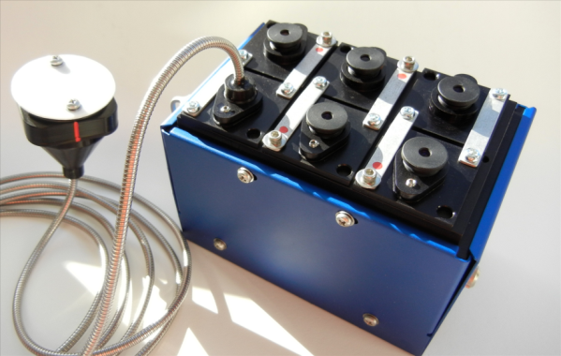
Sensing Tools Currently Being Used by our research group

Slide 11
Sensing Wavelengths
  SPAD Chlorophyll meter - Active
    Wavelengths: 650 (red), 940 (NIR)
Greenseeker model 505 - Active
  Wavelengths: 656nm (red), 774 (NIR)
Crop Circle 470 - Active
    670 (red), 780 (NIR), 730 (Red Edge)
Tetracam Mini-MCA - Passive
      Wavelengths: 490 (Blue), 550 (Green), 680 (Red), 720 (Red Edge), 800 & 900 (NIR)

Slide 12
Historical question?
How do we use these tools?
Use to schedule application during the season. – all N put on in-season.
Put a small amount on at planting and use the tool to determine the need in-season?
Put half or more pre-plant and use the tool to determine if it needs to be topped off?

Slide 13
First work!
Used SPAD meter as part of MSEA project in the 90’s
Outcome – growers did adopt because of high labor input.

Slide 14
Second Stage
Randall and Vetsch – Greenseeker on dryland corn in Southeast and South Central Minnesota.

Slide 15
GreenSeeker NDVI as affected by N rate

Slide 16
General Findings As of Summer 2007
Grain yield: preplant N generally > split N
  for both CC & C-Sb
  especially when split has a low rate of preplant N or SD N is applied after V8
NUE: not consistently improved with split N
NDVI: For CC, V6-V12 distinguished among N
rates w/V7-V11 best.
  For C-Sb, V7-V11 sometimes distinguished between 0-lb vs greater N rates.
  delta NDVI is small, does not distinguish between 30 & 150 lb N rates.
Randall et.al. corn grown on heavy textured soils.

Slide 17
Why unsuccessful?
Minnesota soils have high organic matter.
  Soils provide 70 % of N to corn crop.
N deficiencies in check do not show up early enough to detect and treat.
Short growing season and corn grows through V stages quickly.

Slide 18
Stage 3
Irrigated sandy soils
  Less organic matter and good yield potential.
Compared N BMPS Split V2 and V4 with use of SPAD and NDVI methods

Slide 19
Applications based on sensors
Site | Trt | Pre | SD | V6 | V8 | V10 | V12 | Total
H08 | SPAD | 30 | 30 | 30 | 30 |  |  | 120
H08 | NDVI | 30 | 30 |  |  |  | 30 | 90
CF08 | SPAD | 30 | 30 |  | 30 |  | 30 | 120
CF08 | NDVI | 30 | 30 | 30 |  | 30 | 30 | 150
SW09 | SPAD | 30 | 30 | 30 |  | 30 |  | 120
SW09 | NDVI | 30 | 30 |  | 30 |  | 30 | 120
SE09 | SPAD | 30 | 30 | 30 | 30 |  |  | 120
SE09 | NDVI | 30 | 30 |  | 30 | 30 |  | 120
Lamb, 2010

Slide 20
Grain yield comparisons
Site | ENOR 0.10 | Yield | SPAD | Yield | NDVI | Yield
 | lb N/A | bu/A | lb N/A | bu/A | lb N/A | bu/A
SW09 | 192 | 223 | 120 | 210 | 120 | 227
SE09 | 148 | 242 | 120 | 239 | 120 | 232
CF08 | 148 | 217 | 120 | 224 | 150 | 222
H08 | 202 | 290 | 120 | 271 | 90 | 248

Slide 21
Summary
Sensing crop so N could be spoon fed with irrigation system show some efficiencies.
  SPAD meter worked at 2 of 4 sites.
  NDVI with dryland equation worked at 2 of 4 sites. Data needs to be analyzed for irrigated equation.

Slide 22
The next chapter – Stage 4
Adding the tetracam to collect more wavelength data.
Dan Kaiser is leading this effort.

Slide 23
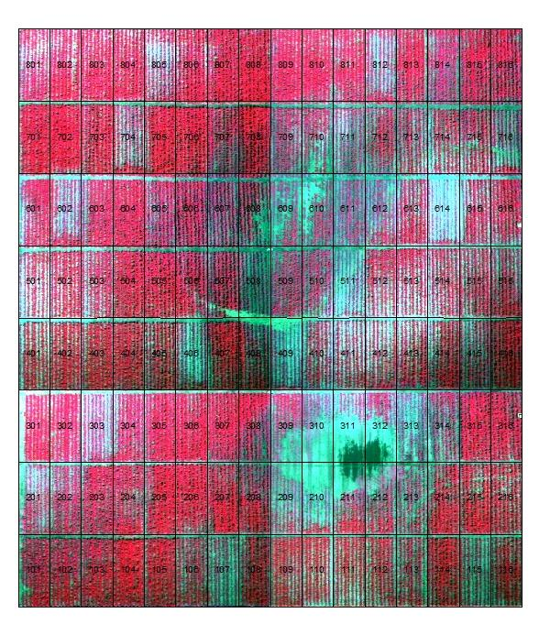
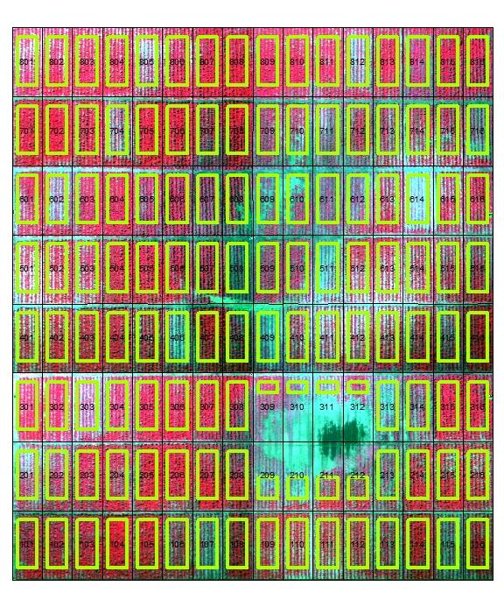
Willmar NUE Study – V5 False Color – Is this just another pretty picture?
40 280 240 160 0 80 120 200
Low Plant Pop
Drowned out area

Slide 24

SPAD Chlorophyll Meter
SPAD meters consistently provide the best correlation to final yield
V10 measurements taken from the uppermost fully developed leaf, R2 taken from the ear leaf
Not a popular test and cannot be completed on-the-go
Easy to do in plots but how do you sample a large field

Slide 25
Early Season NDVI Measurements
Canopy saturation tends to occur for the Greenseeker (values ~ 0.80-0.85)
  Toss out the low points would result in no correlation
Slightly better data for the crop circle
Greater range in values for the Tetracam (aerial)
  Sampling a larger area
  Some variation due to population

Slide 26
Mid-Season NDVI Measurements
Poor relationship for the Greenseeker
Slightly better for the Crop Circle but very few points < 0.80
  Both are at Saturation
Tetracam showing the greatest amount of variation

Slide 27
Mid-Season NDRE Measurements
NDRE with the crop circle has correlated well to yield
Tetracam V10 data was ugly
  Measurement is taken using ambient light
NDRE correlates better to SPAD

Slide 28
What is the best Index of N Availability
Red/NIR indices from active sensors are not good enough to determine yield differences due to N unless soil N availability is low
SPAD provides better prediction but is more labor intensive
  May not get a good representative sample
NDRE may be a better index
  (NIR-R_{edge})/ (NIR+R_{edge})
Does anything correlate well to SPAD?

Slide 29
Is Aerial Imagery Better Able to Detect N Stress
Aerial imagery may offer better flexibility in determining N stress
  Appears to offer a better sensitivity
  Scanning a larger area may have benefits
Selecting the right wavelengths is important
  Red, NIR, Red Edge, Green, Blue, Yellow…..
How certain are we that we are actually seeing a N deficiency and not something else?

Slide 30
Sensing Possibilities
Good future for use of cameras with UAS/Drones
  Offers greater flexibility for sample timing and multiple possibilities for use throughout the season (general scouting, sensing)
Currently need to provide a good database on correlation/calibration
  Make the pictures useful
Active sensors may still have a place
  Crop circle (470) seems to be outperforming the Greenseeker in our studies
  Not all crop circles are the same (our research unit has three bands, production units may only have 2)
  Being able to measure the Red Edge band is important

Slide 31
Limitations for Use: Aerial Images
Data turn around - training
Determinations on which bands work the best (picking an index)
Platform (airplane versus UAS/Drone)
Data calibration (i.e. how much fertilizer should be applied based on the sensing value)
Cost
FAA

Slide 32
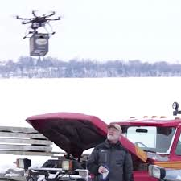
FAA did not approve of this innovative use of Drones!

Slide 33
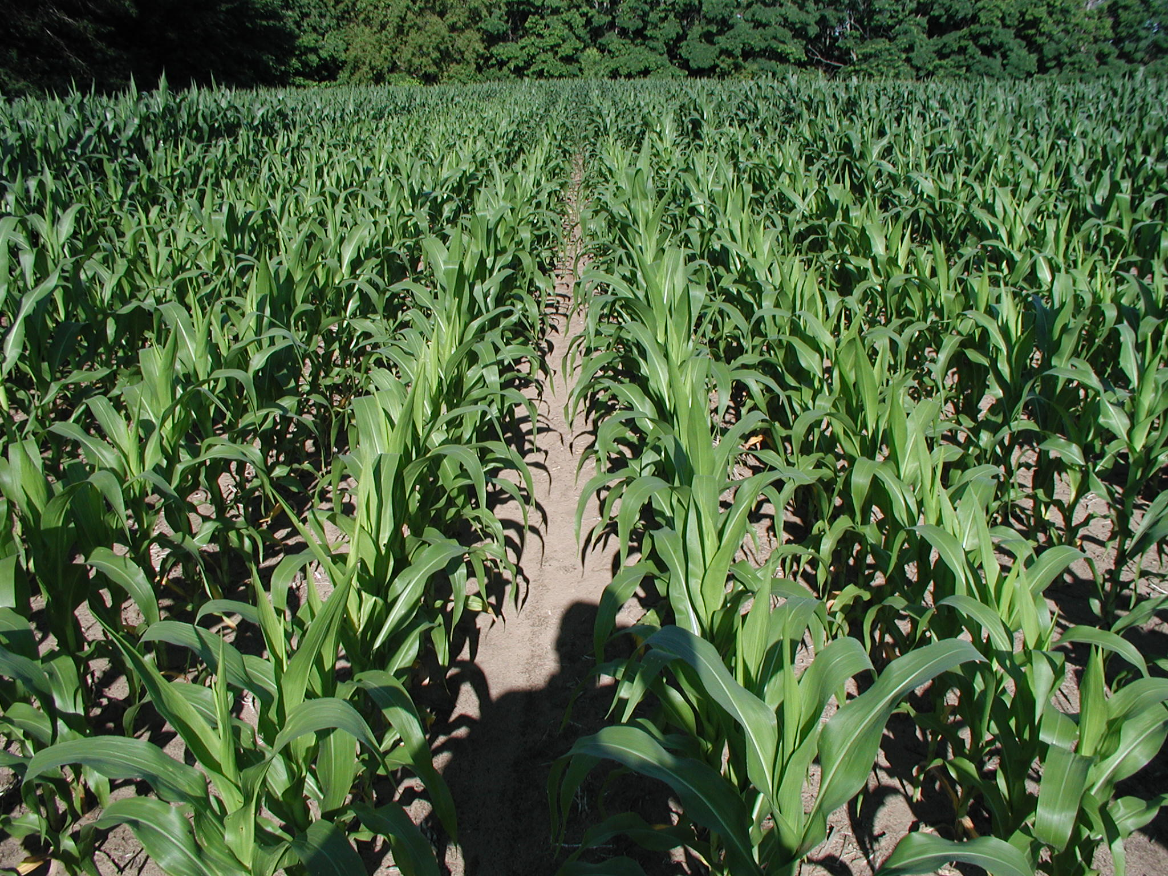
Questions??

