Slide 1
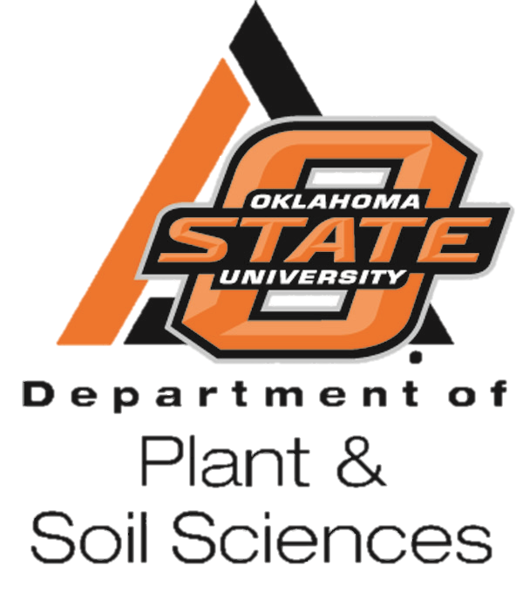
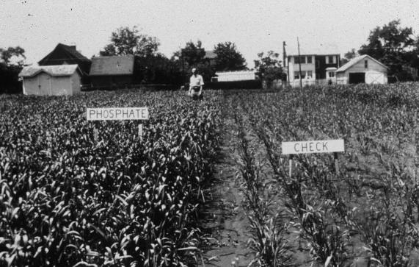
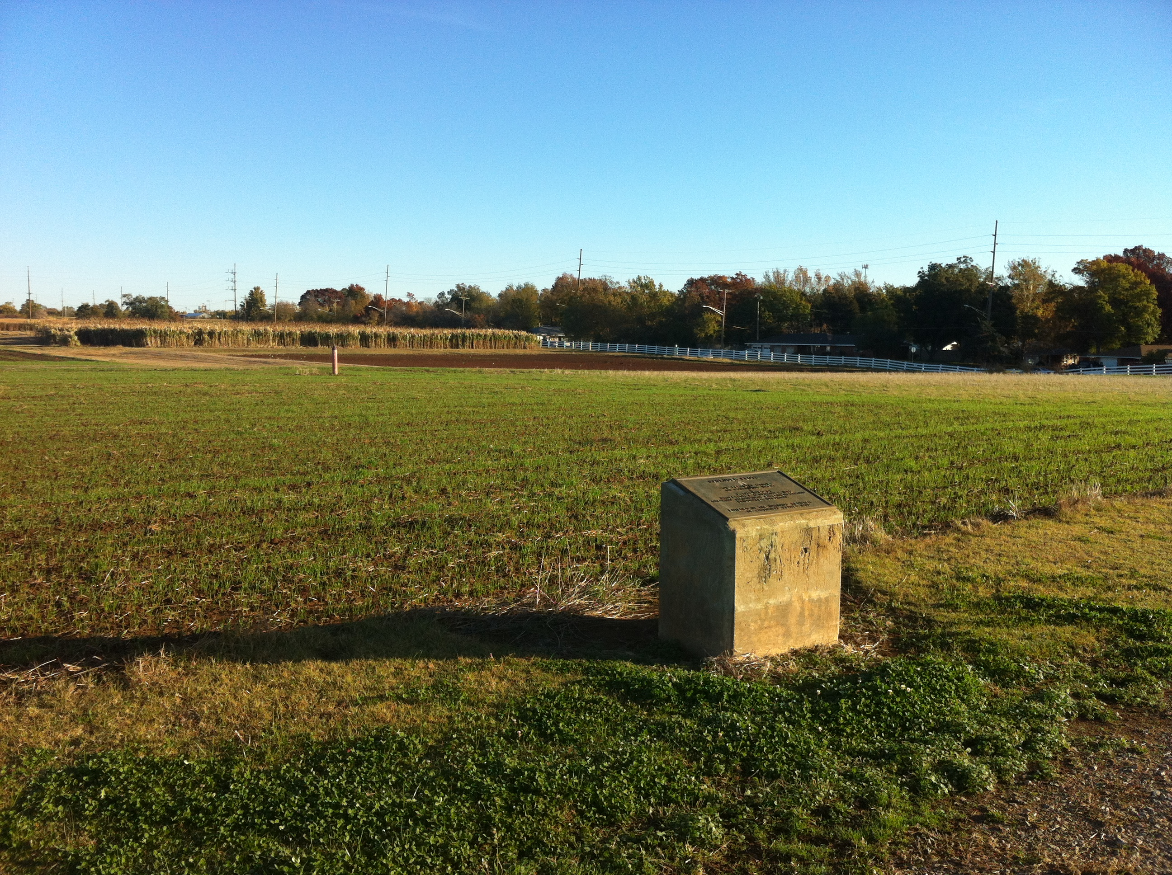
Effect of Long-term Cattle Manure Application on Soil Test Phosphorus,
Organic Carbon and Winter Wheat Grain Yield
Natasha Macnack, Peter Omara, Lawrence Aula, and William Raun
Department of Plant and Soil Sciences, Oklahoma State University
Introduction
Soil organic matter is arguably the most important soil quality factor. However, in a continuous cropping system, soil organic matter can be depleted. The rate of depletion often depends on agronomic practices employed. Animal manure has been shown to have many agronomic benefits including increasing soil organic matter content. However, there have been concerns about phosphorus (P) accumulation in agricultural soils receiving manure. In this study, data from 1990 to 2013 from the Magruder Plots (Stillwater, OK, est. 1892), were used to determine the effect of cattle manure on soil test phosphorus (STP), soil organic carbon (SOC), and grain yield of winter wheat (Triticum aestivum L.).
Objective
The objective of this study was to determine the effect of long-term cattle manure application on soil test P (STP), SOC, and the yield of winter wheat.
Materials and Methods
Treatments (6): P, NP, NPK, NPK+Lime, Cattle
manure, Check plot
N source and rate: Urea at 67 kg N ha⁻¹
P source and rate: TSP applied at 14.6 kg P ha⁻¹
K source and rate: KCl applied at 28.8 kg K ha⁻¹
Lime applied when pH < 5.5
Cattle manure applied every 4 years at 269 kg N ha^{–1}
at N:P ratio of 3:1 annual P rate of 22 kg P ha⁻¹
Soil test P: Mehlich-3 extraction
Soil organic C: dry combustion (LECO Truspec)
Statistical analysis: SAS 9.3
.
Table 1. Simple statistics showing mean, maximum, minimum values and range for Magruder plots at Stillwater, OK. 1990-2013.
Statistics | Manure | Check | P | NP | NPK | NPKL
Grain Yield |  |  |  | (Mg ha⁻¹)
Mean | 2.14 | 1.04 | 1.16 | 2.25 | 2.45 | 2.51
max | 4.04 | 1.81 | 2.54 | 4.05 | 4.17 | 4.35
Min | 0.17 | 0.11 | 0.07 | 0.17 | 0.32 | 0.35
Range | 3.87 | 1.70 | 2.47 | 3.88 | 3.85 | 4.00
CV, % | 46 | 43 | 46 | 46 | 41 | 43
STP |  |  |  | (mg kg⁻¹)
Mean | 38.82 | 6.29 | 49.32 | 42.25 | 47.59 | 42.09
max | 48.63 | 11.49 | 96.5 | 68.34 | 92.27 | 89.74
Min | 17.67 | 2.53 | 29.55 | 24.44 | 30.59 | 21.94
Range | 30.96 | 8.96 | 66.95 | 43.9 | 61.68 | 67.8
CV, % | 24 | 35 | 31 | 30 | 36 | 43
Figure 2. Soil organic carbon from 1990 to 2013 for Manure and Check plot, Magruder Plots, Stillwater, OK.
Figure 1. The Magruder Plots between 1920-1930
Figure 3. Soil test phosphorus (STP) for all treatments, Magruder Plots , Stillwater, OK. 1990- 2013
Figure 5. The Magruder Plots in 2013
Results & Conclusions
Over the study period, SOC in check plot decreased from
9 to 4 g kg⁻¹ (Fig. 2)
Rate of SOC decline slower in manure treated plot
Over all years, higher SOC observed in manure treated plot
versus other treatments
STP levels on average higher in inorganic treated plots
compared to manure treatment (Fig. 3)
On average lower P removal in inorganic P treated plot
NPKL treatment had the highest average yield over
the study period at 2.51 Mg ha⁻¹
Average yield in manure treated plots over the study period
was 2.14 Mg ha⁻¹ (Table 1)
Long term additions of manure can reduce SOC loss
and still maintain productivity relative to plots fertilized
with inorganic sources
Figure 4. Grain yield for all treatments, Magruder Plots, Stillwater, OK. 1990-2013
OKLAHOMA STATE UNIVERSITY

