Slide 1
Predicting Grain Yield Potential Using Corn Hybrids Having Improved Drought Tolerance
Eric C. Miller
Jeremiah L. Mullock, Jacob T. Bushong, and William R. Raun
NUE Conference
Sioux Falls, SD
August 5th, 2014

Slide 2
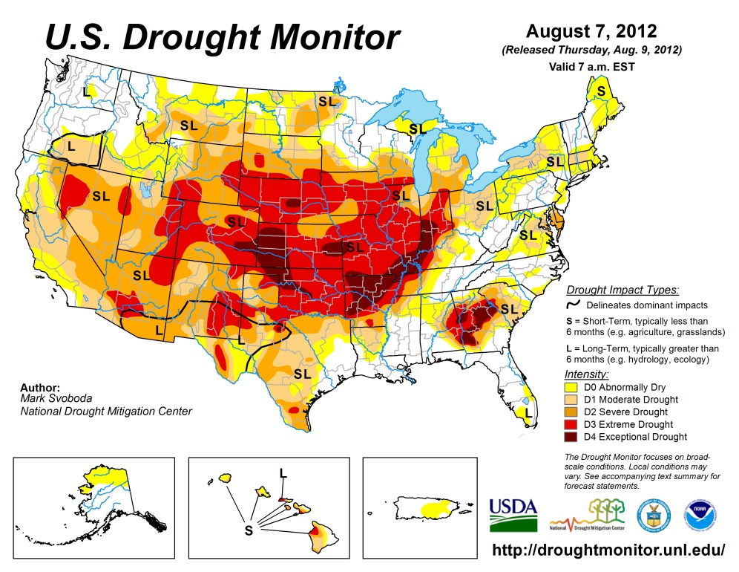
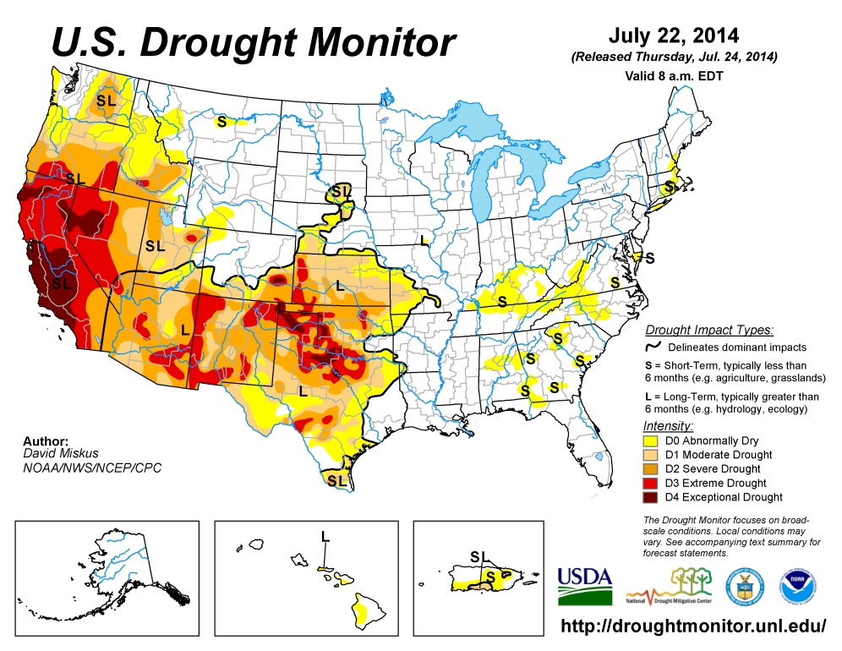
Drought
The 2012 drought, 597 counties in 14 states primary natural disaster areas (USDA, 2013).
$14 billion in crop insurance indemnity payments (Congressional Budget Office, 2013).

Slide 3
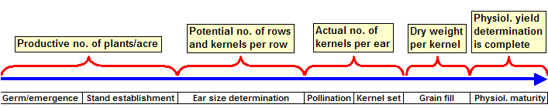
Drought effects on corn
Figure adapted from Nielsen, 2007

Slide 4
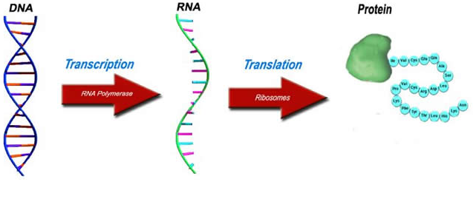
Transgenic trait/GMO
Cold shock protein B gene
Called ‘cspB’
Bacillus subtilis bacterium
Cold shock proteins accumulate
Act as RNA chaperones
Bind and unfold tangled RNA molecules to promote normal function (Castiglioni et al., 2008)
http://www.lhsc.on.ca/_images/Genetics/centraldogma.jpg

Slide 5
Conventional breeding
Express native drought tolerant traits using marker assisted selection (Butzen and Schussler, 2009)

Slide 6
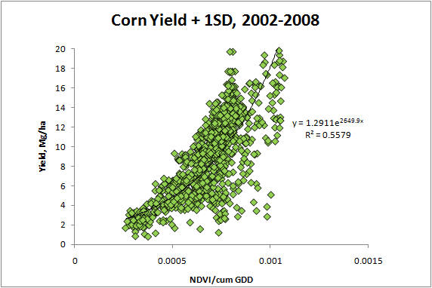
OSU grain yield prediction approach
YP₀ (kg ha⁻¹) = 1291exp[(NDVI_{FP}/Cumulative GDD)*2649.9]
GDD = [(T_{Max}+T_{min}/2)–T_{base}
10 ºC and 30 ºC are threshold values
RI = NDVI_{N-Rich}/NDVI_{FarmerPractice}
YP_{N} (Mg ha⁻¹) = YP₀*RI
N Rate (kg ha⁻¹) = YP_{N}-YP₀*0.0125/NUE

Slide 7
Objective
Evaluate grain yield potential
Drought tolerant and less drought tolerant corn hybrids
Irrigated and rainfed production systems

Slide 8
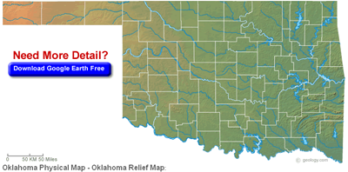
Experiment sites
Established in 2013 and has continued in 2014
3 replicates
4 row plots, 6.1 m long
Soils:
Efaw
Norge: Fine-silty, mixed, active, thermic Udic Paleustolls
Lake Carl Blackwell (LCB)
Port: Fine-silty, mixed, superactive, thermic Cumulic Haplustolls, Oscar: Fine-silty, mixed, superactive, thermic, Typic Natrustalfs
LCB
Efaw

Slide 9
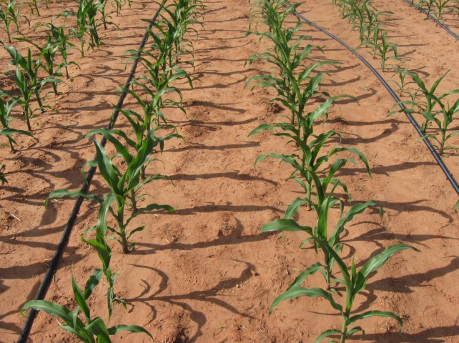
Experimental design: GxExM
Genetics
Drought tolerant
Pioneer P1498: Optimum AQUAmax
Monsanto 63-55: Droughtgard
Less drought tolerant
Pioneer P1395
Monsanto 62-09
Environment x Management
Photo Courtesy of Jacob Bushong
Irrigated production system
Preplant N rates
0, 101, and 202 kg ha⁻¹
Seeding rate
75,650 seeds ha⁻¹
Rainfed production system
Preplant N rates
0, 67, and 134 kg ha⁻¹
Seeding rate
53,800 seeds ha⁻¹

Slide 10
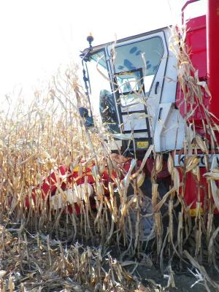
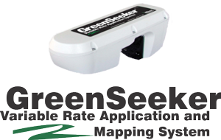
Data collection
NDVI collected with Trimble GreenSeeker optical sensor
V8 and V10
Grain yield (kg ha⁻¹)
Center two rows per plot
Adjusted to 155 g kg⁻¹ moisture
http://web.extension.illinois.edu/nwiardc/ eb270/20121015_6040.html

Slide 11
Analysis of variance
Main effects and interactions for normalized difference vegetative index (NDVI₆₆₀) and grain yield at Efaw and Lake Carl Blackwell (LCB), 2013.
 | Efaw |  |  | LCB
 | NDVI: V8 | NDVI: V10 | Grain Yield | NDVI:V8 | NDVI:V10 | Grain Yield
 | ----------------- Pr > F -----------------
Irrigation | 0.012 | 0.003 | 0.002 | 0.001 | 0.059 | 0.001
Hybrid | 0.004 | 0.025 | 0.297 | 0.001 | 0.014 | 0.292
N Rate | 0.091 | 0.021 | 0.722 | 0.001 | 0.002 | 0.017
Irrigation x Hybrid | 0.314 | 0.054 | 0.529 | 0.612 | 0.939 | 0.705
Irrigation x N Rate | 0.435 | 0.033 | 0.503 | 0.045 | 0.520 | 0.027
Hybrid x N Rate | 0.952 | 0.346 | 0.795 | 0.840 | 0.226 | 0.684
Irrigation x Hybrid x N Rate | 0.095 | 0.058 | 0.084 | 0.006 | 0.168 | 0.548

Slide 12
Potential grain yield : V8-V10
= Current YP0 equation

Slide 13
Potential and actual yield: V8-V10

Slide 14
Grain yield by hybrid
Drought tolerant

Slide 15
Hybrid grain yield differences
Single degree of freedom contrasts and differences of the means for grain yield (kg ha⁻¹) at Efaw and LCB, 2013.
 | Efaw |  | LCB
 | P > F | Diff. | P > F | Diff.
Drought tolerant vs. Less drought tolerant | 0.416 | -485 | 0.928 | 84
Monsanto vs. Pioneer | 0.110 | 994 | 0.065 | 832
Droughtgard vs. AQUAmax | 0.116 | 1380 | 0.139 | 916

Slide 16
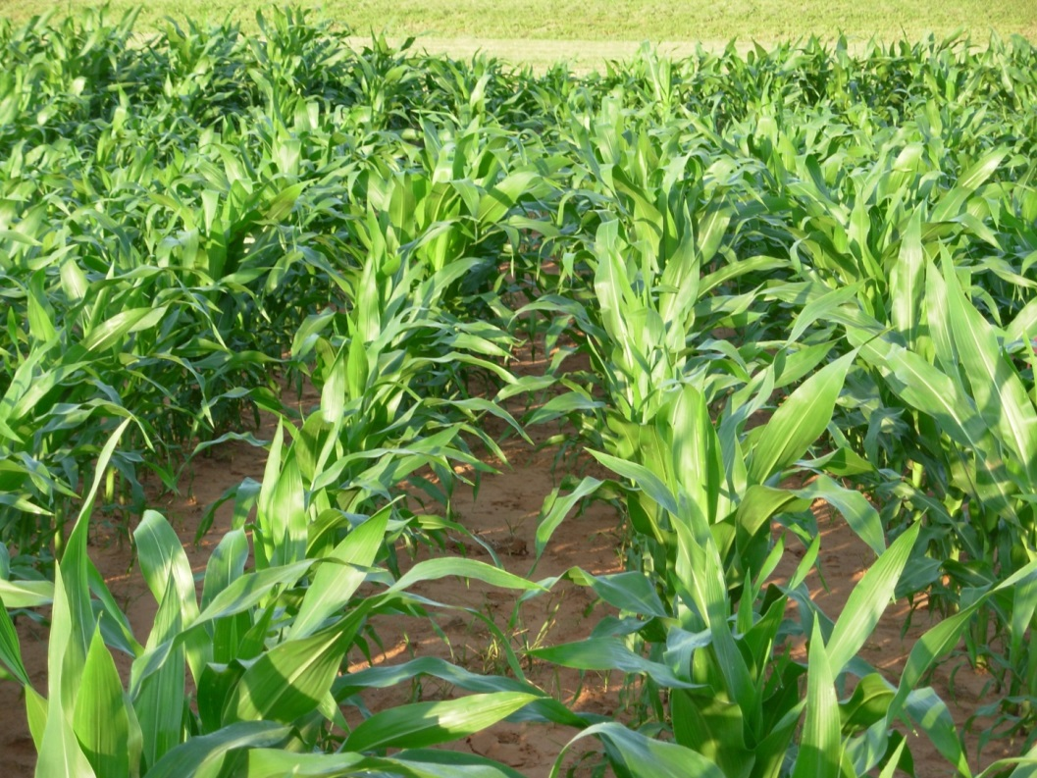
Conclusions
Few differences existed between DT and non-DT corn hybrids when predicting potential grain yield
Clear differences were detected between irrigated and rainfed production systems
Potential grain yield was over-predicted

Slide 17
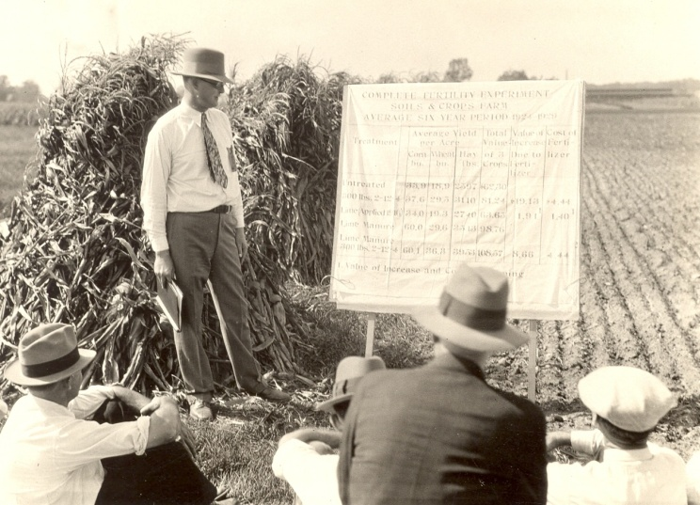
Questions?

Slide 18
Evaluation of the Trimble Experimental Sensor
Eric C. Miller
Jeremiah L. Mullock, Jacob T. Bushong, and William R. Raun
NUE Conference
Sioux Falls, SD
August 5th, 2014

Slide 19
Appearance
Trimble Experimental
Sensor
GreenSeeker

Slide 20
Sensor footprint – 36” high
36”
GreenSeeker
¾”
30”
Trimble Experimental Sensor
15”

Slide 21
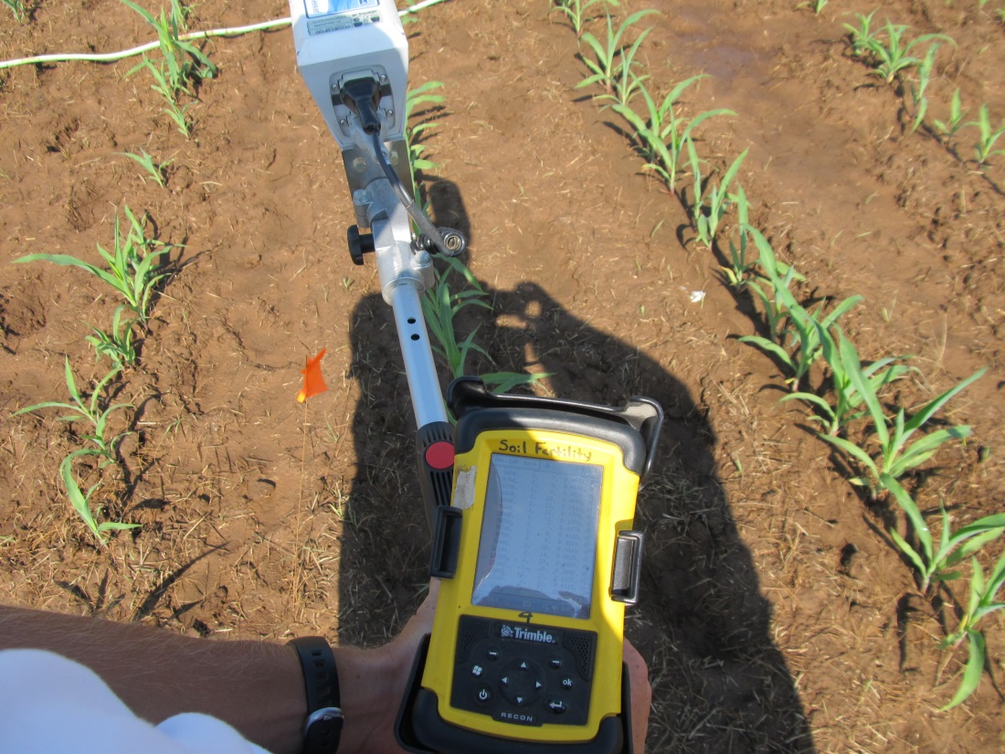
Data storage and processing
Recon or Nomad
vxHpc - hyperterminal program
Reflectance of red and NIR bands individually
Microsoft Access data query
Calculate NDVI
Plot averages

Slide 22
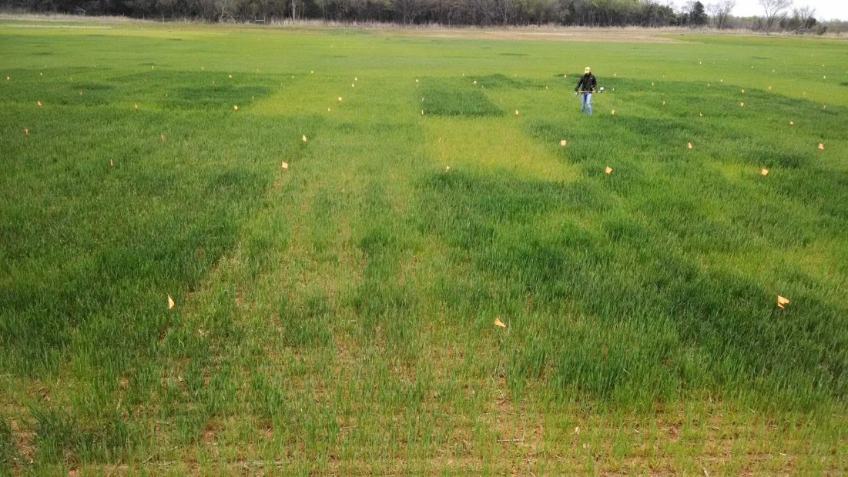
Research question
How does NDVI₆₆₀ collected with the Trimble Experimental Sensor relate to GreenSeeker NDVI₆₆₀?
Data collection
2013 and 2014
Wheat
Feekes 3 to 9
Corn
V6 to V12
Photo Courtesy of Jeremiah Mullock

Slide 23
Relationship with GreenSeeker: All Data

Slide 24
Relationship with GreenSeeker: Wheat Data

Slide 25
Relationship with GreenSeeker: Corn Data

Slide 26
Conclusions
Overall, good relationship between the GreenSeeker and Trimble experimental sensor
Clear differences between crops
Possible need for a calibration for corn to utilize current algorithms
Further evaluation of high biomass corn data

Slide 27
Questions?

