Slide 1
Adapt-N: A Cloud Computational Tool for Precision Nitrogen Management Chris Graham Harold van Es

Slide 2
Changing Paradigm: Nitrogen Management with Cloud Computational Tools
Universal access through web-based services
Move from generalized to adaptive, real-time, site-specific recommendations using information on
Weather
Local soils
Soil and crop management
Universal process-based approach
Incorporates system complexity, variability and risk
Real-time and post-season evaluations
Progressive improvement and refinement
Notes:
The approach we have taken is to develop a calibrated/tested simulation model combined with near-real time location-specific weather data
Computational tool we use (PNM model) is a dynamic simulation model, which I’ll briefly describe in the next slide. MENTION THIS: Dynamic simulation models: Represent the behavior of an object/process/system, usually expressed mathematically. Mathematical modeling is an accepted scientific practice. Models are used for many different purposes. They are used in agriculture in a variety of applications, including applications related to soil and crop management..)]
Why did we use this approach?
Go through list above.
Disadvantages: Rigorous calibration and testing are required if these are to be used as management tools. Testing can be difficult due to the large number of variables in the model.
Can change parameters (soils, management, etc.) for local (field/farm level)
Can change or have different sets of forcing/driving variables (climate) that we can also obtain at the local level
Incorporates complexity, projects how complex system will ‘unfold’ or change; disadvantage is that we have limited knowledge of some of the processes, and their representation is relatively crude.
BACKGROUND
Dynamic:
In agriculture, we are most often interested in how things change over time: weather, crop growth, soil water availability, soil N; As mentioned, dynamic models integrate components of a complex system and can provide quantitative descriptions of how that system and its components change over time. In the past, such models were not typically used in ag management but, given these advances, we believe these can be useful.
Mechanistic: PNM model is [largely] a mechanistic model.
What is mechanistic? Describes the behavior of a system by mathematical representation of the component or underlying processes contributing to that behavior. Application to ag: Recent advances in our understanding of some of the key processes in the soil-crop-atmosphere system combined with greatly increased computational power have allowed us to explicitly (i.e mathematically) represent these with reasonable model performance, thereby making the use of mechanistic models as management tools possible.
Because the PNM model is a dynamic, mechanistic model, it gives an integrated (and dynamic) view of whole-system behavior, e.g. N losses and crop N uptake over time for different climates/soils/N management inputs. Why is such a model useful for estimating N availability in soils? Unlike other plant nutrients, inorganic N, as NH4-N but particularly as NO3-N is subject to multiple [factors?] which can lead to leaching/gaseous losses/plant N uptake/fixation. These are all dynamic processes: result of a complex and constantly changing physical, chemical and biological soil environment.
Advantages: Allows broad application, as opposed to ‘Empirical’ models which are certainly very useful (model is based on equations describing observed relationships among experimental data, e.g., calculating N response curves) but don’t give any information beyond the original data or about the mechanisms responsible for the response. This limits the applicability of such models to the particular location/management practice from which the data to develop the model were obtained.(for example, how would N response curves change from year to year or on different soil types).
Because of its much broader applicability (due to representation of the processes contributing to a system response, e.g. changes in soil N over time), mechanistic models offer more possibilities for manipulating and improving a system.
Disadvantages: Rigorous calibration and testing are required if these are to be used as management tools. Testing can be difficult due to the large number of variables in the model.
Note that these interact in complex way; argument for sophisticated tools like models if well-calibrated/tested.
Able to represent component processes/linkages/changes over time.
[More verbage from other talks?]

Slide 3
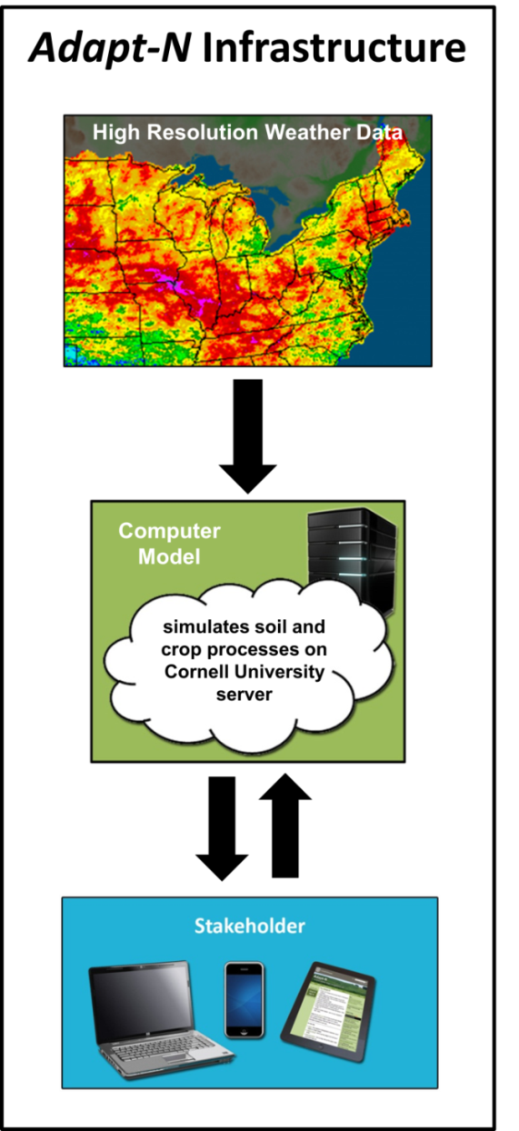
Adapt-N History
1970’s through early 2000’s: field research on space-time aspects of N response to fertilizer (response trials, lysimeter studies, etc.)
1980’s to early 2000’s: model development (LEACHM, Sinclair model, combined into PNM model)
2004-2007: Semi-weekly adaptive N recommendations through email
2008-2013: Adapt-N tool available through web-based user interface
2011-2014: extensive field testing through on-farm trials
2014: Adapt-N licensed and commercialized through Agronomic Technology Corporation
Notes:
Field testing from 2011. Licensed this year

Slide 4
What factors does Adapt-N include in making a recommendation?
High resolution daily precipitation & temperature data
Soils: texture/soil type, slope, rooting depth, % organic matter (NRCS databases)
N fertilizer applications: rate, type, timing, placement
Cultivar: Silage, grain, or sweet corn; planting date, maturity class
Population and expected yield
Tillage: fall or spring plowing; conservation tillage/residue management
Manure applications: date, rate, N analysis, incorporation info
Rotations: soy, corn - silage or grain, or sod - last 3 yrs, % legume, surface killed or incorporated
Irrigation amounts and dates
Fertilizer and grain prices & profit loss risk
Notes:
Takes too long to go over this but please read over to see some of the facets that go into making a recommendation

Slide 5
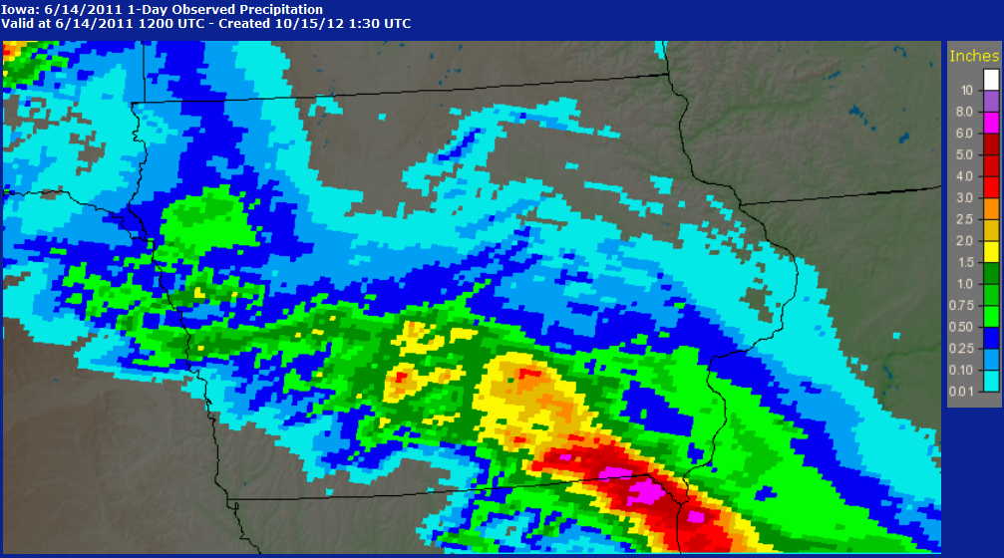
High Resolution Climate Data (4x4 km)
Critical Input to Adapt-N Tool
Iowa, June 14, 2011
Notes:
Obtained through regional climate centers (NOAA)
Error corrected through ground truthing

Slide 6
Adapt-N Commercialization through Agronomic Technology Corporation
Public-private partnership, independent from product sales
Scientific integrity with continued advancements
Integration with complementary technologies (farm GIS, data mgmt, field application softwares)
Better organization-level functionality and customization
Commercial data center (bigger Cloud)
Notes:
Licensed through a startup
At a commercial data center

Slide 7
Adapt-N.com
Notes:
This is the homepage

Slide 8
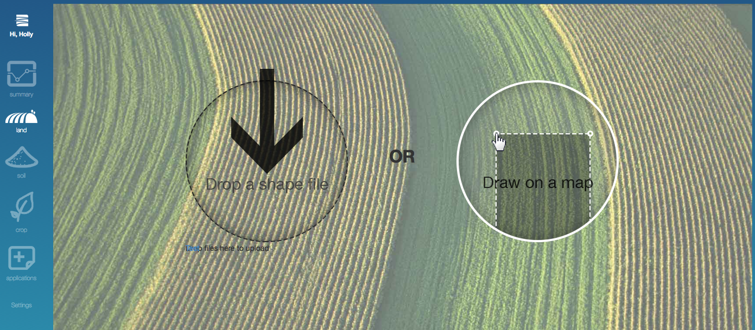
Adapt-N Interface Defining your location
Notes:
Can use a shapefile of the farm or draw out the location

Slide 9
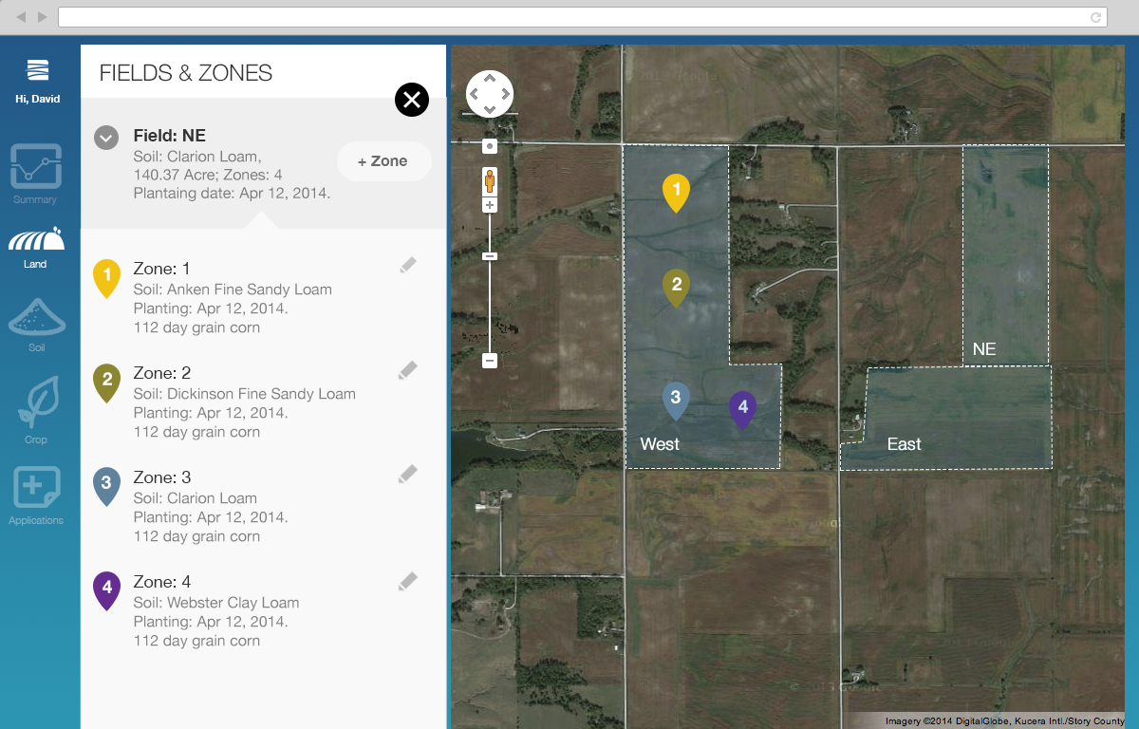
Adapt-N Interface Viewing your locations
Do soil types get added here instead of in soils tab?
Get new screenshots that have one scenario all the way through with realistic info already in the system, a recommendation, and pdf

Slide 10
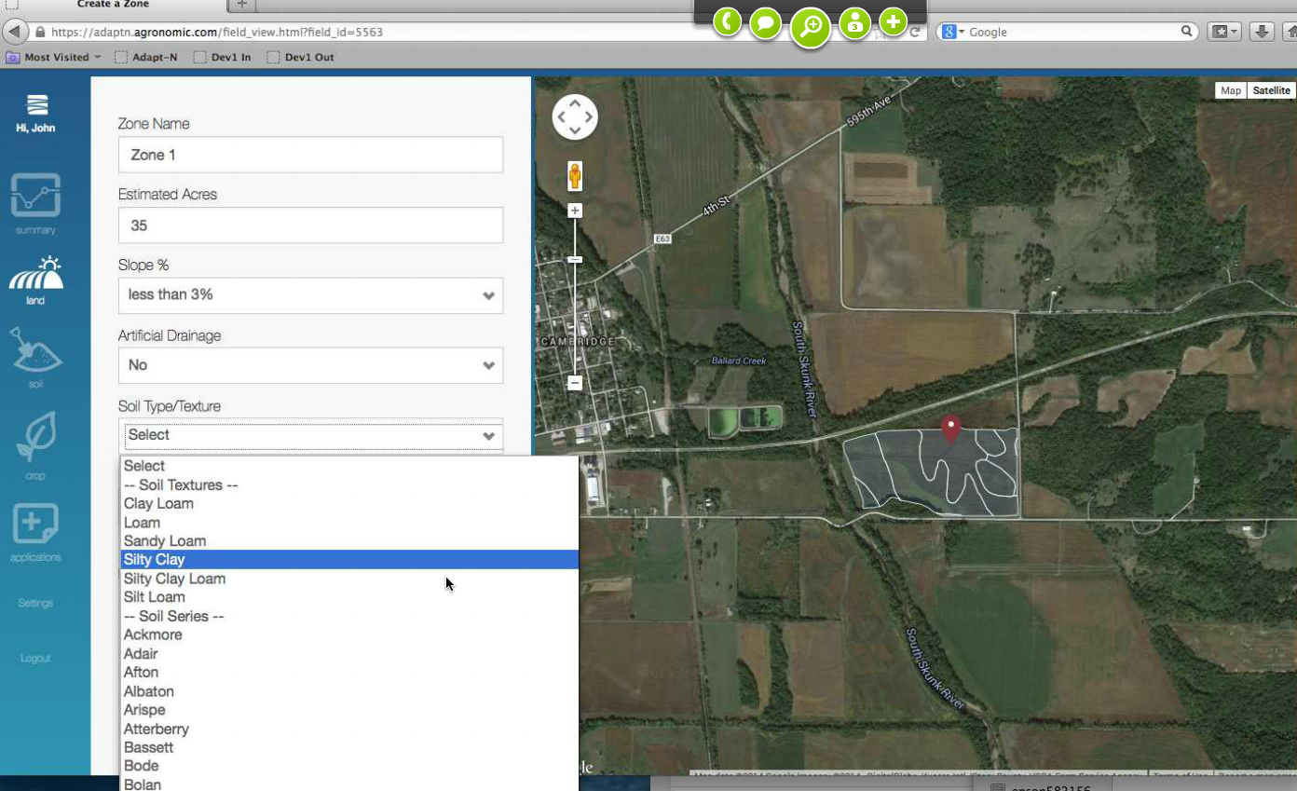
Adapt-N Interface Entering Soil Information

Slide 11
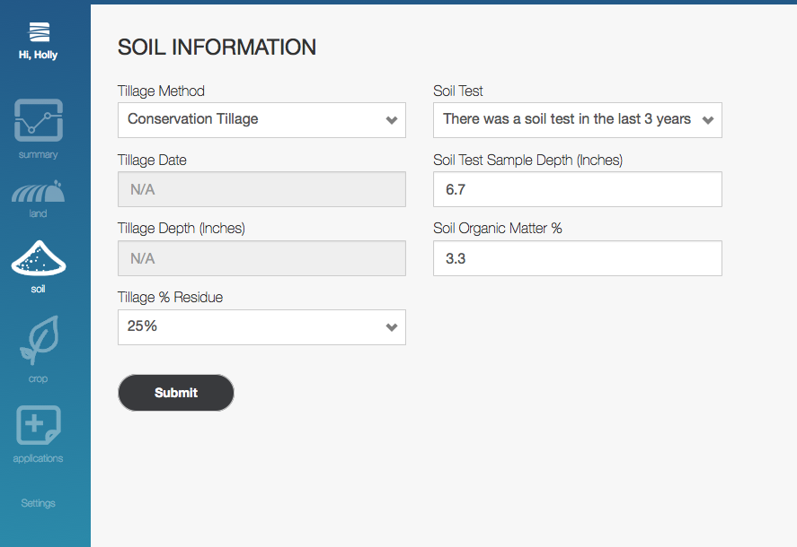
Adapt-N Interface Entering Soils Information
Need new screenshot that has soil type/texture input and rooting depth input (and drainage toggle switch?)
Good to show bulk editing tray in one of these all

Slide 12
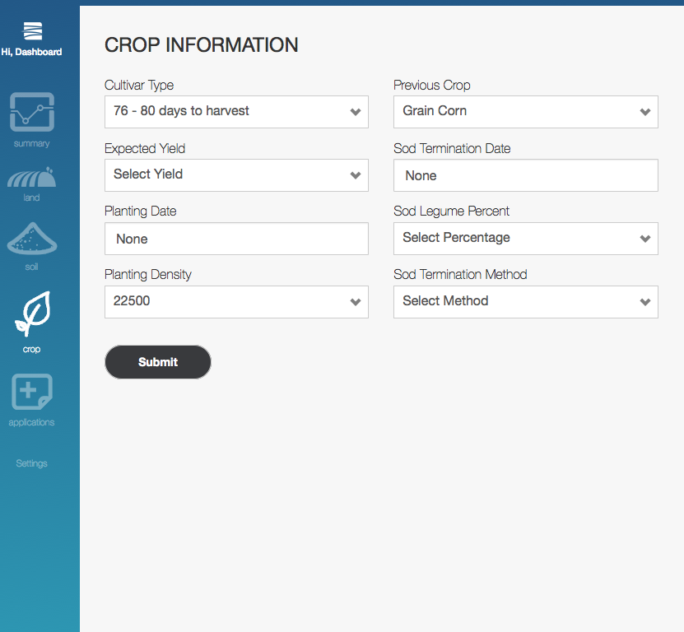
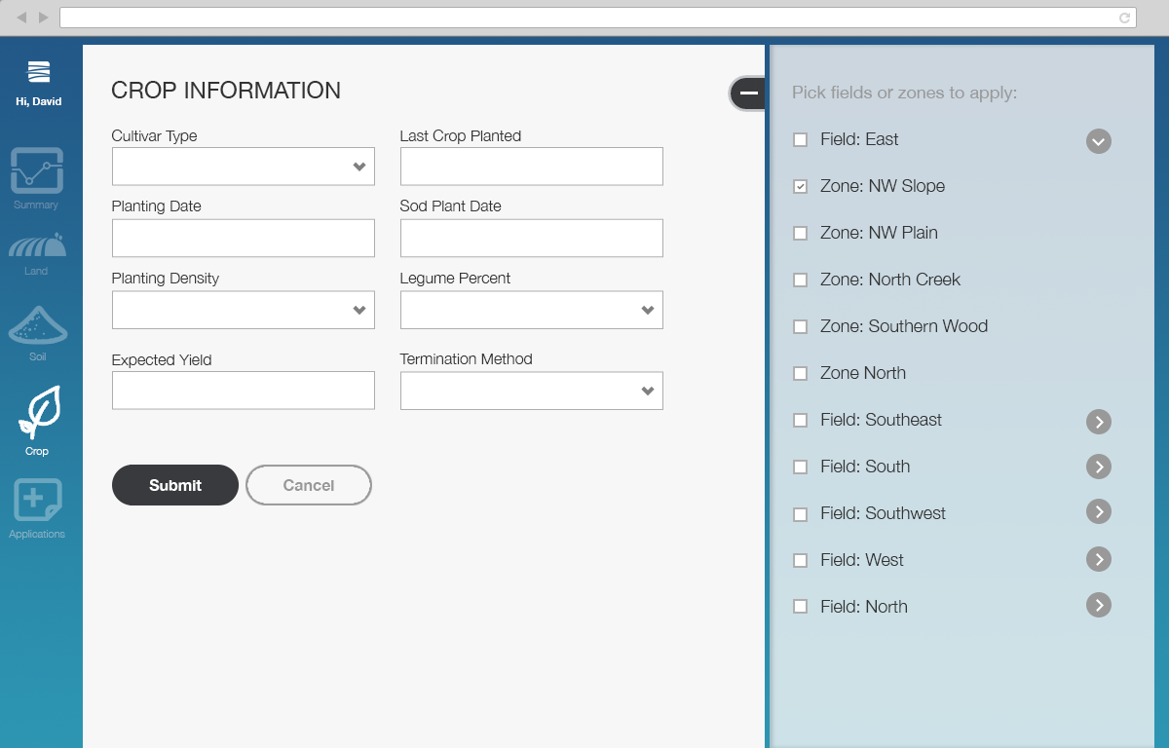
Adapt-N Interface Entering Crop Information
Notes:
Generally take the 4th best yield out of the past 5 years

Slide 13
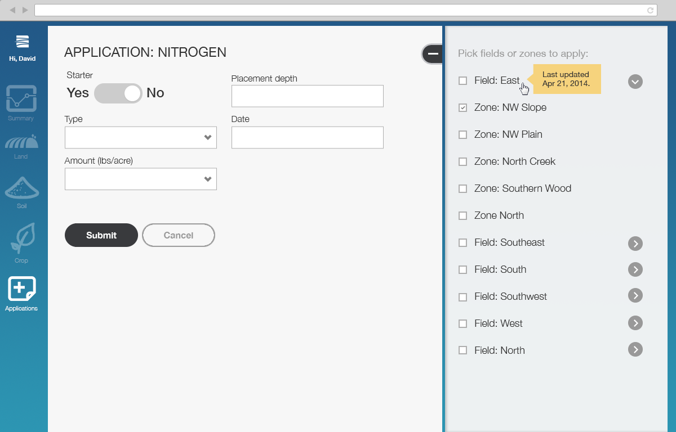
Adapt-N Interface Entering N Fertilizer Inputs
Notes:
What fertilizer has already been applied

Slide 14
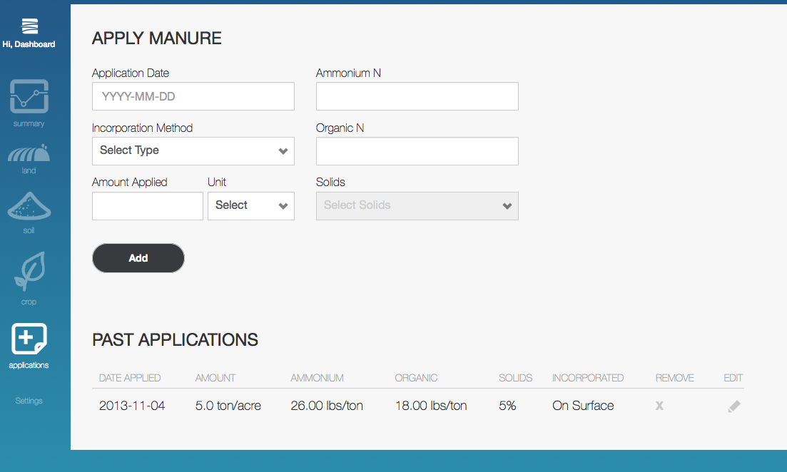
Adapt-N Interface Entering Manure Inputs

Slide 15
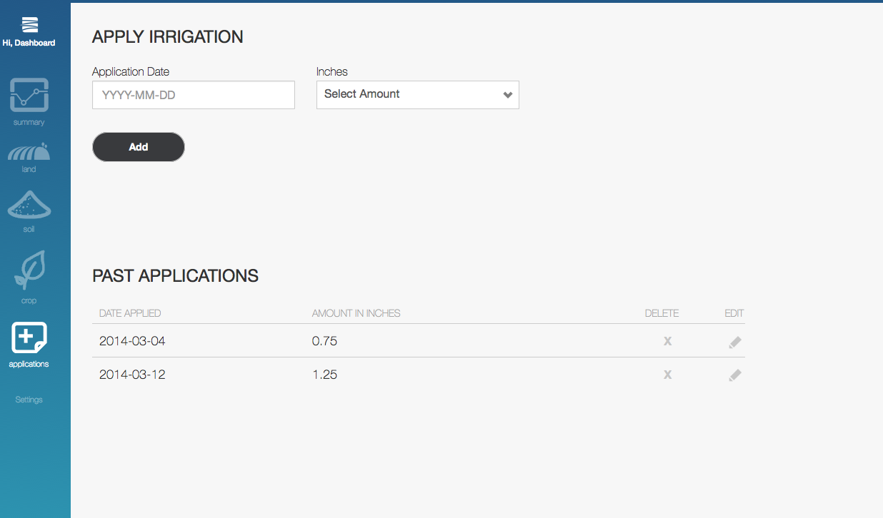
Adapt-N Interface Entering Irrigation Inputs

Slide 16
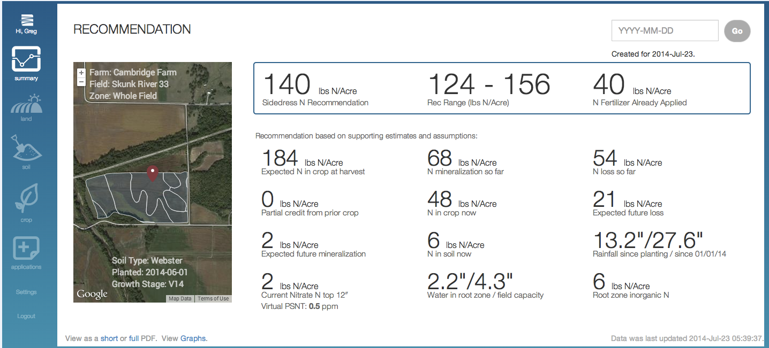
Zone Recommendation
Date selection

Slide 17
Farm Summary
Notes:
Summary of the total farm recommendations. Dashboard view.

Slide 18
Agronomist Summary
Notes:
Summarizes multiple farms. Overview of every field that an agronomist is managing

Slide 19
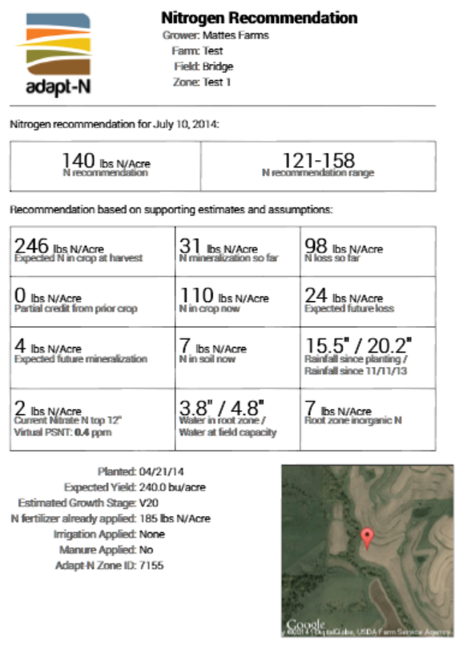
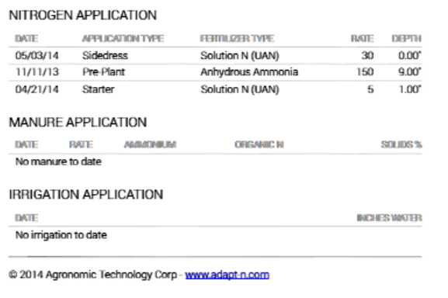
Standard Report - PDF
Notes:
Generates a pdf report as well

Slide 20
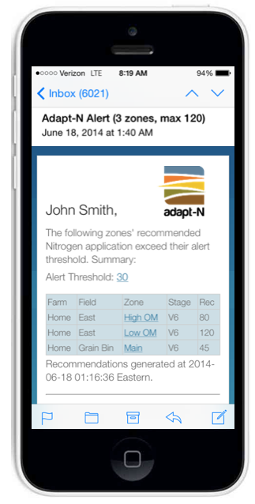
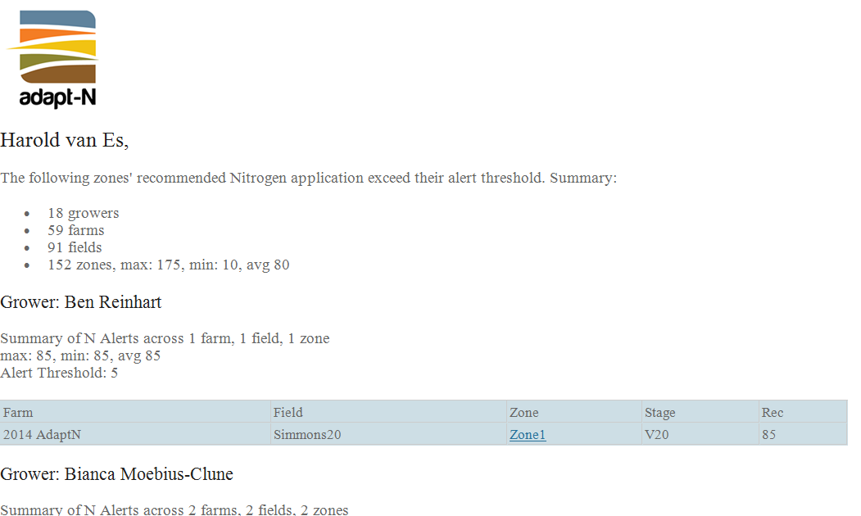
Daily Alerts
Text
Notes:
Email summary to track on a daily basis the N status

Slide 21
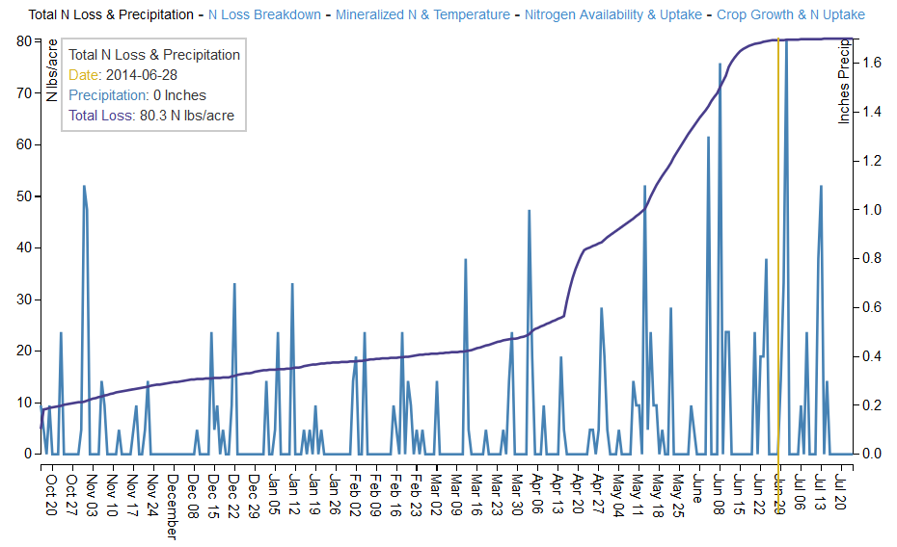
Adapt-N Graphs
Precipitation and Total N Loss
Notes:
The brown bar can be moved to get a daily value
Simulation starts at Fall if there was an application

Slide 22
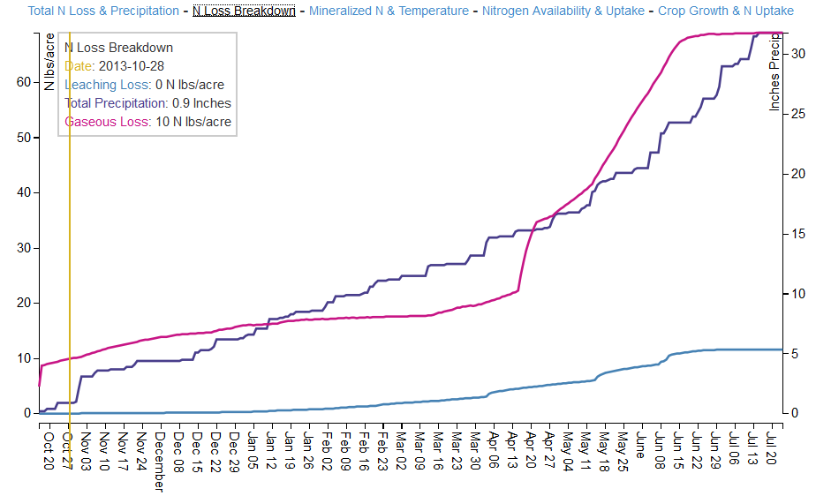
Adapt-N Graphs
cumulative precipitation; leaching and gaseous N losses

Slide 23
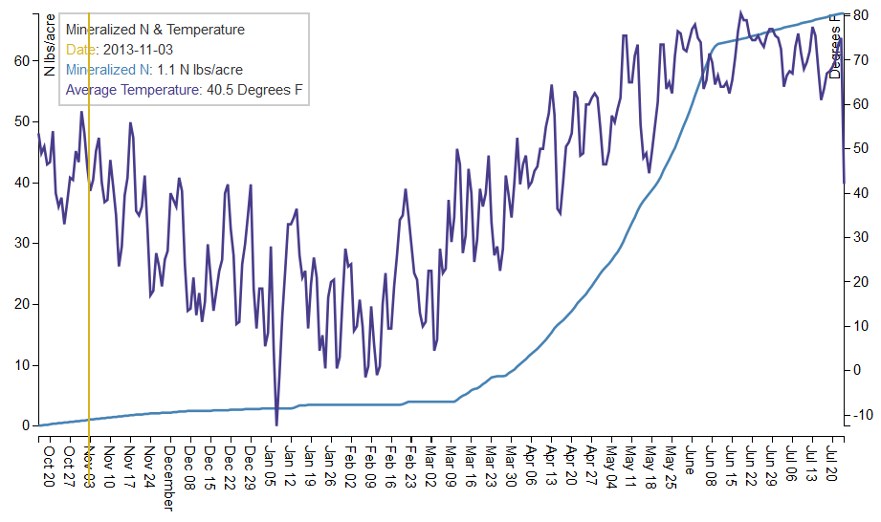
Adapt-N Graphs
Mineralized N and Temperature

Slide 24
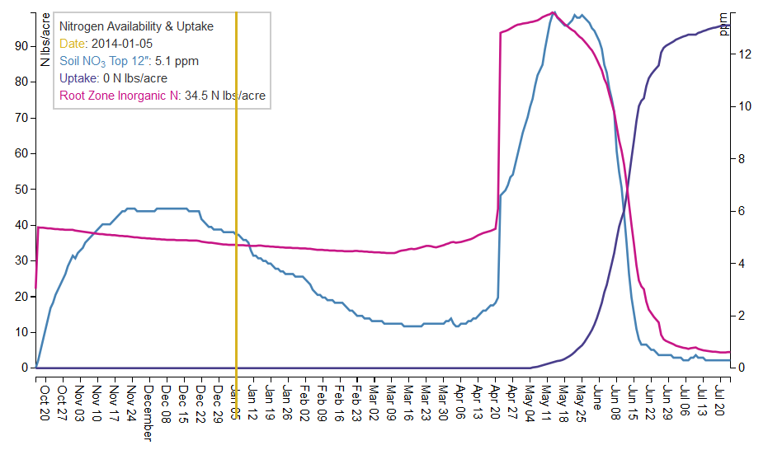
Adapt-N Graphs
Nitrogen Availability and Uptake

Slide 25
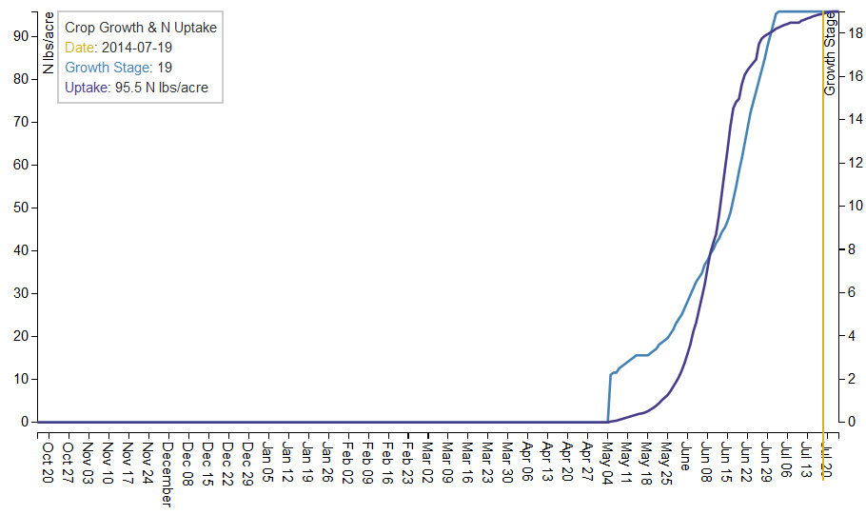
Adapt-N Graphs
Crop Growth and N Uptake

Slide 26
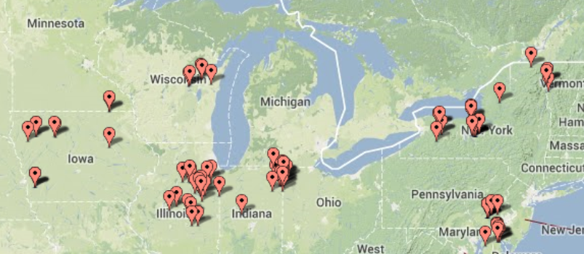
2011 – 2013 Adapt-N On-Farm Trials
Over 100 replicated trials in 10 states.
Adapt-N vs. Grower rate: side-by-side; some with zero-N
N response trials (4-6 N rates)

Slide 27
Overall Adapt-N Performance 2011-2013, New York and Iowa
Average Change due to Adapt-N use (Adapt-N - Grower-N) | By State |  | By N rate change |  | Grand Mean
 | NY trials | IA trials | N decrease (A<G) | N increase (A>G)
 | n=67 | n=37 | n=87 | n=17 | n=104
Total N fertilizer applied (lb/ac) | -52 | -29 | -60 | 38 | -44
Simulated N leaching loss (lb/ac)* | -11 | -1 | -10 | 3 | -8
Simulated N total loss (lb/ac)* | -36 | -4 | -34 | 16 | -26
Yield (bu/ac equivalent) | 2 | 0 | -2 | 17 | 1
Profit ($/ac) | $37 | $17 | $23 | $65 | $30
Notes:
Have shown reductions of 60 lbs N with only 2 bushel difference
Higher response when Adapt N increases the N rate

Slide 28
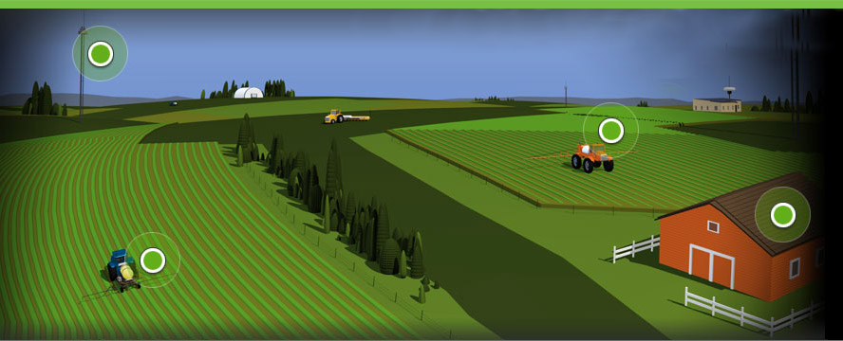
Adapt-N: In-progress
Nitrous oxide losses (NIFA-AFRI project)
Cover crops and soil health (NIFA-SARE project)
Integration with farm GIS and data management software
Enhanced efficiency
compounds
Canopy sensors?
Image by Raven-Slingshot
Notes:
- Expansion into combining canopy sensors into the modeling approach to manage some of the variability

Slide 29
Adapt-N Active Zones - July 2014
Notes:
This is where it is being used

Slide 30
Bottom Line: What are Adapt-N’s Benefits?
Profit increases, with overall less N use
Economic and environmental benefits
Transparency and insights
Incentives for better management

Slide 31
Acknowledgements
Adapt-N Core Team
Harold van Es
Jeff Melkonian
Art DeGaetano
Laura Joseph
Bianca Moebius-Clune
Bob Schindelbeck
MGT Envirotec – Iowa
Agronomic Technology Corporation
Funders
USDA-NIFA Special Grant
USDA-AFRI
Northern New York Agricultural Development Program
New York Farm Viability Institute
USDA-NRCS
McKnight, Packard and Walton Family Foundations
Environmental Defense Fund
International Plant Nutrition Institute

Slide 32
N Recommendation Methodology: deterministic-stochastic mass balance
Input:
Expected Yield
Near-Real-Time
Simulation at Sidedress
SidedressNrate = CropN_{Harvest} - CropN_{Current} - SoilN_{Current} - SoilN_{postsidedress} - SoybeanN_{credit} + NLoss_{postapplication} - Correct_{profit}
simulated & partial fixed credit
Probabilistic simulations

