Slide 1
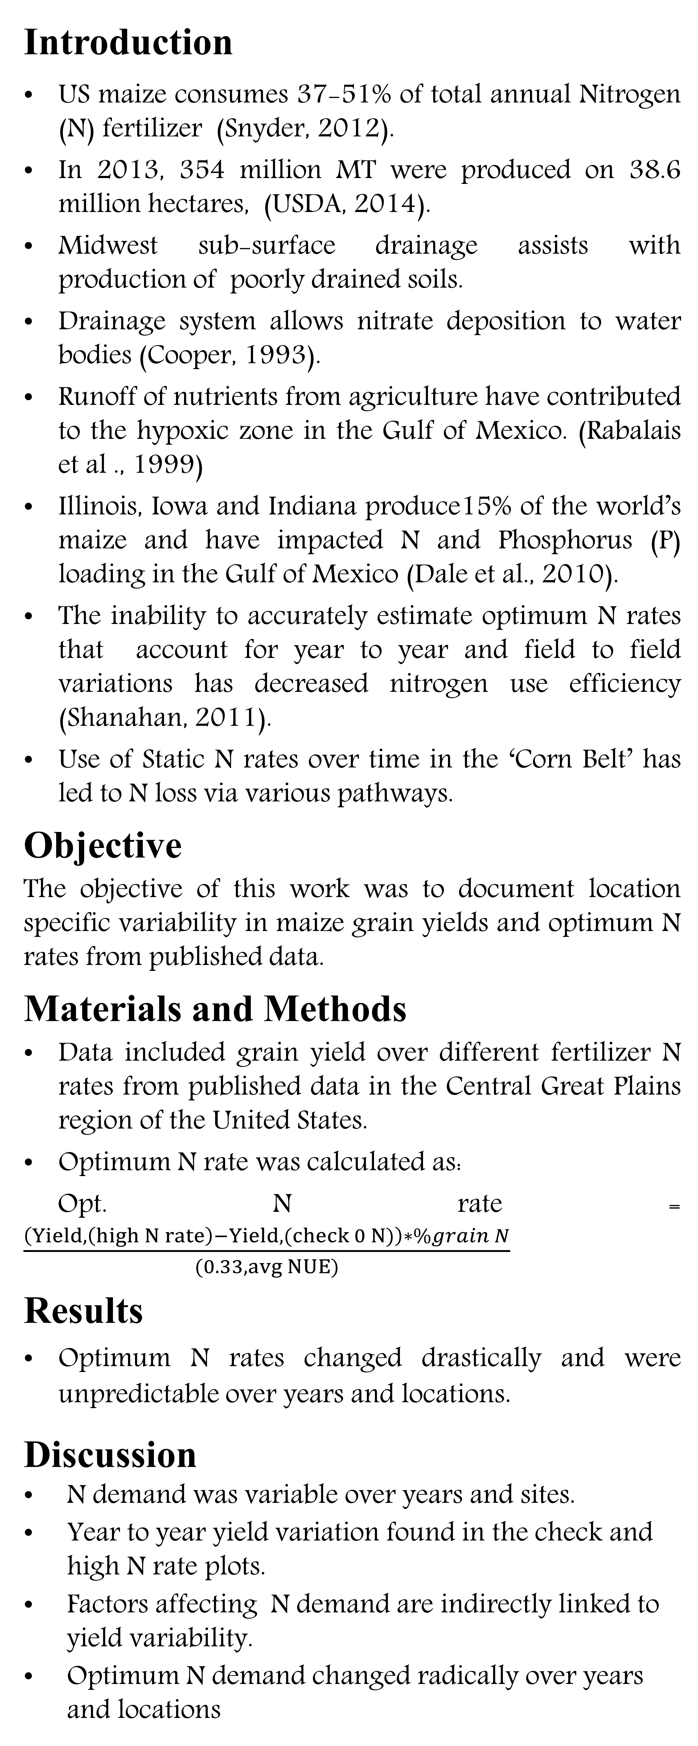
Variability in Optimum N Rates for Maize in the Midwest
Sulochana Dhital, Natasha Macnack, and William Raun
Plant and Soil Sciences Department, Oklahoma State University
Introduction
US maize consumes 37-51% of total annual Nitrogen (N) fertilizer (Snyder, 2012).
In 2013, 354 million MT were produced on 38.6 million hectares, (USDA, 2014).
Midwest sub-surface drainage assists with production of poorly drained soils.
Drainage system allows nitrate deposition to water bodies (Cooper, 1993).
Runoff of nutrients from agriculture have contributed to the hypoxic zone in the Gulf of Mexico. (Rabalais et al ., 1999)
Illinois, Iowa and Indiana produce15% of the world’s maize and have impacted N and Phosphorus (P) loading in the Gulf of Mexico (Dale et al., 2010).
The inability to accurately estimate optimum N rates that account for year to year and field to field variations has decreased nitrogen use efficiency (Shanahan, 2011).
Use of Static N rates over time in the ‘Corn Belt’ has led to N loss via various pathways.
Objective
The objective of this work was to document location specific variability in maize grain yields and optimum N rates from published data.
Materials and Methods
Data included grain yield over different fertilizer N rates from published data in the Central Great Plains region of the United States.
Optimum N rate was calculated as:
Opt. N rate = $\frac{\left(Yield, \left(high N rate\right)−Yield, (check 0 N)\right)∗\%grain N}{(0.33, avg NUE)}$
Results
Optimum N rates changed drastically and were unpredictable over years and locations.
Discussion
N demand was variable over years and sites.
Year to year yield variation found in the check and high N rate plots.
Factors affecting N demand are indirectly linked to yield variability.
Optimum N demand changed radically over years and locations
Table 1. Maize grain yield for the high N rate and optimum N rate from 233 site years of published data in the Central Great Plains, United States, 1958-2010.
Source | Loc. | Years | High N Yield Range | Check plot Yield Range | Optimum N rate
 |  |  | Mg ha⁻¹ | Mg ha⁻¹ | Min | Max | Avg.
Bundy et al. (2011) | WI | 21(1958-1983) | 4.3-8.8 | 1.57-7.59 | 46 | 213 | 119
Bundy et al. (2011) | WI | 24(1984-2007) | 5.7-14.1 | 1.67-5.58 | 143 | 334 | 238
Mallarino and Torres (2006) | IA | 32(1979-2010) | 5.1-12.5 | 0.75-5.91 | 75 | 314 | 193
Mallarino and Torres (2006) | IA | 26(1985-2010) | 5.3-12.8 | 1.4-6.3 | 123 | 332 | 214
Varvel et al. (2007) | NE | 11(1995-2005) | 10.4-13.6 | 3.5-10.9 | 67 | 280 | 191
Jokela et al.(1989) Carroll | MN | 3(1982-1984) | 7.1-9.1 | 5-7.3 | 5 | 120 | 77
Jokela et al.(1989) Webster | MN | 3(1982-1984) | 1.8-8.7 | 1.7-5.6 | 64 | 103 | 84
Fenster et al. (1978) Waseca | MN | 7(1970-1976) | 7.12-10.65 | 2.71-7.43 | 55 | 227 | 140
Fenster et al. (1978) Martin | MN | 7(1970-1976) | 4-9.6 | 3.8-8.2 | 21 | 116 | 62
Fenster et al. (1978) Martin | MN | 6(1971-1976) | 6.2-12 | 6.2-11.3 | 0 | 34 | 15
Al Kaisi et al.(2003) | CO | 3(1998-2000) | 5-14.1 | 3.53-12.57 | 24 | 126 | 84
Ismail et al.(1994) NT | KY | 20(1970-1990) | 5.2-10.9 | 2.1-7.4 | 31.7 | 211 | 117
Ismail et al.(1994) CT | KY | 20(1970-1990) | 3.5-10.4 | 1.9-9.5 | 0 | 186 | 90
Rice et al.(1986) NT | KY | 16(1970-1985) | 5.7-9.2 | 3.1-4.9 | 93 | 163 | 132
Rice et al.(1986) CT | KY | 16(1970-1985) | 5-8.8 | 1.9-6.1 | 63 | 187 | 114
Stecker et al.(1993) | MO | 3(1988-1990) | 6.04-10.13 | 3.32-5.59 | 91 | 178 | 140
Stecker et al.(1993) | MO | 3(1988-1990) | 6.7-9.9 | 4.54-7.2 | 42 | 167 | 94
Stecker et al.(1993) | MO | 2(1989-1990) | 8.2-8.5 | 4.95-5.98 | 82 | 108 | 95
Peterson et al.(1989) | NE | 4(1983-1986) | 3.9-10 | 2.1-6.4 | 10 | 200 | 96
Woodruff et al.(1984) | SC | 3(1974-1976) | 13-20.2 | 1.04-15.6 | 0 | 639 | 302
Eck (1984) | TX | 3(1977-1979) | 3.41-13.21 | 1.79-5.03 | 13 | 300 | 146
Total |  | 233 |  | average | 50 | 216 | 131
 |  |  |  | stdev | 41 | 127 | 66
At some sites the 0-N check plot yielded almost the same as the high N rate plot after years of continuous maize production.
Ideally, N rates should change from year to year.
Growers need to consider that the demand for fertilizer N should change from year to year.
Conclusions
Static N recommendations do not account for the variability in soil available N and maize N uptake as influenced by weather.
Need to reconsider the common practice of applying the same N fertilizer rates over time.
References
Al-Kaisi, M. M., and X.Yin. 2003. Effects of nitrogen rate, irrigation rate, and plant population on corn yield and water use efficiency. Agron. J. 95(6), 1475-1482.
Bundy, L.G., T.W. Andraski, M.D. Ruark, and A.E. Peterson. 2011. Long-term continuous corn and nitrogen fertilizer effects on productivity and soil properties. Agron. J. 103:1346–1351.
Cooper, C.M. 1993. Biological effects of agriculturally derived surface water pollutants on aquatic systems—A review. J. Environ. Qual.22:402–408.
Eck, H. V. (1984). Irrigated corn yield response to nitrogen and water. Agron. J. 76(3), 421-428.
Fenster, W. E., C. J. Overdahl, G.W. Randall, and R. P. Schoper.1978. Effect of nitrogen fertilizer on corn yield and soil nitrates . (Vol. 153) Misc. Rept 153-1978. Agr. Exp. Station. U. of Minnesota, St. Paul.
Ismail, I., R.L. Blevins, and W. W. Frye. 1994. Long-term no-tillage effects on soil properties and continuous corn yields. Soil Sc. Soc. Am. J. 58(1), 193-198
Jokela, W. E., and G. W. Randall. 1989. Corn yield and residual soil nitrate as affected by time and rate of nitrogen application. Agron. J. 81(5), 720-726.
Mallarino, A.P., and E. Ortiz-Torres. 2006. A long-term look at crop rotation effects on corn yield and response to N fertilization. In: The Integrated Crop Management Conference Proceedings, Ames, IA. 29–30 Nov. 2006. Iowa State Univ. Ext. Ames. p. 209–213.
Peterson, T. A., and G. E. Varvel. 1989. Crop yield as affected by rotation and nitrogen rate. III. Corn. Agron. J. 81:735-738..
Rabalais, N. N., R. E. Turner, D. Justic, Q. Dortch, and W. J. Wiseman. 1999. Characterization of hypoxia. Rep.for the integrated assessment of hypoxia in the northern Gulf of Mexico. NOAA Coastal Ocean Program Decision Analysis Ser.No. 18. NOAA Coastal Ocean Program, Silver Spring, Md.
Randall, Gyles W., Jeffrey A. Vetsch, and Jerald R. Huffman. 2003. Corn production on a subsurface-drained mollisol as affected by time of nitrogen application and nitrapyrin. Agron. J. 95:1213-1219.
Rice, C. W., M.S. Smith, and R.L. Blevins. 1986. Soil nitrogen availability after long-term continuous no-tillage and conventional tillage corn production. Soil Sc. Soc. Am. J. 50 (5), 1206-1210.
Stecker, J. A., D. D. Buchholz, R.G. Hanson, N.C. Wollenhaupt and K. A. McVay. 1993. Broadcast nitrogen sources for no-till continuous corn and corn following soybean. Agron. J. 85(4), 893-897.
Shanahan, J. 2011. Determining Optimum Nitrogen Rates for corn. Crops Insights, Vol. 20, No. 6 Pioneer Hi-Bred, Johnston, IA.
United States Department of Agriculture. 2014. Crop Production 2013 Summary. National Agricultural Statistics Service. Jan. ISSN:1057-7823.
Varvel, G.E., W.W. Wilhelm, J.F. Shanahan, and J.S. Schepers. 2007. An algorithm for corn nitrogen recommendations using a chlorophyll meter based sufficiency index. Agron. J. 99:701-706.
Vetsch, J. A., and G. W. Randall. 2004. Corn production as affected by nitrogen application timing and tillage. Agron. J. 96(2), 502-509.
Woodruff, J. R., J.T. Ligon, and B. R. Smith. 1984. Water table depth interaction with nitrogen rates on sub-irrigated corn. Agron. J. 76(2), 280-283.

