Slide 1
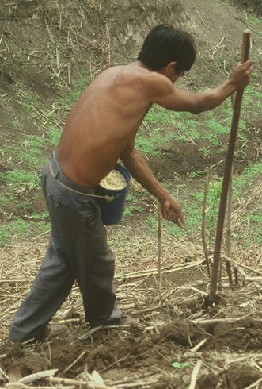
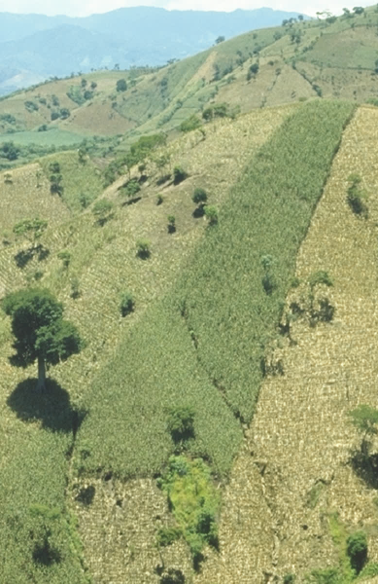
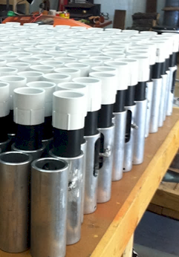
OSU Hand Planter, What this means for NUE
Lawrence Aula, Bruno Figueiredo, Peter Omara, Jagmandeep Dhillon, Jeremiah Mullock, Randy Taylor, Nyle Wollenhaupt, Adrian Koller,
Sulochana Dhital, Natasha Macnack, Eric Miller,
Edgar Ascencio, CIMMYT

Slide 2
Maize (FAOSTAT, 2012)
Area, ha Production, Mt Avg. Mt/ha
World 177,380,000 872,066,770 4.9 (78 bu/ac)
USA 35,359,790 273,832,130 7.8 (124 bu/ac)
China 34,966,000 208,234,649 6.1 (97 bu/ac)
Brazil 14,198,496 71,072,810 5.1 (81 bu/ac)
Low income Food Deficit Countries
48,280,856 115,633,219 2.4 (38 bu/ac)
60% hand planted
28,968,510
USA 2014, 37,125,000 ha’s

Slide 3
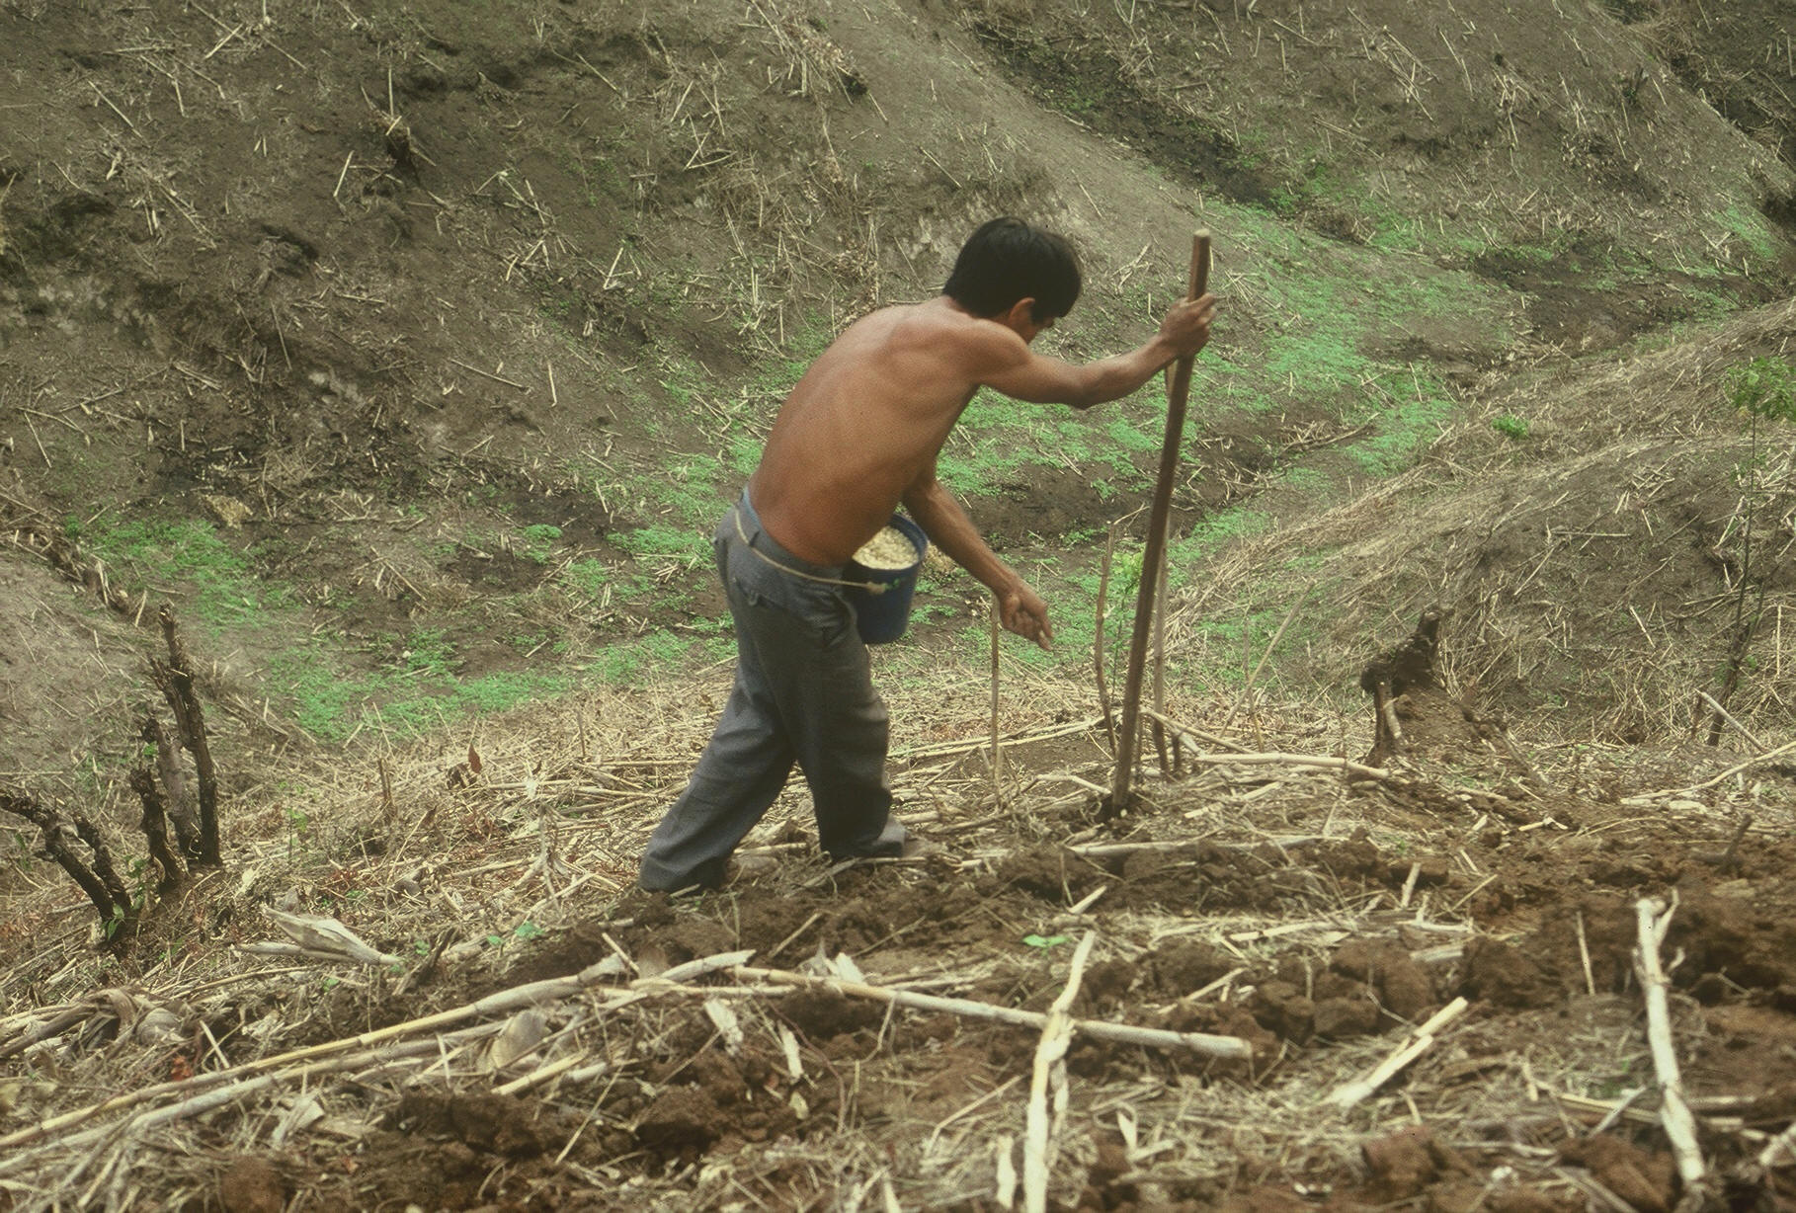

Slide 4
World area planted by hand ≈ corn area in the USA
Developing world, avg. farm size = 1 ha
NGO support, interaction, source for subsidizing planters
By 2050 there will be 9.1 billion people.
Increase of 30%
Food production during the same period will have to increase 70%
95% of the increased population will be in the developing world
Alexandratos, N. and J. Bruinsma. 2012. World agriculture towards 2030/2050: the 2012 revision. ESA Working paper No. 12-03. Rome, FAO.

Slide 5
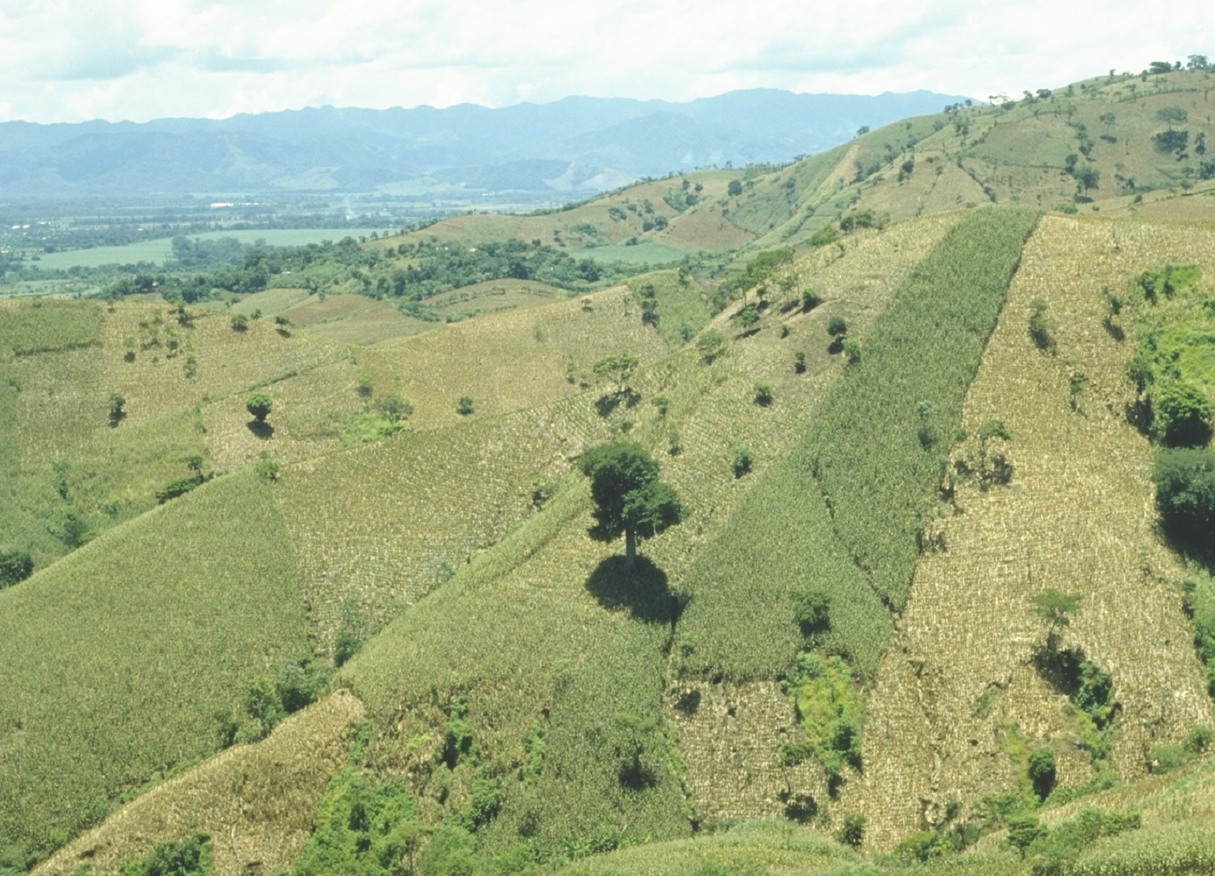
EL SALVADOR

Slide 6
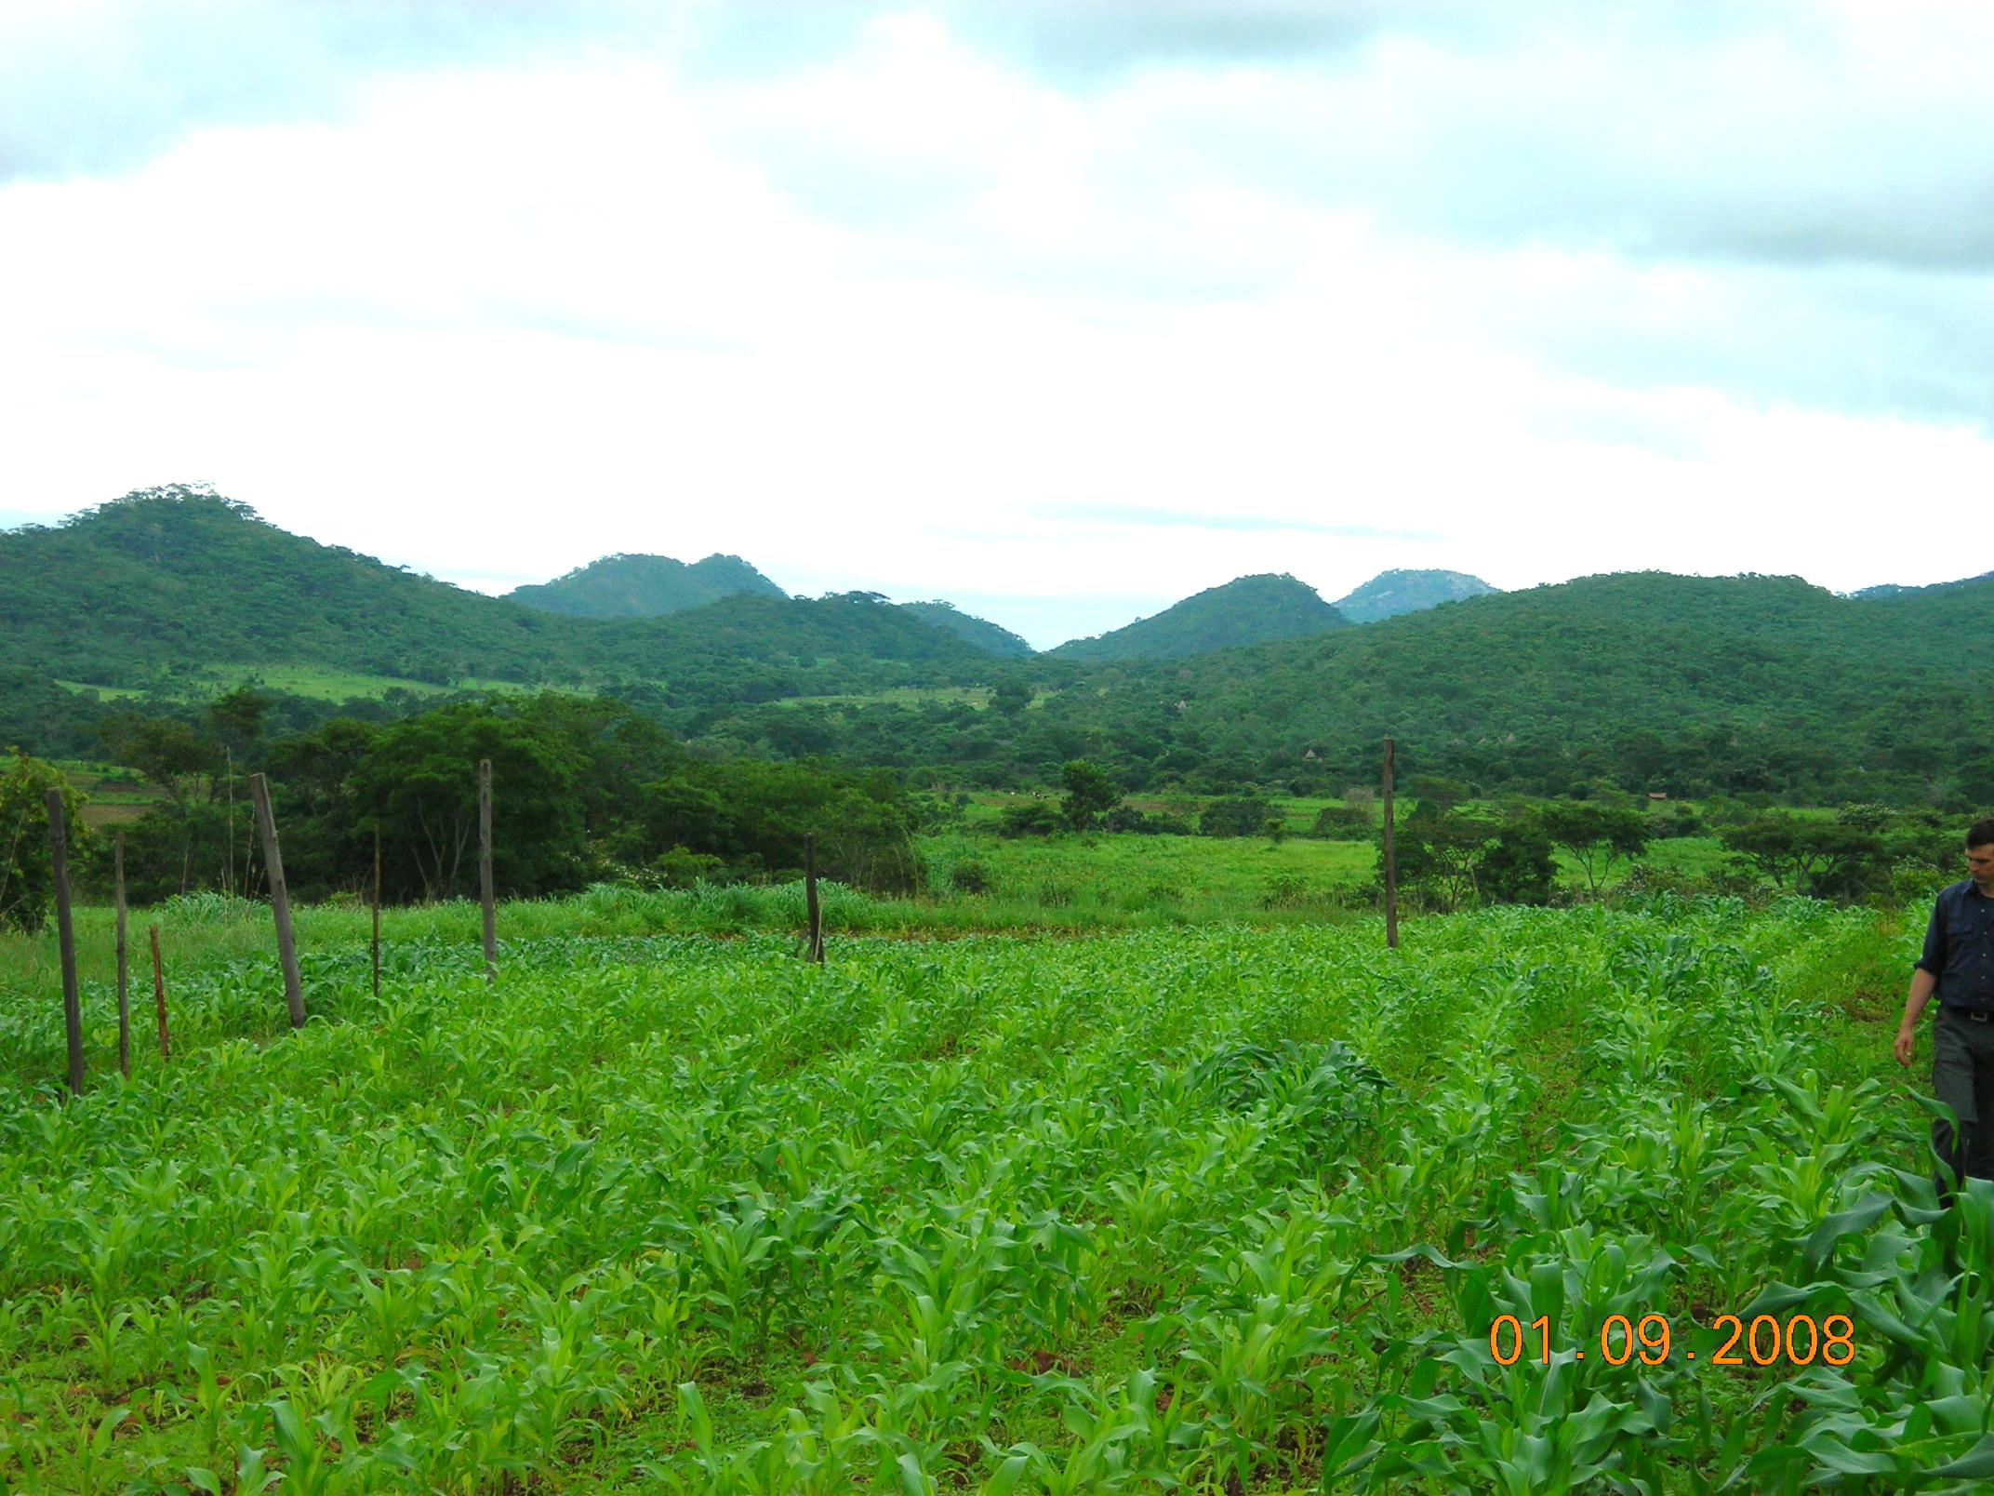
ZIMBABWE

Slide 7
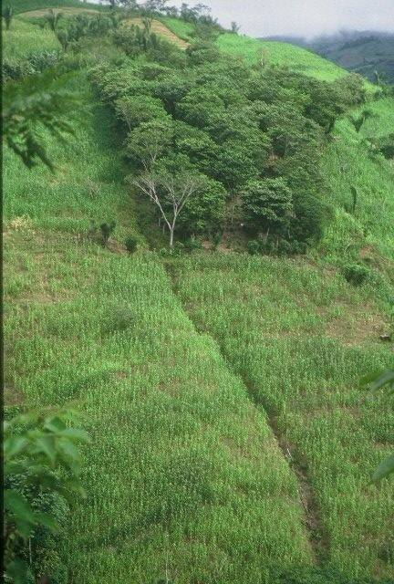
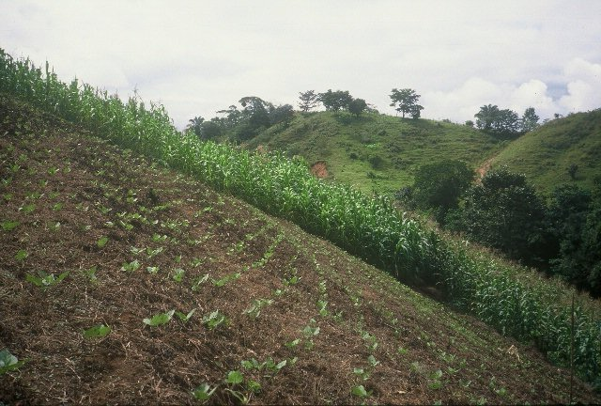
HONDURAS

Slide 8
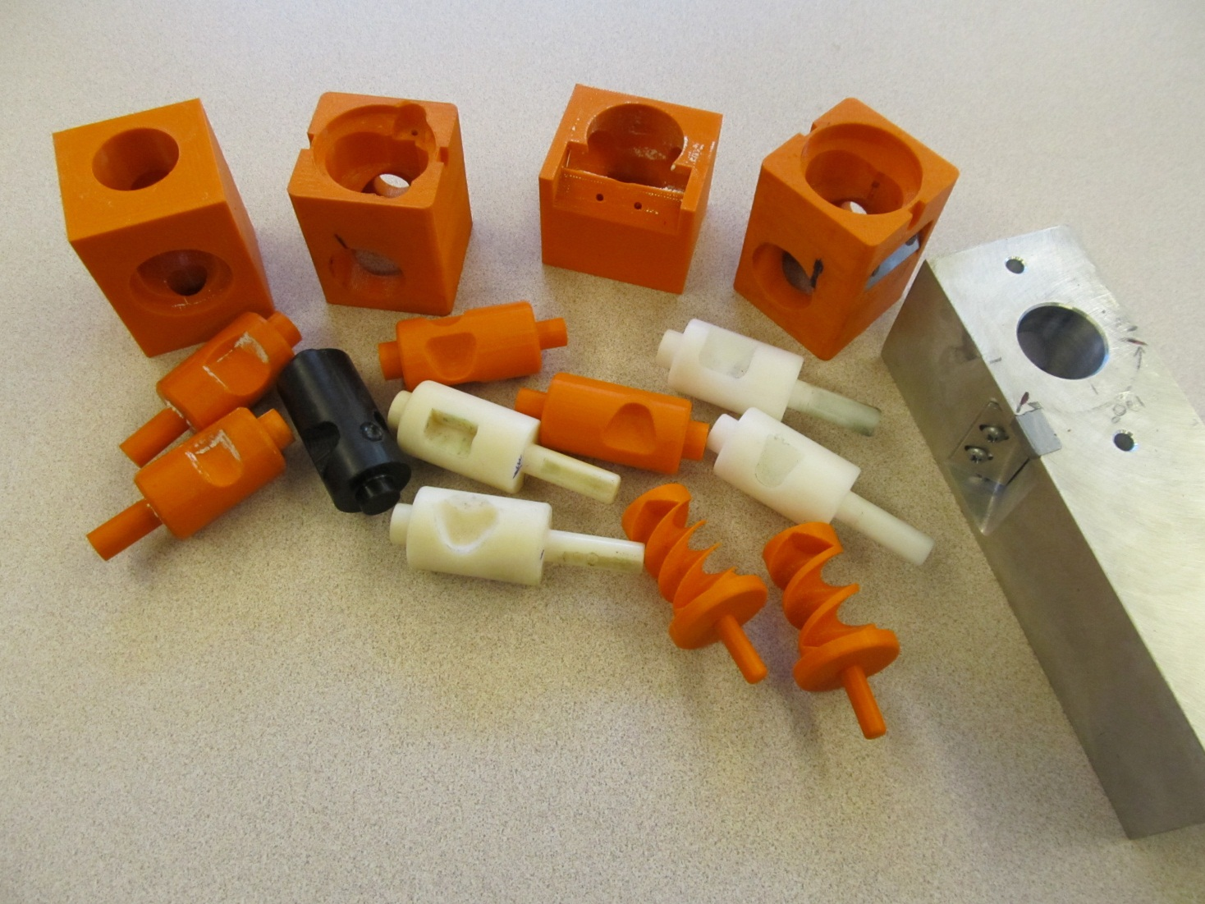
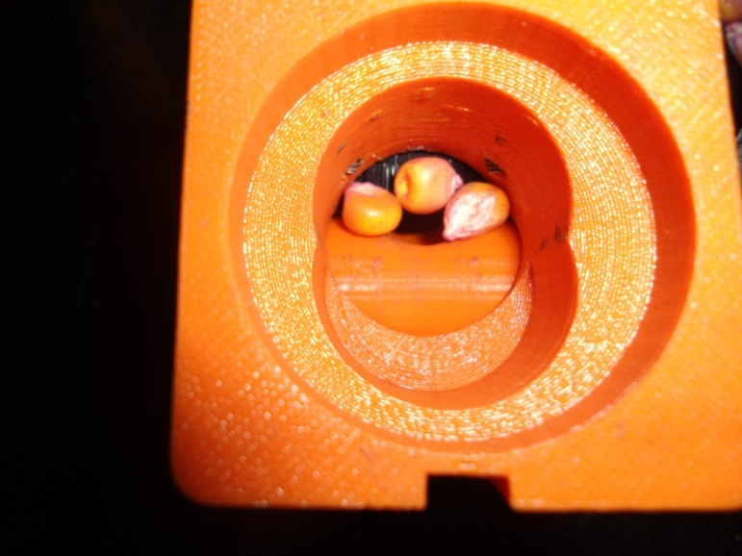
Singulation Design

Slide 9
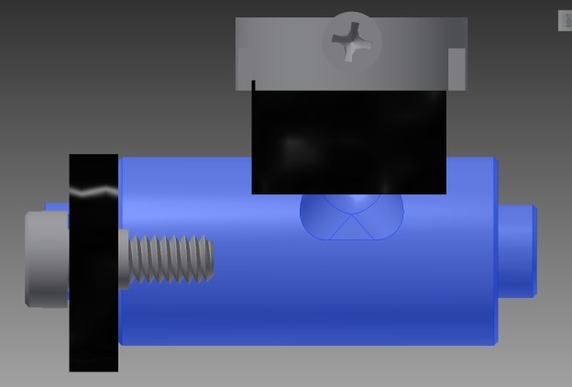
Reciprocating Drum Action
Drum rotates with the cavity moving back into the seed hopper as the spring is compressed.
Spring is fully compressed and the singulation drum cavity is exposed to seed in the hopper
Drum position when planter is relaxed.
As the force on the spring is released, the singulation drum rotates back to the initial ‘relaxed’ position and the seed is dropped.

Slide 10
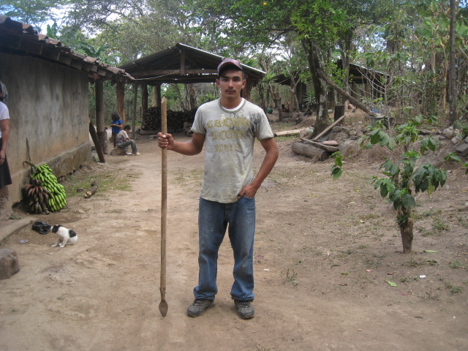
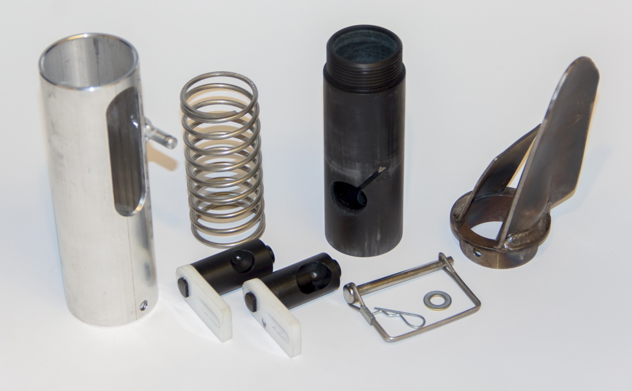
seed size (2653-4344 seeds/kg) seed type, shape
fertilizer
1,000,000 cycles
0.29g/seed
60,000 seeds/ha
3443 seeds/kg
1.0 kg hopper
17 times refill
http://nue.okstate.edu/Hand_Planter.htm

Slide 11
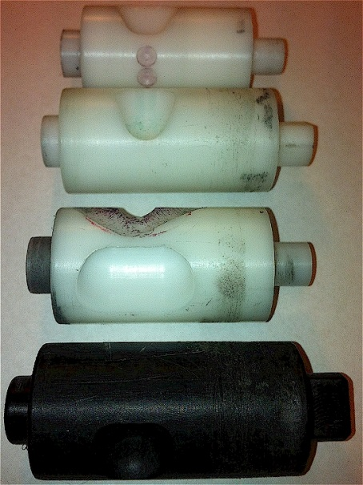
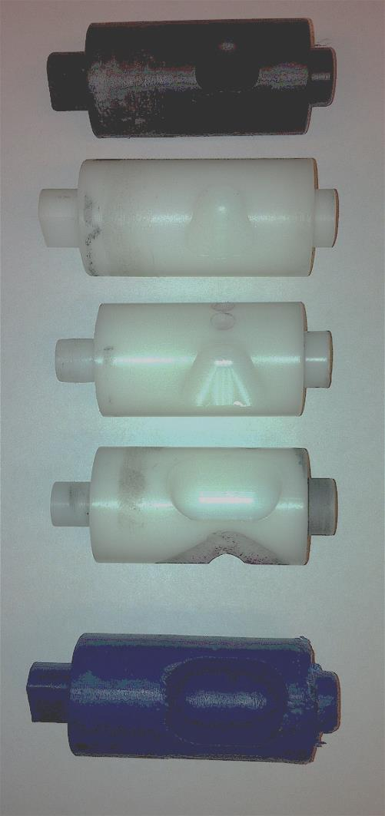
INTERNAL DRUM
Drum | Mass (g) | Volume (cm³)
A | 0.69 | 0.507
B | 0.71 | 0.521
OS | 0.88 | 0.646
OM | 3.36 | 2.468
OC | 3.38 | 2.482

Slide 12
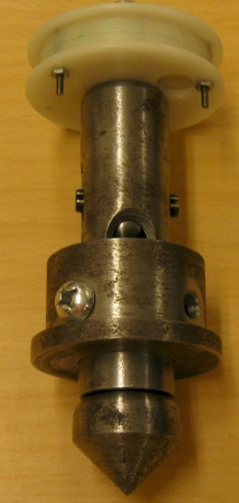
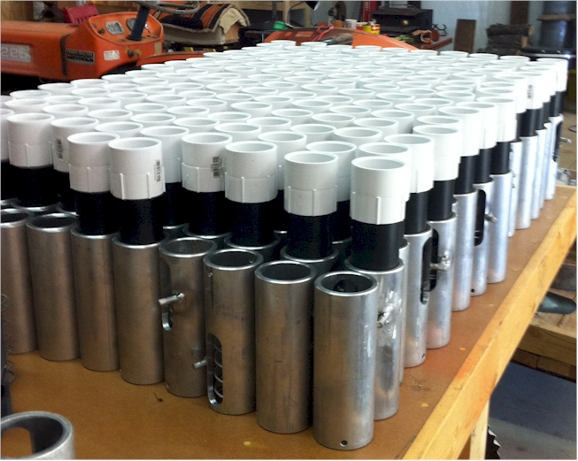

Slide 13
OSU Hand Planter

Slide 14
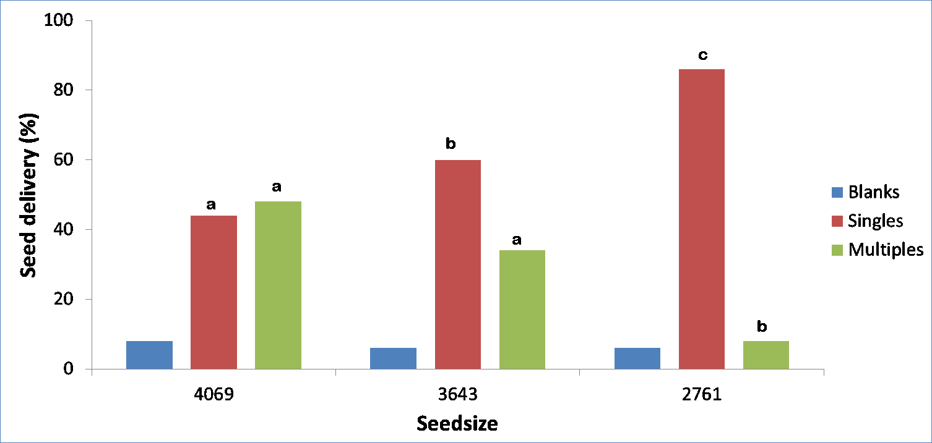
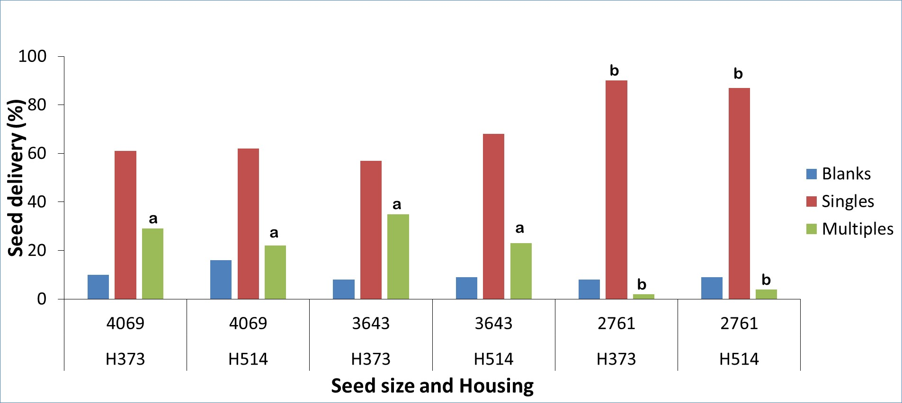
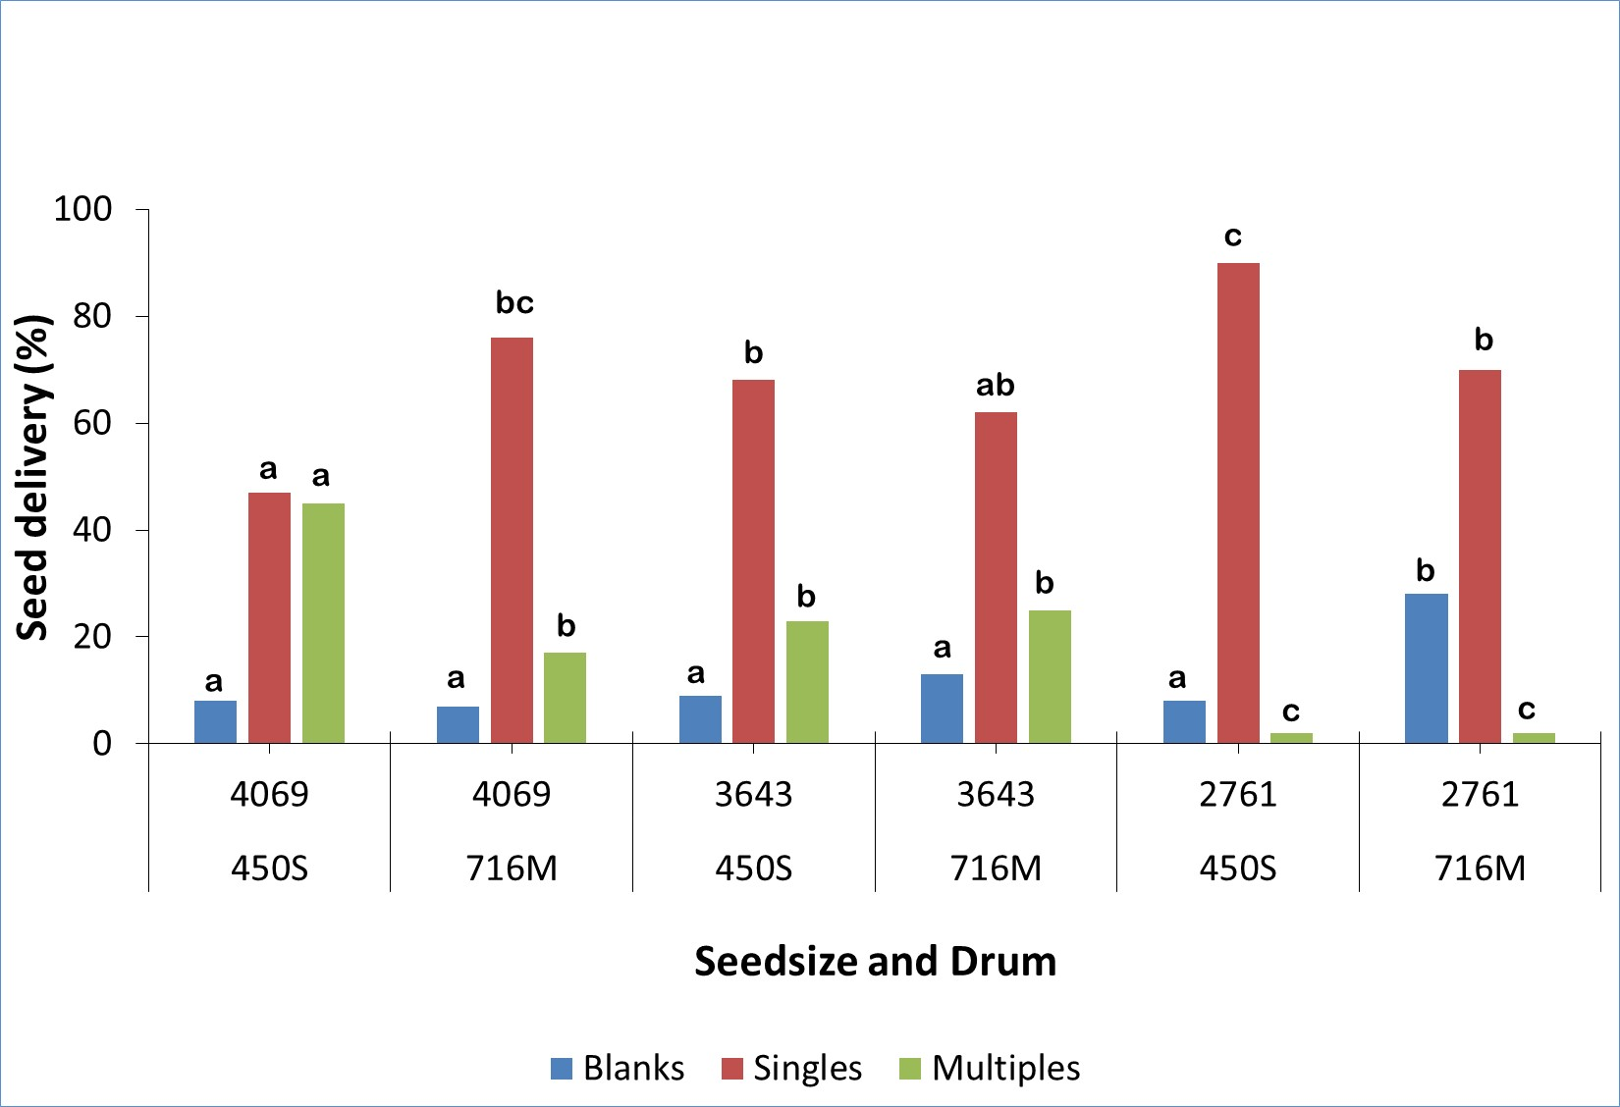

Slide 15
Nov 13, 2013
SED = 8.6

Slide 16
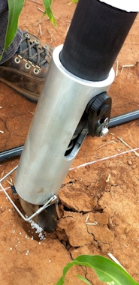
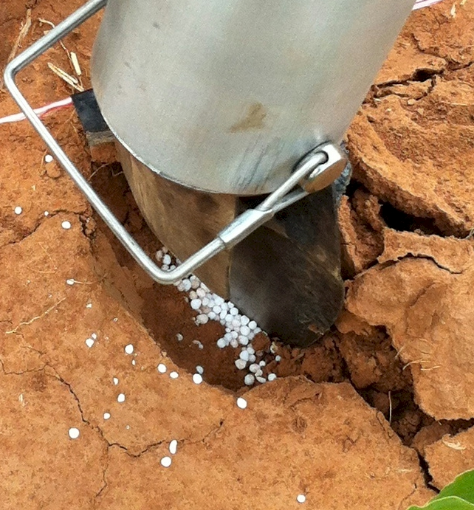
Mid Season Fertilizer N
Combined, Efaw and Perkins, 2013
Topdress N, Corn, V12 |  | 70,000 plants/ha
Methods | N, kg/ha | Mg/ha
Check | 0 | 6.6
Hand planter (0.9 g/plant) | 30 | 11.2
Hand planter (1.8 g/plant) | 60 | 10.6
Broadcast | 30 | 6.4
Broadcast | 60 | 7.0
Dribble urea | 30 | 9.3
Dribble urea | 60 | 7.8
Dribble UAN | 30 | 7.3
Dribble UAN | 60 | 10.4
SED = 1.81

Slide 17
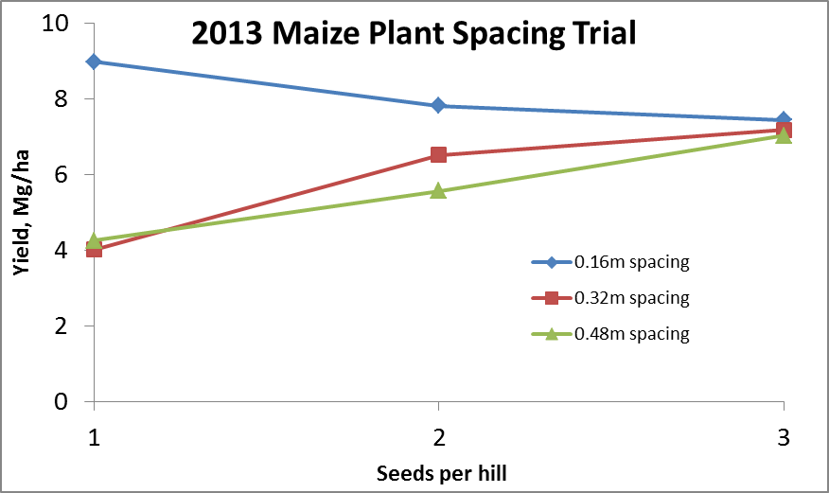
Importance of Singulation
0.76m Row Spacing
Heterogeneity in plant spacing, and plant stands reduce yields (Bob Nielsen, http://www.agry.purdue.edu/ext/corn/pubs/agry9101.htm)

Slide 18
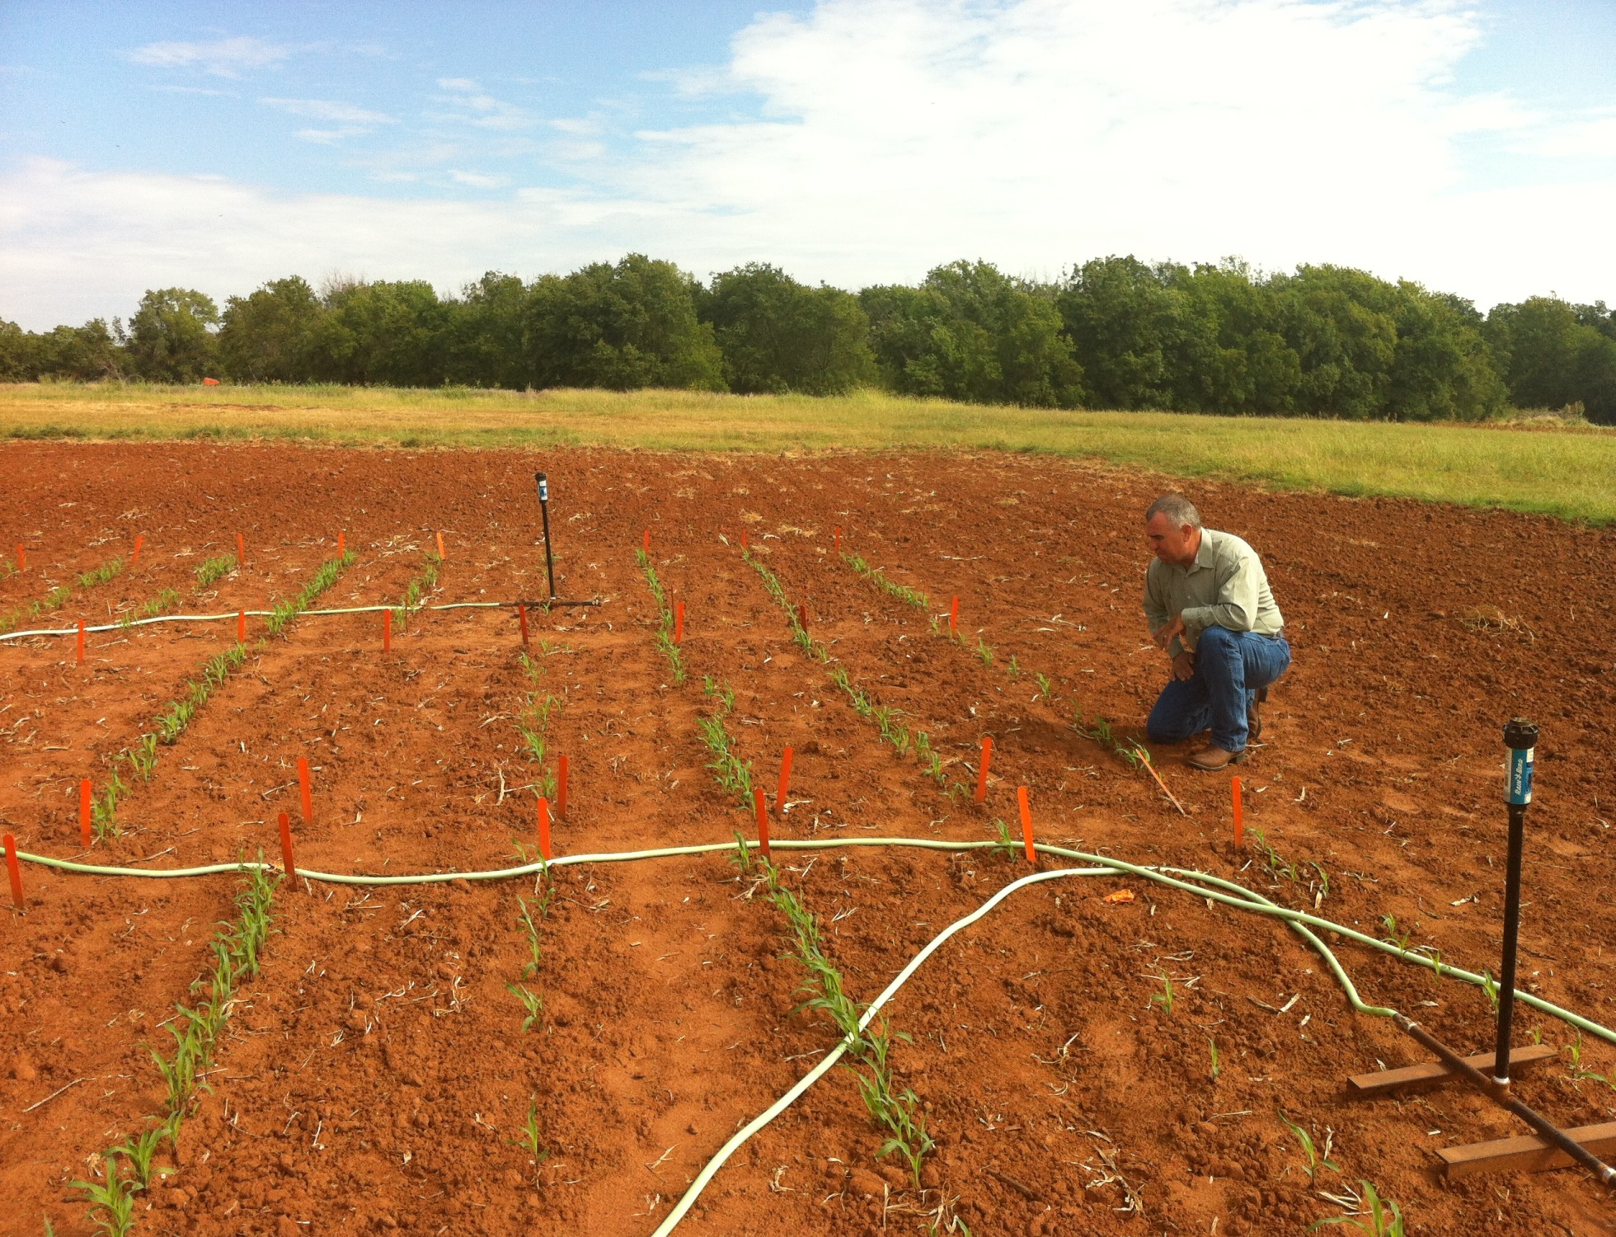
Dr. Randy Taylor Dr. Nyle Wollenhaupt
1,000,000 cycles, no failures 1 hectare, 100,000 seeds/ha, 10 years

Slide 19
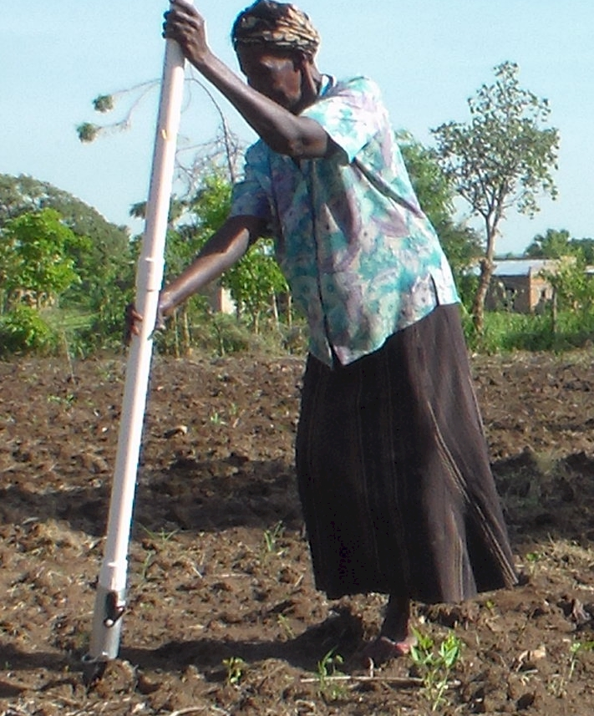
UGANDA

Slide 20
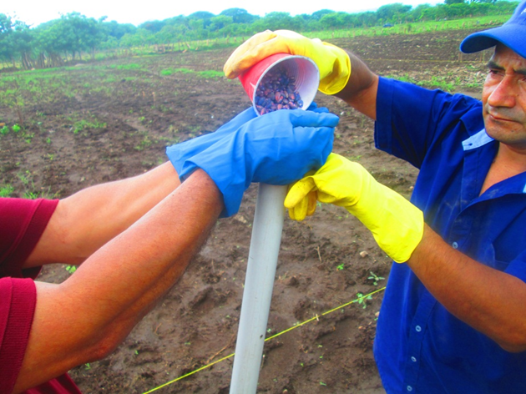
El Salvador, Hand Planter Trials, June, 2014

Slide 21
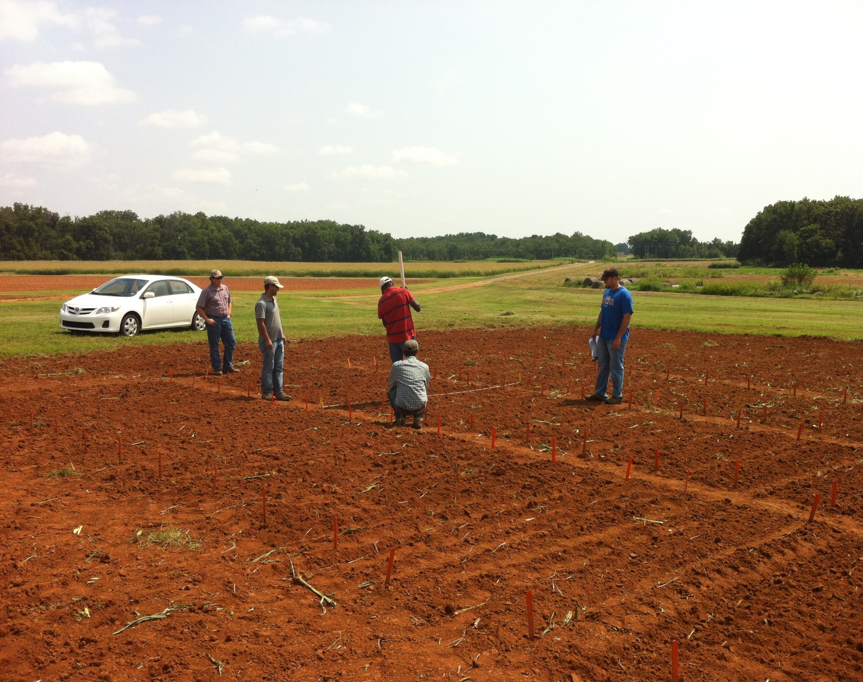

Slide 22
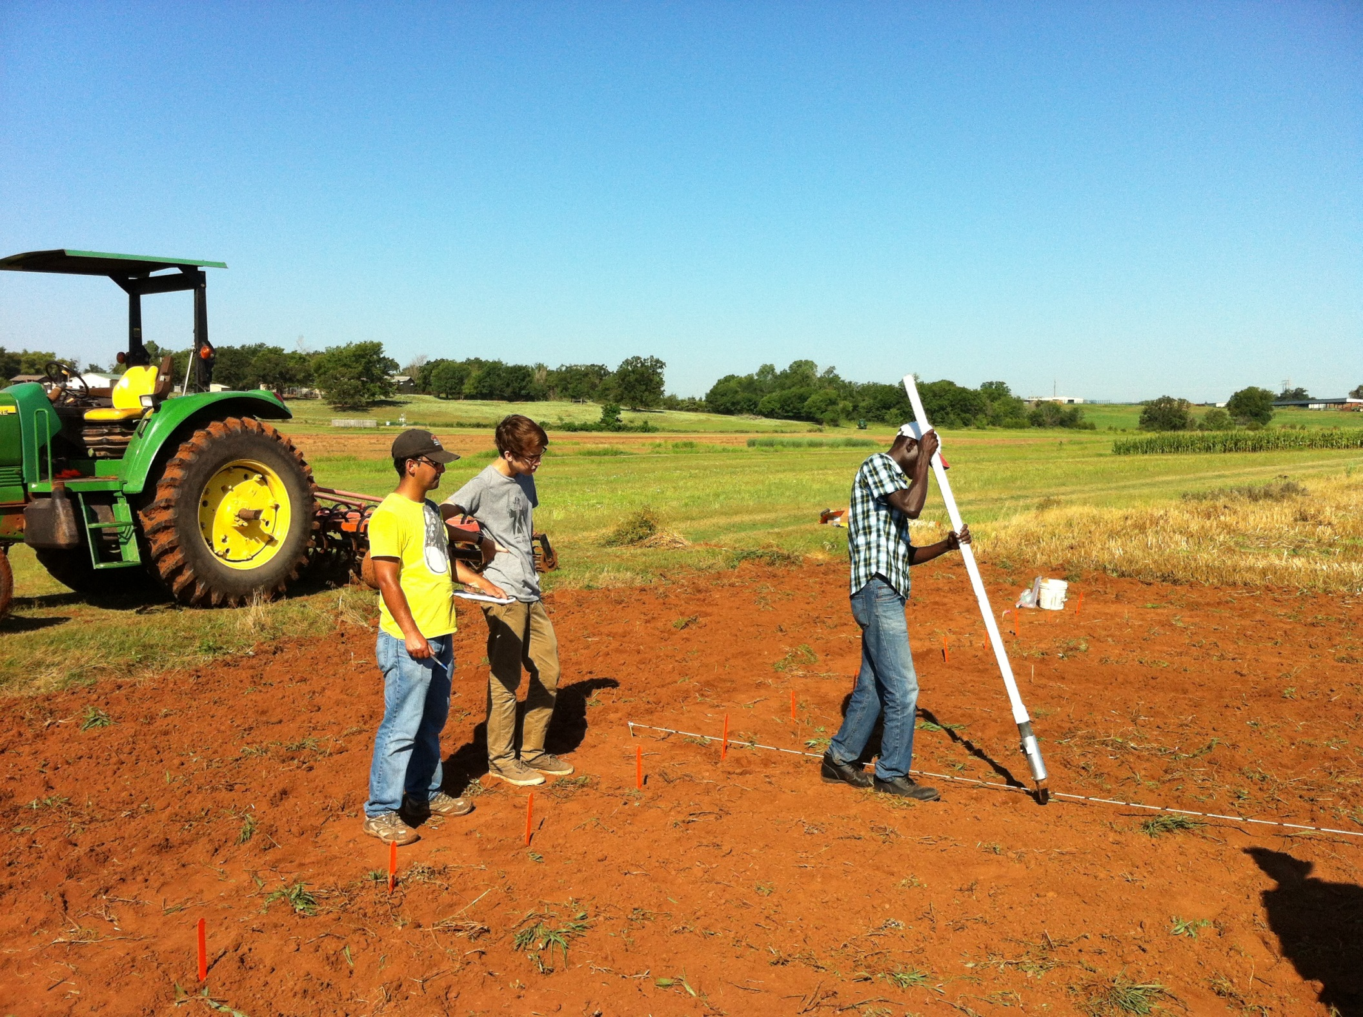

Slide 23
OSU Hand Planter
Thailand Mexico Zambia El Salvador Guatemala

Slide 24
Benefits
Remove chemically treated seeds from the hands of small farmers
Decrease soil erosion via improved plant spacing
Accommodate mid-season application of urea-N
Place urea below the surface reducing NH3 losses
Potential to increase maize production and NUE
Khim et al. (2014). Over three sites, planting 1 seed, every 0.16m increased yields by an average of 1.15 Mg ha⁻¹ (range, 0.33 to 2.46 Mg ha⁻¹) when compared to the farmer practice of placing 2 to 3 seeds per hill, every 0.48 cm.

Slide 25
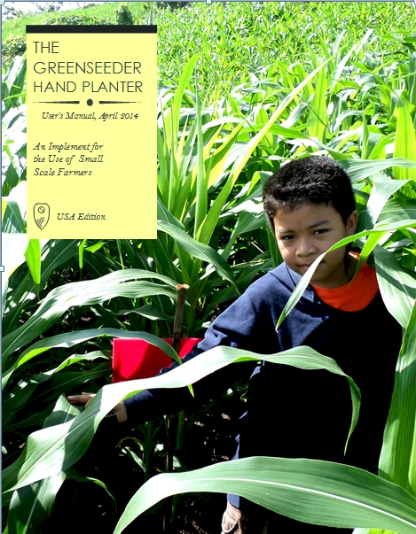
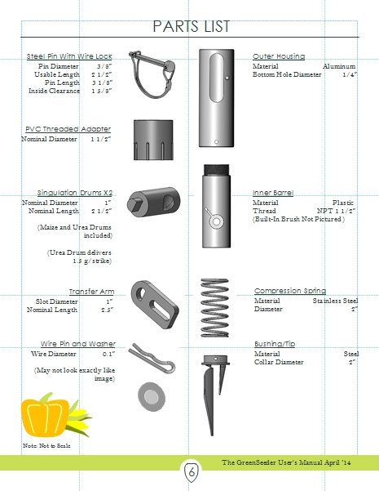
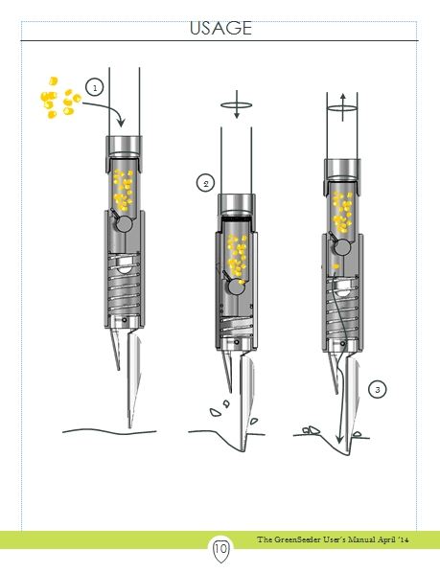
GreenSeeder Manual
http://www.nue.okstate.edu/Hand_Planter/Planter%20User's%20Manual%20EL.pdf

Slide 26
Bangladesh
Burundi
Belize
Brazil
Colombia
El Salvador
Ethiopia
Guatemala
India
Kenya
Malawi Mali
January 2014, on-line hand planter workshop http://nue.okstate.edu/Hand_Planter/osu_hand_planter_workshop.html
Mexico
Mozambique
Sierra Leone
Nepal
Philippines
Tanzania
Togo
Uganda
USA
Zambia
Zimbabwe

Slide 27
Optimum N Rate (over sites)
1. Grain yield * 1.19 (percent grain N) = grain N removed
2. Compute #1 for check
3. Compute #1 for high N yield treatment
4. Estimate of actual N needed (3 – 2)
5. Estimate of optimum fertilizer N = #4/0.33
1.19 (average percent N in corn grain)
0.33 (average for expected fertilizer NUE)

Slide 28
Maize grain yield, high N rate and optimum N rate from 213 site years, Central Great Plains, 1958-2010. (Sulochana Dhital)
Source | Location | Years | Period | High N, yield range | Check plot, yield range | Optimum N rate
 |  |  |  | Mg ha⁻¹ | Mg ha⁻¹ | Min | Max | Avg.
Bundy et al. (2011) | WI | 21 | 1958-1983 | 4.3-8.8 | 1.57-7.59 | 46 | 213 | 119
Bundy et al. (2011) | WI | 24 | 1984-2007 | 5.7-14.1 | 1.67-5.58 | 143 | 334 | 238
Mallarino and Torres (2006) | IA | 32 | 1979-2010 | 5.1-12.5 | 0.75-5.91 | 75 | 314 | 193
Mallarino and Torres (2006) | IA | 26 | 1985-2010 | 5.3-12.8 | 1.4-6.3 | 123 | 332 | 214
Varvel et al. (2007) | NE | 11 | 1995-2005 | 10.4-13.6 | 3.5-10.9 | 67 | 280 | 191
Jokela et al.(1989) Carroll | MN | 3 | 1982-1984 | 7.1-9.1 | 5-7.3 | 5 | 120 | 77
Jokela et al.(1989) Webster | MN | 3 | 1982-1984 | 1.8-8.7 | 1.7-5.6 | 64 | 103 | 84
Fenster et al. (1976) Waseca | MN | 7 | 1970-1976 | 7.12-10.65 | 2.71-7.43 | 55 | 227 | 140
Fenster et al. (1976) Martin | MN | 7 | 1970-1976 | 4-9.6 | 3.8-8.2 | 21 | 116 | 62
Fenster et al. (1976) Martin | MN | 6 | 1971-1976 | 6.2-12 | 6.2-11.3 | 0 | 34 | 15
Al Kaisi et al.(2003) | CO | 3 | 1998-2000 | 5-14.1 | 3.53-12.57 | 24 | 126 | 84
Ismail et al.(1994) NT | KY | 20 | 1998-2000 | 5.2-10.9 | 2.1-7.4 | 32 | 211 | 117
Ismail et al.(1994) CT | KY | 20 | 1970-1990 | 3.5-10.4 | 1.9-9.5 | 0 | 186 | 90
Rice et al.(1986) NT | KY | 16 | 1970-1985 | 5.7-9.2 | 3.1-4.9 | 93 | 163 | 132
Rice et al.(1986) CT | KY | 16 | 1970-1985 | 5-8.8 | 1.9-6.1 | 63 | 187 | 114
Stecker et al.(1993) | MO | 3 | 1988-1990 | 6.04-10.13 | 3.32-5.59 | 91 | 178 | 140
Stecker et al.(1993) | MO | 3 | 1988-1990 | 6.7-9.9 | 4.54-7.2 | 42 | 167 | 94
Stecker et al.(1993) | MO | 2 | 1989-1990 | 8.2-8.5 | 4.95-5.98 | 82 | 108 | 95
Peterson et al.(1989) | NE | 4 | 1983-1986 | 3.9-10 | 2.1-6.4 | 10 | 200 | 96
Woodruff et al.(1983) | SC | 3 | 1974-1976 | 13-20.2 | 1.04-15.6 | 0 | 639 | 302
Eck (1982) | TX | 3 | 1977-1979 | 3.41-13.21 | 1.79-5.03 | 13 | 300 | 146
Total |  | 233 |  |  | average | 50 | 216 | 131
 |  |  |  |  | stdev | 41 | 127 | 66

Slide 29
References
Al-Kaisi, M. M., and X.Yin. 2003. Effects of nitrogen rate, irrigation rate, and plant population on maize yield and water use efficiency. Agron. J. 95(6), 1475-1482.
Bundy, L.G., T.W. Andraski, M.D. Ruark, and A.E. Peterson. 2011. Long-term continuous corn and nitrogen fertilizer effects on productivity and soil properties. Agron. J. 103:1346–1351.
Eck, H. V. (1984). Irrigated corn yield response to nitrogen and water. Agron. J. 76(3), 421-428.
Fenster, W. E., C. J. Overdahl, G.W. Randall, and R. P. Schoper.1978. Effect of nitrogen fertilizer on maize yield and soil nitrates (Vol. 153). Misc. Rept 153-1978. Agr. Exp. Station. U. of Minnesota, St. Paul.
Ismail, I., R.L. Blevins, and W. W. Frye. 1994. Long-term no-tillage effects on soil properties and continuous maize yields. Soil Sc. Soc. Am. J. 58(1), 193-198
Jokela, W. E., and G. W. Randall. 1989. Maize yield and residual soil nitrate as affected by time and rate of nitrogen application. Agron. J. 81(5), 720-726.
Mallarino, A.P., and E. Ortiz-Torres. 2006. A long-term look at crop rotation effects on maize yield and response to N fertilization. In: The Integrated Crop Management Conference Proceedings, Ames, IA. 29–30 Nov. 2006. Iowa State Univ. Ext. Ames. p. 209–213.
Peterson, T. A., and G. E. Varvel. 1989. Crop yield as affected by rotation and nitrogen rate. III. Maize. Agron. J. 81:735-738.
Rice, C. W., M.S. Smith, and R.L. Blevins. 1986. Soil nitrogen availability after long-term continuous no-tillage and conventional tillage maize production. Soil Sc. Soc. Am. J. 50 (5), 1206-1210.
Stecker, J. A., D. D. Buchholz, R.G. Hanson, N.C. Wollenhaupt and K. A. McVay. 1993. Broadcast nitrogen sources for no-till continuous maize and maize following soybean. Agron.J. 85(4), 893-897.
Varvel, G.E., W.W. Wilhelm, J.F. Shanahan, and J.S. Schepers. 2007. An algorithm for maize nitrogen recommendations using a chlorophyll meter based sufficiency index. Agron. J. 99:701-706.
Woodruff, J. R., J.T. Ligon, and B. R. Smith. 1984. Water table depth interaction with nitrogen rates on sub-irrigated corn. Agron. J. 76(2), 280-283.

Slide 30
Workshop Products:
People, our group (need picture) Concepts
N Rich Strip (Nebraska) brochures
Predicting YPO and Predicting RI
Regional Trials (Missouri)
Independence of YPO and RI, Sufficiency
Indicator crops (Minnesota)
N Cycle (cards, site)
Passive sensors, EM
Active sensors
Algorithms (K-State, OSU)
NUE web site (presentations, posters) SBNRC
Improved fertilizer N rate recommendations
Either Sensor
Extension (Yaqui Valley, China, Oklahoma )
Big Picture (Minnesota) Legislation

Slide 31
“The most conservative man in traditional agriculture is the scientist, and sometimes I am not proud to be one of them. This is most discouraging. The scientist is a privileged person, the man should lead us out of the wilderness of static, underproductive agriculture, and yet by his apathy and failure to exercise his unique vision, he keeps us in the swamp of despair. The scientist fears change because he is in a relatively privileged position in his own society. If there is no breakthrough in yield, he will not be criticized. But if he makes a recommendation and something goes wrong, he may lose his job. “ N.E. Borlaug

Slide 32
Agriculture and the Environment
Food and Agricultural Organization, “Livestock's Long Shadow” surveys damage done by sheep, chickens, pigs and goats. But in almost every case, the world's 1.5 billion cattle are most to blame. Livestock are responsible for 18 per cent of the greenhouse gases that cause global warming, more than cars, planes and all other forms of transport put together.
The Independent.co.uk
“Wheat is an equal opportunity performer, it never discriminates. It grows as well for the poor as for anyone” N.E. Borlaug

Slide 33
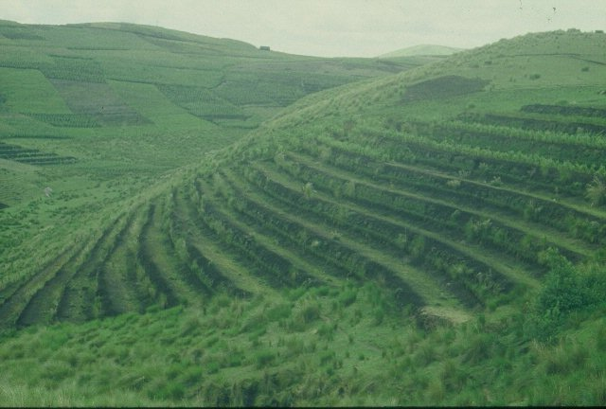
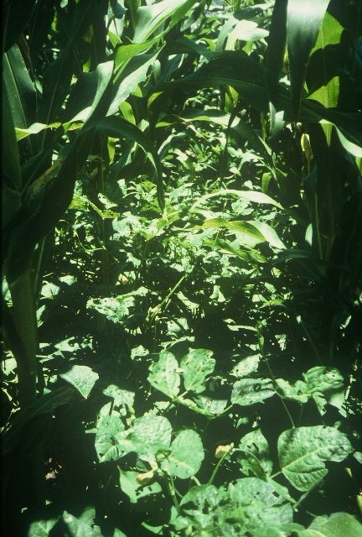
GUATEMALA

