Slide 1

Use of computer vision, spectral data, and analytics to improve the allocation of agricultural inputs
Tyler Nigon
Signature Product Manager
12th annual NUE Conference
August 5, 2014
SDSU, Sioux Falls, SD

Slide 2

Outline
Use of computer vision, spectral data, and analytics to improve the allocation of agricultural inputs
What we do: problems and solutions
UAVs and sensors
Computer vision
Spectral data
Analytics
12th annual NUE Conference
August 5, 2014

Slide 3


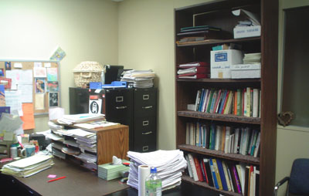
Use of computer vision, spectral data, and analytics to improve the allocation of agricultural inputs
Problems & Solutions
What we do: problems & solutions
12th annual NUE Conference
August 5, 2014
Notes:
Growers have lots of data, but don’t necessarily know what to do with it
Our objectives are to:
Turn this data into information that help growers plan, manage, and delegate time/money.
Make this information accessible and available in a timely

Slide 4
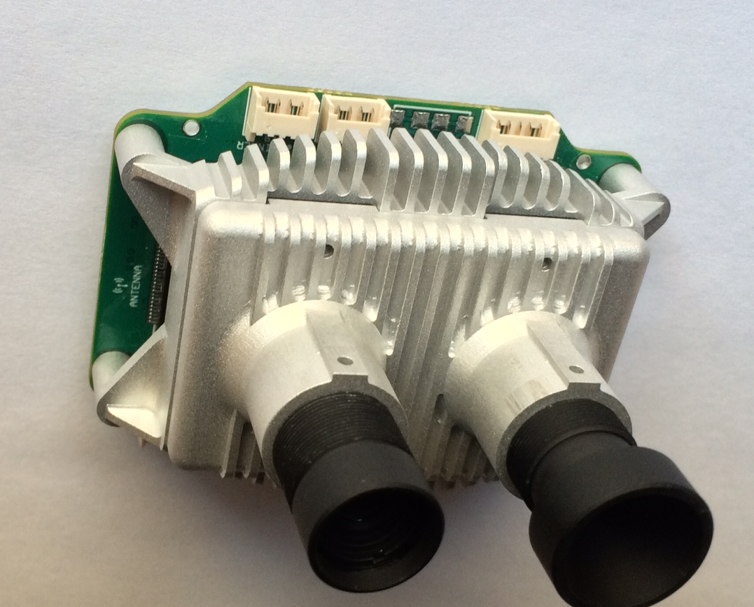


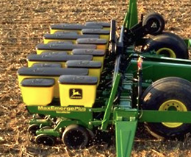

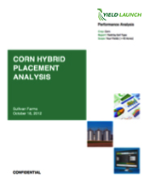
Use of computer vision, spectral data, and analytics to improve the allocation of agricultural inputs
Problems & Solutions
Input Data
Computer Vision, Spectral, and Analytical Signatures
Information that Leads to Decisions
Crop Status
UAV, Other
Multi-View
In-season Proactive Alerts
Farm Intelligence² Data
A Farmers’ Proprietary Data
Other Farmer Data (Benchmark)
Stand Alert: 63.2 acres on Wedinger 10
Various Engines
CLU
www. Importer
www. WingScan
Processors
NAIP
Farm Intelligence²
Data
Farm Intelligence² Algorithms & Signatures
Soils
Problems Mapped
Satellite
Weather
Analysis & Benchmark
Farmer Provided
Exported
As Planted
Fertility
Farm Software
APEX, Field Works, Ag Leader, etc.
Other Operations
12th annual NUE Conference
August 5, 2014
Yield

Slide 5
Use of computer vision, spectral data, and analytics to improve the allocation of agricultural inputs
Problems & Solutions
Computer Vision, Spectral, and Analytical Signatures
Information that Leads to Decisions
Crop Status
UAV, Other
Multi-View
In-season Proactive Alerts
Farm Intelligence² Data
A Farmers’ Proprietary Data
Other Farmer Data (Benchmark)
Stand Alert: 63.2 acres on Wedinger 10
Various Engines
CLU
www. Importer
www. WingScan
Processors
NAIP
Farm Intelligence²
Data
Farm Intelligence² Algorithms & Signatures
Soils
Problems Mapped
Satellite
Weather
Analysis & Benchmark
Farmer Provided
Exported
As Planted
Fertility
Farm Software
APEX, Field Works, Ag Leader, etc.
Other Operations
12th annual NUE Conference
August 5, 2014
Yield

Slide 6
Use of computer vision, spectral data, and analytics to improve the allocation of agricultural inputs
Problems & Solutions
Computer Vision, Spectral, and Analytical Signatures
Crop Status
UAV, Other
Multi-View
In-season Proactive Alerts
Farm Intelligence² Data
A Farmers’ Proprietary Data
Other Farmer Data (Benchmark)
Stand Alert: 63.2 acres on Wedinger 10
Various Engines
CLU
www. Importer
www. WingScan
Processors
NAIP
Farm Intelligence²
Data
Farm Intelligence² Algorithms & Signatures
Soils
Problems Mapped
Satellite
Weather
Analysis & Benchmark
Farmer Provided
Exported
As Planted
Fertility
Farm Software
APEX, Field Works, Ag Leader, etc.
Other Operations
12th annual NUE Conference
August 5, 2014
Yield

Slide 7
Use of computer vision, spectral data, and analytics to improve the allocation of agricultural inputs
Problems & Solutions
Crop Status
UAV, Other
Multi-View
In-season Proactive Alerts
Farm Intelligence² Data
A Farmers’ Proprietary Data
Other Farmer Data (Benchmark)
Stand Alert: 63.2 acres on Wedinger 10
Various Engines
CLU
www. Importer
www. WingScan
Processors
NAIP
Farm Intelligence²
Data
Farm Intelligence² Algorithms & Signatures
Soils
Problems Mapped
Satellite
Weather
Analysis & Benchmark
Farmer Provided
Exported
As Planted
Fertility
Farm Software
APEX, Field Works, Ag Leader, etc.
Other Operations
12th annual NUE Conference
August 5, 2014
Yield

Slide 8
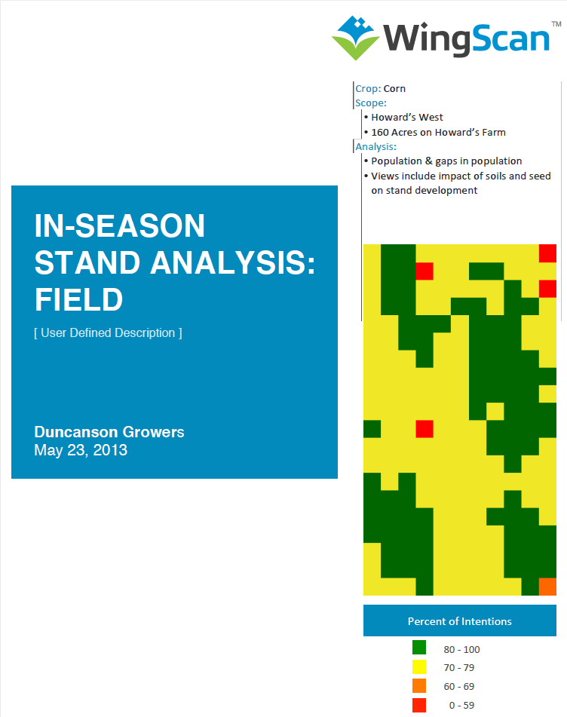
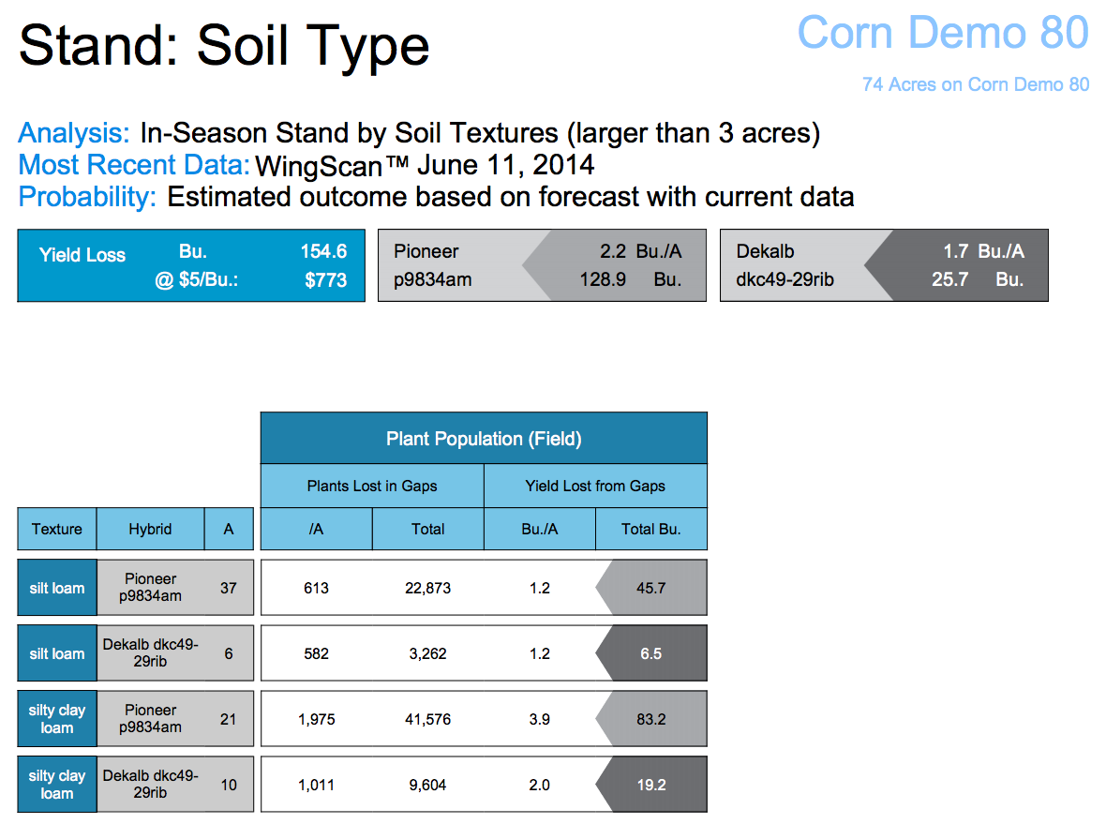
Use of computer vision, spectral data, and analytics to improve the allocation of agricultural inputs
problems and solutions
Data → Information
The Grower Receives: Analysis Reports
12th annual NUE Conference
August 5, 2014
Notes:
Combine aerial imagery with data generated in agricultural operations, then analyze it with our WingScan™ software.
Decision Agriculture

Slide 9
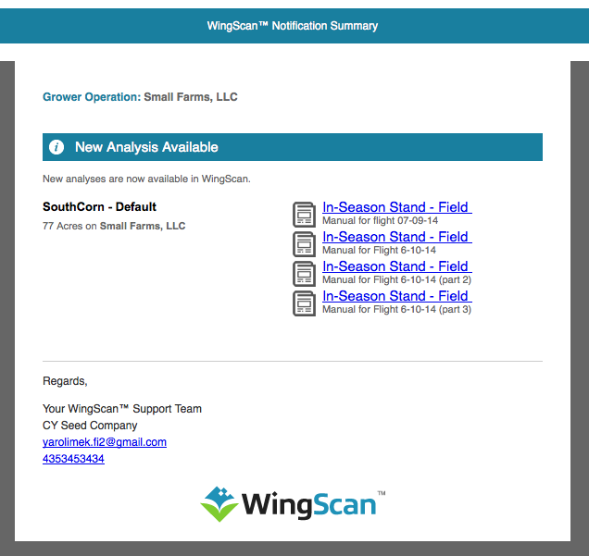

Use of computer vision, spectral data, and analytics to improve the allocation of agricultural inputs
problems and solutions
Data → Information
The Grower Receives: Timely Alerts
12th annual NUE Conference
August 5, 2014
Notes:
Combine aerial imagery with data generated in agricultural operations, then analyze it with our WingScan™ software.
Decision Agriculture

Slide 10
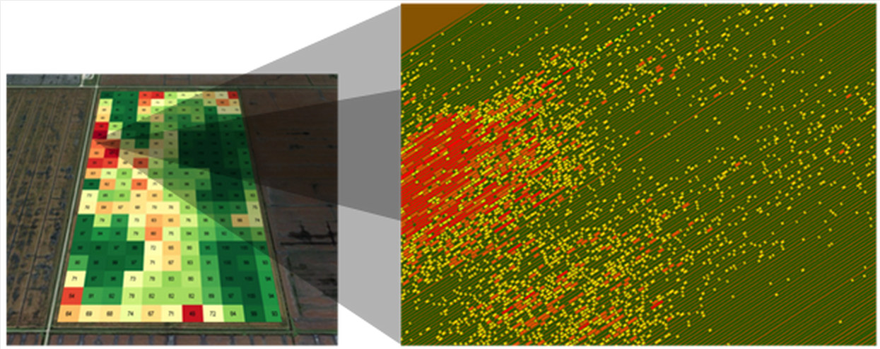
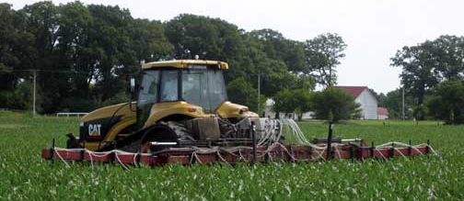
Use of computer vision, spectral data, and analytics to improve the allocation of agricultural inputs
problems and solutions
Data → Information
The Grower Receives: Shapefile Exports
12th annual NUE Conference
August 5, 2014
Notes:
Combine aerial imagery with data generated in agricultural operations, then analyze it with our WingScan™ software.
Decision Agriculture

Slide 11
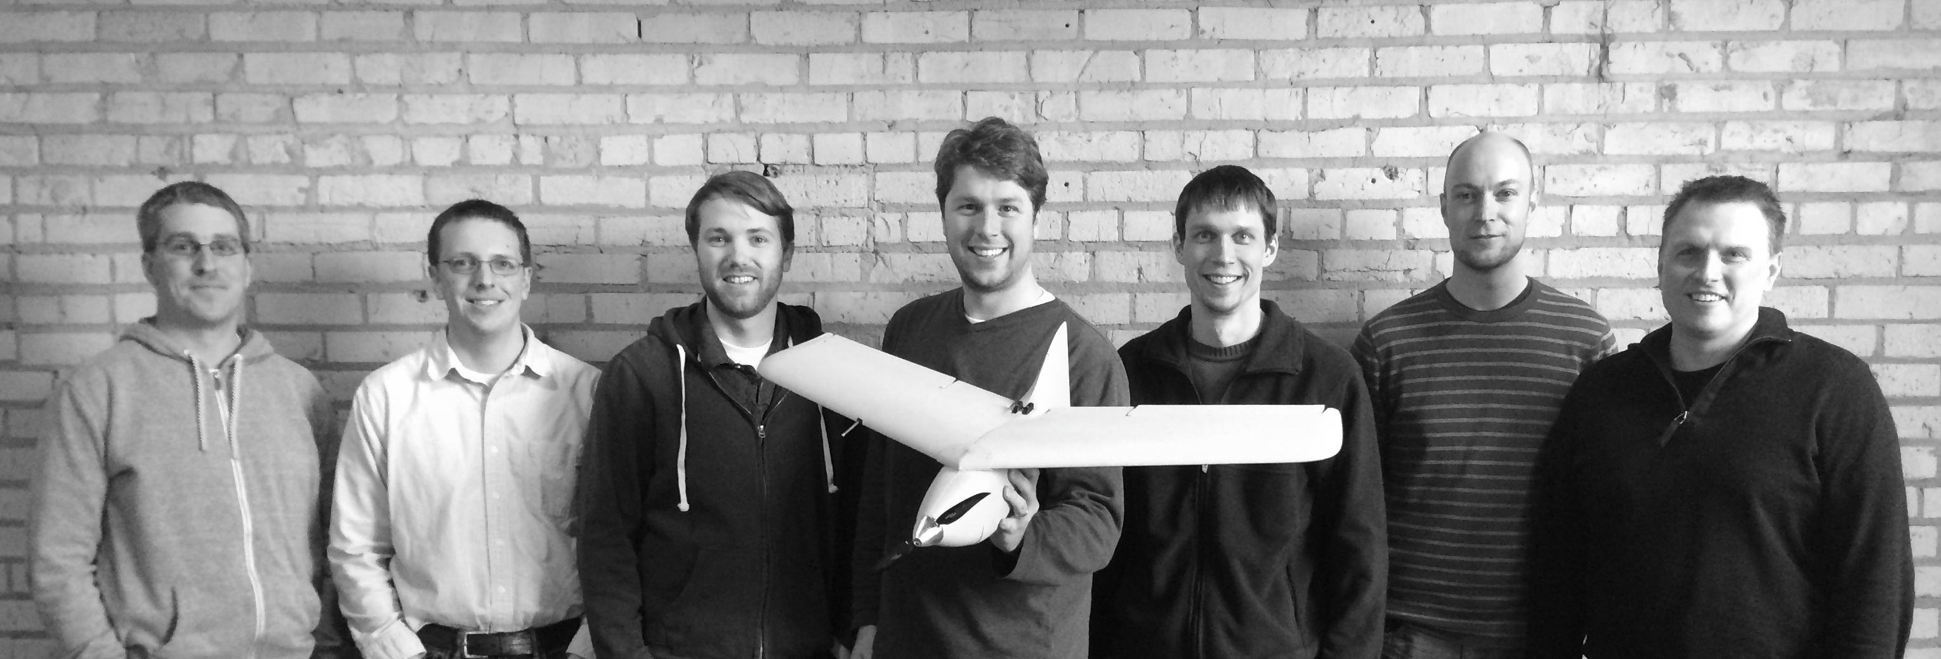
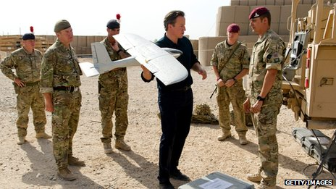
Use of computer vision, spectral data, and analytics to improve the allocation of agricultural inputs
UAVs and Sensors
A
Company
12th annual NUE Conference
August 5, 2014
Notes:
Former Lockheed Martin and United Technologies small UAS engineering team
Build UAVs and sensors to be fully integrated with WingScan®
Their products have tens of thousands of flight hours with military testing

Slide 12
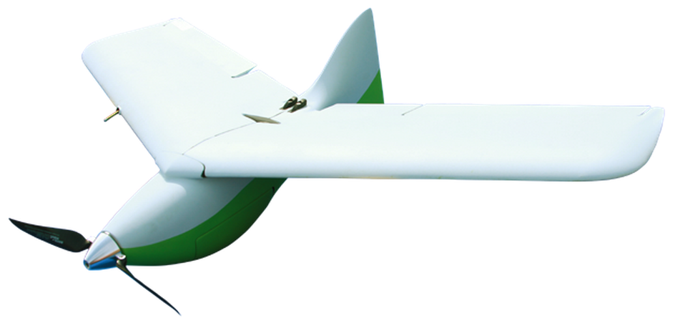
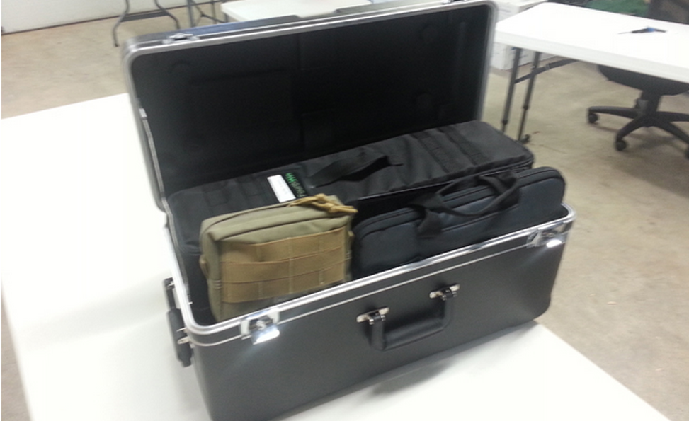
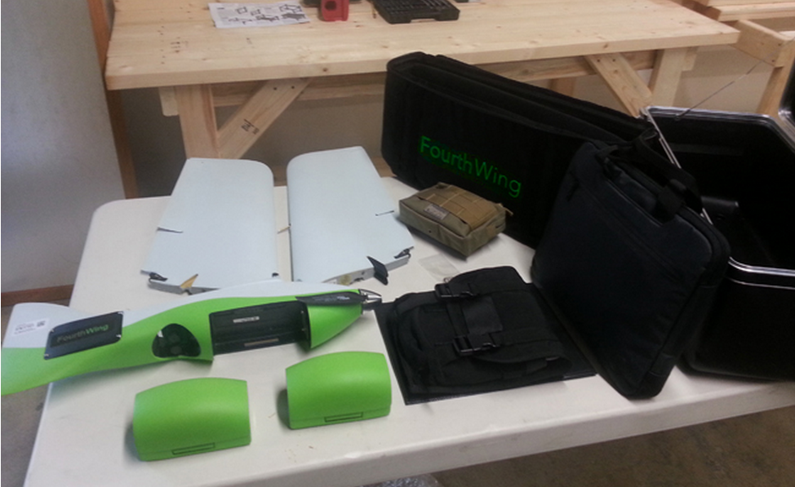
Use of computer vision, spectral data, and analytics to improve the allocation of agricultural inputs
UAVs and Sensors
VireoTM
Specifications:
Endurance: 60 minutes
Gross Weight: 3.0 lbs
Payload: 0.45 lbs
Cruise Speed: 33 mph
Dash Speed: 46 mph
Wingspan: 3.2 ft
Length: 1.9 ft
12th annual NUE Conference
August 5, 2014
Notes:
FourthWing provides turnkey, integrated UAS solutions that efficiently collect, manage, and integrate data products with WingScan™

Slide 13
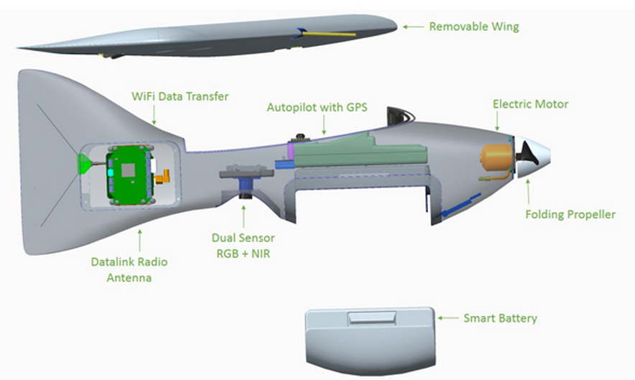
Use of computer vision, spectral data, and analytics to improve the allocation of agricultural inputs
UAVs and Sensors
VireoTM
12th annual NUE Conference
August 5, 2014
Notes:
Goals are to build systems that are:
Easy to learn and use
Reliable
Affordable

Slide 14
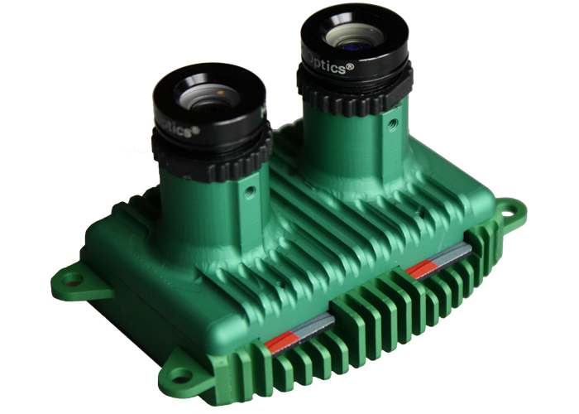
Use of computer vision, spectral data, and analytics to improve the allocation of agricultural inputs
UAVs and Sensors
Dual-Band Imaging Sensor
12th annual NUE Conference
August 5, 2014
Notes:
Capable of capturing NIR and RGB data
Data are transferred to the Ground Control Station laptop wirelessly
Exposure settings and radiometric correction are performed via firmware updates – very easy to use
Electronic stabilization and record of heading, yaw, pitch, and roll allow for quicker/more accurate mosaic and rectification

Slide 15
Use of computer vision, spectral data, and analytics to improve the allocation of agricultural inputs
problems and solutions
Signature Definition:
The sum of all components required to generate visual and analytical outputs, including:
  Analysis Reports
  Processed imagery
  Alerts
  Notifications
  MultiView experience in
  Shapefiles and other exports
Specific sensor(s), data processing techniques, software algorithms, spectral data, and/or other data may be required to generate a signature
12th annual NUE Conference
August 5, 2014

Slide 16
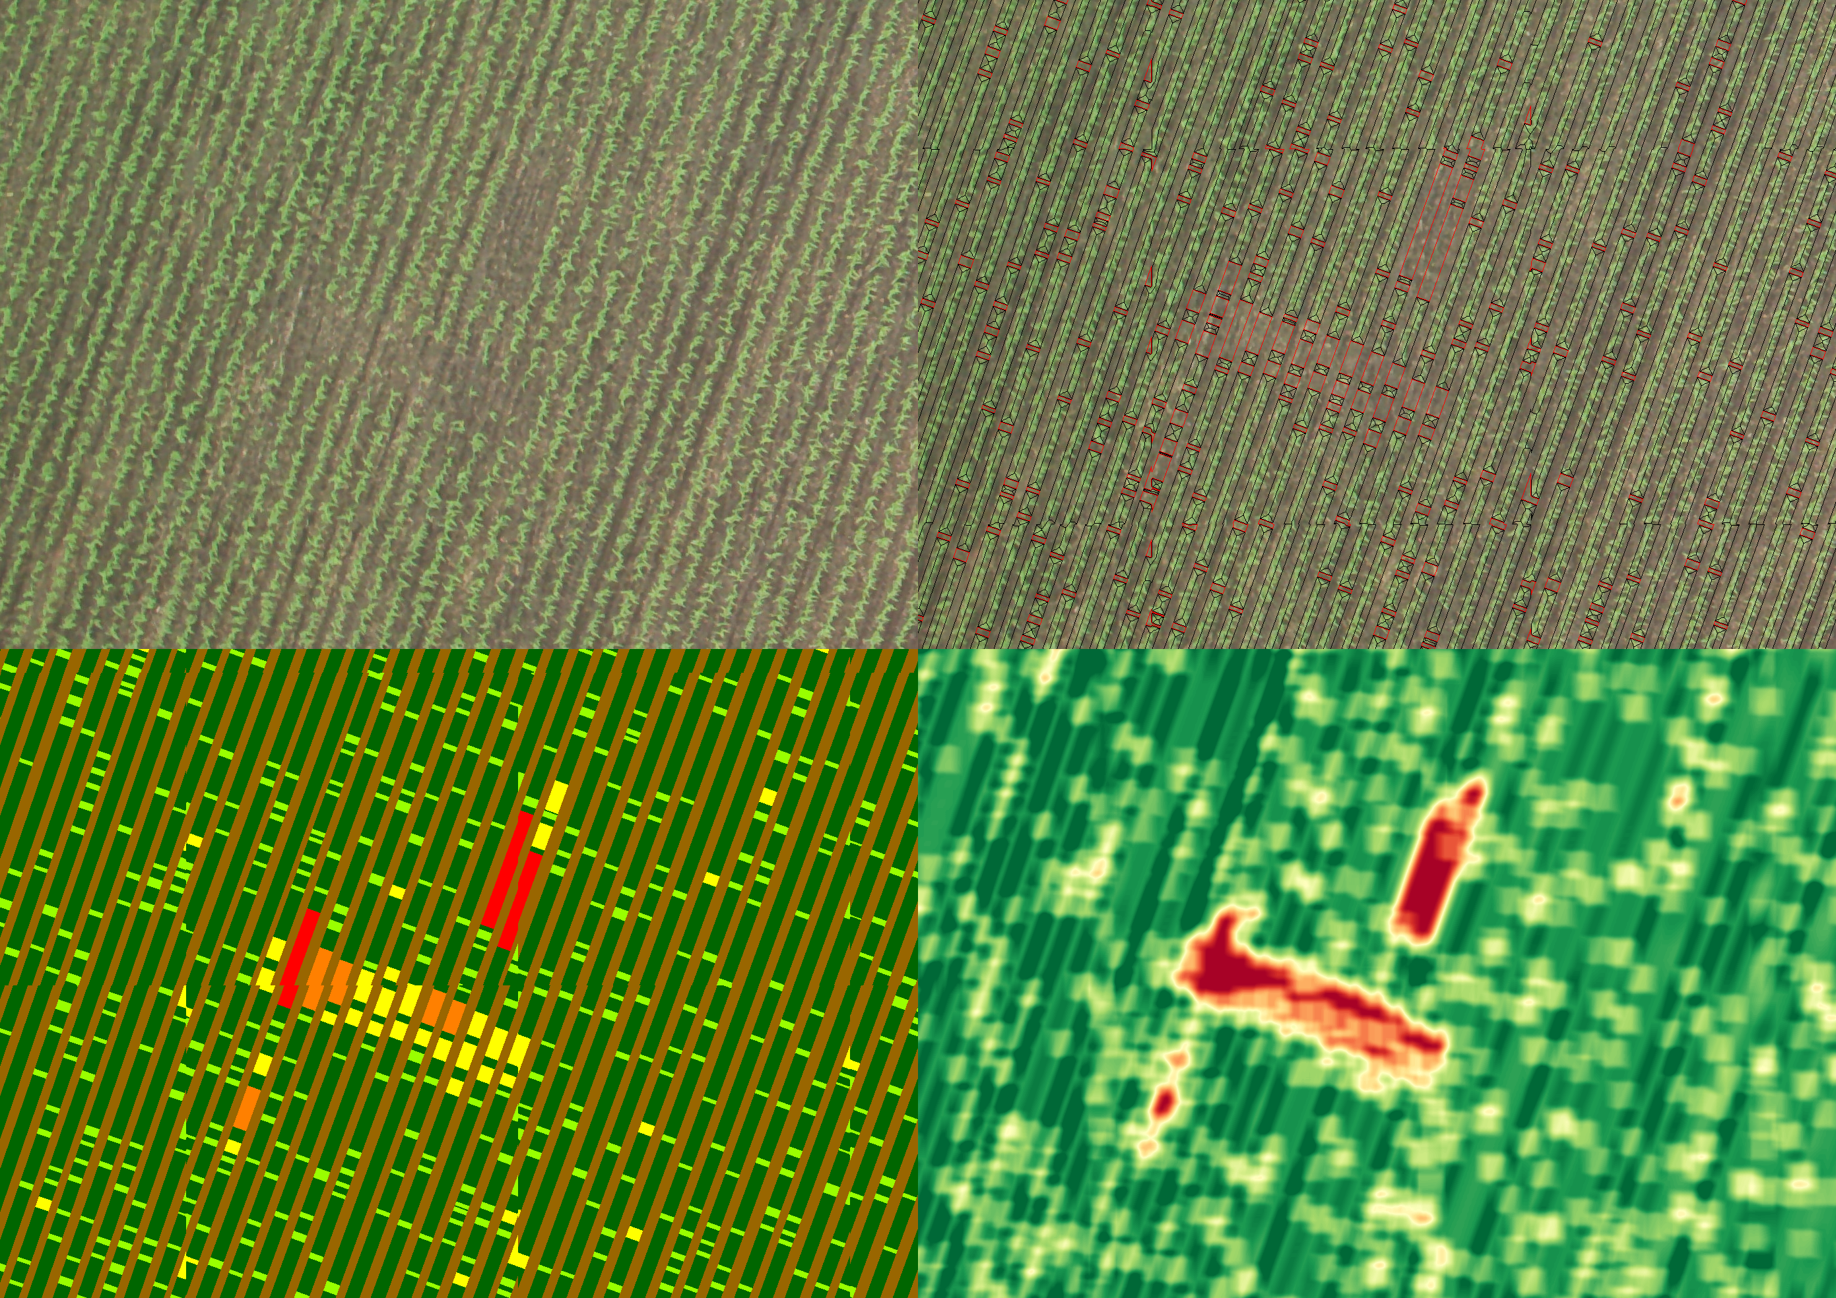
Use of computer vision, spectral data, and analytics to improve the allocation of agricultural inputs
Computer Vision
Computer Vision - RGB Imagery
12th annual NUE Conference
August 5, 2014
Notes:
~V6 corn – working on different algorithms to detect gaps at earlier growth stages

Slide 17
Use of computer vision, spectral data, and analytics to improve the allocation of agricultural inputs
Computer Vision
Determination of gap vs. plant
12th annual NUE Conference
August 5, 2014
Notes:
Within rows

Slide 18
Use of computer vision, spectral data, and analytics to improve the allocation of agricultural inputs
Computer Vision
Classification of gaps
12th annual NUE Conference
August 5, 2014
Notes:
Based on size thresholding

Slide 19
Use of computer vision, spectral data, and analytics to improve the allocation of agricultural inputs
Computer Vision
Stand gap density map
12th annual NUE Conference
August 5, 2014
Notes:
This can be output

Slide 20
Use of computer vision, spectral data, and analytics to improve the allocation of agricultural inputs
Computer Vision
Computer Vision
12th annual NUE Conference
August 5, 2014
Notes:
How does this help the grower?
Timely analysis may help determine replant decisions
Knowledge of where plants are absent could help growers decide where to/where not to allocate inputs:
Pesticide
In-season fertilizers
Other computer vision signatures:
Field patterns
Residue distribution
Storm damage
Irrigation performance

Slide 21
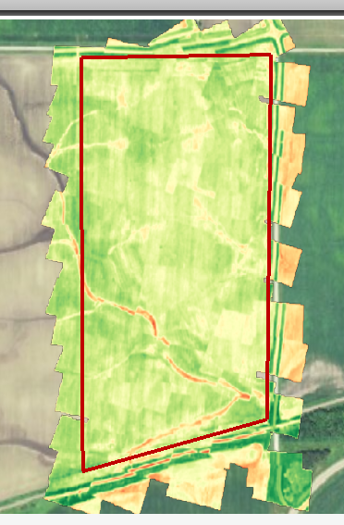
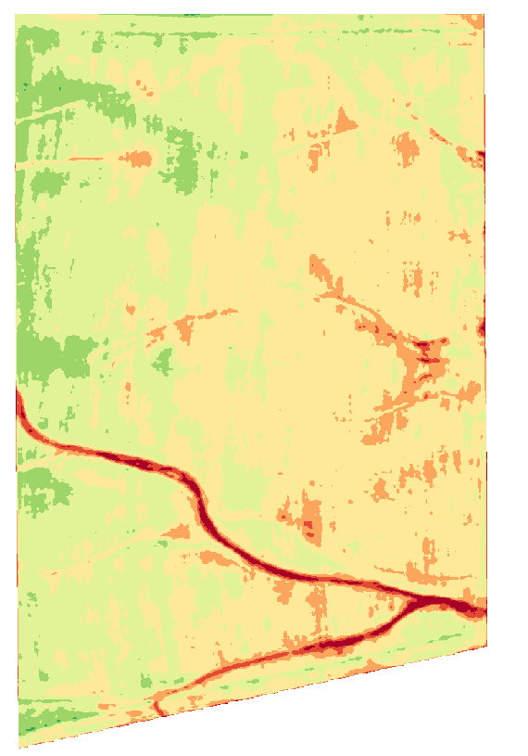
Use of computer vision, spectral data, and analytics to improve the allocation of agricultural inputs
Spectral
Spectral Data
12th annual NUE Conference
August 5, 2014
Notes:
Other spectral signatures:
Crop Stress Variability
Nitrogen Variability
Field Patterns
SB Cyst Nematode
SB Aphids

Slide 22
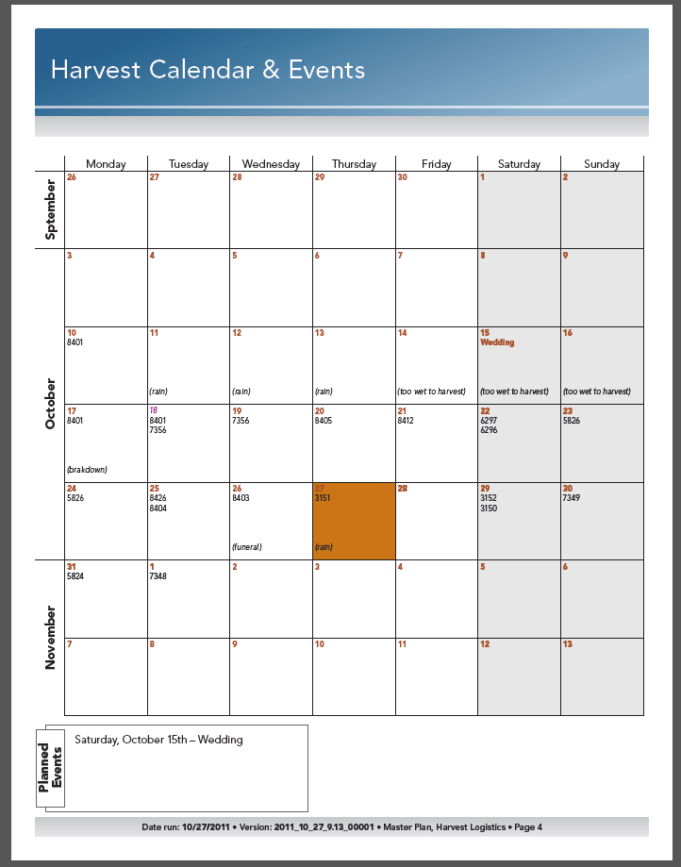
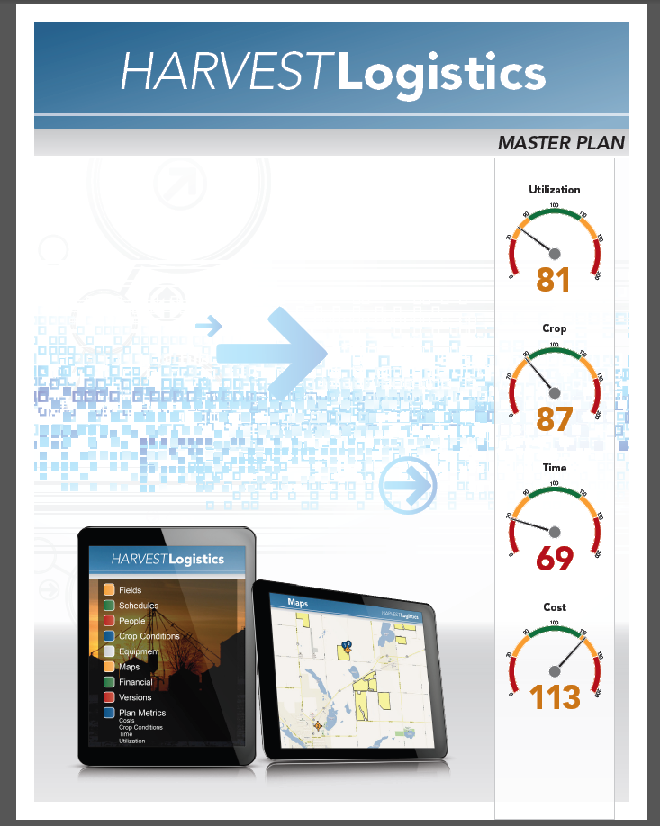
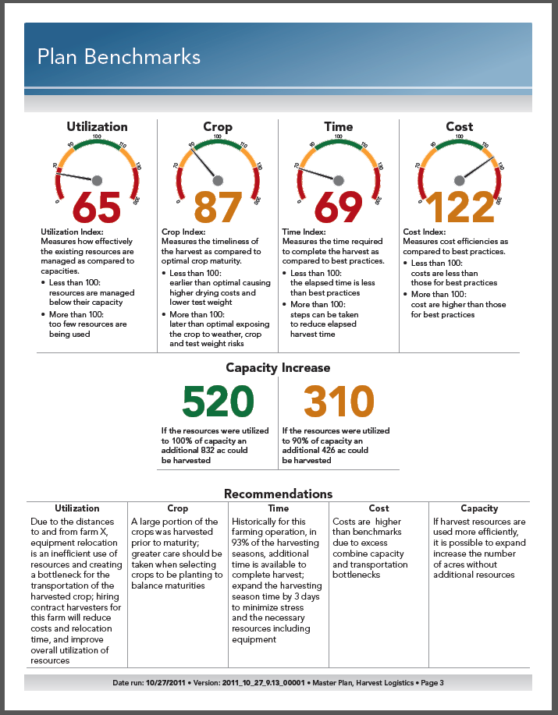
Use of computer vision, spectral data, and analytics to improve the allocation of agricultural inputs
Analytical
Analytical
12th annual NUE Conference
August 5, 2014
Notes:
Help growers to save $$ in:
Fuel
Labor
Time

Slide 23
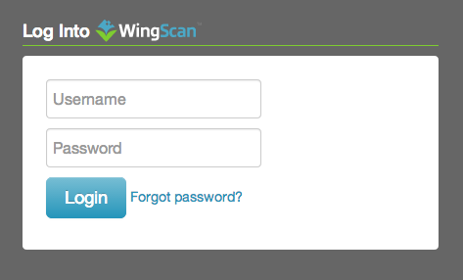
Use of computer vision, spectral data, and analytics to improve the allocation of agricultural inputs
Web-based software application that growers, crop consultants, dealers, etc. can log into to:
  View imagery and other data layers
  Generate analysis reports
  Export data layers
  https://wingscan.com/signin
12th annual NUE Conference
August 5, 2014

Slide 24
Use of computer vision, spectral data, and analytics to improve the allocation of agricultural inputs
Thank-You!
1650 Madison Ave.,
Mankato, MN
(507) 388-7638
http://www.fi2salesandleasing.com/index.html
Tyler Nigon
Signature Product Manager
tyler.nigon@farmintelligence.com
12th annual NUE Conference
August 5, 2014

Slide 25
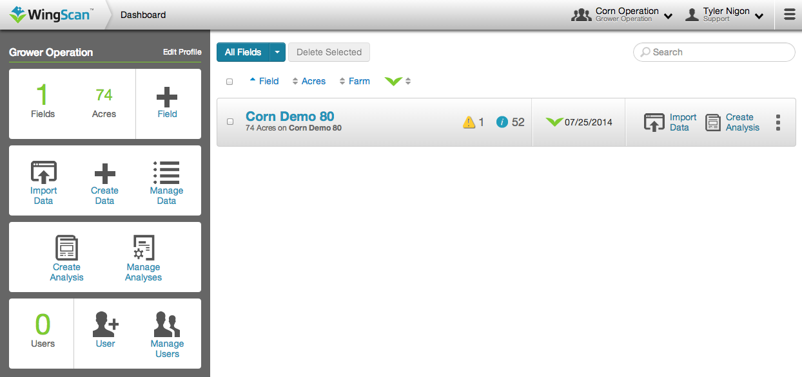
Use of computer vision, spectral data, and analytics to improve the allocation of agricultural inputs
Dashboard View
12th annual NUE Conference
August 5, 2014

Slide 26
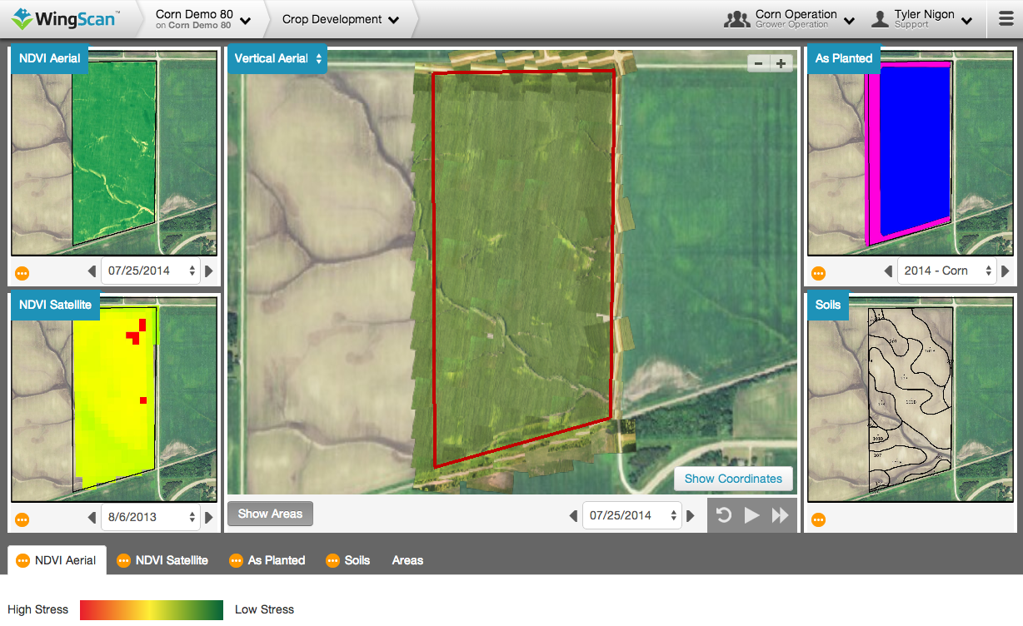
Use of computer vision, spectral data, and analytics to improve the allocation of agricultural inputs
MultiView – Quick Mosaic
12th annual NUE Conference
August 5, 2014

Slide 27
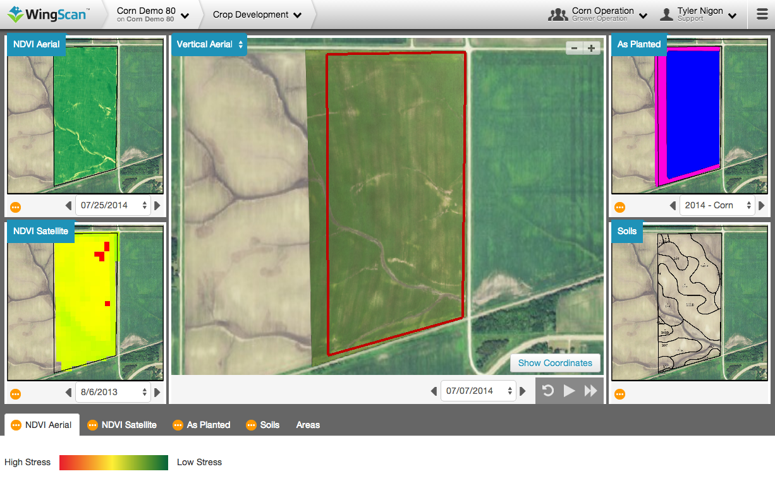
Use of computer vision, spectral data, and analytics to improve the allocation of agricultural inputs
MultiView – Full Mosaic
12th annual NUE Conference
August 5, 2014

Slide 28
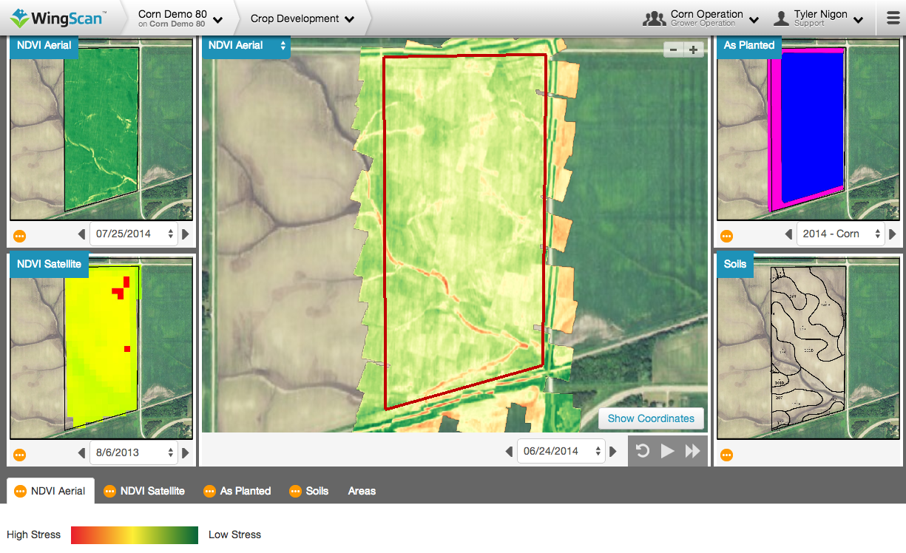
Use of computer vision, spectral data, and analytics to improve the allocation of agricultural inputs
MultiView – NDVI Quick Mosaic
12th annual NUE Conference
August 5, 2014

Slide 29
Use of computer vision, spectral data, and analytics to improve the allocation of agricultural inputs
Quick Mosaic vs. Full Mosaic
12th annual NUE Conference
August 5, 2014
Notes:
Other spectral signatures:
Crop Stress Variability
Nitrogen Variability
Field Patterns
SB Cyst Nematode
SB Aphids

Slide 30
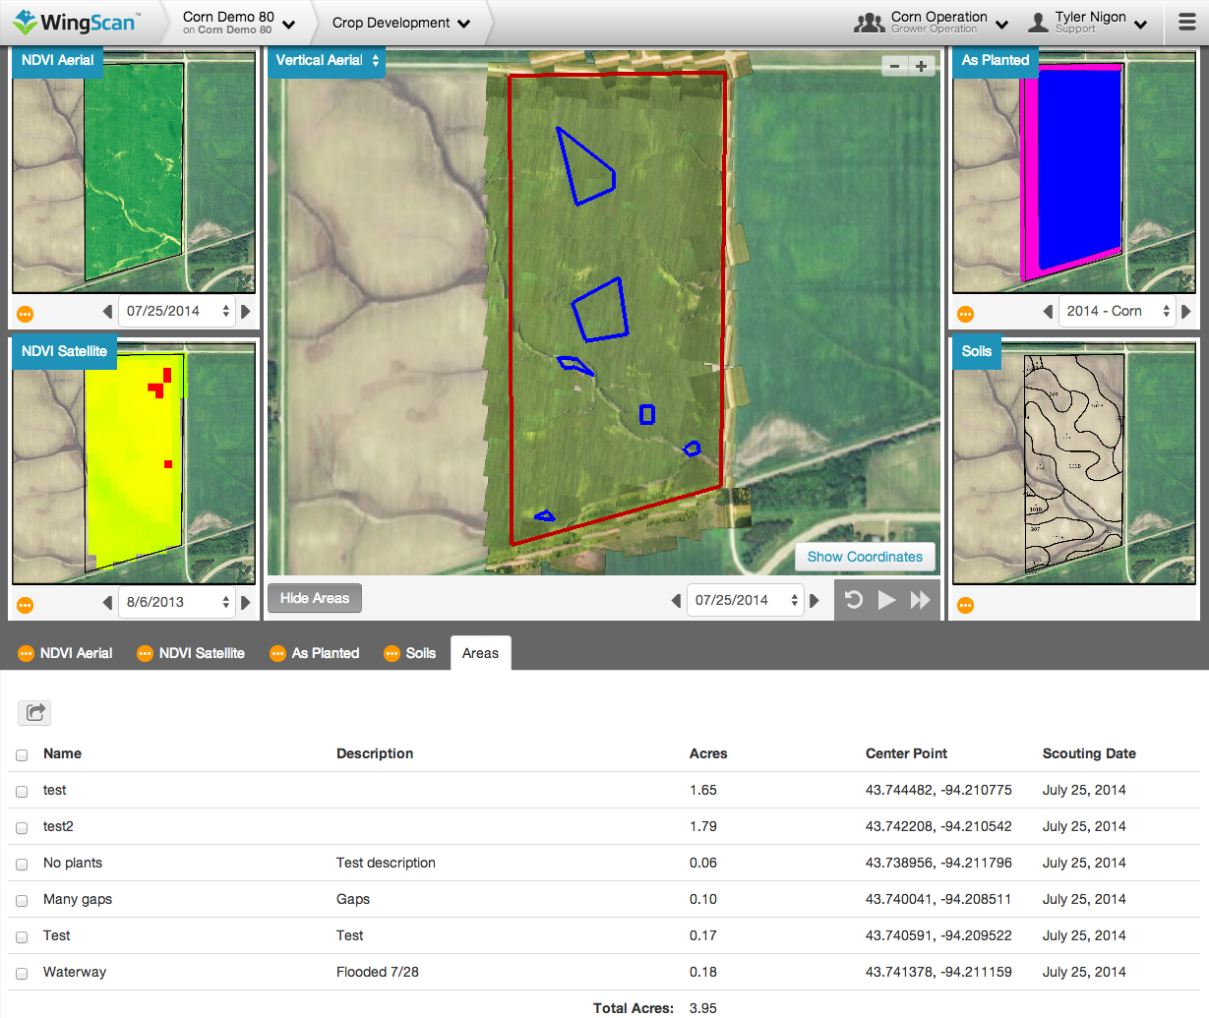
Use of computer vision, spectral data, and analytics to improve the allocation of agricultural inputs
MultiView – Areas Feature
12th annual NUE Conference
August 5, 2014

