Slide 1


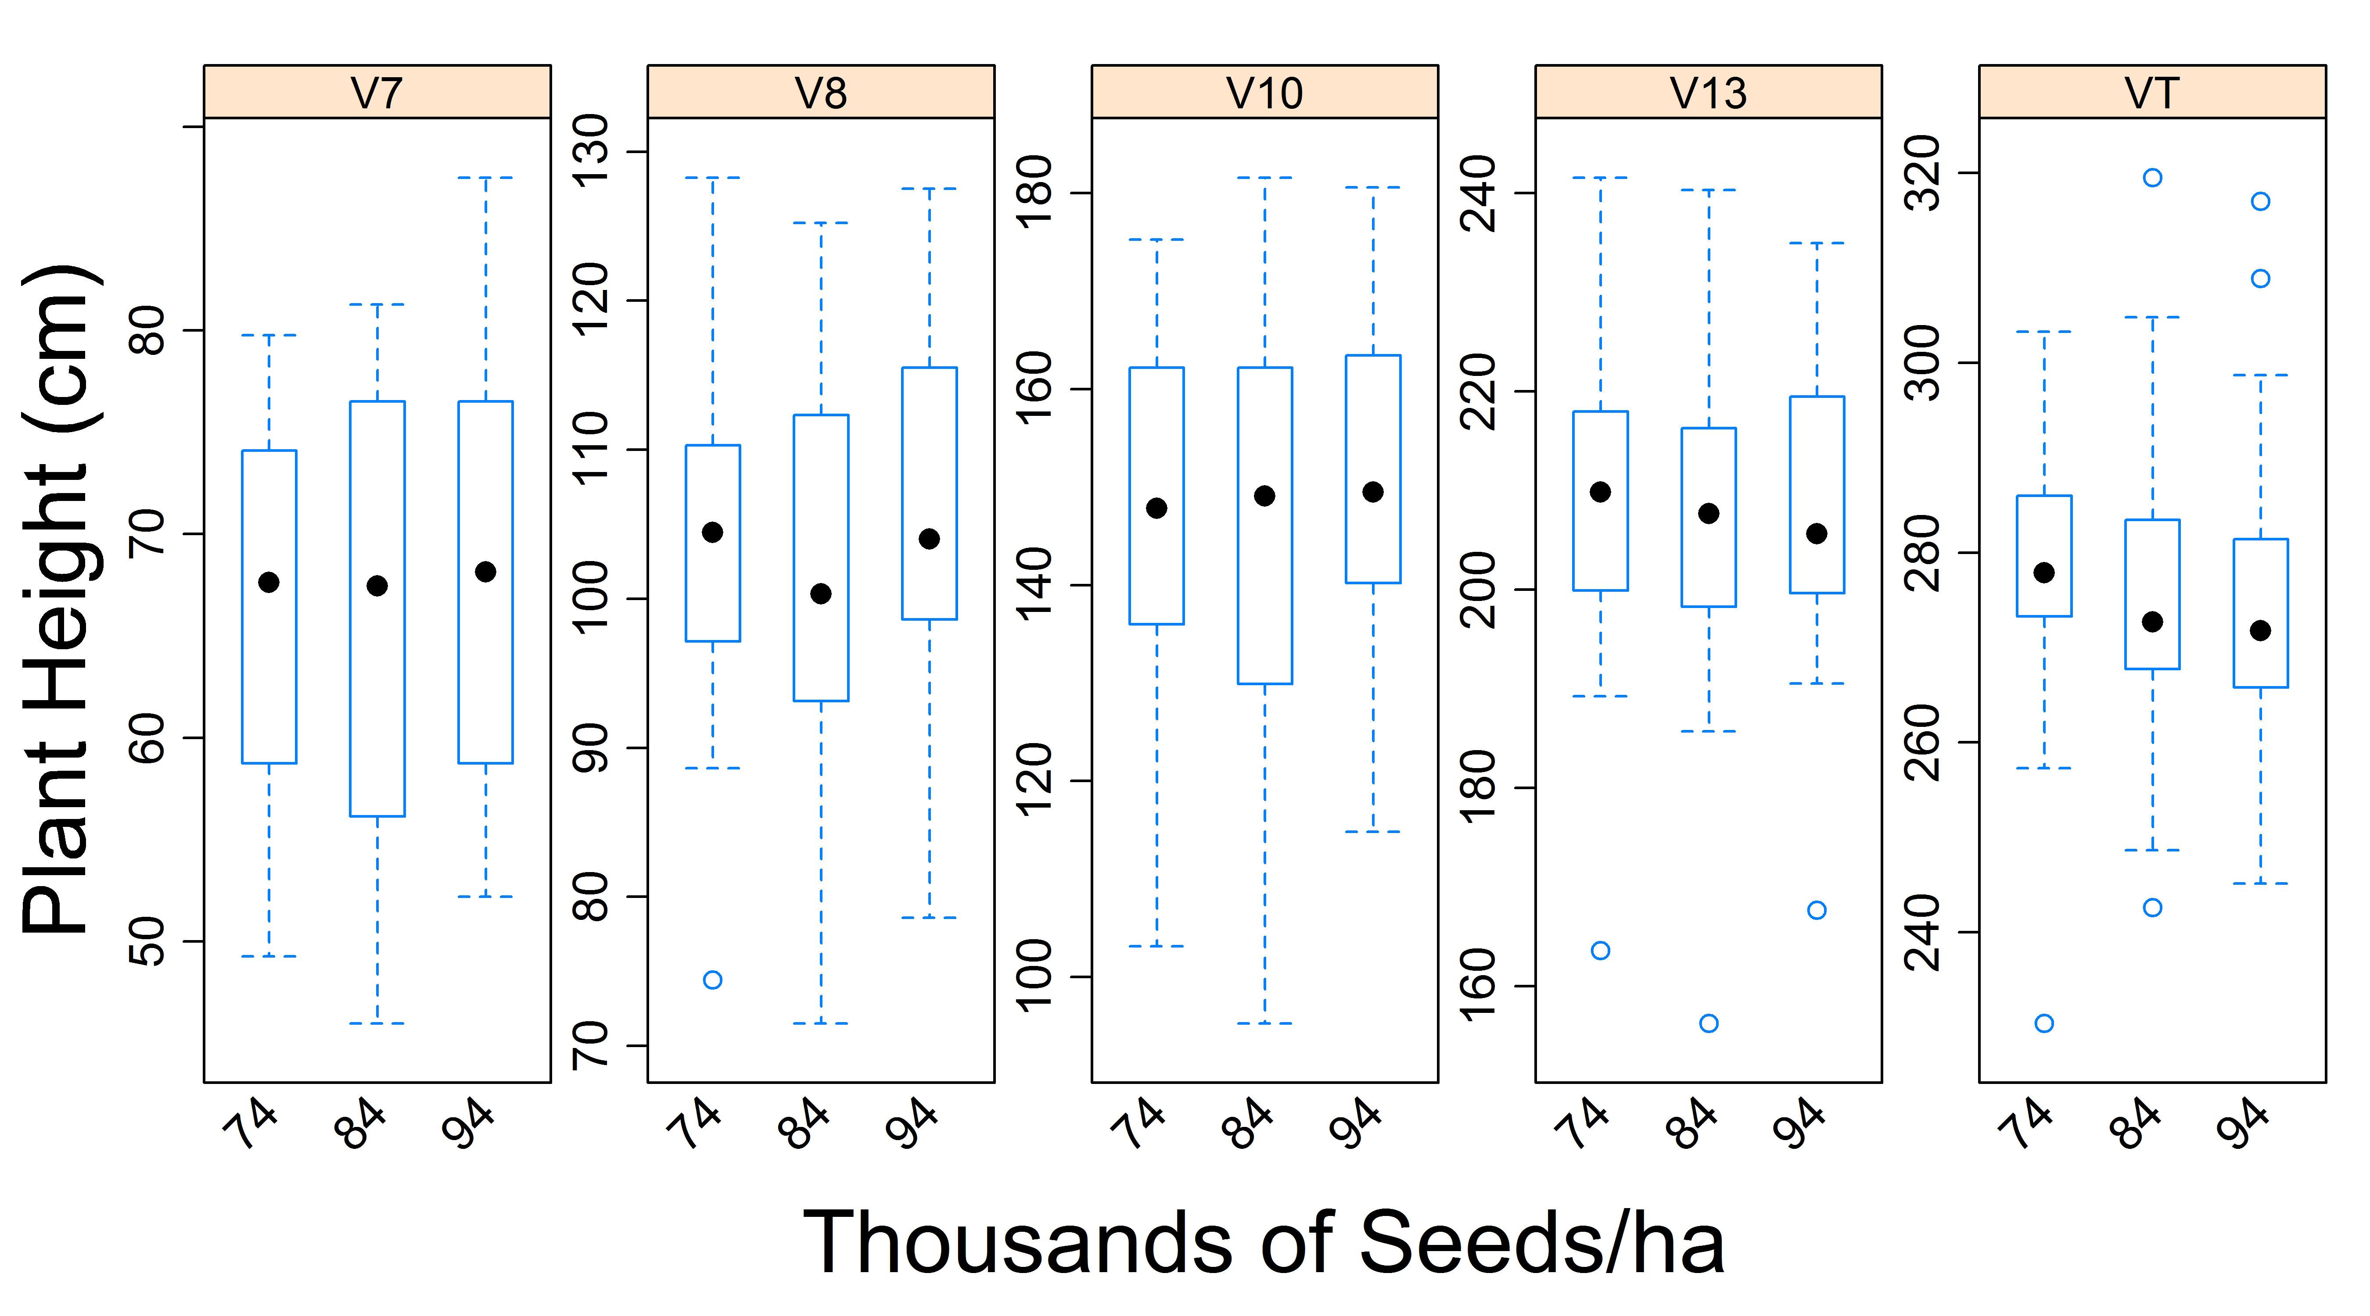
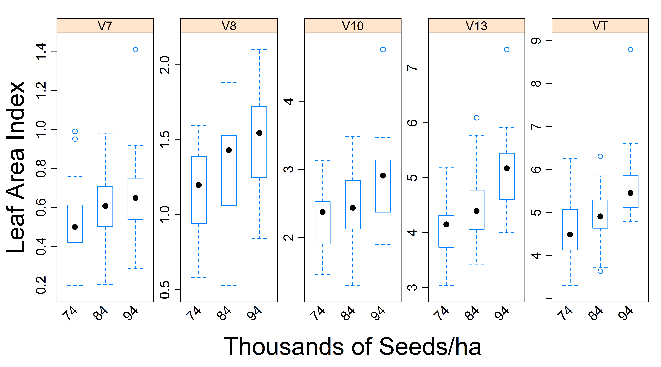
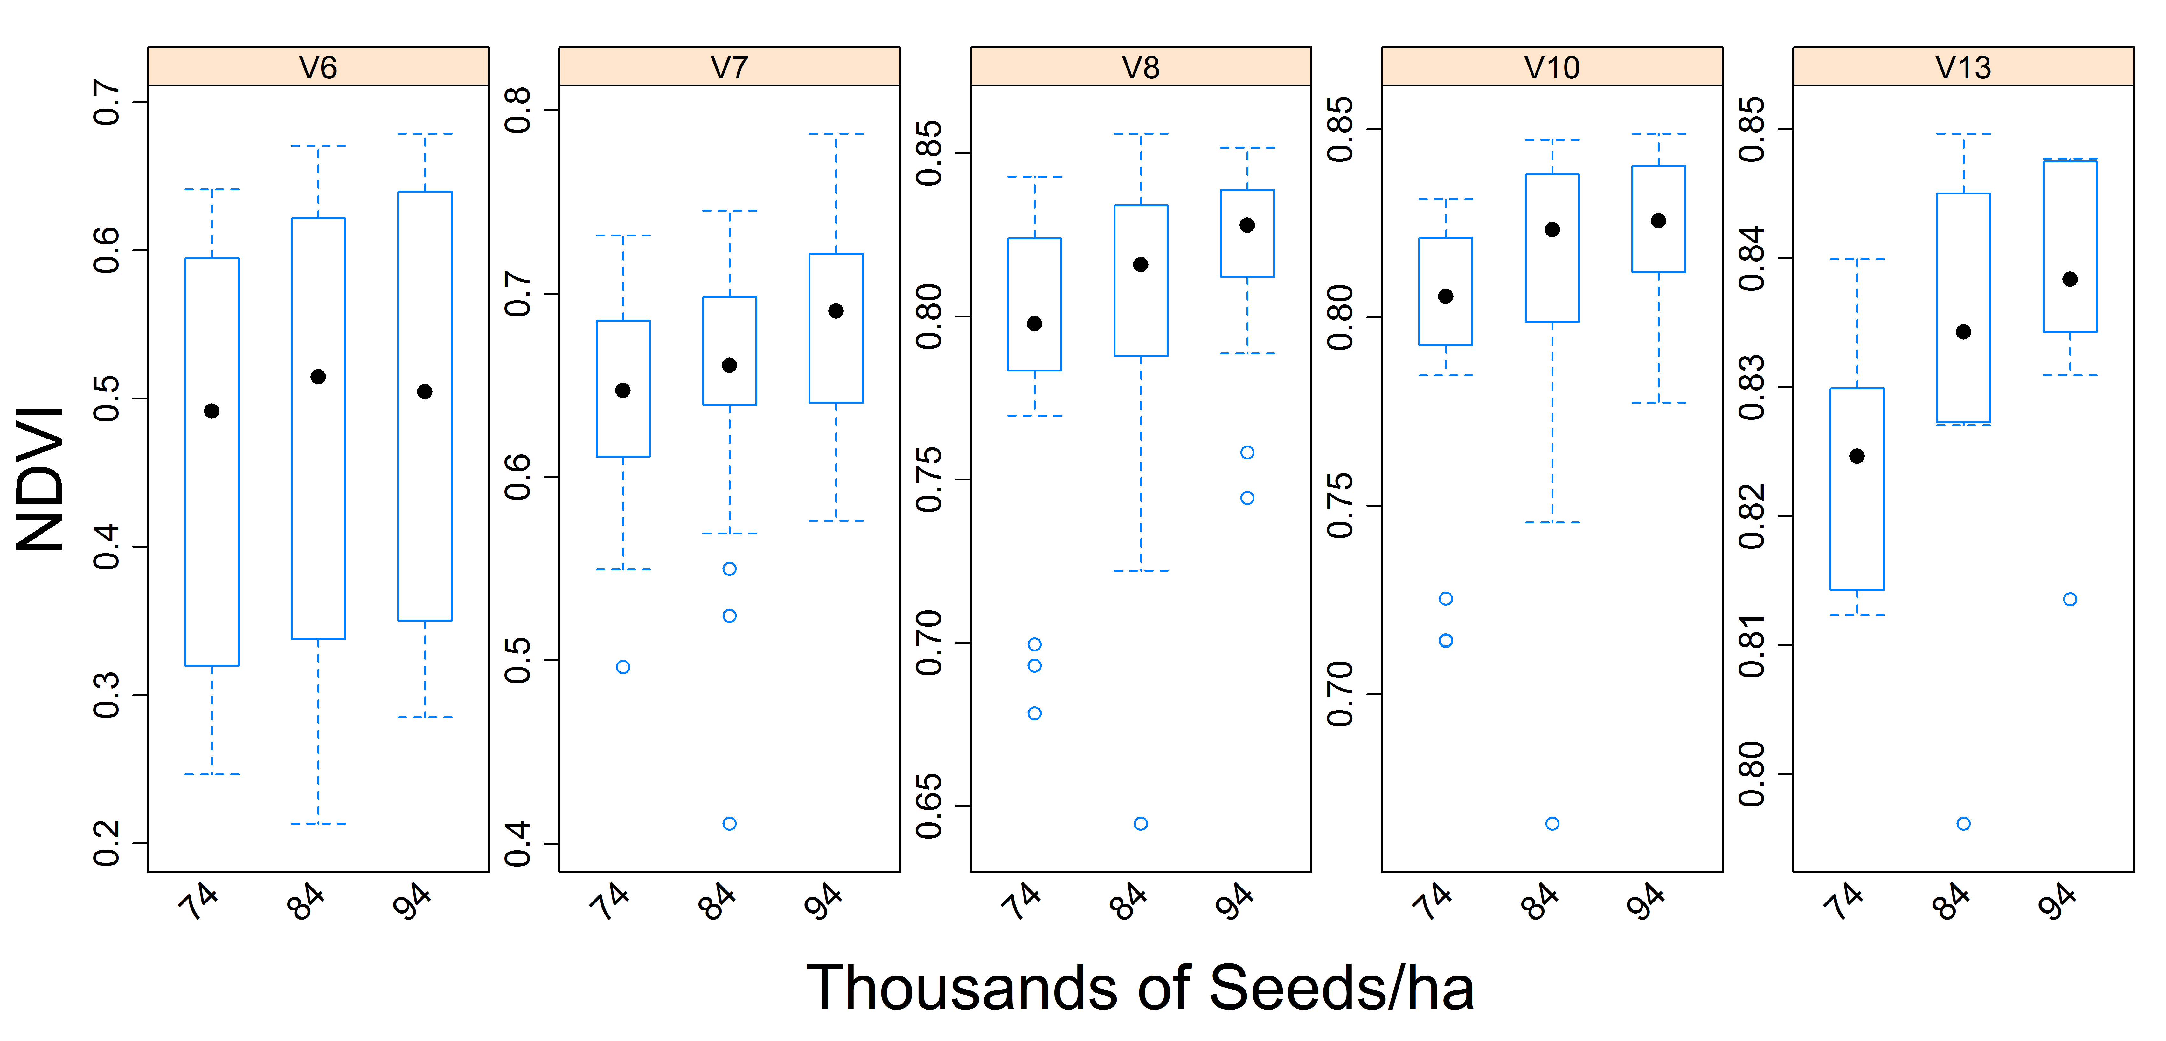
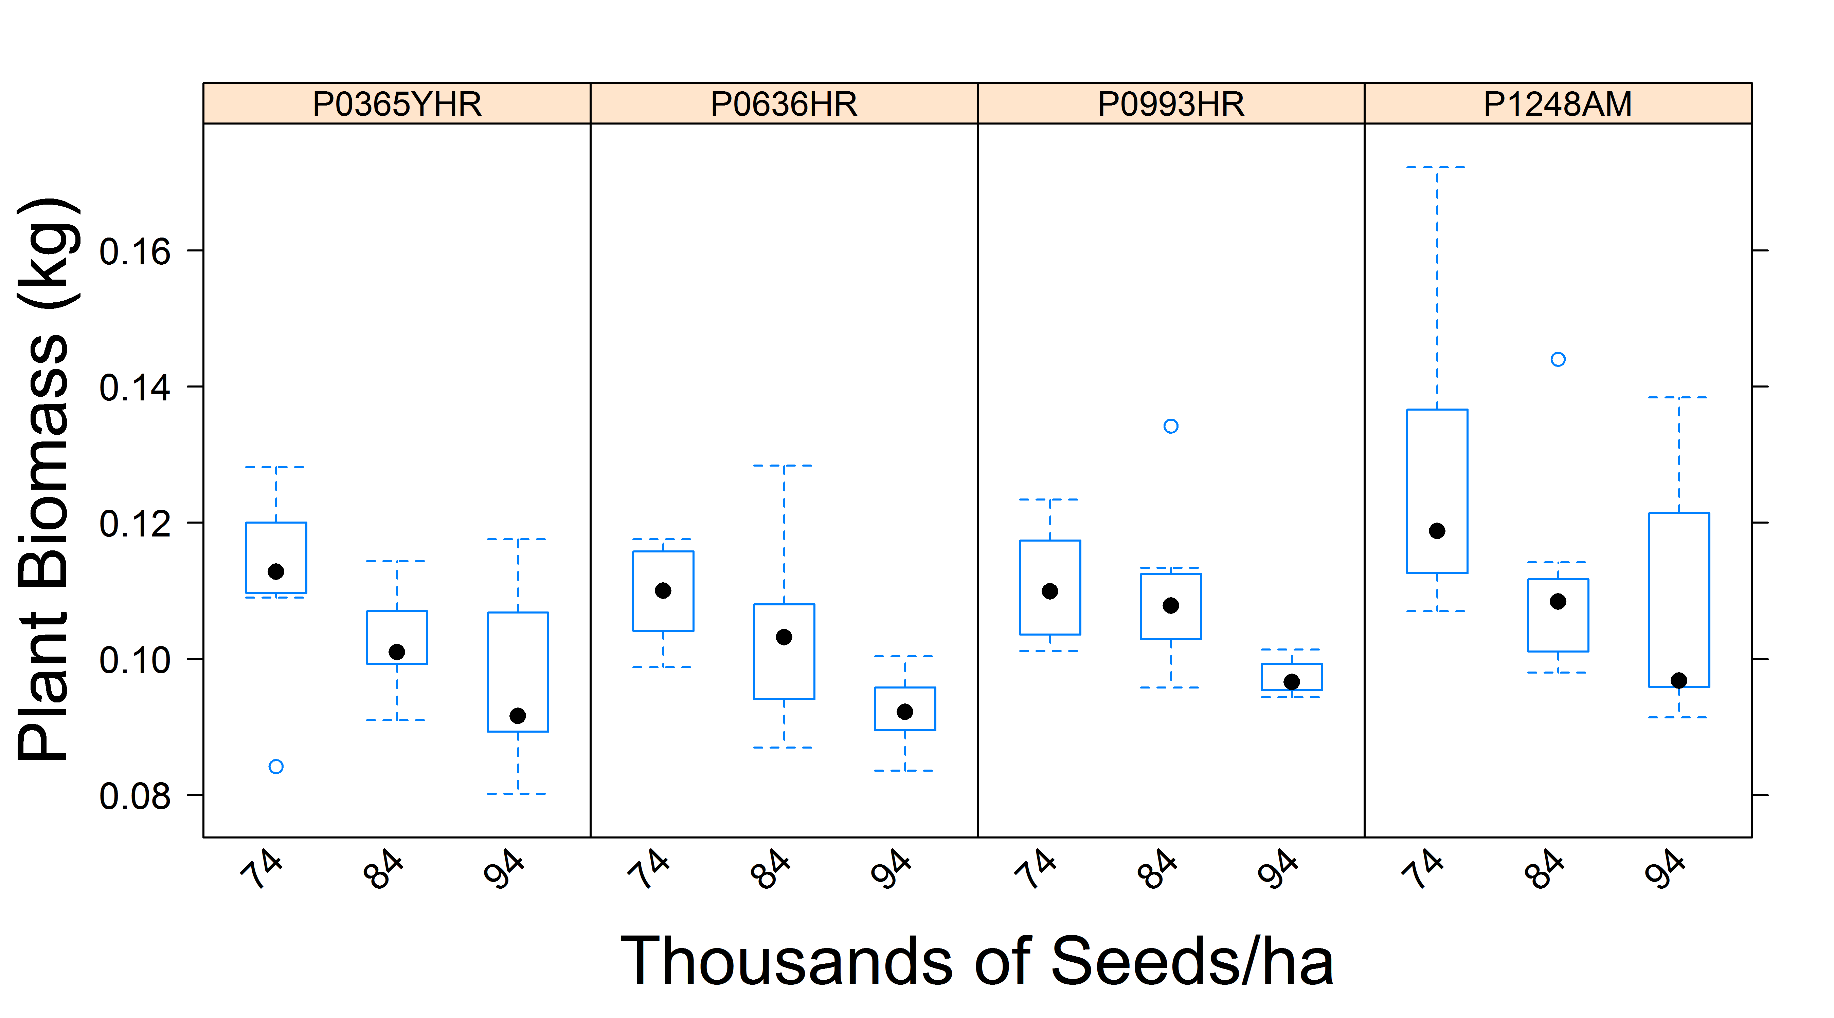
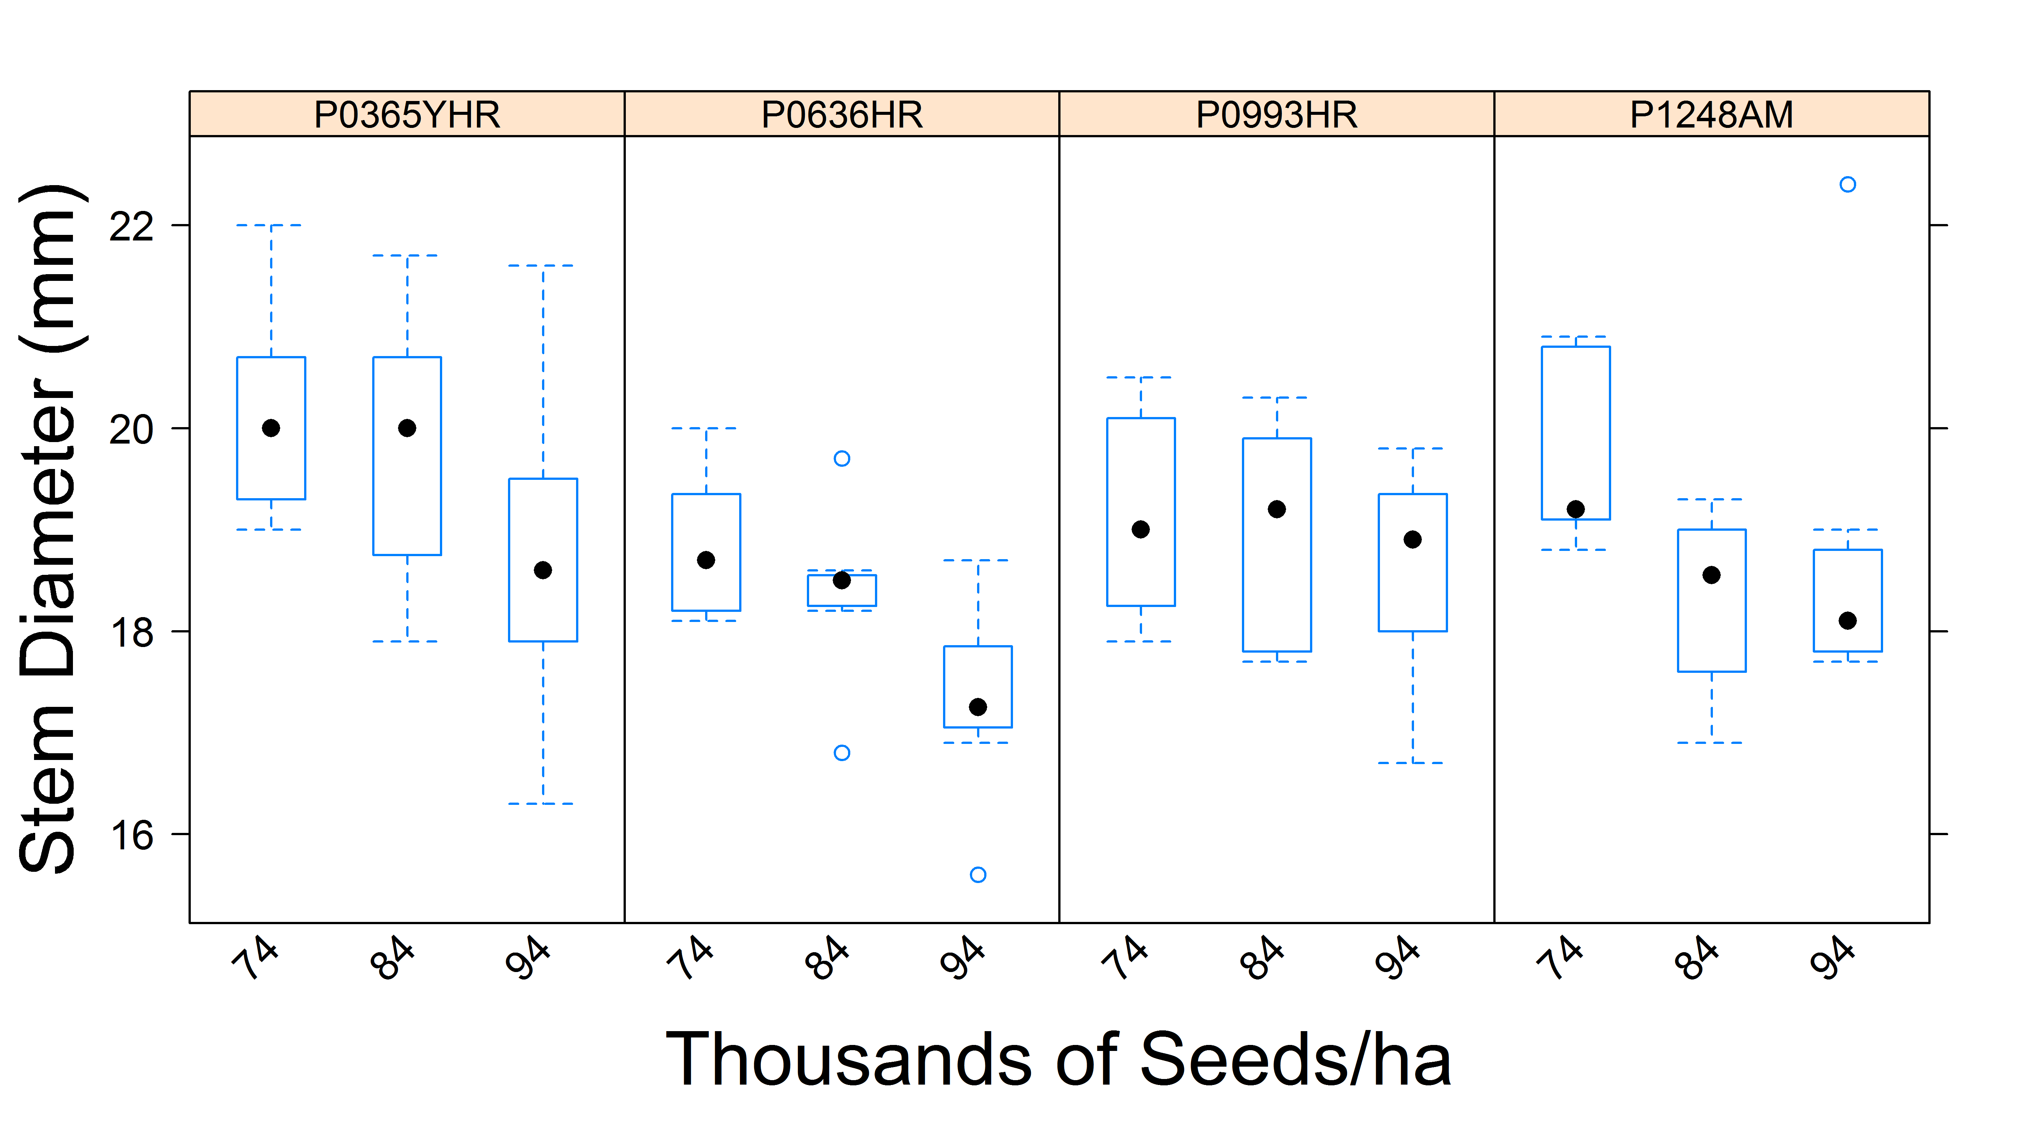
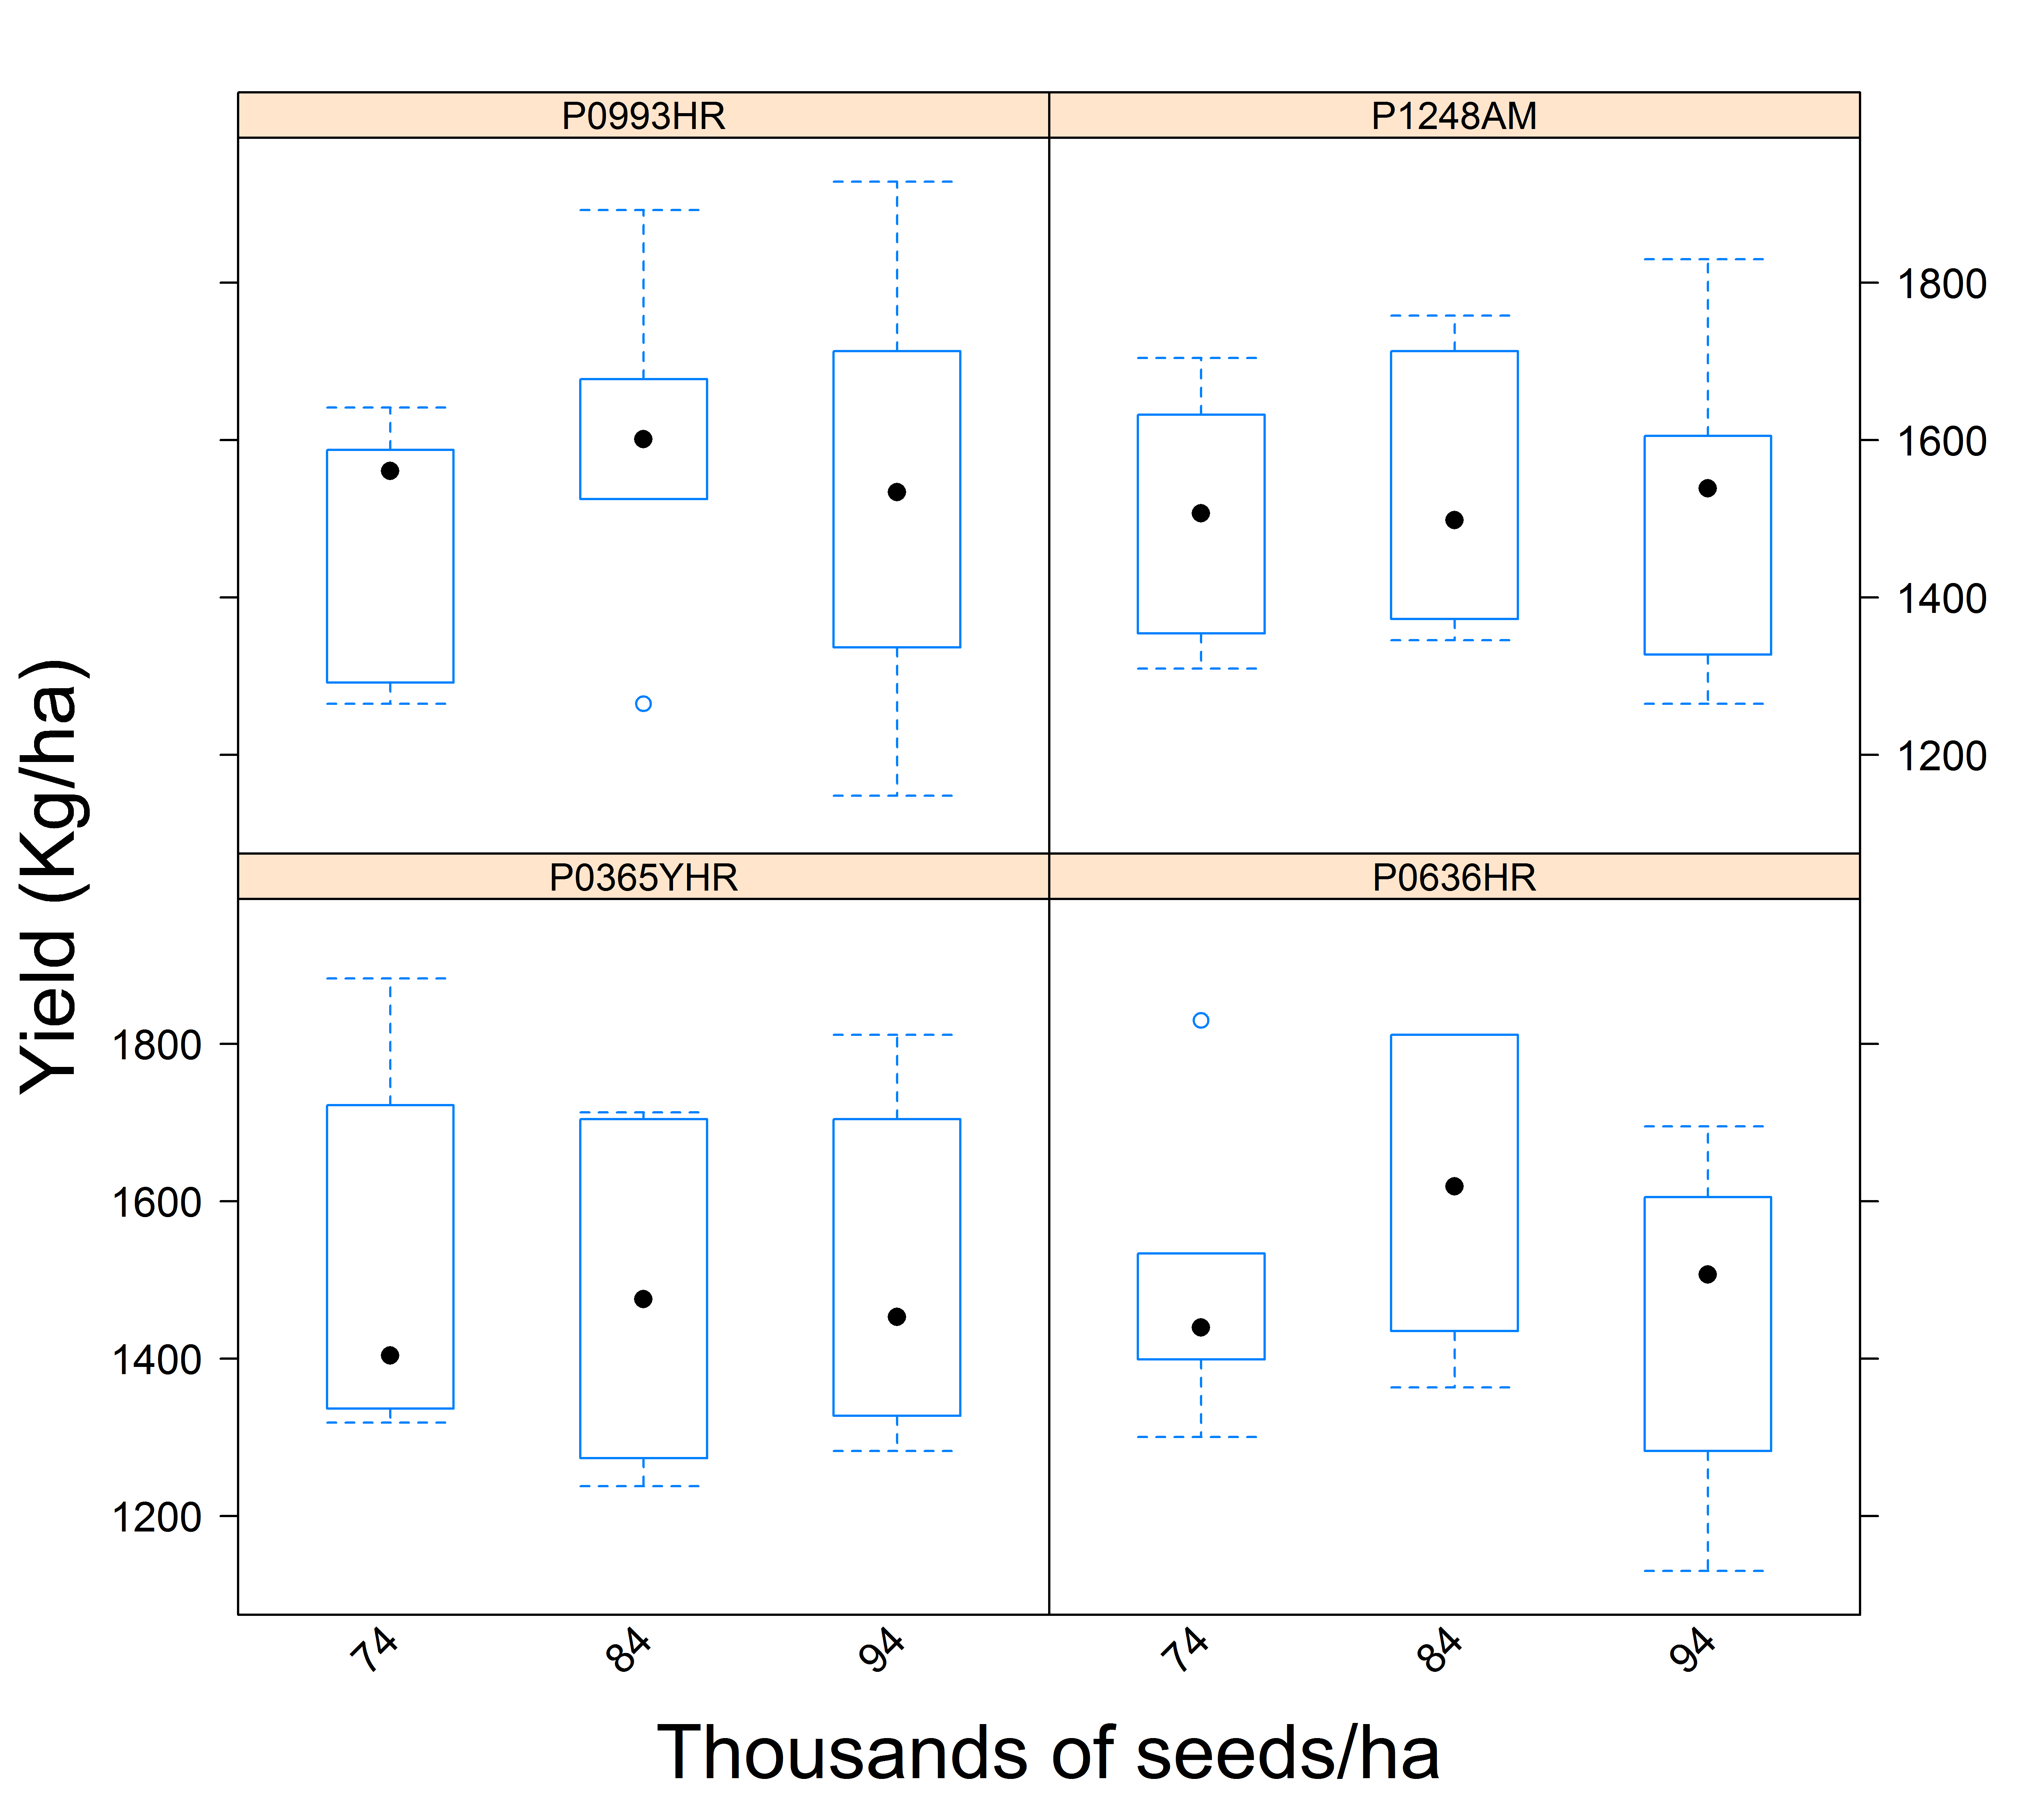
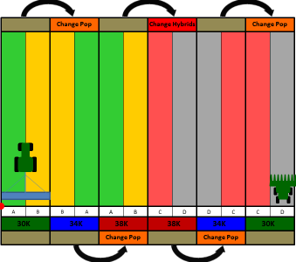
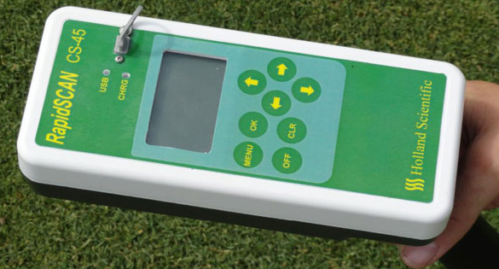
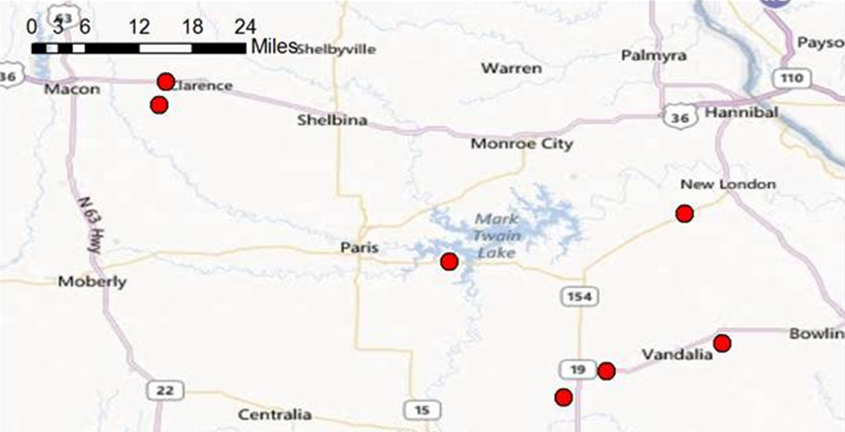
Physiological Responses of Corn to Variable Seeding Rates
In Landscape-Scale Strip Trials
B.J. Leonard¹, D.B. Myers¹, N.R. Kitchen², K.A . Sudduth²,
¹University of Missouri, Columbia, MO, ²Cropping Systems and Water Quality Research Unit, USDA-ARS, Columbia, Missouri
Background
Results
A goal in precision agriculture is to identify seeding rates that optimize yield, but that also minimize intra-specific competition.
Intra-specific competition occurs when plants of the same species compete for vital resources needed for plant growth and fruit development.
Methods are needed to develop variable rate seeding approaches in corn but require an understanding of the physiological and phenotypical response of corn to competition.
  Phenotypical and physiological plant measurements
Canopy sensor measurements
Objectives
Determine seeding rate and hybrid effects on:
    Phenotypical and physiological plant measurements
    Canopy and leaf sensor measurements
Figure 4. Effect of corn seeding rate on plant height (cm) for 5 developmental stages.
Figure 5. Effect of corn seeding rate on Leaf Area Index (LAI) for 5 developmental stages
Figure 8. Effect of corn seeding rate on normalized difference vegetation index (NDVI) at 5 developmental stages.
Table 1. Statistics for the relationship between NDVI and seeding rate by hybrid for 5 developmental stages.
Materials & Methods
Field-scale strip-trial design plots were conducted in 2013 at seven locations (Figure 3) in the Central Claypan Areas of Northeast Missouri. Individual locations serve as replicates in a spatially-distributed analysis of variance design.
Treatments were laid out in field length strips, 6 or 8 rows wide at 30-inch row spacing (Figure 1).
The study includes four different hybrids (P0365YHR, P0636HR, P0993HR, and P1248AM) at three different seeding rates: (74,000, 84,000, and 94,000 seeds ha⁻¹.)
Phenotypical and physiological plant measurements:
    Season long - Leaf Area Index (LAI, LI-3100C Area Meter) and Plant height
    Season final - Stem diameter, Plant biomass, and Yield
Canopy and leaf sensor measurements:
    Normalized difference vegetative index (NDVI,
    Holland Scientific Rapid-scan CS-45, Figure 2.)
  Supplemental Measurements
    plant growth stage
    normalized difference red edge
    plant biomass
    ear height
    estimated leaf area (LICOR 2000)
    harvest index
Figure 6. Effect of corn seeding rate on plant biomass (kg) for 4 hybrids at harvest.
Figure 7. Effect of corn seeding rate on stem diameter (mm) for 4 hybrids at VT developmental stage.
Plant height is different by hybrid but not by seeding rate for all measured developmental stages (Figure 4).
LAI is different by hybrid and seeding rate for some developmental stages, especially later in the growing season (Figure 5).
Leaf area per plant does not change by seeding rate but is different by hybrid at several growth stages (data not shown).
Plant Biomass increases by hybrid but decreases by seeding rate at harvest (Figure 6).
Stem Diameter at VT decreased by hybrid and seeding rate (Figure 7).
NDVI increased by seeding rate but was not different by hybrid for some developmental stages (Figure 8 and Table 1).
The interaction between hybrid and seeding rate is not significant for any of the treatments or measurements (Table 2).
Yield is not different for any seeding rates or by hybrid (Figure 9).
Figure 9. Effect of seeding rate on yield (kg/ha) for 4 hybrids at harvest.
Conclusions
Figure 1. Plot Layout.
Table 2. Statistics for Phenotypical and physiological plant measurements.
There are more differences in LAI between seeding rate and hybrid closer to maturity, however the leaf area per plant does not differ between those treatments at any developmental stage.
Differences in NDVI due to seeding rate indicate a potential need to calibrate or interpret sensor measurements used for agronomic treatments (N app.).
Physiological responses of corn can be different for seeding rates and hybrids but the overall yield in this study did not result in differences.
Figure 2. Holland Scientific Rapid-SCAN CS-45.
Figure 3. Plot locations.
Acknowledgements: This project is funded by DuPont Pioneer Incorporated.
References: Maddonni, G.A., and M.E. Otegui. 2004. Intra-specific competition in maize: early establishment of hierarchies among plants affects final kernel set. Field Crops Res. 85(1): 1–13.

