Slide 1
A Regional Investigation of In-season Nitrogen Requirements for Maize
Using Model and Sensor Based Recommendation Approaches
Laura (Stevens) Thompson – University of Nebraska-Lincoln
Richard Ferguson – University of Nebraska – Lincoln
Dave Franzen – North Dakota State University
Newell Kitchen – USDA-ARS, Columbia, MO
Martha Mamo – University of Nebraska - Lincoln

Slide 2
Key Questions
1. How do two different in-season N rate recommendation strategies – model (Maize-N) vs. sensor (with Holland-Schepers algorithm) – compare across a broad region?
2. How do different hybrids and populations impact these N recommendation strategies?
3. How do other sensor algorithms compare?

Slide 3

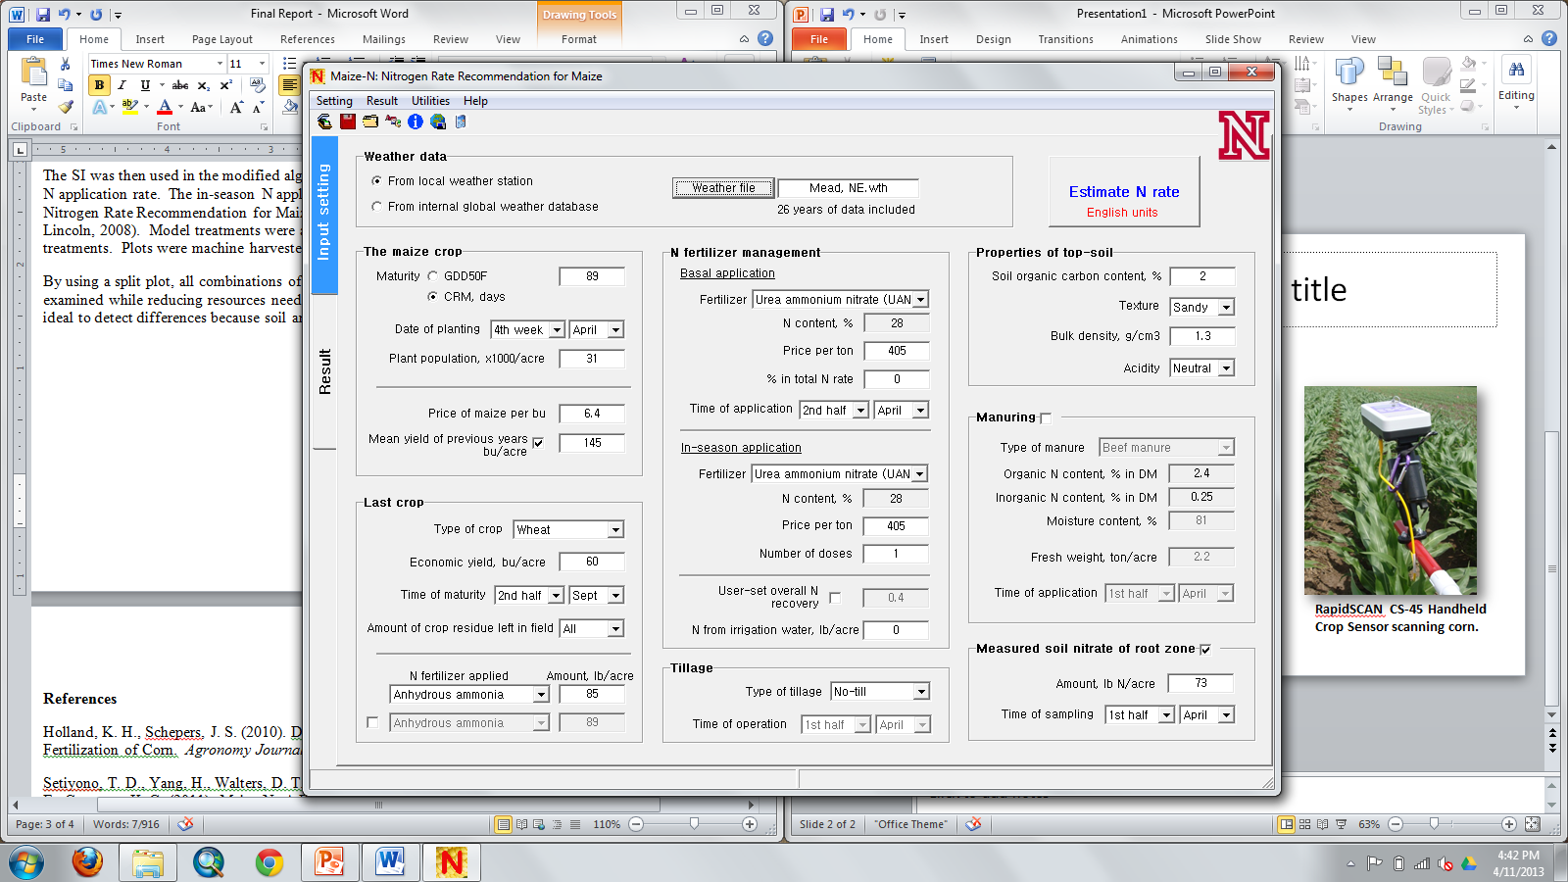
Model Approach
Maize-N Model : Nitrogen Rate Recommendation for Maize
(Yang, H.S., et al., UNL, 2008)
Notes:
Based on the Hybrid-Maize crop growth model; interactions between management and environment.
Used to predict N need – and can be used to determine how much needs to be applied in-season.

Slide 4
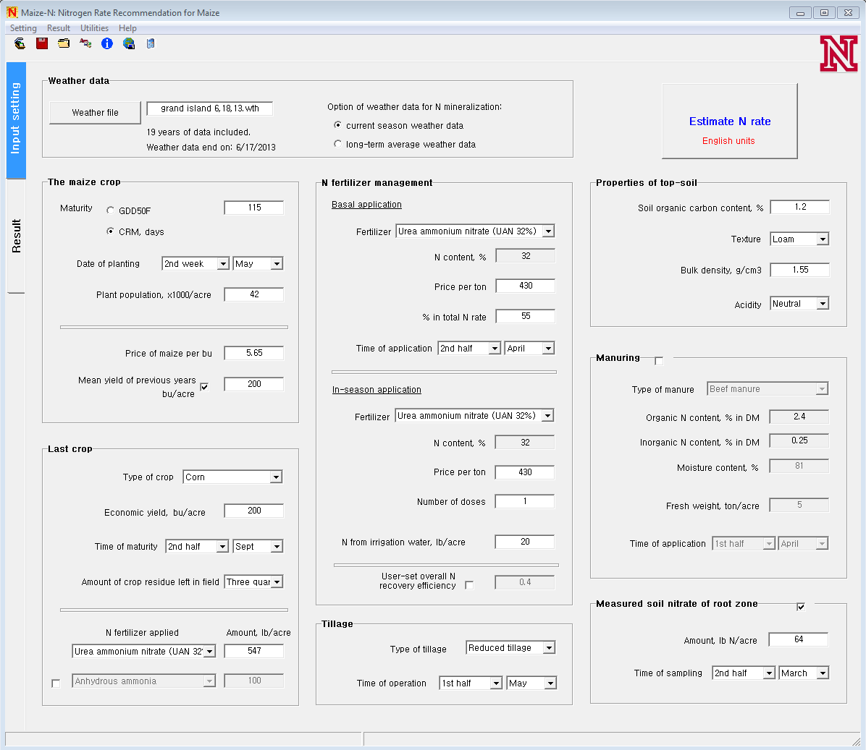
Fertilizer source
weather
Soil and
OM info
Planting date
Previous crop
Other N
credits
Notes:
Versions – Mineralization.

Slide 5
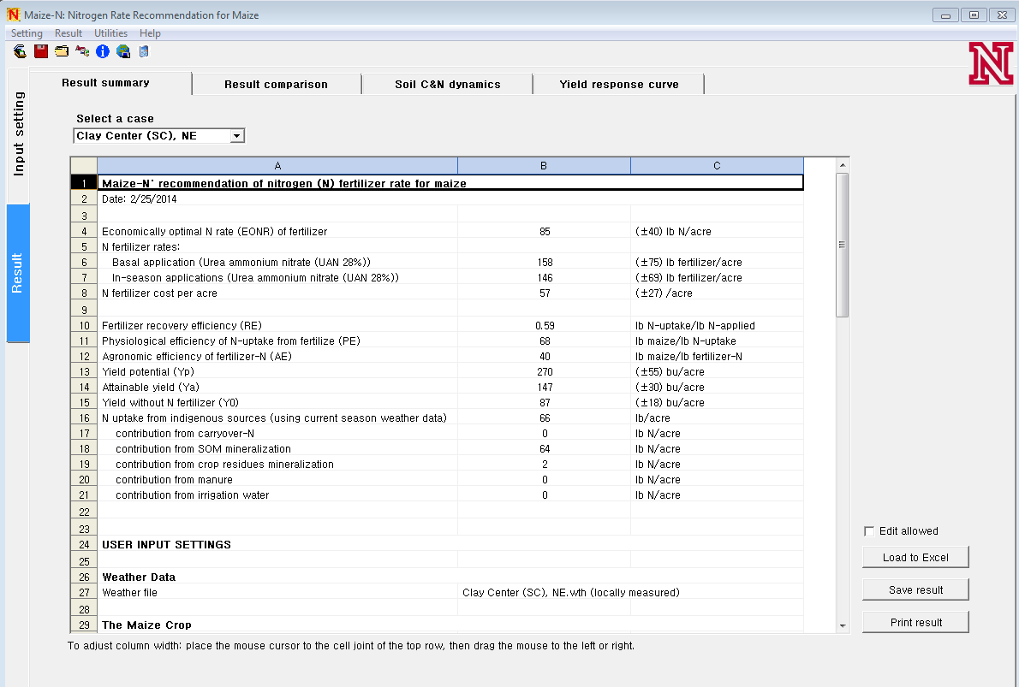
Economically Optimum N Rate
Attainable Yield
Notes:
Of interest: N rate and the in-season amount.
Is a variable approach to the degree that unique soil types, weather data, OM, residual N, planting population, hybrid maturity, etc is inputted by the user.

Slide 6
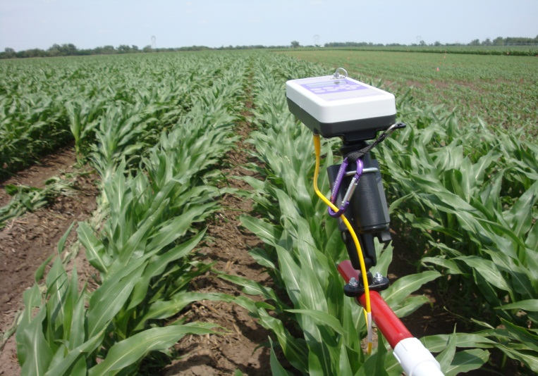

Sensor Approach
- RapidScan
3 band: red, red-edge, NIR
- NDRE with Holland/Schepers algorithm for N rate calculation
Notes:
Active sensor—own light source.
3 bands – 670, 730, 780 nm
Recieves reflectance back and had three bands – can use these to make indices – correlate to crop N status
Normalized Difference Red Edge Index
$$NDRE= \left(\frac{NIR −Red Edge}{NIR+Red Edge}\right)$$
Sufficiency Index (SI) = $\frac{NDRE of Target }{NDRE of Reference}$
NDRE is a vegetation index that is correlated with leaf area index and green biomass. LAI and green biomass and photosynthetic efficiency are affected by N and also affect NDRE. Because of this, This allows NDRE to be a good indicator of leaf N content.
For red regions, there is reduced sensitivity at high chlorophyll levels, therefore rededge is more sensitive. Occur at higher plant densities, later growth stages.
Reflectance values and indicies have little meaning without being related to an area where N is not limiting.
Sufficiency index or response index, relate the
N is applied at a rate where N will not be limiting, therefore crop will not show any N deficiencies. Often 200lb/ac or greater.
Use this to relate the reflectance values of for the field.
Sensor readings collected over the reference strip are considered the optimum sensor reflectance value.
target and reference reflectance values. Relative N status of crop.
How much N to apply?
Algorith allows us to take crop N status that was determined and come up with a N rate to apply.

Slide 7
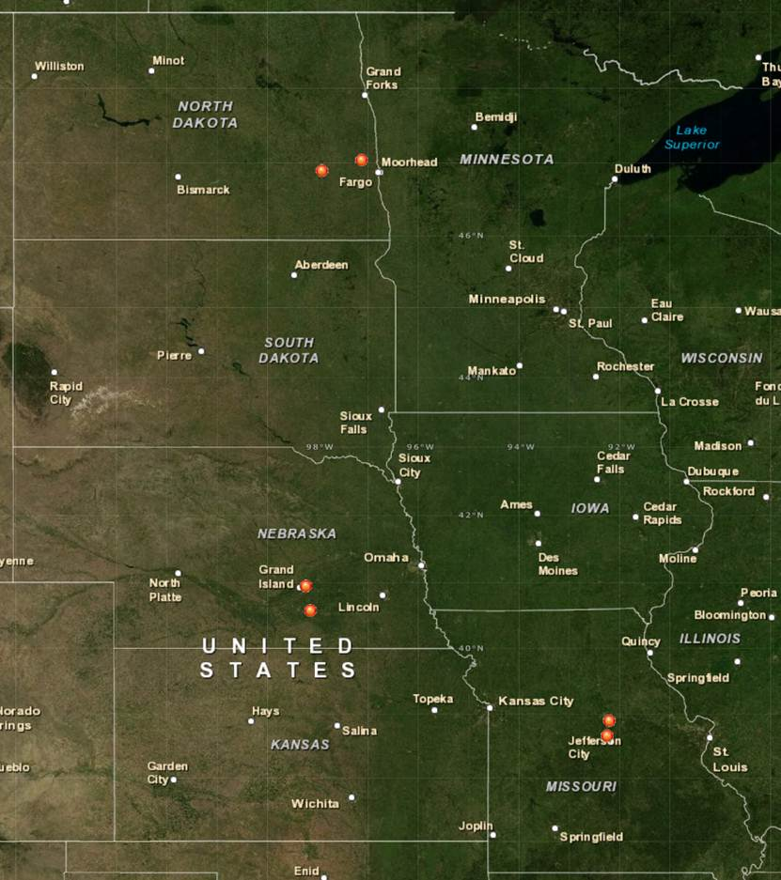
Locations
Notes:
2 years, 2012 and 2013 growing season.
6 sites each year. 2 eastern ND, 2 central NE, 2 central MO.
Total 12 site years.
Indicated on map

Slide 8
Treatments
2 Hybrids:
High & low drought tolerance
2 Plant Populations:
~79,000 & 104,000 plants ha⁻¹
Notes:
Same hybrids at MO and NE. One classified as higher drought tolerance, on with a lower drought tolerance score. ND hybrids different. 2 hybrids were used but did not differ in their drought tolerance ratings.
2 population – standard and higher rate.

Slide 9
Treatments
4 Nitrogen Strategies:
Unfertilized Check – 0 kg ha⁻¹
High N Reference – 224-280 kg ha⁻¹
Maize-N Model & Crop Canopy Sensor -
Initial N rate:
  Nebraska = 84 kg ha⁻¹
  Missouri = 56 kg ha⁻¹
  North Dakota = 0 kg ha⁻¹
In-season rates:
Determined by model and sensor

Slide 10
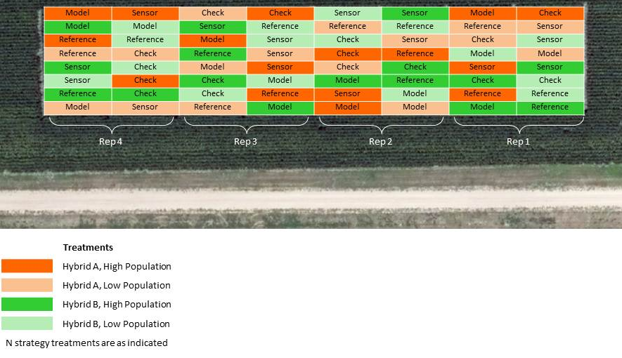
16 treatments:
(2 Hybrids X 2 Plant Populations X 4 Nitrogen Strategies)
Notes:
Total of 16 treatments, arranged in RCBD.

Slide 11
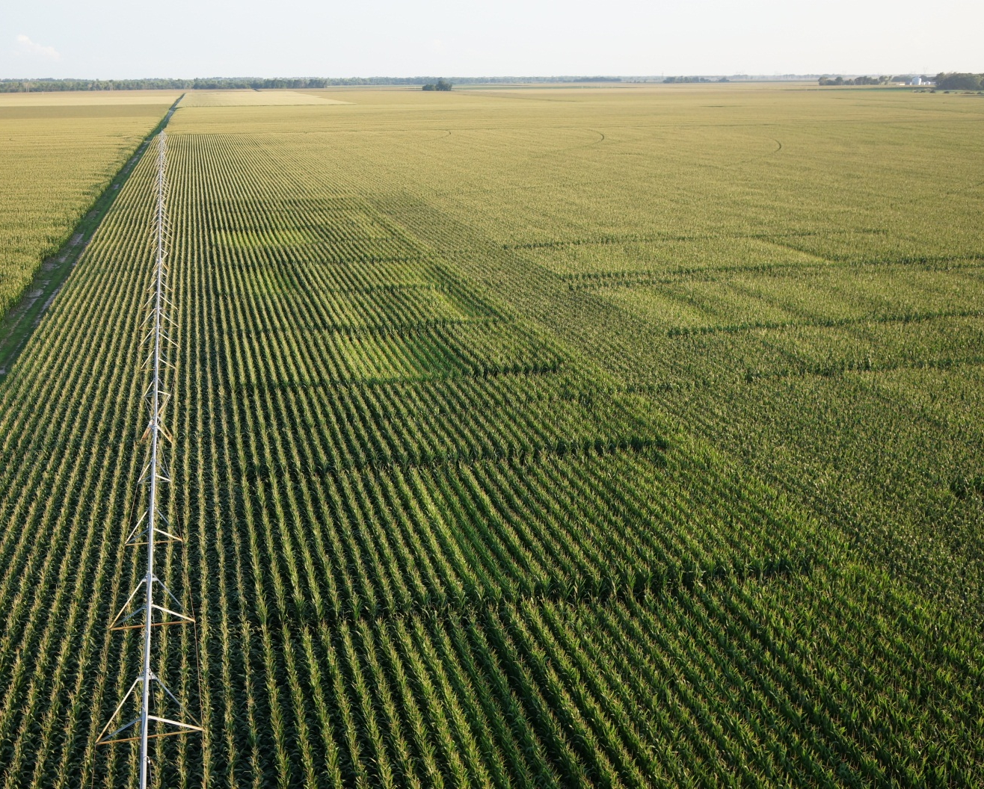
Notes:
Study area for a Nebraska site, 4 rows wide plots. Can see different replications and some treatment differences.

Slide 12
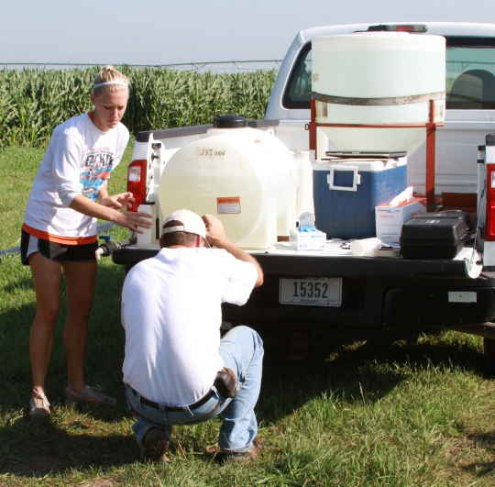
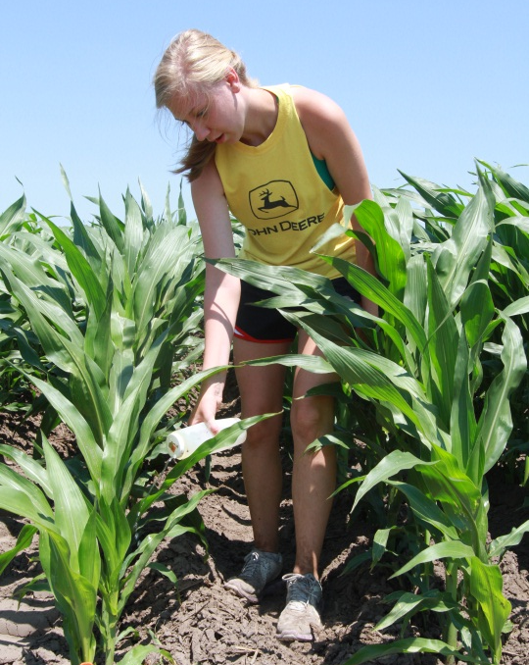
Nebraska
Notes:
For in-season application, Crop was sensed…in-season rate determined. Model was run and rate determined. Then applied N at the same time.
In-season N application at Nebraska
Hand applied UAN 32%
Plots were 4 rows and 15.24 meters long (50’)
Targeted V8-10, same time for both sensor and model treatments.

Slide 13
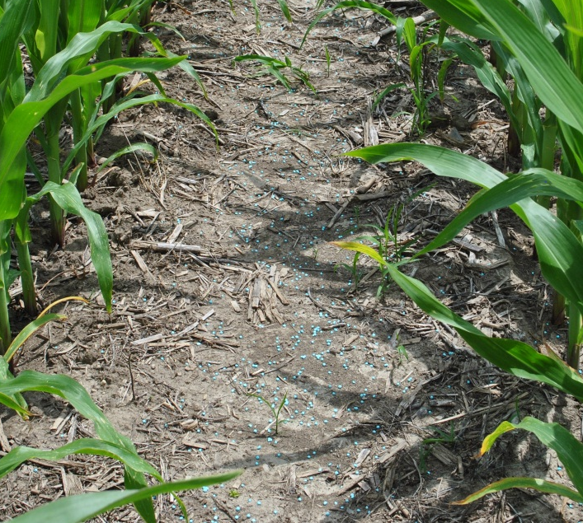
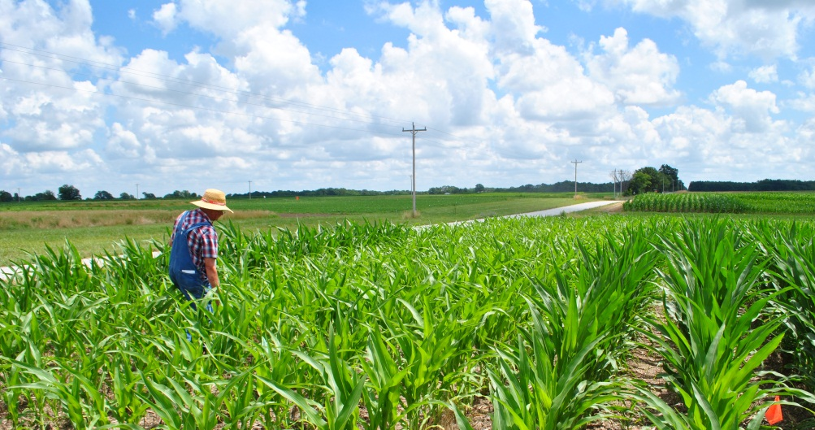
Missouri
Notes:
In season application at Missouri.
Granular Super Urea 46%
Plots 4 rows by 15.24 meters, 50’

Slide 14
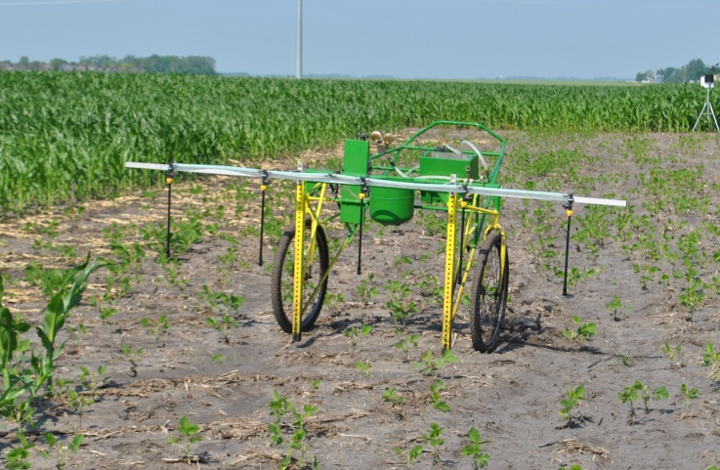
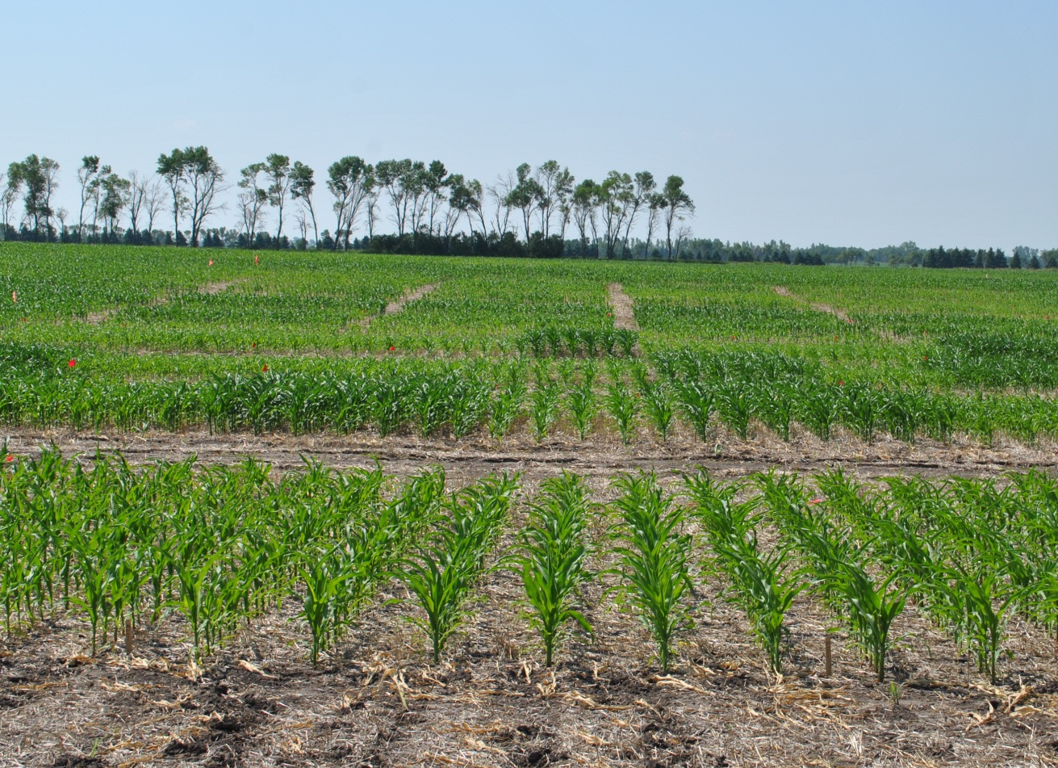
North Dakota
Notes:
North Dakota at In-season application.
6 rows wide by 9.14 meters (30’)
UAN 28% applied with applicator shown.

Slide 15
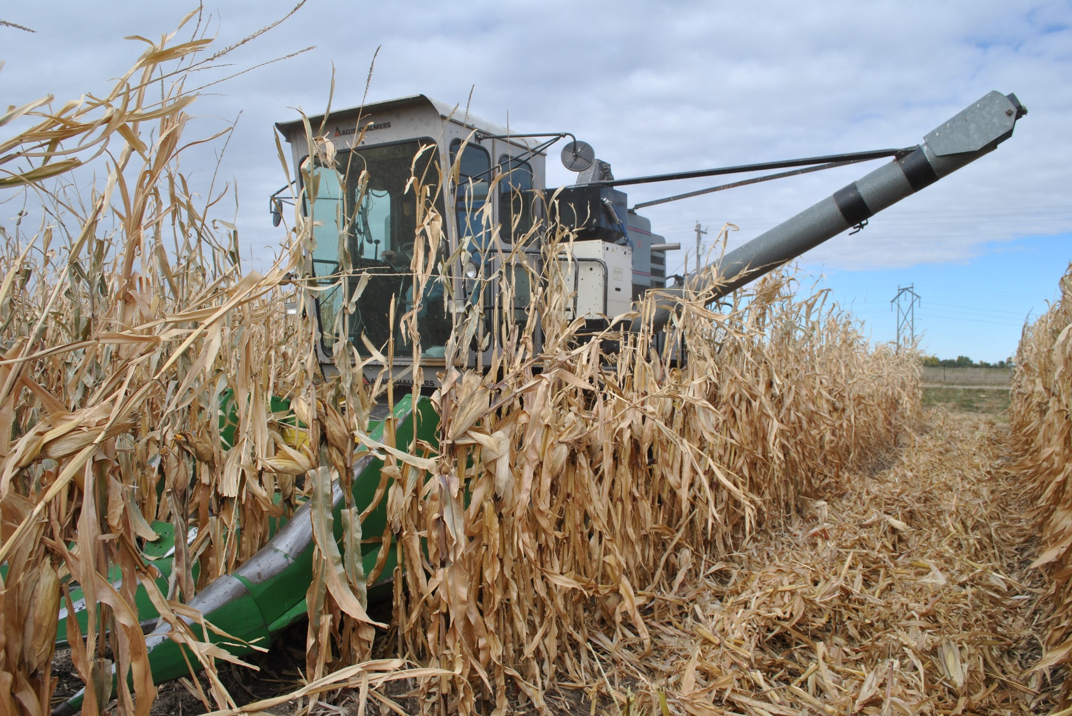
Harvest
Notes:
Plots harvested using plot combine at some sites and hand harvested at other sites.

Slide 16
Results and Discussion

Slide 17
Key Questions
1. How do two different in-season N rate recommendation strategies – model vs. sensor (with Holland-Schepers algorithm) – compare across a broad region?
2. How do different hybrids and populations impact these N recommendation strategies?
3. How do other sensor algorithms compare?

Slide 18
Notes:
Model generally calls for more N than sensor.
Exceptions are MOBA13 and NDVC13. NDVC had high levels of residual N that likely caused N recommendation with model to be 0.
How does N rate relate to yield?

Slide 19
Notes:
Rollins – explain
Explain axis.
Over all site years, sensor treatment was significantly higher yielding than the model at 1 site (MOBA) and the model treatment was significantly higher yielding than the sensor treatment at 2 sites (NEMC13, MOTR).
Comparing to reference, sensor had significantly lower yield at 4 sites, while model at 2 sites.
Overall, the model better protected yield than the sensor.
Look at N applied, and if higher N rates resulted in higher yield. Generally true, as expected. Not always significant differences (a=.05) though. There is notable exception NEMC and NECC12.
Discuss MOTR.
NDAR, NDVC

Slide 20

NUE
$$Partial Factor Productivity of N= \frac{kg grain }{kg N}$$
$$Agronomic Efficiency= \frac{kg grain increase}{kg N}$$
Notes:
Agronomic Efficiency is accounting for the N that was supplied other than fertilizer N. By subracting check yield, we take into account N available from other sources that impacted yield.

Slide 21
Notes:
Explain axis.
Yield on secondary for comparison.
At all sites, where N app from sensor was less than model, the sensor had higher PFP.
Sensor has higher PFP than model at almost all sites. Generally has higher PFP.
Can see how that relates to yield. Generally the sensor treatments with the higher PFP have a lower yield.
Exception, notable, NEMC12 and NECC12 where higher yields were seen and higher PFP for the sensor. The sensor also called for lower N application here. This is an example of where the sensor performed well. High mineralization, appropriately accounted for by the sensor, resulted in appropriately reduced N application with no loss to yield and therefore improved PFP

Slide 22
Notes:
Similar. See that sensor is higher.

Slide 23
Notes:
$5/bu corn = $0.20 /kg
$.50 N fert = $1.1/kg
No clear trend in profitability.
Sensor was more profitable than model at 2 sites. (2 NE 2012, where N was reduced for the minerailization appropriately.)
Model was more profitable than sensor at 2 sites. (MOTR13, sensor applciation of N was very low and resulted in sign. Reduced yields. NEMC)
Remainder of sites, no difference in profitability between the model and sensor.

Slide 24
(Model—Sensor)
Site | N-input |  | Yield | Profit | AE | PFP_{N}
 | kg ha⁻¹ |  | kg ha⁻¹ | $ ha⁻¹ | kg grain increase kg N⁻¹ | kg grain kg N⁻¹
NEMC12 | 67 | -545 |  | -181* | -10* | -72.4*
NECC12 | 25 | -657 |  | -157* | -8 | -47.9*
MOLT12 | 36 | 377 |  | 21 | -7 | -13.9*
MORO12 | 55 | -- |  | -- | -- | --
NDDN12 | 117 | 629 |  | -8 | -8 | -21.9*
NDVC12 | 151 | 755 |  | -15 | -3 | -101.7*
NEMC13 | 85 | 1377* |  | 177* | -9* | -39.3*
NECC13 | 82 | 81 |  | -74 | -11* | -53.7*
MOTR13 | 165 | 3528* |  | 510* | -39* | -81.2*
MOBA13 | -20 | -485* |  | -73 | 3 | 6.0*
NDAR13 | 24 | 270 |  | 28 | 2 | -37.1*
NDVC13 | -59 | -735 |  | -79 | -- | --
*Indicates significant difference at P≤0.05.
Notes:
Talk about two sensor cases where they performed well. Talk about that Model when re-run with 2013 version was improved and closer to the values for the sensor.

Slide 25
Notes:
N response at 9 sites was calculated using a linear plateau model. This allowed for estimation of the ONR. ONR is on y axis. Actual N rate on x axis.
Black 1:1 line is ideal.
-points above line are under applied
-points below line are over applied.
Maize N tends to over apply as seen by treandline through data.
Sensor with Holland-Schepers algorithm underapplieds as seen by trendline through data.
Maize in more closely approximates ONR. y=.8145x, closest to y=1x.
Also has higher coefficient of determination as seen by R2.
Non-responsive sites?

Slide 26
Notes:
$5/bu corn = $0.20 /kg
$.50 N fert = $1.1/kg
Calculated profit from ONR and yield achieved at ONR. Compare to model and sensor. Compared to profit that would’ve been obtained at ONR.
Profit loss due to excess N was more prevelant for model.
Profit loss due to lost yield was more prevelant for sensor.
Looking at change in net profit for these two approaches, the sensor was less profitable at 4 sites, and the model was less profitable at 5 sites.
Over all sites combined, the sensor approach lost $388 ha-1 more than the model approach.

Slide 27
Model | Sensor
Recommended more N; better protected yield | Recommended less N; had higher NUE
2008 version did not use current year’s weather for mineralization. 2013 version does have capability. | Performed well when unexpected N was supplied. Responsive to in-season additions of N.
Does not attempt to account for N losses due to denitrification, leaching, or volatilization. | Can account for losses of N due to denitrification, leaching, or volatilization if they are evident in plant reflectance.
Compared to ONR, model more closely approximates and errs by over-recommending N. | Compared to ONR, sensor errs by under- recommending N.
Does not rely on the N status to be expressed in crop. | If N losses or additions have occurred but are not yet evidenced in the plant by the time of sensing, they will not be accounted for.
Attempts to predict effect of weather between in-season N application and harvest based on historical long-term weather. | Cannot predict effects of weather on crop health and N availability between in-season N application and harvest.
Maize-N requires more information input by user. It also requires user input unique values to generate a spatial recommendation. | Sensor requires little information from user. It intrinsically generates spatial recommendations.
Profit loss due to excess N applied. | Profit loss due to reduced yield.
  User convenience. Narrow window of application time.

Slide 28
Conclusions
Consider combining Model and Sensor approaches. Model can provide ONR or expected yield that are required by sensor algorithms.

Slide 29
Key Questions
1. How do two different in-season N rate recommendation strategies – model vs. sensor (with Holland-Schepers algorithm) – compare across a broad region?
2. How do different hybrids and populations impact these N recommendation strategies?
3. How do other sensor algorithms compare?

Slide 30
Hybrid Differences
Notes:
Significant differences in hybrid for sensor data occurred at a few MO and NE sites where hybrids were the same.
NDRE of Hybrid A was always greater when significant differences occurred. (33D49)
NDRE at time of N aapplication was significantly different for 3 sites (Hybrid A was greater than Hybrid B). ~2 weeks following application another sensor reading was taken and NDRE was significantly different for hybrid at 6 sites, (only one of those sites was the same as from the original difference at time of N application) and again Hybrid A was always greater.
When translated to SI however, there was only one site that had significant difference at 1 site at the time of application (not any of the three) and at 2 sites following application.
This did not translate into yield. Where there were significant hybrid differences in yield at MO and NE sites, Hybrid B was greater.
It is thought that the sensor differences were due to leaf architecture and hybrid color differences that were visually observed rather than differences in N content and overall plant health.
However, it also appears that the differences in NDRE became more significant following the time of application and were not as frequently significant at the time of in-season application.

Slide 31
Population Differences
Notes:
Many sites where there were significant differences in sensor data NDRE due to population main effects.
Almost always higher population had higher NDRE. Exception was NDDN12 where there were poor and uneven plant stands that may have influenced this.
How does this impact the N rate that would be recommended?

Slide 32
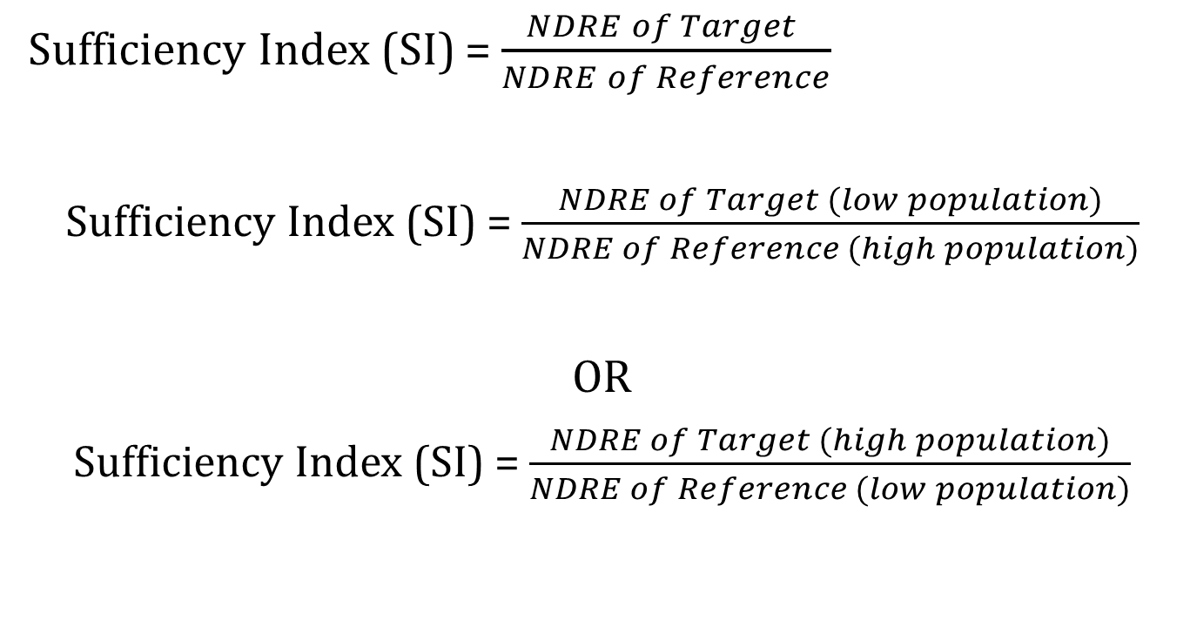
Sufficiency Index (SI) = $\frac{NDRE of Target }{NDRE of Reference}$
Sufficiency Index (SI) = $\frac{NDRE of Target (low population)}{NDRE of Reference (high population)}$
OR
Sufficiency Index (SI) = $\frac{NDRE of Target (high population)}{NDRE of Reference (low population)}$
Notes:
How would using alternate SI calculated with different populations impact the N recommendation with sensor and Holland/Schepers algorithm?

Slide 33
Notes:
0 = same population for both target and reference crops
Some cases, like NECC12, there was not a difference because SI values were almost always at or above 1.
Other times, larger differences.
Generally higher population had higher NDRE. IF this was used as the reference (green), and a lower population area was used as the target, the SI would be lower, resulting in higher N rates.
Generally the lower population had lower NDRE. If this was used as the reference, the SI was higher and N rates were lower.
Opposite for NDDN12 because population differences had opposite NDRE responses to the remainder of sites.
Message here: using different populations for target and reference will impact N rate.
Generally using a reference that is a higher population than the target results in a higher N rate.
Using a reference that is a lower population than the target results in a lower N rate.
With variable rate planting becoming more prevelant, this is important to consider.

Slide 34
Conclusions
Hybrid and plant population differences impact sensor data, and consequently has potential to impact N recommendations.
SI values for different hybrids were not significantly different for many sites.
It is recommended that reference crop be of the same population as the target crop being sensed.

Slide 35
Key Questions
1. How do two different in-season N rate recommendation strategies – model vs. sensor (with Holland-Schepers algorithm) – compare across a broad region?
2. How do different hybrids and populations impact these N recommendation strategies?
3. How do other sensor algorithms compare?

Slide 36
How do other sensor algorithms compare?
Notes:
Used same sensor data only now calculated N recommendation using two other algorithms.
Blue is still maize-N, red is still the Holland/Schepers sensor algorithm ( here termed Nebraska algorithm)
Green is an algorithm developed in Minnesota
Yellow is an algorithm developed in Missouri.
Between the sensor algorithms, Missouri generally has highest recommendations and Minnesota generally has the lowest.
So how does this compare to the ONR calculated at the 9 sites we looked at before?

Slide 37
ONR (kg ha⁻¹)
N Recommendation (kg ha⁻¹)
Notes:
Maize N and Missouri over applied.
Minnesota and Nebraska under applied.
Maize N was still closest to ONR.
Of sensor algorithms Missouri was closest to ONR Y=.788x then Nebraska.
Minnesota algorithm did not perform well at any of the sites. Much poorer fit and much lower coefficient of determination.
Can break down by state to see if certain algorithms performed better at sites from specific states. Differences between algorithms when looking at all sites combined and sites from each state individually. Highlights the importance of algorithm selection to be used with the sensor data.
Missouri was best sensor algorithm at NE and MO sites. ND sites, none of the algorithms performed particularly well. Either fit line was far from optimum or coeff. Of deter was low.

Slide 38
Conclusions
Various algorithms have large differences in N rates recommended.
When compared to ONR, performance and tendency to over or under recommend N at all sites and at individual state’s sites varied.
Highlights the importance of algorithm selection to be used with sensor data.

Slide 39
Thanks to…
DuPont Pioneer and the International Plant Nutrition Institute for funding of this project
Dr. Ferguson, Dr. Mamo – UNL, Dr. Franzen – NDSU, Dr. Kitchen – USDA-ARS, Columbia, MO
Glen Slater and graduate students Nick Ward, Brian Krienke, Lakesh Sharma, Honggang Bu, and Brock Leonard for their assistance

Slide 40
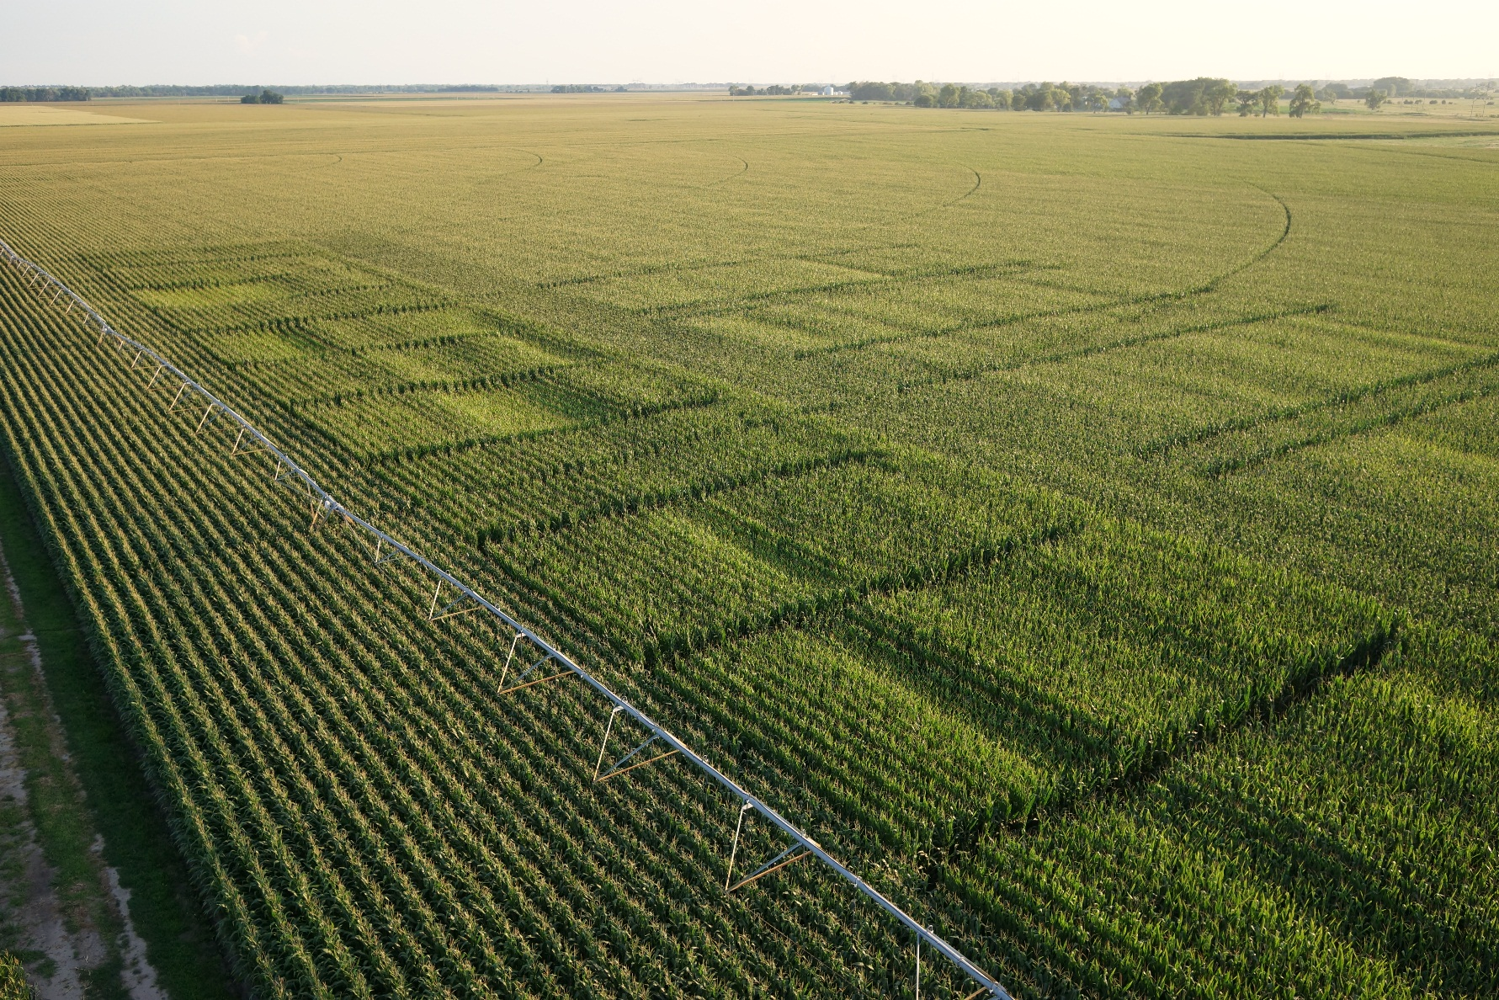
Questions?

