Slide 1
Reflections on Years of
Sensor Research
and
Algorithm Development
N
Jim Schepers

Slide 2
When you went off to college -
You established a new group of friends
These folks came from different backgrounds
  They had somewhat different interests
    They had different goals and aspirations
      They had different skills and abilities
And So - - -
nowledge
- - -You became a bit of a hybrid - - -
Knowledge

Slide 3
When we met for the first NUE Workshop - 2003
We had a common interest, and we
established a growing group of friends
We came from different backgrounds
  We had different experiences
    We had different skills, abilities, and knowledge
    - - BUT
        We had a common goal
Goal - - -
- - - Develop a common in-season N algorithm - - -
Work in progress !

Slide 4
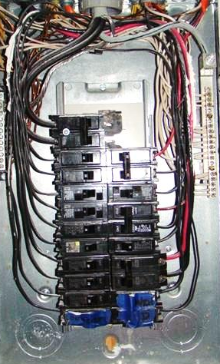
Everybody is wired differently
- - some a little
- - some a lot !
We see things differently
We process information differently - -
We respond differently to situations - -
We approach challenges differently - -

Slide 5
Responding to a challenge
Here and Now - - - Step by Step
Envision the end product first - - -
Knowledge
- - - - - - - - - - - - - - - - -
Look backwards for stumbling blocks

Slide 6
Oklahoma Nebraska
Backgrounds
S, K, As (expertise)
Connections
Experiences / Funding
Target Crop
Farm Farm
Soil Scientist Soil Scientists
Ag Engineers Plant Physiologist
Electrical Engineer
N-Tech Industries Li-Cor
Holland Scientific
CALMIT @ UNL
Trimble AgLeader
Noble Foundation MSEA (water quality)
Resource21 (Boeing et al.)
NASA
EPA
Wheat Corn

Slide 7
Putting Knowledge to Work
Look backwards for stumbling blocks
Envision the end product first - - -
- - - - - - - - - - - - - - - - -
    - Modulation
    - Power supply stability
        - Light source
        - Foot-print / optics
        - Red waveband saturation
patents
carry-over
WeedSeeker
technologies
GreenSeeker
modifications
120 volts
240 volts

Slide 8
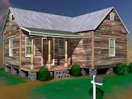


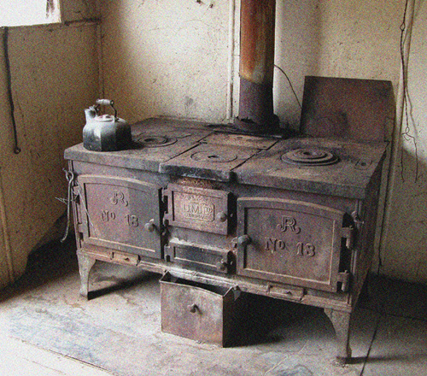
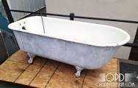
Need to discard the outdated stuff

Slide 9
Putting Knowledge to Work
Look backwards for stumbling blocks
Envision the end product first - - -
- - - - - - - - - - - - - - - - -
    - Modulation
    - Power supply stability
        - Light source
        - Foot-print / optics
        - Red waveband saturation
patents
Co-variants
Plant height
Soil water
CV (plant spacing)
carry-over
WeedSeeker
technologies
GreenSeeker
modifications

Slide 10
GreenSeeker Holland
Wavebands
Light sources
Detectors
Reference
Yield
Algorithm Specificity
Cost
Features
Red and NIR Amber and NIR (original)
Red, Red-edge, NIR (now)
Others
Two One (polychromatic)
One Two, three, five . . . 20
N-Rich (1/SI or RI) Virtual (SI)
Predicted Relative to reference
Crop by crop Any crop

Slide 11
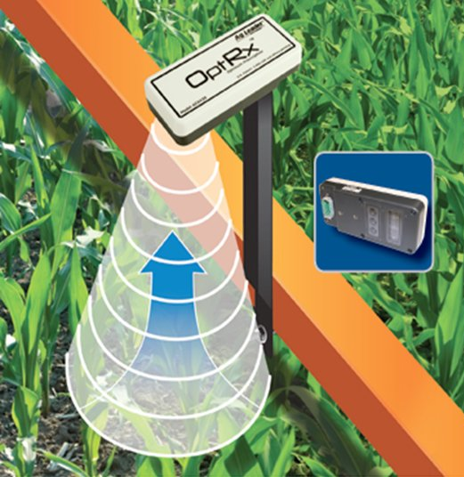
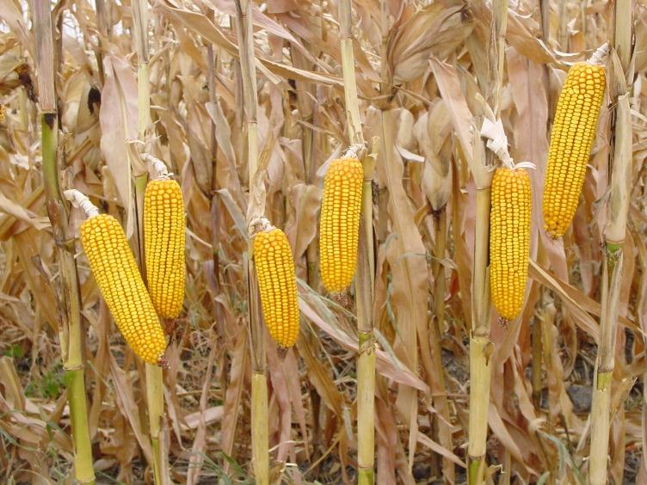
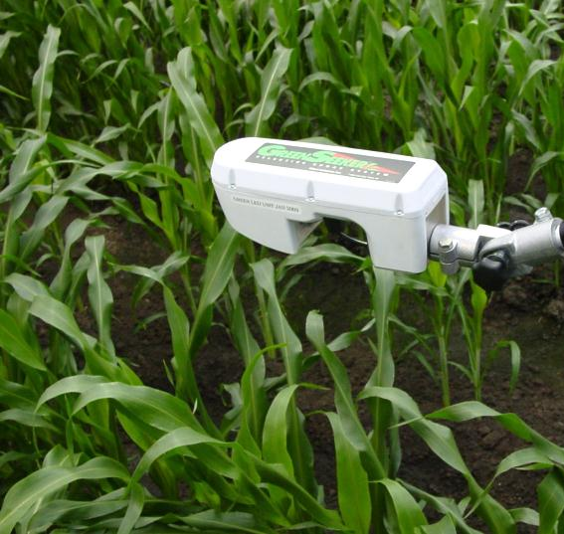
Converting light reflectance to nitrogen requirement: Different approaches
algorithm

Slide 12
In-season algorithms were developed to accommodate specific cropping systems.
Small Grains Europe (N-Sensor by Yara)
        Europe (CropSpec by Topcon)
        Europe (Crop Circle by Holland)
Oklahoma (GreenSeeker by Trimble)
Corn Nebraska (Crop Circle by Holland)
Midwest (OptRx by Ag Leader)
Missouri (sensor specific)
THEN extended to other crops
N-Rate Regressions for :
crop (growth stage)
cultivar
soil type
climatic region
Question -
Where will it end ?
Can controllers accommodate user algorithms ?

Slide 13
Algorithm / Sensor Considerations
In-season algorithms were developed with a specific sensor in mind, and (in some cases) for given crops and local cropping practices.
Wave-band differences
Calibration / Reference Strategy (normalization)
Opportunity for producer input (yield, N rate)
Preplant N differences (rate)
Yield (relative, predicted, not used)
NUE input

Slide 14
Common Vegetation Indices
(NIR – Red)
----------------------------------
(NIR + Red)
(NIR – Red Edge)
--------------------------------------------------
(NIR + Red Edge)
(NIR – Red)
-----------------------------------------------
(Red Edge – Red)
(Red)
----------------
(NIR)
NDVI =
NDRE =
Chl Index =
Visible / NIR =
When the canopy closes. RED reflectance approaches zero, and so the vegetation index becomes non-responsive
(NIR)
------------------------------
(Red Edge)
OR - 1

Slide 15
Summary of Algorithms
N Credits | Cut-Back Feature | Yield Prediction | Management Zones | Genetic Potential | Nitrogen Rescue
No | No | No | No | No | Yes
No | No | No | No | No | Limited
No | No | Yes | No | No | Sensor Limited
Yes | Yes | No | Yes | Yes | Yes
German
Missouri
Oklahoma
Holland

Slide 16
Here and Now
Adoption by producers is growing, but weak
It will require regulations or economics to drive more adoption
Hurdles to Overcome
Bad experiences
Need to extract practical applications from research
Poor service regarding algorithms
Meeting user needs - convenience, reliability
Opportunities / Questions
Where is the low hanging fruit for producers?
What environmental factors affect visible and/or NIR reflectance?
Measure canopy temperature to assess crop water status
Opportunities for expanded adoption (specialty crops)
UAV applications for sensors
Practical applications for all ongoing research projects?

Slide 17
Thank You
Jim Schepers
402-310-6150
james.schepers@gmail.com

