Slide 1
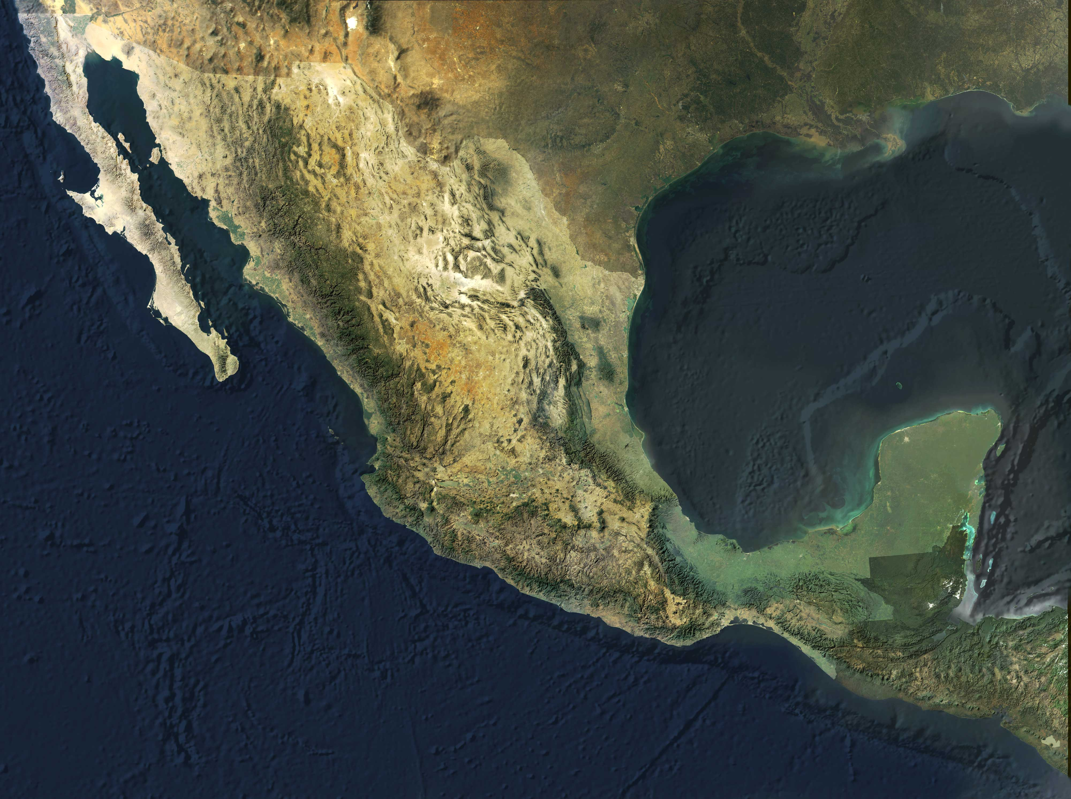
CIMMYT
Ivan Ortiz-Monasterio
Francelino Rodriguez, Urs Schulthess, Ma. Elena Cardenas,
Alberto Mendoza
OSU
Bill Raun

Slide 2
Challenges in Technology Transfer
Area managed with the GreenSeeker in Southern Sonora

Slide 3
Total
# Evaluations in
Farmers’ fields
86
60
101
107
78
=
432
Wheat yield (kg/ha)

Slide 4
N Saving Using the GreenSeeker
2007-2008
60 kgN/ha
1.00 USD/kgN = 60 USD/ha
2008-2009
68 kgN/ha
1.30 USD/kgN = 88 USD/ha
2009-2010
64kg N/ha
1.00 USD/kgN = 64 USD/ha

Slide 5
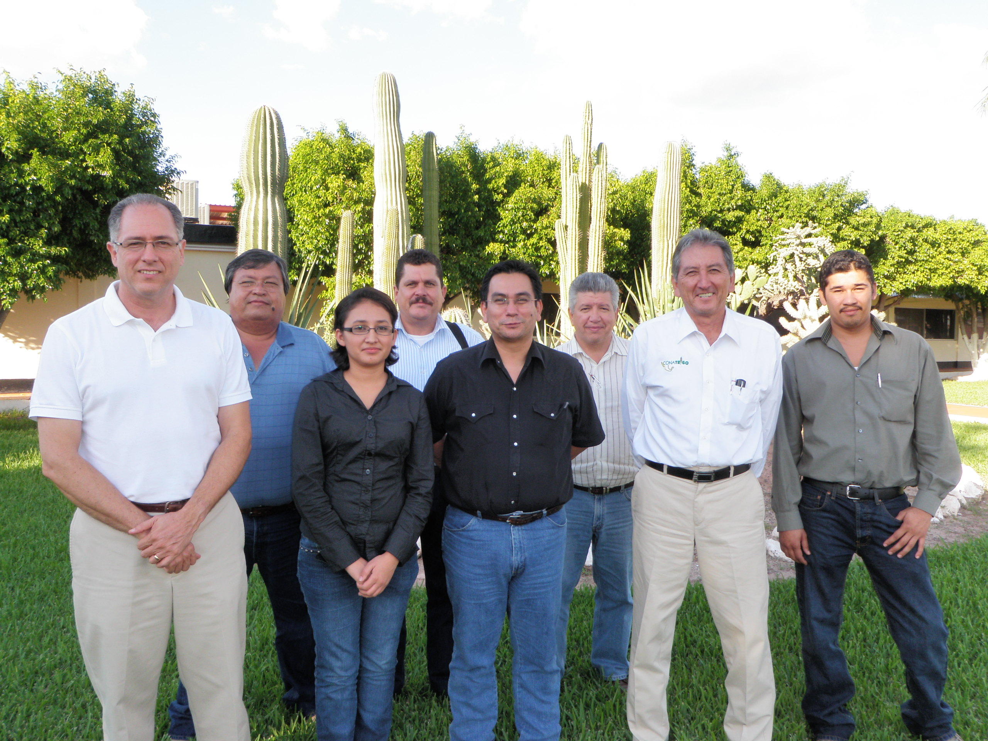
SENSOR USE COMRECIALLY
6000 has
7000 has
50 has
1000 has

Slide 6
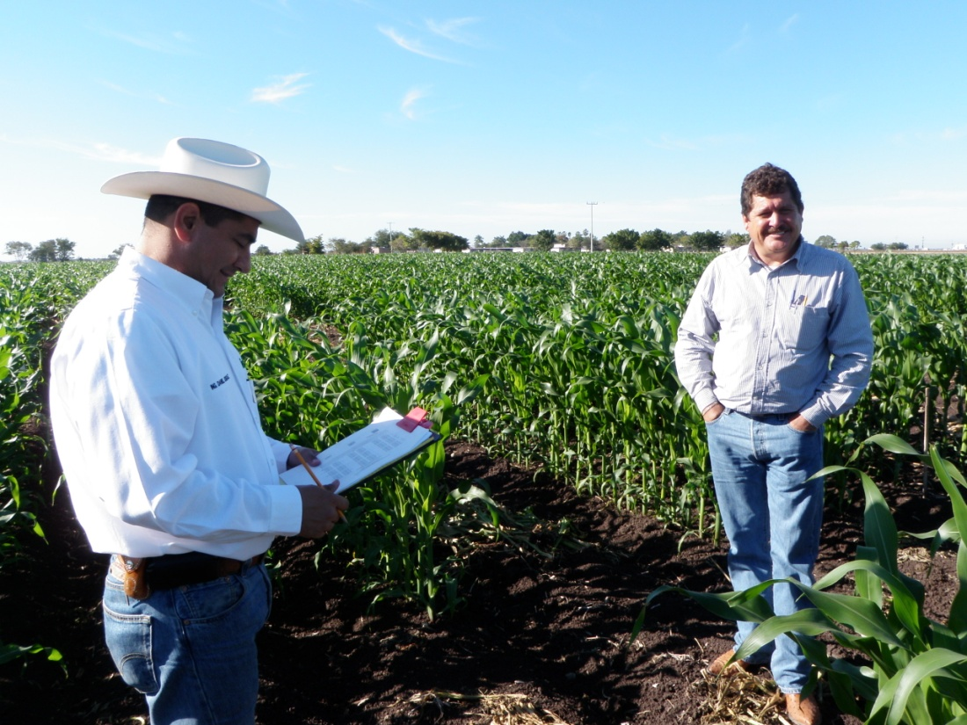
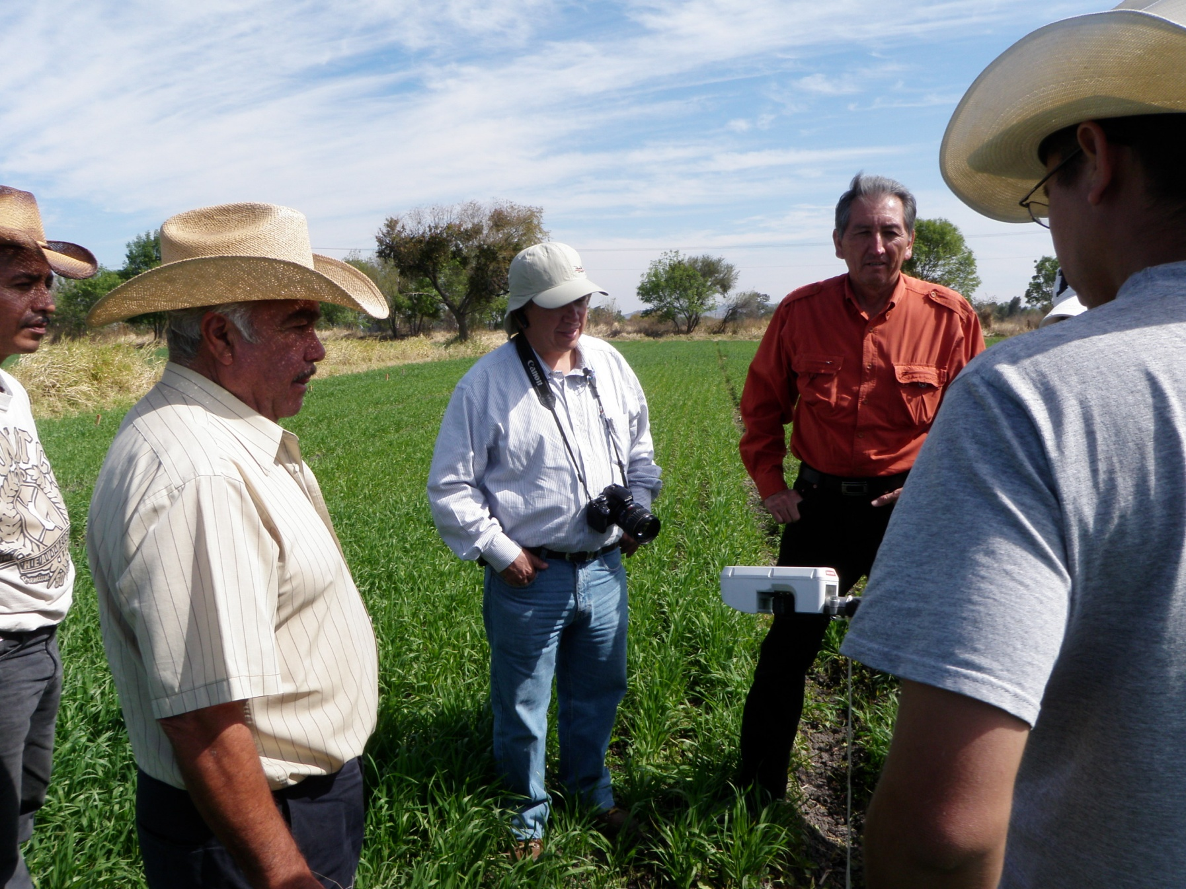
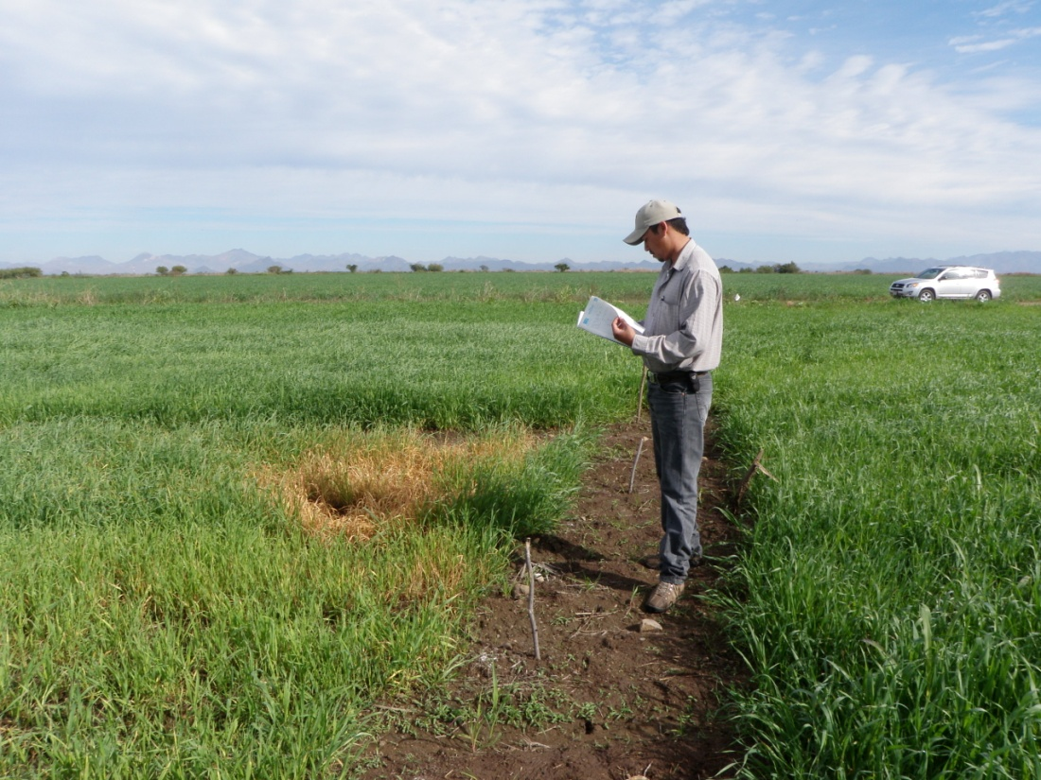
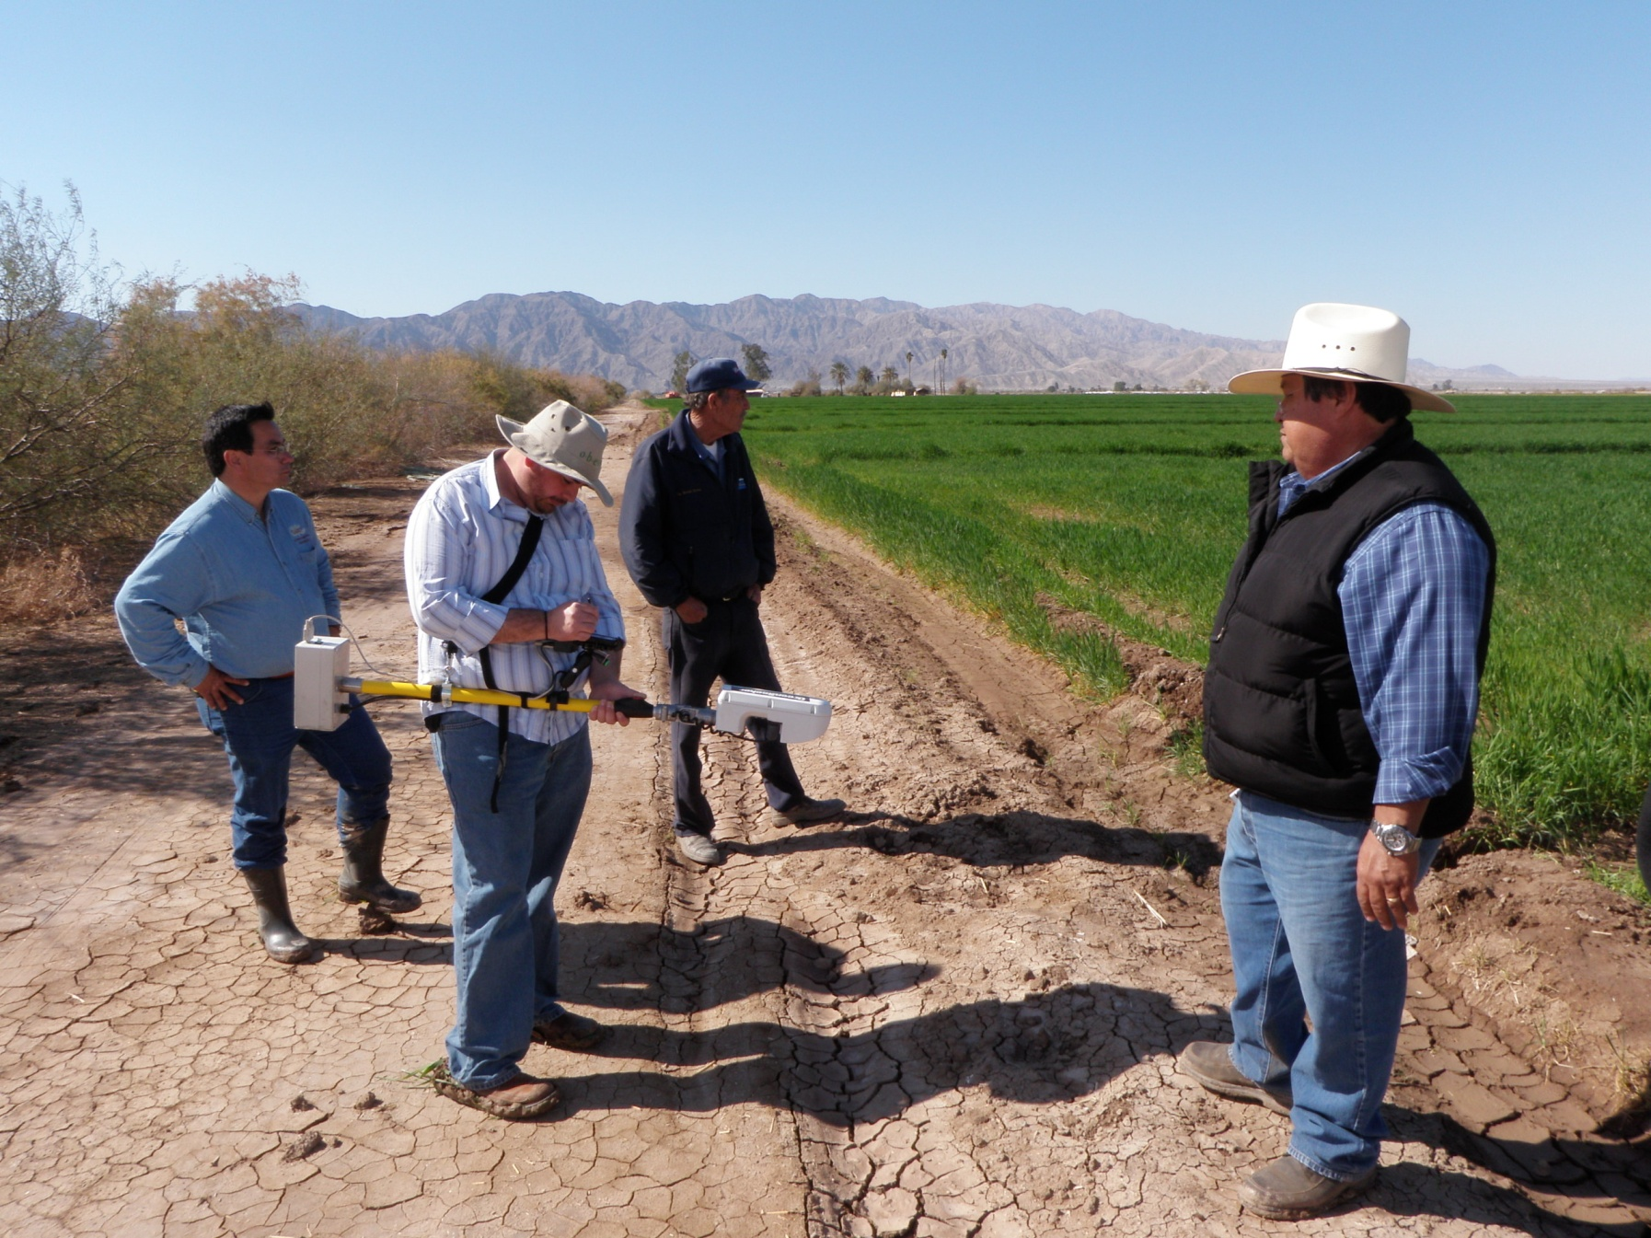
Culiacan, Sinaloa
Pastor Ortiz, Guanajuato
50 has
1000 has
Ocoroni, Sinaloa
Mexicali, Baja California
6,000 has

Slide 7
N Saving Using the GreenSeeker
Yaqui Valley
60 – 68 kgN/ha
Same yield
Mexically Valley
68 kgN/ha
Same yield
Guanajuato
30-35 kg N/ha
Same yield

Slide 8
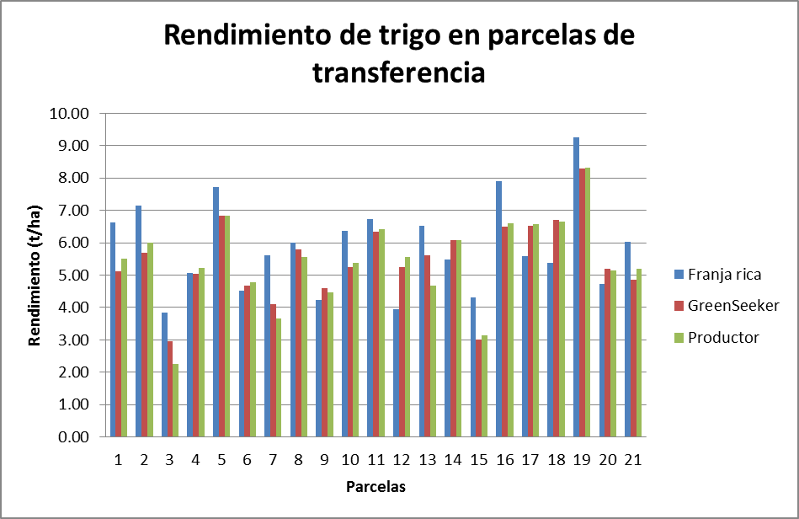
Wheat yield in technology transfer plots
in Guanajuato

Slide 9
WHEAT ALGORITHMS

Slide 12
Nitrogen Recommendations I
Advisor | Ing. Roberto García Ponce
Information | Recomendation
 | Obregón Algorithm | Obregón Algorithm (2000-2011) | Mexicali Algorithm (2010-2013) | Sinaloa Algorithm (2009-2011) | Gto. Algorithm (2010-2011) | States Algorithm (CEN, Sin, Gto, MXL) (2000-2013)
Equation | Y= 9892e^{130.65x} | y = 650.73e^{128.08x} | y = 1132.7e^{125.99x} | y = 353.02e^{166.85x} | y = 1529.2e^{120.96x} | y = 870.34e^{111.73x}
Cultivar | ATIL | ATIL | ATIL | ATIL | ATIL | ATIL
Max Yield (Kg/ha) | 8000 | 8000 | 8000 | 8000 | 8000 | 8000
Sowing date: | 22-Dec-12 | 22-Dec-12 | 22-Dec-12 | 22-Dec-12 | 22-Dec-12 | 22-Dec-12
Sensing date: | 3-Feb-13 | 3-Feb-13 | 3-Feb-13 | 3-Feb-13 | 3-Feb-13 | 3-Feb-13
NDVI (FRN) | 0.68 | 0.68 | 0.68 | 0.68 | 0.68 | 0.68
NDVI (PDA) | 0.66 | 0.66 | 0.66 | 0.66 | 0.66 | 0.66
Expected NUE | 0.35 | 0.35 | 0.35 | 0.35 | 0.35 | 0.35
Days after sowing: | 43 | 43 | 43 | 43 | 43 | 43
Potential Yield without N (Kg/ha) | 7346.8 | 4647.0 | 7833.5 | 4571.0 | 8000.0 | 4835.8
Potential Yield with N (Kg/ha) | 7649.6 | 4838.5 | 8156.3 | 4759.3 | 8329.7 | 5035.1
Apply N (Kg/ha) | 21 | 13 | 23 | 13 | 23 | 14
Apply N, (Urea Kg/Ha) | 47 | 30 | 50 | 29 | 51 | 31

Slide 13
Nitrogen Recommendations II
Advisor | Ing. Ramon Gil
Information | Recomendation
 | Obregón Algorithm | Obregón Algorithm (2000-2011) | Mexicali Algorithm (2010-2013) | Sinaloa Algorithm (2009-2011) | Gto. Algorithm (2010-2011) | States Algorithm (CEN, Sin, Gto, MXL) (2000-2013)
Equation | Y= 989.2e^{130.65x} | y = 650.73e^{128.08x} | y = 1132.7e^{125.99x} | y = 353.02e^{166.85x} | y = 1529.2e^{120.96x} | y = 870.34e^{111.73x}
Cultivar | CIRNO | CIRNO | CIRNO | CIRNO | CIRNO | CIRNO
Max Yield (Kg/ha) | 8000 | 8000 | 8000 | 8000 | 8000 | 8000
Sowing date: | 12/12/2012 | 12/12/2012 | 12/12/2012 | 12/12/2012 | 12/12/2012 | 12/12/2012
Sensing date: | 1/22/2013 | 1/22/2013 | 1/22/2013 | 1/22/2013 | 1/22/2013 | 1/22/2013
NDVI (FRN) | 0.729 | 0.729 | 0.729 | 0.729 | 0.729 | 0.729
NDVI (PDA) | 0.672 | 0.672 | 0.672 | 0.672 | 0.672 | 0.672
Expected NUE | 0.35 | 0.35 | 0.35 | 0.35 | 0.35 | 0.35
Days after sowing: | 41 | 41 | 41 | 41 | 41 | 41
Potential Yield without N (Kg/ha) | 8000 | 5310.1 | 8000.0 | 5438.4 | 8000.0 | 5432.6
Potential Yield with N (Kg/ha) | 9066.8 | 6018.1 | 9066.8 | 6163.6 | 9066.8 | 6157.0
Apply N (Kg/ha) | 75 | 50 | 75 | 51 | 75 | 51
Apply N, (Urea Kg/Ha) | 166 | 110 | 166 | 113 | 166 | 113

Slide 14
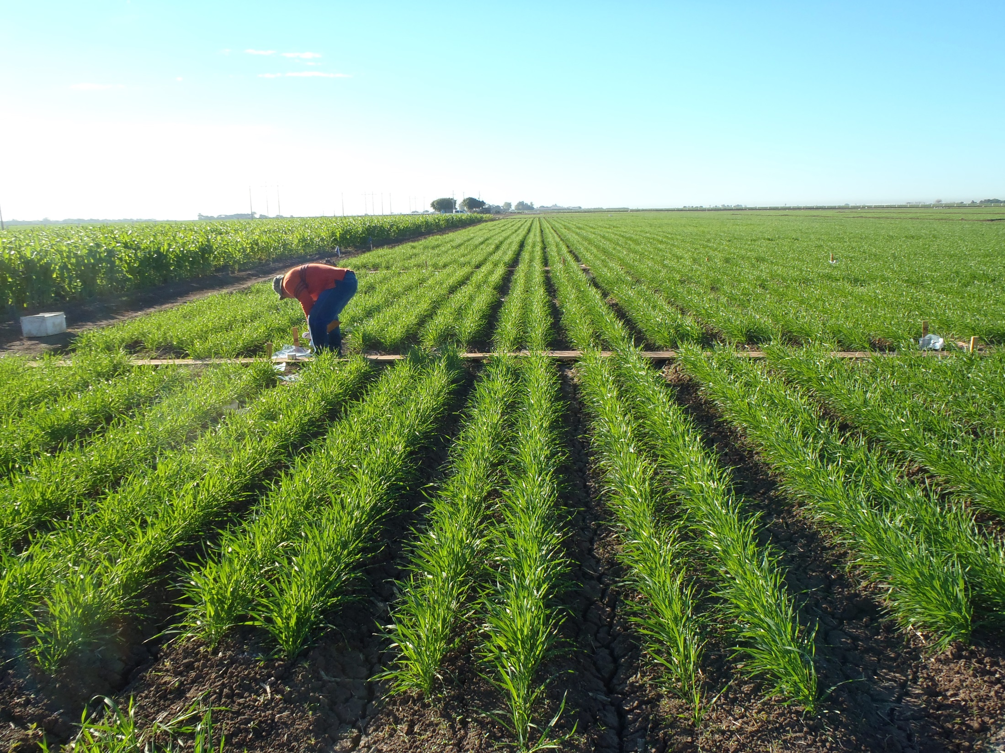
CIRNO
Higher yield potential
Different canopy architecture

Slide 16
Yellow Berry
Sin Panza Blanca
Con Panza Blanca

Slide 18
Algorithm CIRNO

Slide 19
Advisor | Ramón Gil
Information | Y= 989.2e^{130.65x} Y= 1012.32e^{122.14x} Y= 650.7e^{128.08x}
 | Obregón Algorithm | CIRNO Algorithm | 2000-2011 Algorithm
Cultivar | CIRNO | CIRNO | CIRNO
Max Yield (Kg/Ha) | 8000 | 8000 | 8000
Sowing date | 12/12/2012 | 12/12/2012 | 12/12/2012
Sensing date: | 1/22/2013 | 1/22/2013 | 1/22/2013
NDVI (FRN) | 0.729 | 0.729 | 0.729
NDVI (PDA) | 0.672 | 0.672 | 0.672
Expected NUE | 0.35 | 0.35 | 0.35
Days after sowing | 41 | 41 | 41
Potential Yield without N (Kg/Ha) | 8000 | 7494 | 5310
Potential Yield with N (Kg/Ha) | 9067 | 8494 | 6018
Apply N (Kg/Ha) | 75 | 70 | 50
Apply N, (Urea Kg/Ha) | 166 | 155 | 110

Slide 20
Advisor | Ing. Roberto García Ponce |  |  | Ing. Roberto García Ponce |  |  | Ramón gil
Information | Recomendation |  |  | Recomendation |  |  | Recomendation
 | Obregón Algorithm | CIRNO Algorithm | 2000-2011 Algorithm | Obregón Algorithm | CIRNO Algorithm | 2000-2011 Algorithm | Obregón Algorithm | CIRNO Algorithm | 2000-2011 Algorithm
Cultivar | ATIL | ATIL | ATIL | CIRNO | CIRNO | CIRNO | CIRNO | CIRNO | CIRNO
Max Yield (Kg/Ha) | 8000 | 8000 | 8000 | 8000 | 8000 | 8000 | 8000 | 8000 | 8000
Sowing date | Dec-22-12 | Dec-22-12 | Dec-22-12 | 22-Dec-12 | 22-Dec-12 | 22-Dec-12 | 12/12/2012 | 12/12/2012 | 12/12/2012
Sending Date: | Feb-13-13 | Feb-13-13 | Feb-13-13 | 5-Feb-13 | 5-Feb-13 | 5-Feb-13 | 1/22/2013 | 1/22/2013 | 1/22/2013
NDVI (FRN) | 0.685 | 0.685 | 0.685 | 0.712 | 0.712 | 0.712 | 0.729 | 0.729 | 0.729
NDVI (PDA) | 0.668 | 0.668 | 0.668 | 0.695 | 0.695 | 0.695 | 0.672 | 0.672 | 0.672
Expected NUE | 0.35 | 0.35 | 0.35 | 0.35 | 0.35 | 0.35 | 0.35 | 0.35 | 0.35
Days after sowing | 43 | 43 | 43 | 45 | 45 | 45 | 41 | 41 | 41
Potential Yield without N (Kg/Ha) | 7900 | 6751 | 4759 | 7439 | 6677 | 4705 | 8000 | 7494 | 5310
Potential Yield with N (Kg/Ha) | 8161 | 6974 | 4916 | 7672 | 6886 | 4852 | 9067 | 8494 | 6018
Apply N (Kg/Ha) | 18 | 16 | 11 | 16 | 15 | 10 | 75 | 70 | 50
Apply N, (Urea Kg/Ha) | 41 | 35 | 24 | 36 | 33 | 23 | 166 | 155 | 110

Slide 21
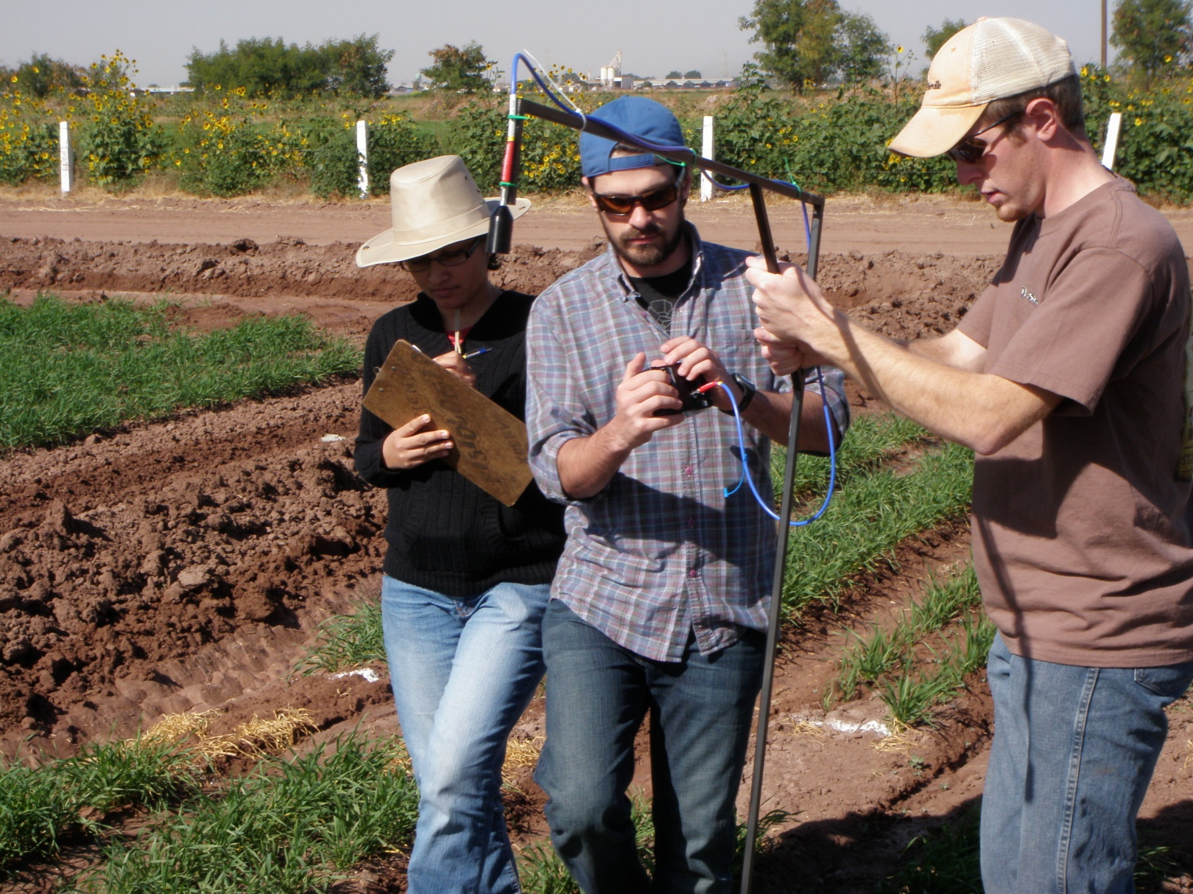
Calibration of GreenSeeker
for Phosphorus Diagnostics

Slide 22
Phosphorus Trials
Experiment repeated for five years
Split plot design with three replications
Main plot two P levels; 0 vs 80 first three years and 120 instead of 80 last 2 years
Subplot 21 wheat genotypes (10 durum and 11 bread wheat)
Main plots with P levels are maintained in the same place year after year.

Slide 23
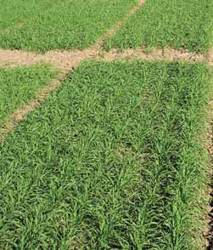
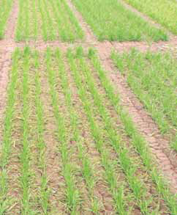
Figure 3.2. Varieties with (+N; at 250 kg N ha-1) and without (0N) nitrogen application, at CENEB, Yaqui Valley, Sonora, Mexico. (Photograph: JI. Ortiz-Monasterio).

Slide 24
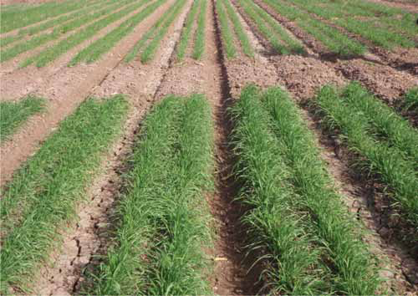
OP
+P
Figure 3.4. Screening plots for phosphorus use efficiency at CENEB Yaqui Valley, Sonora, Mexico. The plants at the bottom of the picture received 80 kg P2O5 ha-1 (+P), while those at the top received none (0P). (Photograph: JI. Orti z-Monasterio).

Slide 25
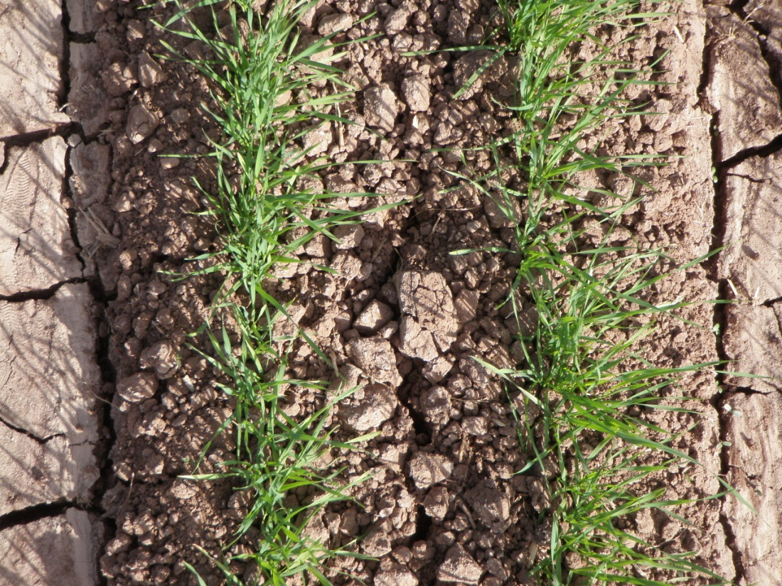
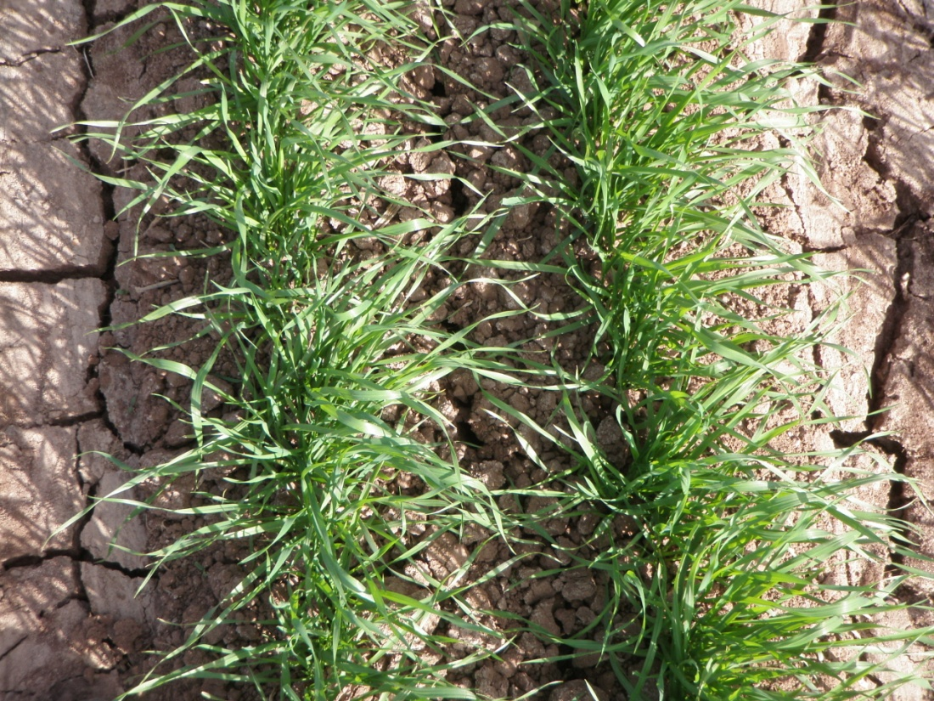
- P
+ P

Slide 29
Results Validation P

Slide 30
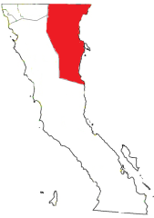
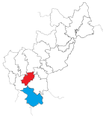
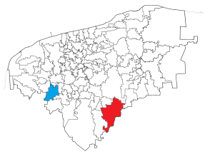
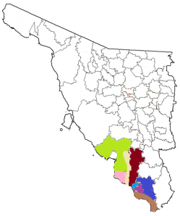
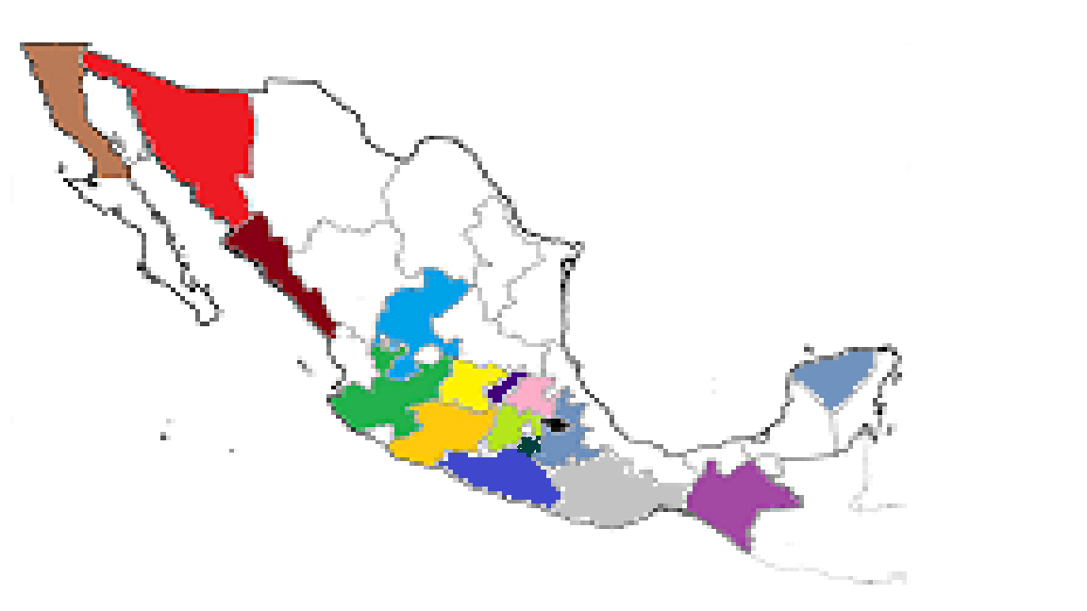
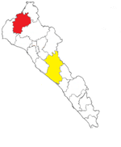
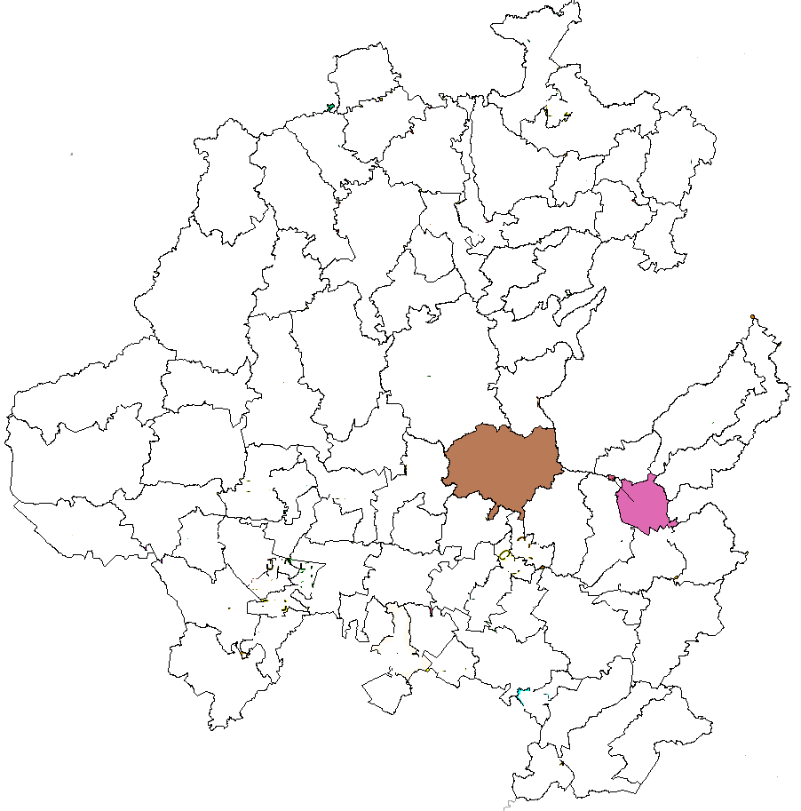
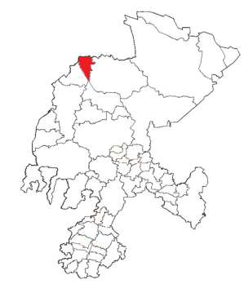
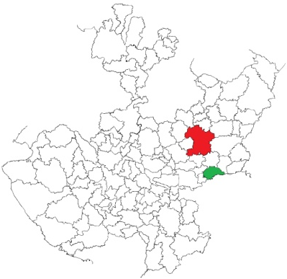
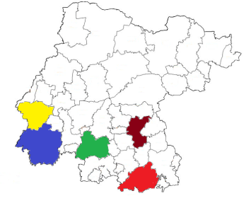
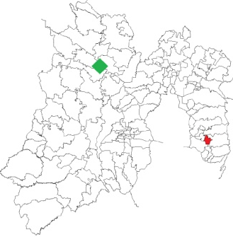
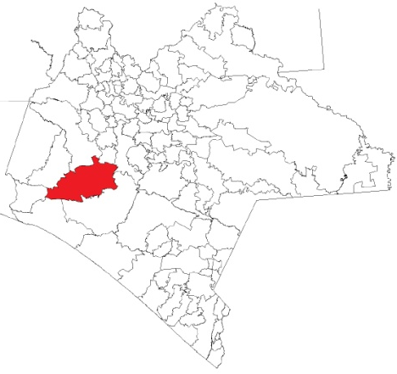
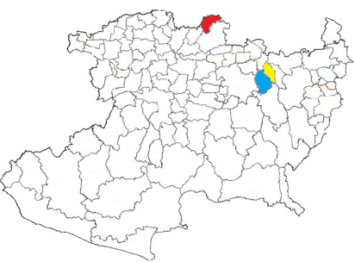
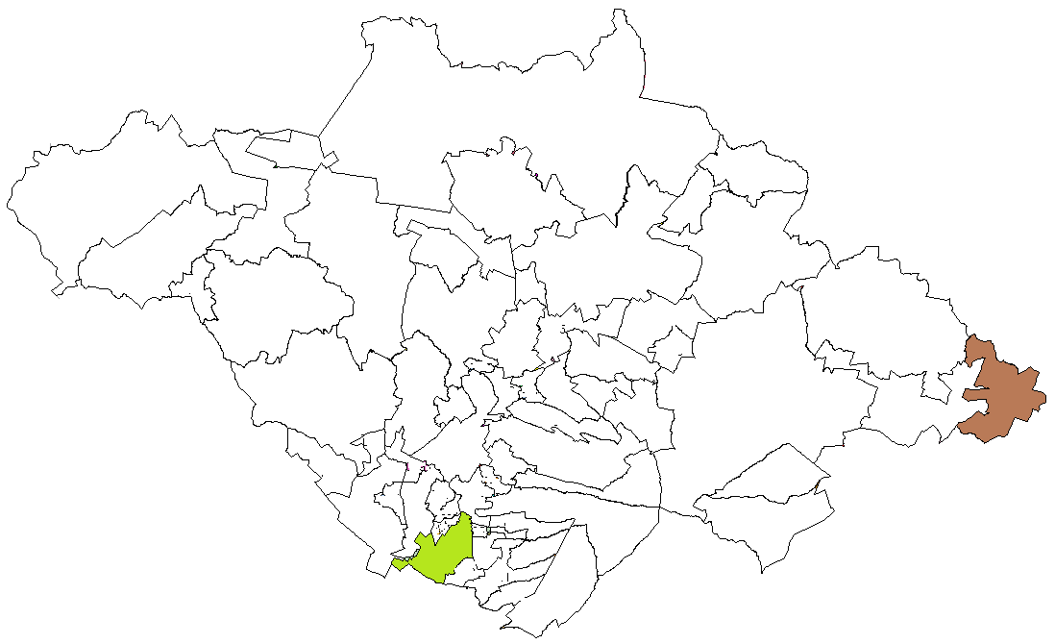
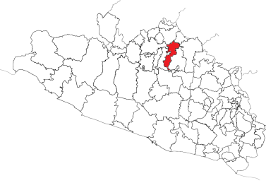
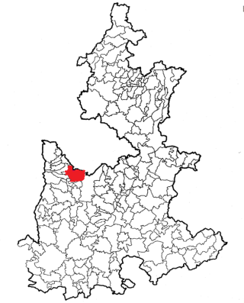
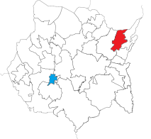
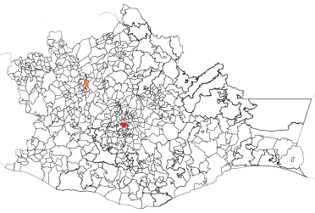
GREENSEEKER SENSOR CALIBRATION 2012
Baja California
Querétaro
Sonora
Yucatan
Sinaloa
Hidalgo
Guanajuato
Zacatecas
Jalisco
Edo. De México
Tlaxcala
Puebla
Michoacan
Chiapas
Guerrero
Morelos
Oaxaca

Slide 31
Maize
Preliminary Validations
100 kgN Guanajuato
175 kgN Sinaloa

Slide 32
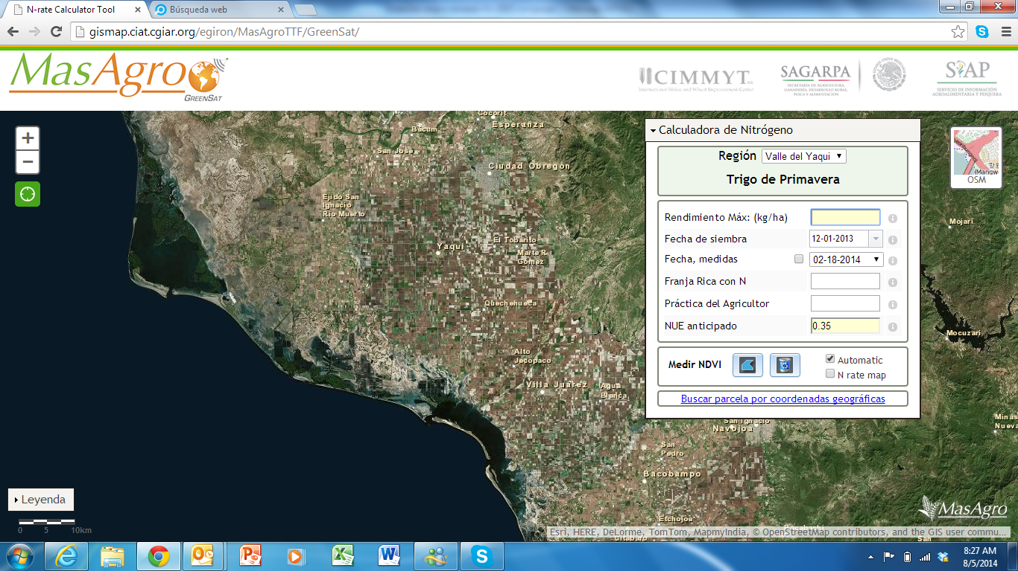
GreenSat
Sonora, Sinaloa, Baja California
Guanajuato

Slide 33
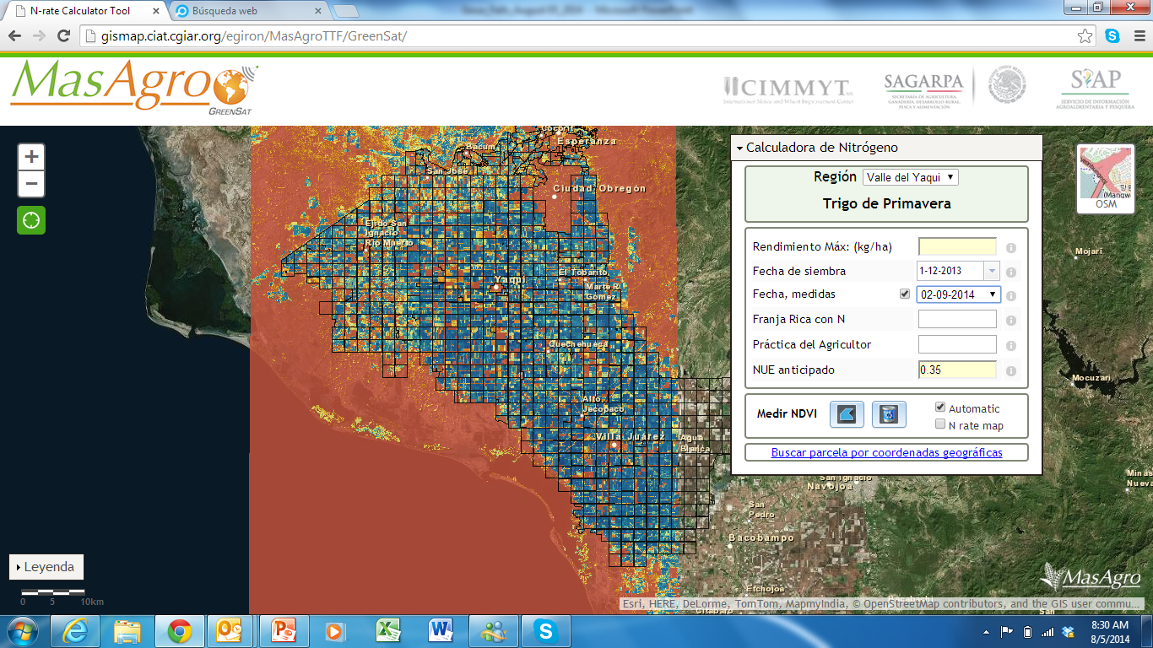
GreenSat

Slide 34
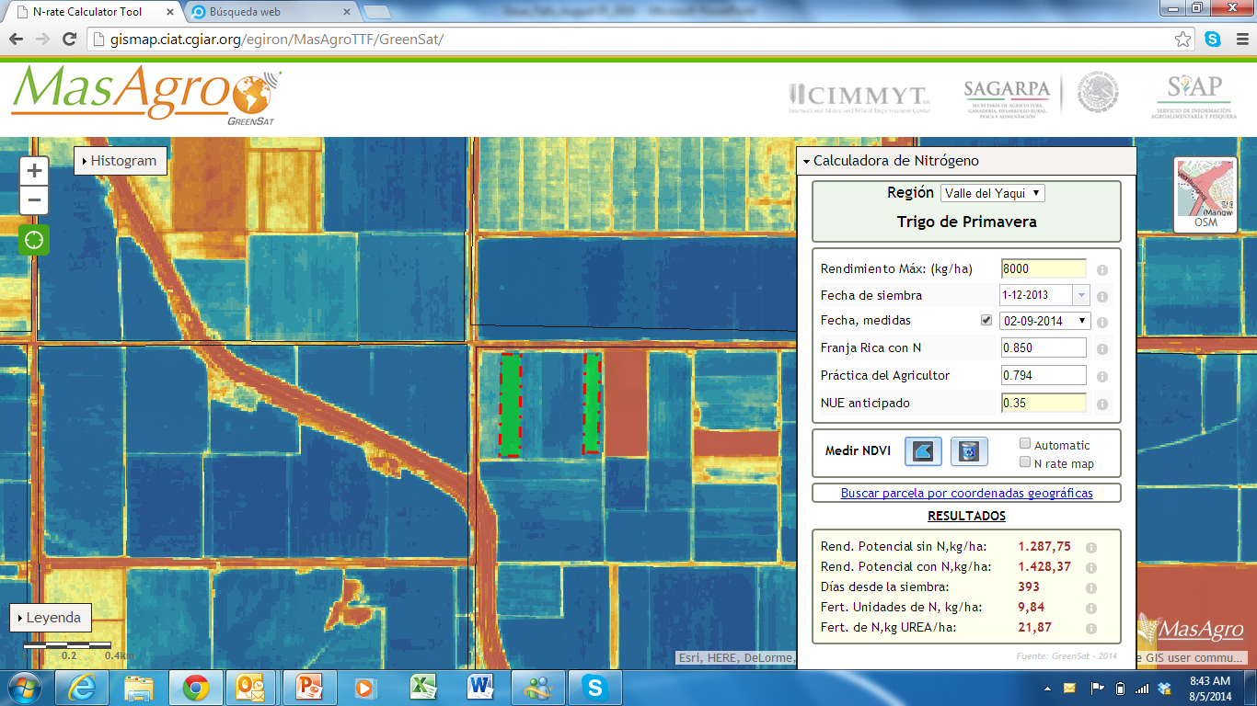
GreenSat

Slide 35
Prediction of NDVI measured with the GreenSeeker from satellite data acquired on Jan 23, 2012
Input:
15 fields
NRich strip
Control
Total of 30 data points
GreenSeeker measurements had been made within +/- 7 days of the satellite image
Satellite seems to measure larger differences in NDVI than GreenSeeker (slope = 0.63). This may have implications when the data are used to calculate a N recommendation.

Slide 37
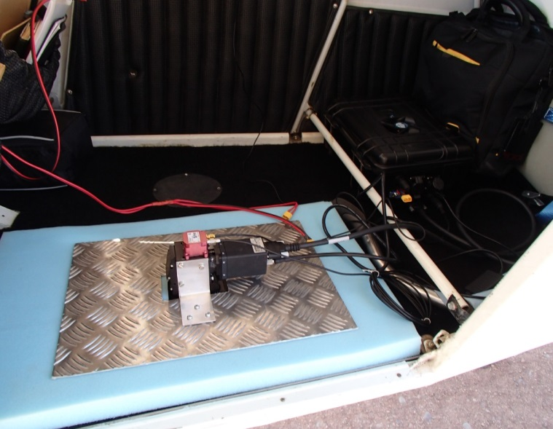
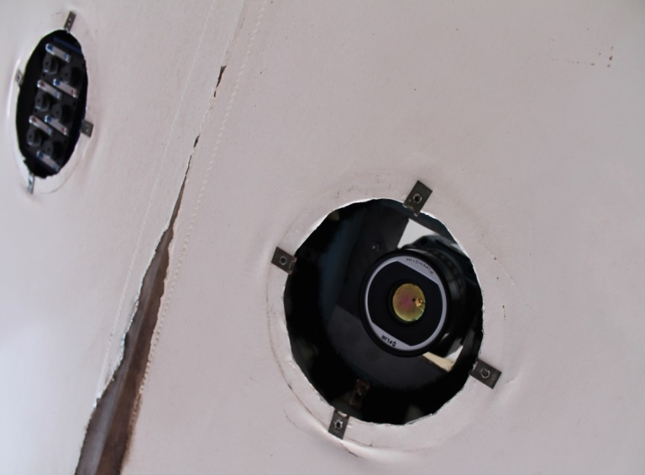
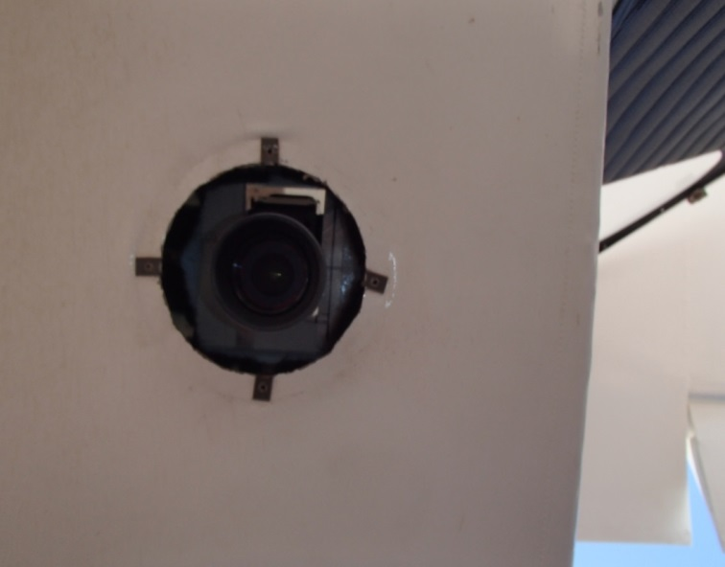
Multispectral and thermal cameras
Hyperspectral scanner

Slide 38
Hyperspectral Camera
250 bands of 6.4 nanometer width
400 to 885 nanometer region
Swaths of 500 meter at 30-50 centimeter pixel resolution.
Thermal Camera

Slide 39
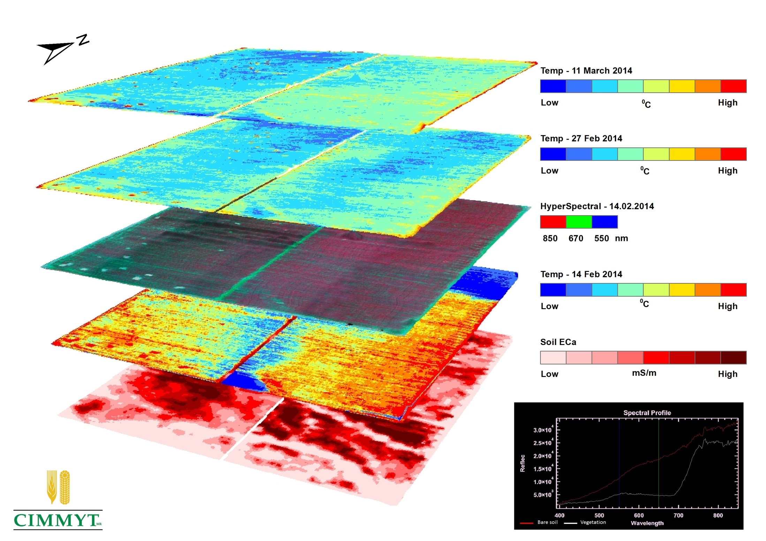

Slide 40
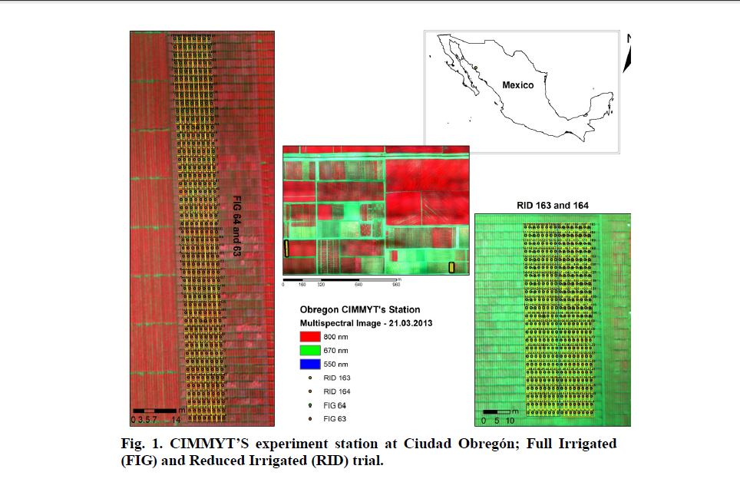

Slide 43
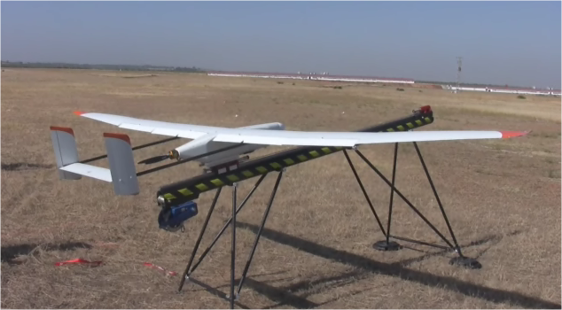
Viewer
(1.5-3 h endurance)

