Slide 1

Saline (salts) and Sodium Problems and Their Management in Dryland Corn Production.
Gregg Carlson, David Clay, Doug Malo, Sharon Clay, and Cheryl Reese.
SDSU

Slide 2
Saline and sodic soil problems
Saline and sodic soil problems are serious problems in South Dakota.
Management practices such as no-till, summer fallow, tile drainage, and/or misdiagnosing a sodium problem as a saline problem, all can contribute to the sodic problem.
The development of corrective solutions is complicated by soil testing laboratories that do not use standard analysis techniques.

Slide 3
Why are sodium and saline effected soils different
Saline soils are soils that contain high concentrations of soluble cations (Ca⁺², Mg⁺², Na⁺¹_{{not dominate}}, K⁺¹) and anions (SO₄^{_2}, NO₃^{_1}, Cl⁻¹)
  In saline soils, seed germination and/or plant growth can be reduced by high salt concentrations,
Sodic (Na⁺¹_{{dominate}} ) soils are soils that contain high Na concentrations
  In sodic soils, water infiltration can be reduced by Na-induced soil aggregate dispersion.
Saline (high salts) and sodic soils require different reclamation management practices. (discussed later)

Slide 4
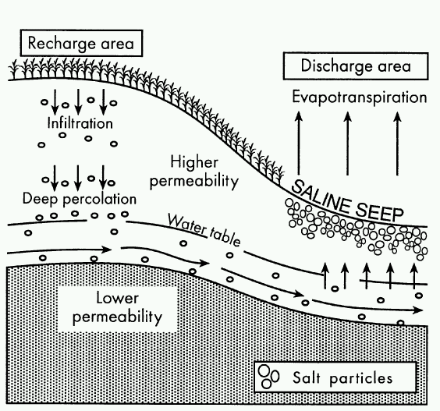

Slide 5
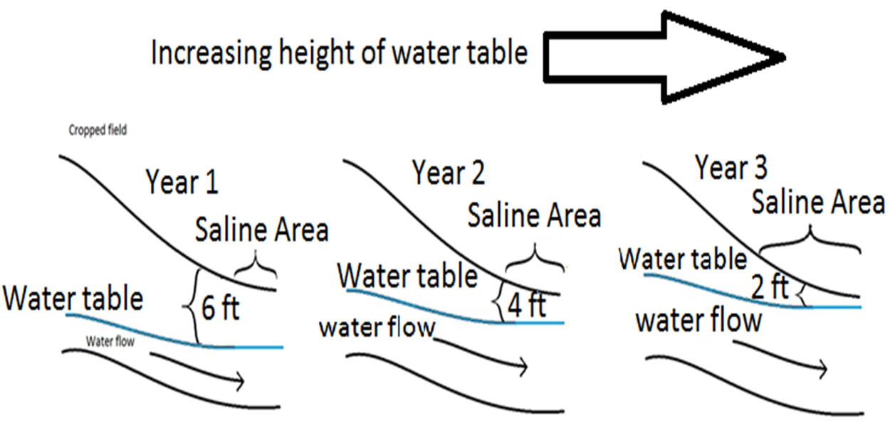

Slide 6
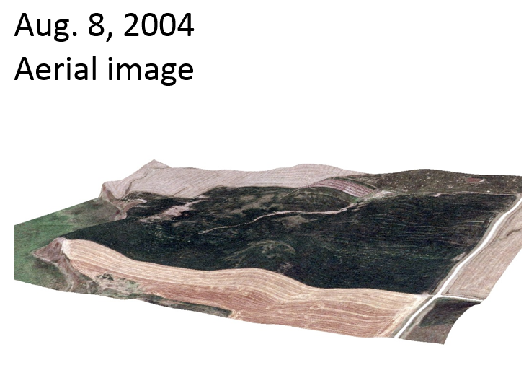
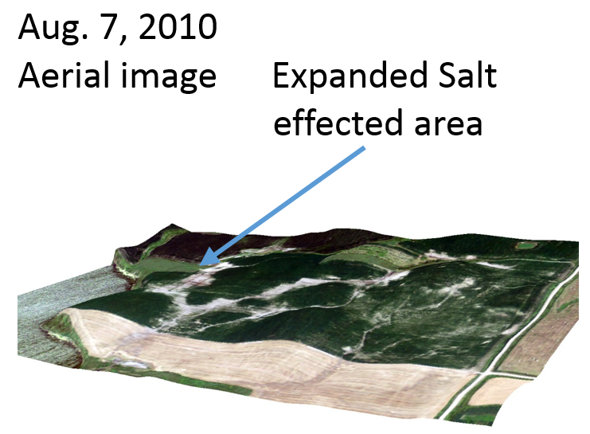

Slide 7
Diagnosis
The first step in the diagnosis of a saline problem is visual. You may have an area in a field that looks like this picture. This often occurs in poorly drained areas. The second step is to collect a soil sample and determine the soil extract electrical conductivity.

Slide 8
The interpretation of the laboratory results
Important: Results of laboratory analysis depend upon the method used to acquire the extracted soil water.
Saline (salts) diagnosis and recommendations have traditionally been based upon analysis of saturated paste extract. A saturated paste is made by adding water to soil until it glistens and flows slightly when jarred. After allowing the mixture to equilibrate the soil water solution is extracted by suction filtration.
However, most commercial soils laboratory do not currently routinely use the saturated paste method. Currently, the most commonly used commercial laboratory soil water extraction methods for determining soil EC and specific ions are:
  1:1, soil mass to water mass,
  1:5, soil mass to water mass, and
  1:10, soil mass to water mass”.

Slide 9
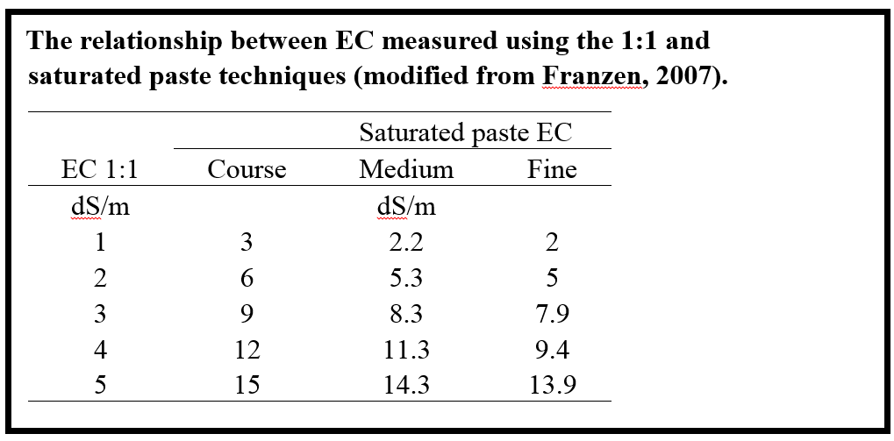

Slide 10
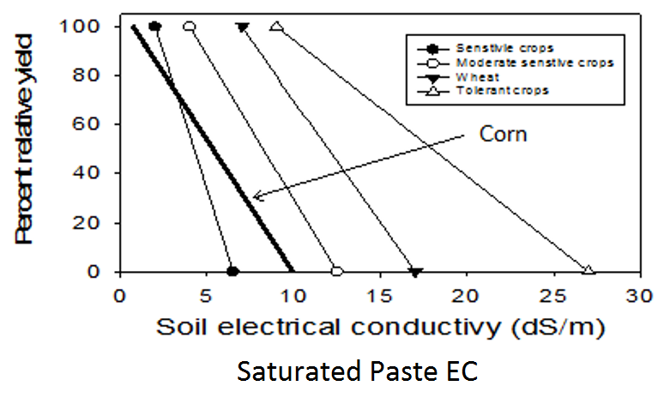
Plants have different salt tolerances

Slide 11
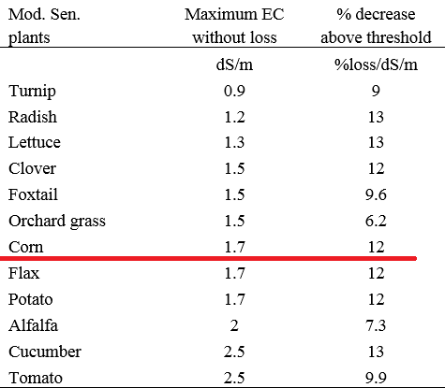
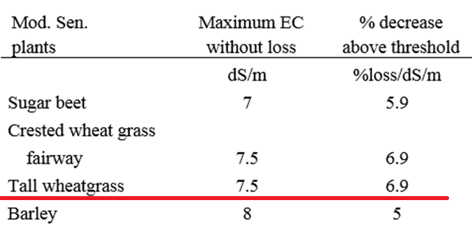
Plants have different salt tolerances

Slide 12
Techniques to reduce soil salinity problems
Map the extent of the problem and lower the water table.
  Areas that appear white as they dry often have high salt concentrations.
  Use a Veris Technologies EC cart or or a Geonomics EM 38 to conduct field scouting,
Establish vegetation
  Irrigation agronomist rule of thumb: ET = 80% transpiration + 20 % evaporation
  Stabilize the area surrounding the saline soil. Planting a high water use crop such as alfalfa as close to the saline area may reduce the problem.
  Developing a stand of vegetation in the salty area.
    If the area is poorly drained and very wet, you may find success by dormant seeding tall wheat grass into frozen soil.
Drainage can be used to reduce salinity. On average the soil EC value will decrease 0.5 dS/m for every 6 inches of water that percolates through the soil.
  For tile drainage to be effective a suitable outlet for the drainage water must be available.
  It is becoming more difficult to get approval to drain. Details about tile drainage are provided in the drainage chapter of the new corn manual.

Slide 13
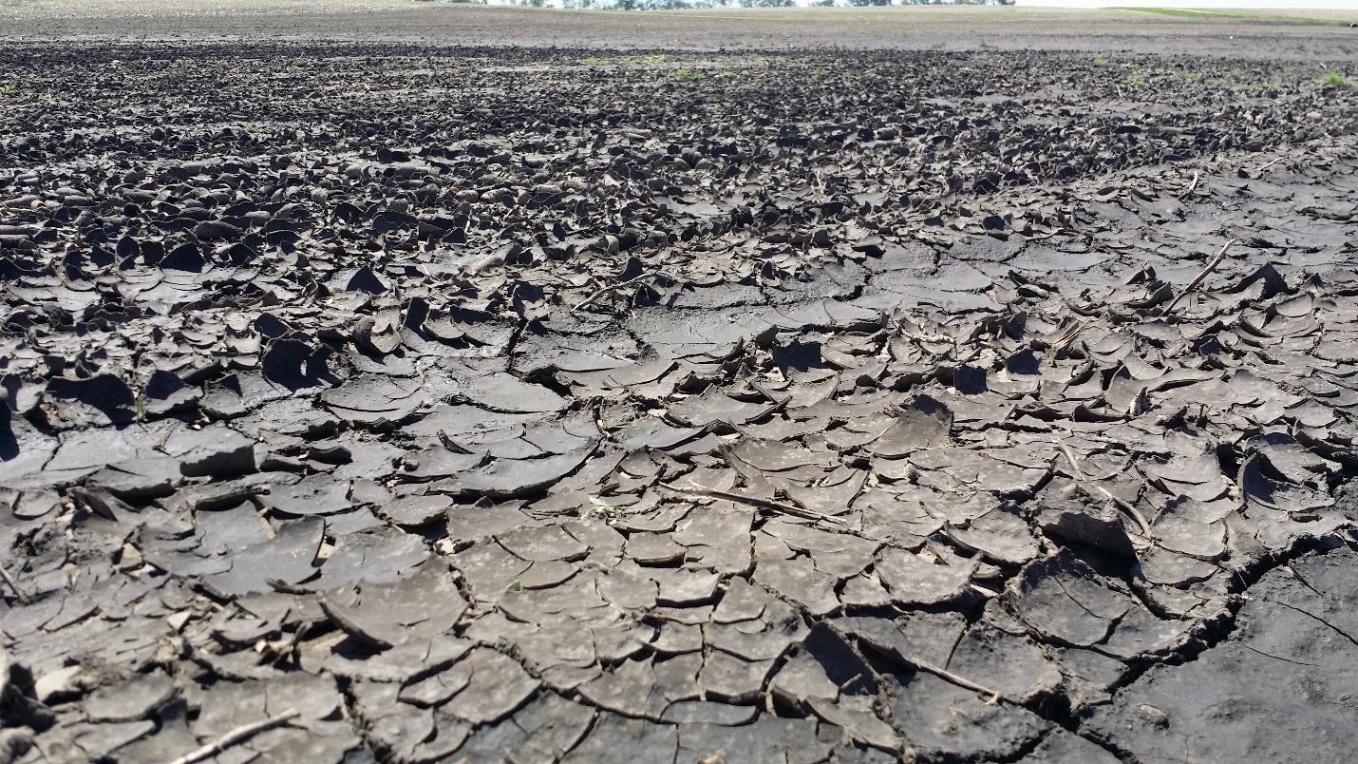
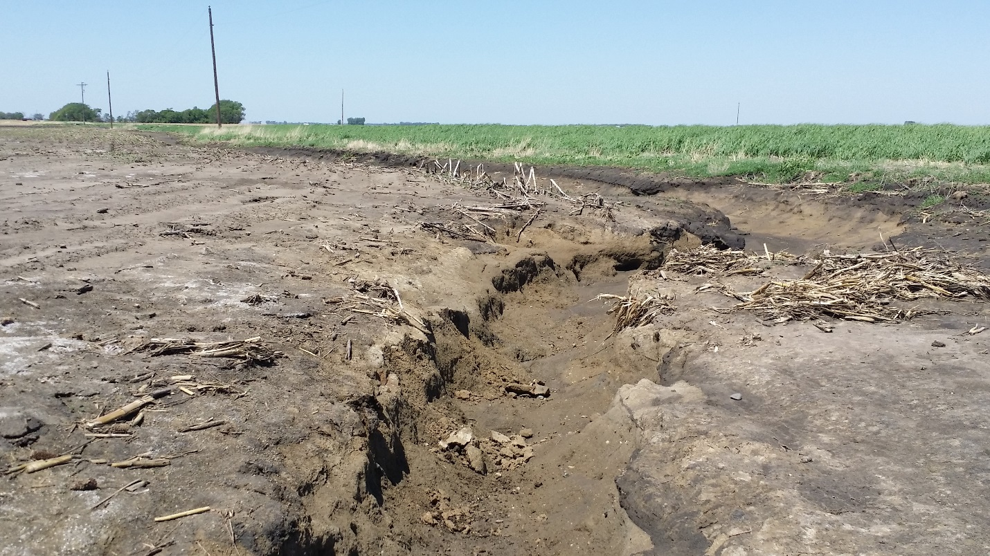
Sodium effected soil
Sodium (Na) is a salt that requires special attention
High relative Na concentrations can disperse soil which in turn can slow water infiltration and increase erosion and formation of gullies.

Slide 14
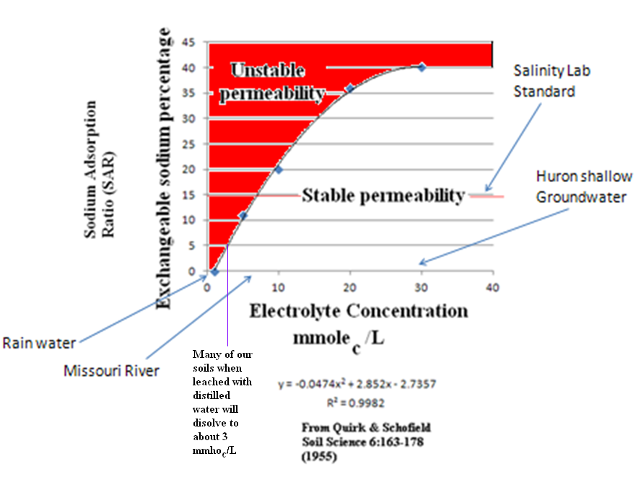
Why Sodium Is
a problem in South Dakota!

Slide 15
Reclamation of sodium effected soils
If the soil has a Na risk (ESP – SAR > 4), the long-term goal should be to prevent further degradation and reduce further addition of Na.
If you have installed a tile line, then careful water management is required.
We recommend use of management practices to maintain a deep water table. This should minimize the need for additional chemical amendment.
If the tile line plugs and the water table raises to the surface, it is likely that Na will be transported to the soil surface causing additional problems.
In South Dakota, an ESP (or SAR) of more than 4 is considered a high risk soil for installing drainage systems. Due to local soils and climatic conditions ESP values of 15 or SAR values of 13 are not appropriate for South Dakota.

Slide 16
Adding organic matter
One relatively inexpensive approach to improve the soil structure is to apply low Na containing manure or apply crop residues to these areas.
The organic matter in these materials can help stabilize and improve soil structure. It must be pointed out that not all manures have low Na concentrations.
Manure from animals that have high concentrations of NaCl in their rations, may not be desirable.

Slide 17
Add chemical amendments
A second approach is to replace the Na on the soil exchange site with calcium. In most situations, (exceptions to be discussed in the next slide) the least expensive amendment that can provide Ca to replace Na on the exchange sites is gypsum.
However, if the soil contains high sulfate concentrations, then the addition of gypsum may not be an effective approach to increase Ca concentrations.
Under high sulfate-S conditions calcium chloride (CaCl₂) or elemental S may be more effective. The numerical definition for high sulfate is currently under investigation at SDSU.

Slide 18
Add chemical amendments
Elemental S is effective because it lowers the pH which in turn increases Ca concentrations.
For many of our naturally saline and sodic soils, there is a significant amount of precipitated CaCO₃ in the soil.
The addition of elemental sulfur will acidize the soil and make the Ca available. Theoretically 1 ton of gypsum is replaced by 380 lbs of elemental S (0.19 *2000 lb/ton = 380 lb Sulfur).
For a typical South Dakota soil with a cation exchange capacity (CEC) of 25 mmol_{c}/(100 gm soil) and a SAR value of 12, a one-ton application of gypsum per acre would be needed to lower the SAR value of the surface 6 inches to 8.
To lower the SAR value to 4, about 2 ton/acre of gypsum are needed

Slide 19
Amendment cost
Estimated costs for Na effected soil remediation with chemical additives.
Cost of the chemical additives
S at $720/ton,
CaCl₂.2H₂O at $740/ton and
CaSO₄.2H₂O at $240/ton.
To reclaim a soil needing 1 ton equivalent gypsum
Gypsum: 1 ton × $240/ton = $240
CaCl₂: 0.86 ton × $740/ton = $636
Elemental S: 0.19 ton × $720/ton = $137

Slide 20
Summary
In South Dakota saline and sodic soils are both serious problems.
The saline and sodic problems can cause long term yield loss and yield decline.
Lowering the water table with management (grass & alfalfa) or drainage is job 1.
The fastest reactor to reduce Na problems is Calcium chloride. Shortly behind this is gypsum. Elemental S is the slowest.
Gypsum may not be as effective if the soil contains high SO₄-S concentrations.
Under these conditions, CaCl₂ or elemental sulfur may be useful. All techniques should be effective within a year of application.

