Slide 1
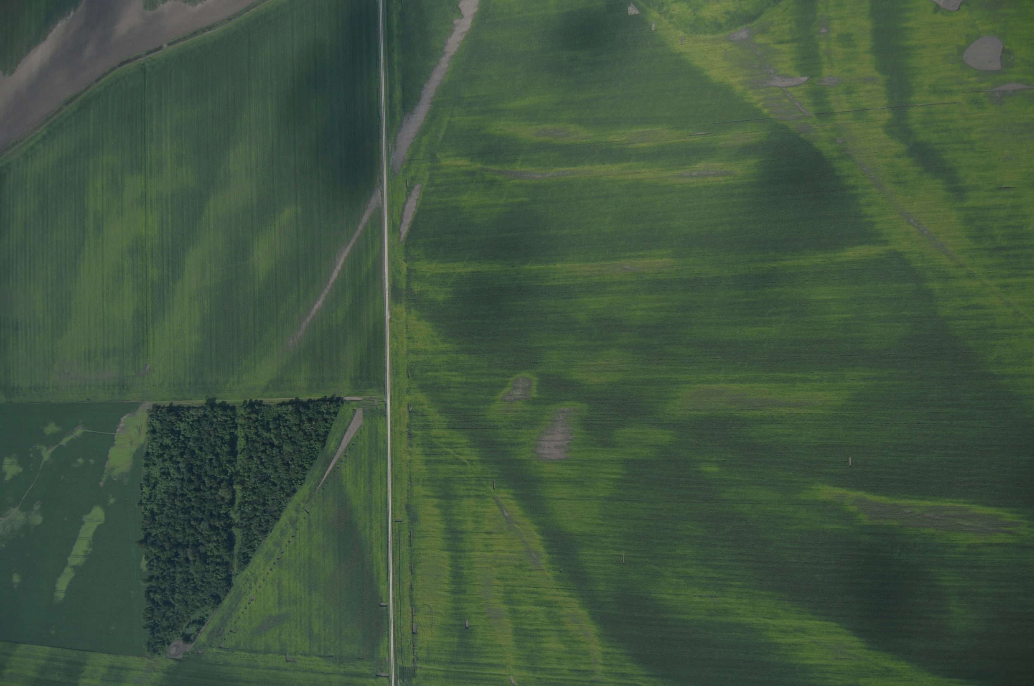
Notes:
What is this?

Slide 2
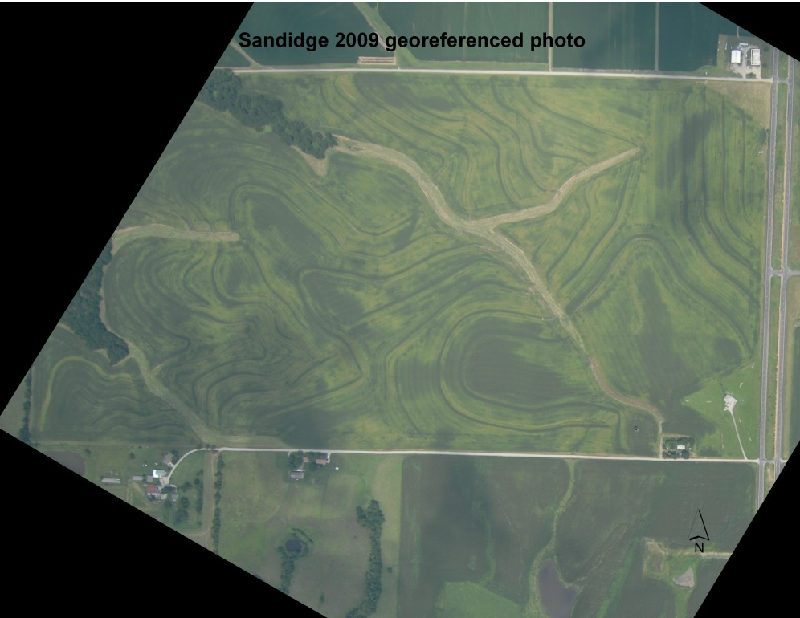
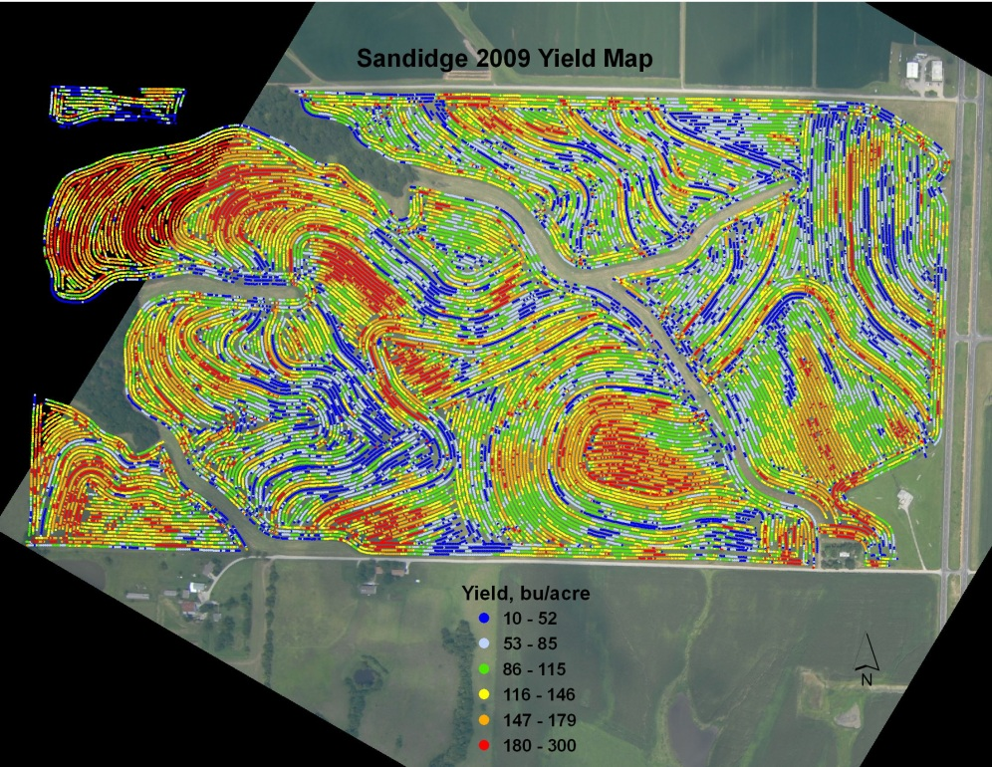
Yield map: yellow corn yielded poorly
Darkest corn around 170 bushels

Slide 3
Yield map: yellow corn yielded poorly
Darkest corn around 170 bushels
Lightest corn around 80 bushels
Average yield 125 bushels
45 bushels less than dark green corn

Slide 4
N Deficiency costs a lot!
Average yield loss = 45 bu/acre
Total yield loss = 11,925 bu
(45 bu/ac x 265 acres)
Total economic loss = $44,720
(11,925 bu x $3.75/bu)

Slide 5
Notes:
OK, yellow corn yields poorly—what are you going to do?

Slide 6
Rescue N experiments
State County Year Yield response to rescue N
when N stress level was:
Low Med High
MO Caldwell 1998 23 57
MO Holt 2004 43
KS Miami 2005 -2 28
IL Adams 2010 17 42
MO Ray 2010 28 54 57
MO Ray 2010 8
average 13 38 57

Slide 7
Sensors!
Aerial photo! (NVision Ag?)
Simulation model?
Adapt-N
Maize-N
Nitrogen Advisor
Soon?—Pioneer Encirca
Farm Intelligence
Notes:
OK, high rates on yellow corn, low rates on dark green—but how? Why?

Slide 8
Aerial photo to decide & apply
OR
Simulation model to decide, sensors to apply

Slide 9
Aerial photo July 16, 2014 vs OptRx

Slide 10
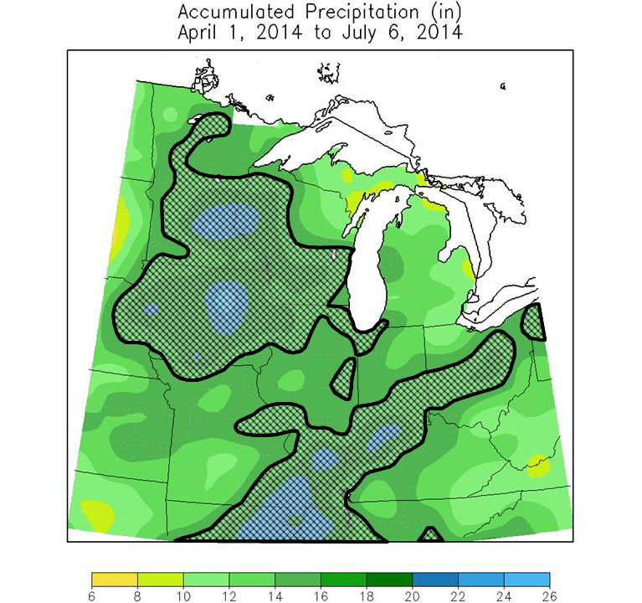
Nitrogen Watch
(on my website)
Updated weekly May & June
Crosshatch areas are in ‘danger zone’ for N loss

Slide 11
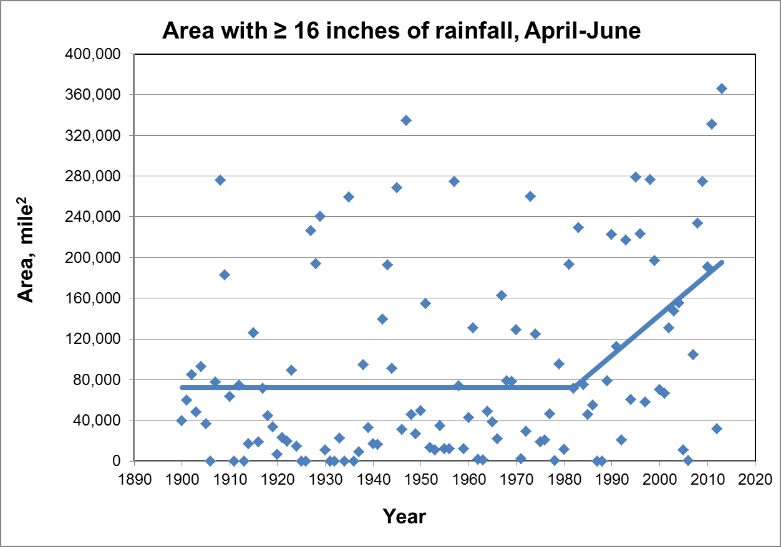
More wet area in the central U.S.
99.97% chance that this is real

Slide 12
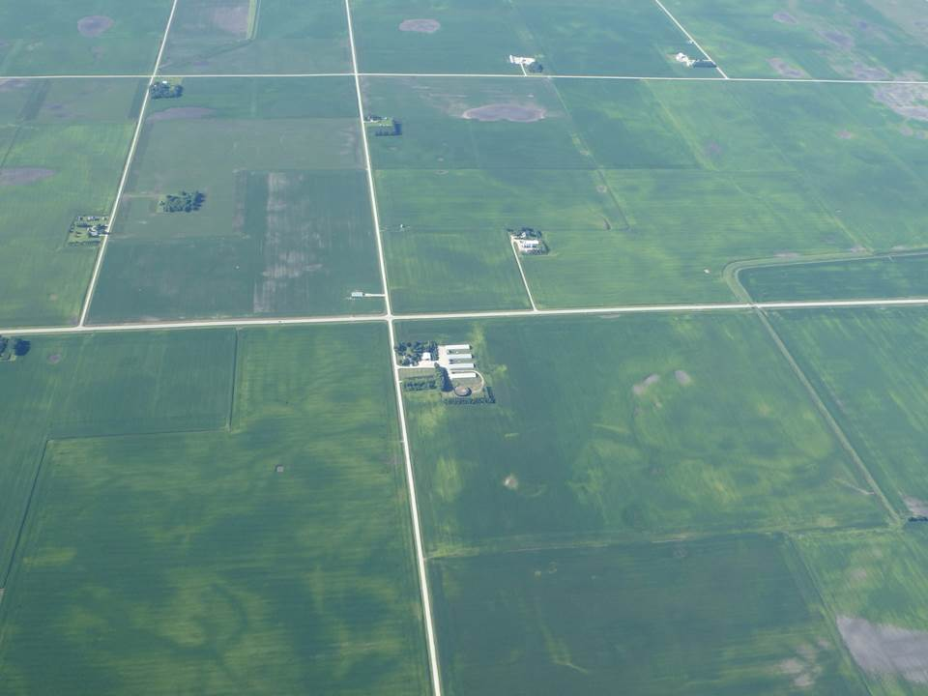
Near Clarion, Iowa, July 16, 2014

Slide 15
Yield loss to N burn: is it a problem? (average of 7 locations in Missouri, 2003-04)
150 lb N applied broadcast at corn height:
Treatment | 1 foot | 2 feet | 3 feet | 4 feet
Ammonium nitrate | 1 | 8 | 20 | 18
28% N solution | 9 | 14 | 33 | 61
Urea | 0 | 0 |  | 4

Slide 16
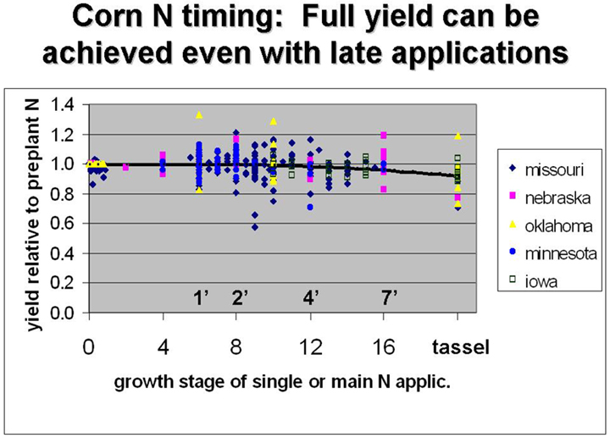
What about risk of yield loss with delayed N?
Eight production corn fields, 1997

Slide 17
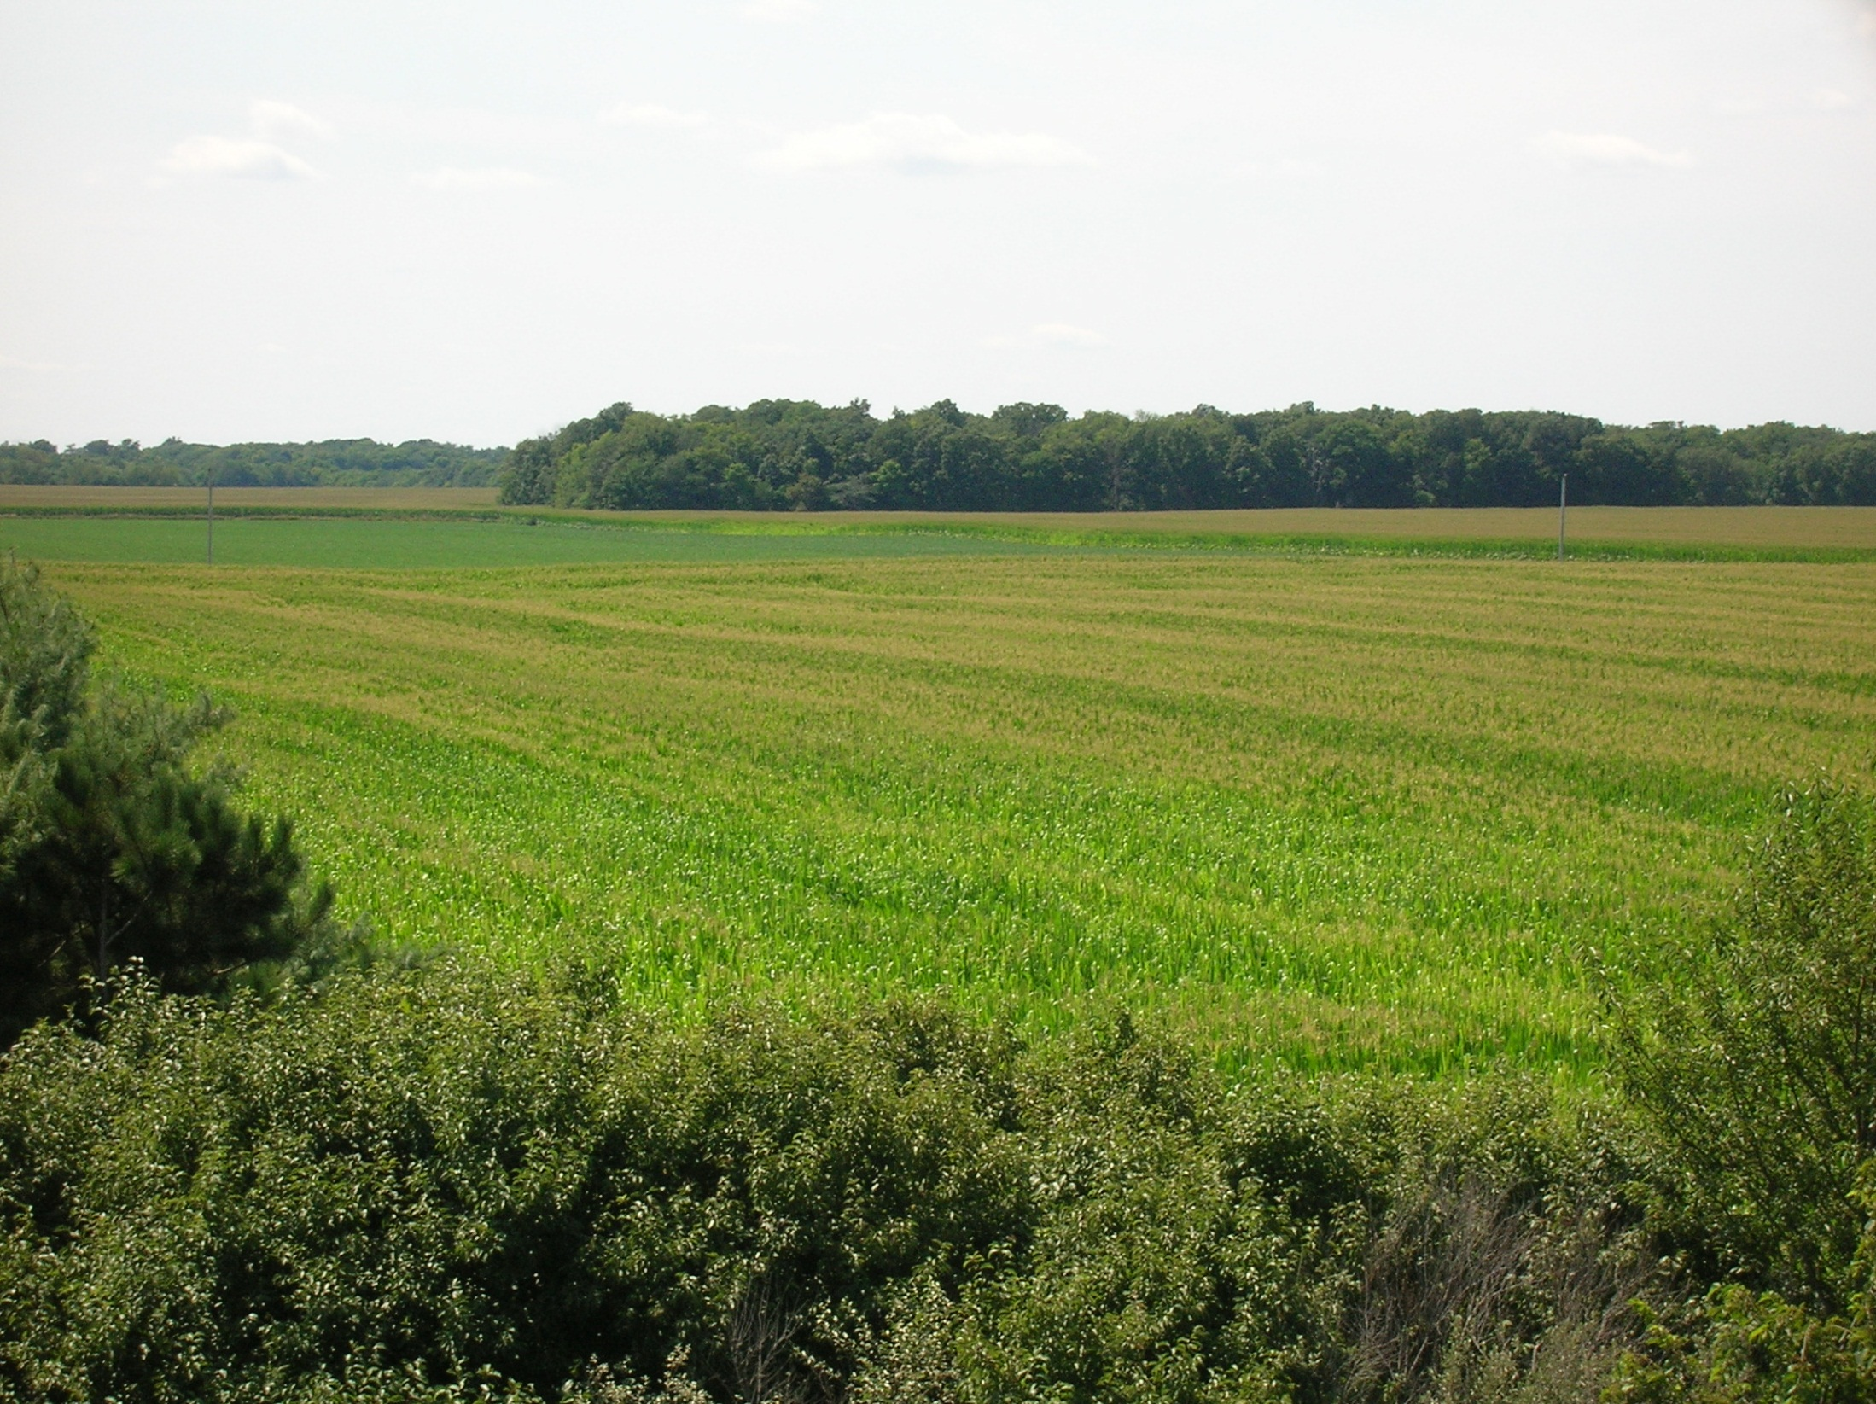
It’s ugly from the ground, too

Slide 18
Climate change: it’s working for South Dakota
http://www.usatoday.com/story/news/nation/2013/09/17/climate-change-agriculture-crops/2784561/

