Slide 1
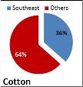
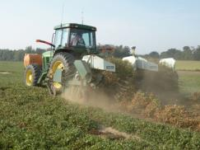
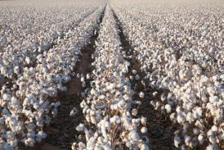
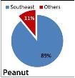
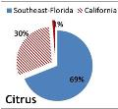
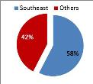
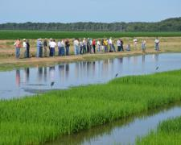
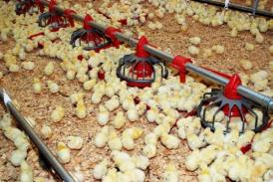
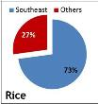
Welcome to the Southeast US…Welcome to Alabama
Forest Industry
Broilers
Notes:
In 2011, Alabama ranked 3 rd in the U.S. in broiler production with marketings of 1.03 billion birds.

Slide 2
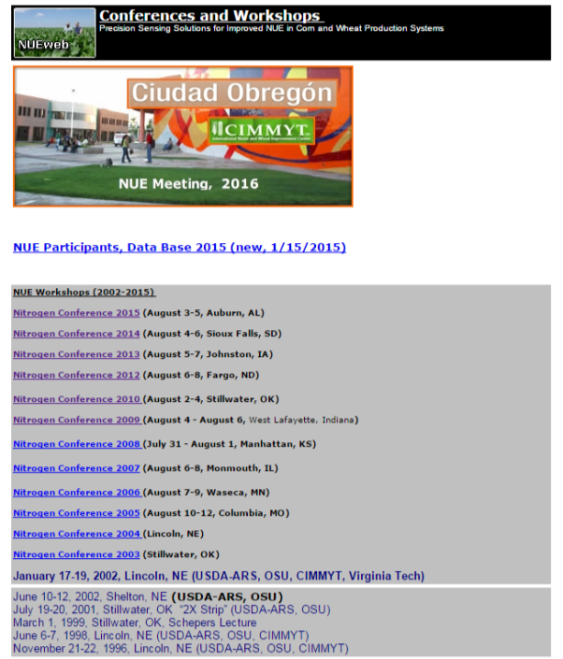

Slide 3
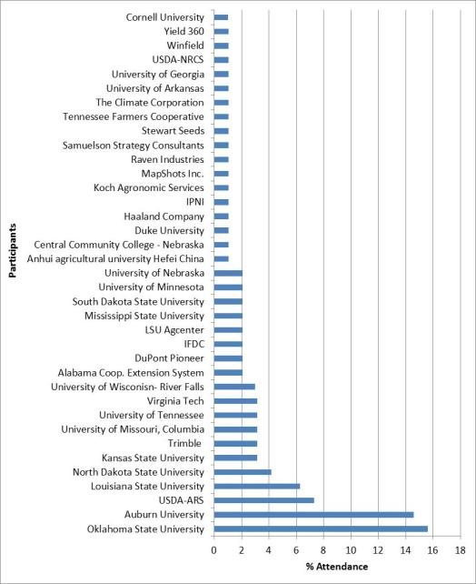
2015 NUE Workshop
37 Institutions:
18 Universities and Private Industry

Slide 4
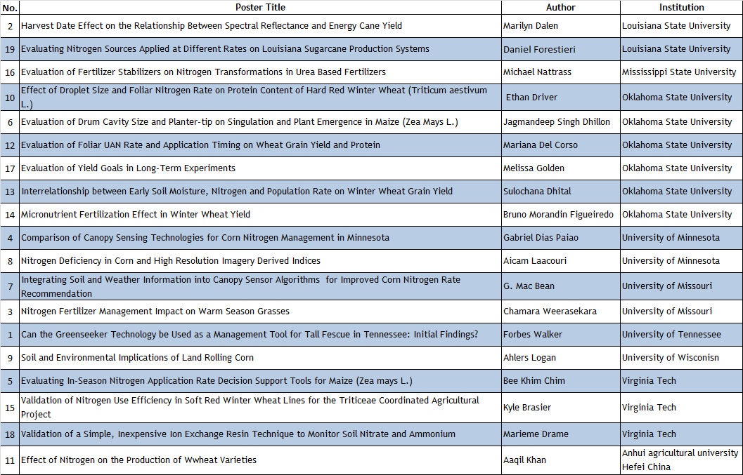
Graduate Student Poster Competition
Do not miss the opportunity to interact with the students during the breaks – Mezzanine Second Floor

Slide 5
Sponsors

Slide 6
AU NUE Meeting Organizing Team
Faculty/Staff
Elizabeth Guertal
Kip Balkcom
Charles Mitchell
Jeana Baker
Christian Brodbeck
Greg Pate
Kaleb Kreamer
T-Speir
Research Assistants/Students
Noel Welch
Jose Franco Leme
Damianos Damianidis
Evie Smith
Lea Hix
Zack Ogles
Chelsey Greene
Mallory McDaniel
Jeffrey Walker

