Slide 1
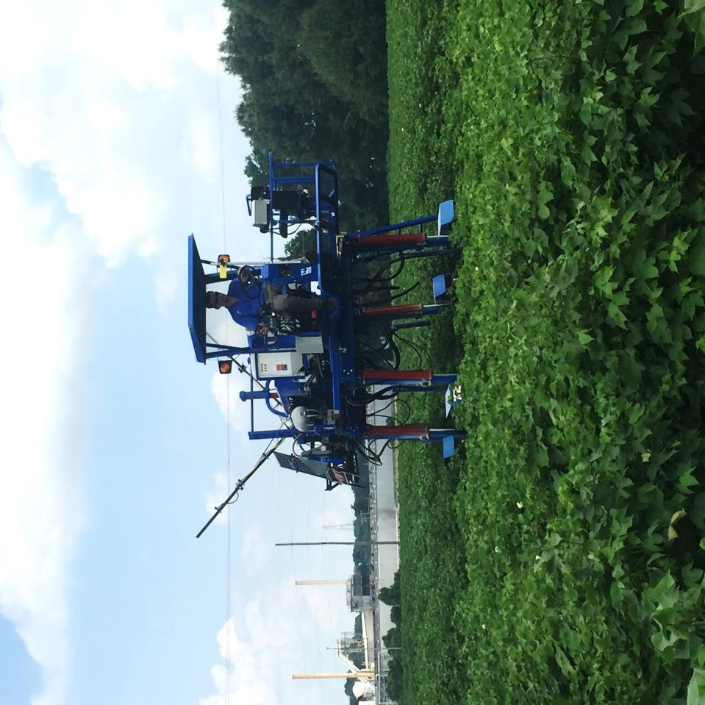
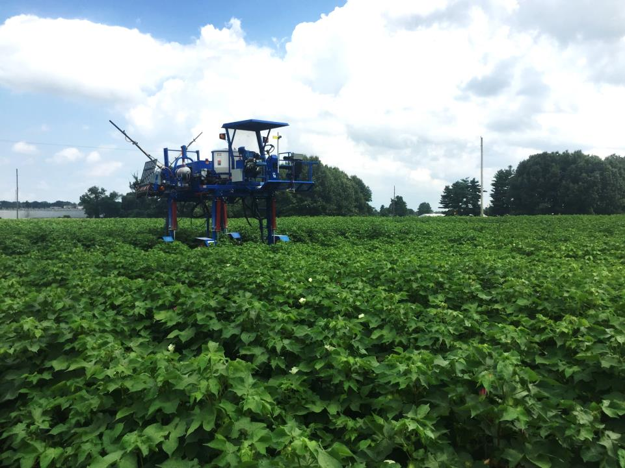
2015 NUE Meeting
Remotely detecting N stress in Cotton
Tyson B. Raper, PhD
Assistant Professor, Cotton and Small Grains Specialist
University of Tennessee- Dept. of Plant Sciences

Slide 2
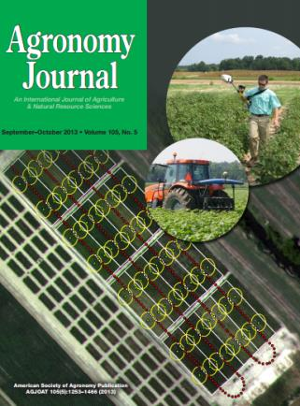
Outline
Introduction
Importance for SE
Mississippi State
Sensor Comparison
Wavelength/Index Analysis
University of Arkansas
Active detection of K deficiencies
Image analysis
Point, camera board
University of Tennessee
Image Analysis
On-the-go?
Notes:
Thank you Mr. Ogle/moderator.
Again, my name is Tyson Raper. The last time I presented at this meeting I was a graduate student in Dr. Jac Varco’s program (that was 2010). Since then, I have completed a PhD and accepted the position of Cotton and Small Grains Specialist at the University of Tennessee. I have served in that capacity for just over a year now, and I believe I can understand the demands of a heavy extension appointment! I’m going to focus on cotton today (my apologies for the shift from wheat).
I will start this presentation with a very brief introduction, skim through some background research which directed us to our current project, and share some preliminary/exploratory data with this format.

Slide 3
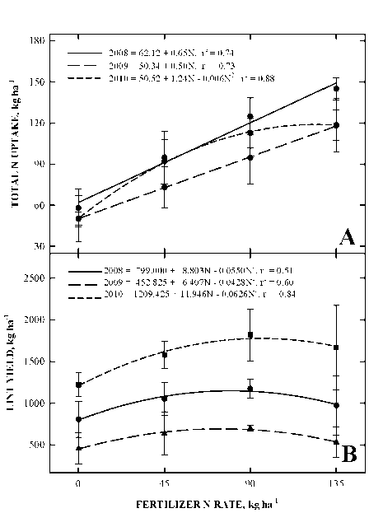
Introduction
Nitrogen in Cotton Production
Overall most yield restricting nutrient
Limits yield, lowers quality
Excessive N Causes-
Rank growth, boll rot, harvesting difficulties
Increased need for growth regulators, insecticides, and defoliants
REDUCED YIELDS
Notes:
This is not news to this crowd!
But I include this slide to emphasize to our grains and oilseeds crowd that we see a true quadratic response to fertilizer N rate in cotton.
Over-applications cause rank growth, boll rot, harvesting difficulties, increased need for growth regulators, insecticides defoliants, reduce returns. . .
and reduce yields!

Slide 4
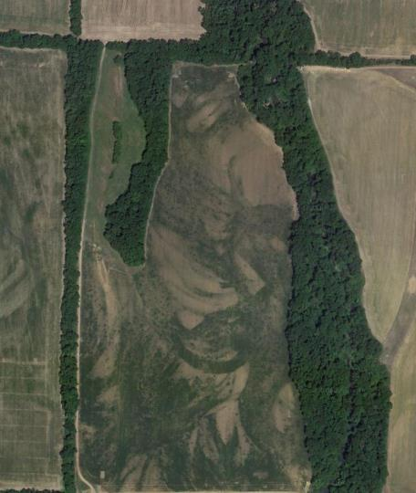
Introduction
Crop production in the humid mid-south and southeast is plagued by temporal and spatial variability.
6/27/2012
9/28/2013
Notes:
Crop production in the humid midsouth/southeast is plagued by temporal and spatial variability.
2013 I was monitoring drought at a variety trial in Bellemina, AL.
I thought it would be appropriate to share this image in AL. This field is located half-way between the Tennessee Valley Experiment Station and the Greenbriar restaurant. I came through on 9/28 and saw this image- the field has areas which are just reaching cutout and some areas that appeared to be 20-30% open. Deficiencies of N and K were very visible. After taking the picture, I found the field on Google Earth. Not all of our fields are this variable (obviously) but we have areas like this in most of our fields.

Slide 5
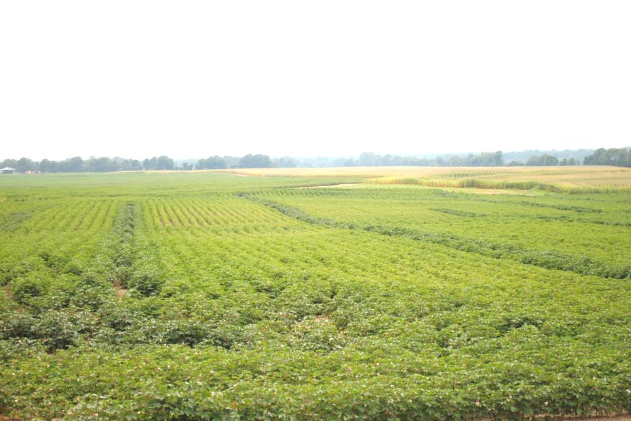
Introduction
Notes:
Complicating N management (especially in cotton) is a general shift from liquid to dry fertilizers, and the issues that subsequently arise.

Slide 6
Objective
Examine relationships between canopy reflectance across wavelengths, calculated ratios and vegetative indices prior to- and at flowering to biomass, leaf tissue N concentration, aboveground total N content, and lint yield.
Notes:
So for my master’s project we had two main objectives.
1. Determine and compare the sensitivities of three commercially produced, ground-based, canopy-reflectance units to changes in cotton N status, and
2. Examine relationships between canopy reflectance across wavelengths and calculated ratios and vegetative indices prior to- and at flowering to biomass, leaf tissue N concentration, aboveground total N content, and lint yield.
I’m going to skim through the results from the second objective.

Slide 7
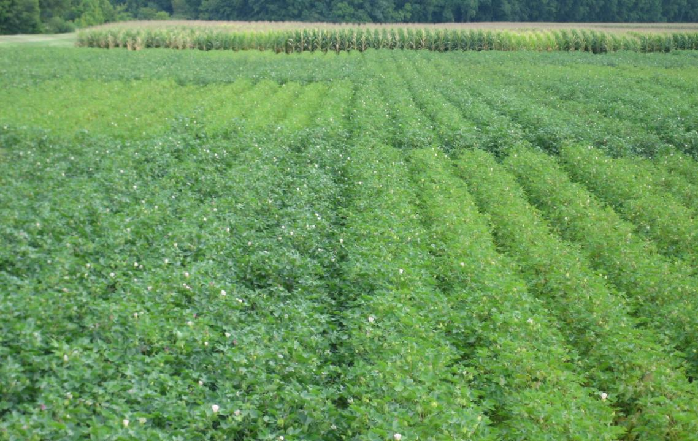
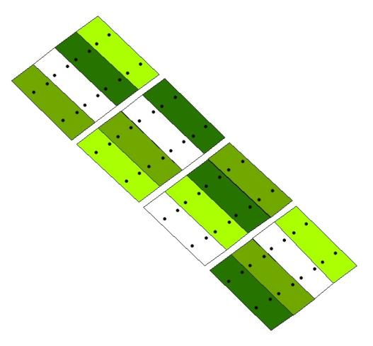
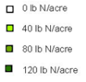
Materials and Methods
Plant Science Research Farm, Mississippi State, MS
Data collected from 2008-2010
4 Treatments x 4 Replications
RCBD
12 rows x125’
0, 40, 80, 120 lb N/acre
Planting (50%)
Early square (50%)
Notes:
Split N, large plots, N rates up to and beyond the recommended rate.

Slide 8
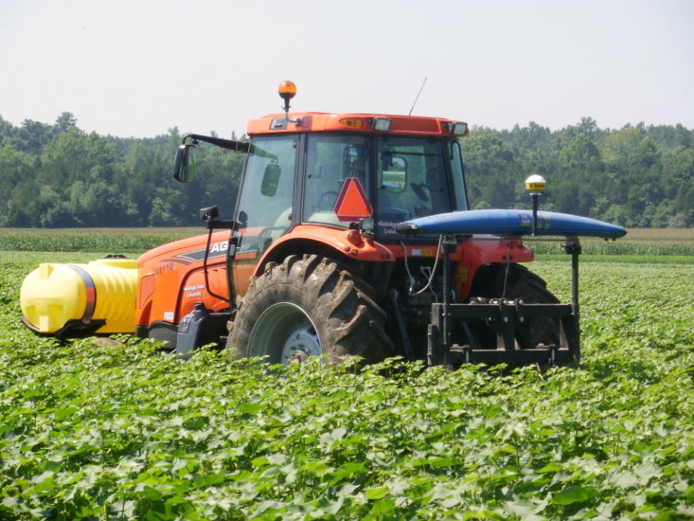
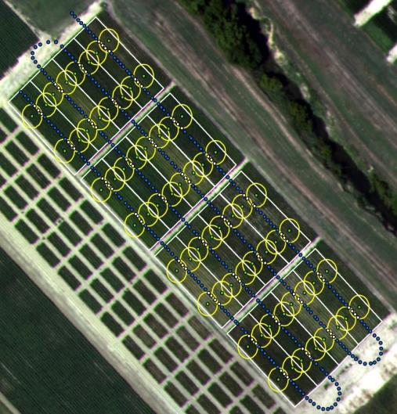
Materials and Methods
Data Collection
Reflectance
YARA N Sensor (YARA International ASA, Oslo, Norway)
Crop Circle Model ACS-210
GreenSeeker Model 505 (N-Tech Industries)
Notes:
We collected data from three sensors and related this to sub-plot measurements in each plot.

Slide 9
Results
 | Pearson Correlation (r)
Wavelength (nm) | Total N Content | Leaf N Concentration | Plant Height | Relative Yield
450 | -0.56826 | -0.32925 | -0.72783 | -0.23993
500 | -0.60931 | -0.36993 | -0.7455 | -0.2663
550 | -0.75304 | -0.54613 | -0.66982 | -0.31762
570 | -0.75012 | -0.53501 | -0.71118 | -0.3294
600 | -0.72077 | -0.49863 | -0.7496 | -0.33123
620 | -0.69522 | -0.47029 | -0.762 | -0.32313
640 | -0.67493 | -0.44788 | -0.76858 | -0.31336
650 | -0.65332 | -0.42338 | -0.77295 | -0.29963
660 | -0.62734 | -0.39463 | -0.77576 | -0.28323
670 | -0.60529 | -0.37079 | -0.77623 | -0.26754
680 | -0.60614 | -0.37243 | -0.77554 | -0.26825
700 | -0.76277 | -0.56012 | -0.72115 | -0.35805
710 | -0.77412 | -0.60679 | -0.58618 | -0.34531
720 | -0.57698 | -0.50047 | -0.19106 | -0.24034
740 | 0.092051 | 0.058845 | 0.514229 | 0.028778
760 | 0.272205 | 0.227299 | 0.627928 | 0.116647
780 | 0.30102 | 0.254799 | 0.64041 | 0.12866
800 | 0.304379 | 0.257982 | 0.63903 | 0.125346
840 | 0.299089 | 0.253435 | 0.625817 | 0.112166
850 | 0.298762 | 0.253063 | 0.623016 | 0.109657
Average Across Wavelengths | 0.547256 | 0.386557 | 0.670191 | 0.240229
Notes:
We trimmed the dataset on growing season to only look at reflectance during the period in which we could make a yield impacting fertilizer N application.
That resulted in 6 total sampling/sensing dates- third week of square and first week of flower in 2008, 2009 and 2010.
Here is the standard pearson correlation table. Instead of trudging through this table, we have ranked wavelengths based upon their sensitivity, with 1 being most sensitive and 20 being least sensitive.

Slide 10
Results
Fig 2 Sensitivity rankings, where low numbers represent high sensitivity immediately prior to and during early flower. Error bars represent one standard deviation from the mean. Line represents average of six observations (2 sampling times/year X 3 years). Points represent values of individual rankings.
Notes:
This should be a little easier to understand. So we have wavelength on the x axis, and parameter of interest on the y axis.
Total N, lint yield, leaf N? sensitive to red-edge and green regions. Plant height? Red.

Slide 11
Results
Fig 4 Average response across the 3rd week of flower bud formation and first week of flowering (end of timely fertilizer application period) in several selected indices to changes in selected cotton growth parameters.
Notes:
This trend held through the index analysis. Again, third week of square, first week of flower for three years.
NDVI- not sensitive to total N uptake or leaf N concentration. Very sensitive to plant height.
Simplified Canopy Chlorophyll Content Index? Moderate to N status, weaker with plant height.

Slide 12
Conclusion
Wavelength/Index Analysis
Wavelengths of green and red-edge regions appeared to be most sensitive to N status
This relationship held through to index analysis
Red edge/green region-utilizing indices tended to relate more strongly to N status
Notes:
At this point, I moved to Arkansas and began exploring the relationships between reflectance and K. I won’t be talking about that today, but I do want to share another study I completed at the University of Arkansas.

Slide 13
Introduction
Do we need NIR?
Can we do this with a camera?
Will a passive system, if properly calibrated, work?
Notes:
I come back to this image to make one point. We know what deficiencies look like. I am fairly confident I can tell you if you have a yield impacting deficiency by just walking a field. To make that assessment I do not need NIR.

Slide 14
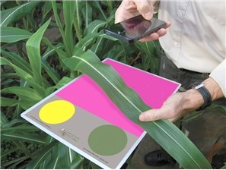
Introduction
Karcher and Richardson (2003)
Need for an objective method of determining turfgrass color
Images from digital camera with standard color board in background
Digital processing software calculates Dark Green Color Index (DGCI)
Rorie et al. (2011)
Adapted to corn
FieldScout GreenIndex + (Spectrum Technologies)
Phone application & board ~$150
Courtesy: Spectrum Technologies, Inc.
Notes:
Dr. Oosterhuis immediately introduced me to Dr. Larry Purcell, who had just completed a study looking at digital image analysis in corn.
A little background-

Slide 15
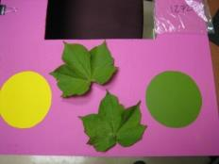
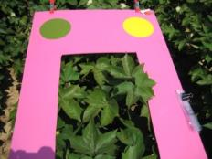
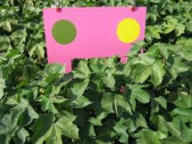
Results
Raper et al. (2012)
Dr. Mozaffari established N rate trial
Fertilizer N from 0-150 lb N/ac
Marianna, AR
Sampled mid-flower
Pre-processed and analyzed in SigmaScan (Systat Software, San Jose, CA)
Process
Convert RGB image to HSB
Set thresholds to eliminate background
Asses remaining tissue for darkness
Notes:
Does this work for cotton?

Slide 16
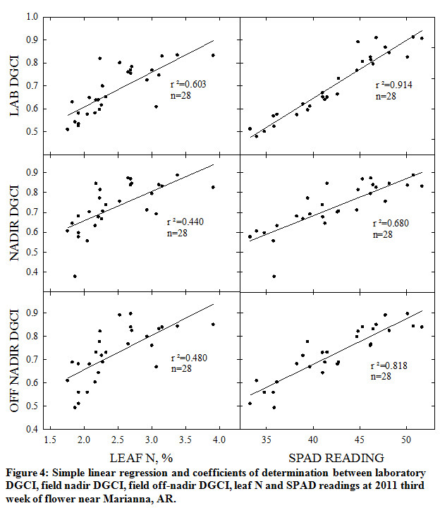
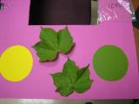
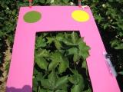
Results
Notes:
Three camera angles, all using the same camera and color board (basic, $120 digital camera on auto settings)
Pulled fully expanded, mainstem leaves 4-5 nodes down from the meristem
As good as SPAD
Off nadir better than nadir, still not as good as lab
Yes. It works, but it is a point measurement.

Slide 17
Next Step
Complete development of a platform which collects digital images and GPS location for further processing.
Initial goal is to complete tasks highlighted in yellow. Black boxes will follow.
Start
Collect GPS coordinates
Determine proper action
Drive platform over area of interest
Store output
Adjust controller
Collect digital image of canopy
Yes
Does output justify action?
Display/define action
Pre-process image to isolate pixels of interest
Store decision
Analyze pixels of interest
No
Is sensing complete?
Yes
Display inaction
Terminate
No
Notes:
Conversion from a point measurement to an on-the-go system

Slide 18
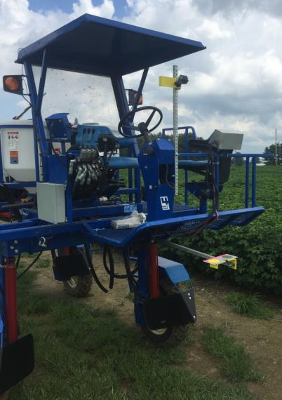
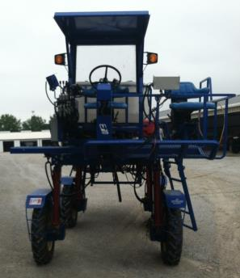
Progress
Notes:
So here are a few images of the setup. We have a GoPro hooked wirelessly to an iphone and we trigger shots remotely.
Color standards are in the field of view of each image and are fully sunlit.

Slide 19
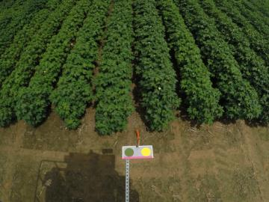
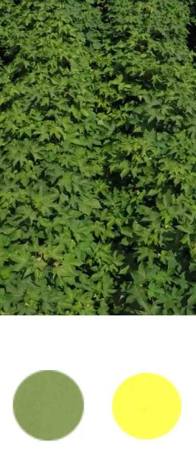
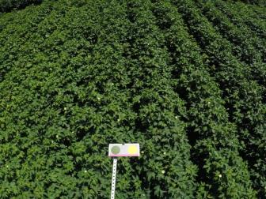
Processing
Notes:
We drive to a plot, and trigger the photo remotely. After the image is collected, we post-process the image to expand the color standards and crop out the outside rows (only interested in the inner two rows).

Slide 20
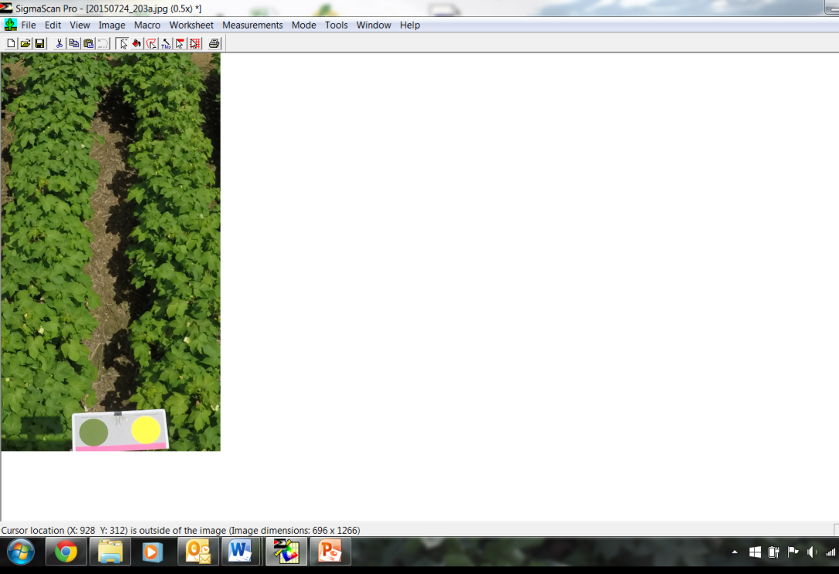
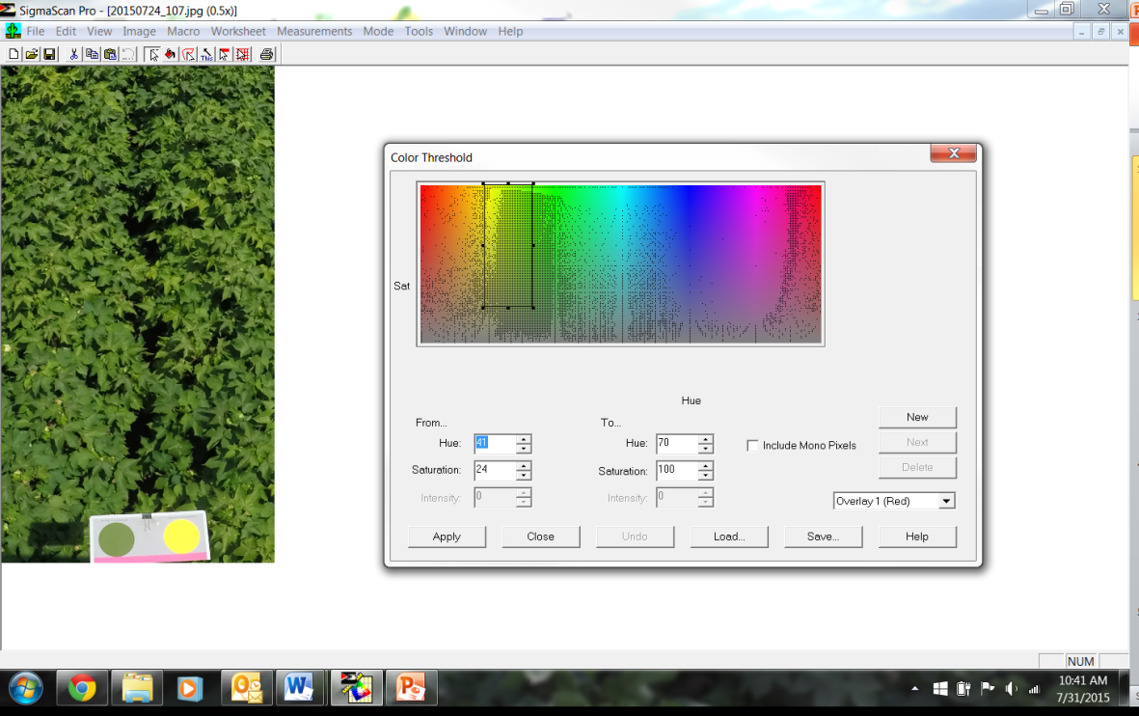
Processing
Notes:
Processing in SigmaScan is conducted with a program written by Karcher and Richardson (first published in 2003).
Initial step is to remove background by establishing color threshold. Next slide is an example

Slide 21
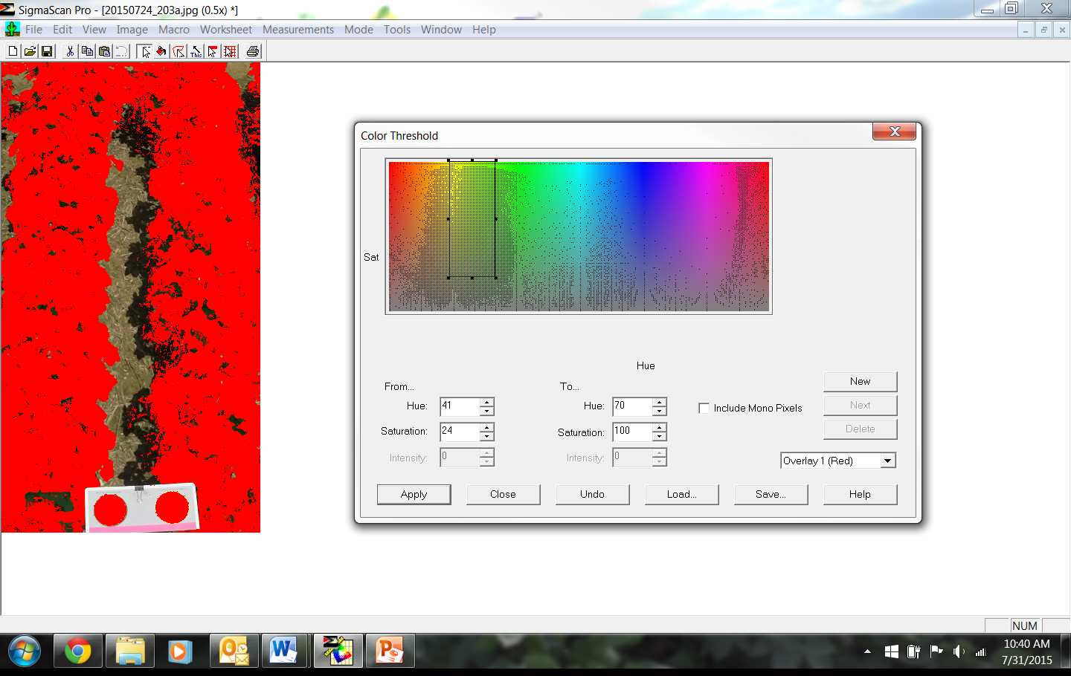
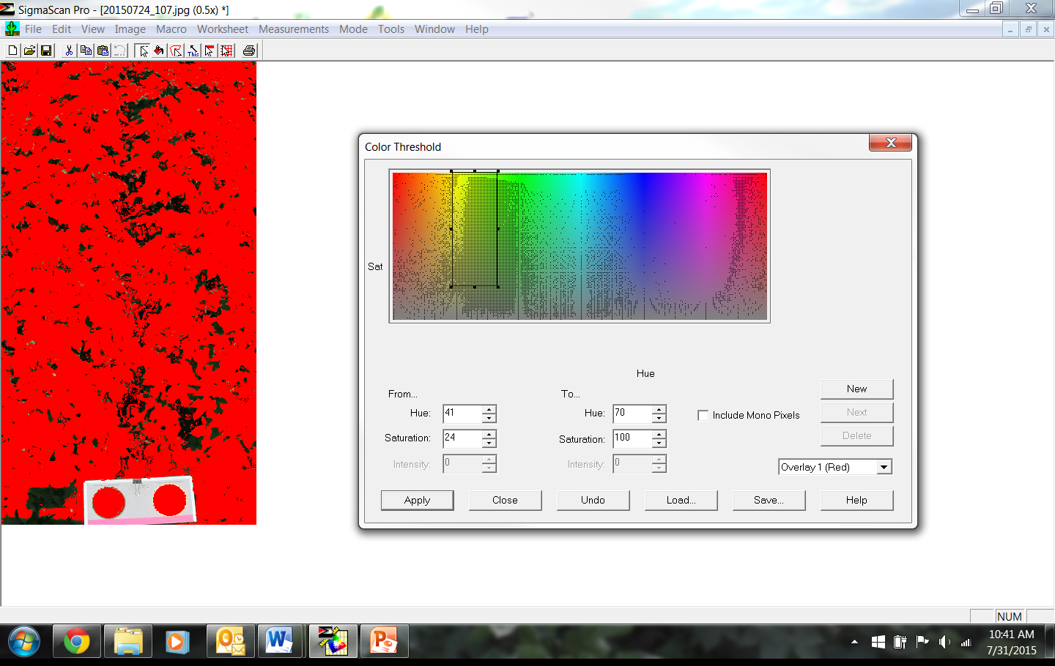
Processing
Notes:
You can se we are analyzing the sunlit canopy and dropping shaded leaves and soil. Color standards are recognized

Slide 22
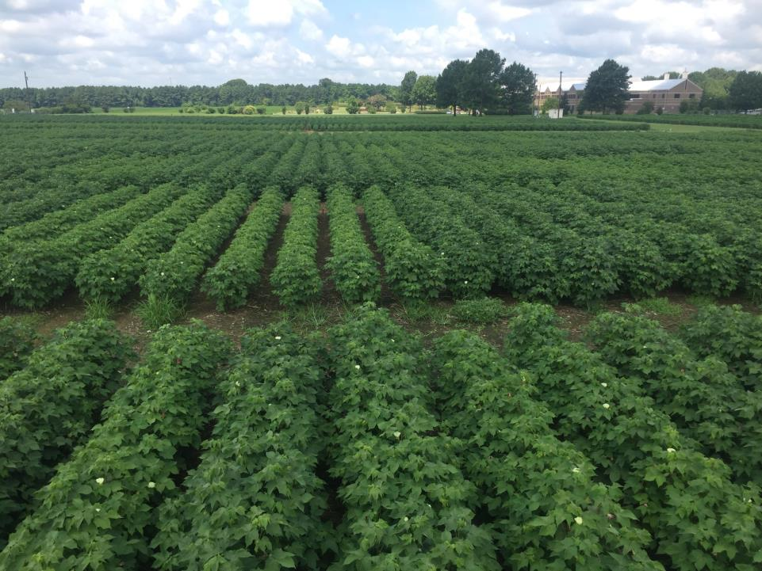
Sampling
Notes:
Here are the plots. Anyone see anything wrong with this picture?

Slide 23
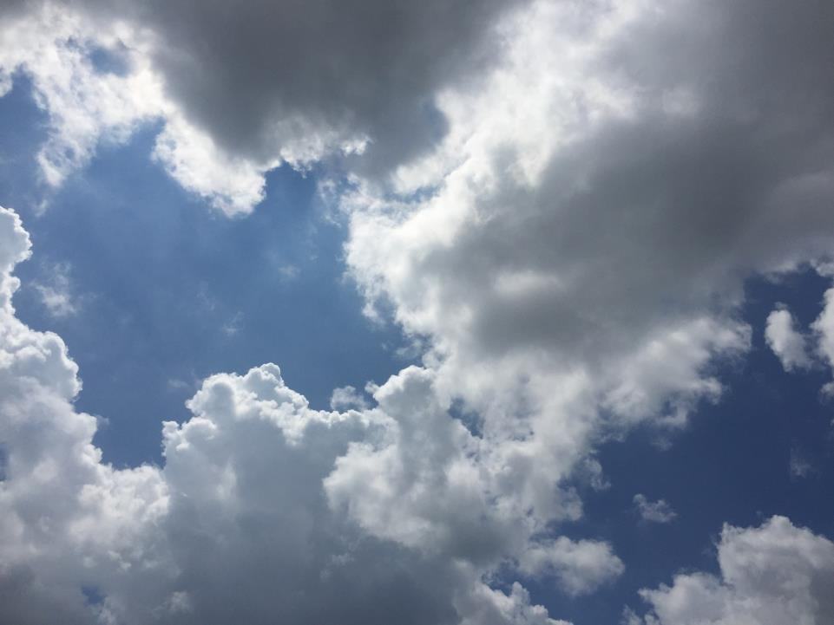
Sampling
Notes:
Clouds. First imagery date- plagued by clouds.

Slide 24
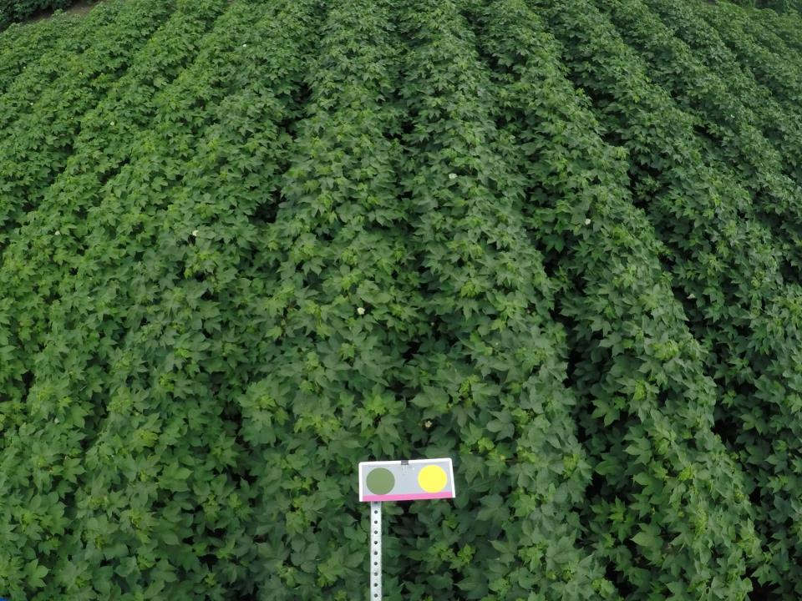
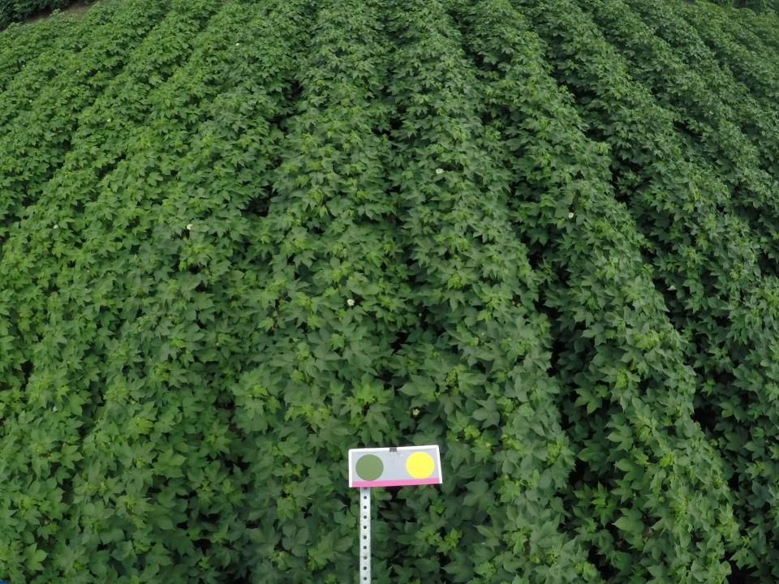
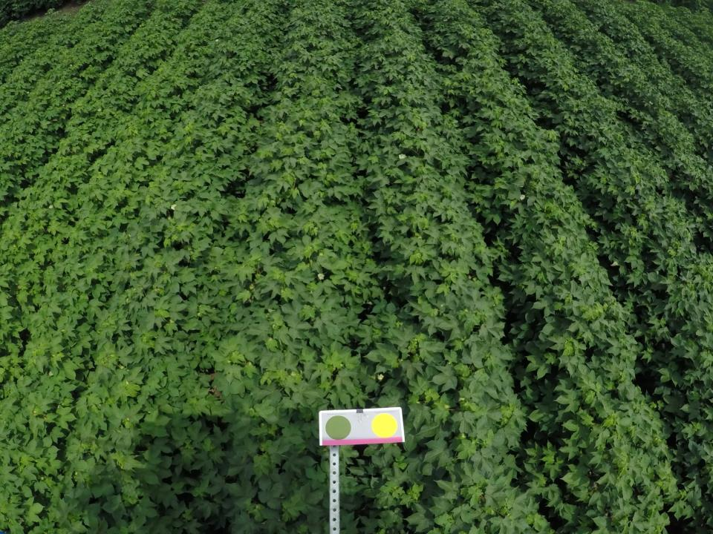
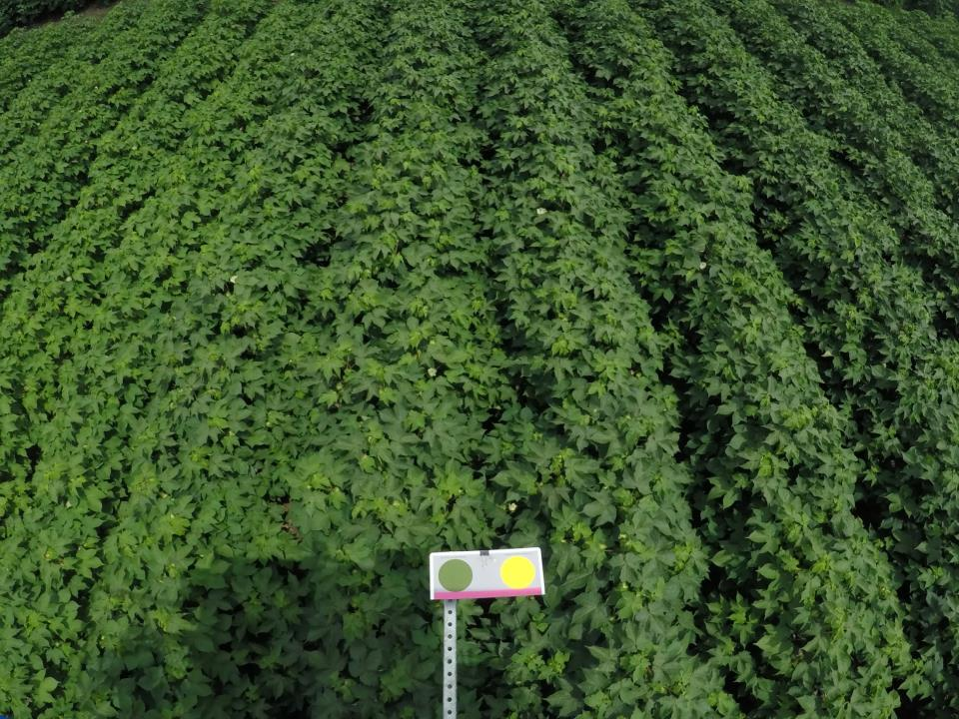
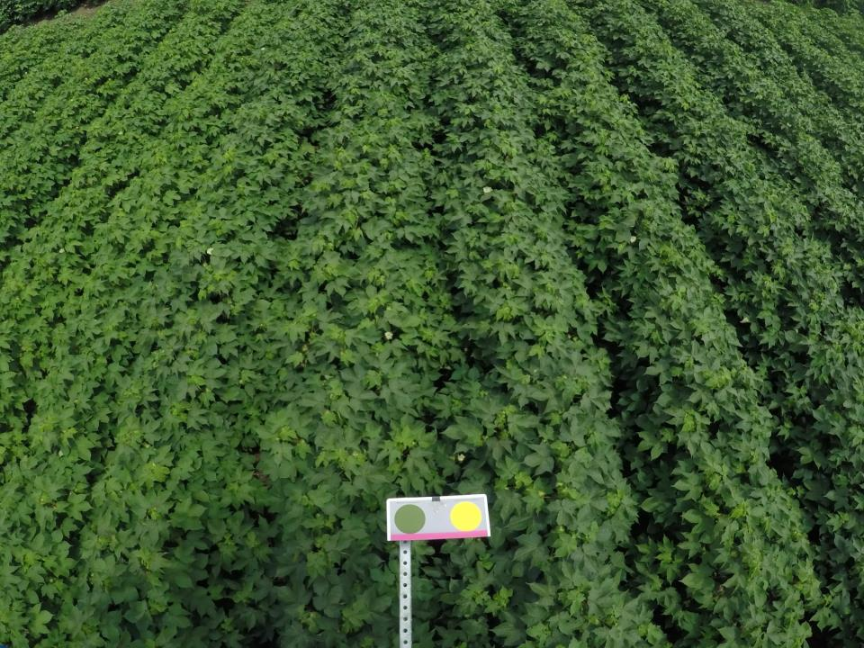
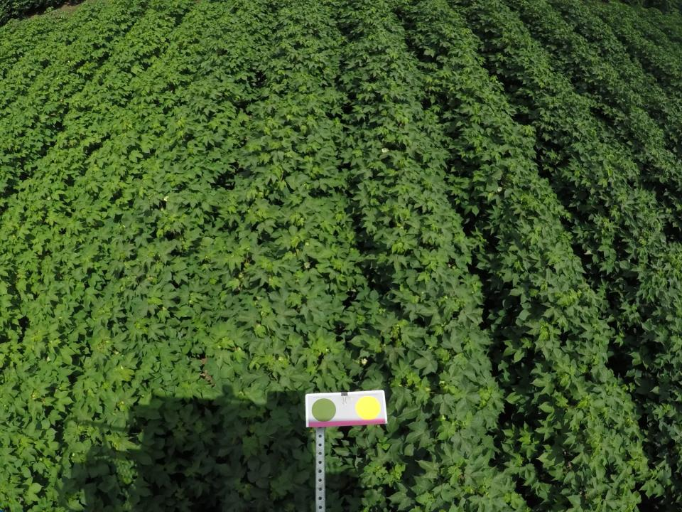
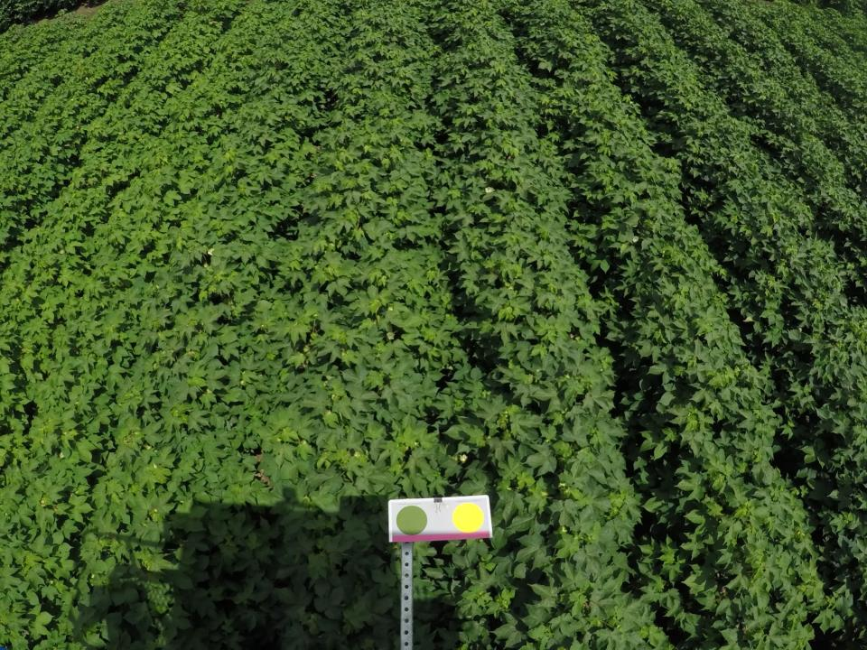
Sampling
Notes:
Here is an example

Slide 25
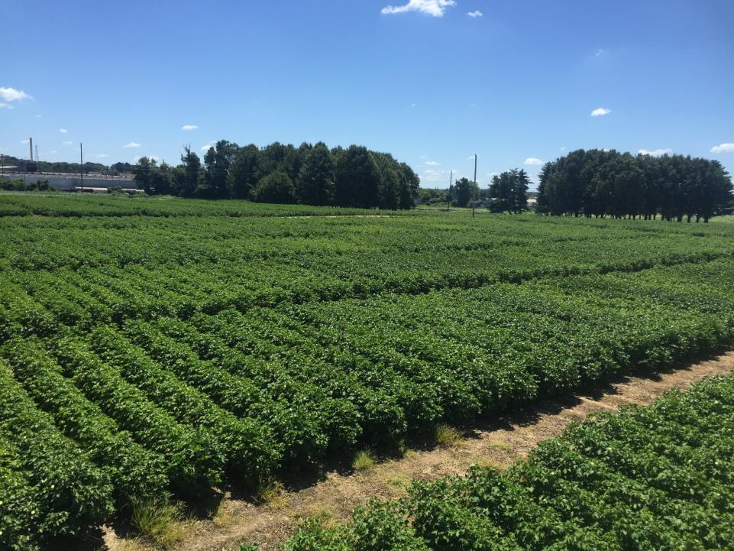
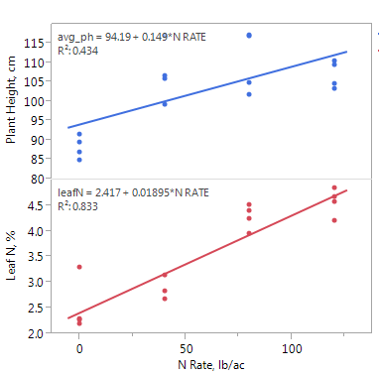
Sampling
Notes:
Took pictures again later in the week- much clearer!

Slide 26
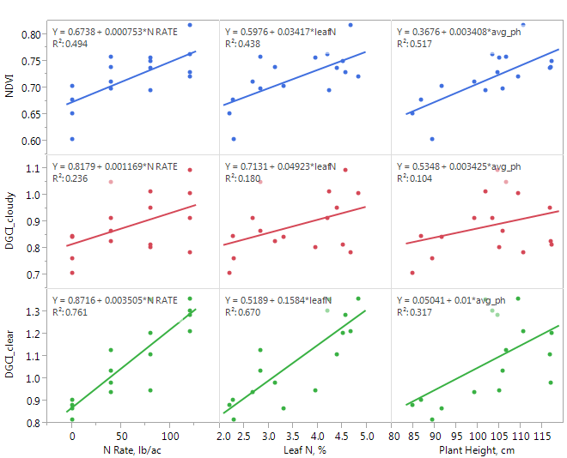
Results
Notes:
So here are the results. We used the GreenSeeker handheld unit and sampled the same area of which we took photos.
NDVI relates moderately well to N rate, leaf N and plant height.
Clouds? Wreak havok on measurements. Poor correlations with N rate, leaf N and plant height.
Clear? Much better. DGCI relationships with N rate and leaf N substantially better than NDVI, weaker relationships with plant height (likely due to the relationship between plant height and ground coverage- which is removed with the pre-processing activities).

Slide 27
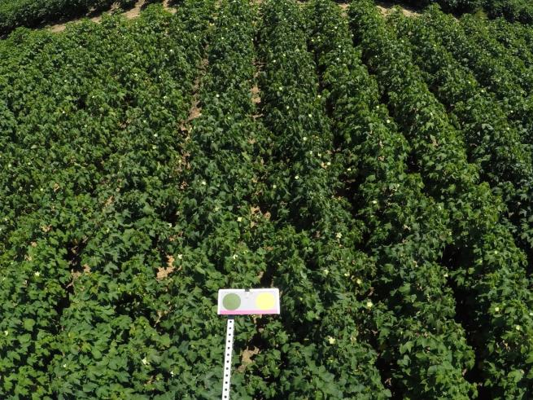
Results
Notes:
Drought stress, outlier point

Slide 28
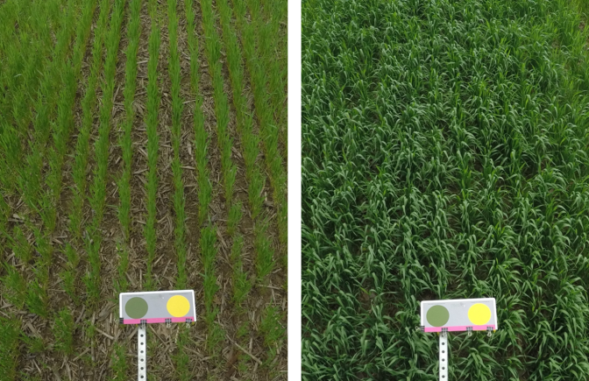
Results
Notes:
I have a similar dataset for wheat. Still have some work to do on this dataset before I Can present- but if I was ever going to get a response, I should be able to detect it here. CAN YOU SEE THE DIFFERENCES?

Slide 29
Closing Remarks
Digital Image Analysis for N determination
Potential. But needs work
Passive system going to be a challenge in the humid southeast/midsouth
Convert to an active system?
Better standards?
Quicker processing necessary

Slide 30
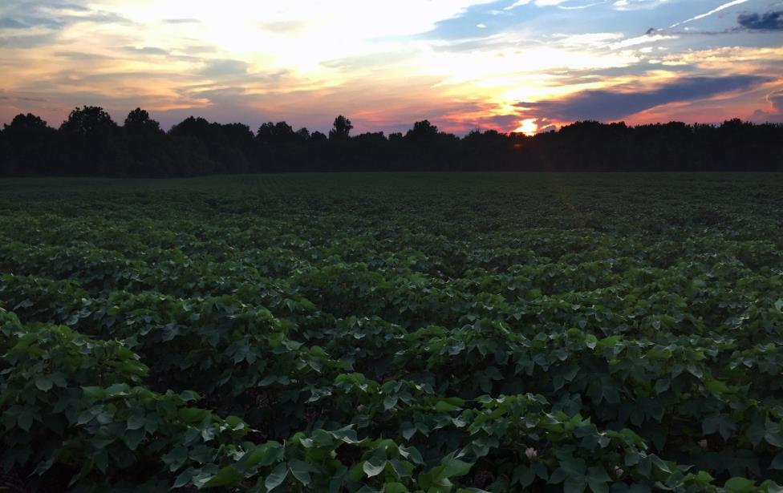
Tyson B. Raper, PhD
Assistant Professor, Cotton and Small Grains
University of Tennessee- Dept. of Plant Sciences
West Tennessee Research and Education Center
605 Airways Blvd. Jackson, TN 38301
cell: (731) 694–1387
email: traper@utk.edu
news.utcrops.com

