Slide 1
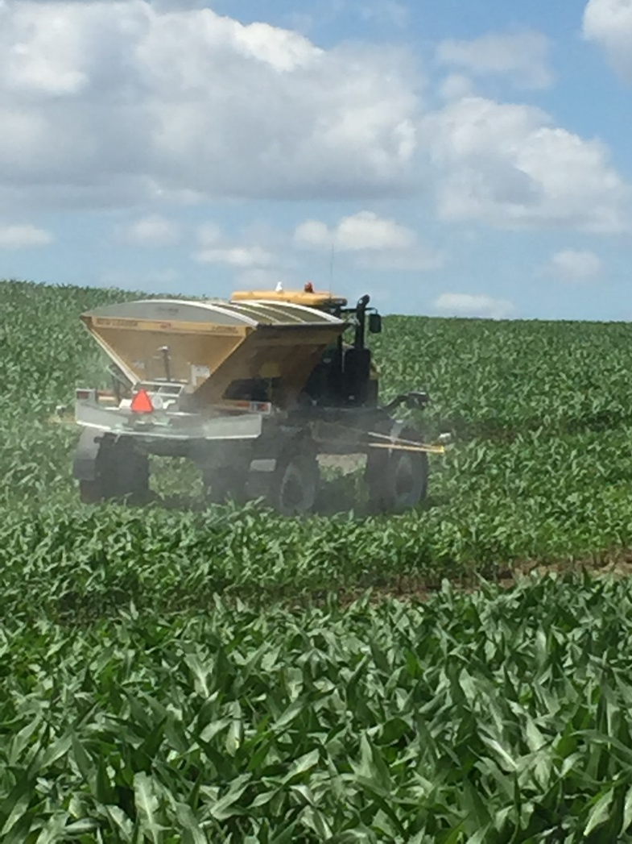
A Simplified Linear Transformation to Calculate N Application Rates in Corn and Wheat
Notes:
In SE Nbraska and NW Missouri a strong interest has developed for top dressing UREA Fertilizers. The challenge has bee to create a simplified method to predict N rate.

Slide 2
Dr. Brenda Ortiz Who Built The Unique Corn Optical Sensor Data Set Required for This Investigation
And Dr. Bill Raun Who Kept this Investigation going Through Hell and High Water
Dr. Jim Schepers Whose argument for measuring NDVI at Two Different Locations Without an N Rich Strip caused me to Modify my approach to the problem.

Slide 3
Corn at three growth stages symmetric sigmoid model
Notes:
The symmetric sigmoid requires two parametric equations to predict crop yield. These control the degree of curvature and the location of the inflection point

Slide 4
Difficulty with the symmetric sigmoid for predicting grain yield
This equation is Parametric – each parameter is a function of an equation.
This means that you cannot directly solve for any value of the yield equation.
This isn’t good. We must adjust the parameters until the equation predicts known yield values. Consequently, we can’t directly solve the yield equation for exact values.
We need a simpler approach which replaces parameters with constants and linearizes the relationship between the independent dependent variable (FP ndvi) and the dependent variable yield.

Slide 5
We can make the following assumptions when developing a model to predict grain yield with optical sensors
Yield without additional N is proportional to Farmer Practice NDVI.
NRich NDVI is independent of location within an area in a field where production variables exhibit geostatistical relatedness.
A straight line can be constructed between the maximum value of NRich NDVI and the minimum value of Farmer Practice NDVI.
Because NDVI is linearly proportional to crop yield, a straight line can be fit through NDVI and crop Yield. (Dr. Jim Schepers)
Notes:
Jim Schepers proposed measuring the highest and lowest values of NDVI in a field, but did not show that NRich NDVI could be used to quantify maximum yield.

Slide 6
Corn and Wheat there is a region where symmetric sigmoid exhibits high linearity
Notes:
In the region bounded by the rectangle, the yield curve is nearly straight.

Slide 7
linearization
Despite the concerns about using sophisticated non-linear models, agronomist have need to use N-Lin models to describe and predict complex biological phenomena. One of these model is the symmetric sigmoid which is a step function i.e. growth models. Many of these models are parametric requiring input of data to change values of coefficients as inputs change. In effect, two, three, or more additional equations are needed to define the coefficients required to implement the non-linear model.
One approach often used by engineers when creating models to control machines and processes, is to break the model up into segments which can be treated as independent models within the range of interest. In the case of symmetric sigmoid, most of the change in the value of the dependent variable occurs for NDVI values ranging form 0.20 and 0.80. Nearly all change occurs between 0.10 and 0.90 NDVI.

Slide 8
Consistently, yield data were linear functions of NDVI

Slide 9
Data Linearization
Fit a straight line (linear regression) through the data
Fit a straight line through at least two N-Rich reference strips
Locate one NRich strip in the highest yielding portion of the field and one from the natural occurring lowest producing area of the field. Exclude alkali spots, pot-holes, abnormally low producing regions, etc.
Although only two carefully selected areas are needed to establish the linear regression line, additional N-Rich strips will improve the accuracy and precision of the fitted straight line.

Slide 10
Linearized Generalized N Rate Algorithm AONR Corn Experiment - 2014
Notes:
AONR – Agrnomic Optimum N Rate. This set of curves should occur routinely, but do not. I suspect that we do not reach the Yield plateau because we do not apply sufficient N in the NRich reference strip. Data were normalized as part of the process of calculating yield.

Slide 11
NDVI Farmer Practice vs NRich NDVI 23 Site Years
Notes:
NRich NDVI is linearly proportional to Farmer Pracitice NDVI

Slide 12
Notes:
Wheat Yield is highly linear to farmer Practice NDVI in wheat. but this same linearity is clearly exhibited in corn

Slide 13
Notes:
Regression values are high,, but slopes of the regression lines, as well as values of NDVI can vary greatly. The upper circle encompass Nrndvi in the most productive area of the field. More measurement are better when fitting data.

Slide 14
Why Linearize Data
Establishes a straight line relationship between NDVI and Grain Yield.
Differences between NDVI values are equivalent to differences in yield.
Yield goal is the maximum expected yield

Slide 15
Additional Steps
NDVI of the yield goal for the most productive area and for the least productive area must be determined using an N-Rich reference strip. Although peak yield generally occurs at approximately 0.80 NDVI, there is no guarantee that it will. A second N-Rich reference strip must be established in the least productive area in the field.
Yield goals must be established at each location. The literature contains several methods for establishing reasonable yield goals.
A linear curve must be fitted to the data with NDVI being the independent variable and yield goal being the dependent variable. Use standard regression equations for linear curves.

Slide 16
Yield Goal
MinYld=Yld Goal*0.48/0.81

Slide 17
Defines the yield limit without additional N. Increase in yield will be proportional to increase in NDVI

Slide 19
Appendix – Additional Examples

Slide 27
Notes:
Wheat Yield is highly linear to farmer Practice NDVI, but this same linearity is clearly exhibited in corn

