Slide 1


On-Farm Sensor Based N Fertilization of Cotton
Jac J. Varco, Amelia A.A. Fox, and Totsanat Rattanakaew
Plant and Soil Sciences Dept.
Mississippi State University
Research support provide by NRCS-CIG program

Slide 2
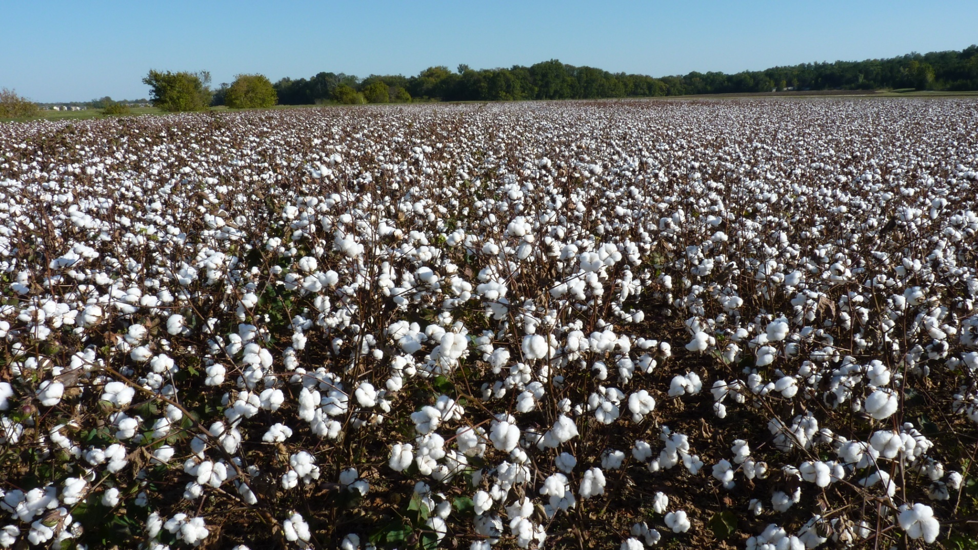
Goals of variable rate N fertilization: reduce variability, match demand and supply, increase yield/and or profitability, and improve fertilizer N use efficiency.

Slide 3
Background Information
Buscaglia, H.J., and J.J. Varco. 2002. Early detection of cotton leaf nitrogen status using leaf reflectance. J. Plant Nutrition 25(9):2067-2080.
Fridgen, Jennifer L., and Jac J. Varco. 2004. Dependency of cotton leaf nitrogen, chlorophyll, and reflectance on nitrogen and potassium availability. Agron. J. 96:63-69.
Raper, T., and J.J. Varco. 2014. Canopy-scale wavelength and vegetative index sensitivities to cotton growth parameters and nitrogen status. Prec. Agric. 15(5). DOI 10.1007/s11119-014-9383-4.

Slide 4
Objectives:
To compare a sensor-based side dress liquid fertilizer N application to a grower’s practice and response to fixed N rates in terms of leaf tissue N concentrations, lint yield, and N-use efficiency.
To compare whether a second factor used to adjust a sensor-based side dress can improve N-use efficiency.

Slide 5
Methods
2012
S. of Natchez, Mississippi; RCB 3 replications, strip plots, non-irrigated, planted 21 April, ST 5288 B2F
Fertilizer N rates of 33.7, 67.4, 101.1, 134.8 kg N ha⁻¹ applied 23 May 2012 along with variable rate (VR) treatments
2013
Highlander, Miss.; planted 21 May DP 1321 B2RF
North plots 33.7, 67.4, 101.1, 134.8 kg N ha⁻¹ applied 13 June including base rate of 33.7 kg N ha⁻¹ to VR treatments.
South plots 12 April received 78.6 kg N ha⁻¹ and a sidedress supplement at early squaring (29 June) of 0, 28, 56, and 84 kg N ha⁻¹ for total rates of 78.6, 106.7, 134.7, and 162.7 kg N ha⁻¹.VR treatments were applied for both North and South sites on 1 July 2013.
2014
Money, Miss.;
Dubbs loam 69.6%, Tensas silty clay loam 22.5%, Alligator clay 7.9%
Planted 12 May DP1321 B2RF. Fertilizer rates of 33.7, 67.4, 101.1, 134.8 kg N ha⁻¹ were applied 19 June along with variable rate treatment.
2013-2014 RCB 4 replications, strip plots, land-planed and furrow irrigated.

Slide 6
General
All locations 12 row plots, spacing of 0.97 m (38 inches) and variable in length.
Grower’s cultural practices used, conventional tillage for all site/years.
Variable rate treatments applied at pinhead to early squaring following canopy reflectance using a YARA N Sensor (Yara International ASA, Oslo, Norway) and calculation of a Simplified CCCI (SCCCI).
A prescription map output of target N rates as a shapefile was generated in ArcGIS. Treatments labeled VR1 are sensor based only and VR2 are sensor based adjusted for historical corn yield the previous year at the Natchez site, and soil electrical conductivity (EC) classified as low, medium, and high for 2013 at the Money site.
At Natchez, the grower used a VR application based on soil CEC. Three categories were identified; Corn yield/Soil EC Low, Medium, and High.
Relative to sensor based targets, 33.7 kg N ha⁻¹ was subtracted from low classifications and added to high classifications, while nothing changed for medium classifications. All N applied as liquid UAN (28-0-0-5S) banded 22.cm from the row and approximately 7.5 cm deep.
Statistical analysis was conducted using SAS 9.3 General Linear Models. Variable treatments were compared to the grower’s current practice, GVRN-CEC based variable rate at Natchez site, and 134.8 kg N ha⁻¹ at Money site.

Slide 7
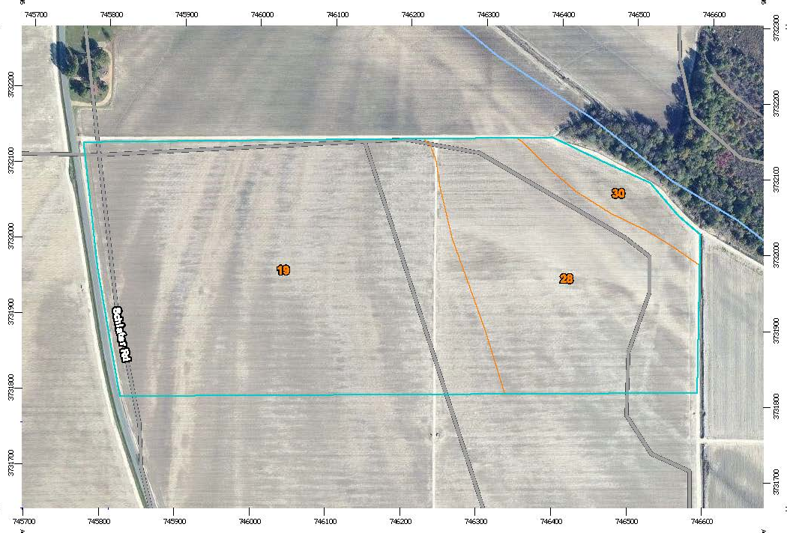
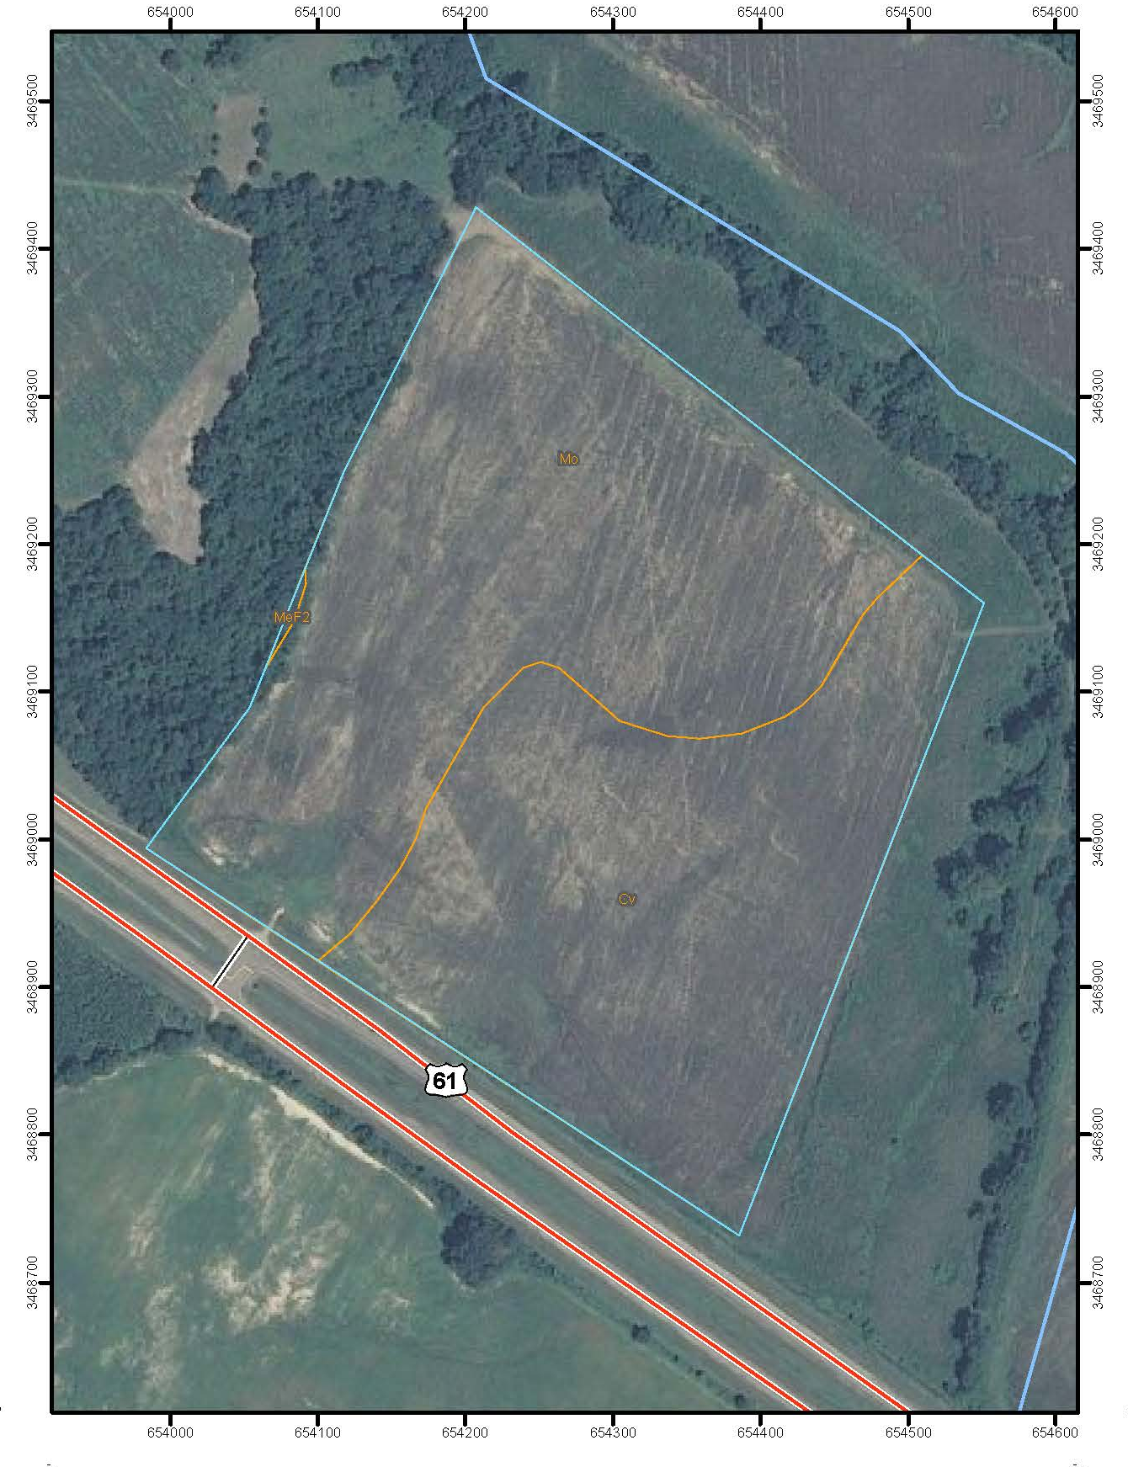
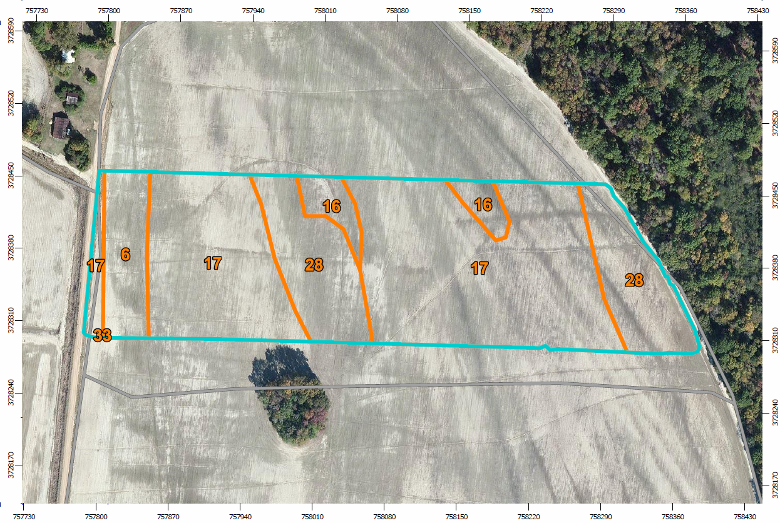
Dubbs-Dundee Complex 63.2%, Tensas silty clay loam 32.1%, Tensas-Alligator Complex 4.7%
Higlander, 2013
Natchez 2012
Convent silt loam 45.9%, Morganfield silt loam 53.9%
Dubbs loam 69.6%, Tensas silty clay loam 22.5%, Alligator clay 7.9%
Money, 2014

Slide 8
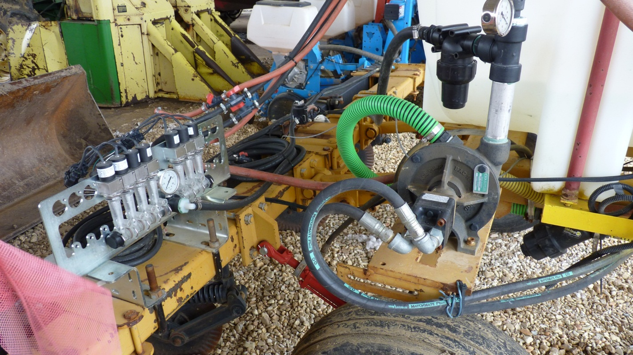
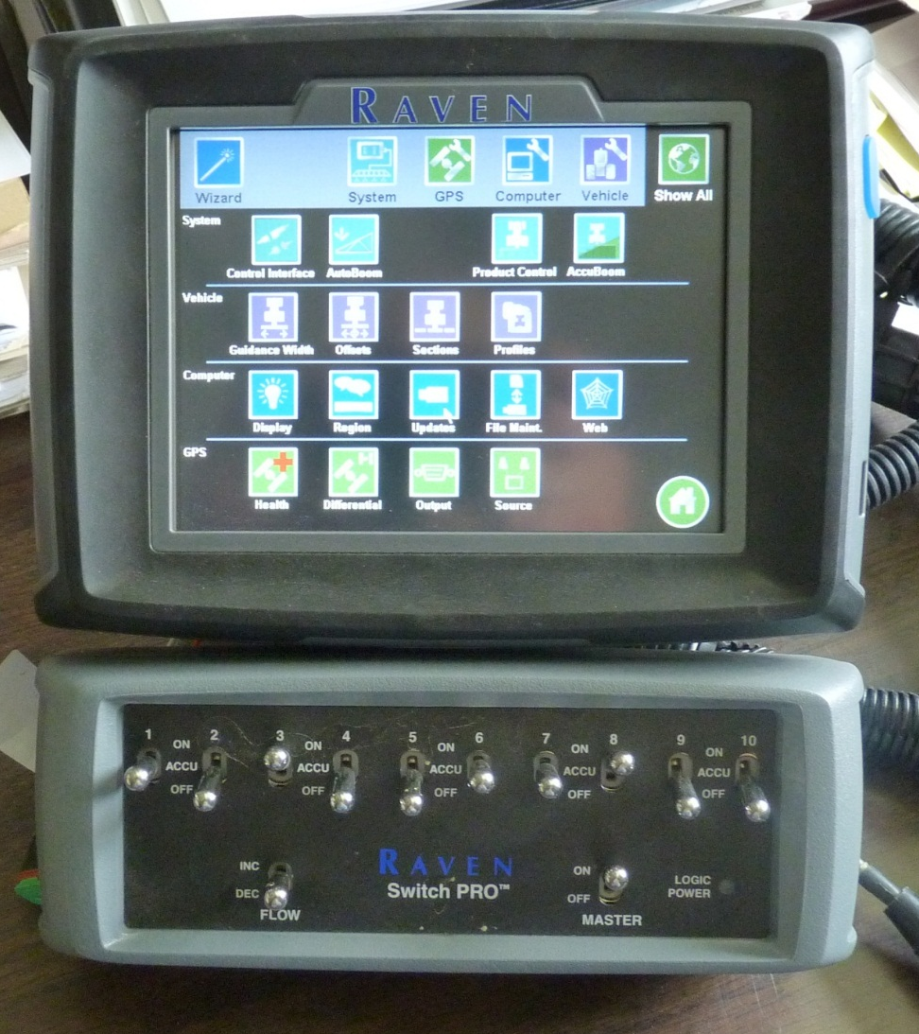
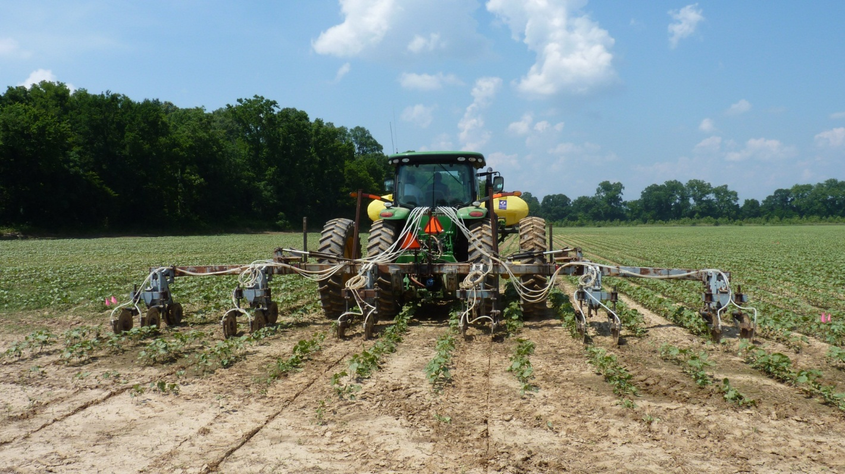
Equipment considerations

Slide 9

N-ject LF, Capstan Ag

Slide 10
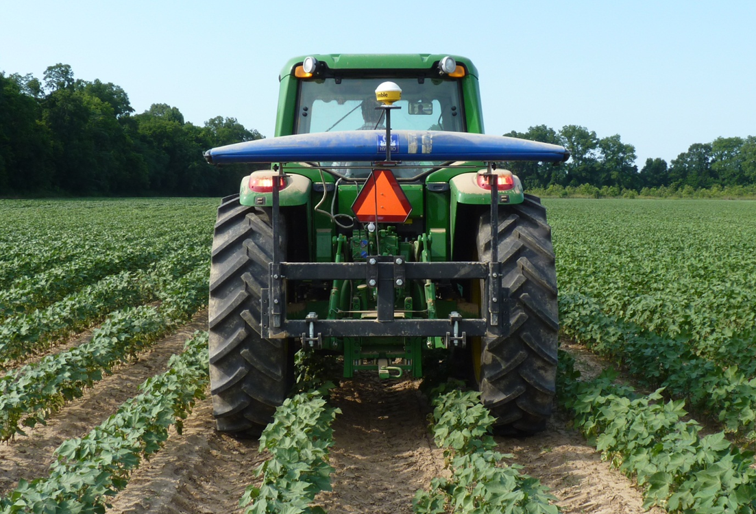
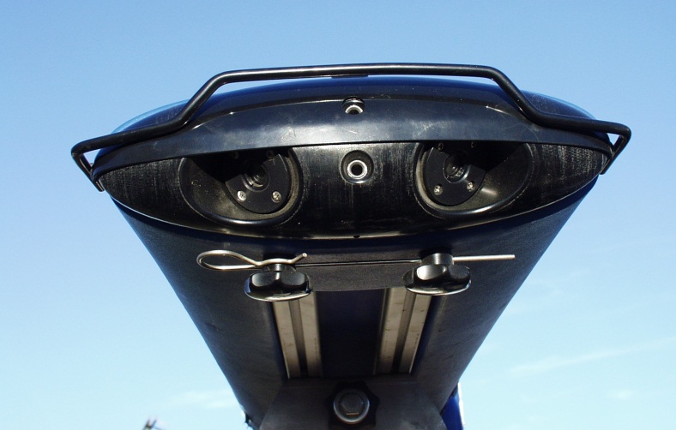
Canopy Reflectance Acquisition
Tractor mounted spectrometer
YARA, passive sensor
Wavelength Channels: 20, user selectable
Wavelength range: 450-900 nm
Optical inputs: 4 reflectance, 1 irradiance
Acquisition interval: 1 second
Area scanned: 50-100 m²/s
Positioning Data: Trimble Pro XR
Speed: 4.0 mph

Slide 11
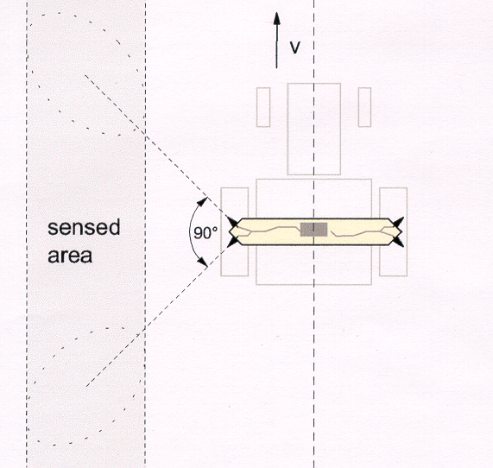
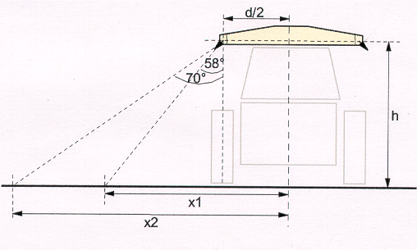
Viewing Geometry
Positioning of optical inputs as viewed from overhead and from behind.
Source: YARA (Hydro Agri), tec5Hellma

Slide 12
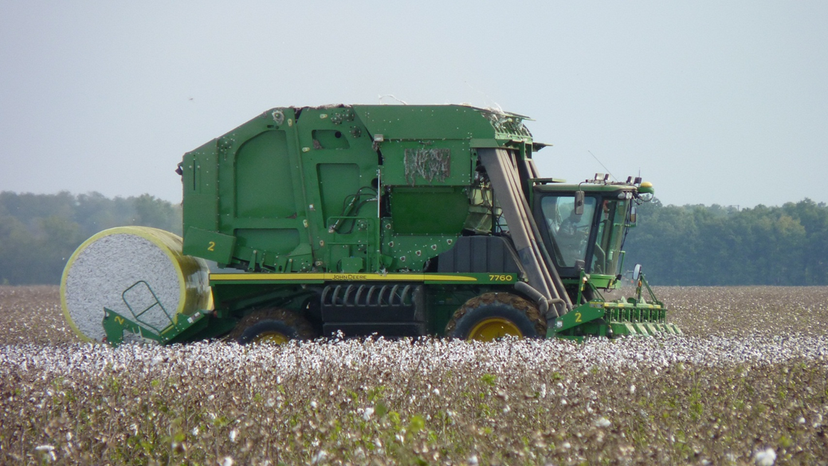
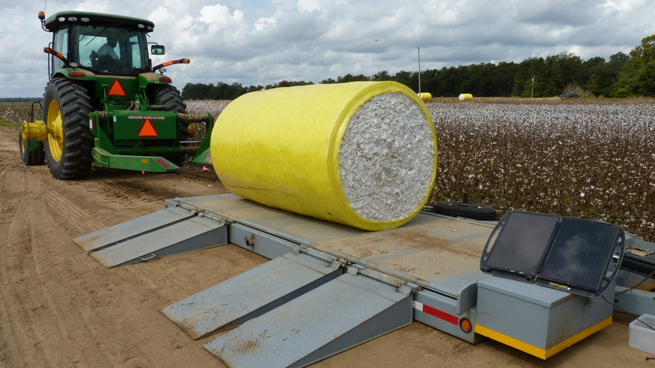
2012 and 2013 weighed modules from harvested strips
2014 Yield extracted from yield monitor

Slide 13
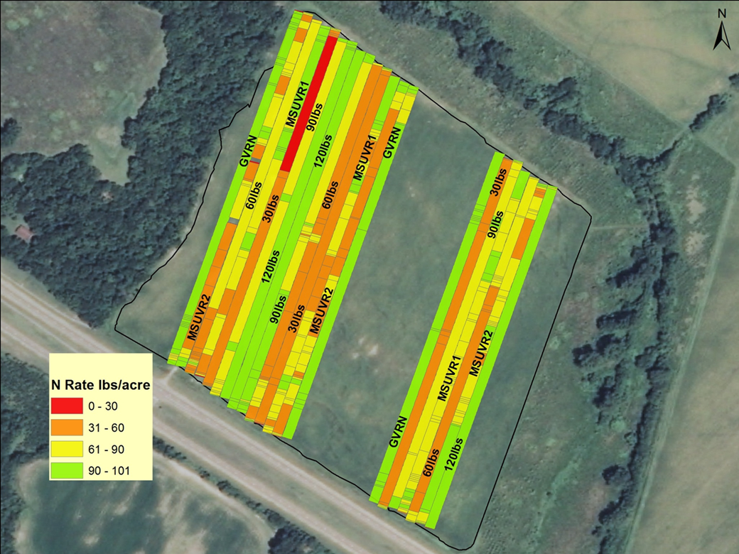
Results:
Natchez, 2011

Slide 14
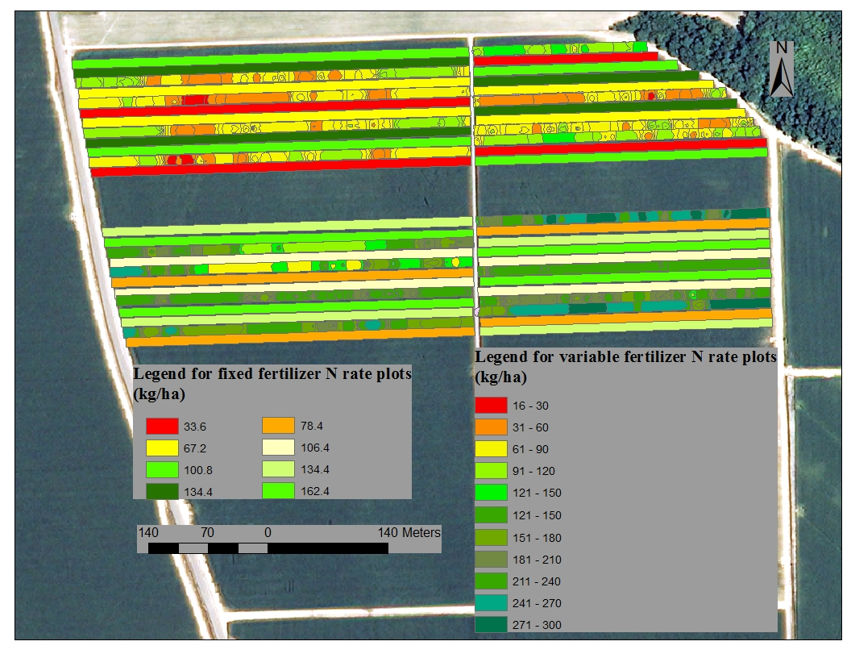
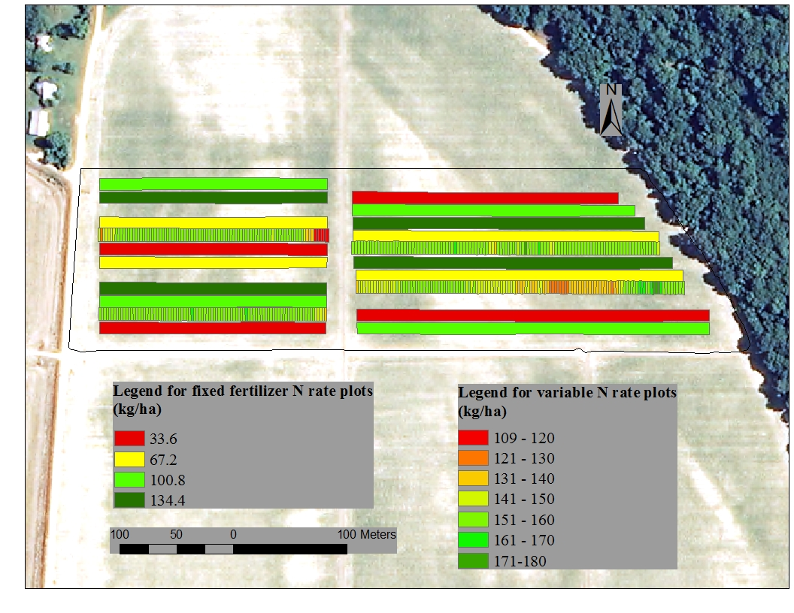
Highlander, 2013
Money, 2014

Slide 15
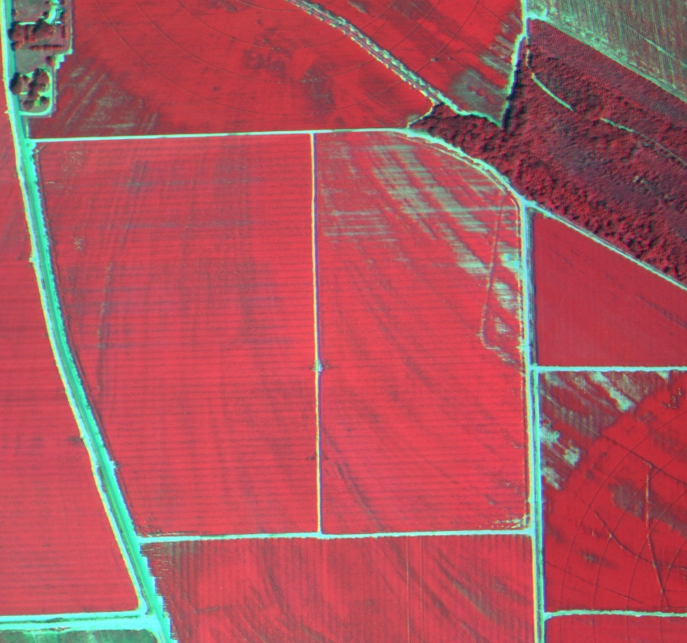
2013 Highlander North and South

Slide 16
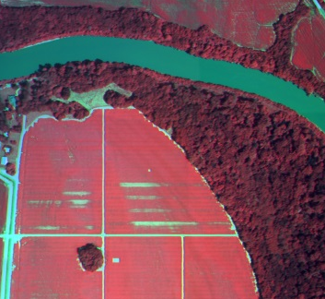
2014 Money

Slide 17
Leaf Tissue N %, 2012 Natchez
N Treatment, kg ha⁻¹ | 2nd week squaring 6/6/12 | Early Bloom 6/20/12 | Peak Bloom 7/17/12
33.7 | 4.08 | 4.52 | 3.64
67.4 | 4.45 | 4.90 | 4.01
101.1 | 4.50 | 5.05 | 3.95
134.8 | 4.52 | 5.02 | 4.08
GVRN/109.3 | 4.71 | 5.14 | 4.14
VR1/85.6 | 4.49 | 4.99 | 4.02
VR2/75.0 | 4.60 | 4.98 | 4.06
LSD_{(0.05)} | 0.48 | 0.34 | 0.17

Slide 18
Leaf Tissue N %, 2013 Highlander, North
N Treatment, kg ha⁻¹ | Early Square 6/27/13 | Early Bloom 7/15/13 | Peak Bloom 7/29/13
33.7 | 5.06 | 3.90 | 3.86
67.4 | 4.89 | 4.16 | 4.38
101.1 | 5.35 | 4.07 | 4.42
134.8 | 5.34 | 4.23 | 4.65
VR1/103.4 | 5.11 | 4.06 | 4.90
VR2/120.0 | 5.13 | 4.12 | 4.93
LSD_{(0.05)} | 0.18 | 0.29 | 0.22

Slide 19
Leaf Tissue N %, 2013 Highlander South
N Treatment, kg ha⁻¹ | Early Square 6/27/13 | Early Bloom 7/15/13 | Peak Bloom 7/29/13
78.6 | 4.58 | 4.43 | 4.61
106.7 | 4.61 | 4.55 | 5.00
134.7 | 4.56 | 4.59 | 5.09
162.7 | 4.63 | 4.56 | 5.20
VR1/145.6 | 4.63 | 4.58 | 5.46
VR2/147.8 | 4.62 | 4.41 | 5.37
LSD_{(0.05)} | 0.13 | 0.25 | 0.26

Slide 20
Leaf Tissue N %, 2014 Money
N Treatment, kg ha⁻¹ | Early Square 6/17/14 | Early Bloom 7/11/14 | Peak Bloom 8/04/14
33.7 | 2.34 | 3.57 | 3.10
67.4 | 2.54 | 4.18 | 3.42
101.1 | 2.70 | 4.72 | 3.70
134.8 | 2.84 | 4.84 | 4.14
VR1/150 | 2.51 | 4.93 | 4.29
LSD_{(0.05)} | 0.45 | 0.15 | 0.14

Slide 21
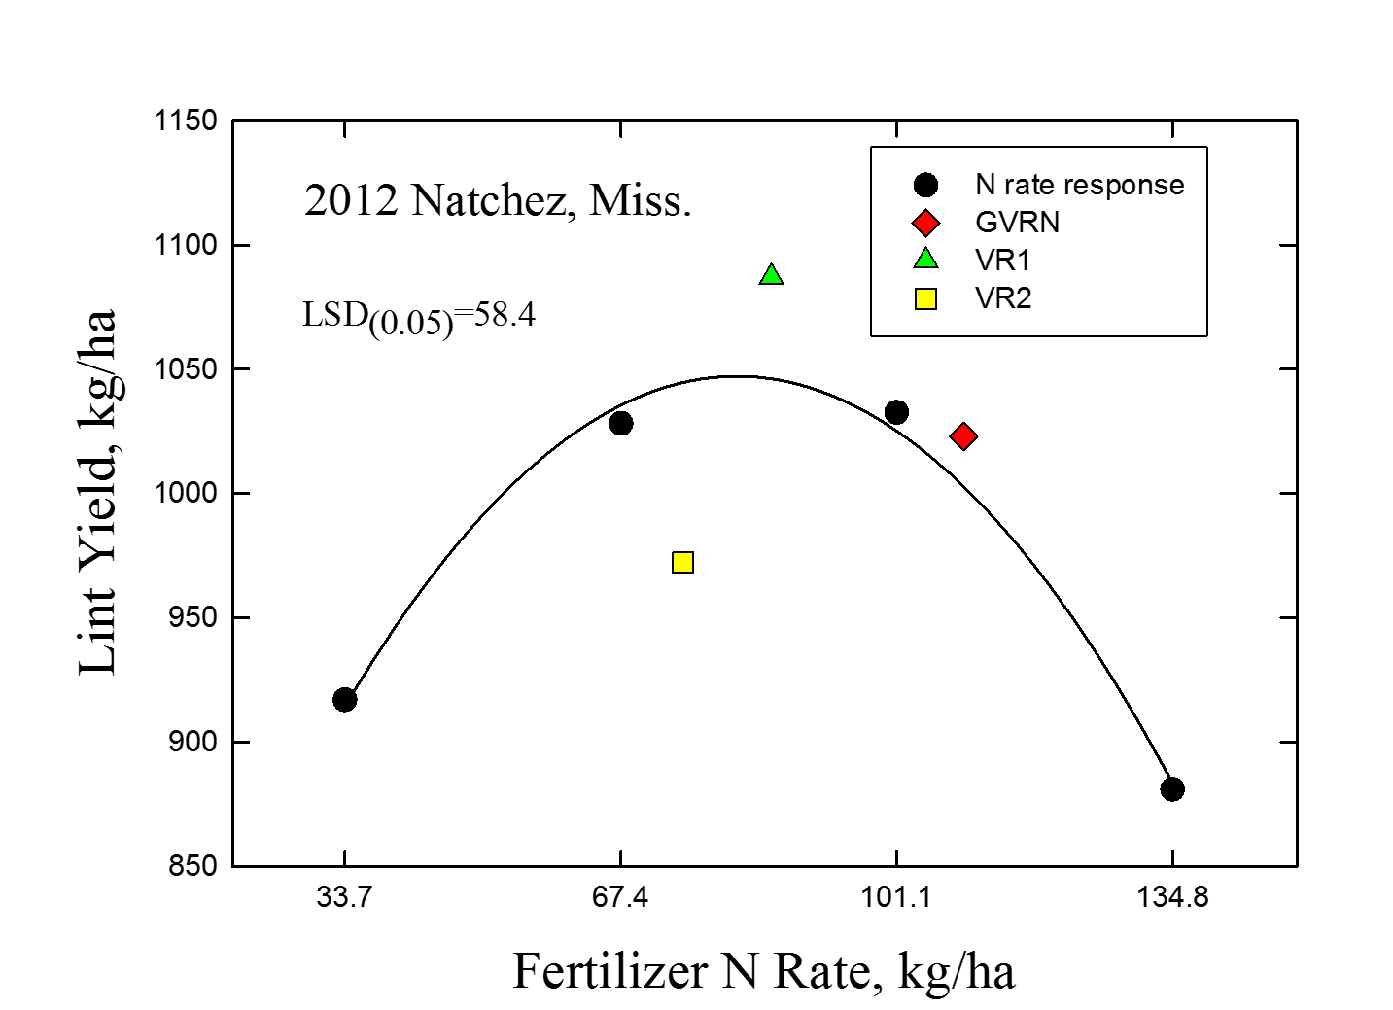

Slide 25
NUE- g Lint/kg N applied
N Treatment, kg ha⁻¹ | Natchez 2012 | Highlander North 2013 | Highlander South 2013 | Money 2014
33.7/78.6 | 30.2 | 43.2 | 22.4 | 35.3
67.4/106.7 | 15.3 | 23.6 | 17.2 | 20.6
101.1/134.7 | 10.2 | 16.9 | 14.1 | 15.9
134.8/162.7 | 6.5 | 13.1 | 11.7 | 12.9
GVRN | 9.4 | N/A | N/A | N/A
VR1 | 12.7 | 16.9 | 13.8 | 11.9
VR2 | 13.0 | 14.3 | 13.2 | N/A

Slide 26
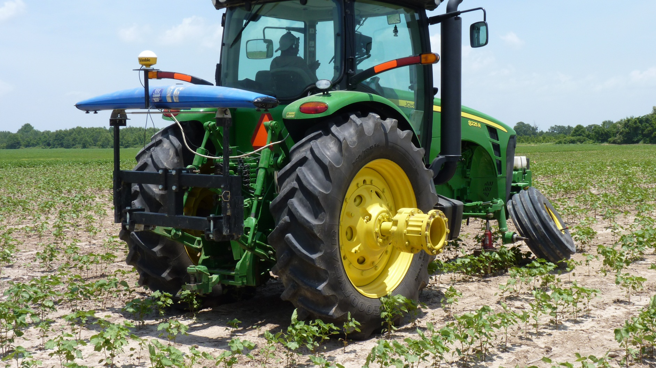
Advanced technologies vs. old

Slide 27
On-Farm Observations:
Producers want N on early as possible
Equipment and capabilities vary
Producers prefer average N rate to be close to theirs

Slide 28
Conclusions:
Sensor based fertilization displayed sensitivity to different environments resulting in < N, >yield; < N, = yield; > N, = yield
Divergence in yield from constant N rate response trend suggests improvement in matching demand through spatial distribution.
Based on economics alone, all sensor based VRN results were more profitable
Spatial N fertilization based on a tissue N/chlorophyll sensitive VI has the potential to increase or equal NUE of farmer based fertilization.

Slide 29

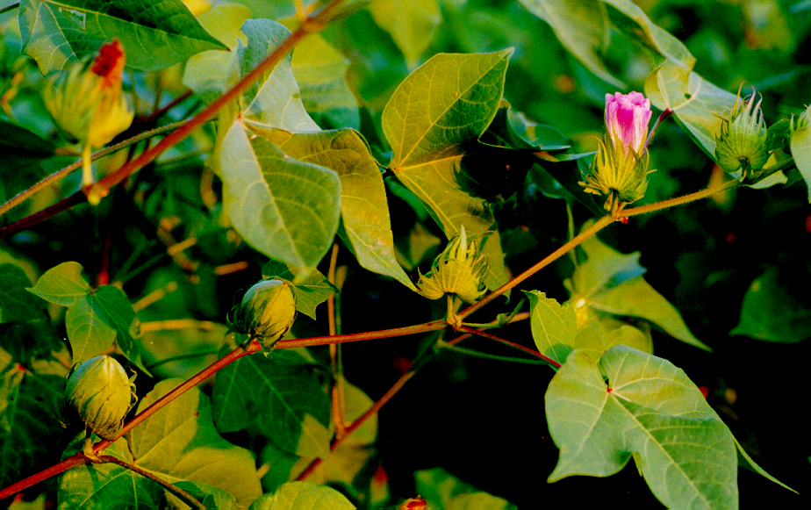
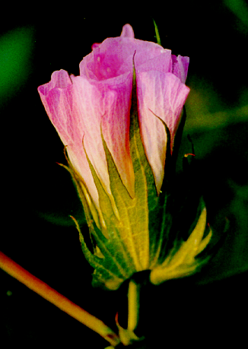
Questions/Comments?

