Slide 1
Optimizing Nitrogen and Irrigation Timing for Corn Fertigation Applications Using Remote Sensing
Ray Asebedo, David Mengel, and Randall Nelson
Kansas State University
Manhattan, KS

Slide 2
Objectives
Measure the impact of the relationship between irrigation timing, N rate, and timing of N application with corn grain yield
Evaluate the potential for developing algorithms designed for fertigation systems

Slide 3
Experimental Design
Research plots 10’x40’
Randomized complete block design
Four replications
Two irrigated sites at KSU experiment fields
One flood irrigation site with farmer cooperation in 2012 only

Slide 4
Treatment Protocol, 2012
Treatment | N Source | Starter N | Pre-Plant N | In-Season N Rate | Total N Rate
1 | Urea | 20 | 80 | 0 | 100
2 | Urea | 20 | 160 | 0 | 180
3 | Urea | 20 | 250 | 0 | 270
4 | UAN | 20 | 40 | 40 V4 | 100
5 | UAN | 20 | 80 | 80 V4 | 180
6 | UAN | 20 | 125 | 125 V4 | 270
7 | UAN | 20 | 40 | Sensor | 60+Sensor
8 | UAN | 20 | 80 | Sensor | 100+Sensor
9 | UAN | 20 | 125 | Sensor | 145+Sensor
10 | Check | 20 | N/A | N/A | N/A

Slide 5
Treatment Protocol, 2013-14 Total N Rate Reduced
Treatment | N Source | Starter N | Pre-Plant N | In-Season N Rate | Total N Rate
1 | Urea | 20 | 60 | 0 | 80
2 | Urea | 20 | 120 | 0 | 140
3 | Urea | 20 | 180 | 0 | 200
4 | UAN | 20 | 30 | 30 V4 | 80
5 | UAN | 20 | 60 | 60 V4 | 140
6 | UAN | 20 | 90 | 90 V4 | 200
7 | UAN | 20 | 40 | Sensor | 60+Sensor
8 | UAN | 20 | 80 | Sensor | 100+Sensor
9 | UAN | 20 | 120 | Sensor | 140+Sensor
10 | Check | 20 | N/A | N/A | N/A

Slide 6
Sampling Methods
0-6” and 0-24” soil samples prior to planting
Irrigation scheduling made with KanSched2
Canopy reflectance measured at multiple growth stages
Optical Sensor utilized, Trimble Greenseeker
V-10 and R-1
Tucker and Mengel(2010) algorithm utilized for sensor based N recommendations
Harvested with plot combine at KSU Experiment fields. Hand harvested at farmer fields
Combine harvest area, 5’x40’
Hand harvest area, 5’x17.5’

Slide 7
Site Information, Scandia Station
Year | 2012 | 2013 | 2014
Soil Type | Crete silt loam | Crete silt loam | Crete silt loam
Previous Crop | Soybeans | Soybeans | Soybeans
Tillage Practice | Ridge Till | Ridge Till | Ridge Till
Corn Hybrid | NA | NA | Pioneer P1602
Plant Population (plants/ac) | 30000 | 29500 | 33500
Irrigation Type | Lateral | Lateral | Lateral
Planting Date | 4/27/2012 | 5/16/2013 | 5/5/2014
Second Treatment V-4 | 6/4/2012 | 6/19/2013 | 6/19/2014
Third Treatment V-8 through V-10 | 6/14/2012 | 7/3/2013 | NA
Last Treatment V-16 through R-1 | 6/28/2012 | NA | 8/4/2014
Harvest Date | 10/24/2012 | 11/1/2013 | 11/11/2014

Slide 8
Site Information, Scandia Site 2
Year | 2012
Soil Type | Carr Fine Sandy loam
Previous Crop | Soybeans
Tillage Practice | Ridge Till
Corn Hybrid | NA
Plant Population (plants/ac) | 32000
Irrigation Type | Flood
Planting Date | 4/27/2012
Second Treatment V-4 | 6/4/2012
Third Treatment V-8 | 6/14/2012
Last Treatment V-16 | 6/26/2012
Harvest Date | 9/25/2012

Slide 9
Site Information, Rossville Station
Year | 2013 | 2014
Soil Type | Eudora sandy loam | Eudora sandy loam
Previous Crop | Soybeans | Soybeans
Tillage Practice | Conventional | Conventional
Corn Hybrid | Pioneer 0876 | Producers Hybrid 7224 VT3
Plant Population (plants/ac) | 32000 | 32000
Irrigation | Lateral | Lateral
Planting Date | 4/29/2013 | 4/23/2014
Second Treatment V-4 | 6/3/2013 | 6/6/2014
Third Treatment V-10 | 6/25/2013 | NA
Last Treatment V-16 through R-1 | NA | 7/8/2014
Harvest Date | 9/23/2013 | 9/17/2014

Slide 10
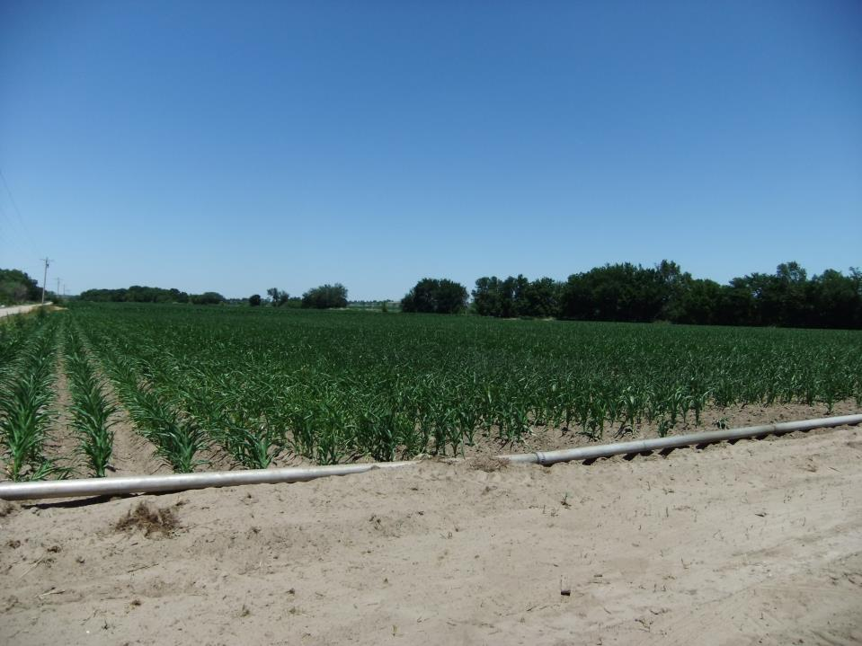
Results: By Site and By Year

Slide 11
2012, Scandia Site 2 Farmer Cooperative Field
Treatment | Timing Method | Starter N (lb/a) | Preplant N (lb/a) | In-Season N (lb/a) | Total N Applied (lb/a) | Yield (bu/a) | LSD Grouping
4 | Pre-plant/V4 | 20 | 40 | 40 | 100 | 209 | A
9 | Pre-plant/Sensor | 20 | 125 | 30 | 175 | 209 | ABC
1 | Pre-plant | 20 | 60 | 0 | 80 | 203 | ABC
2 | Pre-plant | 20 | 140 | 0 | 160 | 201 | ABC
3 | Pre-plant | 20 | 230 | 0 | 250 | 199 | ABC
7 | Pre-plant/Sensor | 20 | 40 | 94 | 154 | 199 | ABC
8 | Pre-plant/Sensor | 20 | 80 | 86 | 186 | 198 | ABC
5 | Pre-plant/V4 | 20 | 80 | 80 | 180 | 197 | BC
6 | Pre-plant/V4 | 20 | 105 | 105 | 230 | 193 | C
10 | Check | 20 | 0 | 0 | 20 | 193 | C
 |  |  | Treatments with same letter are not statistically different at an 0.05 alpha

Slide 12
2012, Scandia Site 2 Farmer Cooperative Field

Slide 13
2012, Scandia Site 2 Farmer Cooperative Field
Approximately 60 pounds of N per acre was applied through the irrigation water
Low response to applied N
Site not utilized after 2012 due to high NO3-N in irrigation water
Sensor treatments over applied N

Slide 14
2012, Scandia Station
Treatment | Timing Method | Starter N (lb/a) | Preplant N (lb/a) | In-Season N (lb/a) | Total N Applied (lb/a) | Yield (bu/a) | LSD Grouping
6 | Preplant/V4 | 20 | 105 | 105 | 230 | 188 | A
5 | Preplant/V4 | 20 | 80 | 80 | 180 | 187 | A
3 | Preplant | 20 | 230 | 0 | 250 | 185 | A
9 | Preplant/Sensor | 20 | 125 | 86 | 231 | 185 | A
8 | Preplant/Sensor | 20 | 80 | 44 | 144 | 173 | B
2 | Preplant | 20 | 140 | 0 | 160 | 166 | BC
7 | Preplant/Sensor | 20 | 40 | 91 | 151 | 166 | BC
1 | Preplant | 20 | 60 | 0 | 80 | 156 | C
4 | Preplant/V4 | 20 | 40 | 40 | 100 | 138 | D
10 | Check | 20 | 0 | 0 | 20 | 119 | E
 |  |  | Treatments with same letter are not statistically different at an 0.05 alpha

Slide 15
2012, Scandia Station

Slide 16
2012, Scandia Station
Split N applications Preplant/V-4 achieved highest yield 187 bu/ac at 180 lbs N/ac
Preplant treatment required 230 lb N/ac to be statistically equal to highest yielding Split treatments
Sensor treatment with 125 lb N/ac at Preplant was able achieve high yield but overestimated N need to attain it

Slide 17
2013, Scandia Station
Treatment | Timing Method | Starter N (lb/a) | Preplant N (lb/a) | In-Season N (lb/a) | Total N Applied (lb/a) | Yield (bu/a) | LSD Grouping
5 | Preplant/V4 | 20 | 60 | 60 | 140 | 179 | A
8 | Pre-plant/Sensor | 20 | 80 | 87 | 187 | 177 | AB
4 | Preplant/V4 | 20 | 30 | 30 | 80 | 176 | AB
3 | Pre-plant | 20 | 180 | 0 | 200 | 173 | AB
6 | Preplant/V4 | 20 | 90 | 90 | 200 | 172 | AB
7 | Pre-plant/Sensor | 20 | 40 | 123 | 183 | 172 | AB
2 | Pre-plant | 20 | 120 | 0 | 140 | 170 | AB
9 | Pre-plant/Sensor | 20 | 120 | 133 | 273 | 169 | AB
1 | Pre-plant | 20 | 60 | 0 | 80 | 167 | B
10 | Check | 20 | 0 | 0 | 20 | 149 | C
 |  |  | Treatments with same letter are not statistically different at an 0.05 alpha

Slide 18
2013, Scandia Station

Slide 19
2013, Scandia Station
Overall yields were lower than expected at 179 bu/ac. Expected yields were 250 bu/ac. Likely due to late planting
Low response to applied N
Primary response was to total N rate
Conditions were conducive for mineralization of N
Sensor treatments achieved highest yield group but overestimated the N requirements

Slide 20
2013, Rossville Station
Treatment | Timing Method | Starter N (lb/a) | Preplant N (lb/a) | In-Season N (lb/a) | Total N Applied (lb/a) | Yield (bu/a) | LSD Grouping
8 | Pre-plant/Sensor | 0 | 80 | 144 | 224 | 148 | A
7 | Pre-plant/Sensor | 0 | 40 | 212 | 252 | 148 | A
9 | Pre-plant/Sensor | 0 | 120 | 149 | 269 | 144 | AB
6 | Preplant/V4 | 0 | 90 | 90 | 180 | 139 | AB
5 | Preplant/V4 | 0 | 60 | 60 | 120 | 135 | ABC
2 | Pre-plant | 0 | 120 | 0 | 120 | 127 | ABC
3 | Pre-plant | 0 | 180 | 0 | 180 | 123 | BC
4 | Preplant/V4 | 0 | 30 | 30 | 60 | 116 | CD
1 | Pre-plant | 0 | 60 | 0 | 60 | 96 | D
10 | Check | 0 | 0 | 0 | 0 | 70 | E
 |  |  | Treatments with same letter are not statistically different at an 0.05 alpha

Slide 21
2013, Rossville Station

Slide 22
2013, Rossville Station
Significant response to applied N
Soil is a deep sandy loam and incurred frequent leaching events, lowering overall yield ranging from 70-148 bu/ac
Sensor treatments generated the highest yields but only statistically different from lower rate preplant treatments
Results indicate fertigation systems may need to make frequent low rate N applications to satisfy N demand despite water requirements being met or exceeded

Slide 23
2014, Rossville Station
Treatment | Timing Method | Starter N (lb/a) | Preplant N (lb/a) | In-Season N (lb/a) | Total N Applied (lb/a) | Yield (bu/a) | LSD Grouping
2 | Pre-plant | 0 | 120 | 0 | 120 | 257 | A
6 | Preplant/V4 | 0 | 90 | 90 | 180 | 254 | AB
5 | Preplant/V4 | 0 | 60 | 60 | 120 | 248 | ABC
3 | Pre-plant | 0 | 180 | 0 | 180 | 248 | ABC
1 | Pre-plant | 0 | 60 | 0 | 60 | 239 | ABC
7 | Pre-plant/Sensor | 0 | 40 | 15 | 55 | 237 | ABC
9 | Pre-plant/Sensor | 0 | 120 | 0 | 120 | 228 | BC
4 | Preplant/V4 | 0 | 30 | 30 | 60 | 225 | C
8 | Pre-plant/Sensor | 0 | 80 | 0 | 80 | 223 | C
10 | Check | 0 | 0 | 0 | 0 | 186 | D
 |  |  | Treatments with same letter are not statistically different at an 0.05 alpha

Slide 24
2014, Rossville Station

Slide 25
2014, Rossville Station
Excellent yields and significant response to N
Clay lense at 24” to 36” depths held up water in the rooting zone, preventing leaching losses. As a result much higher yields were obtained compared to the 2013 Rossville site 186-257 bu/ac
Sensor treatments were effective at finding 90% economic optimum, achieving 237 bu/ac from 55 lb of applied N/ac

Slide 26
2014, Scandia Station
Treatment | Timing Method | Starter N (lb/a) | Preplant N (lb/a) | In-Season N (lb/a) | Total N Applied (lb/a) | Yield (bu/a) | LSD Grouping
6 | Preplant/V4 | 0 | 90 | 90 | 180 | 239 | A
3 | Pre-plant | 0 | 180 | 0 | 180 | 232 | AB
9 | Pre-plant/Sensor | 0 | 120 | 30 | 150 | 231 | AB
7 | Pre-plant/Sensor | 0 | 40 | 120 | 160 | 229 | AB
2 | Pre-plant | 0 | 120 | 0 | 120 | 223 | B
8 | Pre-plant/Sensor | 0 | 80 | 60 | 140 | 223 | B
5 | Preplant/V4 | 0 | 60 | 60 | 120 | 218 | BC
1 | Pre-plant | 0 | 60 | 0 | 60 | 204 | C
4 | Preplant/V4 | 0 | 30 | 30 | 60 | 189 | D
10 | Check | 0 | 0 | 0 | 0 | 163 | E
 |  |  | Treatments with same letter are not statistically different at an 0.05 alpha

Slide 27
2014, Scandia Station

Slide 28
2014, Scandia Station
Excellent yields 163-239 bu/ac and significant response to applied N
Low N loss
Conducive conditions for mineralized N, resulting in high productivity, 163 bu/ac check
Sensor treatments were effective at determining the optimum N rate (150 lb N/ac) and achieve high yield 231 bu/ac

Slide 29
Potential for Fertigation and Remote Sensing
Would be able to conduct crop monitoring throughout the growing season, thus presenting the possibility to determine the optimize N rate and timing for any given soil and year (weather)
Sensor algorithms must be specifically designed for fertigation systems
Fertigation systems may need to apply N when water requirements have been met or exceeded

Slide 30
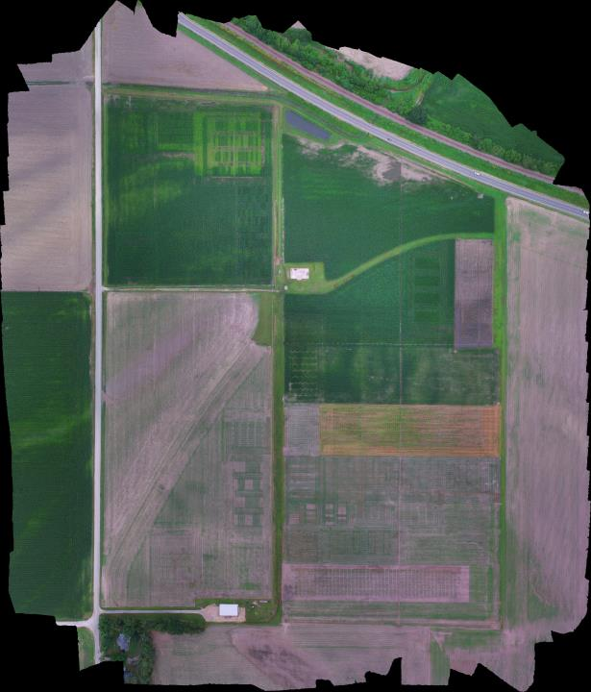
2015
So Far

Slide 31
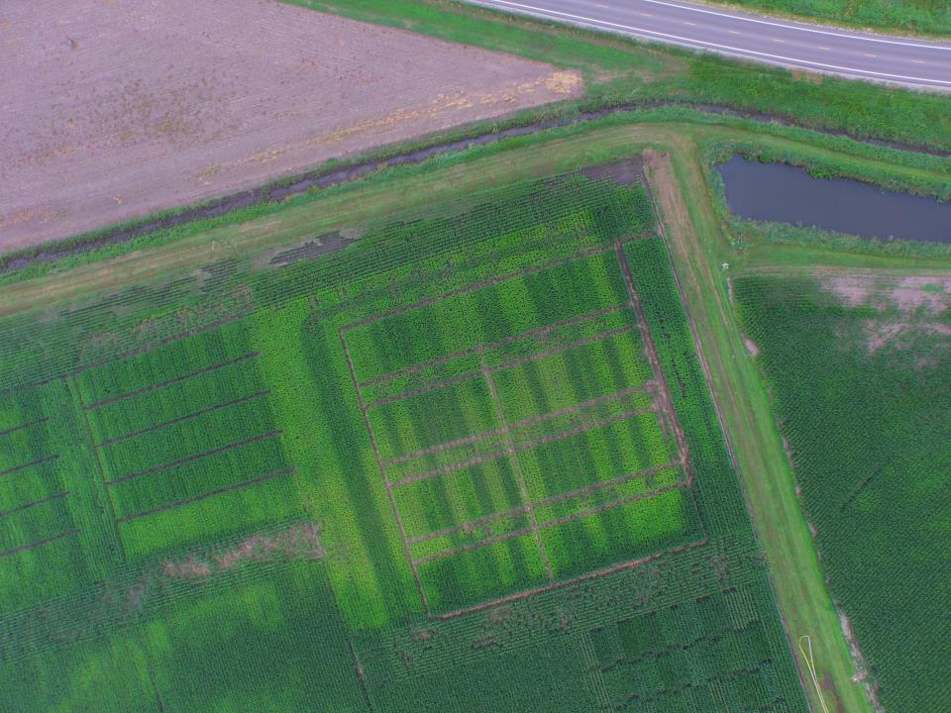

Slide 33
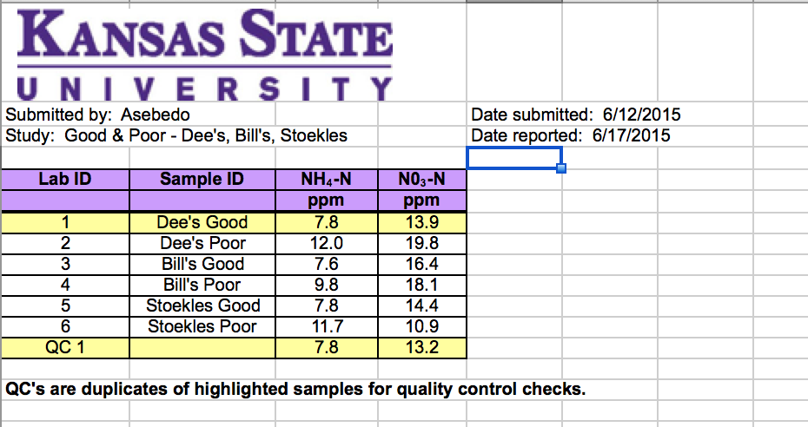
But… Heavy rain created anaerobic conditions Most fields did not need additional N

Slide 34
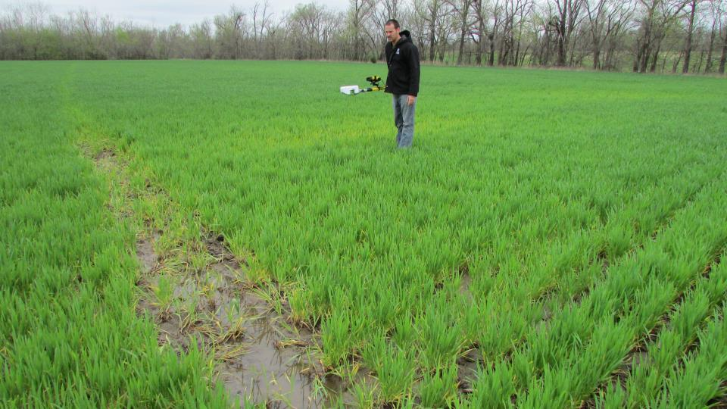
Questions

