Slide 1


Maize Nutrient Accumulation and Partitioning in Response Planting Density and Nitrogen Rate
Ignacio A. Ciampitti, Cropping Systems Specialist
K-State Research & Extension
ciampitti@ksu.edu, 785-410-9354
@KSUCROPS (TWITTER)

Slide 2
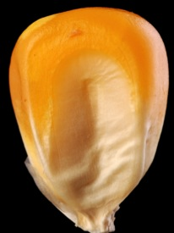
Unraveling the Physiological Puzzle of Maize Yield Formation and Plant Nutrient Uptake Processes
Total Plant
BM
Nutrient Uptake
NutrientHI
Grain Nutrient Uptake=
GY * %Nug
Grain HI
Source: CYMMIT
© IA Ciampitti, K-State Univ

Slide 3
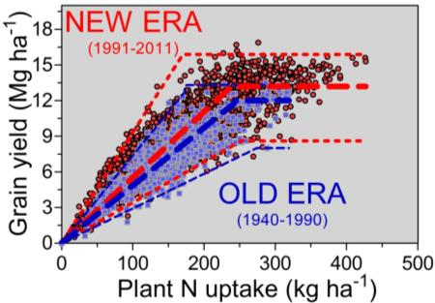
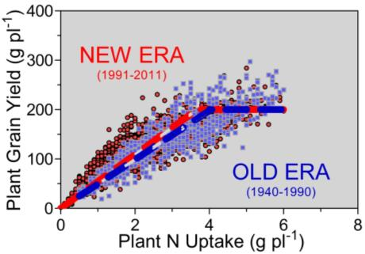
Gap #1: Relationship between Yield and N uptake
Review Paper: 100 reports (~3000 treatment means)
Hybrid Era (1940-1990 vs. 1991-2011)
Community-Level
Plant-Level
Ciampitti and Vyn (2012, Review Paper, Field Crops Research 133, 48-67)
© IA Ciampitti, K-State Univ

Slide 4
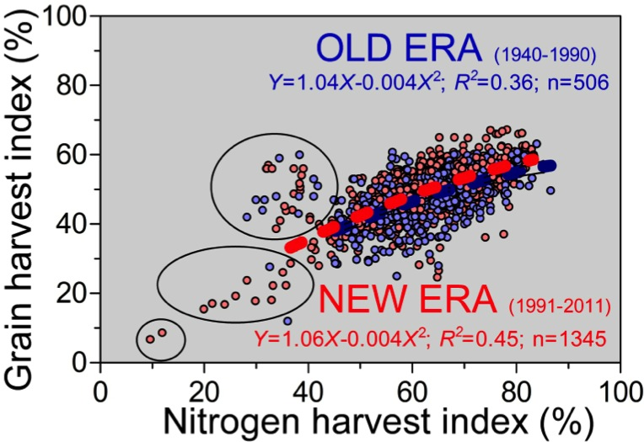
Gap #2: Dry Matter and N Partitioning at Maturity
Review Paper: Hybrid Era (1940-1990 vs. 1991-2011)
Ciampitti and Vyn (2012, Review Paper, Field Crops Research 133, 48-67)
© IA Ciampitti, K-State Univ

Slide 5
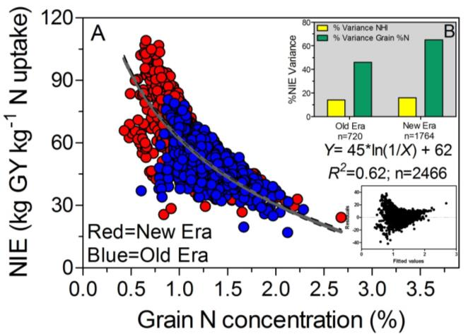
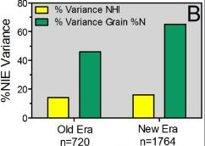
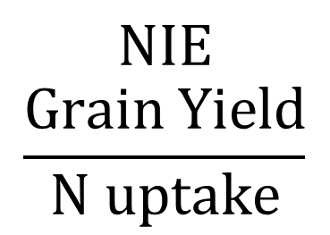
Gap #3: Effect on NIE and Grain N Concentration
Review Paper: Hybrid Era (1940-1990 vs. 1991-2011)
$$NIE$$
$$\frac{Grain \text{Yield}}{N \text{uptake}}$$
Ciampitti and Vyn (2012, Review Paper, Field Crops Research 133, 48-67)
© IA Ciampitti, K-State Univ

Slide 6
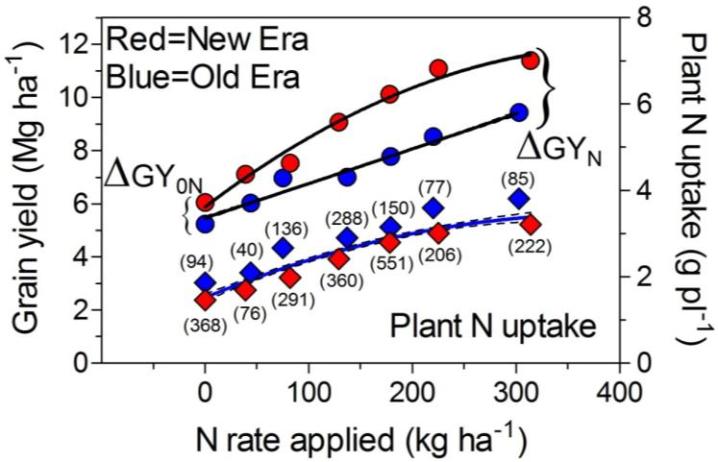
Gap #4: Yield and Plant N Uptake versus N rate
Review Paper: Hybrid Era (1940-1990 vs. 1991-2011)
~2
Mg ha⁻¹
~1
Mg ha⁻¹
Ciampitti and Vyn (2012, Review Paper, Field Crops Research 133, 48-67)
© IA Ciampitti, K-State Univ
Notes:
Last point of plant N uptake is 3.8 for New versus 3.2 for Old Era, but the slope (model) is equivalent for both Eras.

Slide 7
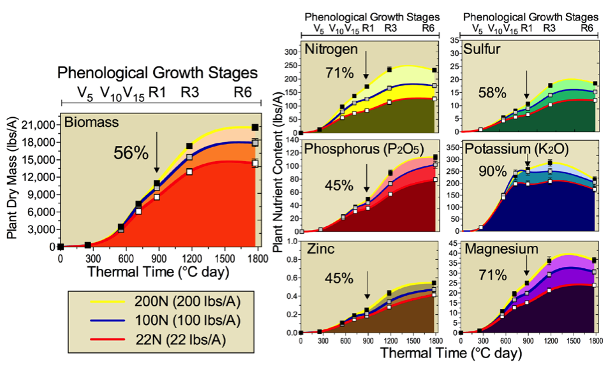
FIELD RESEARCH: NUTRIENT UPTAKE in CORN
Ciampitti and Vyn (2014, Field Research, Crop Management Journal 1-7)
© IA Ciampitti, K-State Univ

Slide 8
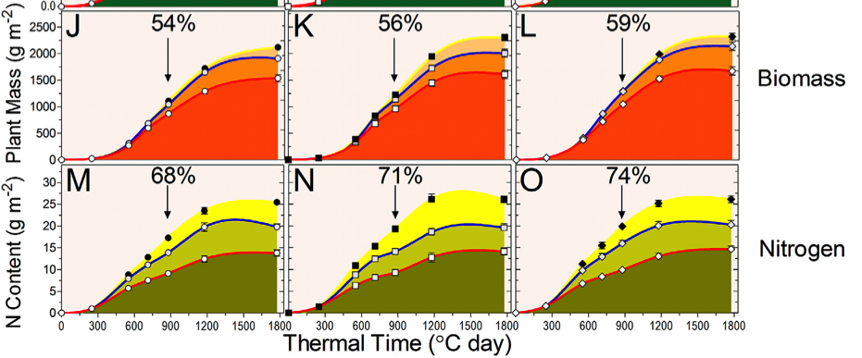
Plant Growth and Nutrient Uptake
(Grain Yield = 210 bu/acre)
“Biomass and Nitrogen”
>50% of the total biomass was accumulated at flowering; while >65% of N was already present at the same stage.
Ciampitti and Vyn (2014, Field Research, Crop Management Journal 1-7)
© IA Ciampitti, K-State Univ

Slide 9
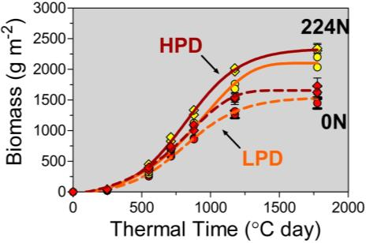
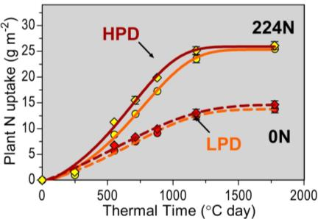
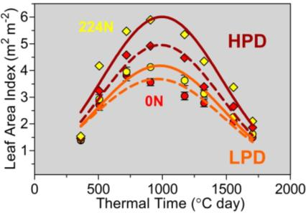
FIELD RESEARCH
Functional Physiological Framework
Plant Biomass (BM)
Plant N Uptake (PNU)
Leaf Area Index
(LAI)
Notes:
Moving from 0N to 224N, across Low and High PD, represents around ~600 g/m2 at maturity. For PNU, the difference was around 12 g m/2.

Slide 10
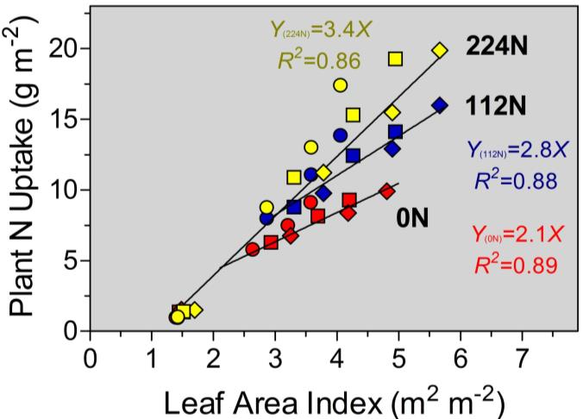
Physiological N adaptations: Vegetative Period
GAP #1: Is the N storage more affected than Leaf Expansion?
GAP #1:
At equivalent LAI,
N storage capacity is mainly reduced as the N supply was diminished, regardless density and genotypes.
Minor ∆Maximum LAI
Ciampitti et al. (2013, Vegetative NUE, Crop Science 53:2105-2119)
© IA Ciampitti, K-State Univ

Slide 11
Physiological N adaptations: Vegetative Period
GAP #2: Are the leaf and stem mass and N ratios modified?
i. Leaf to Stem Ratios at Equivalent Stage
Dry Mass Ratio (g g⁻¹)
N Uptake Ratio (g g⁻¹)
V15 Stage
R1 Stage
1.0
V15 Stage
R1 Stage
Leaf:Stem Dry Mass Ratio increased (+leaf vs. stem) as plant density increased.
Leaf:Stem N Uptake increased as plant density increased, but also as N is more deficient.
0.50
0.44
Nitrogen rate
0N 112N 224N
0N 112N 224N
1.7
PD1 PD2 PD3
PD1 PD2 PD3
PD1 PD2 PD3
PD1 PD2 PD3
Plant density
Plant density
Ciampitti et al. (2013, Vegetative NUE, Crop Science 53:2105-2119)
© IA Ciampitti, K-State Univ

Slide 12
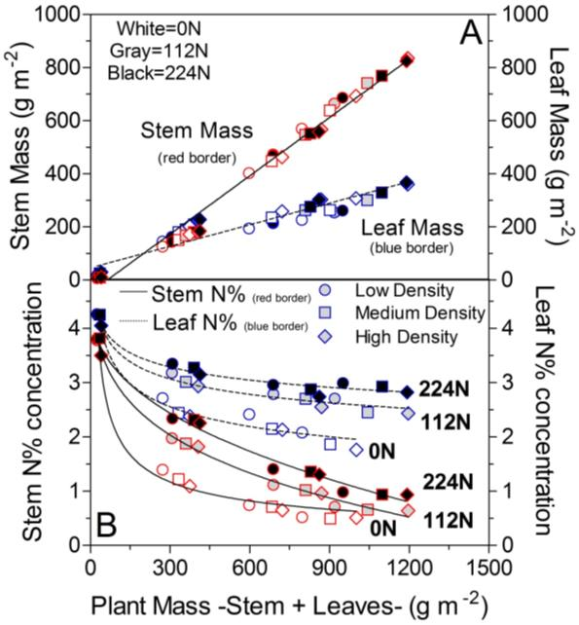
Physiological N adaptations: Vegetative Period
ii. Leaf and Stem at Comparable Mass Level
Stem Mass= 2/3 Total Plant
Leaf Mass= 1/3 Total Plant
GAP #2:
At equivalent mass, dry mass partition was not affected, but with detrimental influence over the plant %N components.
Ciampitti et al. (2013, Vegetative NUE, Crop Science 53:2105-2119)

Slide 13
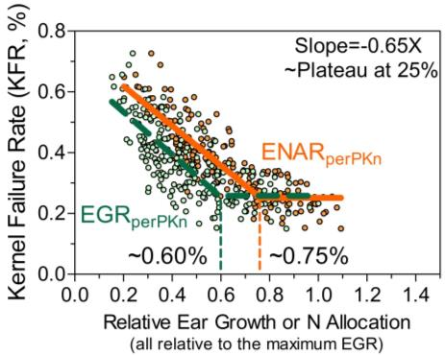
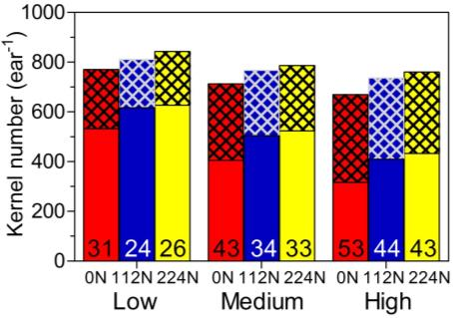
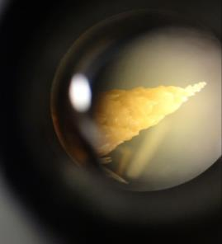
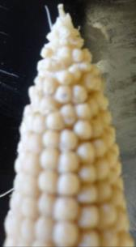
Physiological N adaptations: Reproductive Period
GAP #3: Effect over potential kernel number and failure rate?
Potential and Actual Kn
C and N Allocation
Plant Density
GAP #3: Minimum impact over PKn, large over KFR.
The KFR’s behavior is tightly related to ear C and N gains.
Ciampitti et al. (2013, Reproductive NUE, Crop Science 53:2588-2602).
© IA Ciampitti, K-State Univ

Slide 14
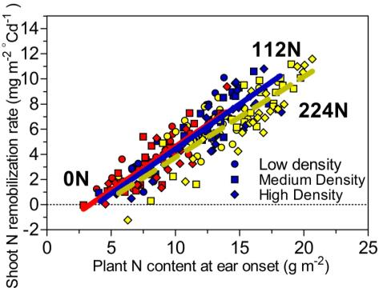
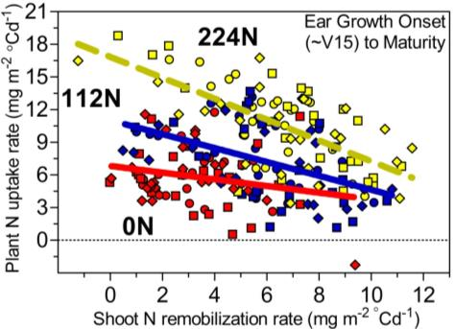
Physiological N adaptations: Reproductive Period
GAP #4: Effects over Vegetative and Reproductive N uptake versus the Reproductive Shoot N remobilization rate.
Slope ~0.70X (0-112N)
~0.64X (224N)
Intercepts ~2.3 (0N)
~2.7 (112-224N)
Slope -0.31X (0N)
-0.64X (112N)
-0.96X (224N)
Ciampitti et al. (2013, Reproductive NUE, Crop Science 53:2588-2602).
© IA Ciampitti, K-State Univ

Slide 15
NUE: Physiological explanation
Plant Biomass and Grain %N
22
NUE
(isolines)
26
Grain %N
28
30
32
Plant Biomass
Superior NUE resulted from combinations of higher GY and
lower grain %N regardless the treatment factors evaluated.
© IA Ciampitti, K-State Univ

Slide 16
General Conclusions
From the review analysis:
  i) newer hybrids presented greater tolerance to N deficiency and responsiveness as the N rate applied increased as compared to older materials
  ii) superior NUE (also NIE) for newer materials can be explained by a lowering grain %N as compared to older genotypes.
  -Under severe stresses (crowding intensity and N deficiency intensifies):
  Vegetative Period
Reproductive Period
= LAI, ↓ N uptake capacity, ↓ ↓ stem N reservoir, minor leaf %N
minor PKn, ↓ ↓ KFR, ↓ N uptake, ↑ early Shoot N Remobilization
© IA Ciampitti, K-State Univ

Slide 17
Future Paths (plant perspective)
Increase overall maize N uptake (NUE)
1- Vegetative N uptake (A- improvements in LAI by density changes or B- increasing leaf number or size)
2- Reproductive N uptake
  i) Changes in Sink Strength, Grain %N (Protein zein/glutelin)
  ii) Changes in NHI (trait stability under low N uptake levels)
  iii) Prolific hybrids with functional stay green trait
  iv) Flexible traits: to overcome the reported N uptake trade-off
  v) Study using maize landraces for natural NHI variability
© IA Ciampitti, K-State Univ

Slide 18
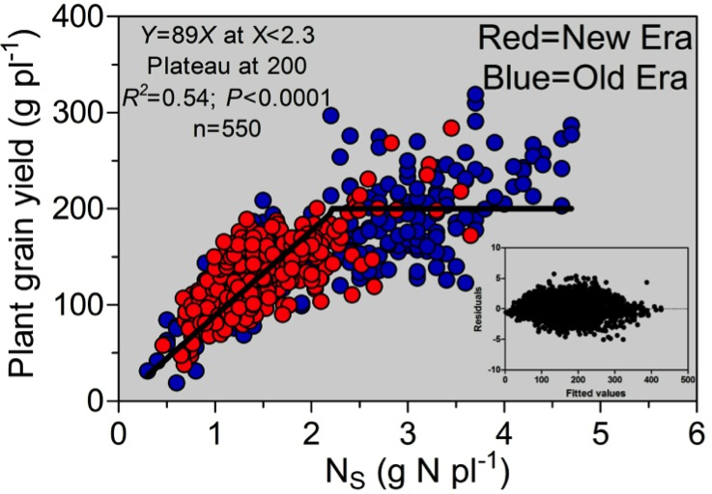
At plant-scale: Vegetative N vs. Grain Yield
Sayre, 1948
Chandler, 1960
Karlen, 1988
Prolific and Semi-Prolific Materials
Ciampitti & Vyn, 2012
Ciampitti et al., 2014
Balboa and Ciampitti, 2015
Vegetative N status was tightly related to the final per-plant grain yield achieved at maturity.
CIAMPITTI & VYN, 2012
© IA Ciampitti, K-State Univ
Notes:
Sayre (2.7 pl/m2), Chandler (2.9 pl/m2), Karlen (11 pl/m2), Ciampitti & Vyn (7.9 pl/m2), Prolific and Semi-Prolific (2.7 pl/m2)

Slide 19

In the Path of finding the solution for the Puzzle
Crop
Productivity
Total Plant
BM
Plant N Uptake
Grain HI
NHI
High N
Use Efficiency
© K-State Univ, IA Ciampitti
Dr. Ignacio Antonio Ciampitti • Assistant Professor Crop Production/ Cropping Systems • Agronomy Department • Kansas State University

Slide 20



QUESTIONS
THANKS!
Ignacio A. Ciampitti, K-State Univ
Crop Production Specialist
ciampitti@ksu.edu, 785-410-9354
@KSUCROPS
/KSUCROPS
© K-State Univ, IA Ciampitti
Dr. Ignacio Antonio Ciampitti • Assistant Professor Crop Production/ Cropping Systems • Agronomy Department • Kansas State University

Slide 21
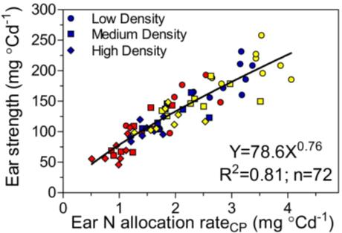
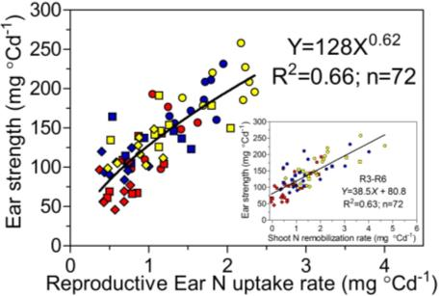



Gaps: Review
Field experiment
Results
Conclusion
Future Paths
GAP #3: ii. Is the ear strength associated with N allocation?
EAR STRENGTH= Kn * (Kw/TT_{from silking to maturity})
Kn= Kernel Number, Kw=Kernel Weight, TT= thermal time units
N allocation to the Ear
Reproductive N Uptake
High stress scenario:
0N plus HPD
High stress scenario:
0N plus HPD
Ignacio Antonio Ciampitti • Ph.D.’s Defense • June 18th, 2012

Slide 22
GAP #5: Grain Nutrient Removal Coefficients?
N-limiting factor (dilution process)
Y = 0.095 X
Non-Stress Factors, N REMOVAL
(from FITTED LINE):
 | N removal
GY, Mg ha⁻¹ | 7.5/ 15/ 20
NU, kg ha⁻¹ | 100/ 200/ 260
IF N is limiting, N REMOVAL:
 | N removal
GY, Mg ha⁻¹ | 9.5/ 19/ 25
NU, kg ha⁻¹ | 100/ 200/ 260
IF Yield is limited, N REMOVAL:
 | N removal
GY, Mg ha⁻¹ | 5.5/ 11/ 14
NU, kg ha⁻¹ | 100/ 200/ 260
Yield is limited
(accumulation process)
Y = 0.055 X
© IA Ciampitti, K-State Univ

