Slide 1
Nitrogen Losses: A Meta-analysis of 4R Nutrient Management in U.S. Corn-based Systems
Alison Eagle, Ph.D., Policy Associate
Nicholas Institute for Environmental Policy Solutions
Duke University
August 4, 2015
NUE Workshop, Auburn, AL
Notes:
NI link academic knowledge (in this case science of agricultural management) to needs of decision makers
T-AGG – review lit w/o meta wide range of agricultural land management activities with potential for GHG mitigation
Ecosystem ecologists, biogeochemists – try to think systematically about understanding N losses.

Slide 2
Policy context
GHG-N₂O
  California – nutrient management protocol
  Walmart sustainability effort
  Executive order in spring 2015 and other supply chain initiatives
Water quality impacts – NO₃
  Water quality trading – Chesapeake Bay, Ohio River…
  USDA nutrient management programs and funding
  Foundation funding
Notes:
Executive order in spring determined that federal gov’t would reduce GHG emissions by 40% within next decade.
All of these programs and policies are looking at fertilizer management as a key component of reducing N losses. But how, for example, does a water quality program determine which activities they will pay farmers to adopt? And how does a carbon offsets program decide the amount of GHG emissions reductions to credit a landowner for changing to an improved activity?
They all want to make informed decisions.

Slide 3
Outstanding Questions
How can we strategically encourage improved management practices (with limited resources)?
How are losses affected by different fertilizer management activities?
Focus on N₂O or NO₃ or BOTH?
How do these loss pathways interact AND how do they relate to yield?
And what about region, climate, etc.?
Notes:
To guide management decisions, we need a better understanding of agricultural nitrogen losses.
[--click--]
From the land-management perspective, what can be supplied? What loss reductions are possible?
[--click--]
Should we focus on N2O, NO3, or both?
[--click--]
And how do the losses interact with one another, are there tradeoffs with certain management? And how do they relate to yield?
We need to make sure that yield is either maintained or increased while reducing N losses – otherwise the problem just moves somewhere else (leakage).

Slide 4
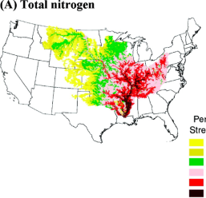
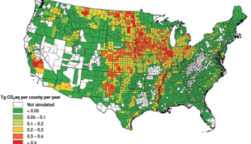
Need for Mesoscale Research
Plant
Uptake
?
Dissolved N
Nitrate
Loss
N₂O
?
Nitrous
Oxide
Loss
Test Strips
Experimental Farms
Continental Models
Notes:
Where Duke came into the picture. Saw desperate need for mesoscale research to inform policy and nutrient management strategies.
Gaps in not only magnitude of change but direction of change for some management practices, and little to no information on trade-offs or complementarities across N pathways – NO3 management leading to increases or decreases in N2O or visa versa
Policies moving forward despite this.
How can we inform more efficient and strategic use of resources?

Slide 5

Objectives
Understand the dynamics of N loss across soils and climates to improve targeting of agri-environmental policy (incentives, extension, etc.)
  Understand how key management practices affect N loss dynamics
    4Rs (right rate, right time, right source, right place)
    Other management (tillage, cover crops, etc.)
  Understand relationships between N₂O and NO₃
Notes:
This brings us to the objectives of our research. We want to advise the best management in different locations and for different types of nitrogen losses while maintaining or increasing productivity.
To do this, we need to understand N loss across different soil types and varied climates, thus helping to improve targeting of agri-environmental policy (incentives, extension, etc.).
We need to determine how management affects N losses. For fertilizer management, we use the 4R Nutrient Stewardship framework. Other management practices also play a role.
[Tying these first two items together, we may ask whether some management actions are more effective in certain soil types as compared to others?]
Finally, and very important for any policy or program design, we need to know the relationships between N2O and NO3. Are there cases where nitrate losses go up while nitrous oxide goes down or vice versa? If a practice is encouraged in order to reduce NO3, might it have unintended negative climate change impacts?
We started by finding out what information is already available… [--click--]

Slide 6
Database from the scientific literature
Focus on corn cropping systems in North America
Field data on 4R fertilizer management with N₂O emissions and/or NO₃ leaching
Recorded all available data on crop management, soil and climate characteristics
Limited analysis to corn only with crop yield measured
Notes:
We conducted a meta-analysis of data from the scientific literature. We began with a literature search for corn-based field studies of fertilizer management in North America that quantified N losses. Why corn?
In the U.S., corn takes up about one-quarter of all harvested cropland and accounts for 45% of the fertilizer N used. We chose studies that compared different fertilizer management activities. All studies also measured the crop yield as well as one or both of nitrous oxide and nitrate losses.
Many other variables were also recorded, including crop rotation, tillage, and other crop management activities, soil type and texture, and temperature and precipitation.
The database contains over 1200 observations with up to 140 variables each. Some of these are crops other than corn (in corn rotations), and some are missing important variables such as yield. In the end, from about 50 published studies, we have a database with about 400 observations for each loss pathway. Each observation reports cumulative annual (or growing season) losses at a certain site, in a given year, with a specific treatment.

Slide 7
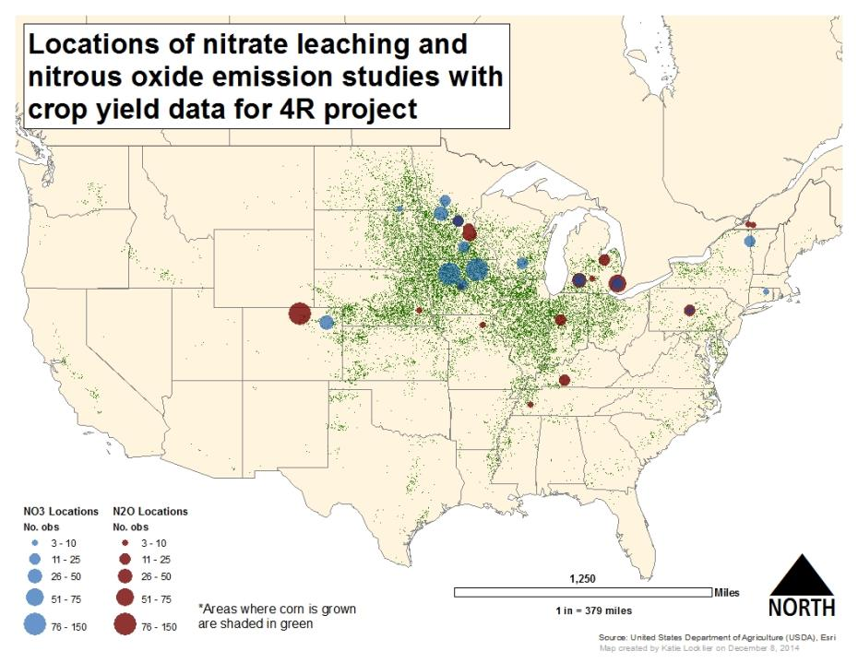
Notes:
This map is colored green where corn is grown. The blue and red dots on this map show the locations of the data, with blue representing nitrate observations and red representing nitrous oxide observations. The size of the dots corresponds to the number of observations at each location.
Near the middle of the map, you can many observations of nitrate losses in Iowa [--with pointer, circle the Iowa dots--]
And quite a few observations of nitrous oxide losses come from northern Colorado, as well as a number of locations in Minnesota, in Indiana, and in Michigan.
[--click--]
The problem is that there are many regions where corn is grown without any N loss data, AND… the studies that measured nitrous oxide tended to be very different locations from studies that measured nitrate. The blue ovals show some of the significant data gaps for nitrate,
[--click--]
and the red ovals where there are significant nitrous oxide gaps.
For example, there are no studies at all in California or the south-east, no nitrate studies in the lower part of the Mississippi, and large gaps in nitrous oxide observations for some parts of Iowa, Minnesota, and Wisconsin that have so much nitrate data.

Slide 8
Difficult to assess relationships between N₂O and NO₃
  N₂O Observations (n=408)
  1994-2012, median: 2007
  Urea (26%), UAN (22%), Super U (9%), Ammon. nitrate (9%), ESN (9%)
    Good info comparing losses between different sources
  No-till (38%)
  Tile drained (1.4% - reportedly)
  NO₃ Observations (n=396)
  1980-2010, median: 1994
  UAN (49%), Anhydrous ammonia (15%), Urea (14%), Ammon. nitrate (8%), Ammon. sulfate (8%)
    Only two sources compared for loss effect
Conv. till (67%), no-till (8%)
Tile drained (60%)
Only one study (16 obs) with both N₂O and NO₃
Notes:
These data may begin to answer some questions, but they are limited in the ability to talk about interactions and possible tradeoffs between nitrous oxide and nitrate.
[--click--]
The nitrous oxide data are on average, 13 years newer than the nitrate data – so likely deal with different cropping systems and even crop cultivars
[--click--]
Different types of fertilizer are used in the nitrous oxide studies than the nitrate studies. Nitrous oxide studies primarily used urea and UAN, but also a wide variety of other types, and we have some good information comparing losses between sources, since these varied sources were compared in side-by-side experiments. Nitrate studies used mostly UAN and anhydrous ammonia, and fertilizer source comparisons were rare.
[--click--]
We also find different tillage and drainage systems in the two types of studies.
[--click]
Only one study (with a total of 16 observations [and published just last year]) measured both nitrous oxide and nitrate.

Slide 9
Research Program: Moving from Informed Guesses to Optimal Solutions
A meta-analysis
Research to assess what is known about Nitrogen loss pathways across the US
Economic & Policy Analysis and Program design
Improving policy and program effectiveness in managing N loss
Notes:
Ideally we would now have enough field studies to answer our questions on N losses,

Slide 10
Working with the Database
Individual experiments
Assess treatment responses at research sites
Effect Sizes
Assess treatment response across locations/years/cropping systems
Modeling with multiple variables
Assess response to treatment AND other important factors
Specific to management, climate, soil characteristics
Standard meta-analysis procedure

Slide 11
Working with the Database
Individual experiments
  Assess treatment responses at research sites
  Specific to management, climate, soil characteristics
Effect Sizes
  Assess treatment response across locations, years, or cropping systems
  Standard meta-analysis procedure
Modeling with multiple variables
  Assess response to treatment AND include other important factors
Notes:
How can we use this database to answer questions?

Slide 12
Relationship between fertilizer rate and N losses
N₂O: log-linear relationship, at typical N rates may look linear
NO₃: response highly variable, increase with rate
Typical losses
  N₂O: 0.5–3 kg N/ha NO₃: 10–50 kg N/ha
Notes:
32% of N2O data points are from experiments with at least four different N rates. Here are examples of three different years from two different locations (blue from Colorado, and orange from Michigan). The best fit is a logarithmic curve, where losses increase at a greater pace with higher N application rates. If we only had a subset of these rates (which we often do), the relationship may look linear, so it is important to measure losses at multiple rates.
[--click--]
Nitrate, on the other hand, is highly variable, and it was not always easy to see a clear relationship. 41% of NO3 data points are from studies with multiple rates and there is an increase in loss with higher rates.
[--click--]
Also note the relative rates of loss: 1) Nitrous oxide losses are typically in the range of 0.5-3 kg N/ha, and 2) Nitrate losses typically between 10 and 50 kg N/ha

Slide 13
Effect sizes from select fertilizer management activities iso = “Instead Of”; (# of comparisons/# of locations)
SuperU -iso- Urea (25/4)
Coated Urea -iso- Urea (46/6)
Urea -iso- Anhydrous Ammonia (11/3)
SuperU -iso- Coated Urea (28/5)
SuperU -iso- UAN (10/2)
UAN+Agrotain -iso- UAN (9/2)
Spring -iso- Fall (20/2)
N₂O
NO₃
Notes:
We can use another sub-set of the data to look at effect sizes of some fertilizer management activities. This is the standard practice for meta-analysis, and works well when you have a control and a single treatment reported in multiple studies. Here we have the effect sizes from select fertilizer management activities. For example, we look at using Super U instead of Urea. With different years, tillage, or cropping systems, we have 25 side-by-side field comparisons at four different locations. The overall effect size (red dot) is the weighted mean of the change in yield-scaled N losses from the treatment. In this case, losses were reduced by an average of 26%, and the 95% confidence interval demonstrates that this is statistically significant (it doesn’t cross over zero).
We had enough data (at least nine side-by-side comparisons from at least two locations) to calculate N2O loss effect sizes for five other source contrasts. Using urea instead of AA, superU instead of coated urea, and superU instead of UAN all resulted in significant reductions in N2O emissions.
Spring fertilizer application instead of fall did not significantly reduce NO3 losses. As you can see, this was compared in only two locations, with a total of 20 side-by-side comparisons.

Slide 14
Modeling includes more data and explores other variables
N₂O Example | Direct contrasts for Effect sizes | Total observations in dataset
Super U vs. Urea | 25 (4 locations) | 35 Super U & 100 Urea (6 locations with both, 13 total)
UAN vs. Urea | 4 (1 location) | 64 UAN & 100 Urea (3 locations with both, 14 total)
Correct for other variables that affect losses
  can include observations from different time or location
Notes:
Meta-analysis of side-by-side comparisons does the basis analysis, but it doesn’t look at the other important factors such as climate or soil, and cannot include many other observations out there that could contribute valuable information.

Slide 15
Modeling methods
Want to use data from very different studies
  Range from 2 to 100+ observations per location – unbalanced
  Different climate, soils, and management (tillage etc.)
Allow baseline losses and treatment responses to vary by location (intercept and slope)
  e.g., for N₂O, zero-N emissions and response to N rate were affected by location
  Multi-level (hierarchical) regression
    Determines average for each location and overall
    Manages unbalanced data
Notes:
And what does the larger dataset tell us?
When we combine data from all these different studies we can’t just do a simple regression model – the small studies with only 2 observations would be completely lost among the larger studies, where some locations have 100 or more observations. One way to deal with that is to weight the data – reducing the overall impact of the studies that have many observations, but still acknowledging that they contribute more information than the very small experiments.
Baseline losses and treatment response vary between experiments, and especially between locations. Therefore, we want to allow the intercept and slope of relationships to vary by location. For example, in some locations the background nitrous oxide emissions are much higher than in others, and the response to nitrogen fertilizer rate can also be different (that is, the slope of the relationship is different). For this, we used multi-level, or hierarchical, regression models (also called mixed-effects), so that the relationships are figured out for each location, but each location also helps explain the overall effect. These models also help manage unbalanced data by weighting according to number of observations in a group and variability in the data.
The next slides use multi-level modeling to explore the effects of fertilizer management and environmental factors on nitrogen losses.

Slide 16
N₂O emissions increase with temperature
Notes:
All results will show N2O and NO3 losses (and any impacts) in kg N/ha. However, please note that all the important variables also have a similar impact on yield-scaled losses. In other words, crop yield was maintained AT THE SAME TIME AS achieving environmental gains.
Here we have all the nitrous oxide observations, with the two lines showing the modeled emissions as affected by rate and temperature. The x-axis is fertilizer rate in kg/ha, and the y-axis is the nitrous oxide emissions (in kg N/ha).
Higher temperatures result in higher total losses. Here the dotted line (corresponding to the open triangles) is for all observations where the average July temp is higher than 22 degrees. The closed triangles and solid line are from places where the average July temperature is lower.
But, some of these data, especially those where no fertilizer is added, are not realistic field situations. What happens when we take a slice of typical fertilizer N rates?
[--click--]
What factors explain the large range in nitrous oxide losses, even at these typical application rates between 150 and 250 kg/ha of fertilizer nitrogen?

Slide 17
At typical N rates (150–250 kg N), timing & nitrification inhibitors have biggest impact on N₂O
2.7 kg N/ha
1.2 kg N/ha
Notes:
Here the y-axis is again the N2O emissions, and within this range there is little impact of fertilizer N rate. Temperature still has a positive effect, but the models (dotted and solid lines) are shown at average July temperatures.
We can now see the impact of some management practices. The open triangles (and dotted lines) are cases where all or part of the fertilizer is applied in the spring or fall when there is no crop growing. Side-dressing of fertilizer is shown by the closed triangles and solid lines. We can see that applying fertilizer when the crop is growing reduces nitrous oxide losses by a significant amount.
The blue represents all observations without nitrification inhibitors, and the brown are those where nitrification inhibitors are used. As you can see, side-dressing AND using nitrification inhibitors can reduce losses from 2.7 kg [--click--] to 1.2 kg N per ha [--click--] at the average July temperature of 23 degrees Celsius and average fertilizer rate of 180 kg N.

Slide 18
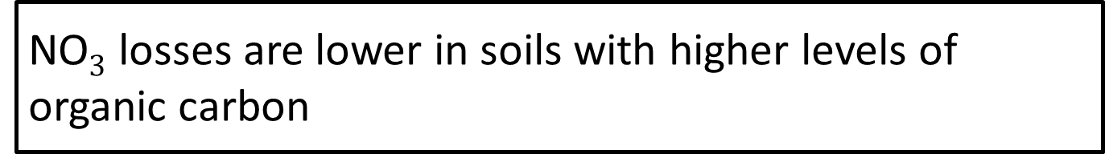
NO$3$ losses are lower in soils with higher levels of organic carbon
Notes:
Soil carbon was one of the most important explanatory factors for nitrate losses. The x-axis is once again, fertilizer N rate in kg per hectare, and the y-axis is nitrate losses, also in kg per hectare. The open circles and dotted line show observations where soil carbon is less than 2%, and the closed circles and solid line are sites with higher levels of soil carbon. We can see significantly lower nitrate leaching in higher carbon soils.
This gives a good incentive for soil carbon management. One potential problem here is that N2O losses tend to be higher in soils with more organic matter – so we have the possibility of a trade-off between our two N loss pathways.
Similar to what we did for nitrous oxide, how do we explain variability in nitrate losses at typical fertilizer application rates? We again took a slice of the observations between 110 and 252 kg N fertilizer per hectare.

Slide 19
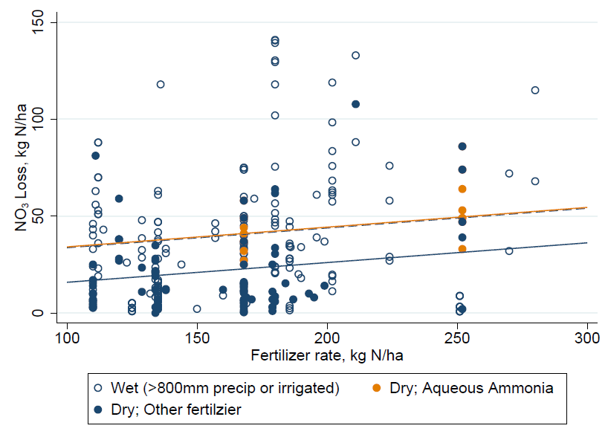
At typical N rates (110-252 kg N/ha), nitrate losses increase with moisture, N rate and Aqueous Amm.
40 kg N/ha
24 kg N/ha
Notes:
Here we can see the effect of fertilizer rate, precipitation, and fertilizer source. The x-axis is fertilizer rate, y-axis is nitrate loss. The open blue circles and dotted blue line are in irrigated or wet climates (with more than 800 mm precip), the solid circles and solid lines are dry climates. In all the testing of models, one source had significantly higher NO3 losses: that was Aqueous ammonia, shown with the orange circles and orange lines (overlapping blue dotted line) (only observations are in dry climates).
The solid blue line shows average NO3 losses from dry climates, with other fertilizers (half were UAN, also some urea and anhydrous ammonia)
Assuming other factors are constant, an irrigated or wet climate loses an average of 18 kg N/ha more than a dry climate. There is the same impact from aqueous ammonia.
Let’s think about the policy implications. If the cost to clean up this nitrate is in the range of values suggested by some economic reports, we could perhaps use the minimum of $7 per kg N (i.e., €5). Then, if a mechanism were designed to encourage the use of UAN or urea over ammonium-based fertilizers, the average value of the reduced losses (i.e., 18 kg X $7) would be around $126/ha. There may be enough value there to overcome the administrative, verification, validation, and other management hurdles.

Slide 20
Possible Policy Implications
Cost to clean up NO₃: minimum of $7/kg N
Benefit of $126/ha ($300/acre) of NO₃ from using something other than aqueous ammonia
In irrigated or wet climates, off-field options may be needed (e.g., clean-up drainage water with vegetative filters)

Slide 21
What did we learn?
Data Gaps
  Geographically limited data
    Cannot design regionally specific programs or protocols for most locations
  Insufficient data relating N₂O and NO₃
  Data for fertilizer management insufficient
    Very little information on placement, timing (and NO₃ in general)
What we did find…
  N₂O – temperature increases losses while nitrification inhibitors and side-dress decrease losses
  NO₃ – soil C decreases losses; Wet climate (or irrigation) and aqueous ammonia increase losses

Slide 22
What next?
$$$
Systematic lab study
Targeted field study
potentially empirical models
$$$$$
More individual studies
More meta-analysis
combined with mechanistic models
Economic & Policy Analysis and Program design
Improving policy and program effectiveness in managing N loss
Notes:
Ideally we would now have enough field studies to answer our questions on N losses,

Slide 23
Acknowledgments
4R Research Fund (Fertilizer Institutes)
Original Data Provision: Ardell Halvorson, Rodney Venterea, Tim Parkin, Phil Robertson, Craig Drury, Doug Smith
Duke Collaborators: Jim Heffernan, Emily Bernhardt
Research Assistants: Katie Locklier, Erin Vining, Jocelyn Tsai

