Slide 1


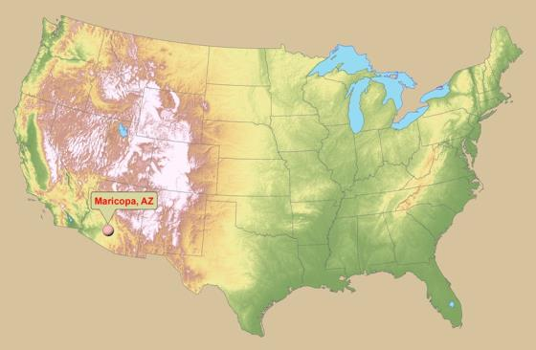
Moving Beyond NDVI for Active Sensing in Cotton
Kevin F. Bronson
US Arid Land Agric. Res. Center,
USDA-ARS, Maricopa, AZ

Slide 2
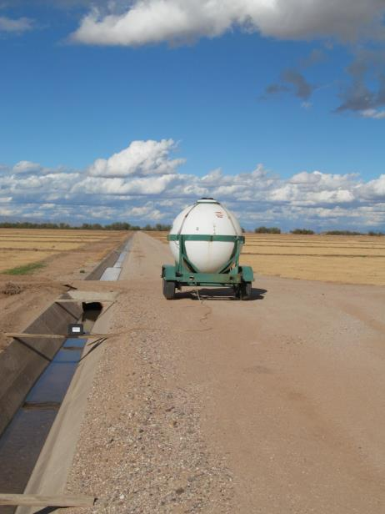
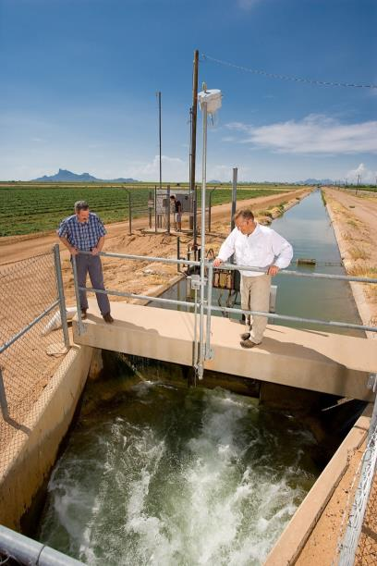
Introduction
Canal infrastruture, and level land means that level-basin surface irrigation in raised beds in the predominant irrigation system in Arizona for cotton production. However, overhead spinklers are coming into central Arizona.
Nitrogen fertilizer is usually managed with early season ground applications followed by “fertigations” i.e. dribbling 32-0-0 UAN into the canal.
Proximal sensing can guide in-season N applications, and improve low NUE in cotton.

Slide 3
Objectives
Compare vegetations indices for ability to detect early to mid-season N deficiencies in irrigated cotton.
Correlate various VIs with first open boll biomass, N uptake and lint yield.
Compare NDVI-based N management with soil profile NO₃ recommendation.
Test UAN + Agrotain Plus vs. UAN alone
Test IRTs and ultrasonic height sensors in combo w/ AOS
Assess N uptake, RE, IE, AE, NO₃ leaching and N₂O emissions

Slide 4
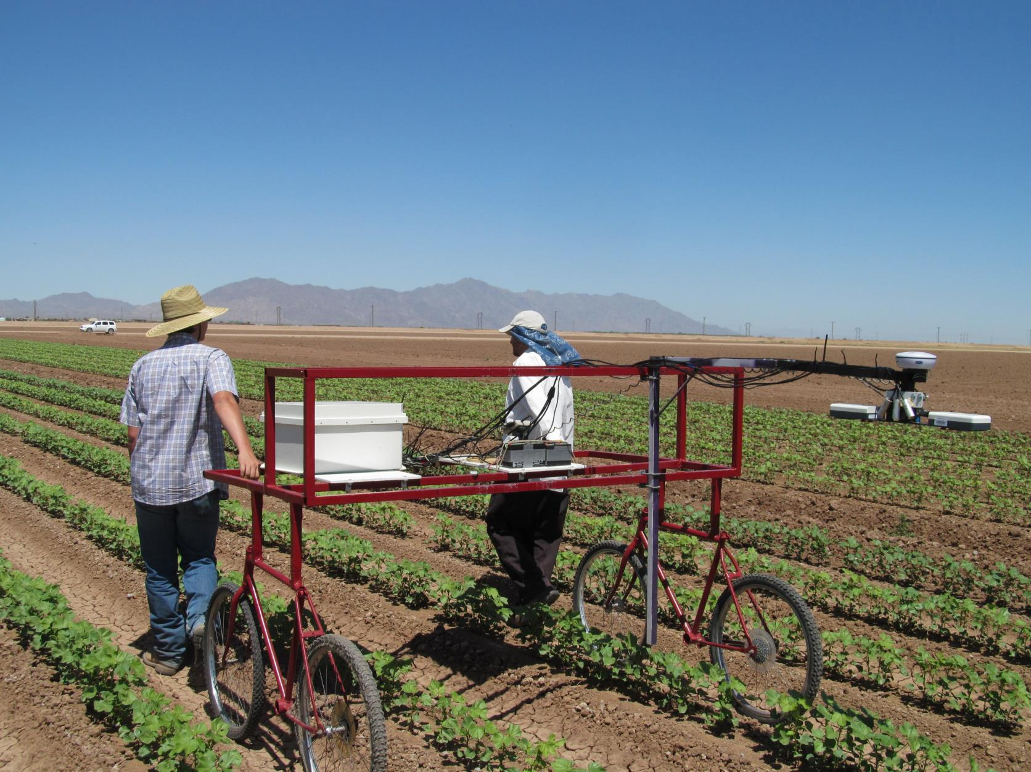
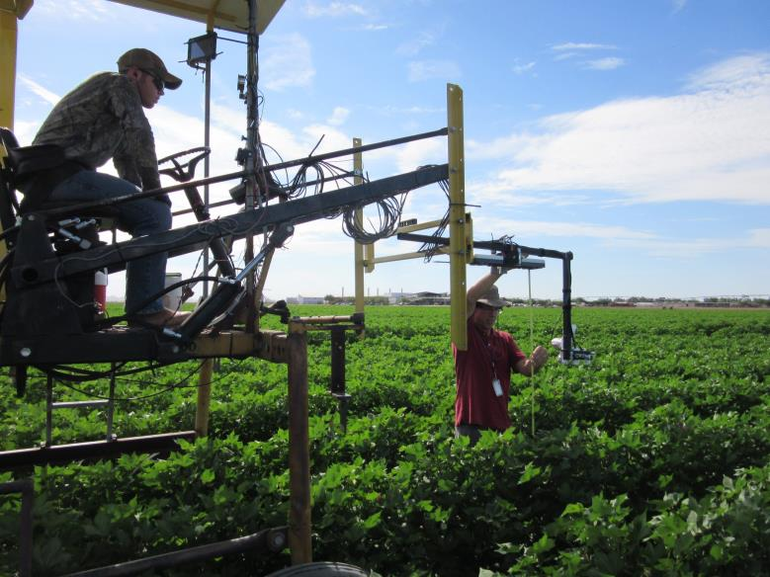
Methods

Slide 5
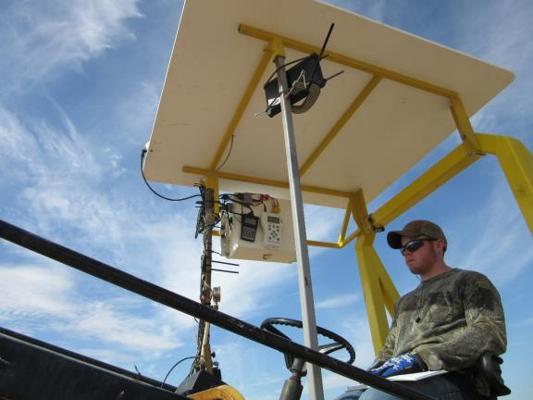
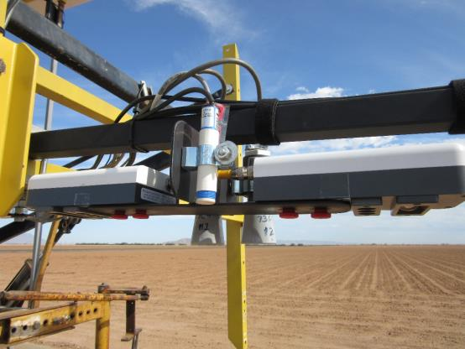
Methods cont.

Slide 6
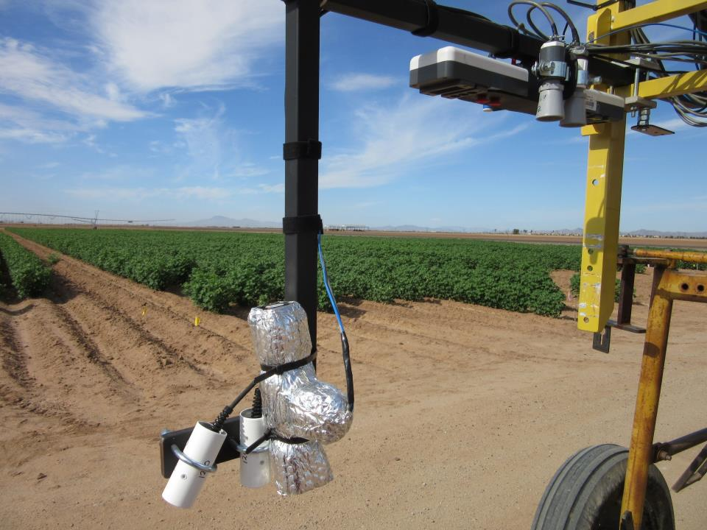
Methods cont.

Slide 7
Methods
Randomized block design, three or four replicates
Six N management treatments in 2012-13, 8 in 2014
Plots 8, 40-in. rows x 550’ in 2012-13, 6 rows x 120’ in 2014
Planted DP 1044 B2RF on May 1, 2013 and 2014
Irrigated 740 to 850 mm for 85 -100% ET replacement
Active optical sensor used weekly from pinhead square to first open boll, one 1 m above canopy
Apogee IRR-P IRTs at 0.8 m, nadir and 30º
Honeywell 943 or MaxBotix HRXL-MaxSonar®-WRTM ultrasonic height sensors
Neutron probe soil moisture measured weekly to 180 cm
Harvest on early November

Slide 8
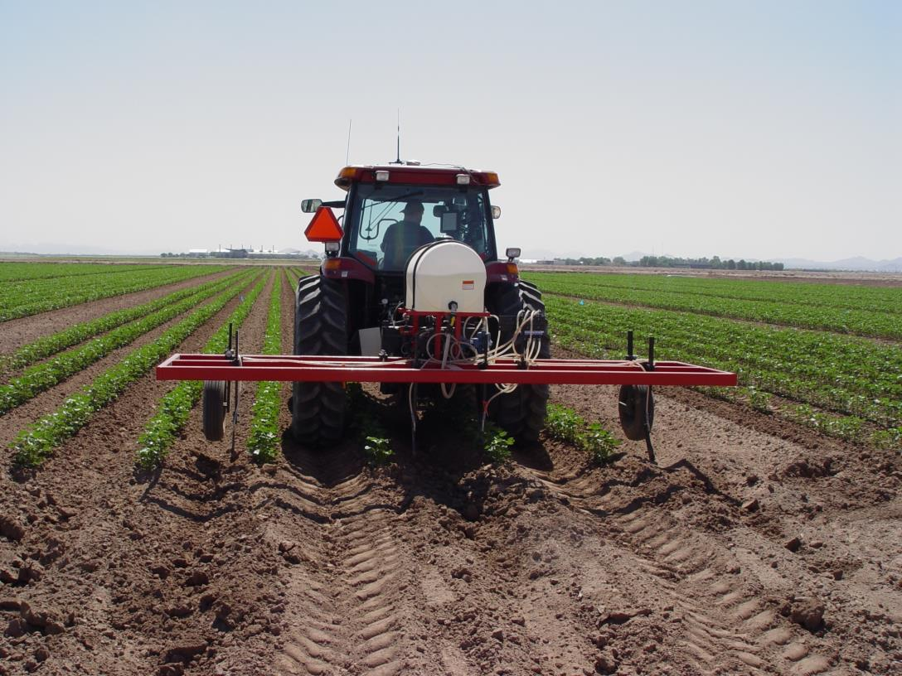

Slide 9
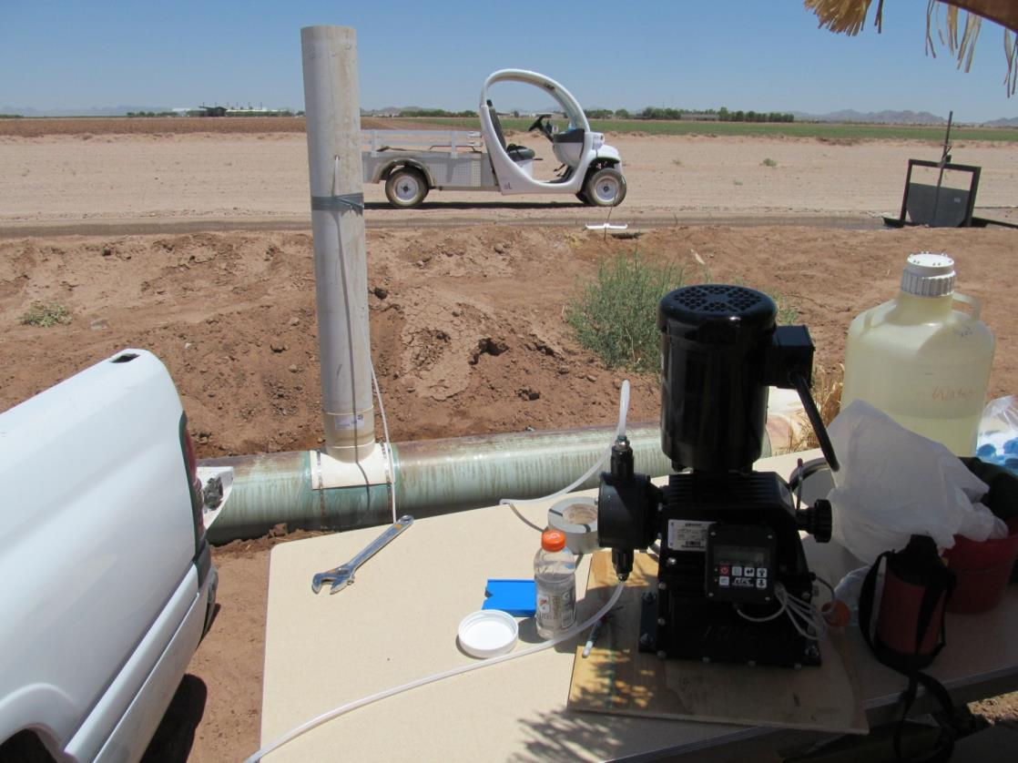

Slide 10
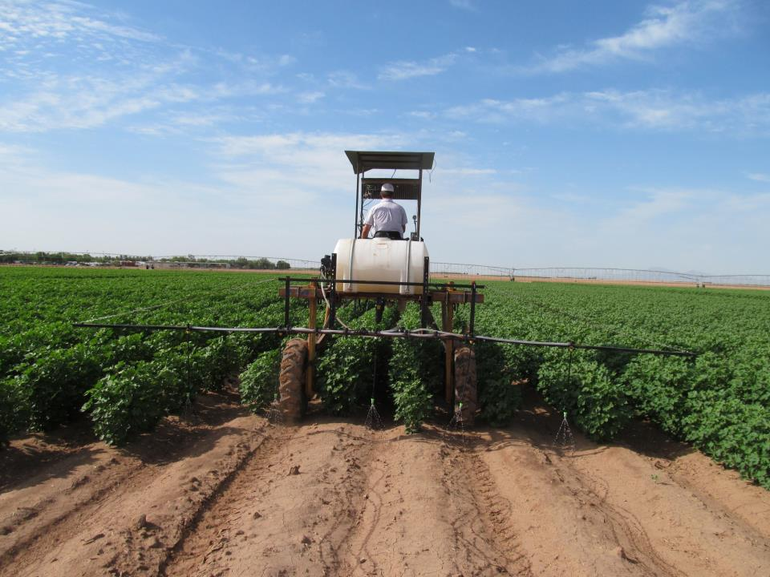

Slide 11
Nitrogen Treatments for cotton, Maricopa, AZ, 2012 and 2013
Fertilizer
Nitrogen treatment
Fertilization
Fertilizer
rate
Notes
mode
source
(lb N/ac)
1.
Zero
-
N
0
2
splits
Urea amm.
:
2.
Soil test
-
based N
†
Knife
132
1
s
t
square
nitrate
,
s
(106 in 2013)
1
t
bloom
†
2
fertigations
Urea amm.
:
3.
Soil test
-
based N
†
Fertigate
132
1
s
t
square
nitrate
,
or 106
1
s
t
bloom
†
2
fertigations
Amm sulfate or
:
4.
Soil test
-
based N
†
Fertigate
132
1
s
t
square
UAN+Agrotain
,
or 106
1
s
t
bloom
†
2
splits
5.
Reflectance
:
-
based
Knife
Urea amm.
66
1
s
t
square
N
‡
nitrate
,
s
1
t
bloom
(53 in 2013)
†
2
irri
gations
6.
Reflectance
:
-
based
Fertigate
Urea amm.
66
1
s
t
square
N
§
nitrate
,
1
s
t
bloom
or 53
†
†
Based on lint yield goal of 1500
lb/ac, 175 lb N/ac requirement, minus 0-
36 in
soil NO
₃-N
20 and 50 lb NO₃-N/ac, 2012&13)
irrigation input of 20 lb N/ac
(estimated 100 cm irrigation of 2 ppm NO₃
.
-N water)
‡
First split equals
50 %
treatment no. 2, second split based on NDVI relative to treatment no. 2.
§
First fertigation
50 %
treatment no. 3, second fertigat
ion based on NDVI relative to treatment no. 3.
Notes:
25 kg NO3N/ha in 0-90 cm

Slide 12
N Requirements (lb N/ac) vs. cotton lint yield (bale/ac)
200
180
160
y
= 40.2x
2
140
R
= 0.73
120
N uptake (lb/ac)
100
80
Stripper
60
Picker
40
20
0
0
0.5
1
1.5
2
2.5
3
3.5
4
4.5
5
Lint yield (ba/ac)

Slide 13
Nitrogen Treatments for sprinkler-irrigated cotton, Maricopa, AZ, 2014 & 2015
Notes:
25 kg NO3N/ha in 0-90 cm

Slide 14
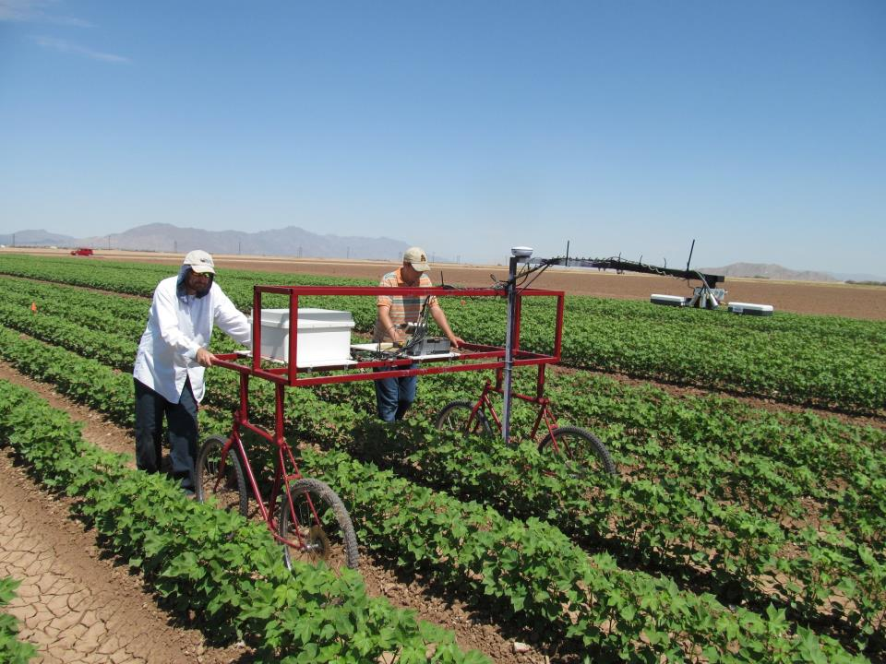

Slide 15
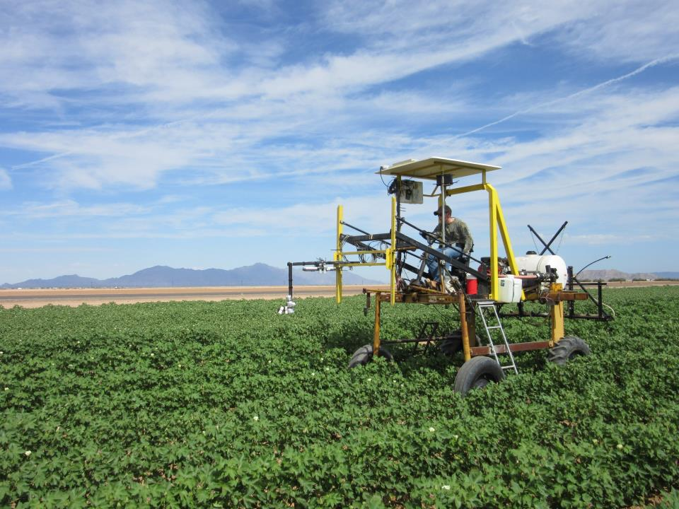

Slide 16
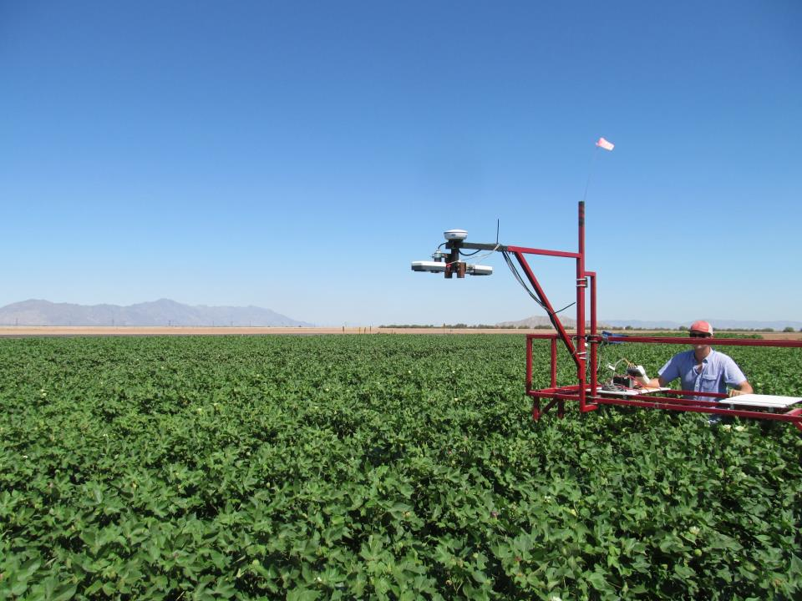

Slide 17
Vegetation indices
NDVI-Red (NDVIR) (Tucker, 1979) was calculated as:
(R₈₀₀ - R₆₇₀)/ (R₈₀₀ + R₆₇₀)
NDVI-Amber (NDVIA) (Solari et al. 2008) was calculated as:
(R₈₀₀ - R₅₉₀)/ (R₈₀₀ + R₅₉₀)
Normalized difference red edge index (NDRE) (Gitelson and Merzlyam 1994) was calculated by as:
(R₈₀₀ - R₇₃₀)/ (R₈₀₀ + R₇₃₀)

Slide 18
Vegetation indices cont.
Canopy chlorophyll content index (CCCI) (red) (Long, et al., 2009; Barnes, 2000, Cammarano et al., 2011) was calculated as:
(NDRE)/ (Red NDVI)
Amber CCCI was calculated as:
(NDRE)/ (Amber NDVI)
The DATT VI (Datt, 1999) was calculated as:
(R₈₀₀ - R₇₃₀)/ (R₈₀₀ - R₆₇₀)

Slide 19
Vegetation indices cont.
Chlorophyll index (CI₅₉₀) (Solari et al., 2008) was calculated as:
(R₈₀₀ - R₅₉₀) - 1
Photochemical reflective index (PRI) (Garbulsky et al., 2011) was calculated as:
R₅₉₀ - R₅₃₀

Slide 20
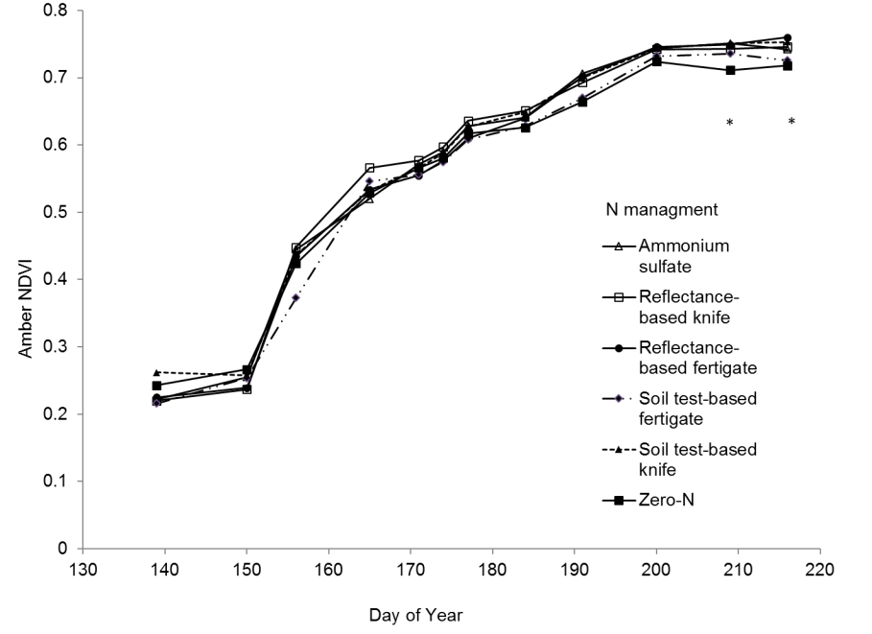
Amber NDVI as affected by N management, 2012

Slide 21
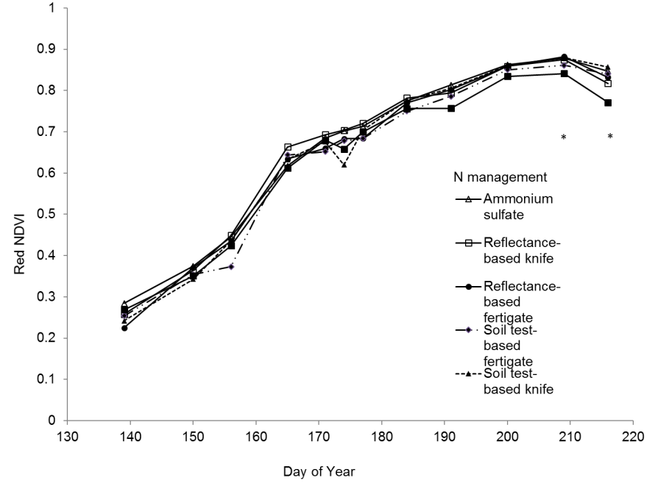
Red NDVI as affected by N management, 2012

Slide 22
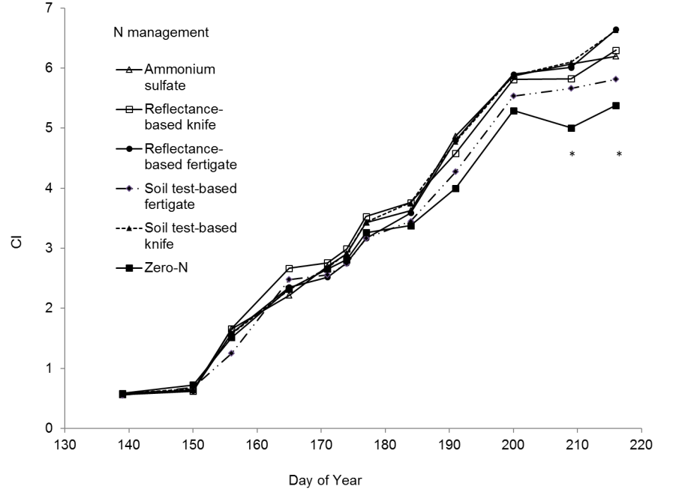
CI as affected by N management, 2012

Slide 23
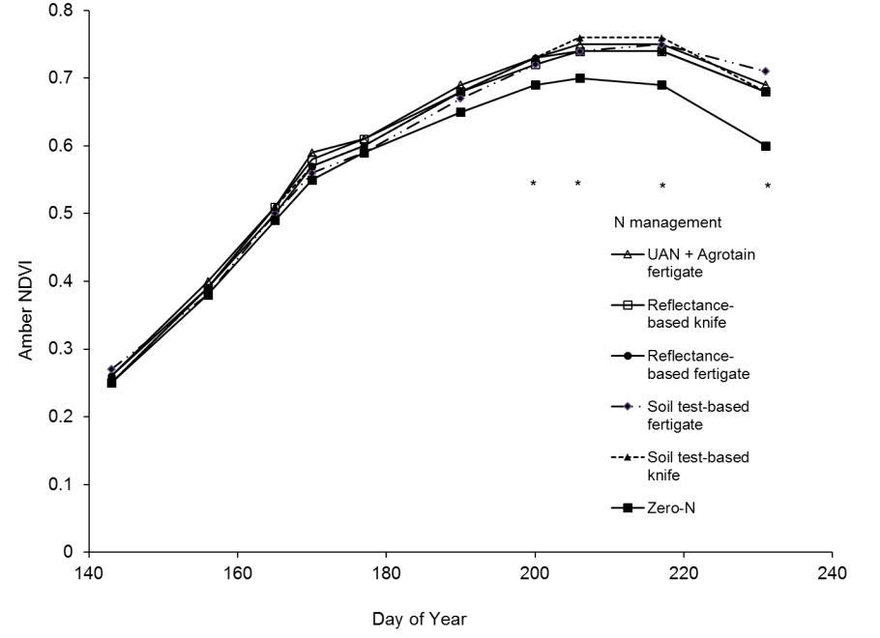
Amber NDVI as affected by N management, 2013

Slide 24
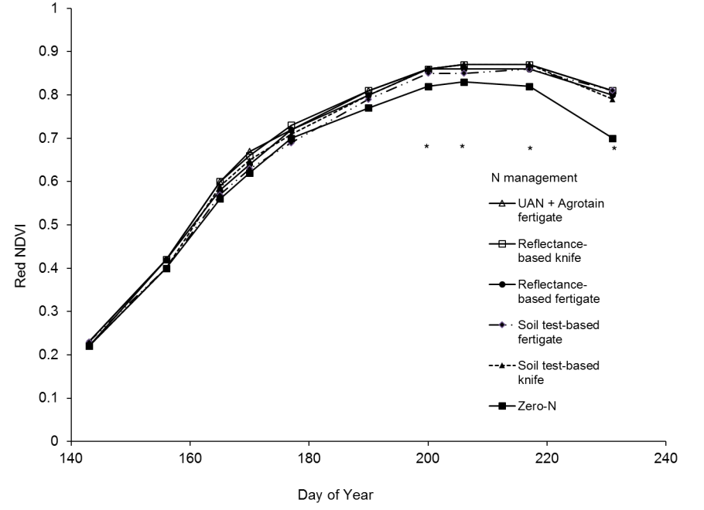
Red NDVI as affected by N management, 2013

Slide 25
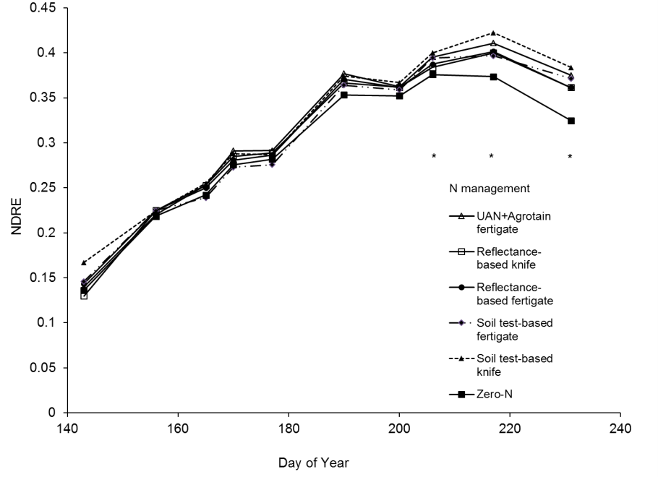
NDRE as affected by N management, 2013

Slide 26
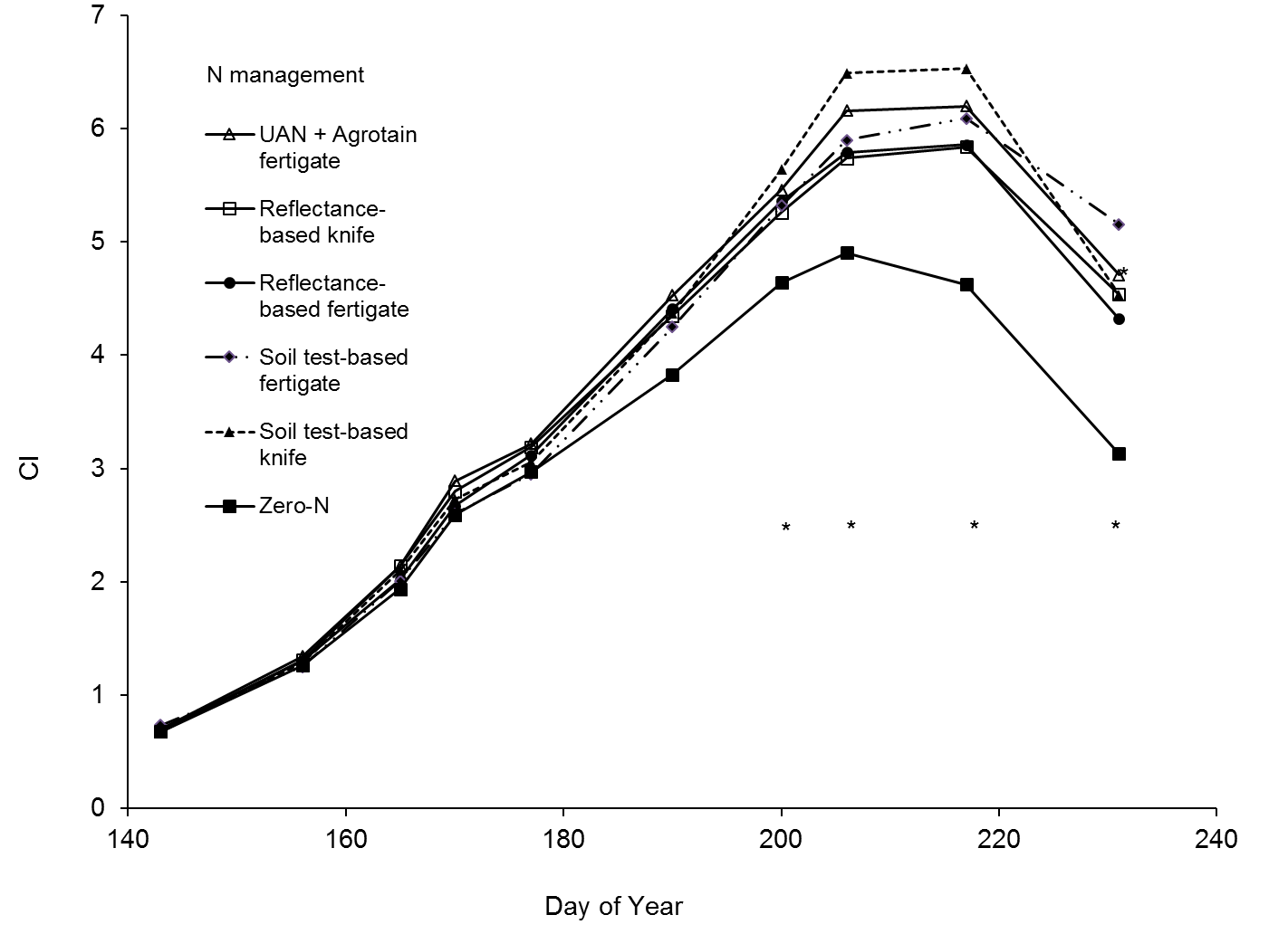
CI as affected by N management, 2013

Slide 27
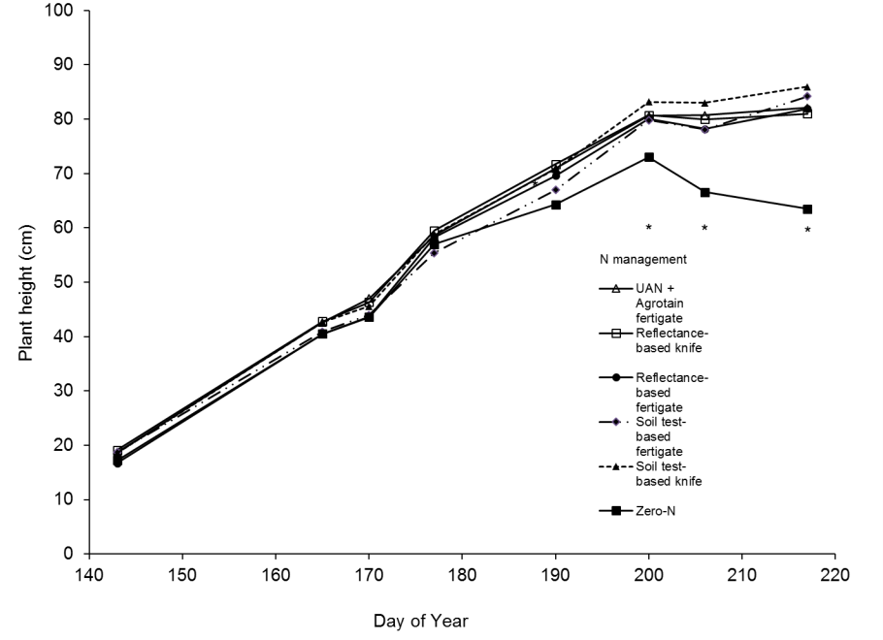
Honeywell 943 ultrasonic height sensor as affected by N, 2013

Slide 28
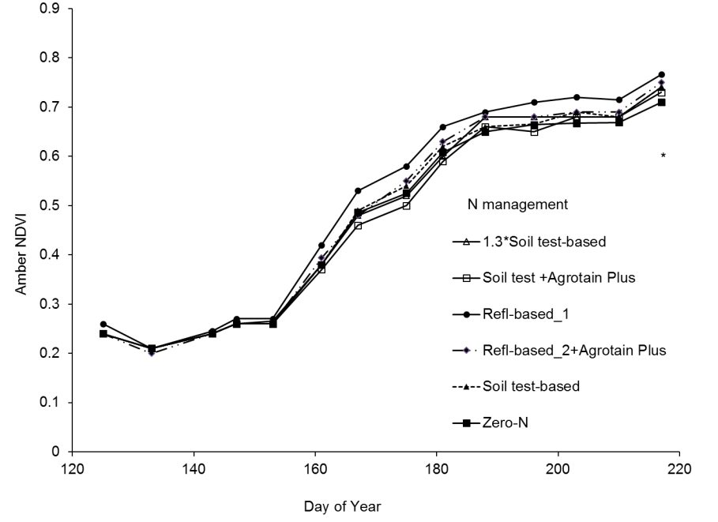
Amber NDVI as affected by N management, 2014

Slide 29
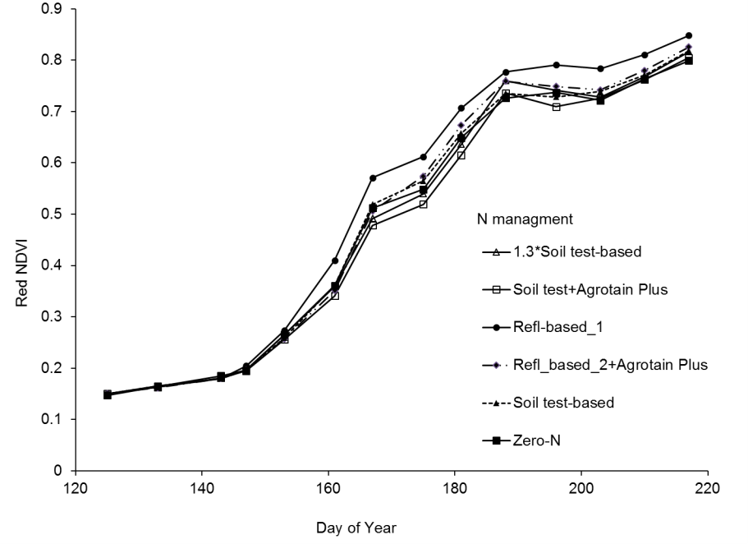
Red NDVI as affected by N management, 2014

Slide 30
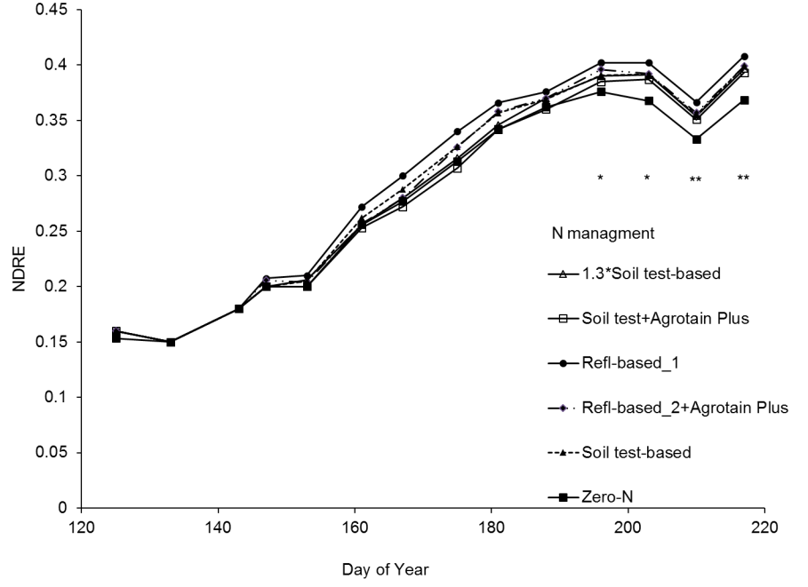
NDRE as affected by N management, 2014

Slide 31
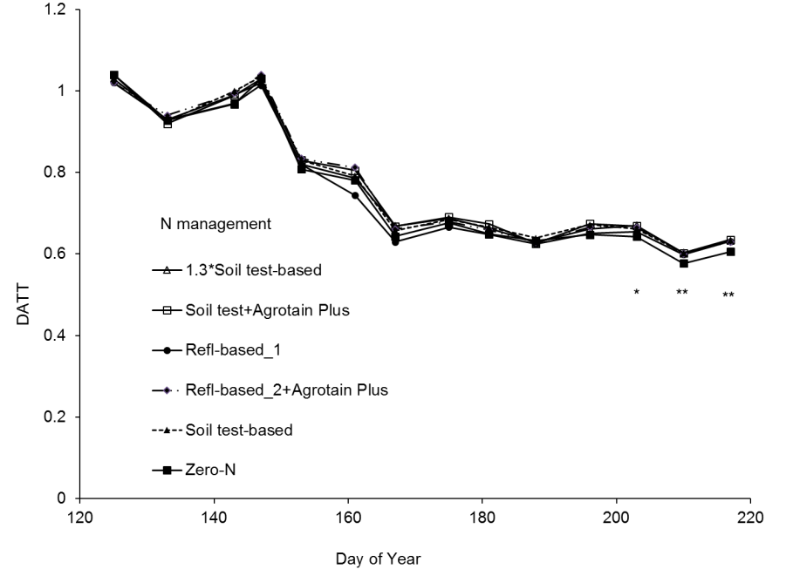
DATT as affected by N management, 2014

Slide 32
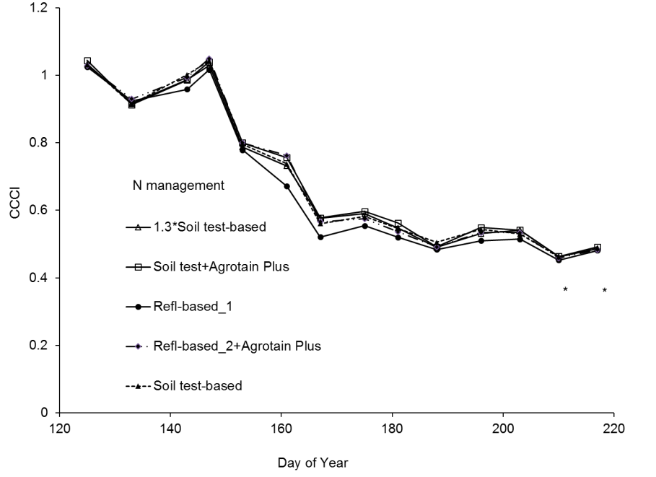
CCCI as affected by N management, 2014

Slide 33
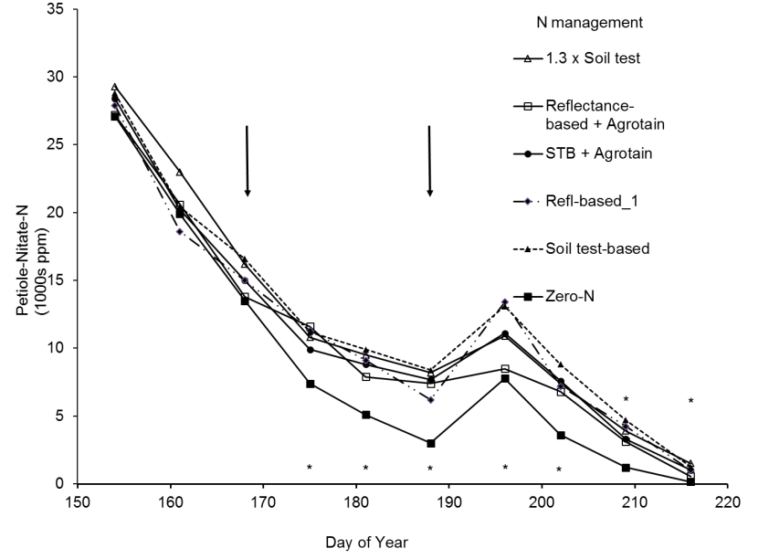
Petiole-NO₃-N as affected by N management, DP1044B2RF, Maricopa, AZ, 2014
Notes:
1st N split was at 147 DOY. 154 DOY is pinhead square
175 DOY is first bloom

Slide 34
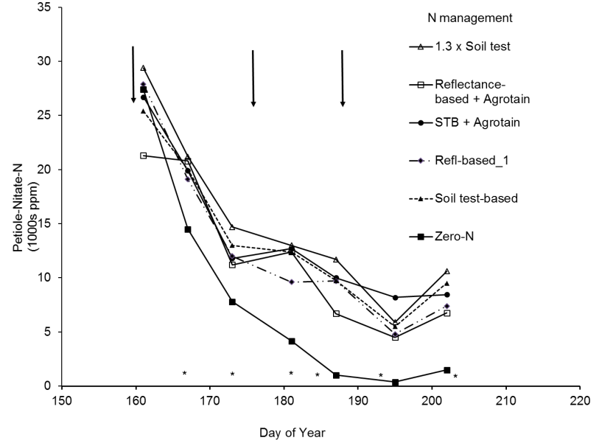
Petiole-NO₃-N as affected by N management, DP1044B2RF, Maricopa, AZ, 2015
Notes:
154 DOY is pinhead square
175 DOY is first bloom

Slide 35
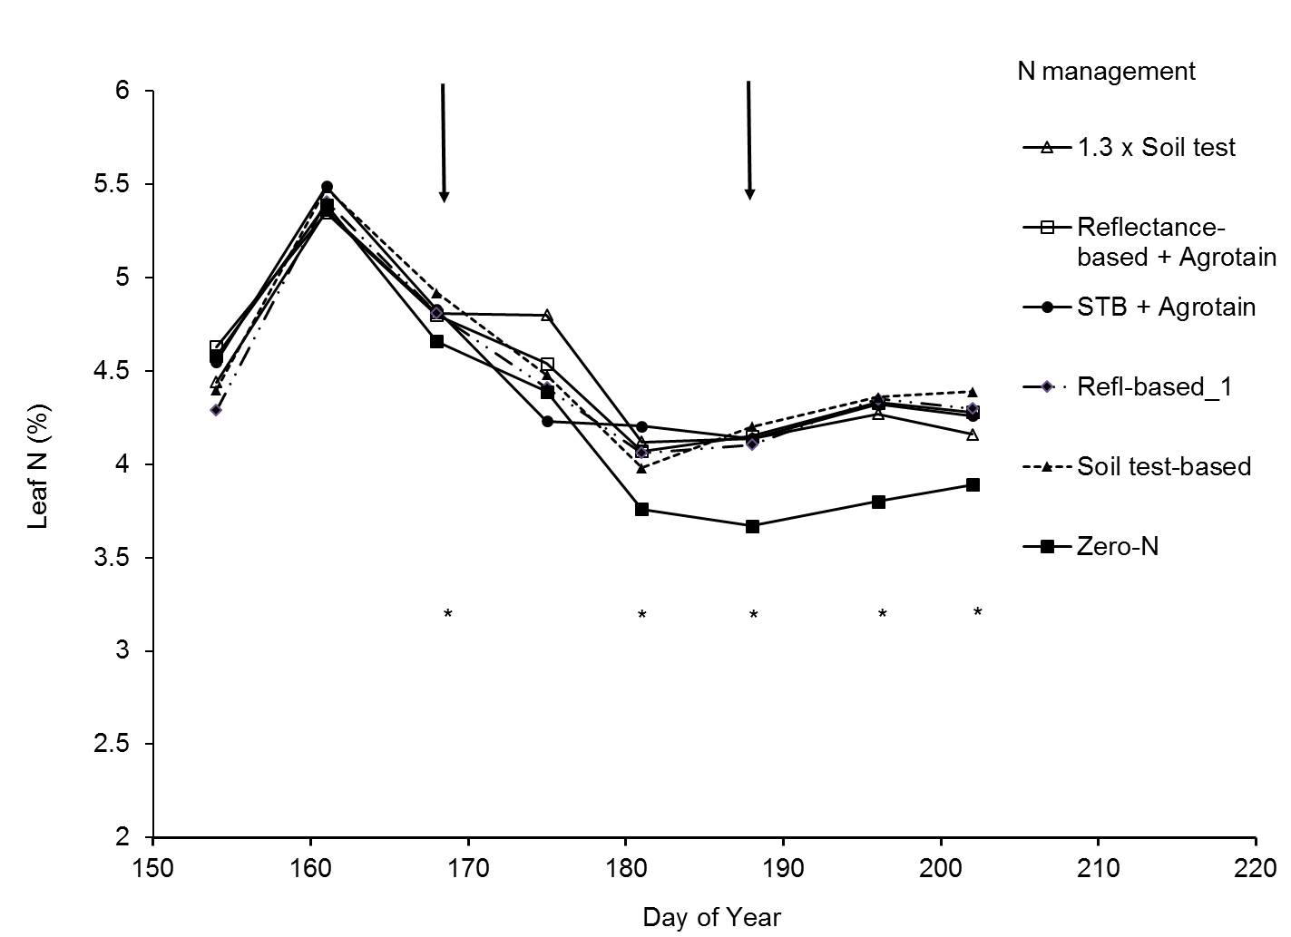
Leaf N as affected by N management, DP1044B2RF, Maricopa, AZ, 2014

Slide 36
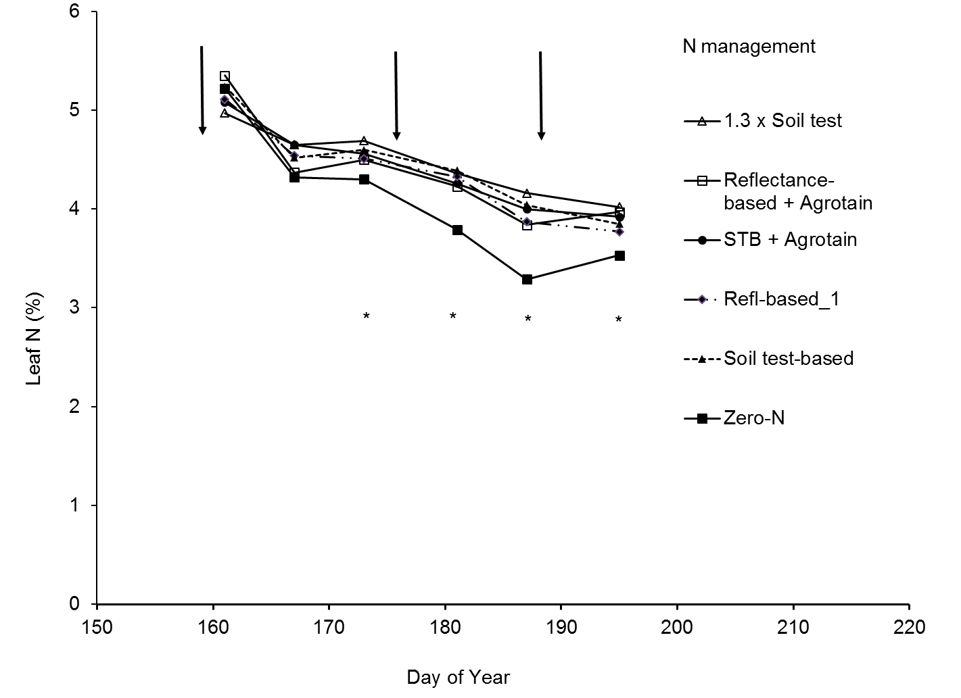
Leaf N as affected by N management, DP1044B2RF, Maricopa, AZ, 2015

Slide 37
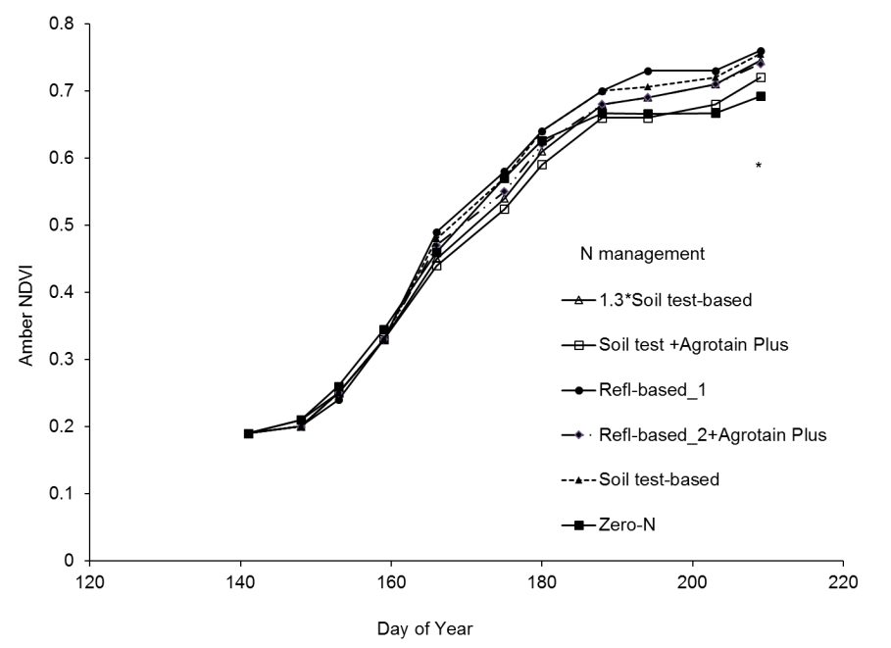
Amber NDVI as affected by N management, 2015

Slide 38
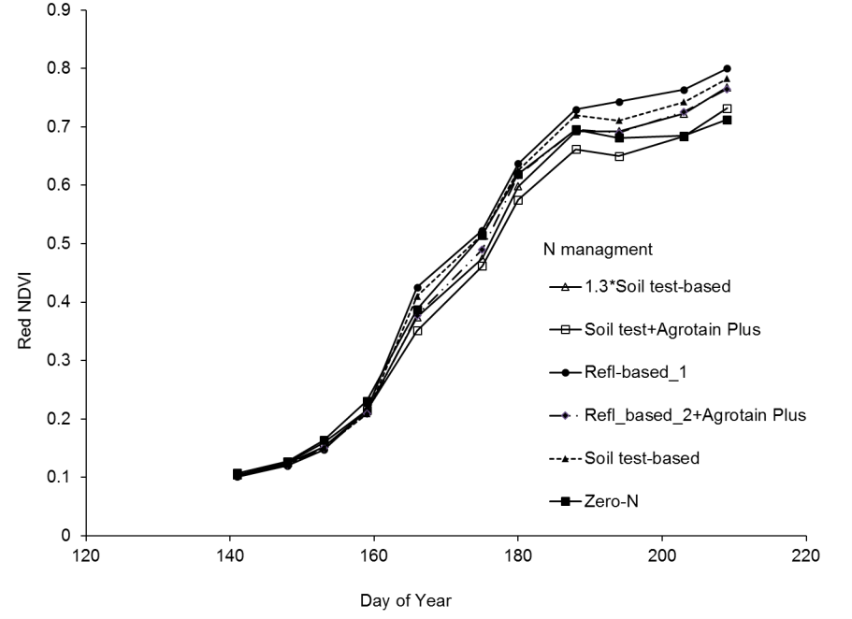
Red NDVI as affected by N management, 2015

Slide 39
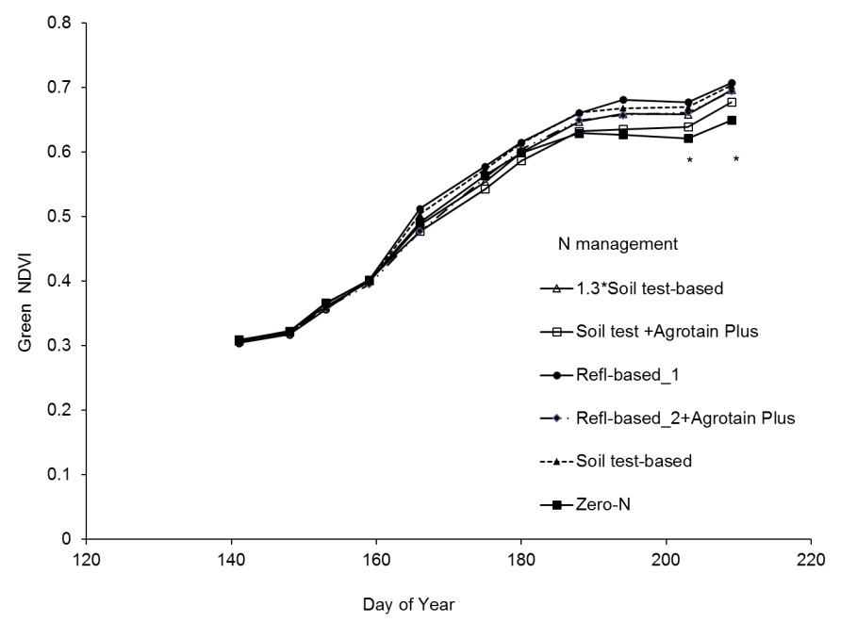
Green NDVI as affected by N management, 2015

Slide 40
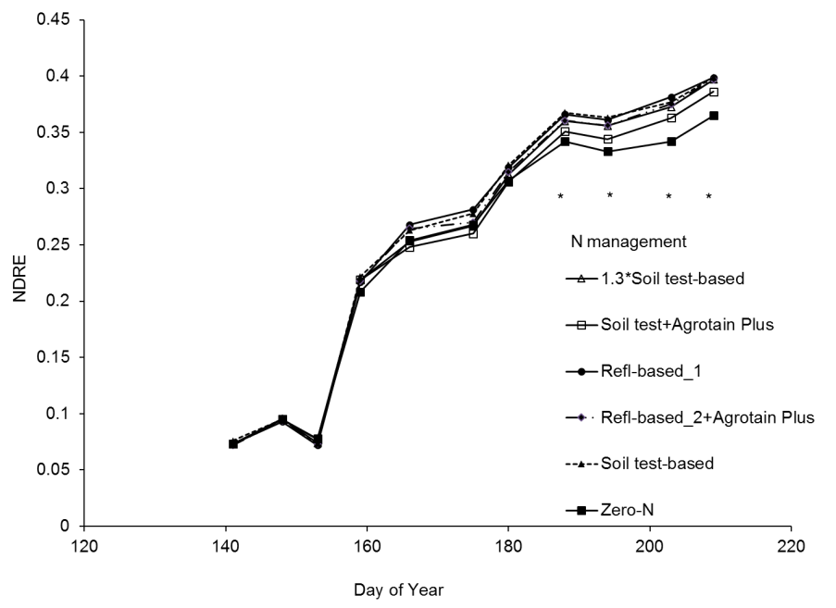
NDRE as affected by N management, 2015

Slide 41
Correlations between VIs and soil/plant parameters, overhead sprinkler cotton, 2014-2015, Maricopa, AZ

Slide 42
Fixed Nitrogen effects for various VIs by date from true leave stage to first open boll, surface irrigation, Maricopa, AZ 2012

Slide 43
Fixed Nitrogen effects for various VIs by date from true leave stage to first open boll, surface irrigation, Maricopa, AZ 2013

Slide 44
Fixed Nitrogen effects for various VIs by date from true leave stage to first open boll, sprinkler irrigation, Maricopa, AZ 2014
Notes:
Leaf N at 167 DOY
Petiole NO3 at 175 DOY

Slide 45
Correlation among peak bloom VIs, first open boll biomass, total N uptake and lint yield, Maricopa, AZ 2012-2014

Slide 46
First open boll biomass, N uptake and recovery efficiency, as affected by N management in surface-irrigated cotton, Maricopa, AZ 2012
Seasonal
Nitrogen treatment
Fertilization
Fertilizer
Fertilizer
Biomass
N uptake
Recovery
N
O flux
mode
source
rate
efficiency
2
g N
O
2
-
lb N/ac
lb/ac
lb N/ac
%
N/ac/96 d
Zero
-
N
0
6558
b
116
b
64
b
Soil test
Urea amm.
-
based N
†
Knife
nitrate
132
7026
a
b
149
a
25
a
139
ab
Soil test
Urea amm.
-
based N
†
Fertigate
nitrate
132
7474
a
147
a
23
a
348
a
Soil
test
Amm.
-
based N
†
Fertigate
Sulfate
132
7981
a
155
a
30
a
342
a
Reflectance
Urea amm.
-
based N‡
Knife
nitrate
66
6103
b
118
b
3
a
Reflectance
Urea amm.
-
based N
§
Fertigate
nitrate
66
6970
ab
126
b
15
a

Slide 47
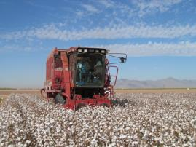
Lint yield, agronomic and internal N use efficiency, as affected by N management in surface-irrigated cotton, Maricopa, AZ 2012

Slide 48
First open boll biomass, N uptake and recovery efficiency, as affected by N management in surface-irrigated cotton, Maricopa, AZ 2013

Slide 49
Lint yield, agronomic and internal N use efficiency, as affected by N management in surface-irrigated cotton, Maricopa, AZ 2013

Slide 50
Lint yield, agronomic, and internal N use efficiency, as affected by N management in sprinkler-irrigated cotton, Maricopa, 2014

Slide 51
First open boll biomass, N uptake and recovery efficiency, as affected by N management in sprinkler-irrigated cotton, Maricopa, AZ 2014
Fertilizer
Fertilize
Season
Nitrogen treatment
r
Biomass
N
Recovery
al N
O
source
rate
2
uptake
efficiency
flux
g N
O
2
-
lb N/ac
lb/ac
lb N/ac
%
N/ac/
91
d
1.
Zero
-
N
0
749
4
a
1
30
b
-
30 b
2.
Soil test
-
based N
†
UAN
160
8310 a
1
8
4
a
3
4
ab
449 a
3.
1.3*Soil test
-
based N
†
UAN
208
8015 a
1
80
a
2
4
b
496 a
UAN +
4.
Soil test
-
based N
†
Agrotain
160
788
7
a
1
69
a
2
4
b
107 b
Plus
5.
Reflectance
-
based N
-
UAN
80
849
7
a
1
74
a
5
5
a
405 ab
1‡
6.
Reflectance
-
based N
-
UAN
104
8076 a
1
72
a
40
a
b
282 ab
2
§
7.
Reflectance
UAN +
-
based N
-
Agrotain
80
855
3
a
1
70
a
50
a
b
259 ab
1
‡
Plus
8.
Reflectance
UAN +
-
based N
-
Agrotain
104
7
757
a
1
63
a
3
2
ab
213 b
2
§
Plus

Slide 52
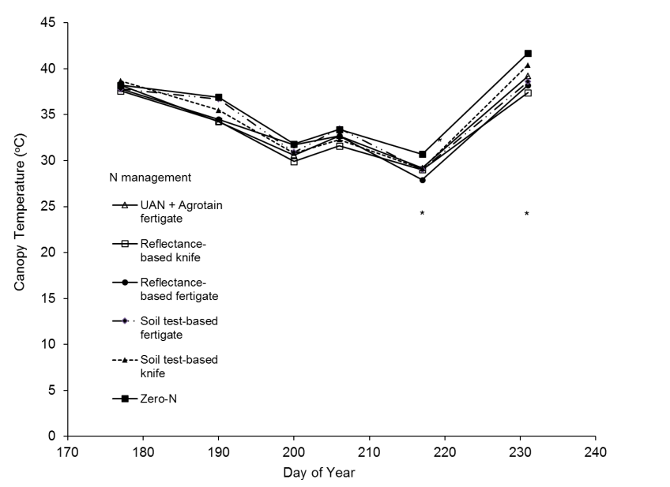
Cotton canopy temperature as affected by N management, surface irrigation, Maricopa, AZ 2014

Slide 53
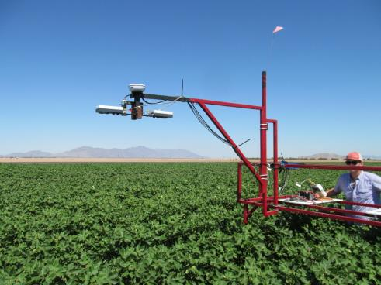
Summary
N fertilizer response in lint yield and TNU all three years was observed, but not different among N treats.
NDVI amber, red, and green showed N deficiency late in 2012 and in 2014.
NDRE showed N deficiency much earlier than NDVI.
CCCI and CI have potential, but were not consistent.

Slide 54
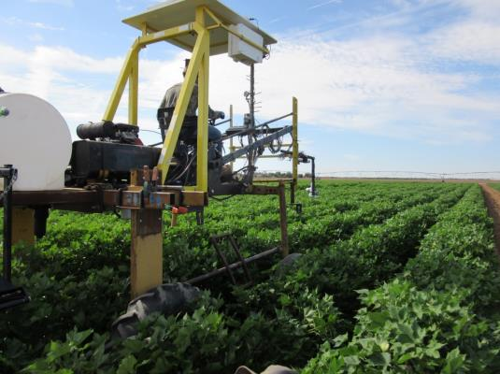
Summary cont.
All NDVIS and CI showed high correlation with lint yield all three years.
NDVI-based N mgt saves N without hurting lint yields.
The Honeywell height sensor correlation with NDVI was very high.

Slide 55
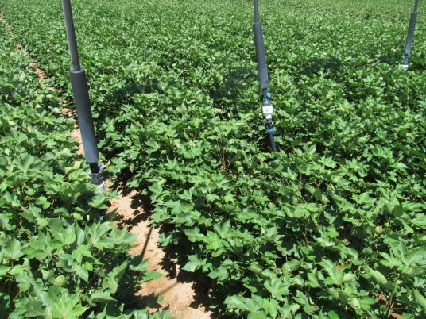
Suggestions for NUE Group
Move to farmers’ fields
Try NDRE
Add IRTS (low NDVI < NDVI_{ref} with hot leafs = sandy/dry not needs N)
Add height sensors
Measure plant N uptake
Measure soil water
If irrigation is in your area, do N x water, and also fertigation
Measure NO₃ leaching
Get involved with HTP

Slide 56
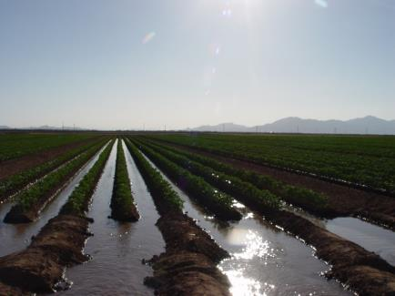
Acknowledgements
Cotton Inc, IPNI, and Koch Agronomic Services

