Slide 1
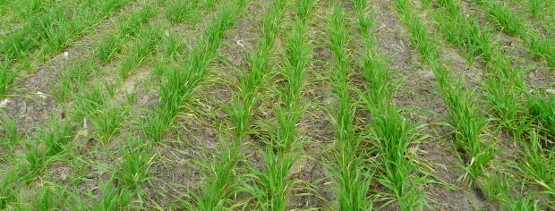
Use of Climate Forecast as a Tool to Increase Nitrogen Use Efficiency in Wheat
Brenda V. Ortiz¹, Reshmi Sarkar¹, Kip Balkcom², Melissa Rodriguez³, Mathew Tapley
¹Auburn University, ²USDA-ARS, National Tillage Lab, ³University of Florida
2015 NUE Workshop
August 4-5, 2015
Auburn University, Auburn, Alabama

Slide 2
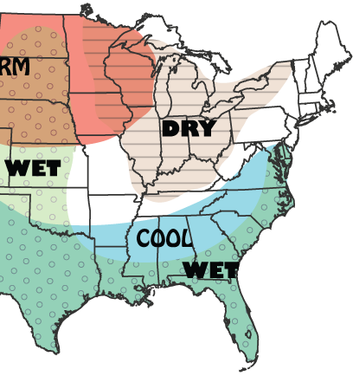
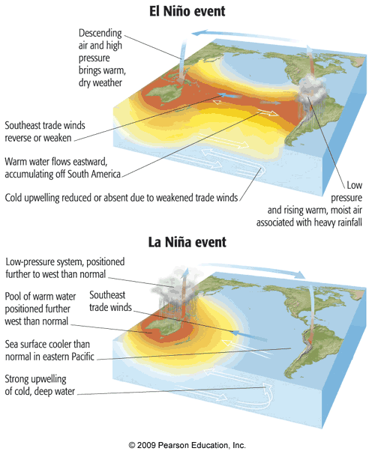
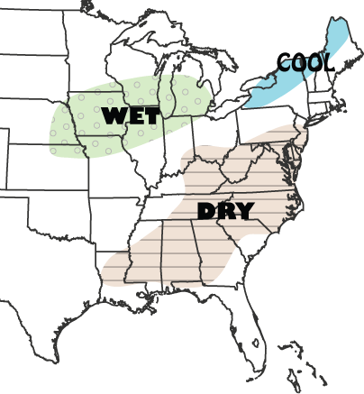
Climate in the Southeast
A. El Niño phase of ENSO
Winter
High influence on Winter and Spring climate
Above average sea surface temperature (SST) across the eastern tropical Pacific
Summer
Notes:
El Niño Southern Oscillation is the driving force of the climate variability in the Winter and Spring Months in the Southeast US.
A warming above normal of the sea surface temperatures (defined as El NINO)in the eastern pacific will result in a wet and cold climatic conditions during Fall, Winter and Spring. Cloudy days are another characteristic of El Nino years.
Decrease in Tmax across the SE
Tmin lower in Florida but higher elsewere
More days with Tmax and Tmin below than the Neutral years mean
During Summer under EL Nino phase, we can expect a dry climate. However, the forecast for ENSO in the Summer is not as accurate as for the winter and Spring months.

Slide 3
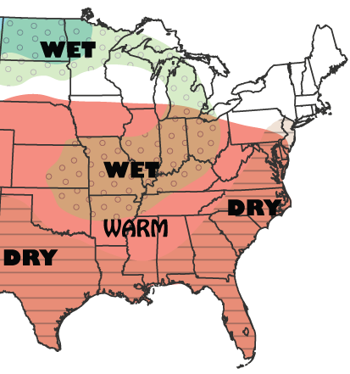
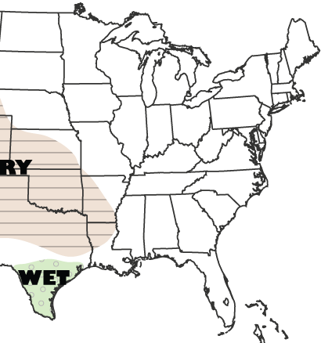
Climate in the Southeast
B. La Niña phase of ENSO
Winter
Below than normal sea surface temp. (SST) across the eastern tropical Pacific
Summer
Notes:
The opposite of El Nino phase is La Nina. And it is characterized by a cooling of the waters in the pacific. During La Nina phase of ENSO, the climate in the Southeast is warm and dry during Fall, Winter and Spring months.
Increase in Daily mean Temperature
Increase in Tmax & Tmin respect to Neutral conditions
More days with Tmax and T min above the Neutral years mean

Slide 4
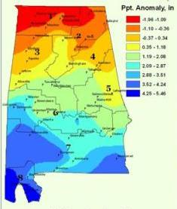
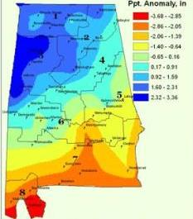
ENSO and Precipitation Anomalies in Alabama
January-February-March
El Niño
La Niña
Location and ENSO phase specific differences
Source: Vaishali Sharda (Biosystems Engineering – Auburn)

Slide 5
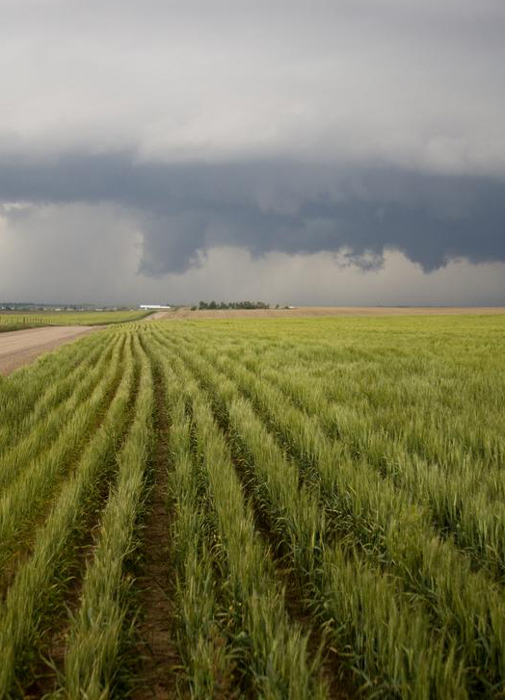
Does wheat nitrogen response change between ENSO phases?
Can we tailor nitrogen fertilization (rate and timing) based on the ENSO forecast?

Slide 6
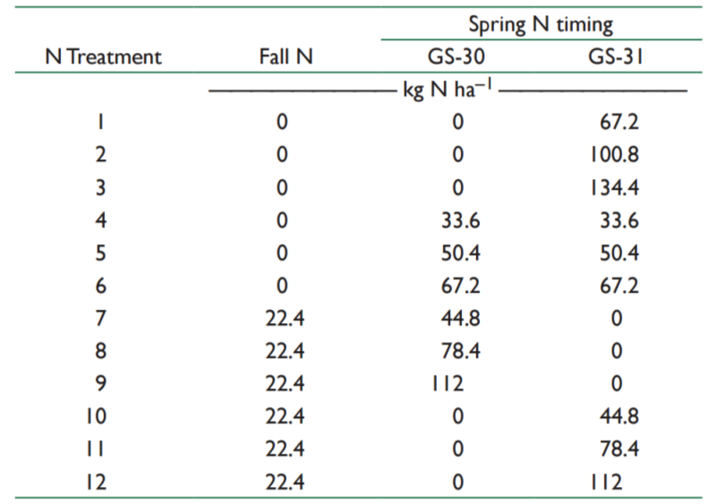
Rates and times of N application study conducted at multiple locations across Alabama
Source: Balkcom & Burmester - Agron. J. 107:425–434 (2015)

Slide 7
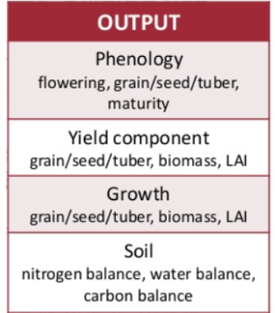
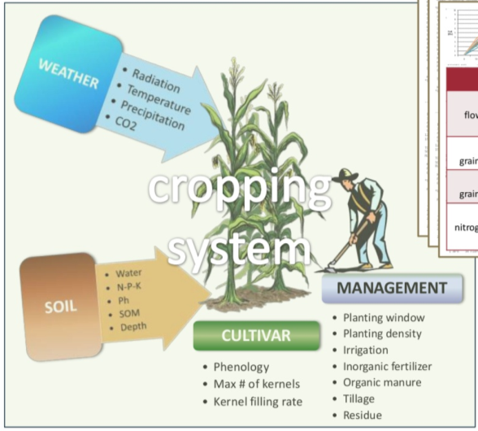
Simulation Modeling
Crop simulation models simulate growth, development and yield as a function of the soil-plant-atmosphere dynamics, and they have been used for many applications ranging from on-farm and precision management to regional assessments of the impact of climate variability and climate change
CERES-Wheat Model

Slide 8
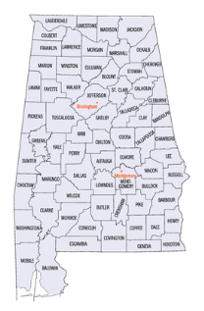
Crop Simulation Modeling Study
TVS
Two locations:
North (TVS), Silt loam soil
Southeast (WGS), loamy sand
Seasonal Analysis - 61yrs (1950-2010) weather data
12 Niña years
10 Niño years
15 N treatments (rate and timing)
Variables under study: yield and N leaching
WGS

Slide 9
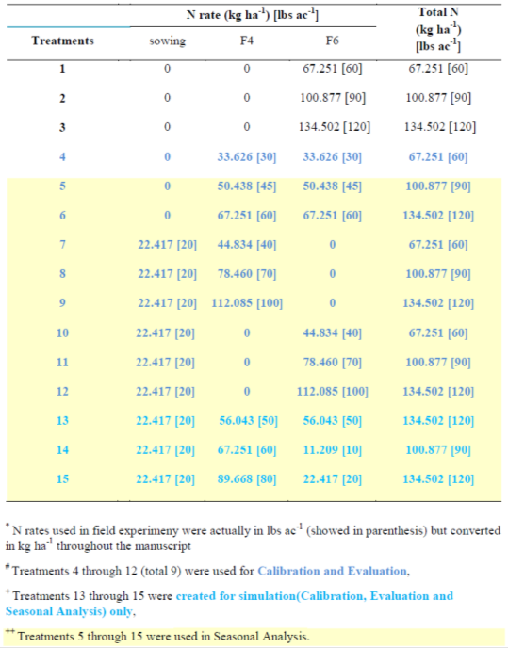
Different combination of N rates used in the Seasonal Analysis
Treatment | N rate (kg/ha) |  |  | Total N (kg/ha)
 | planting | F4 | F6
5 | 0 | 50.4 | 50.4 | 100.8
6 | 0 | 67.2 | 67.2 | 134.4
7 | 22.4 | 44.8 | 0 | 67.2
8 | 22.4 | 78.5 | 0 | 100.9
9 | 22.4 | 112.1 | 0 | 134.5
10 | 22.4 | 0 | 44.8 | 67.2
11 | 22.4 | 0 | 78.5 | 100.9
12 | 22.4 | 0 | 112.1 | 134.5
13 | 22.4 | 56.1 | 56.1 | 134.6
14 | 22.4 | 67.2 | 11.3 | 100.9
15 | 22.4 | 89.7 | 22.4 | 134.5
None at planting
None at Feekes 6
None at Feekes 4
F4 > F6
F4 >> F6

Slide 10
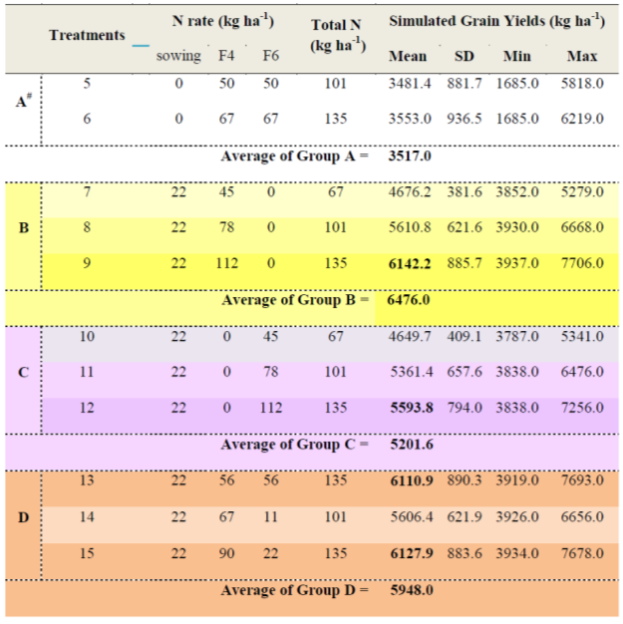
RESULTS – Southeast AL site (loamy sand soil)
None at planting
None at Feekes 6
None at Feekes 4
F4 > F6
F4 >> F6

Slide 11
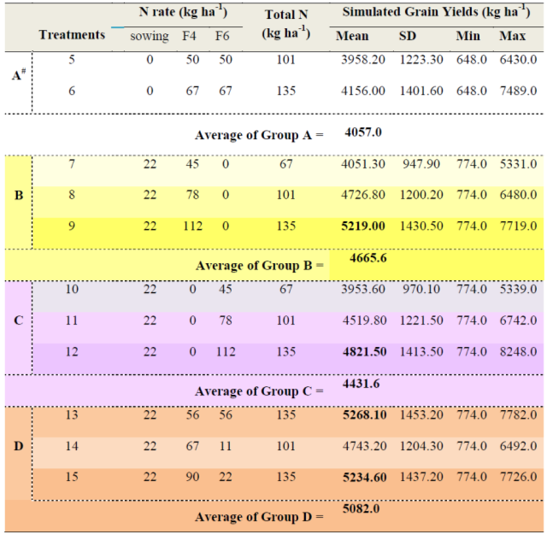
RESULTS – North AL site (silt loam soil)
None at planting
None at Feekes 6
None at Feekes 4
F4 > F6
F4 >> F6

Slide 12
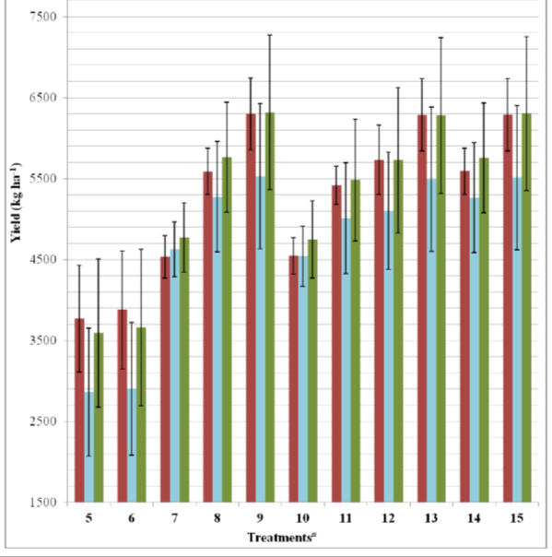
Southeast AL site (loamy sand soil)
Wheat Yield
El Niño > La Niña
Tt 5 = 0-50-50 Tt 7 = 22-45-0 Tt 10 = 22-0-45 Tt 13 = 22-56-56
Tt 6 = 0-67-67 Tt 8 = 22-78-0 Tt 11 = 22-0-78 Tt 14 = 22-67-11
Tt 9 = 22-112-0 Tt 12 = 22-0-112 Tt 15 = 22-90-22

Slide 13
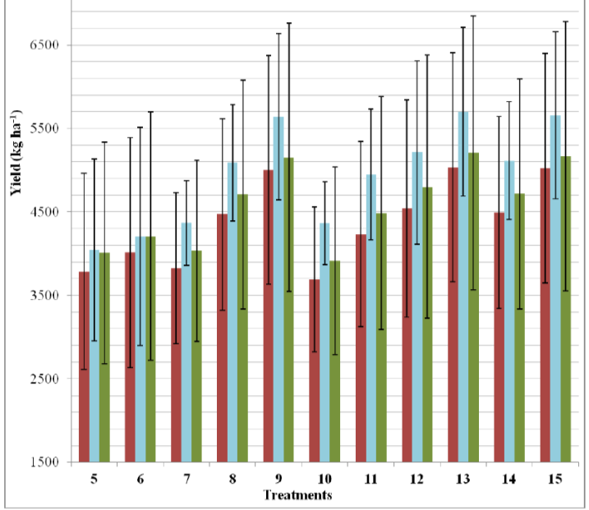
North AL site silt loam soil)
Wheat Yield
La Niña > El Niño
Tt 5 = 0-50-50 Tt 7 = 22-45-0 Tt 10 = 22-0-45 Tt 13 = 22-56-56
Tt 6 = 0-67-67 Tt 8 = 22-78-0 Tt 11 = 22-0-78 Tt 14 = 22-67-11
Tt 9 = 22-112-0 Tt 12 = 22-0-112 Tt 15 = 22-90-22

Slide 14
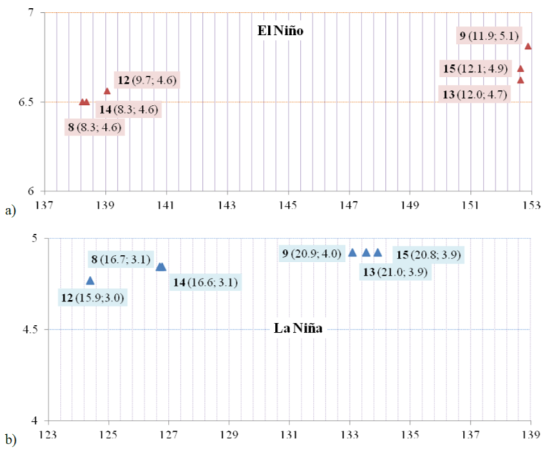
Southeast AL site
Highest leaching @ F4 N
Highest leaching
El Niño > La Niña
N leached (kg/ha)
Treatments and N rates : 8 = 22-78-0; 9 = 22-112-0 ; 12 = 22-0-112 ; 13 = 22-56-56; 14 = 22-67-11and 15 = 22-90-22
Standard Deviation for uptake and leached N are in parenthesis
N uptake (kg/ha)

Slide 15
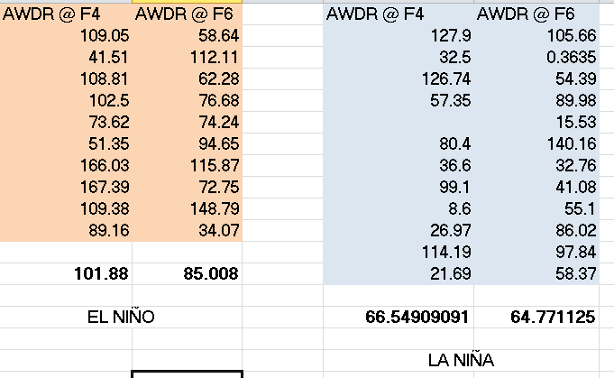
AWDR: Abundant and well distributed rainfall
AWDR → 10 days pre-sidress N & 20 day post-sidress N
Higher leaching → High rainfall well distributed @ F4
AWDR introduced by Trembley et al. (2012). Agron. J. 104:1658–1671 (2012)

Slide 16
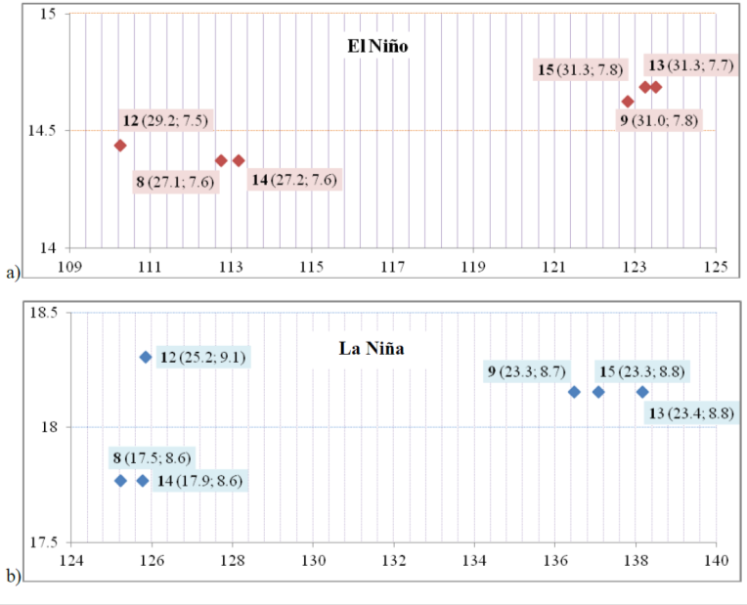
North AL site
Highest leaching
La Niña > El Niño
N leached (kg/ha)
Highest leaching and lowest uptake @ F6 N
Treatments and N rates : 8 = 22-78-0; 9 = 22-112-0 ; 12 = 22-0-112 ; 13 = 22-56-56; 14 = 22-67-11and 15 = 22-90-22
Standard Deviation for uptake and leached N are in parenthesis
N uptake (kg/ha)

Slide 17
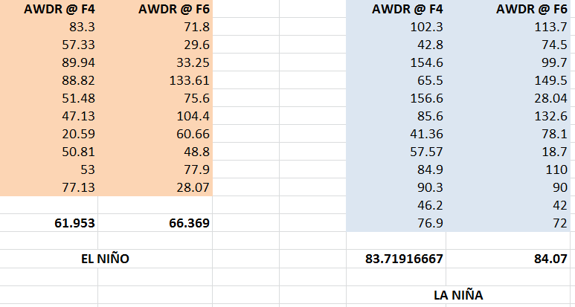
AWDR: Abundant and well distributed rainfall
AWDR → 10 days pre-sidress N & 20 day post-sidress N

Slide 18
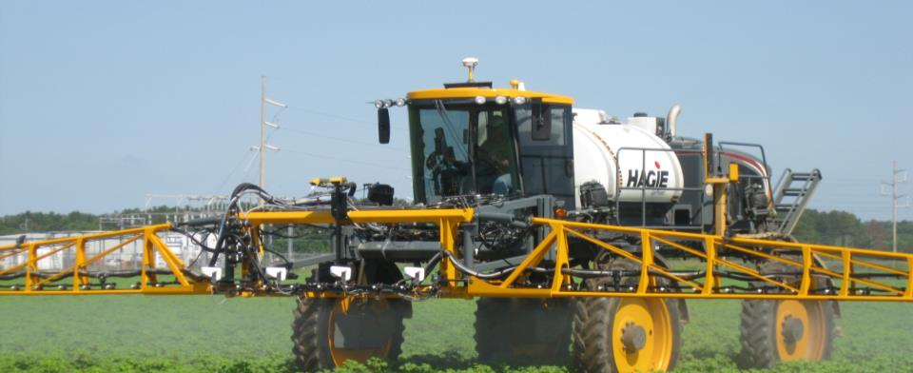
Precision Ag technologies simultaneously enhance production efficiency and environmental stewardship.
Precision Agriculture: Nitrogen Use Efficency
www.AlabamaPrecisionAgOnline.com
Brenda V. Ortiz
bortiz@auburn.edu
AL_Prec_Ag
Alabama Precision Ag Online
Advancing Science & Technology

