Slide 1
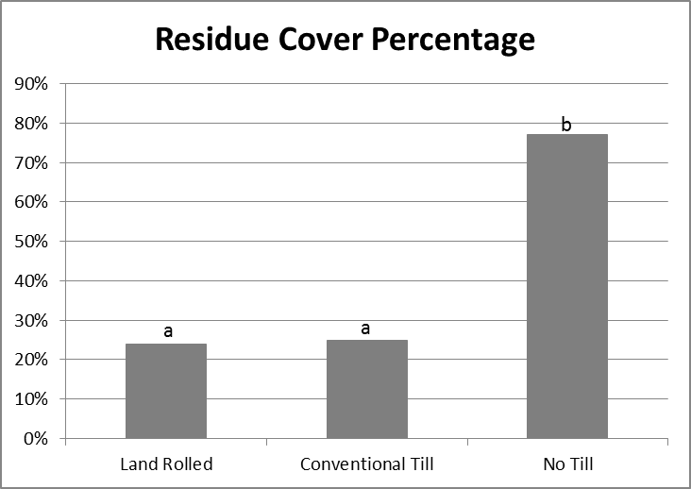
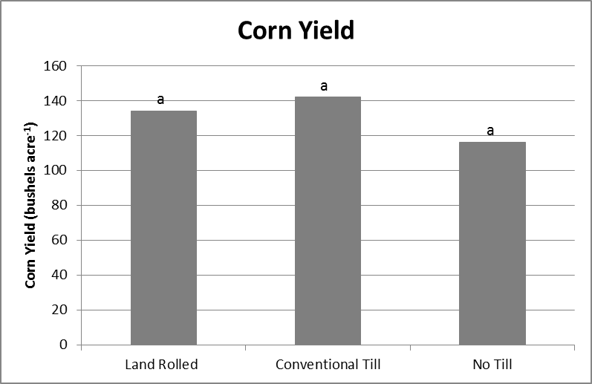
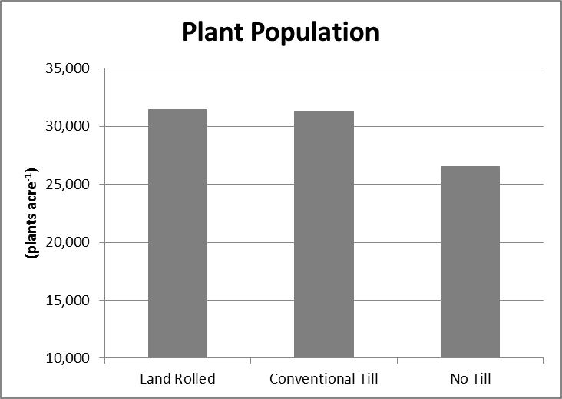
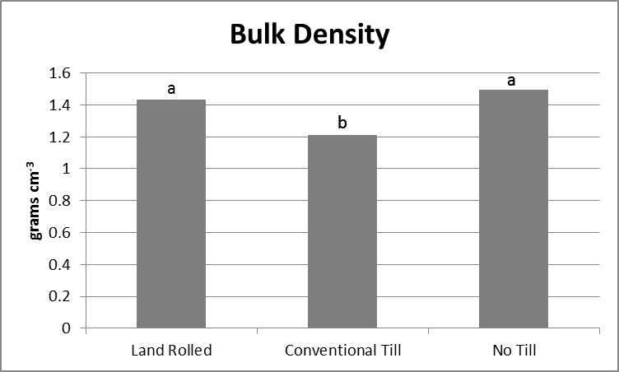
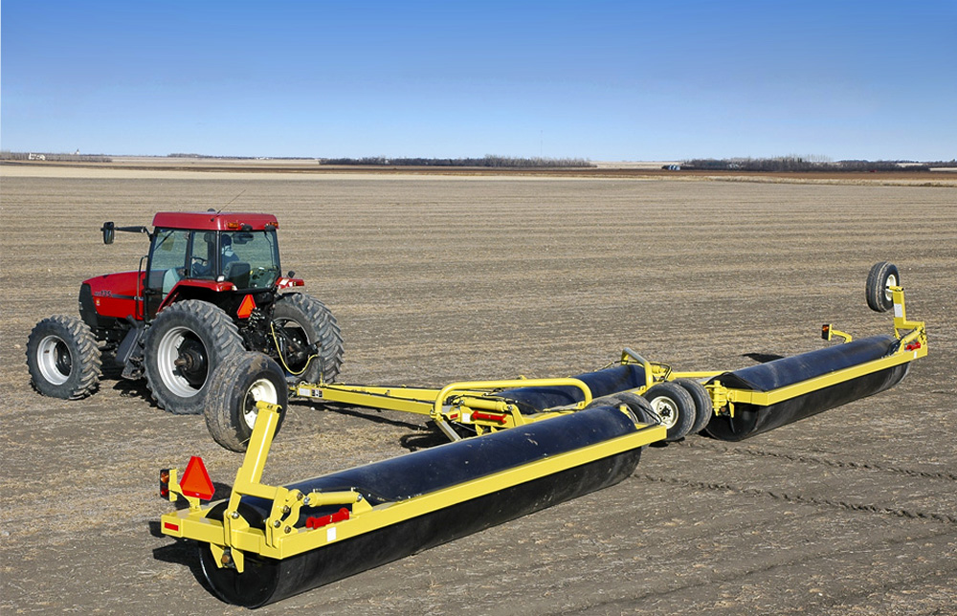
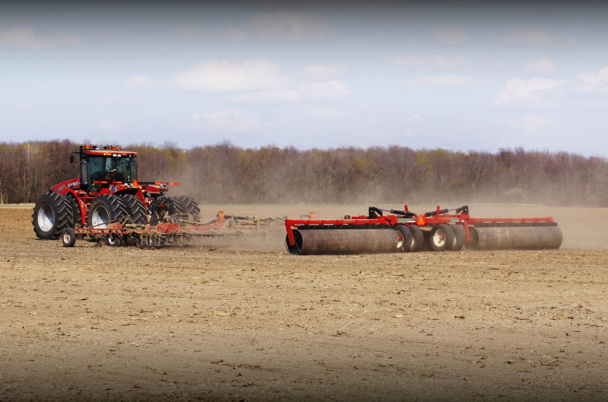
Soil and Environmental Implications of Land Rolling Corn
Logan Ahlers and Paul Kivlin
College of Agriculture, Food, and Environmental Science
University of Wisconsin – River Falls
Introduction and Goal Land rolling is the practice of pulling large cylindrical rollers over fields to smooth the planting surface. The practice originated in commercial agriculture in Canada; mainly to serve the purpose of pushing rocks and unwanted corn residue down in soybean fields to increase speed and efficiency during harvest. It was quickly realized that not only would land rolling make for a quicker, more efficient harvest, but also would reduce the wear and tear on harvest equipment, as well as increasing yields in soybeans. The practice quickly spread throughout the Corn Belt, and is now being used all throughout the Midwest. It is still believed that rolling does in fact increase soybean yields by 1-2 bushels per acre (mainly because after rolling, the combine head can be run lower to the ground and can catch the bottom pods on the plant); however, land rolling in corn is a new concept. Until now, there has been no university research on land rolling corn ground. The goal of this study was to determine if there is a yield benefit to rolling ground planted to corn. |  | Land rolled and conventionally tilled plots leave a significant amount of soil bare compared to no till plots. Although the land rolled and conventionally tilled plots had higher stand counts, there was no significant difference. There was a significant difference in bulk density between the conventionally tilled plot and the land rolled and no tilled plots.
 |  |  |  | There was statistically no significant difference in yields across treatments. Conclusions This study concludes that although claims have been made that land rolling for planting corn increases yields, there is no significant difference between practicees to reinforce those claims. Land rolling in this study created trends that matched up well with the physical property data from the no till plots, but no yield increase or decrease across any of the treatments was statistically significant. Acknowledgements The authors would like to thank Peterson Family Farms, Greg Andrews (Pierce County Ag Agent) and Amy Vandebrake (Pierce County Extension)
Materials and Methods This study was done on 12 acres in Pierce County, Wisconsin on a Lawler silt loam, 0 to 2 percent slope soil. The plot was planted May 24, 2014 with Cropland 3737VRTRLB at a population of 33,000 plants per acre. Measurements were taken on rolled, unrolled and no till areas each replicated three times; recording residue cover percentage, plant populations, bulk density, aggregate stability, penetration resistance, soil moisture and corn yield. All measurements were taken in rows undisturbed by wheel tracks.
Results and Discussion
Figure 1: Residue Cover Percentage across treatments. Bars with the same letter do not differ (P<0.05).
Figure 6: Corn Yield across treatments. Bars with the same letter do not differ (P<0.05).
Figure 2: Plant Population averages were lower in the no till treatment. This was caused by a non treatment erosion issue in the field.
Figure 3: Bulk Density across treatments. Bars with the same letter do not differ (P<0.05).
Figure 4 (above left) and 5 (above right) land rollers being used in agricultural fields in the Midwest.

