Slide 1

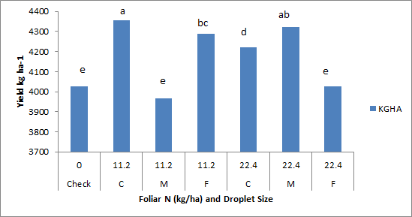
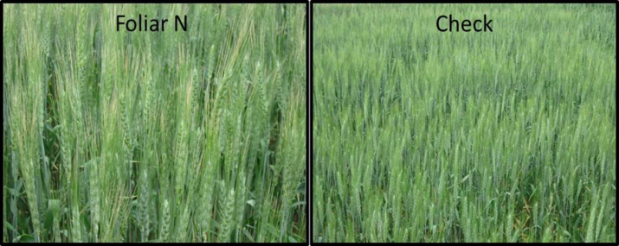
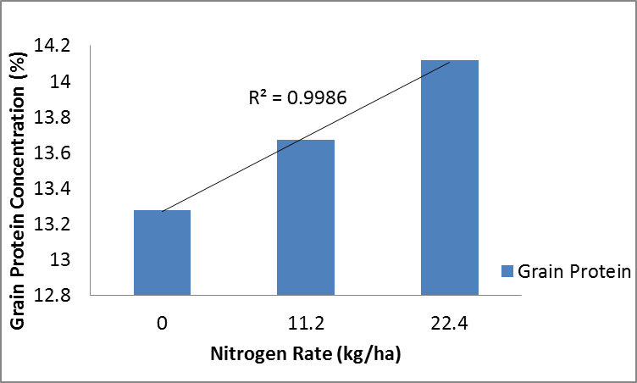
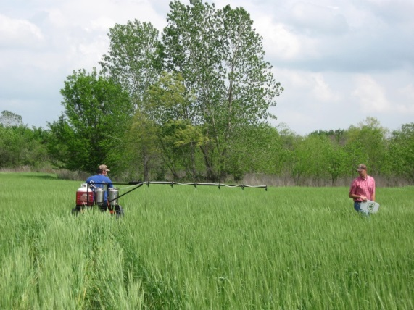
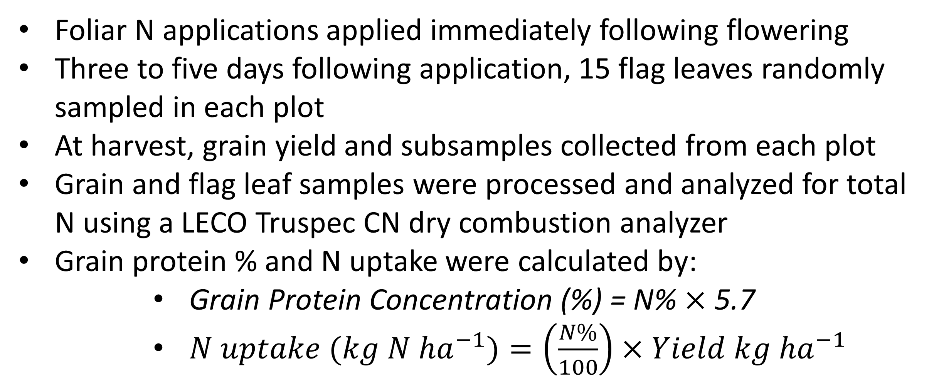
Effect of Droplet Size and Foliar Nitrogen Rate on Protein Content of Hard Red Winter Wheat (Triticum aestivum L.)
Ethan Driver¹, Natasha Macnack*¹, Jacob Bushong¹, Jeremiah Mullock¹, Randy Taylor²,
William Raun^{1,} and Ethan Wyatt¹
Department of Plant and Soil Sciences, Oklahoma State University, 371 Agricultural Hall, Stillwater, OK. 74075. edriver@okstate.edu
Rationale
Results
To increase grain protein concentration (GPC) without damaging yield and meet quality standards. Due to the change in quality standards, requiring a 11% minimum GP to avoid a price reduction, this research was intended to find a balance in late season application, rate, adjuvant used, and nozzle size.
Introduction
Hard red winter wheat (HRWW) is grown extensively in the Great Plains region, accounting for 40% of the total wheat grown in the U.S. In past years, grain protein concentration (GPC) has been highly variable from one location to the next. Much of this variability in GPC can be attributed to environmental and genetic factors (Kramer, 1978).
Objective
Figure 2: Grain yield by treatment at LCB, OK, 2012.
To evaluate the effects of adjuvant, droplet size and foliar N rate of post-anthesis foliar fertilizer applications on grain yield, GPC, and flag leaf tissue.
Materials and Methods
Foliar N applications applied immediately following flowering
Three to five days following application, 15 flag leaves randomly sampled in each plot
At harvest, grain yield and subsamples collected from each plot
Grain and flag leaf samples were processed and analyzed for total N using a LECO Truspec CN dry combustion analyzer
Grain protein % and N uptake were calculated by:
  Grain Protein Concentration (%) = N% $×$ 5.7
  $N uptake ({kg N ha}^{−1})=\left(\frac{N\%}{100}\right)×Yield {kg ha}^{−1}$
Figure 3: Left, visual burn from foliar N application compared to the right (no N check).
Figure 4: Relationship between grain protein and foliar N rate, Efaw, OK, 2012.
Conclusions
Yield differences observed were relatively small across locations and years
For most locations and years GPC increased at higher foliar N rates
When compared to the check, late-season foliar N application can improve grain protein by up to 2.0%
Use of the fine droplet size with a foliar N rate of 11.2 kg N ha⁻¹ with the addition of an adjuvant resulted in the highest GPC
Emphasis should be placed on protein prediction and improving mechanisms to increase late season foliar N uptake
Figure 1: Use of alley to avoid damaging plots with ATV applicator.

