Slide 1

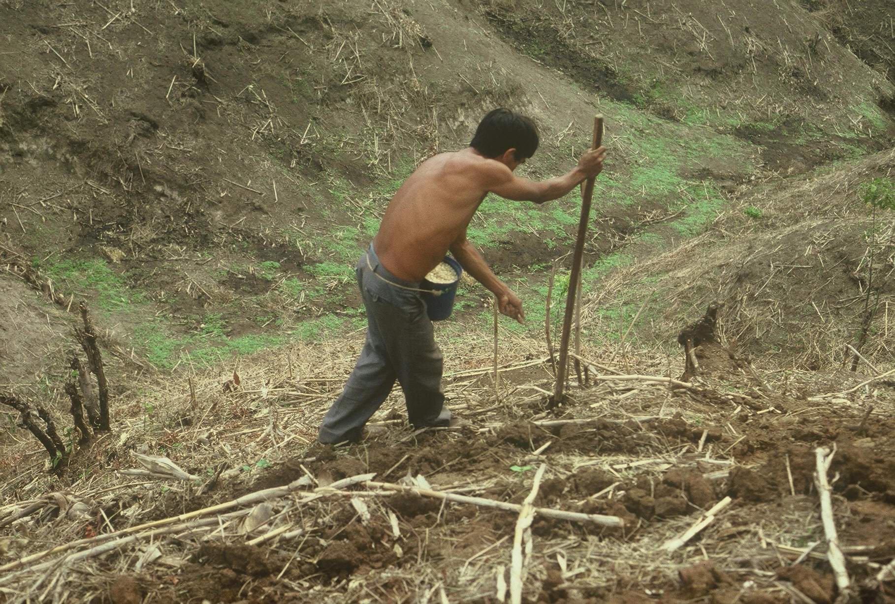
Evaluation of Drum Cavity Size and Planter-tip on Singulation and Plant Emergence in Maize (Zea mays L.)
J.S.Dhillon¹, M. Golden¹, S. Dhital¹, N. Remondet¹, D.A. Kizza¹, M.Corso¹, B.M. Figueiredo¹,
T. Lynch¹,J.Mullock¹, R. Taylor² and W. Raun¹
¹Plant and Soil Sciences, ²Biosystems and Agricultural Engineering, Oklahoma State University
371 Agricultural Hall, Stillwater, OK. 74075. jagman.dhillon@okstate.edu
Rationale
Results
Sixteen percent of the world’s 184 million hectares of maize is produced on marginal landscapes
Introduction
Maize (Zea mays L.) is one of the most important cereals in the world and delivers 30% of the food calories, along with rice and wheat, to more than 4.5 billion people in 94 developing countries (Shiferaw et al.,2011). Developed nation maize yields are 8 Mg ha⁻¹ higher than that encountered in the developing world (FAOSTAT, 2013, avg. developing world = 2.0 Mg ha⁻¹). Sophistication in planter technology accounts for much of the difference. Maize planting in the developing world is accomplished by hand. Oklahoma State University has developed a hand planter (GreenSeeder planter) capable of delivering single seeds per strike, homogeneity of plant stands, and increased grain yields.
Different letters above bars with the same color, significantly different (P < 0.05)
Fig 2. Emergence counts and singulation, Lake Carl Blackwell, 2015.
Emergence
  Drum 450S with 3962 seeds/kg resulted in significantly similar emergence compared to the check
  2651 seeds/kg emerged better using the weld stop tip with both drums
Singulation
  Drum 260-20 was significantly better at delivering single seed
Fig 1. Farmer in El Salvador planting maize with traditional metal-tipped stick
Objective
The objective of this study was to evaluate drum cavity size and GreenSeeder tip on the emergence, singulation, and yield of maize over a range of seed sizes
Materials and Methods
2 sites in Oklahoma
  Lake Carl Blackwell – Conventional tillage (CT)
  Efaw – No tillage (NT)
Variables Evaluated
  Seed size, 2651 and 3962 seeds/kg
  Drums, 450S and 260-20
  GreenSeeder tips Normal (N) and Weld stop (WS)
  Check (simulation of farmer practices)
    Stick planter
    John Deere Vacuum Planter
RCBD, 3 replications
Plant population, 64,200 seeds ha⁻¹
Emergence including singles and multiples collected
NDVI sensor readings
Data analyzed using SAS 9.3
Different letters above bars with the same color, significantly different (P < 0.05 )
Fig 3. Emergence counts and singulation, Efaw, 2015.
Emergence
  Drum 450S resulted in similar emergence compared to the John Deere vacuum planter, with slightly lower emergence than the hand planted checks
  Emergence was improved with Drum 450S compared to 260-20 with both tips and seed sizes
Singulation
  Drum 260-20 was superior for delivering singles
Conclusions
The OSU hand planter also serves as a sidedress urea N-fertilizer applicator, reduces urea volatilization losses and increases NUE
Removes chemically treated seed from farmer hands, reducing health risks
Promises increased developing world maize production

