Slide 1

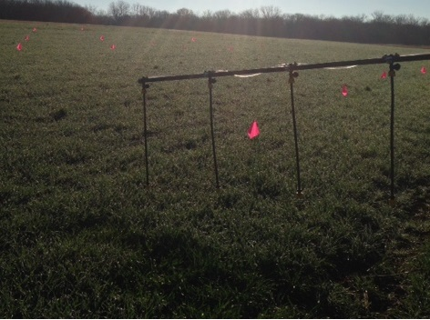
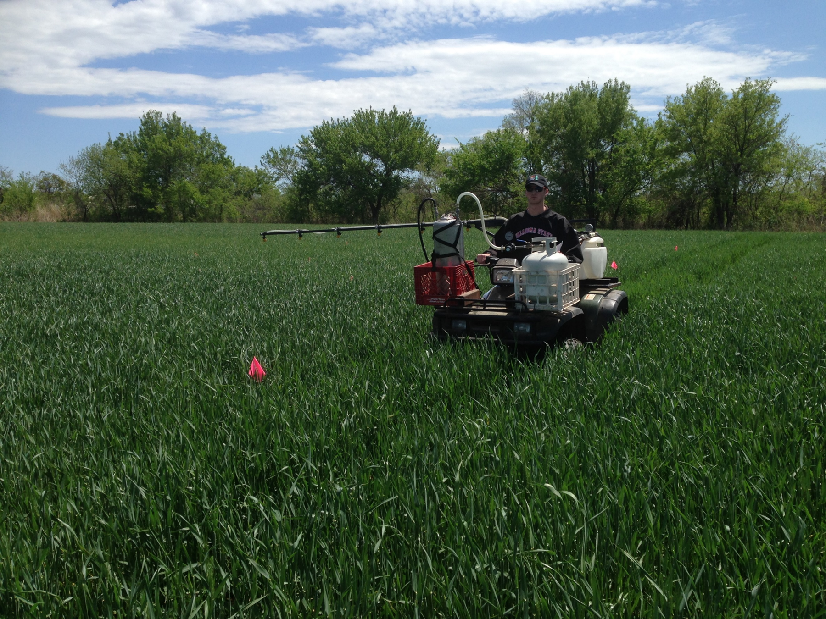
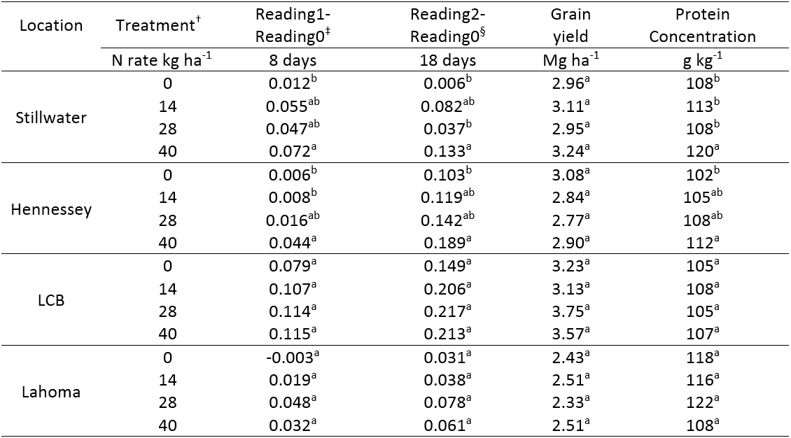
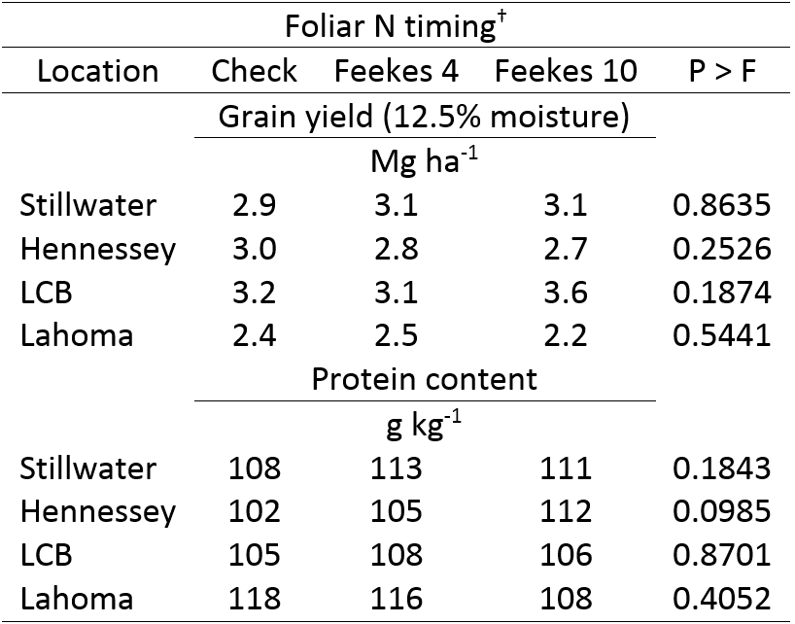
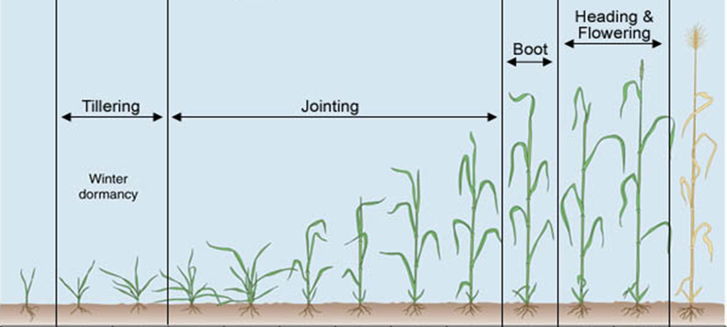
Evaluation of Foliar UAN and Timing on
Wheat Grain Yield and Protein
Mariana Del Corso, Jeremiah Mullock, Bruno Figueiredo, William Raun
Department of Plant and Soil Sciences, Oklahoma State University, 371 Agricultural Hall, Stillwater, OK. 74075. delcors@okstate.edu
Rationale
Foliar Nitrogen (N) fertilization in winter wheat (Triticum aestivum L.) has been inconsistent in delivering either increased yield and/or grain protein.
Introduction
Nitrogen (N) fertilizer is the most costly input for wheat farmers in the Great Plains.
Nitrogen applied pre-plant can be lost via volatilization, nitrification, and leaching.
Foliar applied N if temperatures are below 21°C can be highly beneficial.
Figure 2: Pressurized offset boom used to apply foliar N at Feekes 4 and Feekes 10 growth stages.
Preliminary results
Table 1: Change in NDVI, grain yield, and protein concentration as influenced by foliar N application in hard red winter wheat at Stillwater, Hennessey, Lake Carl Blackwell (LCB), and Lahoma
Objective and Hypothesis
To evaluate grain yield and grain protein response to low rates of foliar N at two growth stages.
Increasing foliar N rates at Feekes 4 can gradually increase yield
Foliar N at Feekes 10 can increase protein concentration.
Materials and Methods
Four locations: Stillwater, Hennessey, Lake Carl Blackwell (LCB), and Lahoma, OK, 2014-2015 under dryland conditions.
Wheat cultivar, ‘IBA’ sown at 78 kg ha⁻¹.
Randomized complete block design with 3 replications.
Foliar N rates: 14, 28, and 40 kg N ha⁻¹ at Feekes 4 and 14 kg N ha⁻¹ at Feekes 10.
Urea ammonium nitrate (UAN) (28-0-0) and water (1:1).
Using a pressurized sprayer and offset boom, foliar UAN was applied at Feekes 4, using flat fan drop nozzles. At Feekes 10 nozzles were connected directly to the boom.
  NDVI sensor readings were collected before each application and throughout the growing season.
  Total N concentration in the grain was determined using a dry combustion analyzer (LECO) and multiplied by 5.7 to determine grain protein (Thachuk, 1969).
  Treatment responses evaluated using SAS software, GLM and Duncan’s multiple range test.
† N rates applied as 1:1 urea ammonium nitrate (UAN)/ water solution, Feekes 4
‡ Difference between NDVI at application and after 8 days
§ Difference between NDVI at application and after 18 days
¶ Different letters, significantly different (P<0.05)
Table 2: Hard red winter wheat grain yield and protein concentration as influenced by time of application
http://weedsoft.unl.edu/documents/growthstagesmodule/wheat/wheat.htm
† Foliar N applied as 1:1 urea ammonium nitrate (UAN)/water solution at 14 kg ha⁻¹
Mid-season NDVI values were not correlated with grain yield
NDVI differences at F4 were not correlated with grain yield, but were correlated with grain protein at two locations (Stillwater and Hennessey). No differences in treatment response were seen between F4 and F10
3
4
5
6
7
8
9
10
10.1
10.5
11
Reading 0
Reading 1
Reading 2
Reading 3
Reading 4
Reading 5
14, 28, 40 kg N ha⁻¹
14 kg N ha⁻¹
NDVI
Treatment
Reading 6
Feekes
2
1
Figure 1: Timeline containing NDVI readings and N applications

