Slide 1

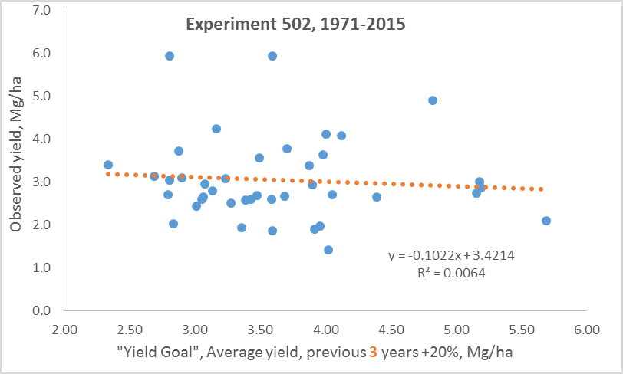
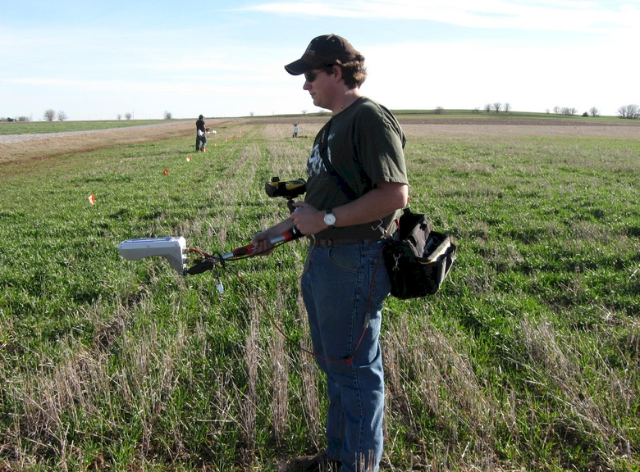
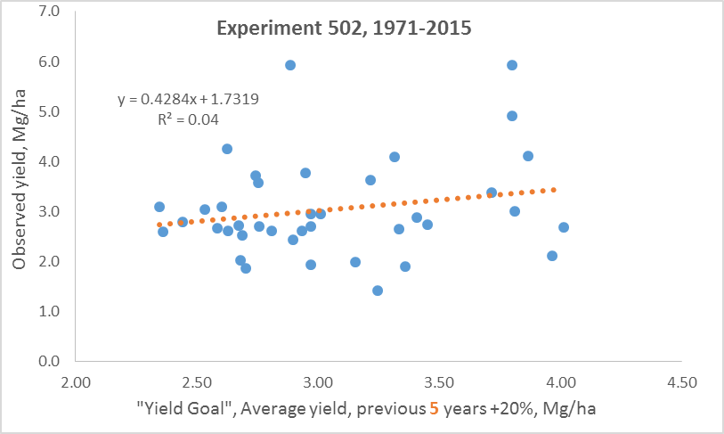
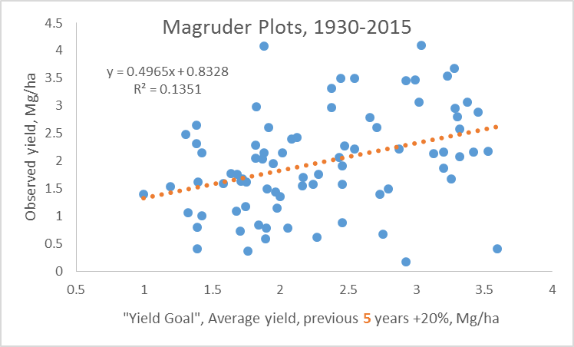
Evaluation of Yield Goals in Long-Term Experiments
M. Golden, R. Schlobohm, N. Remondet, T. Lynch, and W. Raun
Department of Plant and Soil Sciences, Oklahoma State University
368 Agricultural Hall, Stillwater, OK. 74075 melissa.golden@okstate.edu
Rationale
Results Cont’d
Yield goals continue to be used as a starting point for generating preplant fertilizer N rates, using a fixed rate per unit yield, and adjustable by crop
Introduction
A benchmark maize yield goal was established by George Rehm at the University of Minnesota stating that it should be the recent average over the last 3-5 years, and an increase above that average of around 10 to 20% (Rehm and Schmitt, 1989)
Schmitt et al. (2008) advanced this work recommending that late fall or spring preplant soil NO₃-N be subtracted from the recommended N fertilizer rate derived from a realistic yield goal. Because many states continue to employ the use of yield goals, (Zhang, 2006, Dahnke et al., 1988), employing a substitute, like mid-season yield prediction, is prudent considering potential producer adoption
Fig. 3. Relationship between the yield goal determined using the previous 3 year average and the ensuing year observed yield (slope not significant)
Fig. 1 Jeremiah Mullock sensing Experiment 502 using the new Trimble sensor
Fig. 4. Relationship between the yield goal determined using the previous 5 year average and the ensuing year observed yield (slope and intercept components not significant)
Objective
To evaluate the use of grain yields from long-term trials that enable the application of prior data for simulating yield goals and the prediction of yield for ensuing years.
Material and Methods
Observed yield and yield goals established using either the previous 3 and/or 5 year yield average were not correlated.
Two long-term experiments
  Magruder Plots, Stillwater, OK (1930-2015)
  Experiment 502, Lahoma, OK (1971-2015) (Fig. 1)
Conclusion
Results
Yield goals were not effective in predicting observed yield or the wheat response to N fertilizer
Other methods of yield prediction and N recommendation must be employed, such as sensor readings, in order to make an accurate estimation of harvest grain yield fertilizer responses
References
Dahnke, W.C., Swenson, L.J., Goos, R.J., and Leholm, A.G. (1988) SF-822. In Choosing a Crop Yield Goal; North Dakota State Extension Service: Fargo, North Dakota.
Rehm, George and Michael Schmitt. 1989. Setting realistic crop yield goals. Minnesota Extension Service. Univ. of Minnesota. AG-FS-3873.
Schmitt, M. A., G.W. Randall, and G.W. Rehm. 2008. A soil nitrogen test option for N recommendations with corn. WW-06514-GO, Univ. Minnesota.
Zhang, H., and B. Raun. 2006. Oklahoma soil fertility handbook, 6th edition. Okla. Agric. Exp. Sta. Stillwater, OK.
Fig. 2. Relationship between the yield goal determined using the previous 5 year average and the ensuing year observed yield

