Slide 1

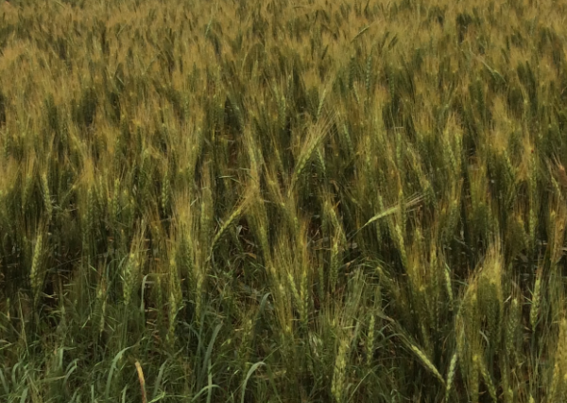
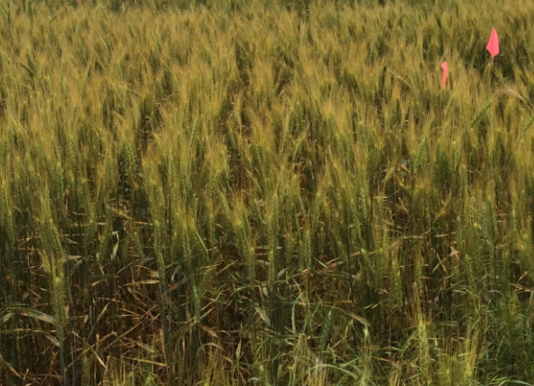
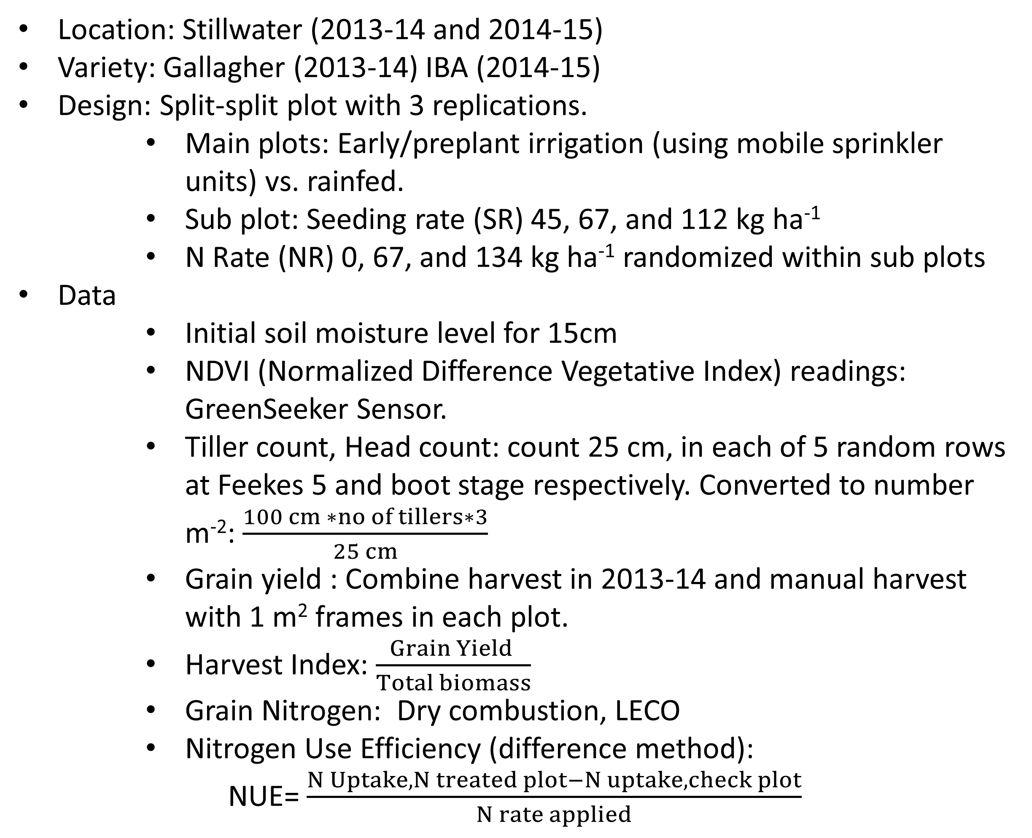
Effect of Preplant/Early Irrigation, Nitrogen and Population Rate on Winter Wheat Grain Yield
Sulochana Dhital¹, Jeremiah Mullock¹, Bruno M Figueiredo¹, Tyler Lynch ¹, Jagmandeep Dhillon¹, Mariana Ramos Del Corso¹ and William Raun¹
Plant and Soil Sciences Department, Oklahoma State University, 368 Agricultural Hall, Stillwater, OK. 74075. Contact: sulochana.dhital@okstate.edu
Rationale
Ground water is the main source of irrigation water in Oklahoma. More precise and efficient utilization of water is needed. Deficit irrigation is an alternative practice in winter wheat management to compensate for the declining ground water resources and cost of pumping (Musick et al., 1994; Eck, 1988).
Introduction
Most of the wheat producing acres in Oklahoma are rainfed. The High plains of Oklahoma utilizes groundwater from the Ogallala aquifer for irrigation. Preplant or early irrigation in winter wheat can improve plant stands and lead to higher grain yields. Optimum seeding density efficiently utilizes resources and optimizes yield.
Objective
Fig.2. Total number of tillers and head per m⁻² winter wheat (2013-14), Stillwater, OK.
To evaluate the differences in yield, tiller count, grain N , and Nitrogen Use Efficiency in early irrigated vs. non irrigated winter wheat.
Materials and Methods
Location: Stillwater (2013-14 and 2014-15)
Variety: Gallagher (2013-14) IBA (2014-15)
Design: Split-split plot with 3 replications.
  Main plots: Early/preplant irrigation (using mobile sprinkler units) vs. rainfed.
  Sub plot: Seeding rate (SR) 45, 67, and 112 kg ha⁻¹
  N Rate (NR) 0, 67, and 134 kg ha⁻¹ randomized within sub plots
Data
  Initial soil moisture level for 15cm
  NDVI (Normalized Difference Vegetative Index) readings: GreenSeeker Sensor.
  Tiller count, Head count: count 25 cm, in each of 5 random rows at Feekes 5 and boot stage respectively. Converted to number m⁻²: $\frac{100 cm ∗no of tillers∗3}{25 cm}$
  Grain yield : Combine harvest in 2013-14 and manual harvest with 1 m² frames in each plot.
  Harvest Index: $\frac{Grain Yield }{Total biomass}$
  Grain Nitrogen: Dry combustion, LECO
  Nitrogen Use Efficiency (difference method):
NUE= $\frac{N Uptake, N treated plot−N uptake, check plot}{N rate applied}$
Fig.3. Grain yield response to seeding rate and N rate treatments in 2013-14 and 2014-15, Stillwater OK.
Year 2013-14 had higher tiller counts and head counts for rainfed treatments (Fig.2). Also grain yield was higher for rainfed treatments whereas grain yield was higher in irrigated plots in 2014-15 (Fig.3).
Table 1. Analysis of variance for grain yield, harvest index, grain N, head count, and tiller counts in 2013-14 and 2014-15.
Source of Variation | DF | 2014-15 |  |  |  |  |  | 2013-14
 |  | Yield | HI |  | Head |  | Grain N | Yield |  | Tiller | Head | Grain N
 |  | Pr > F
Moisture | 1 | ns |  | ns |  | ns | ns |  | ** | ** | ** | **
SR | 2 | * |  | ns |  | ** | * |  | ns | ns | ** | ns
Moisture*SR | 2 | ns |  | ns |  | ns | ns |  | ns | ns | ns | ns
NR | 2 | * |  | ns |  | ns | ** |  | ns | ns | ns | **
SR*NR | 4 | ns |  | ns |  | ns | ns |  | ns | ns | ns | ns
Moisture*NR | 2 | ns |  | ns |  | ns | ns |  | ns | * | ns | ns
Moisture*SR*NR | 4 | ns |  | ns |  | ns | ns |  | ns | ns | ns | ns
Results
Fig. 1. Total monthly rainfall and Average monthly air temperature, (2013-14 and 2014-15).
Fig: Left and right (Irrigated and Rainfed wheat (2014-2015), seed rate 112 kgha⁻¹ respectively )
*Significant at P = 0.05. ns, not significant at P =0.05
**Significant at P = 0.01.
Seed rate was significantly different for yield level, head count and grain N for 2014-15. N rate influenced yield. For 2013-14 moisture was significantly different. Moisture impacted yield level, tiller count, head count and grain N. N rate increased grain N. Seed rate was highly significant for number of heads. Moisture and N rate interaction was significant for tiller counts.
Although, tillers and head count data was higher for the higher grain yield in rainfed plots, they were not correlated with grain yield. Higher rainfall over the growing season in 2014-15 limited observing treatment differences (Fig.1). In both years, higher May-June rainfall decreased yield levels below normal. NUE values were extremely low.
Irrigated
Rainfed
Conclusions
Early irrigation can help but for this study did not impact yield differences due to adequate rainfall received during the growing season
References
Musick, J. T., O. R. Jones, B. A. Stewart, and D. A. Dusek, 1994. Water-yield relationships for irrigated and dryland wheat in the US Southern Plains. Agron. J. 86(6), 980-986.
Eck, H. V., 1988. Winter wheat response to nitrogen and irrigation. Agron. J., 80(6), 902-908.

