Slide 1
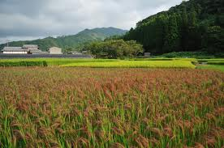
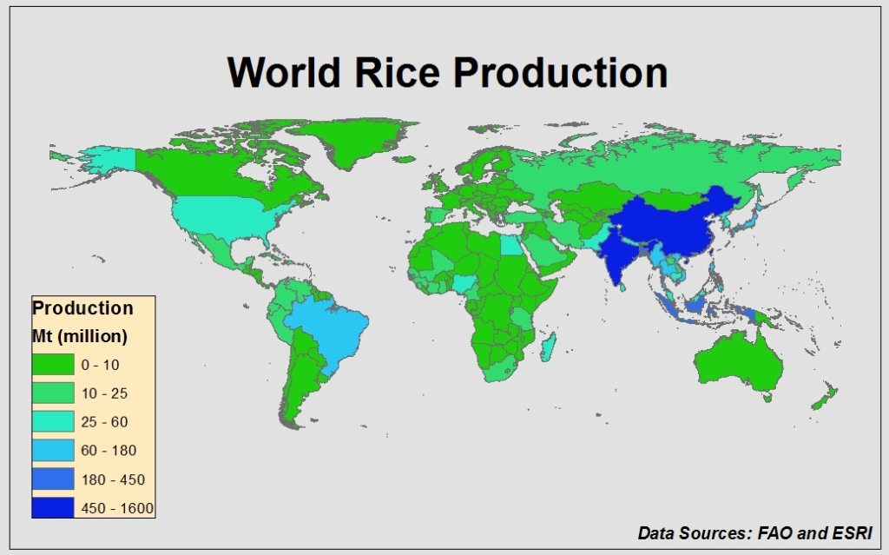
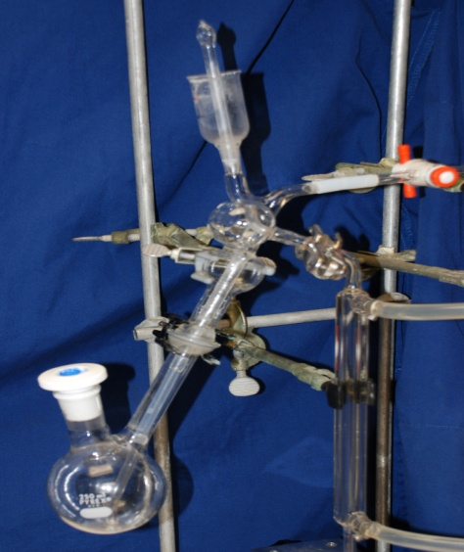
Developing a N Soil Test for Rice in Southeast Asia
Introduction
Rice is the second most abundant crop grown in the world and a major cereal grain produced in Southeast Asia.
If not properly managed, nitrogen use efficiency can be very low, thus leading to increased production costs and potential environment concerns.
The University of Arkansas has developed a nitrogen soil test for rice (N-ST*R) that accurately predicts site specific nitrogen fertilizer requirements (Roberts et al., 2013).
Method measures alkaline hydrolyzable nitrogen via direct steam distillation (Bushong et al., 2008).
Soil test is only currently adapted to the silt loam and clay soils of the Mississippi Delta region of the United States.
Objective
To develop a nitrogen soil test for the different soil types and climatic regions of Southeast Asia.
Benefits
Potentially could increase nitrogen use efficiency by identifying sites that would require more fertilizer and those sites that do not need additional fertilizer.
Simple and inexpensive process.
Total analysis time is one-fifth the time for diffusion techniques.
Roberts et al. (2013)
References
Bushong et al. 2008. Evaluation of Distillation and Diffusion Techniques for Estimating Hydrolyzable Amino Sugar-Nitrogen as a Means of Predicting Nitrogen Mineralization. SSSAJ.
Roberts et al. 2013. Field Validation of N-STaR for Rice Produced on Silt Loam Soils in Arkansas. SSSAJ.

