Slide 1
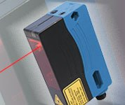
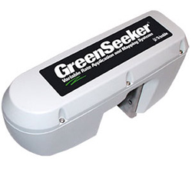
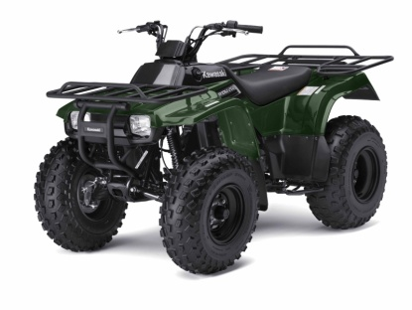
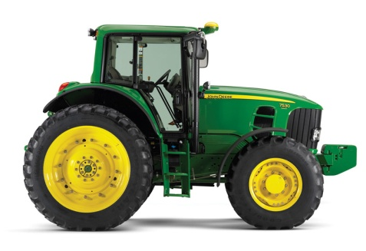
Field Forage Estimator
Quick Stocking Rate and Forage Production Management Decisions based on real time or short delay data.
Spectral based Nitrogen Estimation for Crude Protein Estimation
Height based Forage Mass Estimation
Field Forage Estimator
+
=
Laser height Measurement
Spectral Analysis
Could be mounted on an atv or tractor with readings taken on the go .
Current Limitations: Data acquisition scheme and cost effective data compilation mechanism i.e. computer or handheld. (Data Handling Software Recently Created)
Areas for Development: IPHONE APP and Bluetooth data transfer/ acquisition
Josh Pittman-Soil5112-2-7-2013

