Slide 1
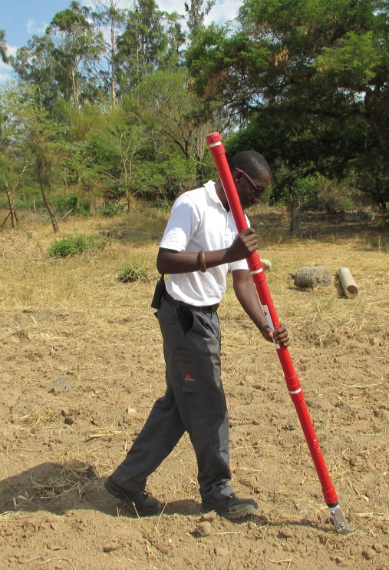
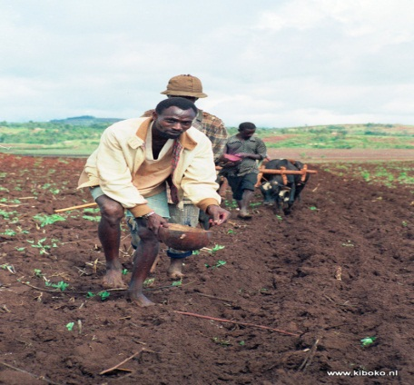
A simple tool to reduce labor and production costs for small scale farmers in Uganda
SINGULATING HAND PLANTER
Introduction
Maize planting in Uganda is normally accomplished by hand with no defined planting pattern. This process results in a heterogeneous increase in plant population, is labor intensive, and exposes soil to erosion which ultimately reduces grain yields. In addition, over 50% of the 1.2milion maize acres are planted without fertilizers (World bank, 2010). One third of the acres are located on hilly landscapes. Oklahoma State University (OSU) has developed a singulating hand planter that delivers one seed per hill and can be used for mid-season application of urea fertilizer. The hand planter is 1.4 m long, 5.8 cm in diameter of the seed hopper and weighs 2 kg when empty. The tip has a sharp pointed shovel knife which delivers seeds at a depth of 7cm in no-till and tilled soils.
Purpose
The purpose of this concept note is to solicit support from AGCO to finance the manufacturing and distribution of this planter to small scale maize farmers with farms on hilly landscapes in Uganda.
Hand planter trial in Zambia
Benefits
The food security situation would be improved, with an estimated increase in maize grain yields of 25% from the current 2.0mg/ha while ensuring environmental protection, through adoption and use of the hand planter
A farmer hand planting maize in ox-plough furrow
Summary by Peter Omara. Browse details at http://nue.okstate.edu/Hand_Planter.htm

